Slide 1
FRCR Ultrasound Lectures
Dr Sarah Bohndiek
seb53@cam.ac.uk
Reader in Biomedical Physics & CRUK Group Leader
University of Cambridge

Slide 2
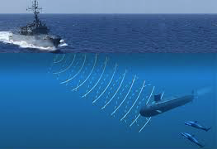
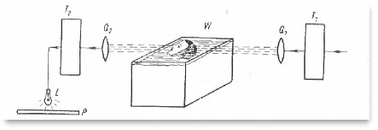
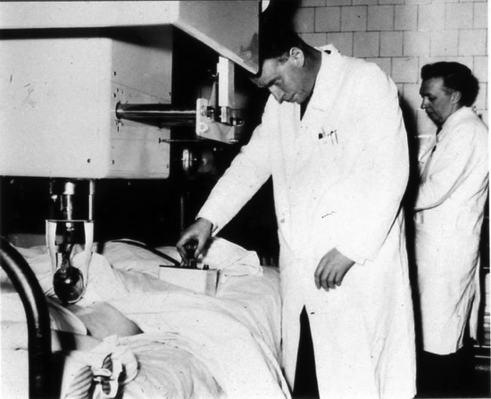
Ultrasound: Some historical context
1980s
Real time ultrasound possible
1912
Destruction caused by U-boats in WWI provides drive for development of SONAR
1942
Dussik investigates ultrasound transmission of the brain
1794
Spallazani discovered ‘non-audible’ sound
1990s
3D and 4D ultrasound emerge
1877
Pierre Curie discovered piezo-electric effect
1917
Langevin produced ultrasound device using piezoelectrics
1950s
Pulsed ultrasound developed at multiple institutions enabling ‘B Mode’ imaging

Slide 3
Learning outcomes
After these lectures, you should be able to:
Explain how ultrasound interacts with tissue
Understand where ultrasound imaging contrast comes from
Describe how ultrasound signals are generated and detected
Explain how anatomical ultrasound images are formed
Compare the different clinical approaches to performing ultrasound imaging and discuss emerging new applications of ultrasound
Describe the origin of the hazards that arise from ultrasound imaging and how they can be mitigated
Explain the key governing legislation around ultrasound safety
Describe common approaches to quality assurance / control

Slide 4
Recommended reading
Physics of Diagnostic Radiology, 3rd edition, Dendy & Heaton
(978-1-4200-8315-6)
Introduction to Medical Imaging, Smith & Webb
(978-0-521-19065-7)
Diagnostic Ultrasound, Matthew Hussey
(0.216.90029.8)
The Safe Use of Ultrasound in Medical Diagnosis, 3rd Edition, ter Haar & Duck
(978-0-905749-78-5)
IPEM Report 102 – Quality Assurance of Ultrasound Imaging Systems
Note: Some material in this course has been taken from previous lecturer Richard Axell

Slide 5
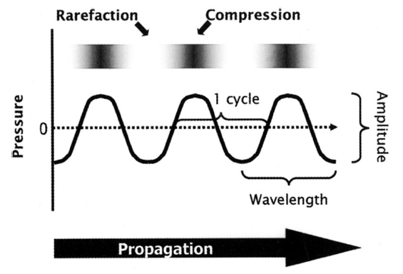
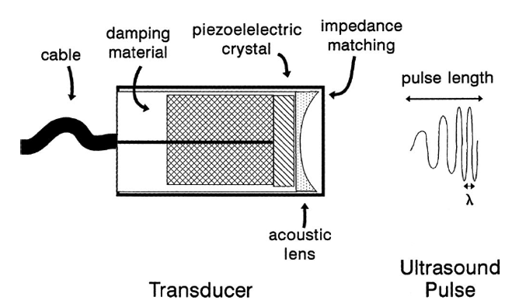
4.19 Physics of Ultrasound
Part 1: Ultrasound basics
Part 2: Ultrasound hardware

Slide 6
4.19 Physics of Ultrasound
Part 1: Ultrasound basics

Slide 7
Ultrasound refers to mechanical waves with a frequency greater than 20 kHz
Speed of sound: speed at which the wave propagates, units of metres per second (ms⁻¹)
Wavelength: distance between successive compressions, units of metres (m)
$$c=fλ$$
Frequency: number of compressions passing a stationary observer per second, units of Hertz (1Hz = 1s⁻¹)
Lawrence (2007) Crit Care Med
Notes:
Sound cannot travel through a vacuum.
Ultrasound is propagated through soft tissues as a longitudinal wave - transverse, shear waves are not supported except in bone.
The driving force causes the particles to oscillate short distances from their equilibrium position.
There will be regions of compression (increased pressure) and rarefraction (reduced pressure), meaning pressure is a function of time and position.

Slide 8
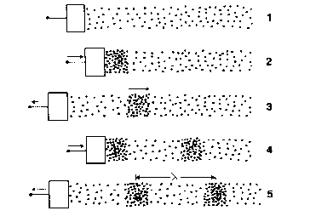
The speed of sound is determined by the properties of the medium: density
m
K
M
k
Notes:
There is no net movement of the medium. Only the disturbance and its associated energy are propagated.
We can think of the propagation by analogy to coupled masses attached to springs
First mass is given a push. It is coupled to the second mass by a stiff spring causing it to accelerate quickly to the right and to pass the movement onto the third mass. As the masses are light (low density)they can be accelerated quickly by the stiff springs - wave travels quickly.
Large mass (high density) is coupled the its neighbour by a weak spring. The second mass will accelerate slowly - large mass, weak force. Its neighbour will also respond slowly, and the wave travels slowly.

Slide 9
The speed of sound is determined by the properties of the medium: adiabatic bulk modulus
Adiabatic: A process that occurs without transfer of heat or matter to the surroundings
Bulk Modulus: The “spring constant” (k) for the tissue
Describes how resistant a substance is to compressibility; the pressure required to produce a fractional change in volume

Slide 10
The quantitative relationship to the speed of sound is given by their ratio
Adiabatic elastic bulk modulus
$$c=\sqrt{\frac{K_{a}}{ρ}}$$
Density
Tissues generally differ more in stiffness than in density, so although bone is much denser than muscle, it has a higher speed of sound because it is much stiffer
Notes:
Suggests that speed should be slower in a dense medium but we often observe sound travelling faster in dense tissues
This is because they also tend to be stiff

Slide 11
Speed of sound through tissue depends on fat, collagen and water content
An increase in water and fat content leads to a decrease in wave speed.
An increase in collagen content leads to an increase in wave speed.
Resolution is related to the wavelength.
A wavelength of 0.8 mm and wave speed of 1540 ms⁻¹ corresponds to a frequency of 2 MHz.

Slide 12
The speed of sound is used to define ‘acoustic impedance’, an ultrasound imaging parameter
Acoustic impedance is crucial in defining how ultrasound is reflected at interfaces between different media
For perfect plane wave conditions, the specific acoustic impedance of the medium is:
Acoustic impedance can be given in units of Mrayls (short for Rayleigh)
$$Z=ρc$$
speed of sound in the medium
density of the medium
Notes:
For perfect plane wave conditions, this is equal to the characteristic acoustic impedance (inherent property) of an unperturbed medium given by the product of the speed of sound in the medium and the density.
Note, in a viscous medium, there will be a phase difference (offset) between the compressions and rarerefactions of pressure and particle velocity so these will not be identical.
Measured in a pressure per velocity per area, often given in “rayls” (short for Rayleigh)

Slide 13
Acoustic properties vary tremendously between different biological tissues
Material | ρ Density (kg m⁻³) | c Speed (m s⁻¹) | Z Impedance (Mrayl)
Perspex | 1180 | 2680 | 3.16
Air | 1.2 | 330 | 0.004
Bone | 1912 | 4080 | 7.8
Water | 1000 | 1480 | 1.48
Lung | 400 | 650 | 0.26
Fat | 952 | 1459 | 1.38
Soft Tissue | 1060 | 1540 | 1.63
Notes:
For medical ultrasound, typical average soft tissue speed of sound is 1540 m/s. This explains why ultrasound coupling gel is needed when performing medical imaging.
Highest Z values: cortical bone, liver parenchyma, blood, fat
Lowest Z value: water

Slide 14
The acoustic mismatch, or reflection coefficient, is the key source of contrast in medical ultrasound
Interface | Reflected intensity (%)
Fat / muscle | 1.1
Bone / muscle | 41.0
Soft tissue / lung | 52.5
Soft tissue / air | 99.9
Soft tissue / water | 0.2
Water based gel is used to remove air
interfaces between transducer and skin

Slide 15
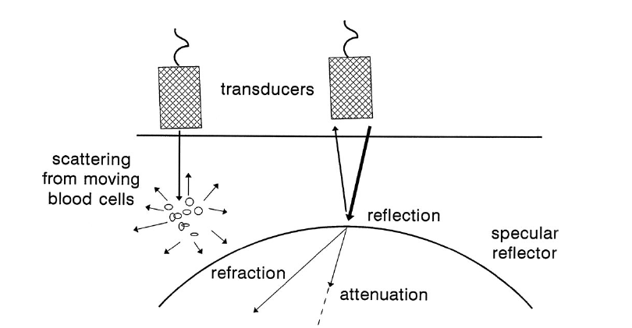
Ultrasound can undergo a range of interactions in soft tissue
Reflection
Scattering
Refraction
Absorption
Lawrence (2007) Crit Care Med
Notes:
For imaging purposes we are most interested in reflected sound waves although other interactions can be used in more sophisticated imaging techniques e.g. scatter and doppler.
Specular reflectors, as shown here, are structures that are relatively large in comparison to the ultrasound wavelength. The amount of sound reflected is related to the density of the reflector and the angle of incidence.
In general, the greater the density of tissue and hence acoustic impedance, the higher the reflectance.

Slide 16
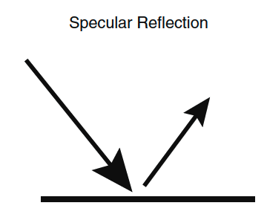
Reflection of ultrasound occurs at boundaries of media with different acoustic impedances
Ultrasound beam
Echo
θ₁
θ₂
Z₁
Z₂
Reflection coefficient for normal incidence:
Notes:
For a large object (compared to the wavelength of sound), or smooth interface of two body tissues with different acoustic impedances, we observe specular reflection.
The difference in acoustic impedance is referred to as acoustic mismatch.
If the incident angle is 90 degrees, almost all of generated echo will travel back to the transducer. If less than 90 degrees, the echo will be reflected at an angle equal to that of the incident beam and potentially not be detected.

Slide 17
Reflections can be good and bad!
Interface | Reflected Intensity (%)
Fat/kidney | 0.6
Fat/muscle | 1.1
Bone/muscle | 41.0
Soft tissue/air | 99.9
Soft tissue/lung | 52.5
Soft tissue/PZT | 79.8
PZT/air | 99.99
Gel is used to remove air interfaces between the transducer and the skin.
It is difficult to image the lung and behind bones, and impossible to image across bowel gas.
There are not many interfaces in the body that are large and smooth on the scale of ultrasound wavelength (1mm or less). Examples include the diaphragm/liver, bladder wall and some large blood vessels.
Notes:
The percentage of ultrasound energy reflected is proportional to the acoustic mismatch. For imaging, a large mismatch gives rise to large echo and hence high signal. If Z1=Z2 then there is no backscattered signal at all.

Slide 18
Specular reflections of ultrasound are analogous to looking into a mirror
Scattering condition:
s >> λ
Scattering strength:
Low
Notes:
For standard specular reflection, the size of the object s is much greater than the wavelength. However, as stated in the previous slide, there are few biological examples where this is the case.
Scattering means that a proportion of the energy is absorbed by the tissue and re-radiated as new, spherical waves.

Slide 19
Scattering can arise from rough or irregular surfaces
Scattering condition:
s ≈ λ
Scattering strength:
Moderate
At 2.5 MHz, the signal from red blood cells is
1/1000 that of a fat/muscle specular reflection
Notes:
Scattering occurs at a rough / irregular interface, where the irregularity is of a similar size order to the wavelength, or with objects that are small compared to the wavelength.
Analogous to light scattering through a ground glass
In the diffuse reflection case shown here, a special case of scattering, surface roughness has dimensions approximately equal to the ultrasound wavelength
Scattering occurs through a wide range of angles and hence shows low echo intensity compared to specular reflections. At a surface, re-radiation is directional.

Slide 20
Scattering can also arise from objects smaller than the ultrasound wavelength
Scattering condition:
s << λ
Scattering strength:
High
Notes:
In addition to interfaces, diffuse reflection can also occur at interfaces with individual objects that have different acoustic impedance.
Within most biological tissues there are structures < 1mm in diameter e.g. red blood cells
The scattering power of these small objects is re-radiated as spherical waves so very little reaches transducer.
The result is that ultrasound images appear as though they are filled with tiny scattering structures.
The appearance is referred to as ultrasound speckle, a coherent noise phenomenon that yields image mottle:
If there are a few small scatterers within a resolution cell, they can produce an interference pattern depending on the relative phase of the waves
the interference pattern from adjacent cells with similar scatterers may be different and hence give a different intensity on the image
The speckle pattern depends on the resolution of the ultrasound system

Slide 21
Refraction occurs when ultrasound is incident on a medium with a different speed of sound
Ultrasound beam
θ₁
If c₁ > c₂, beam bends toward normal
If c₁ < c₂ and θ₁ is large may get total internal reflection
θ₂
Refracted ultrasound beam
Interface | c₁/c₂ | Angle of incidence | Angle of refraction
Fat / muscle | 1.09 | 5 | 4.6
Bone / fat | 2.81 | 5 | 1.8
Notes:
Ultrasound waves obey normal refraction relationship from optics, Snell’s law, depends on difference in speed of sound in the two media
Most prominent at fat / soft tissue interfaces due to low speed of sound in fat.
TIR causes edge effect artefacts, shadow at the side of curved structures due to inward bending of ultrasound

Slide 22
Absorption occurs when mechanical energy of the ultrasound beam is converted to heat energy
Absorption in tissues is strong, accounts for 80 – 90 % of all energy loss by an ultrasound beam
Depends on:
Frequency
Viscosity of the medium
Relaxation time of the medium
Relaxation:
at low frequencies the particles move easily with the passing pressure wave and return to equilibrium before the next disturbance so all energy is transmitted
at higher frequencies, particles are unable to keep up so do not pass all energy
Notes:
Friction like loss - viscosity
Not clinically useful, limits the upper limit of the frequency range that is feasible for use (~20MHz) and leads to imaging artifacts such as poor quality in air filled spaces due to high impedance of air.

Slide 23
Attenuation describes the loss of intensity as ultrasound passes through the tissue
Attenuation includes both scattering and absorption
Where I is intensity, a ~ 0.5 dB cm⁻¹ MHz⁻¹ in soft tissue, f is frequency (MHz) and l is thickness of tissue (cm)
Analogy to X-ray HVT:
$$I=I_{0}e^{−afl}$$
Material | HVT (cm) @ 2MHz | HVT (cm) @ 5MHz
Air | 0.06 | 0.01
Bone | 0.1 | 0.04
Liver | 1.5 | 0.5
Blood | 8.5 | 3.0
Water | 344 | 54
Notes:
longer path length and higher frequency waves experience greater attenuation. all interaction processes described so far contribute in some way to attenuation.
attenuation coefficient alpha is often written as dB / cm / MHz to account also for frequency dependence of attenuation

Slide 24
To avoid the exponential in attenuation calculations, the decibel scale is used
$$\frac{I}{I_{0}}=e^{−afl}$$
Echo pressure amplitudes vary by a factor of 10⁵ or greater, so a logarithmic scale helps:
I/I₀ | dB
1,000,000 | 60
100 | 20
10 | 10
2 | 3
1 | 0
0.01 | -20
Intensity ratio (dB)
Amplitude ratio (dB)
(Factor of 2, since intensity is proportional to square of amplitude)
Notes:
the amount of reflected energy A that is sensed by the ultrasound transducer is a fraction of the initial energy A0
Absorption loss in tissue occurs at a rate of about 1 dB cm⁻¹

Slide 25
Example: Working with decibels
Consider two consecutive regions of tissue with the same acoustic impedance but different attenuation coefficients:
a = 0.5 dBcm⁻¹MHz⁻¹
l = 6 cm
a = 0.8 dBcm⁻¹MHz⁻¹
l = 5cm
Ultrasound in ->
10 Wcm⁻²
Ultrasound out?
Notes:
Attenuation loss due to tissue 1 = -0.5 x 5 x 6 = -15 dB
Attenuation loss due to tissue 2 = -0.8 x 5 x 5 = -18 dB
Total loss = -(15 + 18) = -33 dB
So, -33 = 10 log₁₀(I/I₀) ⇒ I = I₀ antilog(-3.3) = 10 x 5 x 10⁻⁴ W cm⁻² = 5 mW cm⁻²

Slide 26
Ultrasound imaging thus requires a trade off between imaging resolution and penetration depth
Lawrence (2007) Crit Care Med
Notes:
Modern imaging systems use frequencies from 2 MHz to 20 MHz.
If the frequency is too high, we will not penetrate to the most distal structures of interest
If the frequency is too low, the resolution will be poor
The imaging resolution depends on the wavelength e.g. 0.8mm wavelength in tissue corresponding to around 2 MHz frequency. This resolution is relatively poor but enables maximum depth of penetration.
Generally we try to use the highest frequency available and compromise with lower frequencies when necessary

Slide 27
4.19 Physics of Ultrasound
Part 2: Ultrasound hardware

Slide 28
Ultrasound imaging is based on the ‘pulse-echo’ principle
The distance of a reflecting object can be established by the return time of a short pulse if the speed of the pulse is known
For a measured time t and known speed of sound c, the distance in the pulse-echo technique is given by d:
$$d=\frac{ct}{2}$$

Slide 29
Amplitude (A) mode ultrasound displays the ultrasound echoes along one beam, or ‘A Line’
L_{max}
Amplitude
Gain
Amplitude
Amplitude
Time (depth)
Notes:
Ultrasound scanners assume 1540 m/s to locate reflections.
Due to attenuation in tissue, echoes from similar reflectors will have different amplitudes depending on their depth
For tissue imaging, it is desirable to remove this depth dependence so that, for example, an image of the liver will appear uniform.
This is achieved using time gain compensation (TGC), which is a gain applied to the RF amplifier and increases with time after the pulse is transmitted. TGC is normally calibrated using slider controls on a case-by-case basis.
A-mode places a restriction on pulse repetition frequency such that enough time can elapse before the next pulse is transmitted for the echo from the maximum imaging depth of penetration Lmax to return.

Slide 30
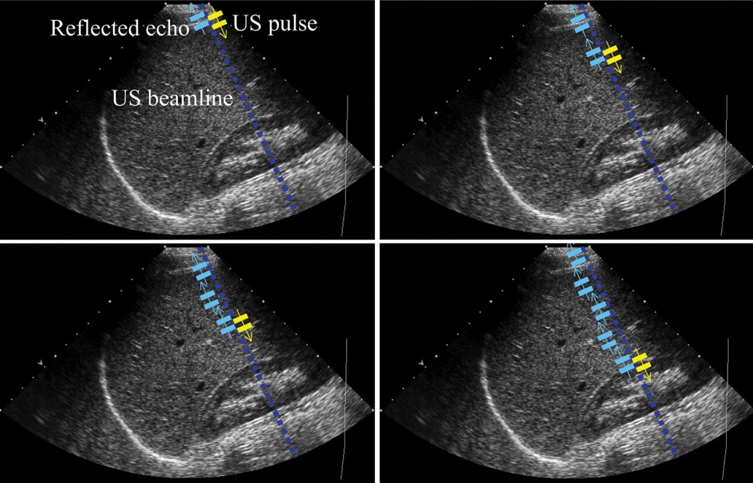
Amplitude (A) mode ultrasound displays the ultrasound echoes along one beam, or ‘A Line’
Restriction on pulse repetition time (T_{p}) given by L_{max}, the maximum desired depth of penetration for imaging:
AAPM/RSNA Physics Tutorial for Residents: Topics in US

Slide 31
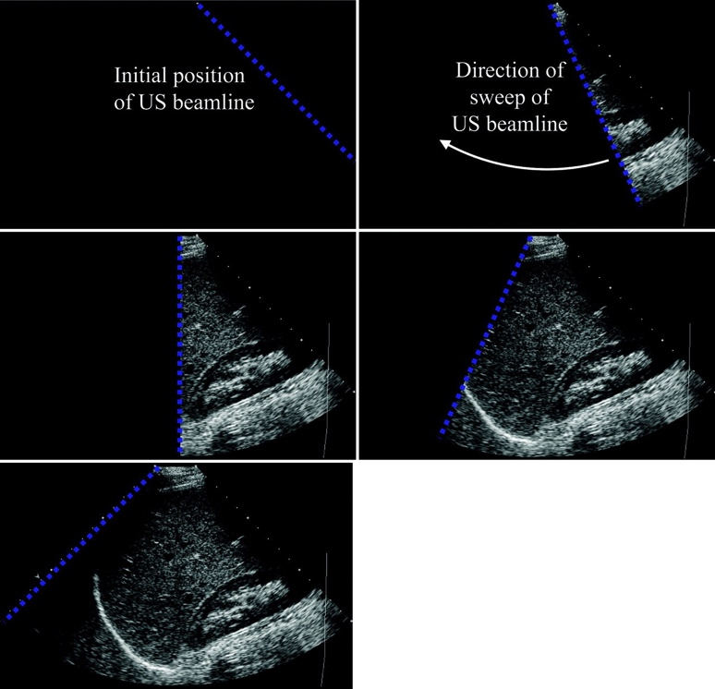
Brightness (B) mode uses each individual echo strength to build up a 2D image
Amplitude
Time (depth)
Amplitude
Time (depth)
Amplitude
Time (depth)
More reflective structures appear brighter
Notes:
An image frame consists of many scan lines built up by sweeping the ultrasound beam through the scan plane, either mechanically or using phased arrays.
Frame rate limited by the how quickly can obtain ultrasound signals from multiple scan lines. frame rate * line density * FOV = constant.

Slide 32
Ultrasound imaging is based on the ‘pulse-echo’ principle
The maximum pulse repetition frequency is therefore
The frame rate, or number of images produced per second is then dependent on the number of scan lines needed to make up the B-mode image:
$$PRF=\frac{c}{2d}$$
Frame rate $=\frac{c}{2dn}$

Slide 33
Block diagram of a typical ultrasound imaging system and typical operator controls
Transducer
Beam former
Signal processing
Image memory
Display
Control | Function
Output power | Increases pulse amplitude (and associated energy deposited in patient)
Receiver gain | Increases size of received signal (but also noise)
Time gain compensation | Compensates for non-uniform acoustic data
Focusing | Improves lateral resolution
Frame rate / line density / field of view | Product is constant, illustrating important trade-off
Notes:
Transducer produces ultrasound pulse
Beamformer steers and focuses the ultrasound pulses.
Signal processing minimises artefacts

Slide 34
The transducer

Slide 35
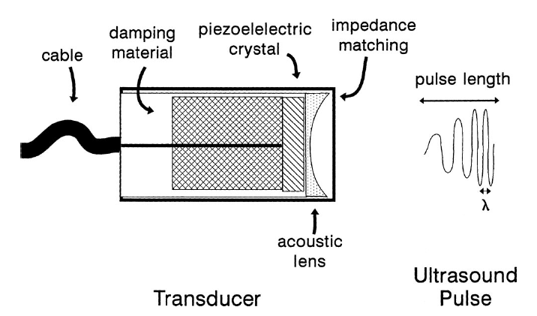
An ultrasound transducer is composed of three main parts
Lawrence (2007) Crit Care Med
Notes:
A pulse of sound waves is transmitted into the body, and the echo is detected with the time of flight used to determine the depth of the reflector that generated the echo.
Ultrasound waves are detected using a transducer made from a piezoelectric material.
Damping material determines bandwidth.
Acoustic lens focuses generated waves and matching layer maximises transmission of produced ultrasound into the tissue

Slide 36
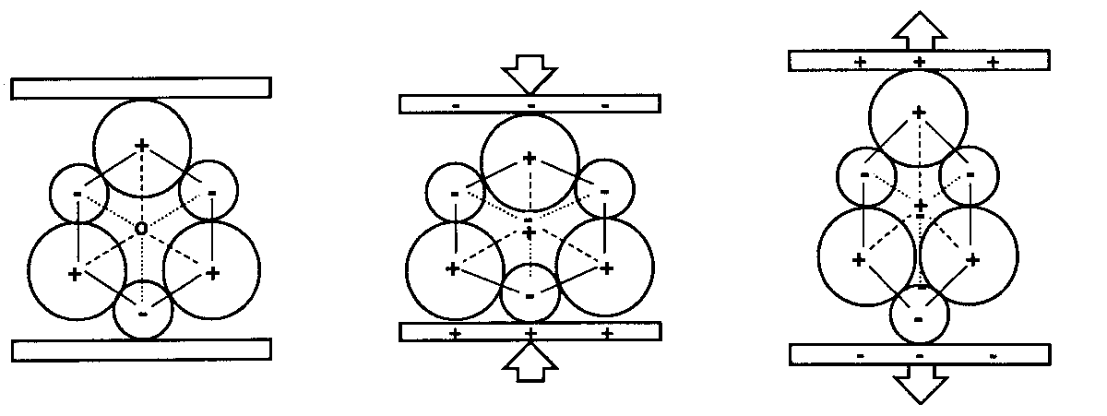
The piezoelectric effect is the appearance of surface charge in response to applied pressure
Ultrasound is detected using this effect
Piezoelectric materials also change dimension in response to an applied electric field.
This is used to produce the ultrasound waves.
Lead zirconate (PZT) is typically used in ultrasound imaging
Notes:
Normally, the dipoles in the crystalline material are arranged randomly.
To align the dipoles (“polarize” the material), it is heated above the Curie temperature of the material and allowed to cool slowly in the presence of a strong electric field.

Slide 37
Piezoelectric elements both generate and detect ultrasound waves
~
~
The application of a short (~ 1 μs) pulse of high voltage (~ 150 V) causes PZT contraction and subsequent vibration at a natural resonant frequency
Notes:
The material is polarized and electrodes attached to two opposite faces.
Quartz is naturally occurring but ultrasound uses PZT – lead zirconate.

Slide 38
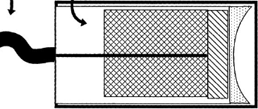
The crystal thickness (l) determines the ultrasound frequency (f) produced
The time for the wave to make a return trip between the faces of the crystal is one period, T (units of seconds):
$$T=\frac{2l}{c_{PZT}}$$
$$f_{0}=\frac{1}{T}=\frac{c_{PZT}}{2l}$$
$$l=\frac{λ}{2}$$
The fundamental mode (maximum pressure) occurs when
Notes:
Each crystal has a characteristic frequency,
The largest resonance occurs when the wave travels from one face of the crystal, is reflected at the opposite face and returns in one period, time T “half wavelength resonance”.

Slide 39
Example: Calculating required PZT thickness
What thickness of PZT is required to produce an ultrasound wave of 5 MHz for imaging soft tissue?
Speed of sound in PZT c_{PZT} = 3791 ms⁻¹
Notes:
Wavelength is 3791 / 5000000 = 0.76 mm
Crystal thickness is 0.76 / 2 = 0.38 mm

Slide 40
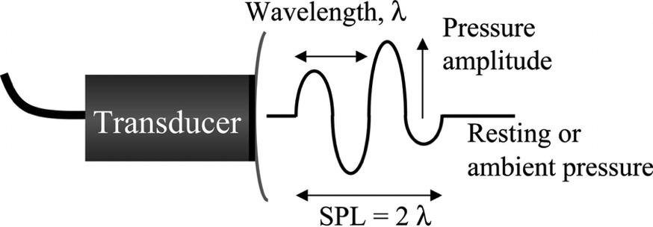
The pulse duration determines ultrasound axial imaging resolution
Axial resolution is determined by the speed of sound (c) and the pulse duration ($τ$):
Increasing the ultrasound frequency means that each pulse can be made even shorter in time, hence the axial spatial pulse length ($τ$c) is smaller, giving better resolution
The lateral extent of the disturbance must be narrower than the distance between the features to be resolved (more later)
$$d_{a min}=\frac{τc}{2}$$
Spatial Pulse Length
Notes:
The pulse of ultrasound emitted by a transducer is typically only a microsecond or so long, which means that the axial length of the pulse is often less than a millimetre (typically two wavelengths).
The axial resolution is half the pulse length because if two features are separated in the axial direction by this amount, the distance travelled by the ultrasound to each of them and back in the pulse echo process are separated by tau * c, meaning that they arrive separately in time and can be resolved.

Slide 41
Example: Axial resolution
What is the axial resolution in soft tissue of a 5MHz transducer producing a pulse of 3 cycles duration?
How much better would this be at 10MHz?
Notes:
Frequency = 5MHz
1 cycle takes 1/5000000, 3 cycles take 3/5000000 so SPL = 1540 * 3/5000000 = 0.9 mm
Best possible spatial resolution is SPL/2 = 0.45 mm
At 10MHz, SPL = 0.46 mm so SPL/2 = 0.23mm (twice as good)

Slide 42
The pulse frequency bandwidth is an important consideration in transducer design
Long spatial pulse length
Poor axial resolution
Narrow frequency bandwidth
Short spatial pulse length
Good axial resolution
Wide frequency bandwidth
Pulse bandwidth $Δf$
~ 1/pulse duration
Energy
Energy
f/f₀
f/f₀
0.8
1
1.2
0.8
1
1.2
“Ringing”
Damped
High sensitivity
Optimal axial resolution
Notes:
Centre frequency f0 is where the spectrum has maximal height
Bandwidth is the width at half maximum
As the pulse gets shorter in time, the bandwidth increases (consequence of Fourier analysis, only a continuous wave has a unique frequency)

Slide 43
Example: Bandwidth
What is the bandwidth of a 5MHz transducer with a pulse duration of 2 cycles?
Notes:
2 cycles takes 2/50000000, bandwidth is 1/ this
The bandwidth is 50% of f0, so a 5MHz imaging pulse is really a pulse with centre frequency 5MHz but with above half maximum energy between 2.5MHz and 7.5MHz

Slide 44
Impedance matching determines the intensity of ultrasound emitted
Piezo
(PZT)
Matching (Al)
Matching 2
Matching 3
The material should have an acoustic impedance of:
$$Z_{match}=\sqrt{Z_{PZT}+Z_{tissue}}$$
Notes:
To get as much energy out of the transducer as possible, impedance matching is placed between the active element and the transducer face.
Optimal impedance matching occurs when the thickness is one quarter of the wavelength – this keeps waves that were reflected within the matching layer in phase when they exit the layer preventing destructive interference.
Impedance matching is usually composed of a material with acoustic impedance between the piezo element and the transducer face, which may be steel for a contact transducer or water in an immersion one.
Choosing a material with acoustic impedance as the geometric mean of PZT and tissue means all energy entering the matching layer from the transducer is eventually transmitted into the tissue. However, this is only true at the designed frequency, so for short pulses with a broad frequency spectrum, multiple layers of materials with acoustic impedance values that are intermediate may be needed.
Note that the transducer is also part of an electrical circuit so electrical impedance matching is also required.

Slide 45
Damping determines the bandwidth of ultrasound emitted
Backing ( W in epoxy)
Piezo
(PZT)
Matching (Al)
Matching 2
Matching 3
Energy
Damped
High sensitivity
Optimal axial resolution
f/f₀
0.8
1
1.2
Notes:
The backing material supporting the crystal has a great influence on the damping characteristics of a transducer.
Damping is necessary as the piezo element will “ring” at its resonant frequency for many cycles after excitation, resulting in a narrow band of frequencies around the centre frequency.
For imaging, short pulses are required, therefore a backing material is used to absorb (backward directed) ultrasound energy.
Using a backing material with impedance similar to the piezo element produces the most effective damping (short spatial pulse length) – such a transducer will have a wide bandwidth and high sensitivity.
As the mismatch between the piezo element and backing increases, the transducer is less damped and will exhibit a narrower frequency range.

Slide 46
Q factor describes how damped an oscillator is
Backing ( W in epoxy)
Piezo
(PZT)
Matching (Al)
Matching 2
Matching 3
$$Q=\frac{f_{0}}{Δf}$$
$$Q=\frac{energy stored per cycle}{energy lost per cycle}$$
or
High Q transducer is lightly damped, so good for continuous wave ultrasound
Low Q transducer is highly damped, so good for pulse echo imaging ultrasound

Slide 47
The ultrasound beam

Slide 48
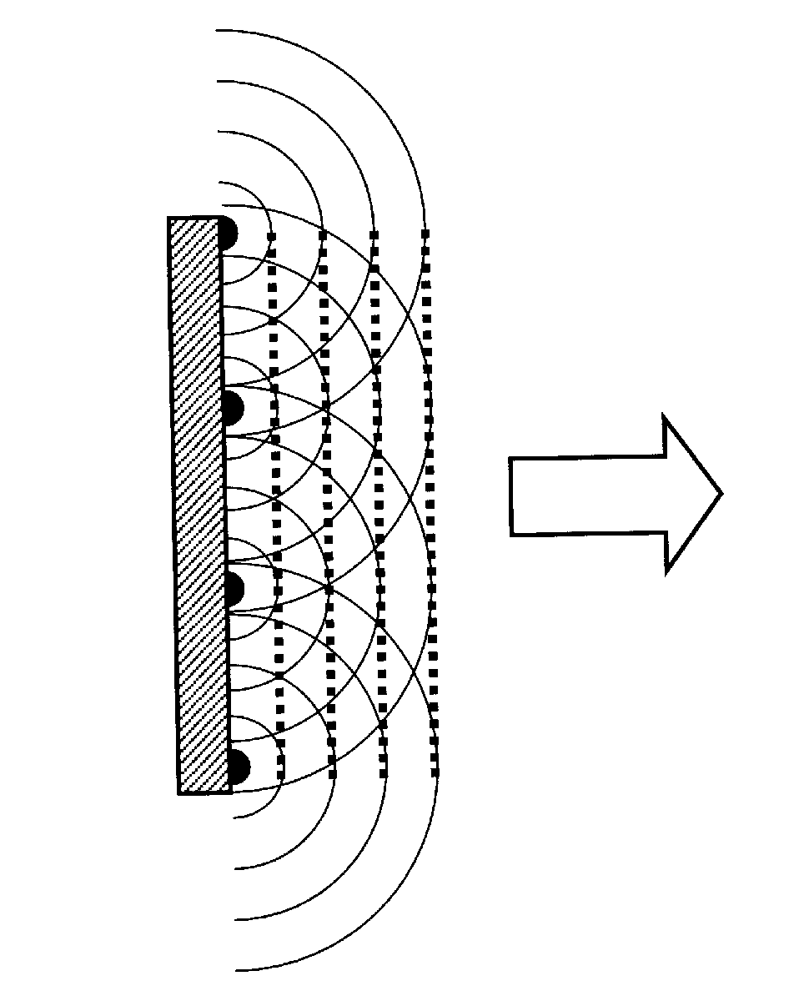
The simplest ultrasound case is a continuous wave created by a circular disk of PZT
The pressure (and intensity) field can be calculated using Huygen’s principle for superposition of wavelets.
Every point on the transducer surface is considered to emit a spherical wave.
The resulting pressure field is found by summing all the waves, taking into account the phase of each contribution.
The mathematical integral is difficult to solve and is typically treated numerically.
Notes:
A PZT element is not a point source of ultrasound. The geometric shape is typically a disc and the behaviour of the emitted ultrasound intensity can be calculated using Huygen’s principle, with every point on the transducer surface considered to emit a harmonic spherical wave and summing these all together.

Slide 49
Considering the axial behaviour along the z axis normal to the centre of the disk:
r
a
I_{z}
z
Last axial max
z
Near field
“Fresnel”
Far field
“Fraunhofer”
Notes:
The pattern of the ultrasound intensity obeys Iz/I0, with repeating maxima and minima until the last axial maximum occurs when a^2 is much larger than the wavelength squared.
Most diagnostic ultrasound occurs in the near field zone.

Slide 50
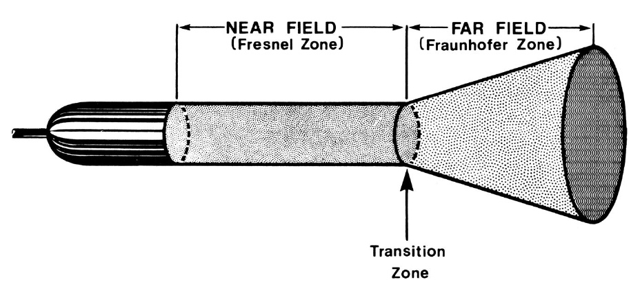
In the far field regime, the cylindrical ultrasound beam diverges
θ
θ
Notes:
The beam is cylindrical in shape close to the transducer (Fresnel zone) then becomes conical further away (Fraunhofer zone).

Slide 51
In the far field regime, the cylindrical ultrasound beam diverges
θ
Lateral behaviour
θ
On axis:
Off axis:
where J1 is a Bessel function of the first kind
The central lobe is confined to a region defined by:
Lawrence (2007) Crit Care Med
Notes:
To optimise lateral resolution the cross section of the beam should be narrow and the Fresnel zone as long as possible – can be achieved by increasing frequency or size of transducer

Slide 52
Lateral resolution is determined by beam divergence
To optimise resolution the cross section of the beam should be narrow and the fresnel zone as long as possible, but is generally poorer than axial resolution
This can be achieved by increasing centre frequency or physical size of PZT disk
Notes:
Zmax = a^2/wavelength = a^2 * frequency / speed of sound
Hence a^2 = Zmax * speed of sound / frequency, so for fixed Z max, a smaller a can be achieved by increasing frequency

Slide 53
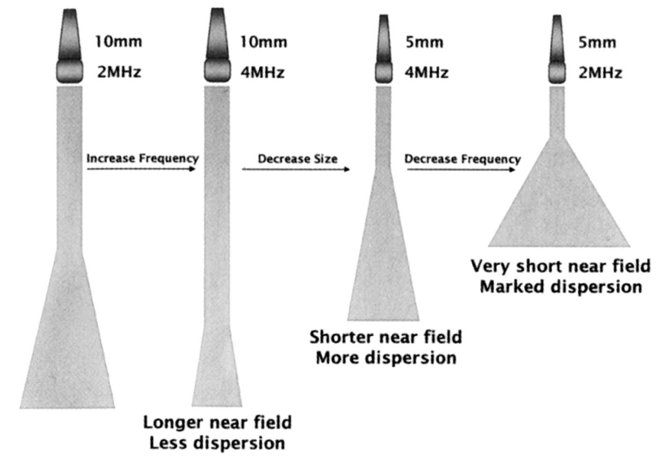
The ultrasound beam can therefore be shaped by adjusting transducer geometry
Lawrence (2007) Crit Care Med
Notes:
directly affects frequency and hence wavelength, then radius also plays in for distance and dispersion

Slide 54
The ultrasound beam can therefore be shaped by adjusting transducer geometry
Lawrence (2007) Crit Care Med
Notes:
directly affects frequency and hence wavelength, then radius also plays in for distance and dispersion

Slide 55
The ultrasound beam can therefore be shaped by adjusting transducer geometry
Lawrence (2007) Crit Care Med
Notes:
directly affects frequency and hence wavelength, then radius also plays in for distance and dispersion

Slide 56
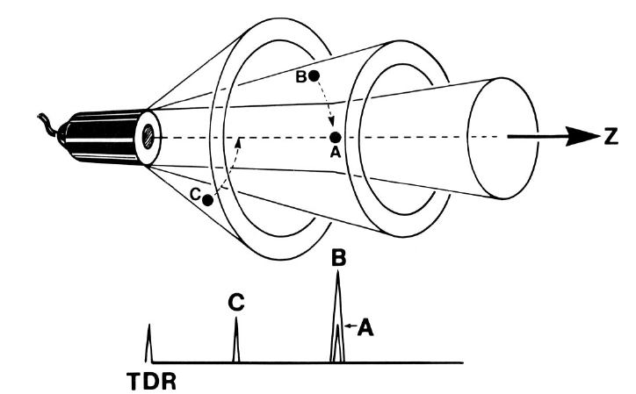
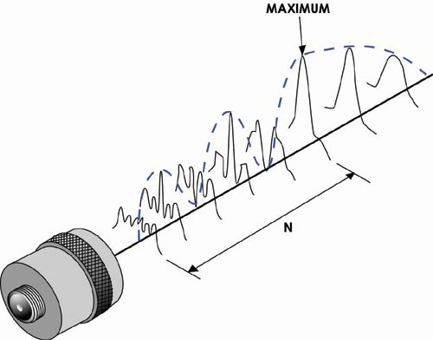
In addition to the inherent far field divergence, in reality no beam is a perfect cylinder
Lawrence (2007) Crit Care Med
http://www.ndt-ed.org/EducationResources/CommunityCollege/Ultrasonics/EquipmentTrans/radiatedfields.htm
Notes:
Ultrasound beam is not perfectly cylindrical, transducer generates extraneous ultrasound called side lobes that interfere with lateral resolution.
Here we see a main beam with two side lobes. Objects will be excited off axis at B and C, generating artifacts in our axial profile.
Side lobes contain maxima and minima at increasing angles from the main lobe, are unwanted regions of ultrasound intensity that lie off the main beam axis

Slide 57
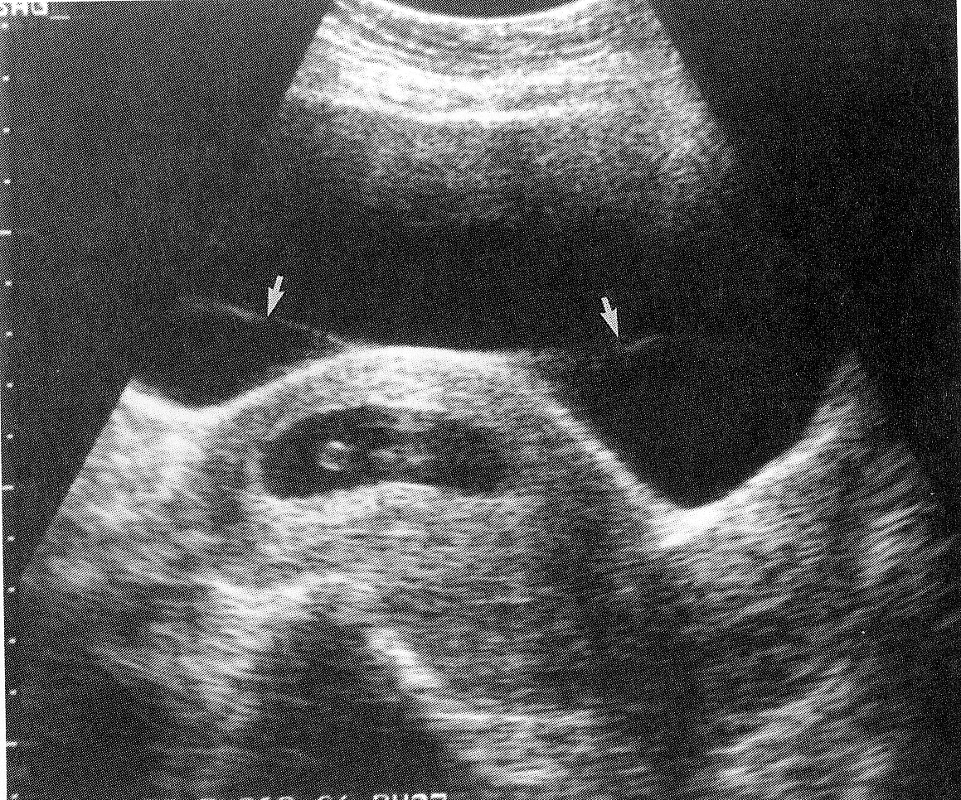
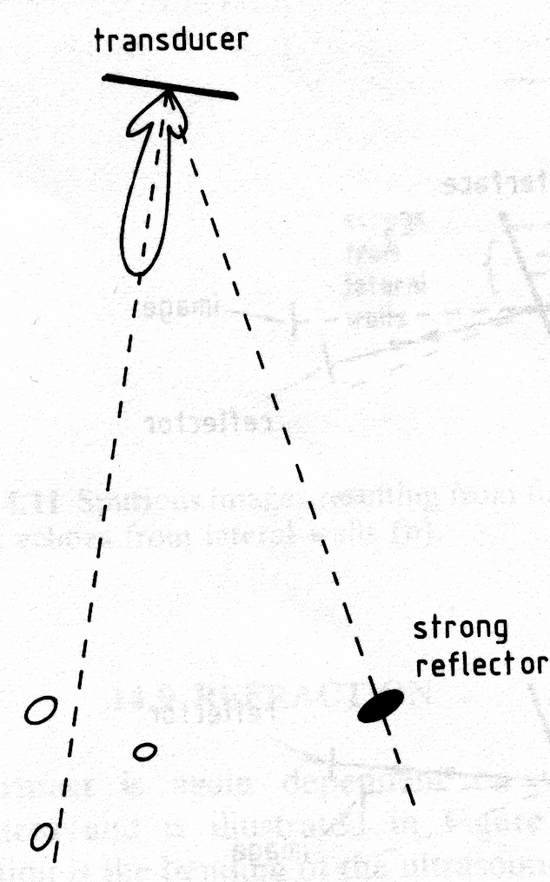
Side lobes are much weaker than the main lobe but can be responsible for artefacts
The strong reflecting surface of the central structure lies in the side lobes of the beam directed at angles away from the perpendicular. The echoes from the sidelobes are misplaced (arrows).

Slide 58
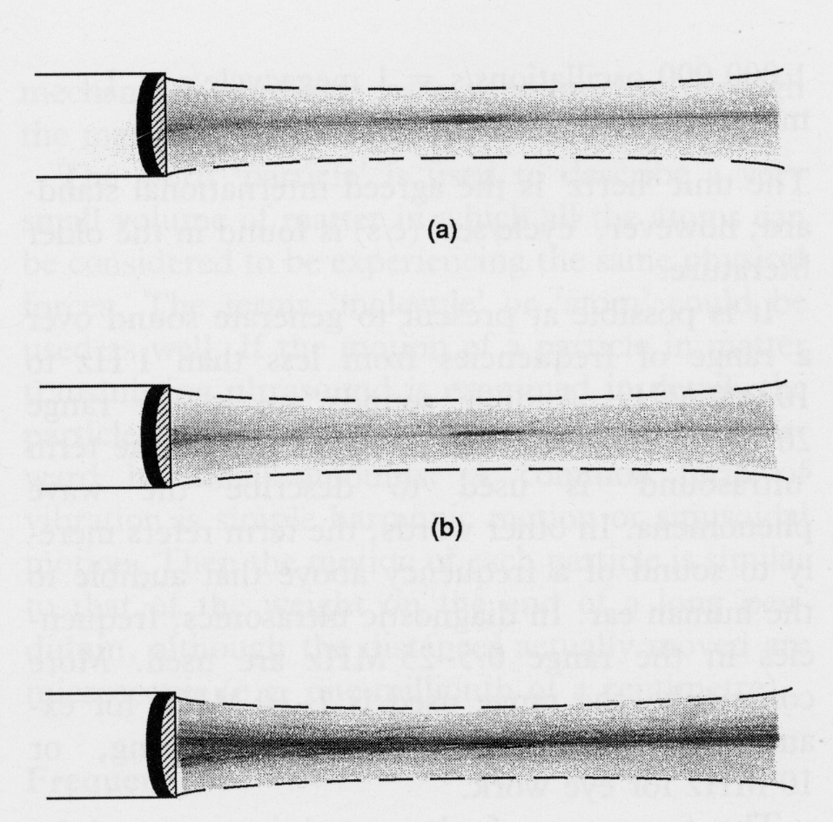
Some terminology
Transmission Field - the “corridor” along which transmitted waves travel and the associated intensity pattern
Reception Zone - the region in which a point source of ultrasound must lie if it is to produce a detectable signal at the receiving transducer.
Ultrasound beam - the product of the transmission field and the reception zone.
In the simple case of a single disc transducer the transmission field and reception zone have the same shape and size.
Notes:
The ultrasound beam will have a narrower width than both the transmission field and the reception zone.

Slide 59
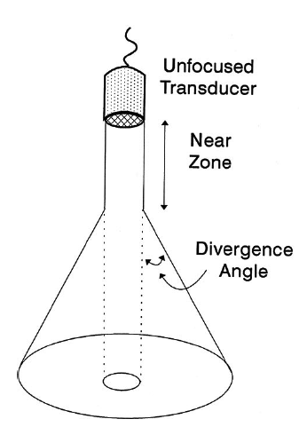
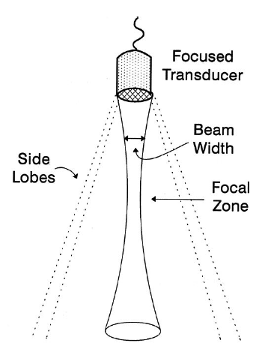
Using a curved transducer or acoustic lens allows for focusing of the ultrasound beam
a
z
z
Lawrence (2007) Crit Care Med
Notes:
Focused transducers use a square wave gated pulse of sinusoidal ultrasound (of around 3-4 cycles) and produce a spherically curved wave front instead of a plane wave. Create a focal point of higher beam intensity.
We already established axial resolution is dependent on spatial pulse length.
Lateral resolution depends on beam width hence is best in the focal zone. The stronger the focusing, the shorter the transducer focus distance and hence the greater the divergence. Trade off between depth and focus.
The beam width can be made smaller by focusing using a curved transducer or an acoustic lens

Slide 60
The beam former (and array designs)

Slide 61
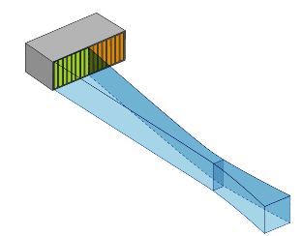
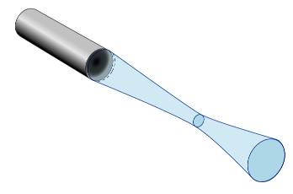
Transducer arrays can be used to build up B-mode images
1D Linear: Enables beam steering; can be unfocused or focus in one axis
2D Square: Spherical or single axis focus, imaging in 3D, more complex design and manufacturing
Notes:
1D mechanical scanning of a single transducer element can be used to create a B-mode image
Linear arrays of transducers are now far more comment; note that the rectangular aperture of the linear array components produces a beam with a non-circular cross-section, so the focal beam width in the vertical (elevation) plane is wider than the horizontal (scan) plane
In a linear array, we typically have 256 – 512 discrete transducer elements, grouped into 15 – 20 adjacent elements that are activated simultaneously and then sequential groups are pulsed.
The reason for the grouping is that small transducers, as we saw previously, produce a short near field and large crystals give poorer line spacing so compromise by making a larger effective transducer size with grouping.

Slide 62
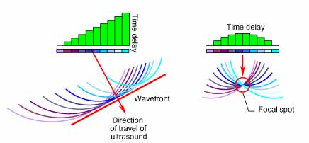
Transducer arrays have the added advantage of enabling directionality and focusing
http://www.olympus-ims.com/en/ndt-tutorials/transducers/
Notes:
By activating all groups at the same time but introducing a time delay between pulsing of the groups we can generate an angled wavefront for beam steering (planar) or we can focus. this is approach is called phased array ultrasound.
The slice thickness (or “elevational resolution”) depends on the transducer element height, so we can develop a 3D imaging array by extending the transducer into two dimensions

Slide 63
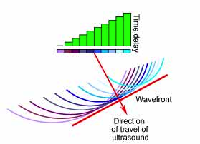
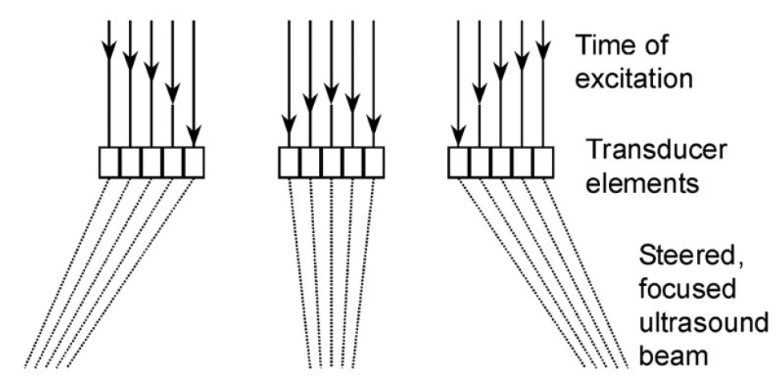
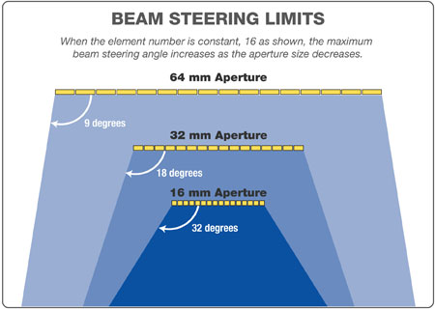
Phased arrays enable electronic beam steering, removing mechanical complexity
http://www.olympus-ims.com/en/ndt-tutorials/transducers/

Slide 64
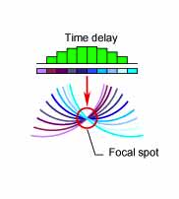
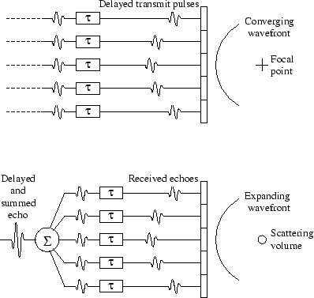
Phased arrays enable beamforming (focusing) on the transmit or receive signals
http://dukemil.egr.duke.edu/Ultrasound/k-space/node2.html
Notes:
The transmit signals passing to, and the received signals passing from, the array elements can be individually delayed in time, hence the term phased array.
This is done to electronically steer and focus each of a sequence of acoustic pulses through the plane or volume to be imaged in the body.
Beamforming refers to the process of steering and focusing these acoustic pulses.
It is possible because the transducer on the far left / right are actually further from the object than the central one so nanosecond pulse delays allow the wavefronts to arrive simultaneously at the object.
We can also perform this retrospectively on reception of the signals and use multiple focal zones, at the expense of imaging speed.
Advantage is that the focus is no longer hard coded by the piezo element geometry, can adjust over time

Slide 65
Side lobes must be reduced for high quality imaging
Side lobes are present in the transmission fields and reception zones of arrays
Apodisation, a beam-forming process, is used to reduce these:
On transmission, inner array elements are excited more than outer
On reception, different amplifications are performed in each array element
Grating lobes can arise from the periodic nature of the linear and phased array designs, producing additional lobes at a range of angles given by:
$$sinθ=\frac{nλ}{x}$$
Where m = 1, 2, 3 …, $λ=wavelength, and x=centre−centre distance between elements$

Slide 66
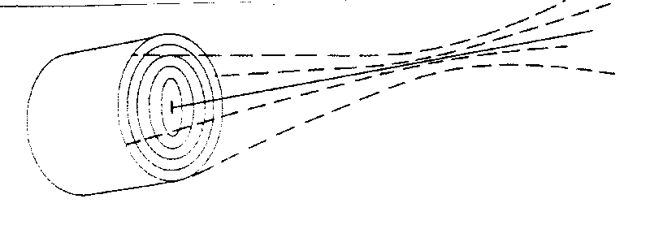
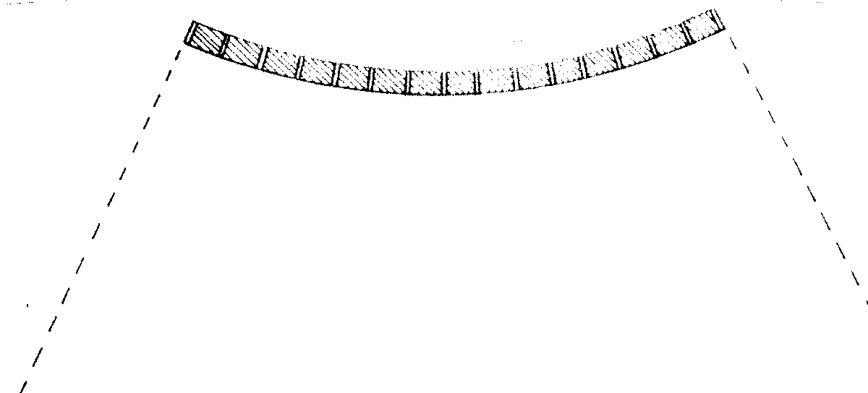
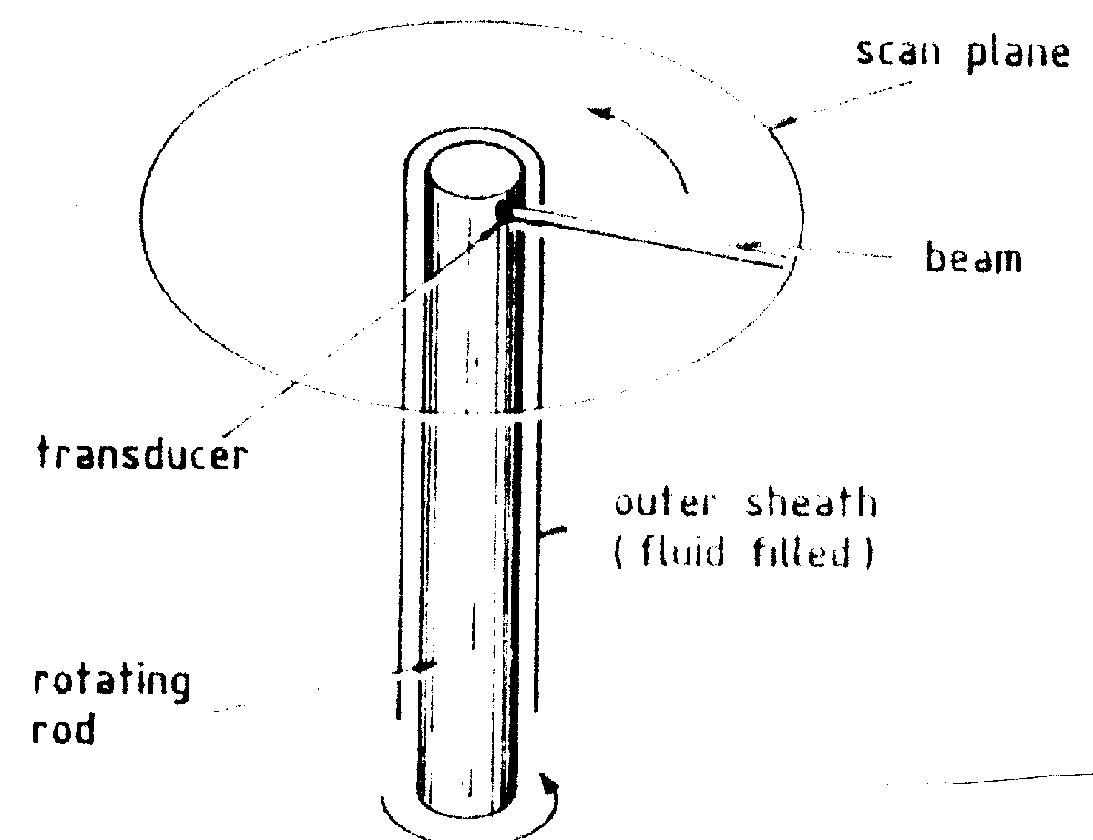
Several different scanning geometries can be employed
Annular arrays consist of concentric annuli of PZT
Axially symmetric focusing
Single scan line requires mechanical scanning
Curvilinear array
Similar operation to linear array
Smaller contact area required
Intra-cavity probes
Avoid problems with strong reflections e.g. air in the bowel
Intra-vascular probes
Operate at high frequencies to give high resolution

Slide 67
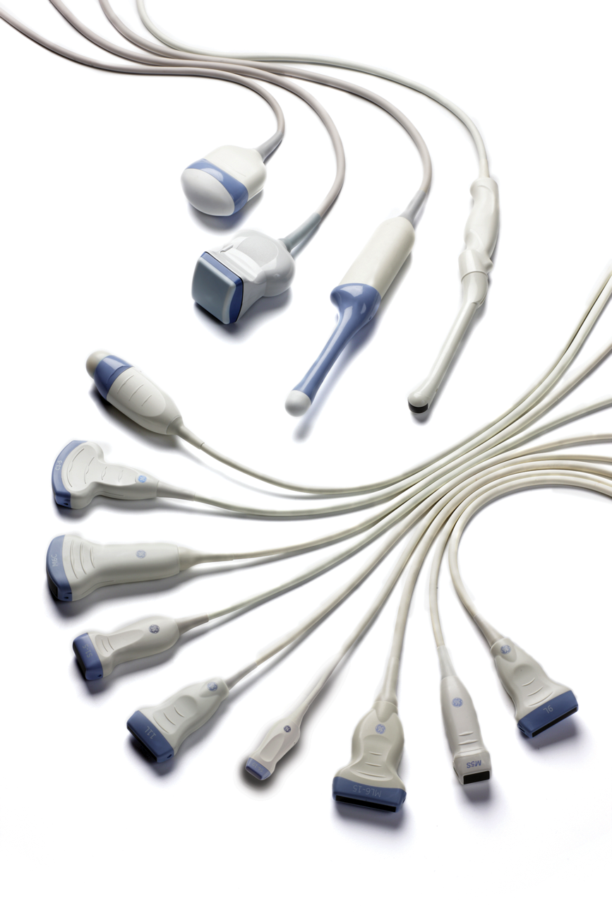
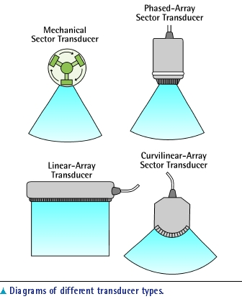
Several different scanning geometries can be employed
GE Healthcare

Slide 68
The signal processor

Slide 69
Pre-processing is typically performed on the analogue signals
Gain applied to the entire ultrasound signal
Amplification applied as a function of arrival time to the recorded ultrasound signal
http://199.116.233.101/index.php/Ultrasound_Instrumentation

Slide 70
Digital signal processing includes demodulation and compression
http://199.116.233.101/index.php/Ultrasound_Instrumentation
Notes:
Every electronic display is defined with a dynamic range that is the effective operational range of the device from the threshold signal to the saturation level.
Ultrasound has on average wider dynamic range (50 dB) than most digital displays (30 dB).
The monitor that displays the ultrasound signal is one of the key components that takes this into account since monitors are only able to display a specific range of grey-scale values.
The measured signals then get rectified (inversion of negative amplitudes into positive amplitudes) and demodulated (converting the sharp amplitudes of the signal into a smooth single amplitude pulse).
The last processing step, rejection, sets a threshold for signal amplitudes that are allowed to go through towards the digitization and display systems. This means that signal amplitudes below the threshold are removed reducing a large amount of the noise that is created by the scattering of sound inside of the body or by the electronics of the ultrasound machine themselves (such as the noise created in TGC). The final step cannot, however, remove all of the noise present in the ultrasound signal.

Slide 71
Summary (1)
Impedance mismatch causes acoustic reflections
Ultrasound can undergo reflection, refraction, absorption and scattering in tissue
Depends on the angle of incidence, size of the object relative to the ultrasound wavelength, acoustic impedance
Resolution must be traded against penetration depth because
High frequency ultrasound provides better spatial resolution
but high frequency ultrasound is strongly attenuated in tissue

Slide 72
Summary (2)
The pulse echo approach is used to form a brightness (B) mode ultrasound image
Transducers are composed of:
A piezoelectric element to generate and detect acoustic waves
Matching elements to maximise coupling of acoustic waves to the piezoelectric element
Backing material for damping to create a short pulse length and improve axial resolution
The finite transducer size results in a far field divergence of the beam and addition of side lobe imperfections
Focusing can partially compensate for this
Transducers are commonly combined into arrays for imaging

Slide 73
Next up: ultrasound imaging modalities!

