Slide 1
Reducing Noise in Electrocardiograms
Amy Caplan, Peter Coffman, and Ronald Chasse

Slide 2
Project description
Overall: we will be exploring how electrocardiogram works, how noise can be created in an electrocardiogram, and how to filter out noise created
We will be investigating how to reduce noise interferences when recording an EKG signal
Perform tests using EKG to demonstrate how EKG signals are recorded and then graphed
Attempt to reduce noise in signals using MATLAB
We will be observing the effects of different breathing patterns and movements affect the heart rate

Slide 3
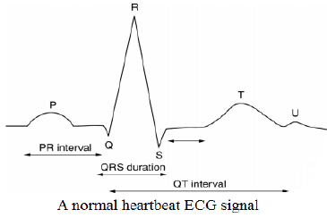
Electrocardiogram- What is it?
Test that measures the electrical activity of the heart
The right and left atria or upper chambers make the first wave called a “P wave" — following a flat line when the electrical impulse goes to the bottom chambers
The right and left bottom chambers or ventricles make the next wave called a “QRS complex"
The final wave or “T wave” represents electrical recovery or return to a resting state for the ventricles
Notes:
Image from: https://www.researchgate.net/figure/Normal-heartbeat-ECG-signal_fig1_258237553

Slide 4
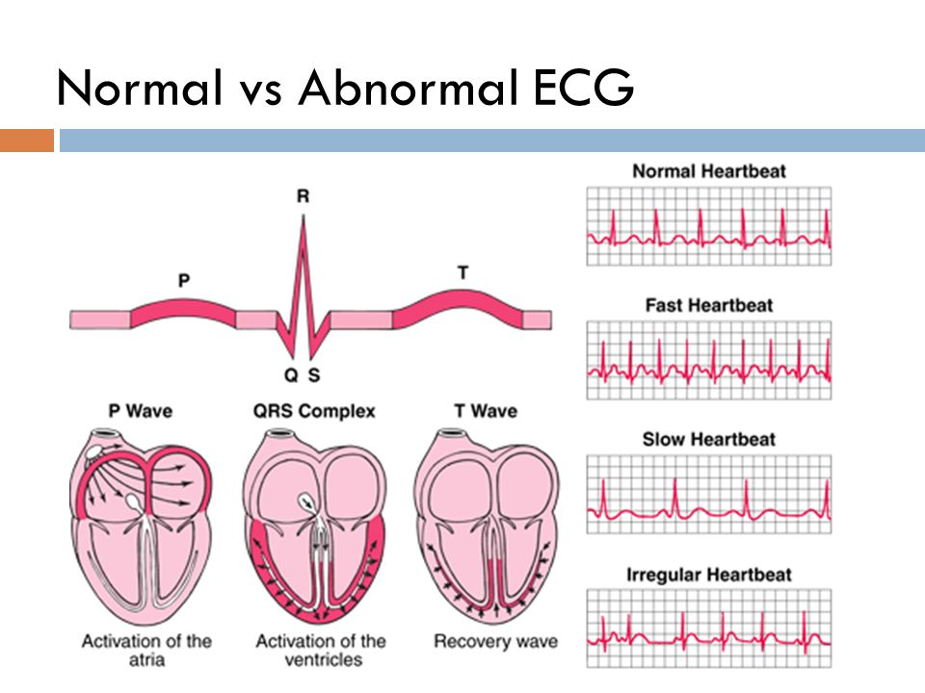
Electrocardiogram- Why is it done?
Determines how long the electrical wave takes to pass through the heart
Slow, fast, normal
Determines which parts of the heart are too large or are overworked
Notes:
Image from: https://slideplayer.com/slide/7612898/

Slide 5
Testing EKG using surface electrodes

Slide 6
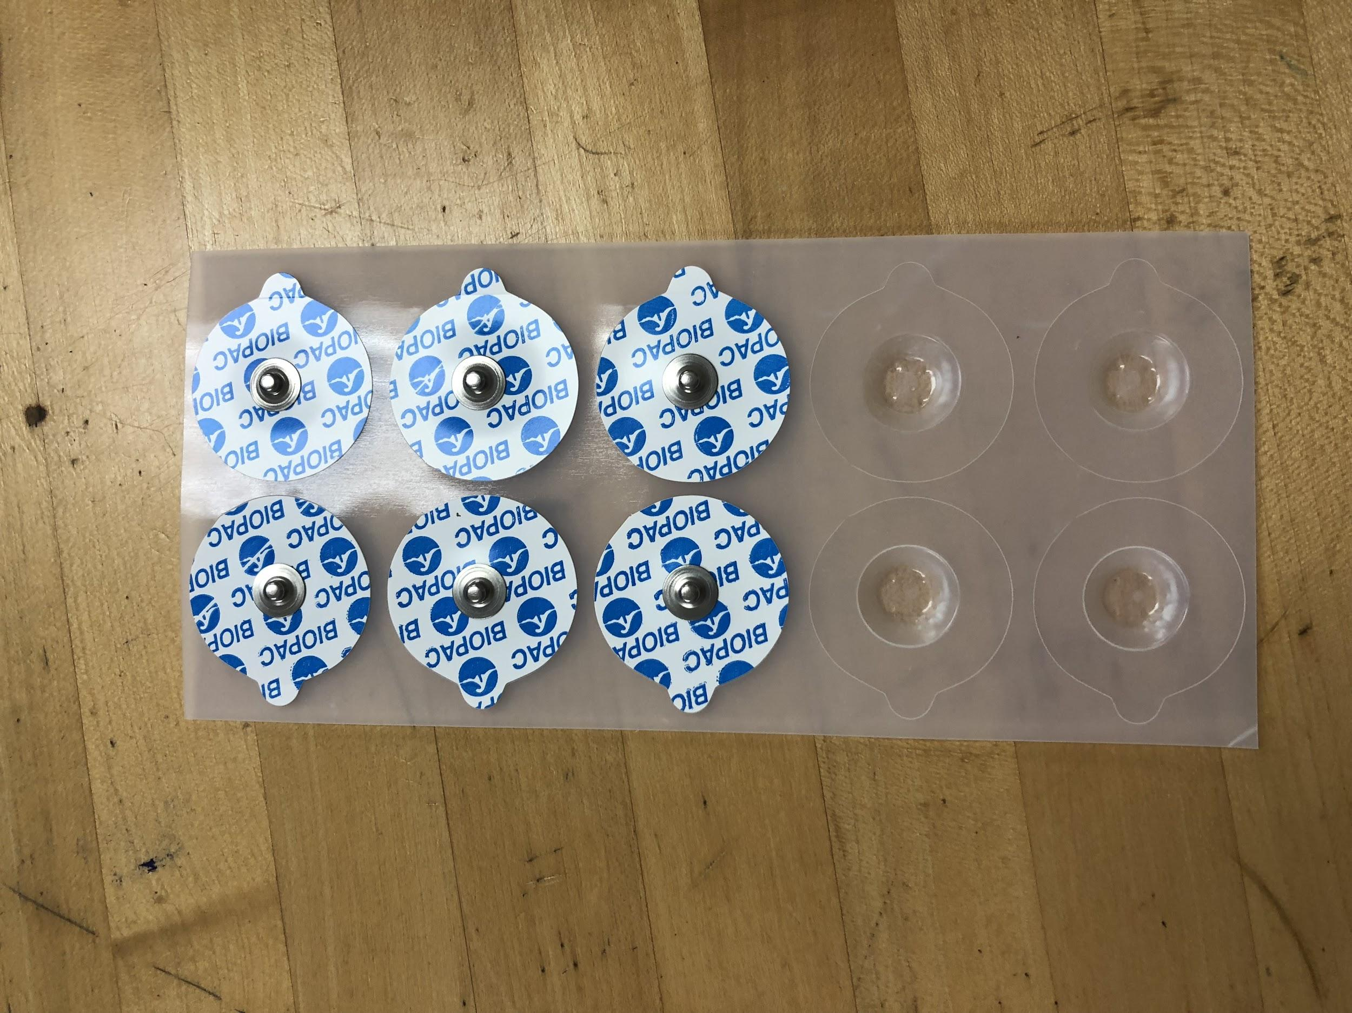
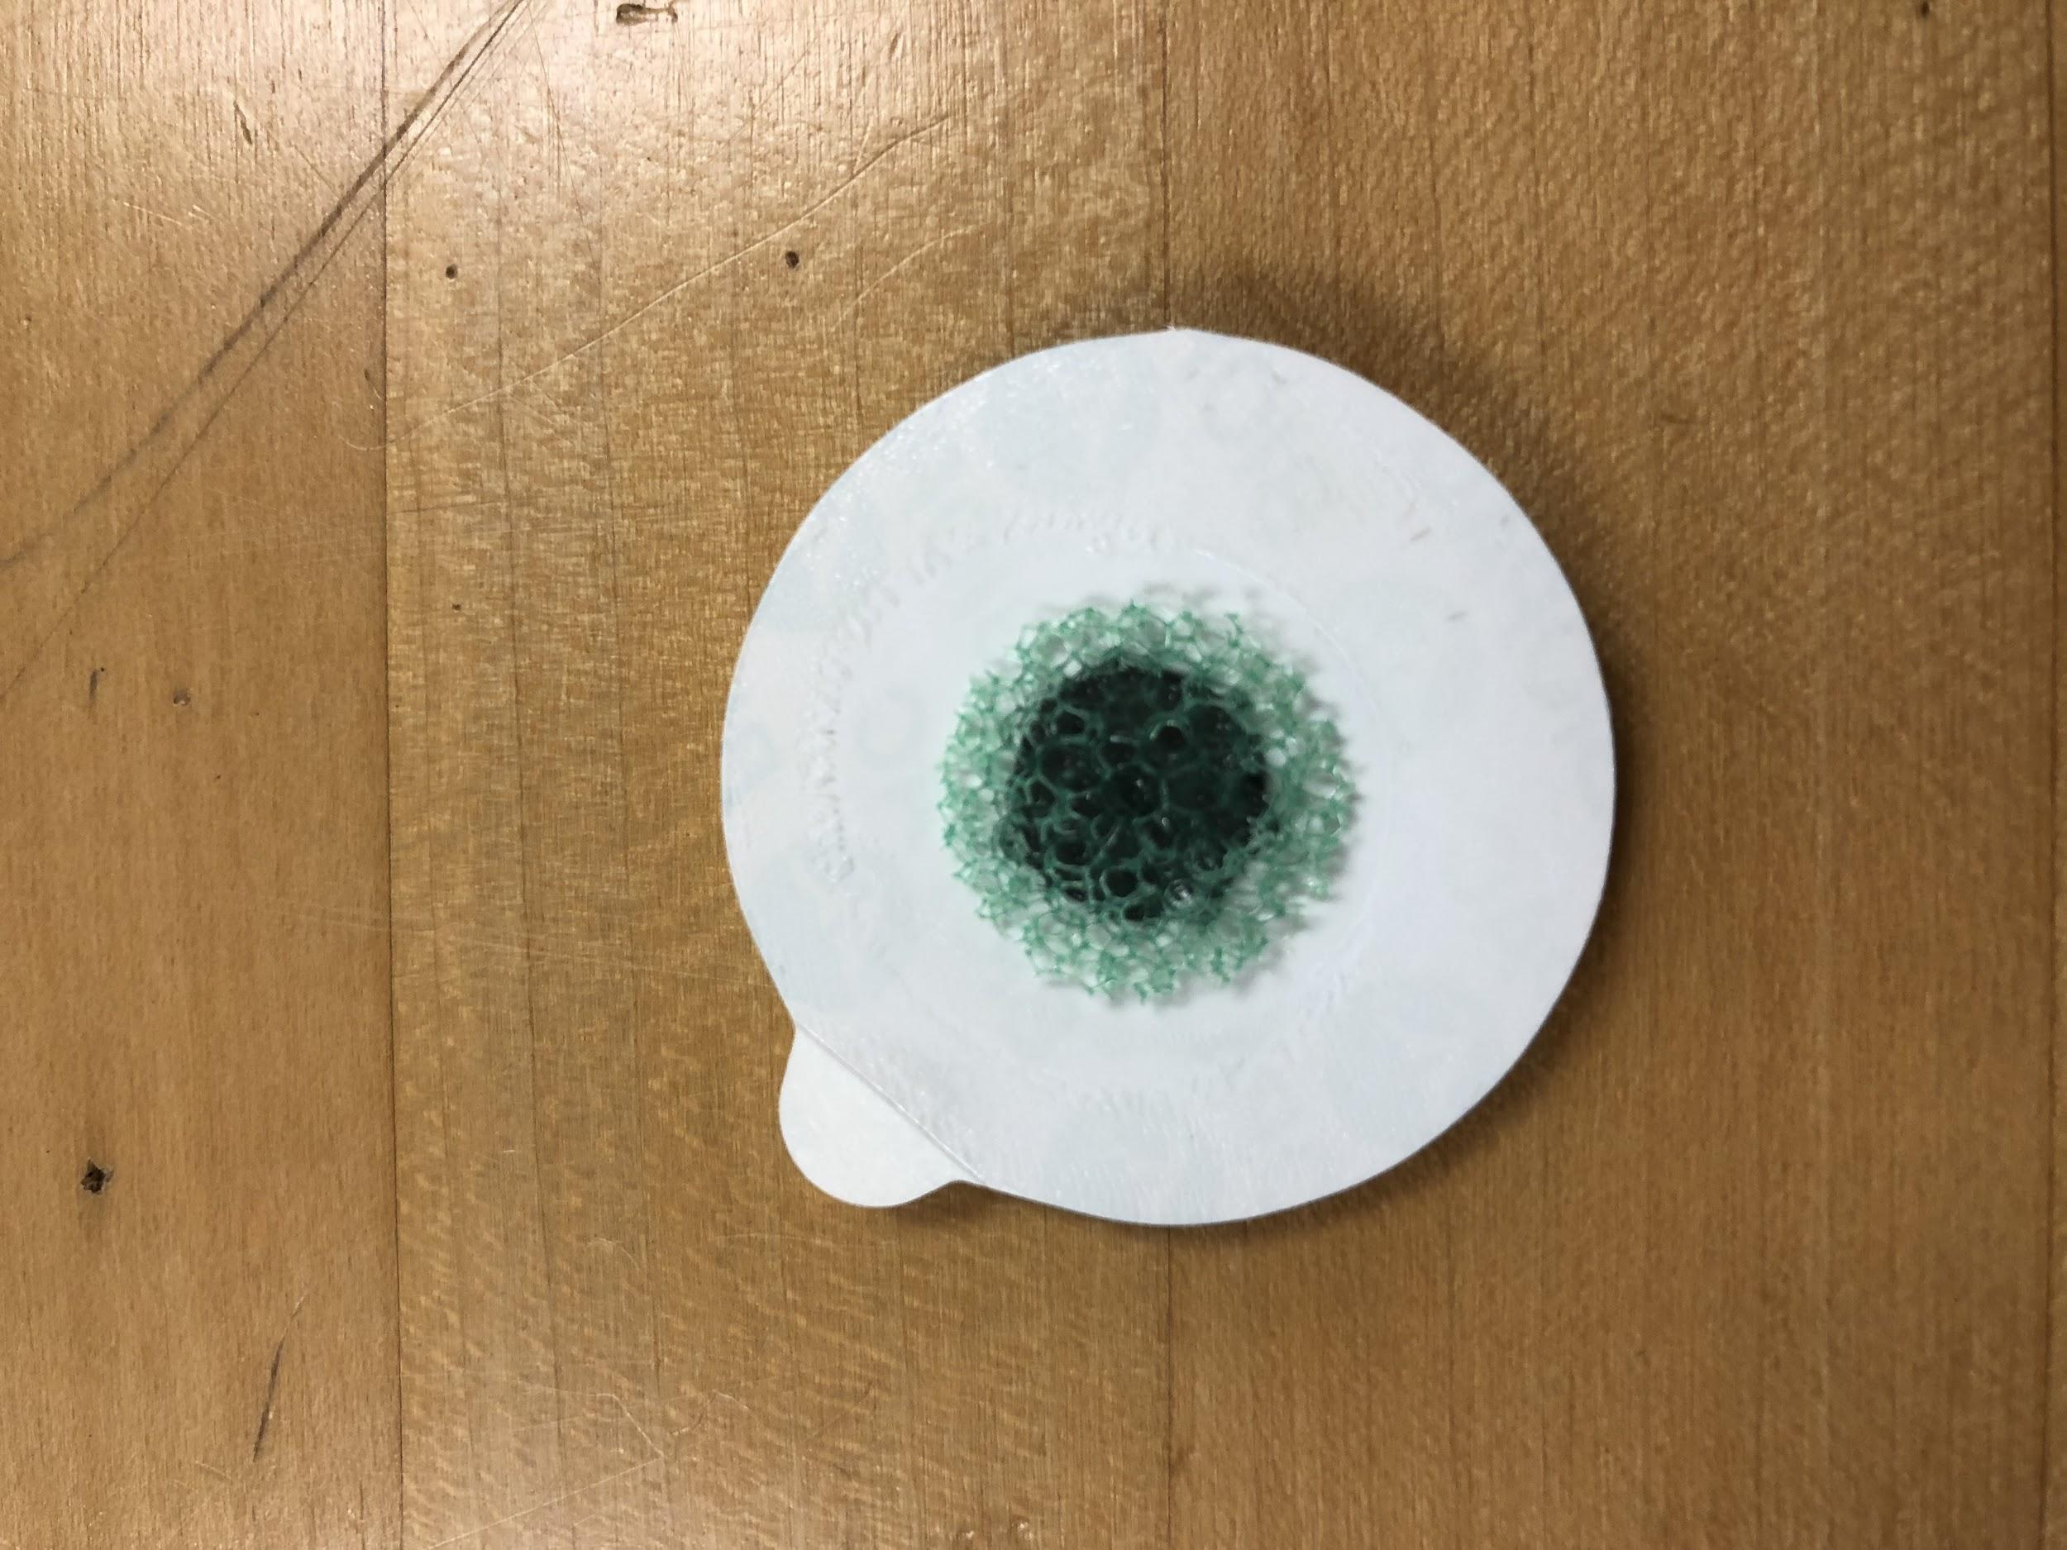
Notes:
Use the BIOPAC system to record electrical data
Surface electrodes are placed on the skin
Electrode wires are attached to the surface electrode and then plugged into the BIOPAC system
BIOPAC system connects to the monitor and records the elctrical activity of the heart in a graph

Slide 7
Surface electrodes are placed on the arms on both sides of the heart (POSITIVE and NEGATIVE)
Third surface electrode is placed on the right wrist (GND)
Notes:
True EKG tests go on both sides of the heart on the chest as opposed to the arms
Electrode on the wrist is a way to ignore noises from room (noise reduction technique)

Slide 8
Graphing Data on MATLAB from Excel Files
T=xlsread('EKG no ground wire.xlsx', 'Sheet1' , 'A1:B15017' )
plot(T(:,1), T(:,2))
Notes:
Used this code to transport excel files to MATLAB and then plotted it

Slide 9
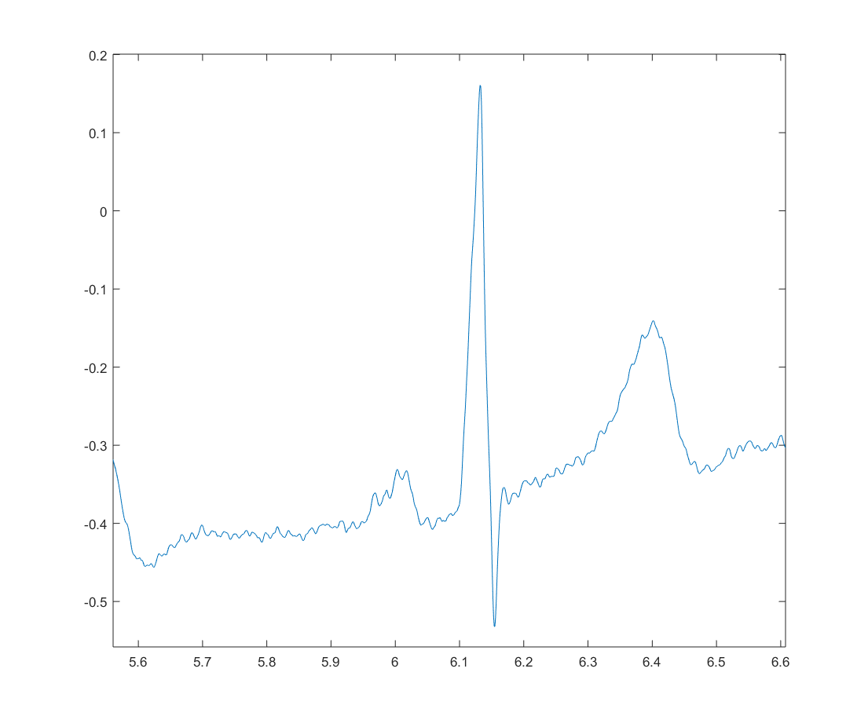
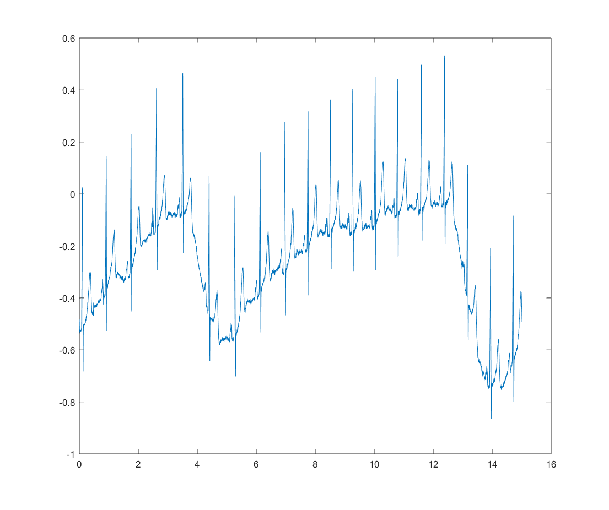
Normal EKG
R
T
S
U
Notes:
Noise could have been from movement while standing, breathing (periodic baseline drift),

Slide 10
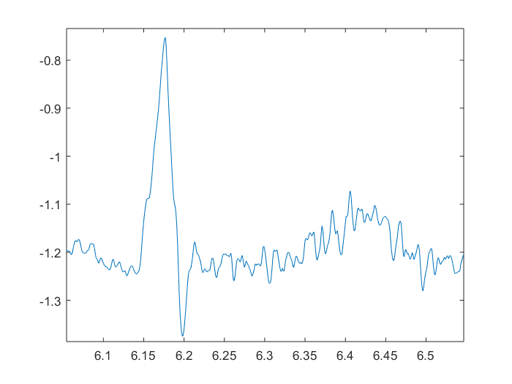
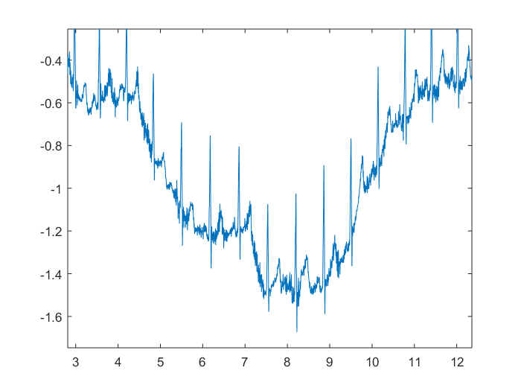
EKG while hyperventilating

Slide 11
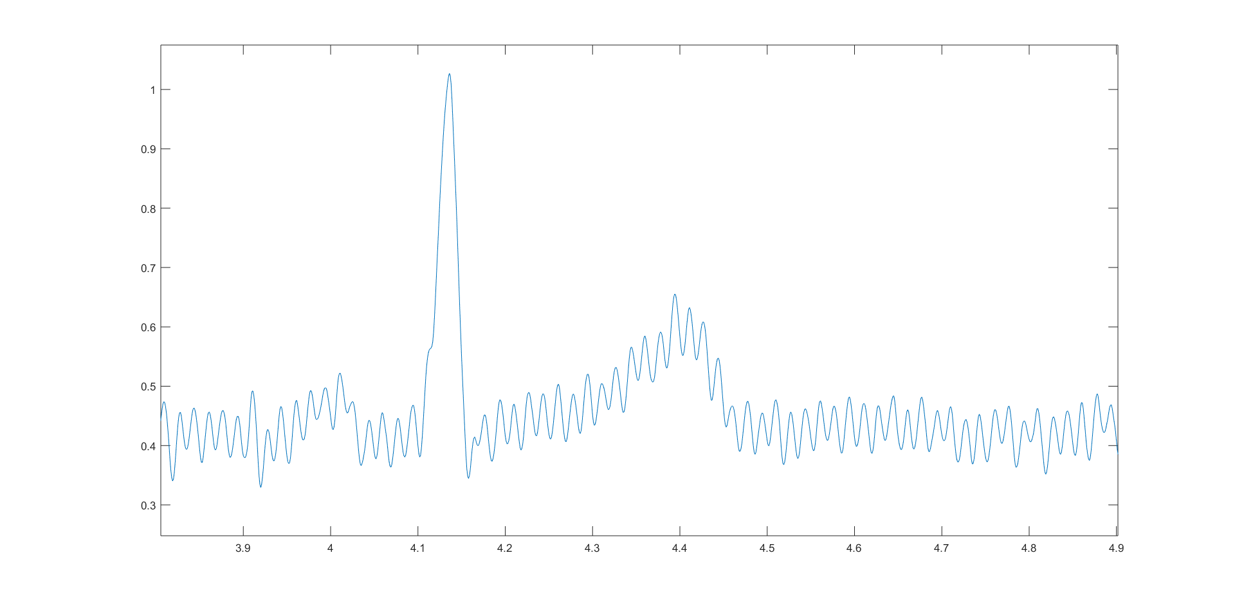
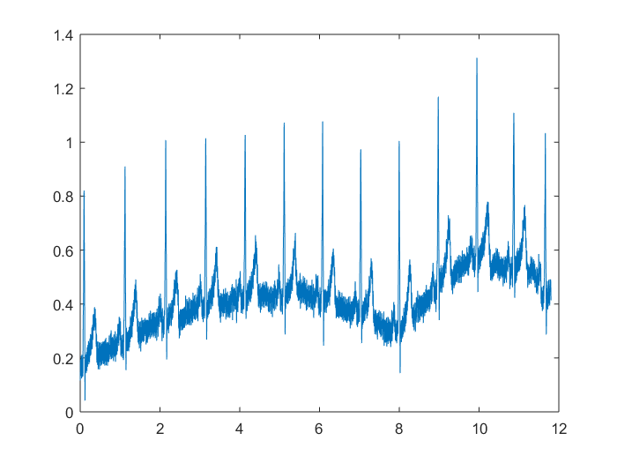
EKG Without Ground Wire

Slide 12
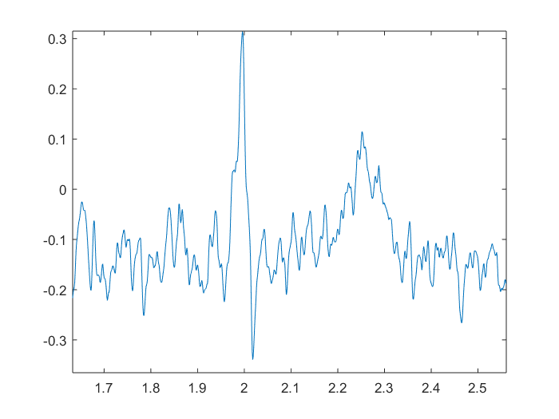
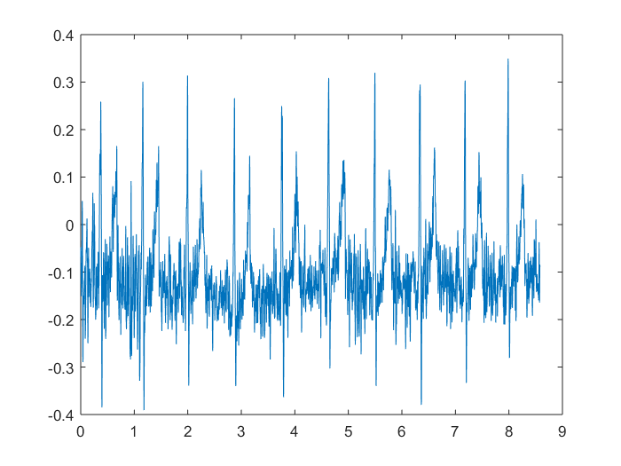
EKG Wire Wrapped Around Power Brick
NOISY!!!

Slide 13
Attempt to Filter Noisy Data #1
→ “AVERAGE” FILTER
b = (1 / 50) * ones(1, 50);
plot(T(:,1), filter(b,a,T(:,2)))

Slide 14
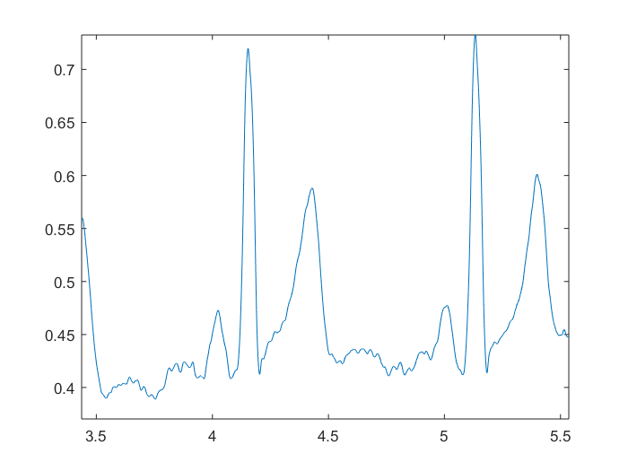
Average Filter Results

Slide 15
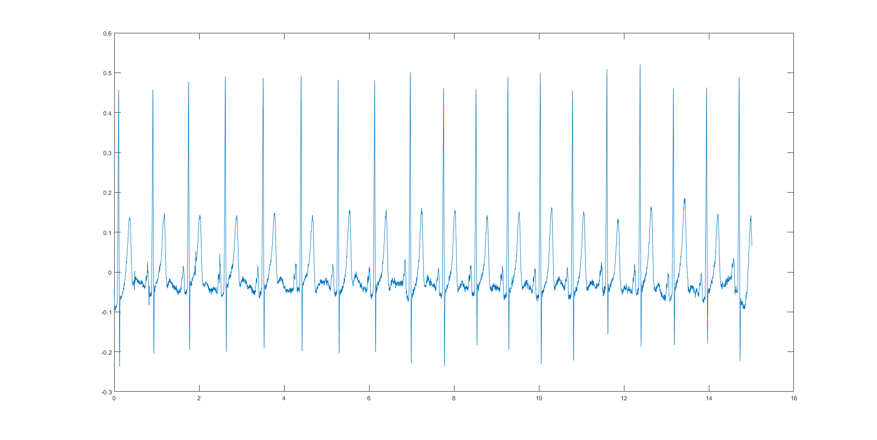
High pass Filter Used to Remove Baseline Drift
plot(T(:,1)), highpass(T(:,2), 0.1, 100)

Slide 16
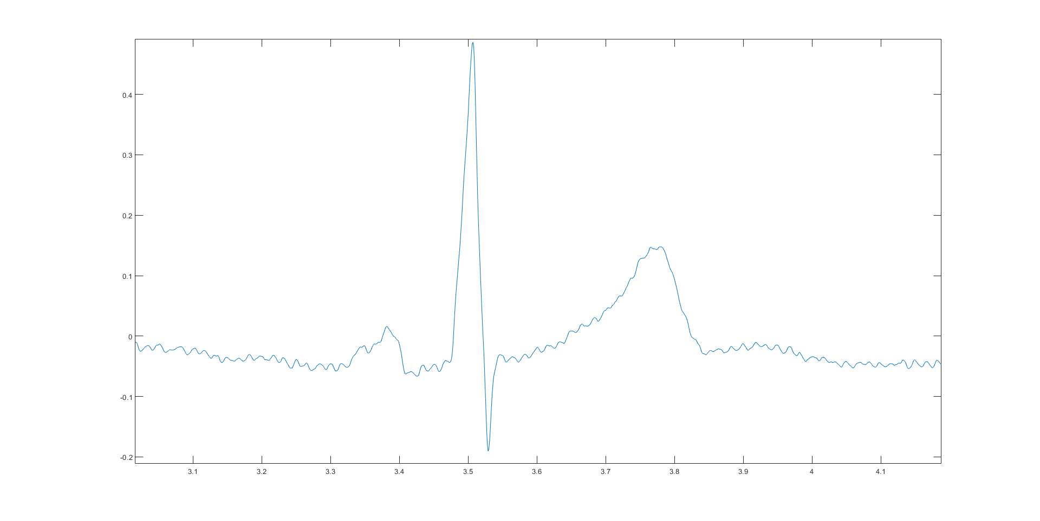
Noise is STILL THERE!

Slide 17
Coming Soon...
Filter for baseline drift ✔️
Creating a lowpass filter on MATLAB to reduce the high frequency noise
MATLAB algorithm to calculate beats per minute
THEN identify P, R, T, U on EKG waveform using MATLAB

Slide 18
Work Cited
http://www.heart.org/en/health-topics/heart-attack/diagnosing-a-heart-attack/electrocardiogram-ecg-or-ekg

