Slide 1
EEG & the Brain
Liliana Delmonico, Ashley Halmans, Andrew Jobson

Slide 2
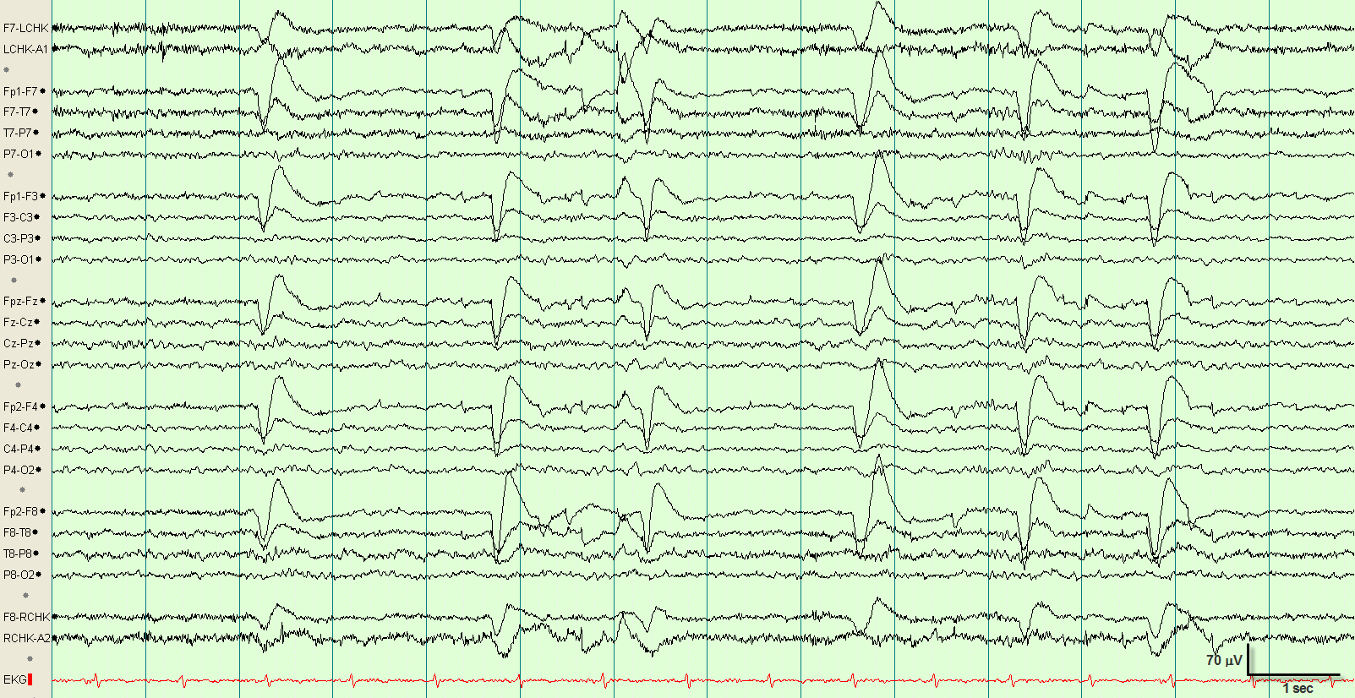
What is an EEG?
A measure of brain wave patterns
Visual Representation of how the brain functions over time
Brain cells communicate via electrical impulses, read by electrodes
Useful in healthcare:
Benefits:
Can evaluate brain disorders
Can determine brain death
Risks:
During procedure, patients may be asked
to take seizure or antidepressant
medications before taking an EEG to go
into a seizure state
Notes:
SImply stated, an EEG is a measure of brain waves
It is a visual description of how the brain functions over time
Brain cells communicate via electrical impulses, and these electrical impulses are what is beign read
Benefits:
Evaluate brain disorders (ie during a seizure, an EEG can detect brain activity)
Determine brain death
Risks:
Patients asked to take seizure or antidepressant medications before taking an EEG so the individual can go into a seizure state.
Analyzed by neurologists
Source:
https://www.emedicinehealth.com/electroencephalography_eeg/article_em.htm#egg_results
https://www.healthline.com/health/eeg#procedure
http://eegatlas-online.com/index.php/en/eeg-archive/eeg0001 (image)

Slide 3
EEG Periodic Rhythms
Frequencies recorded in an EEG
Alpha Rhythm: Prominent when adult is awake but relaxed
Beta Rhythm: Prominent when adult is alert and attentive to external stimuli
Delta & Theta: Prominent when adults are asleep
Notes:
Info from BioPac Lab

Slide 4
Types of Signal Analyzers
Notes:
MATLAB has built in Apps that include signal processing tools. Their Signal Analyzer apps allowed us to filter our signals. Some of them are described here.

Slide 5
Smooth
Goal: Creates an approximating function that attempts to capture important patterns in the data, while leaving out noise or other fine-scale structures/rapid phenomena
How it works: Data points of a signal are modified so individual points (presumably because of noise) are reduced, and points that are lower than the adjacent points are increased leading to a smoother signal
Assumptions: smoothing is reasonable and maintains accuracy in data
Notes:
From wikipedia

Slide 6
Types of Smoothing Data
Moving mean = filter smooths data by replacing each data point with the average of the neighboring data points defined within the span
Moving median
Linear Regression/Robust linear regression
Quadratic Regression/Robust quadratic regression
Gaussian = impulse response is a Gaussian function
Savitzky-Golay = generalized moving average
Notes:
From wikipedia

Slide 7
Lowpass
passes signals with a frequency lower than a certain cutoff frequency and attenuates signals with frequencies higher than the cutoff frequency
Passband frequency = 0.5 rad
Steepness = 0.85
Stopband Attenuation = 60 dB
Notes:
From wikipedia

Slide 8
High Pass
passes signals with a frequency higher than a certain cutoff frequency and attenuates signals with frequencies lower than the cutoff frequency
Passband frequency = 0.5 rad
Steepness = 0.85
Stopband Attenuation = 60 dB
Notes:
From wikipedia

Slide 9
Our Experiment

Slide 10
Experiment 1
Experiment 2
Experiment 3
Duration = 60 seconds
Subject sitting, relaxed
20 seconds: eyes closed
20 seconds: eyes open
20 seconds: eyes closed
Math Test II
Problems written on whiteboard
Question Set 1 = basic operations
Question Set 2 = adding, multiplying, dividing fractions
Question Set 3 = basic derivative rules
Math Test II
Problems written on separate sheets of paper
Question Set 1 = basic operations
Question Set 2 = multiplying & dividing decimals
Question Set 3 = practicing physics equations

Slide 11
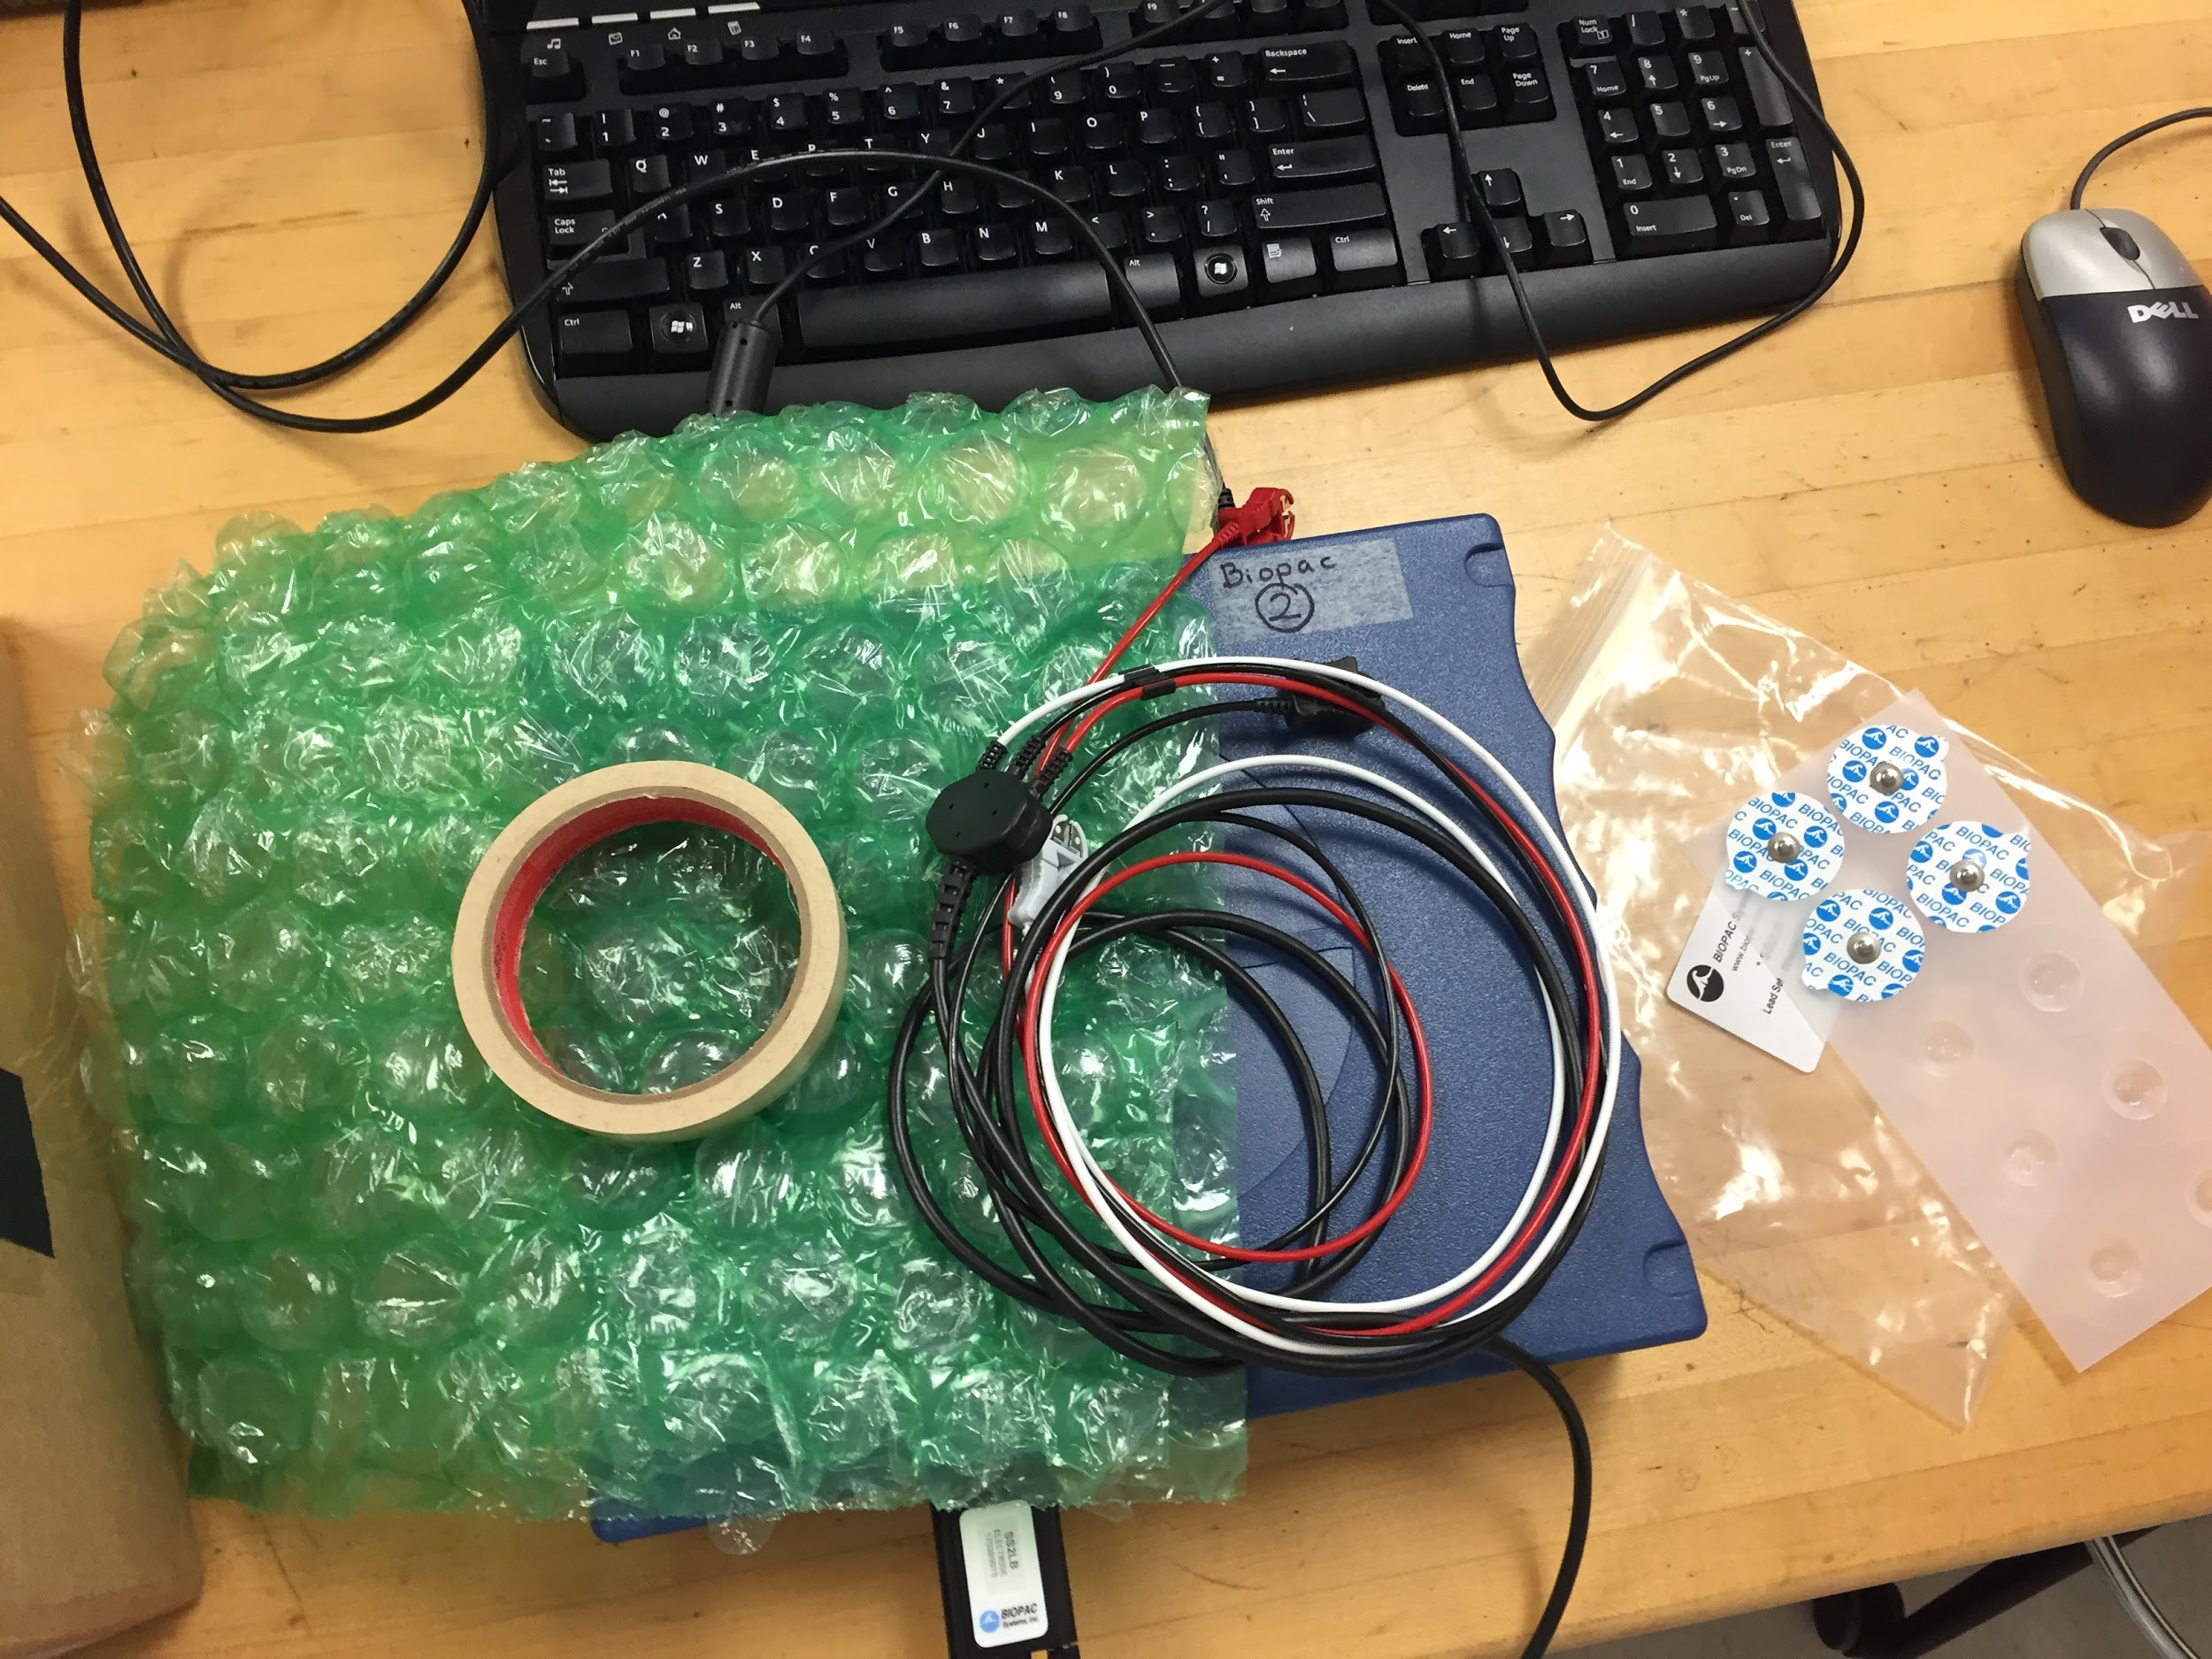
Electrodes
Tape
Bubble Wrap
Clips
Materials

Slide 12
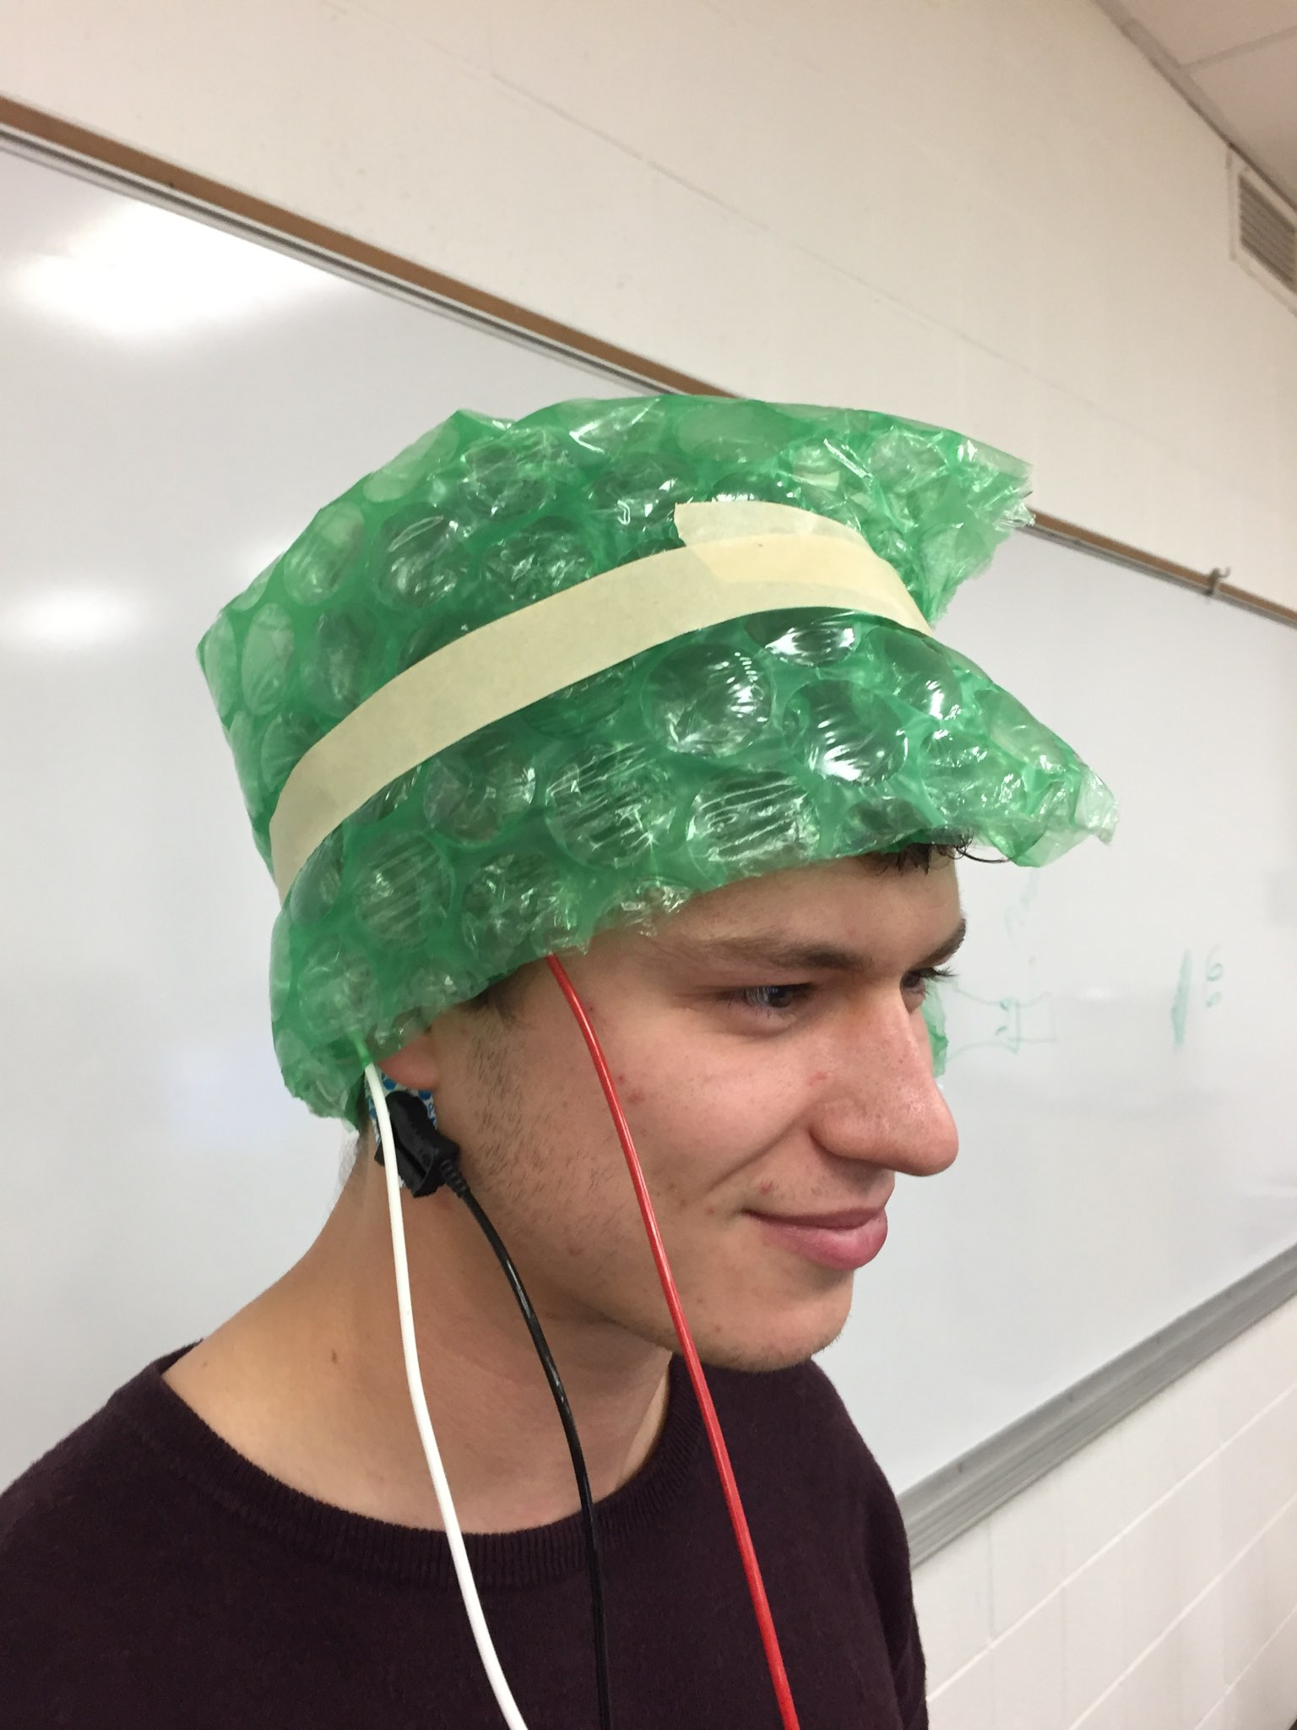
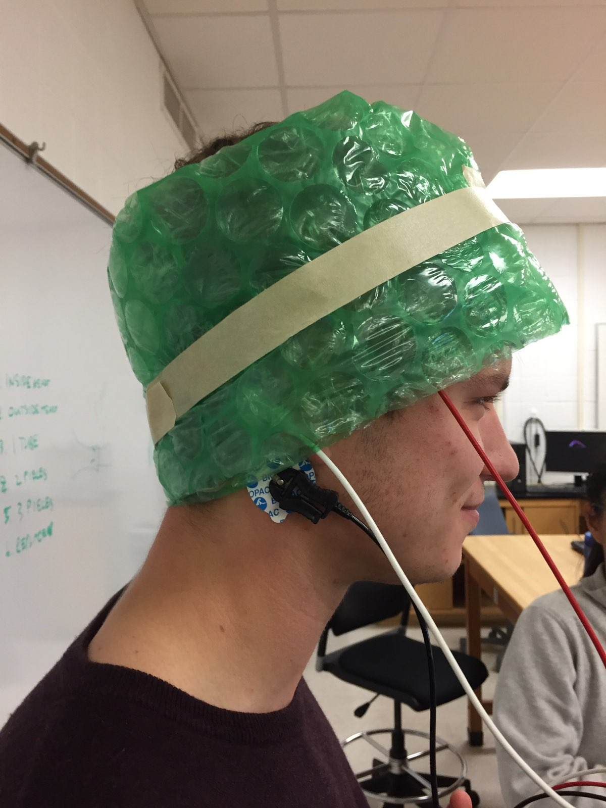
Electrodes were placed above and below the ear and on the temple

Slide 13
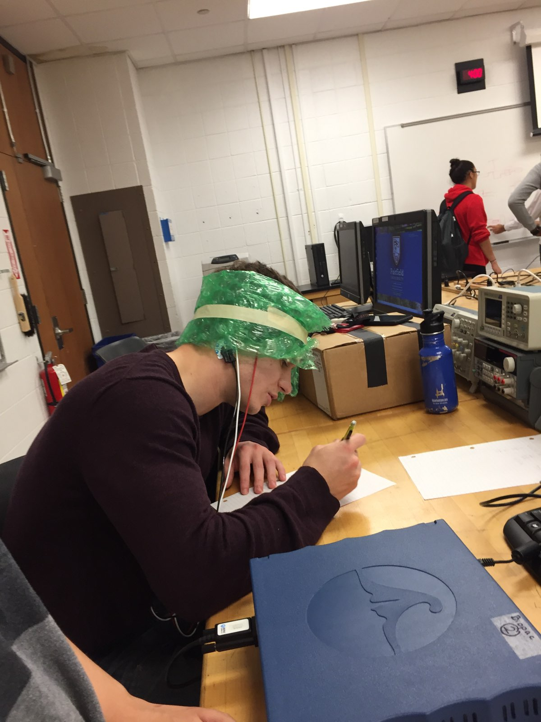

Slide 14
Problem Set for Experiment 1

Slide 15
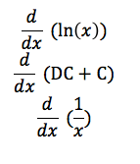
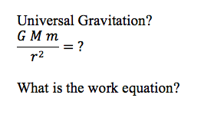
Problem Set for Experiment 2

Slide 16
Results
Notes:
Analyze the EEG and be able to recognize the parts on the EEG that correlate with the action being done

Slide 17
Experiment 1

Slide 18
Experiment 1 Results
Subject would open and close eyes in intervals. We were able to see when the subject had his eyes open and when they were closed based off of the frequencies the EEG was able to detect. By adding a moving mean filter we were able to detect more accurately when the brain was no longer processing visual information. This confirmed that the EEG was accurately detecting the electrical impulses in the brain.

Slide 19
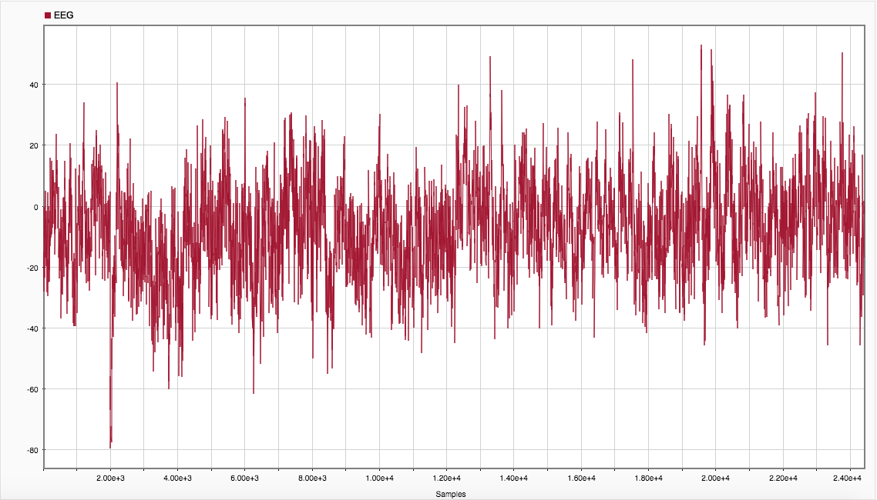
EEG Signal, as received

Slide 20
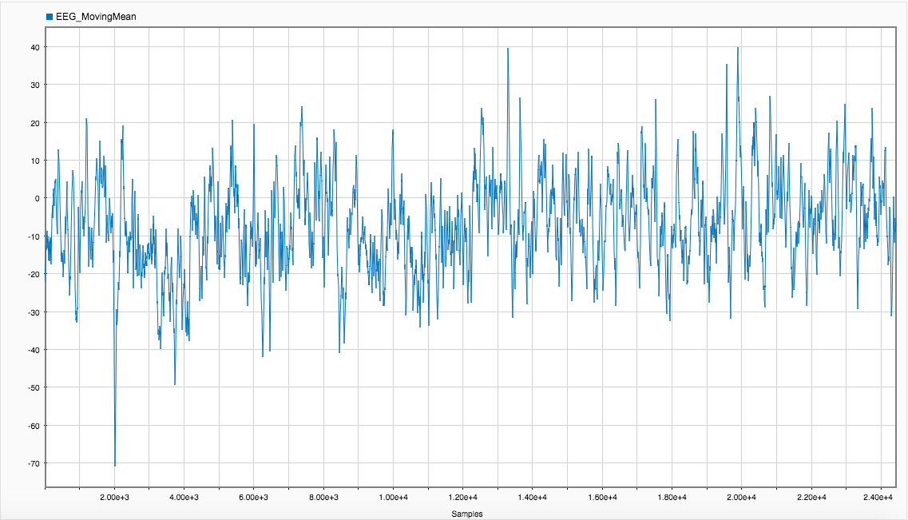
EEG w/ Moving Mean Filter

Slide 21
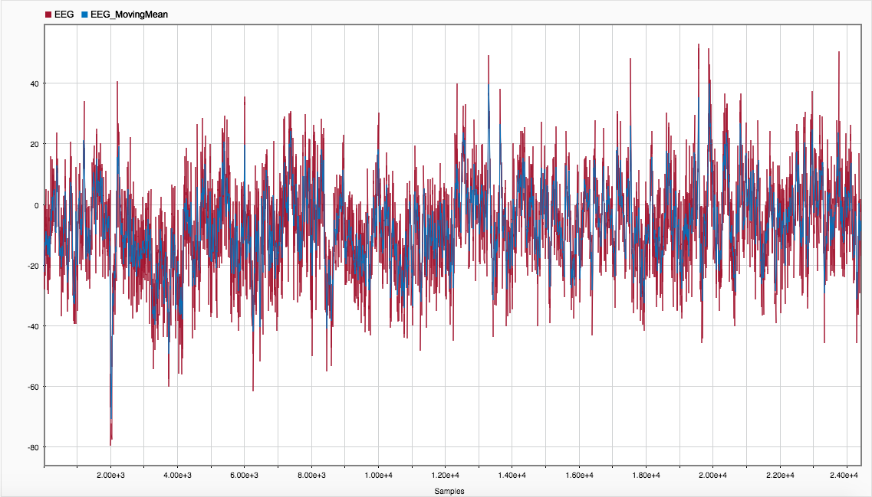
EEG + EEG w/ Moving Mean Filter

Slide 22
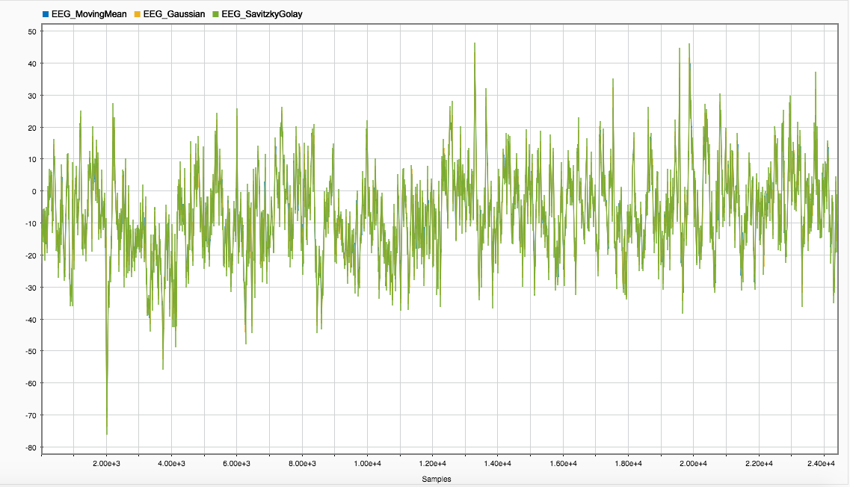
EEG w/ Moving Mean Filter + EEG w/ Gaussian Filter + EEG w/ Savitzky Golay Filter
Notes:
With a variety of smooth filters, there is not much significant difference

Slide 23
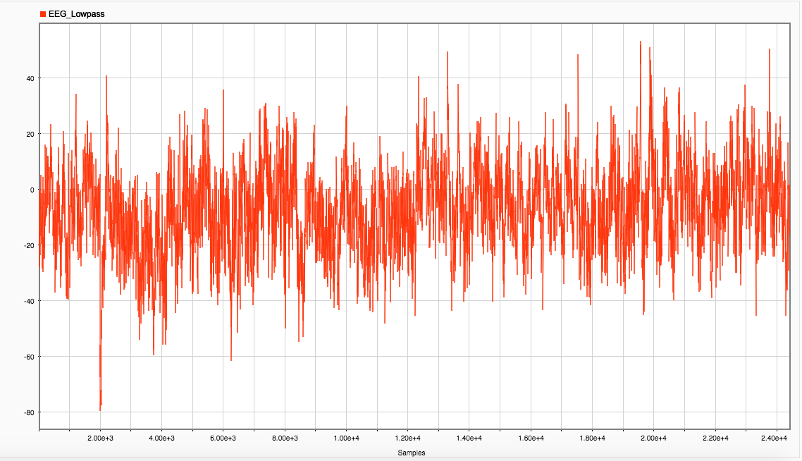
EEG w/ Low Pass Filter

Slide 24
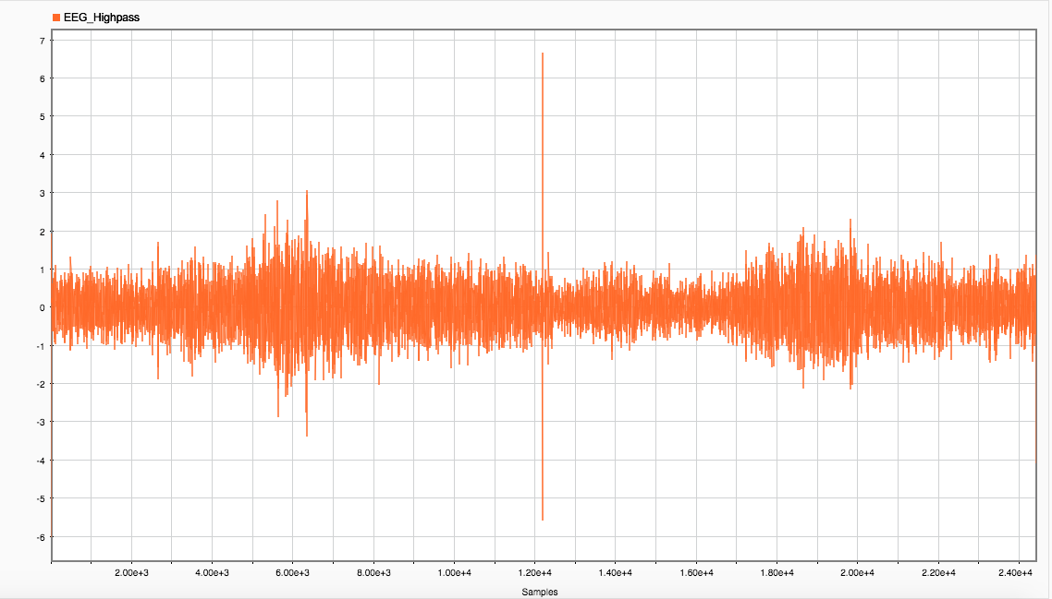
EEG w/ High Pass Filter

Slide 25
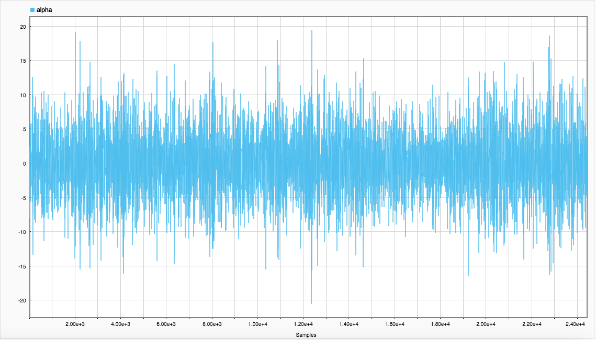
Alpha

Slide 26
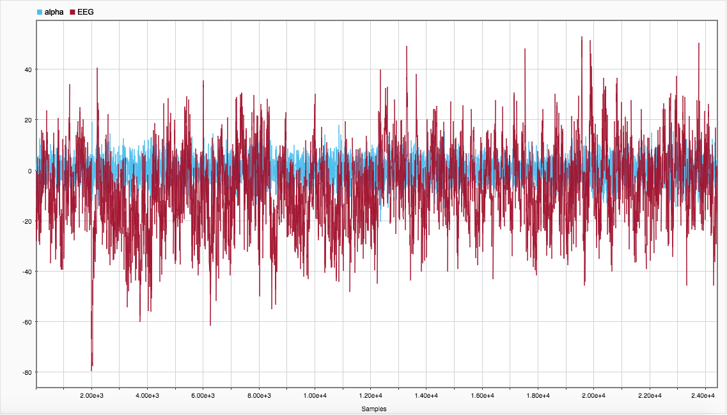
Alpha + EEG, both as received

Slide 27
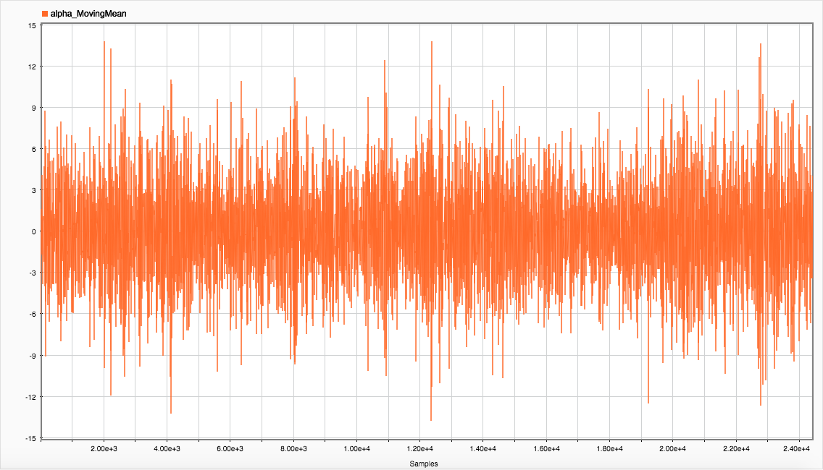
Alpha w/ Moving Mean Filter

Slide 28
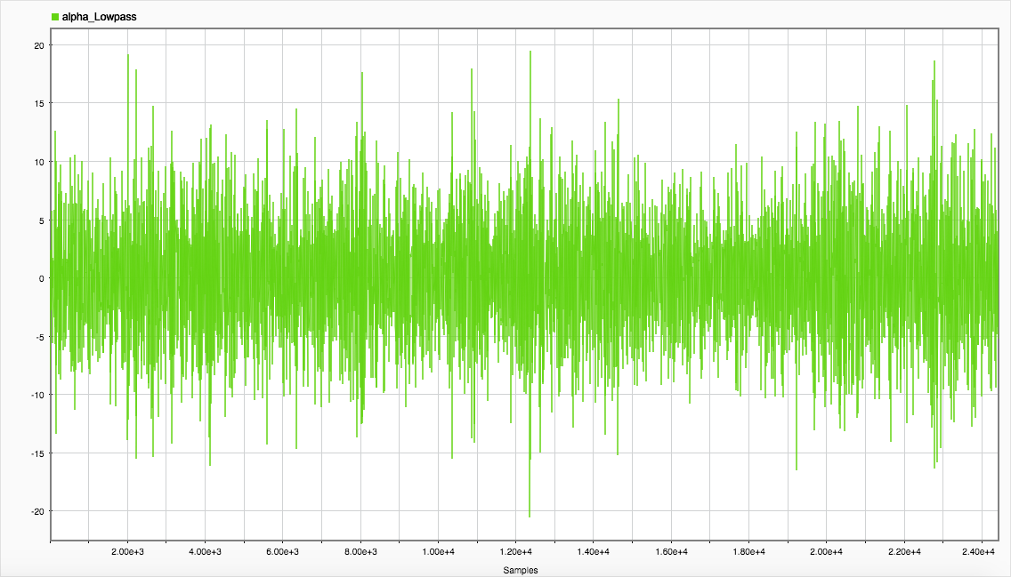
Alpha w/ Low Pass Filter

Slide 29
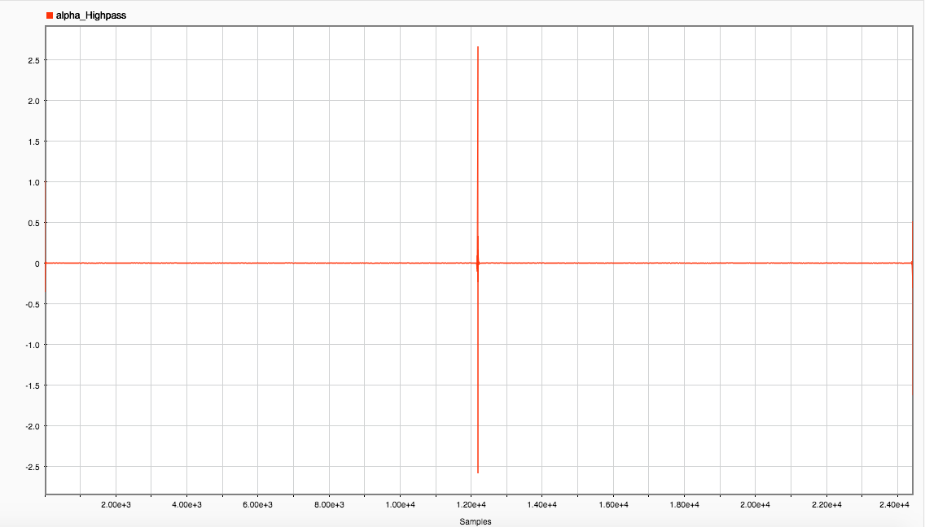
Alpha w/ High Pass Filter

Slide 30
Experiment 2

Slide 31
Experiment 2 Results
The subject was given a series of mathematical questions on a whiteboard next to the EEG. We were able to see when the subject was struggling and when it was easy based on the highs and lows of the frequency. We noticed that stress had the greatest impact on the subject’s brain waves.
The subject was able to see the questions in advance causing stress to be more consistent. This made it harder to compare relaxed states versus stressed states in a single piece of data.

Slide 32
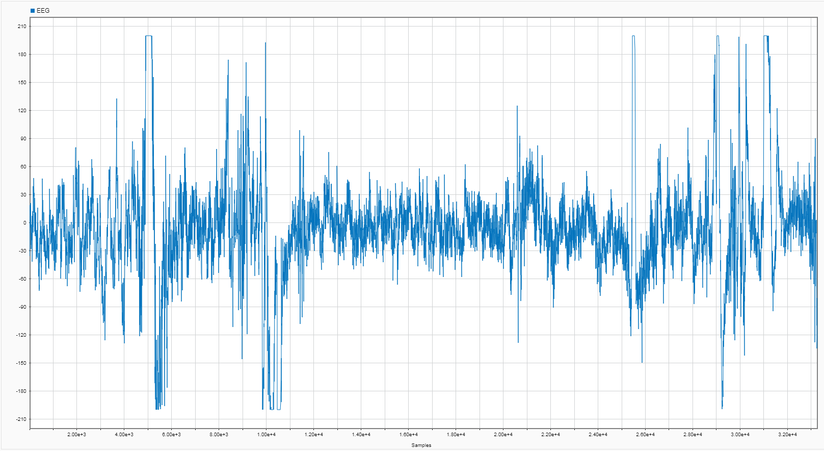
EEG Signal, as received

Slide 33
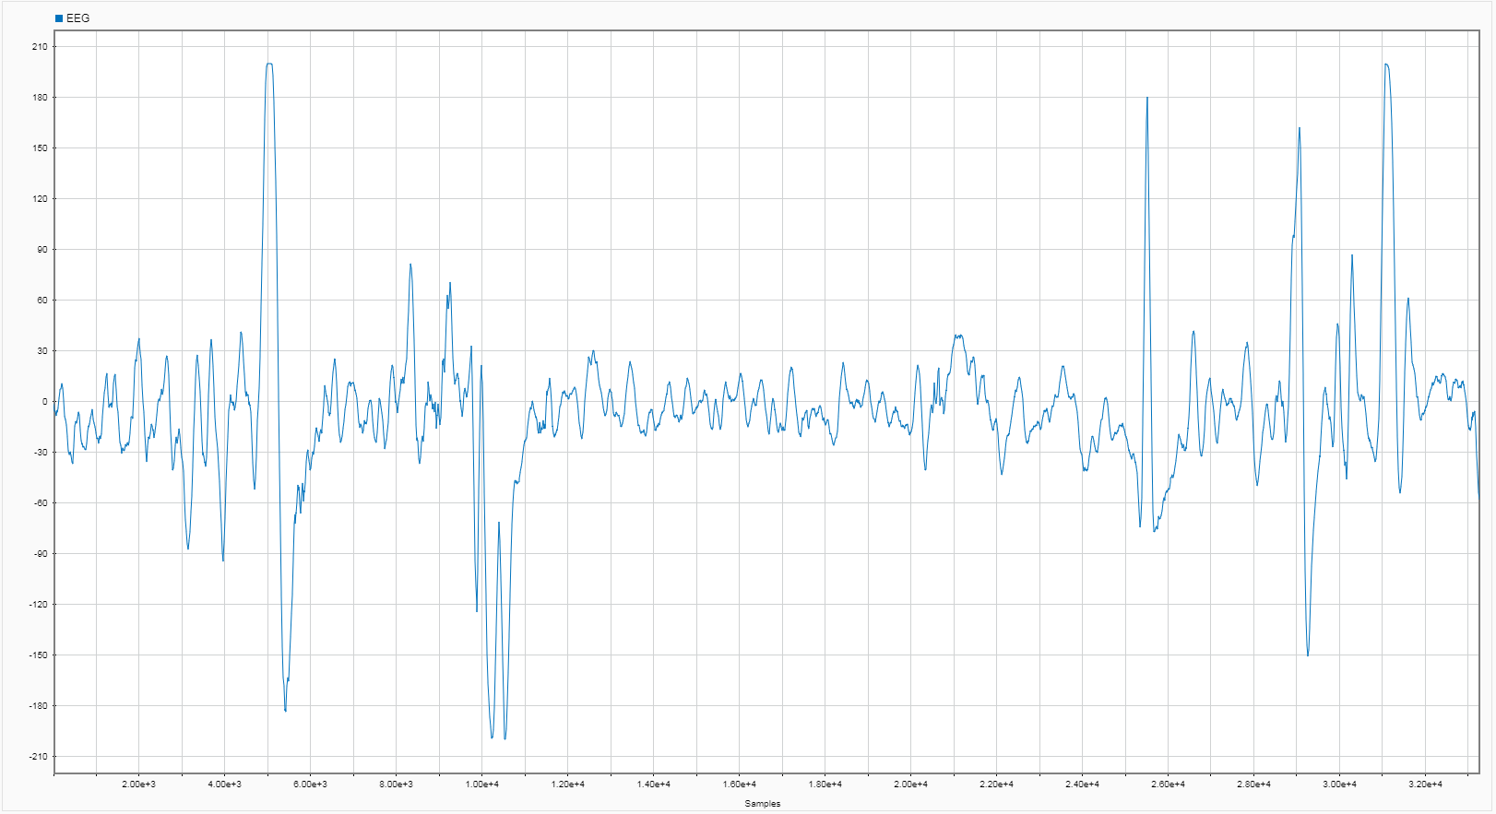
EEG w/ Moving Mean Filter

Slide 34
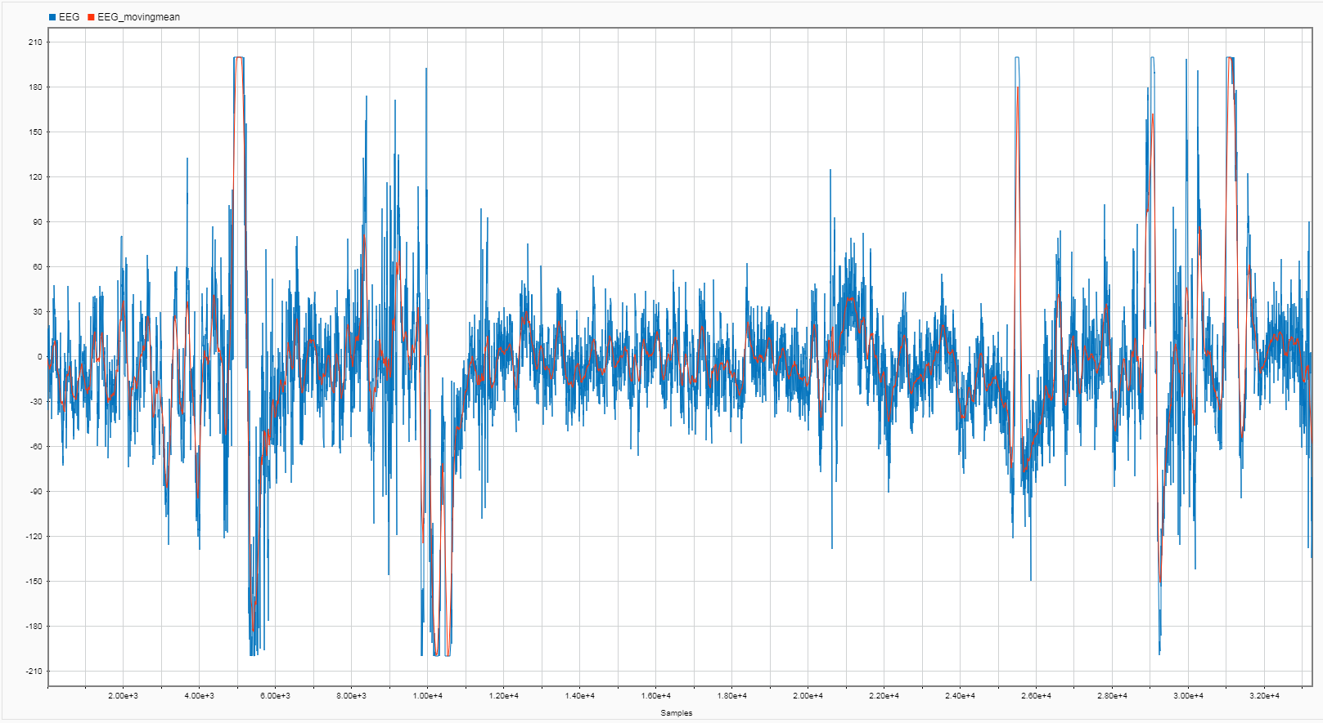
EEG + EEG w/ Moving Mean Filter

Slide 35
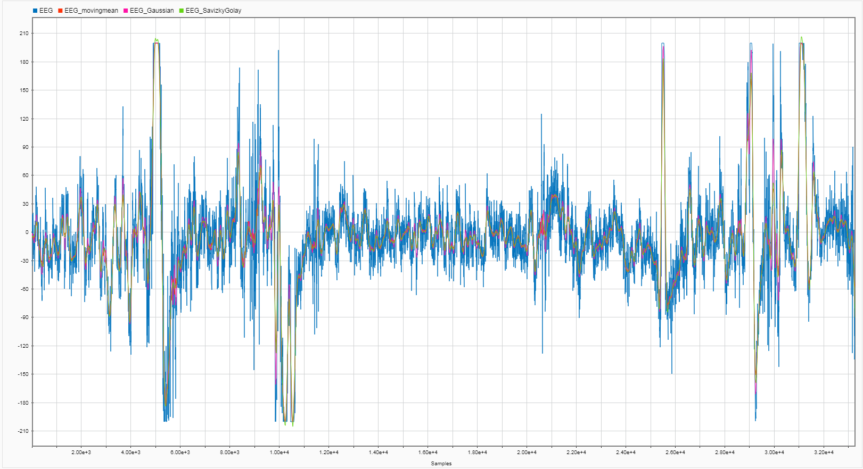
EEG w/ Moving Mean Filter + EEG w/ Gaussian Filter + EEG w/ Savitzky Golay Filter

Slide 36
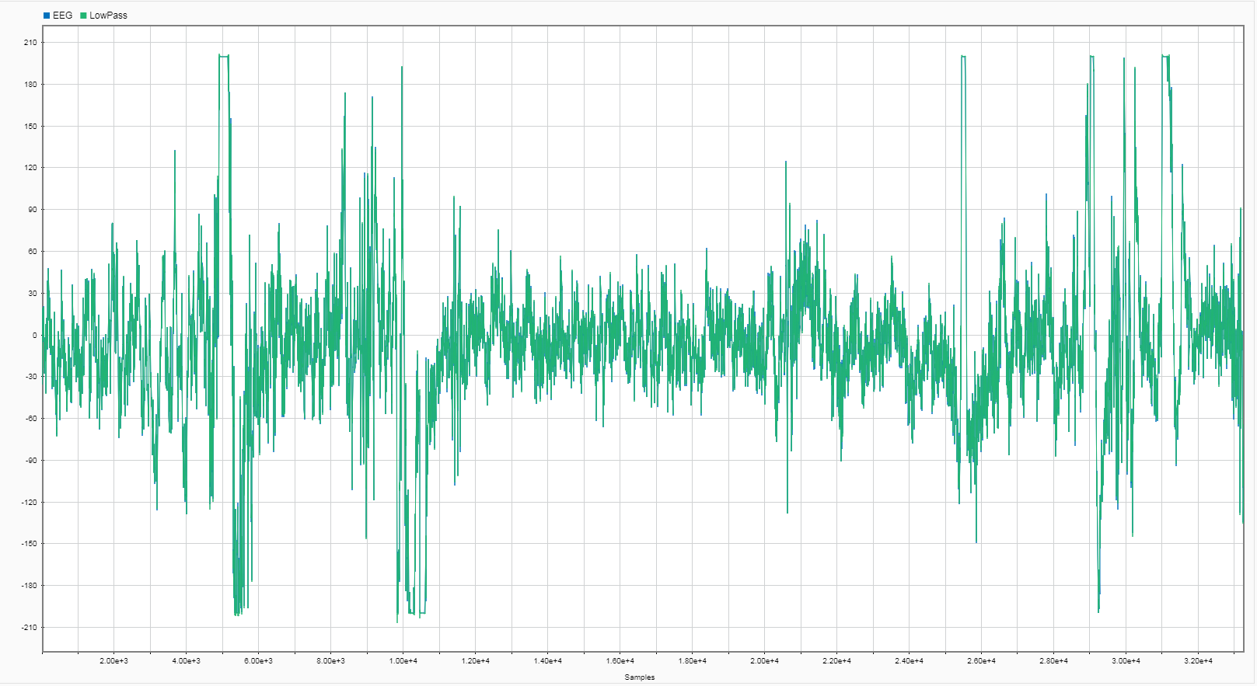
EEG w/ Low Pass Filter
Notes:
.4 frequency
50 was stopband attenuation

Slide 37
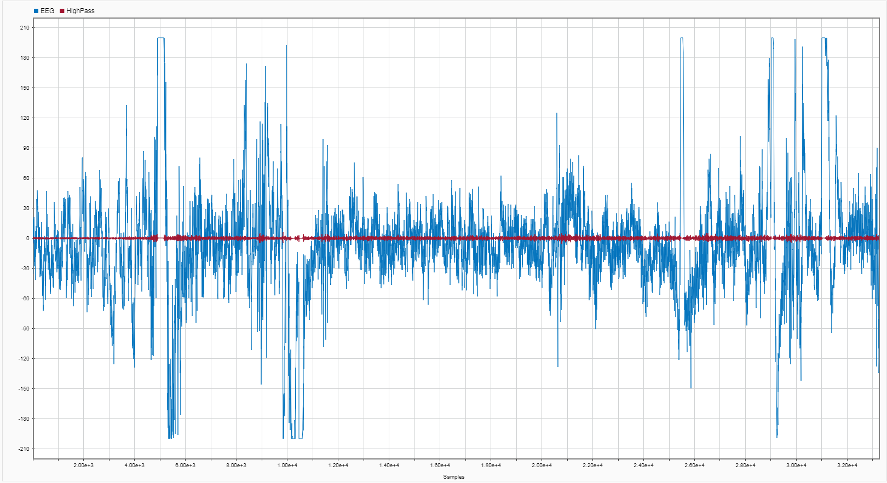
EEG w/ High Pass Filter
Notes:
.5 passband frequency
60 stopband attenuation

Slide 38
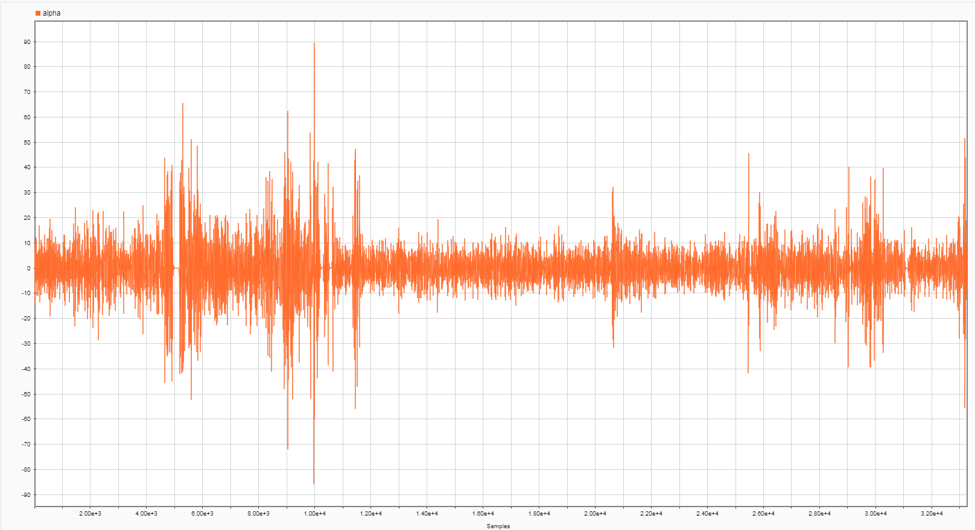
Alpha

Slide 39
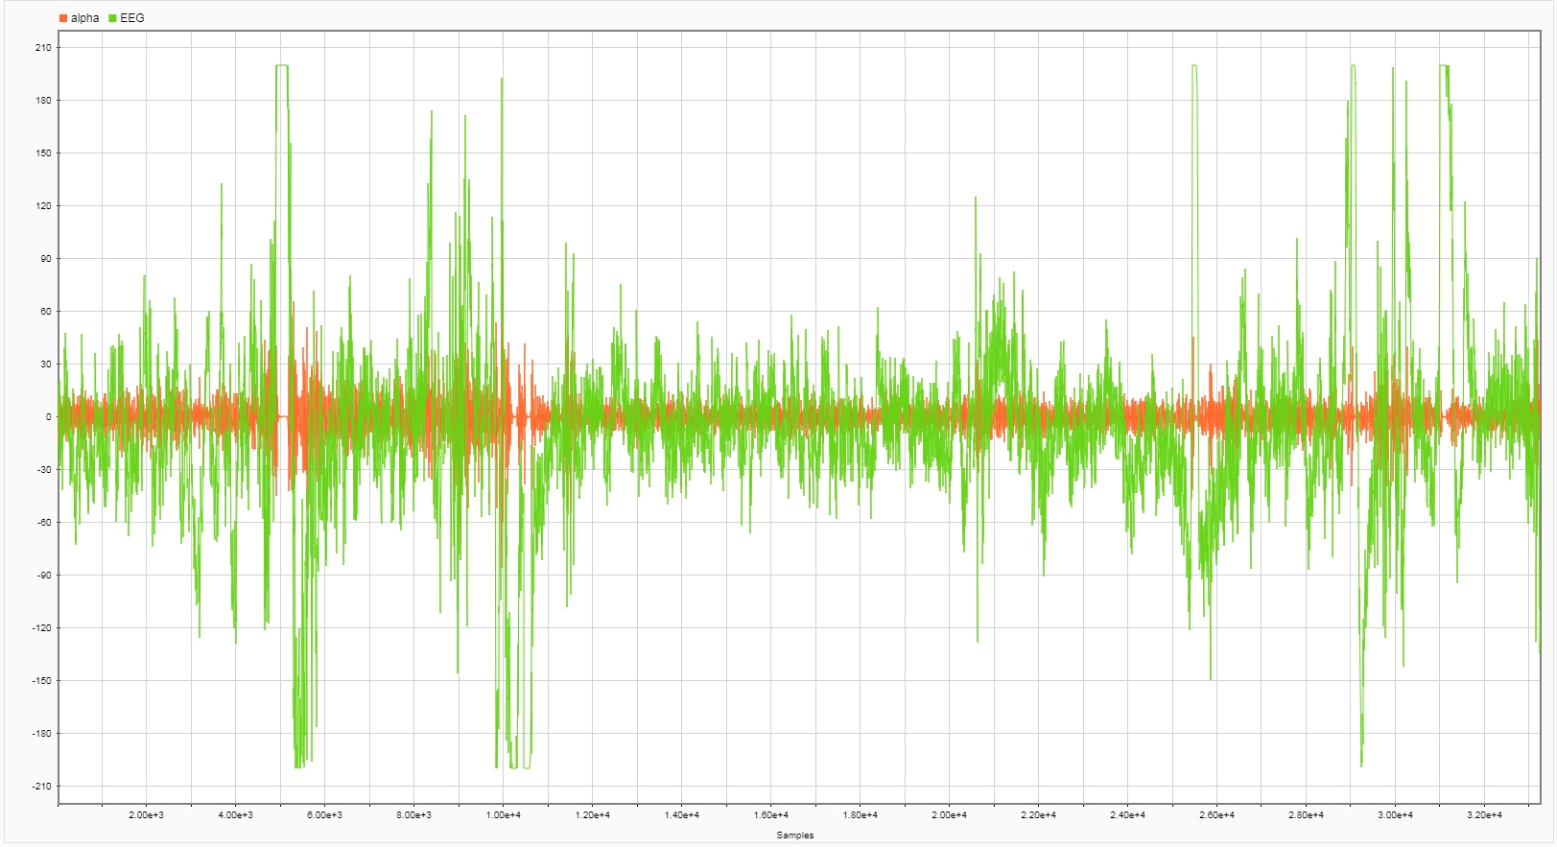
Alpha + EEG, both as received

Slide 40
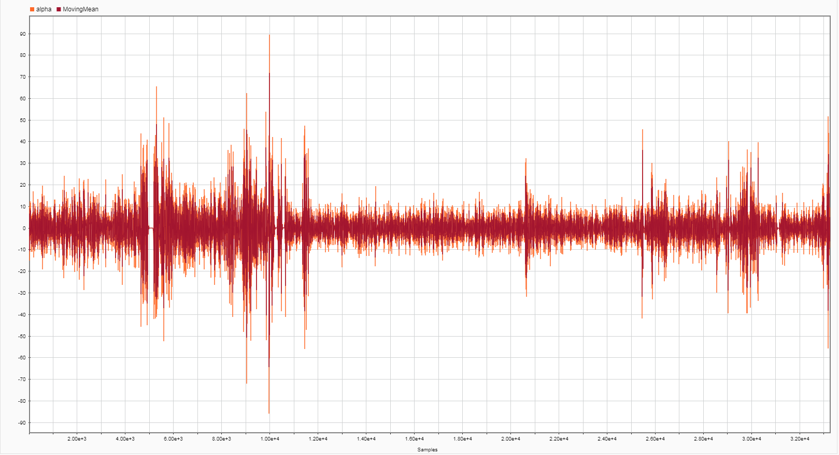
Alpha w/ Moving Mean Filter

Slide 41
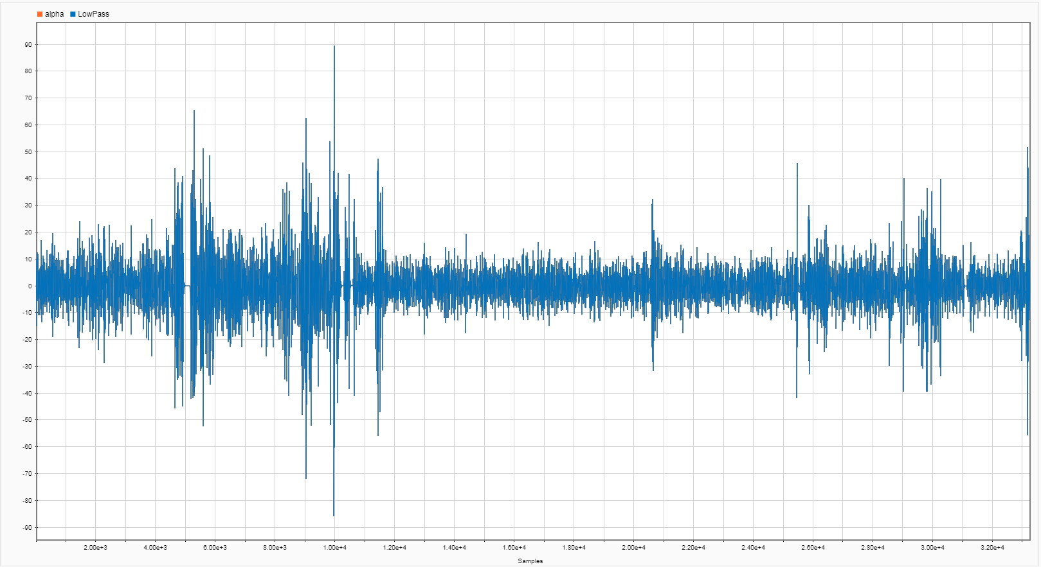
Alpha w/ Low Pass Filter

Slide 42
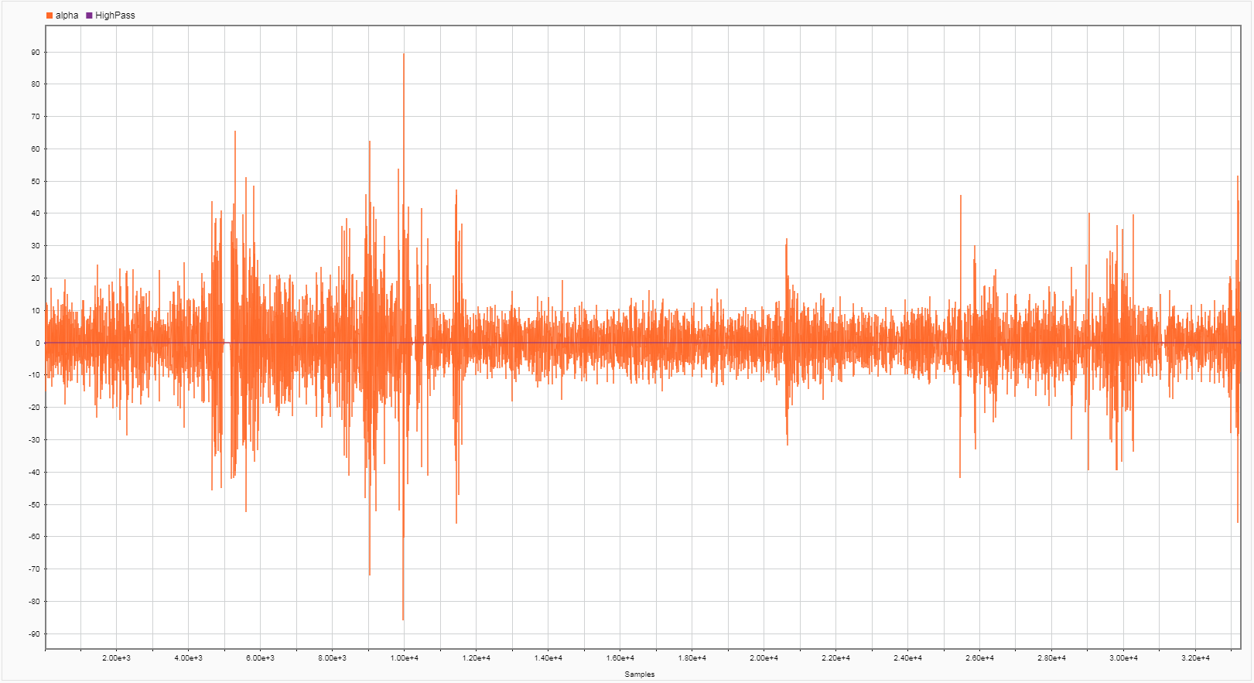
Alpha w/ High Pass Filter

Slide 43
Experiment 3

Slide 44
Experiment 3 Results
Subject sat down and got into a relaxed state. Once that was achieved he was handed sheets of paper with problems. Each paper increased in difficulty with the intention to gradually induce stress. You are able to see the difficulty of the questions based off of the frequency the EEG detected. Each peak is when the subject spoke, after these peaks is a brief increase in brain activity from what we believe is processing auditory information.
This activity gave the most straightforward results giving us clear indications of stress. Unsure of what caused the peaks when speaking.

Slide 45
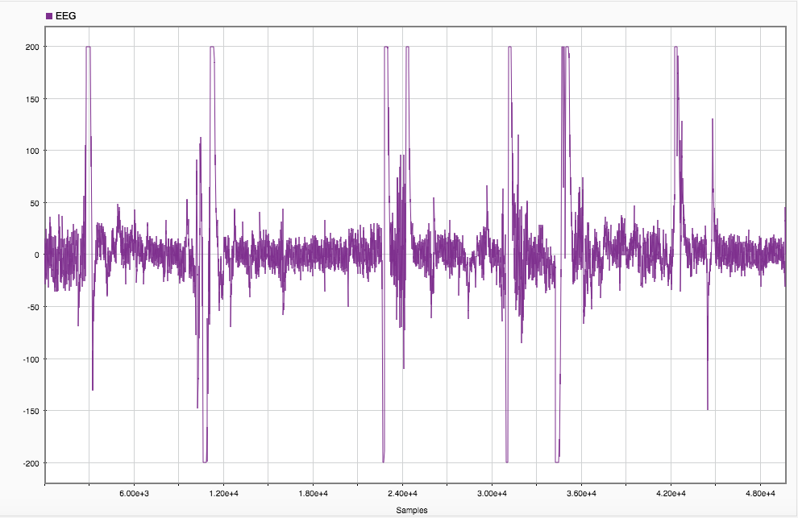
EEG Signal, as received

Slide 46
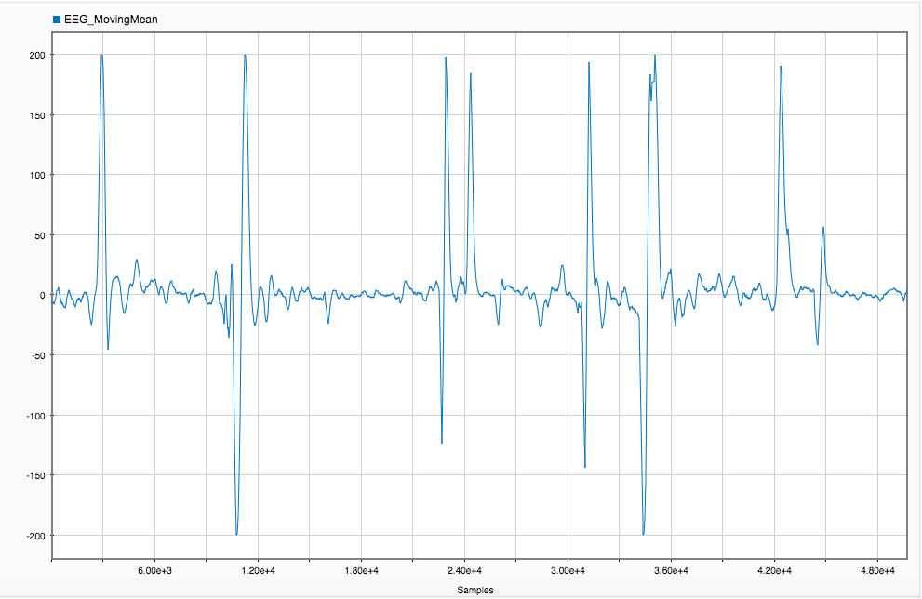
EEG w/ Moving Mean Filter

Slide 47
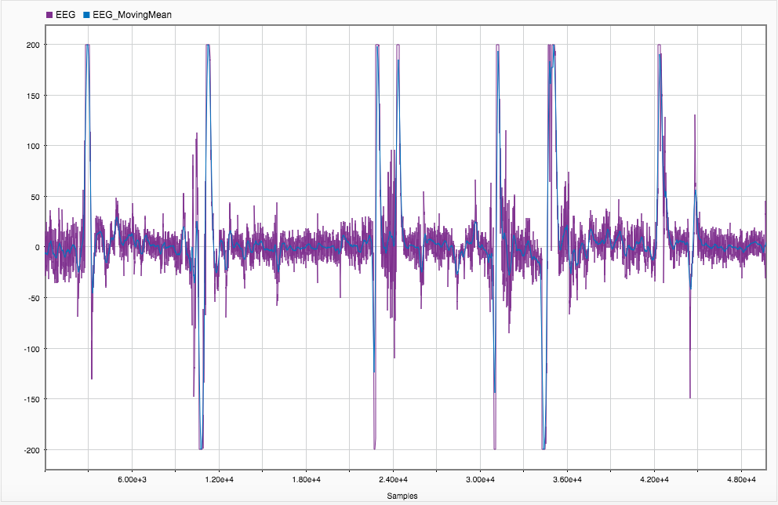
EEG + EEG w/ Moving Mean Filter

Slide 48
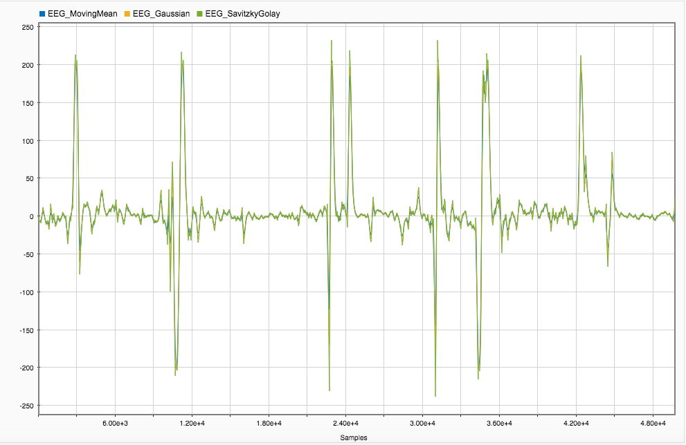
EEG w/ Moving Mean Filter + EEG w/ Gaussian Filter + EEG w/ Savitzky Golay Filter

Slide 49
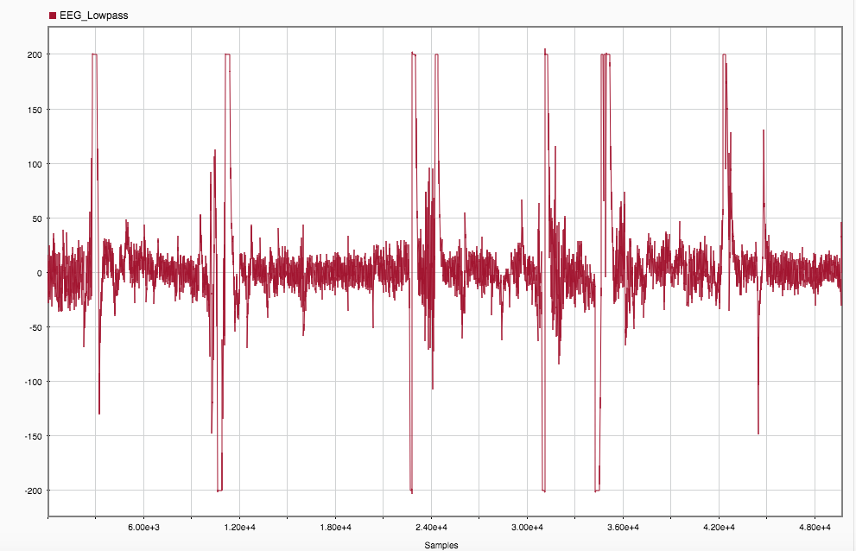
EEG w/ Low Pass Filter

Slide 50
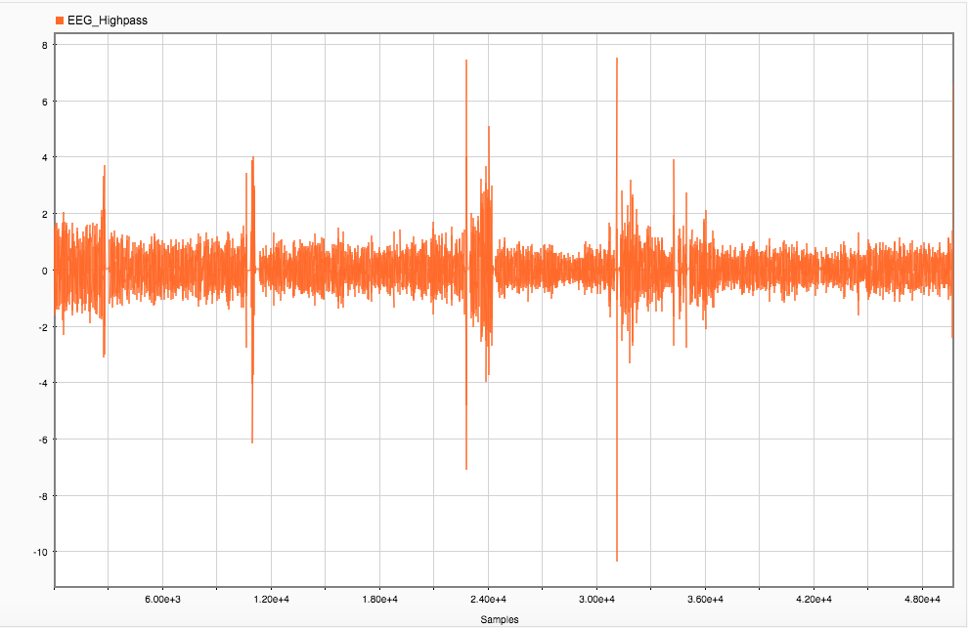
EEG w/ High Pass Filter

Slide 51
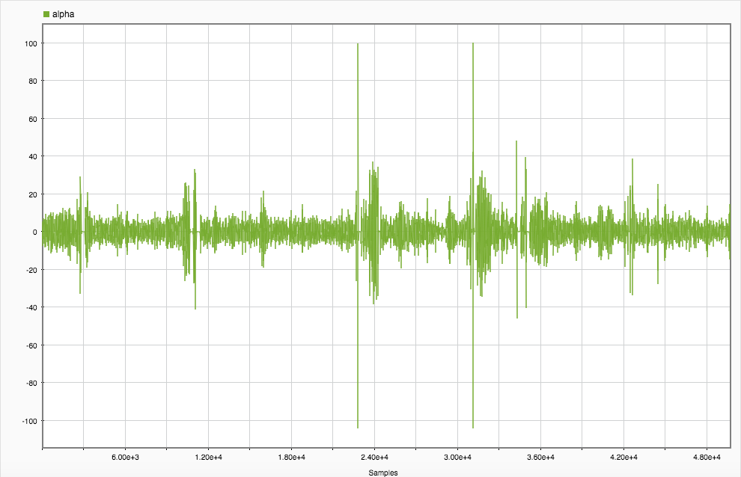
Alpha

Slide 52
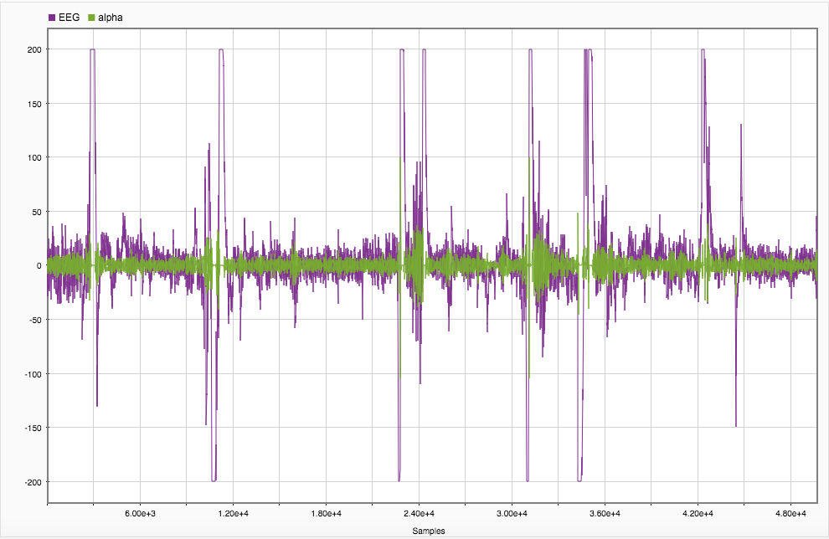
Alpha + EEG, both as received

Slide 53
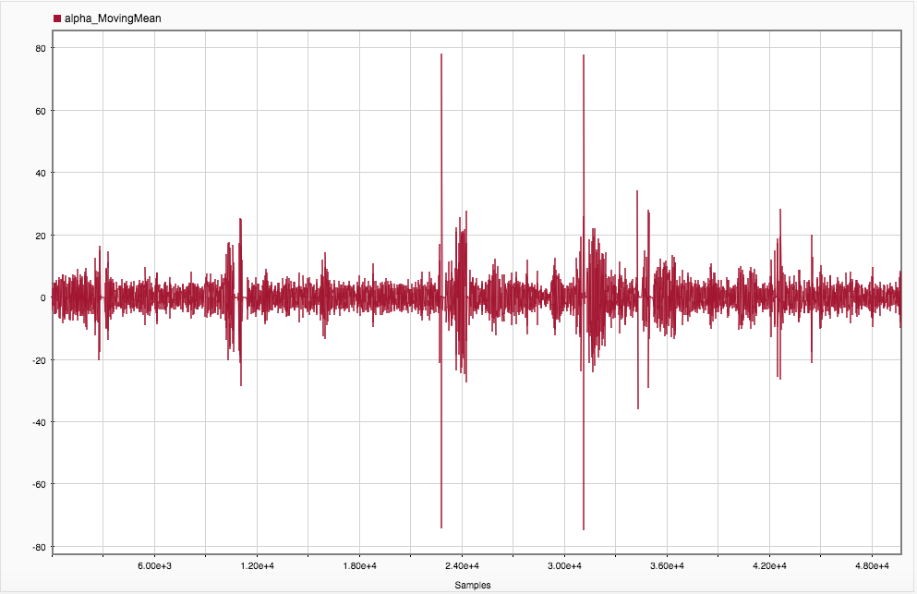
Alpha w/ Moving Mean Filter

Slide 54
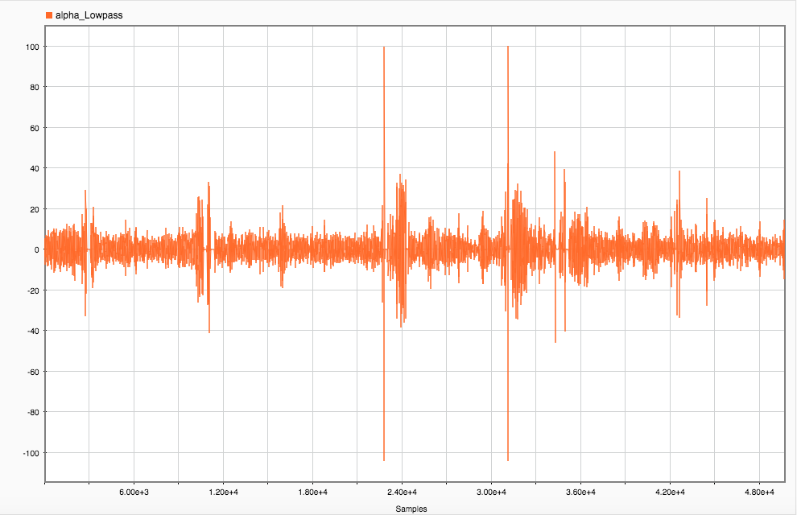
Alpha w/ Low Pass Filter

Slide 55
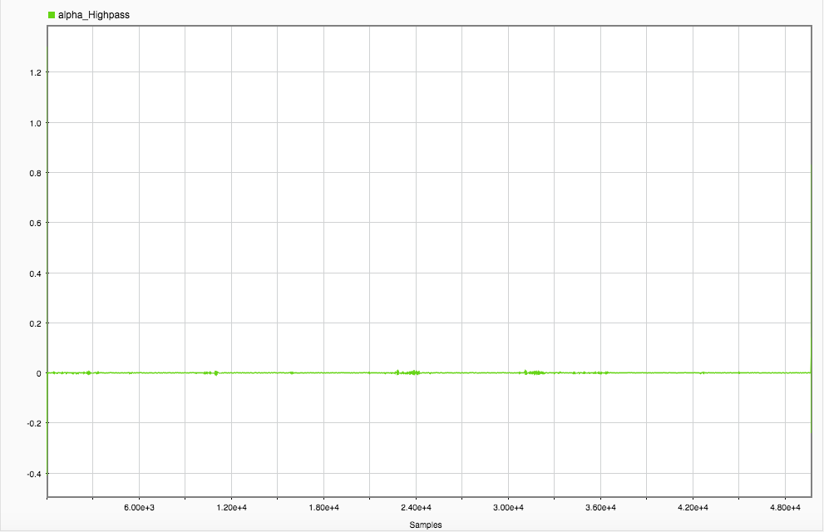
Alpha w/ High Pass Filter

Slide 56
Flaws in Experiment
Subject was mentally drained (E&M is exhausting…)
Subject did not eat
Many distractions in lab (others talking, etc.)
Noise from wires and various power sources
Too much hair

Slide 57
Further Research
More filters
Use different programs i.e. python
Further tests
See effect of music
See effect of meditation
Effect of visual stimuli
Study of emotion/moods
Notes:
Build own Filter
Experiment w/ Python

Slide 58
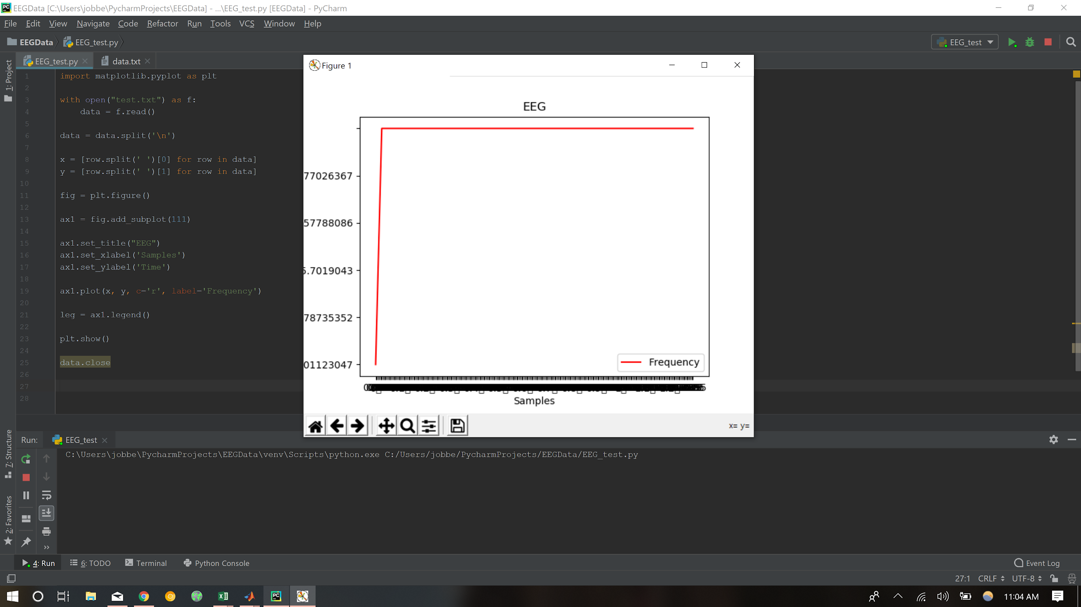
Further Exploration of Python

Slide 59
Thank you!

