Slide 1
Hydro-Electric Power
Presented by Lynne Duvelson and Nick Fraser

Slide 2
Topics on Hydro-Electric
Brief History on Hydro-Electric Power
Instruments Used to Harness the Power of Water
What makes a Hydro-Generator Tick
Advantages and Disadvantages of Harnessing Hydro-Electric Power
The Future of Hydro Power

Slide 3
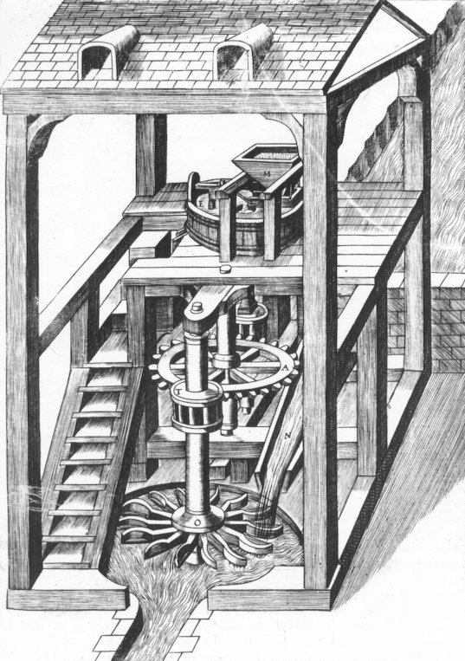
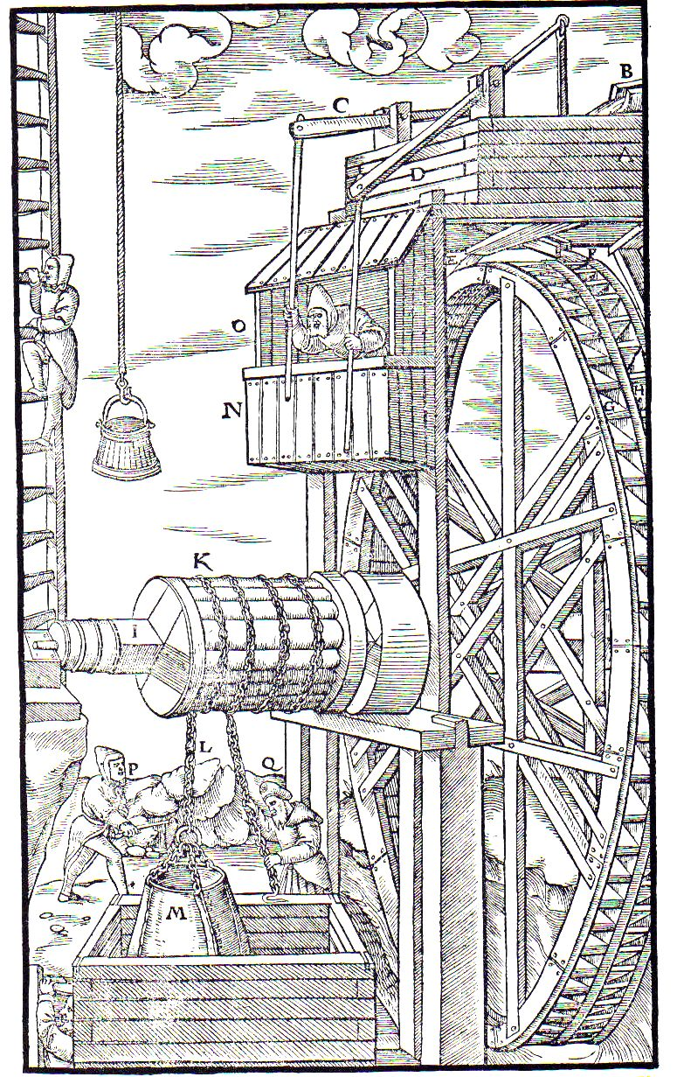
History on Hydro
Water Wheel
Vertical or Horizontal
Civilations that Benefited
China (Han Dynasty (202B.C - 9AD)
Egypt
Romans and Greeks
Islamic Cultures
Medieval Europe
Uses for Water Wheels
Pounding grain
Breakirg ore (Mining)
Paper-making
Irrigation
Lifting large objects
Notes:
Water wheel - instrument used to convert the energy of falling or flowing water into useful forms of energy
-Consists of wheel with blades or buckets arranged on the outside rim used to catch falling water
- Wheel can be mounted vertically on a horizontal axle or wheel can be mounted horizontally on a vertical shaft
Other Types of Water Wheels:
UnderShot Water Wheel
OverShot Water Wheel
Pitchback Water Wheel
BreastShot Water Wheel

Slide 4
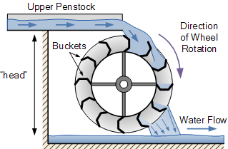
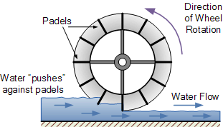
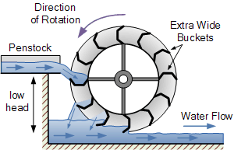
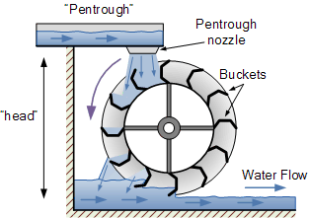
History of Hydro, cont’d
Types of Water Wheel
Under Shot
Over Shot
Breast Shot
Pitchback
Notes:
Undershot Wheel - place directly into a fast moving/flowing river
Simplest design, cheapest construction, easiest type of water wheel
Used in flat areas, with large bodies of fast flowing water
-Cheaper construction, did not have to be so big
Overshot Wheel - used for areas with small bodies of water and high waterfalls
More complicated design since it uses buckets to catch and hold the water
Gravity takes over
-Pitchback Water Wheel - uses gravity of water weight as well as force of incoming stream to move water wheel
Water flows in opposite direction of waterflow
-Breastshot Water Wheel - uses extra wide buckets to catch water from a penstock that is about halfway up the water wheels height
http://www.alternative-energy-tutorials.com/hydro-energy/waterwheel-design.html

Slide 5
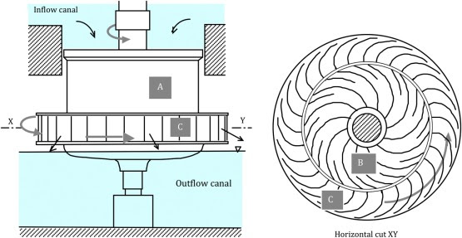
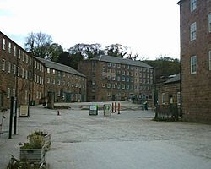
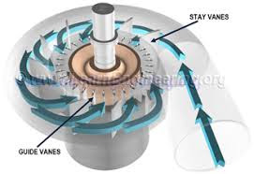
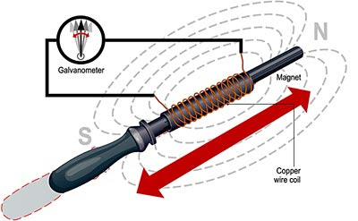
History on Hydro, cont’d
Richard Arkwright
Cromford Mill in 1771
1st Water Powered Cotton Spinning Mill
Cromford, Derbyshire, England
Benoit Fourneyron
Horizontal Water Wheel Called Turbine (1827)
6 HP Turbine (Reaction Turbine)
Michael Faraday
Electric Generator (1831)
James B. Francis
Francis Turbine (1849)
Reaction Turbine
Radial Flow
Notes:
Richard Arkwright
Built Cromford Mill in 1771
Known as the 1st Water Powered Cotton Spinning Mill
Benoit Fourneyron
Built a Horizontal Water Wheel and called it a turbine (Latin for ‘Spinning Top’)
Built a 6HP prototype that moves water thry a central shaft and directs it outward through the blades of the runner
Faraday’s Electric Generator
Michael Faraday discovered electro-magnetic induction in 1837 and prototyped the electric generator to provide his theory
Farady passed a magnet thru a neutral metal cylinder that had insulated copper wire wound around the outside of the cylinder. He connected both ends of the wire to a galvanometer and when he moved the magnet in and out of the tube, the galvanometer registered a change in current
Francis Turbine
James B. Frances (USA) invented the Francis Turbine in 1849
Uses a penstock to funnel a concentrated water flow into the blades of a runner causing the runner to turn
http://www.engineering-timelines.com/how/electricity/generator.asp

Slide 6
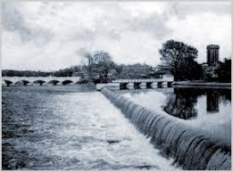
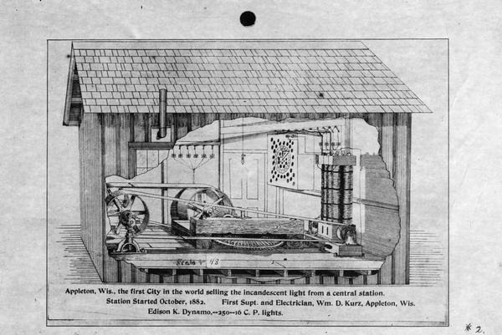
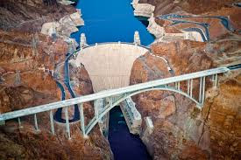
History of Hydro, cont’d
Vulcan Street Plant
1st Hydro-Powered plant
Local Commercial and Residental
Appleton, Wisconsin
On Fox River in 1882
Mill Creek No. 1
1st 3-Phase Commercial AC Hydro Power Plant
San Bernardino, California
In 1887
Hoover Dam
Started: 1931
Generating Power: 1937
https://www.youtube.com/watch?v=gl678len3aY
Notes:
http://www.edisontechcenter.org/Redlands.html

Slide 7
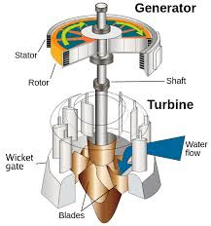
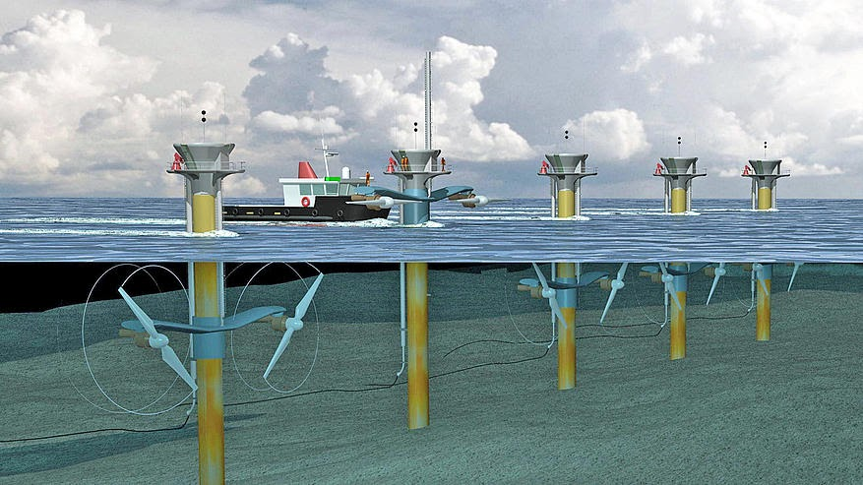
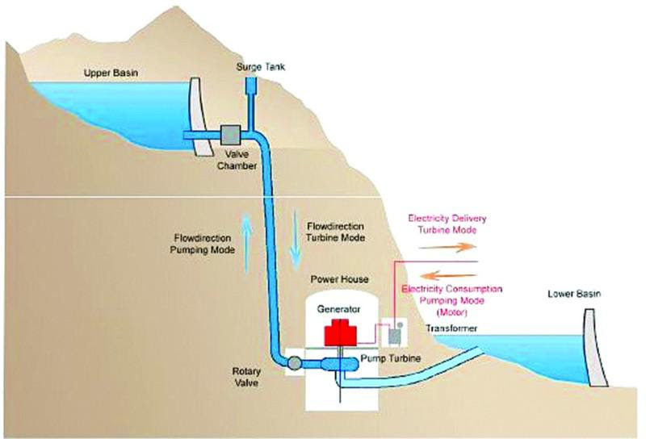
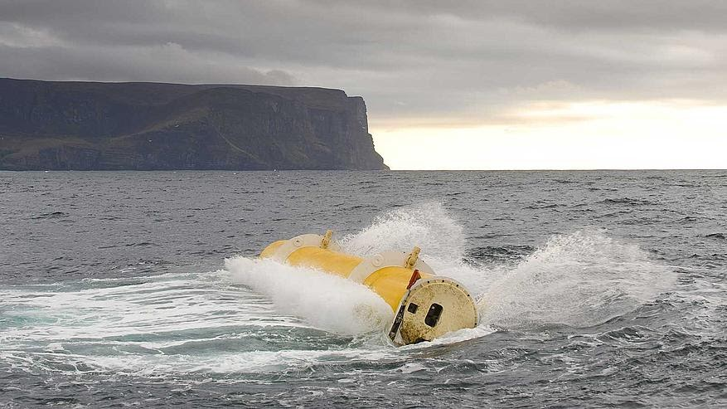
Devices Harnessing Hydro-Power
Steam Turbines
Hydro-Electric Generator
Water Mill (Water Wheels)
Pumped Storage
Tidal
Run of River
https://www.youtube.com/watch?v=tpigNNTQix8

Slide 8
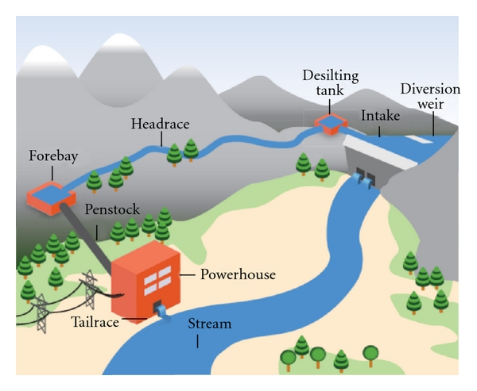
Run of River Hydroelectric Power
Notes:
https://www.researchgate.net/figure/258404306_fig6_Schematic-diagram-of-a-typical-run-of-river-hydropower-system-4
Weir→ intake-->settling tank-->headrace-->Forebay-->Penstock-->turbines in powerhouse-->tailrace from powerhouse and turbines to rejoin river flow

Slide 9
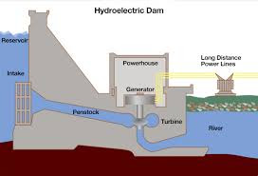
Hydro-Power Generation
Dams
Irrigation
Flood Control
Power Generation

Slide 10
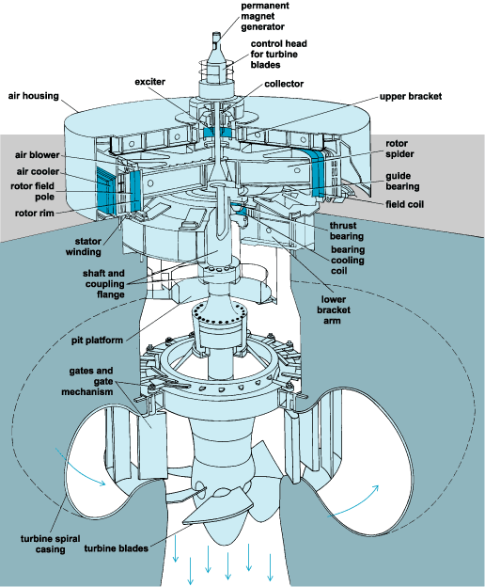
Hydro-Electric Generator
Runner
Wicket Gate
Penstock
Bearings
Generator Rotor
Generator Stator

Slide 11
Equations
Power Generation -> P = phrgk
P -> Power
h -> height
r -> Flow Rate of Water
g -> gravitational constant
k -> coefficient of efficiency

Slide 12
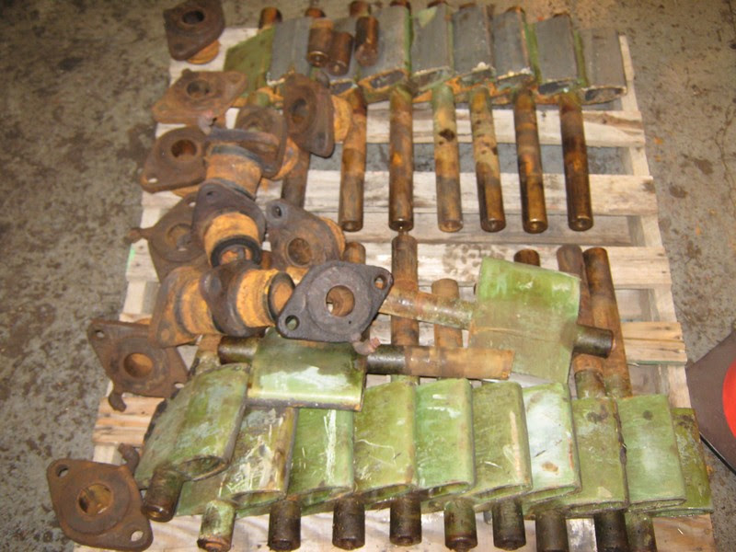
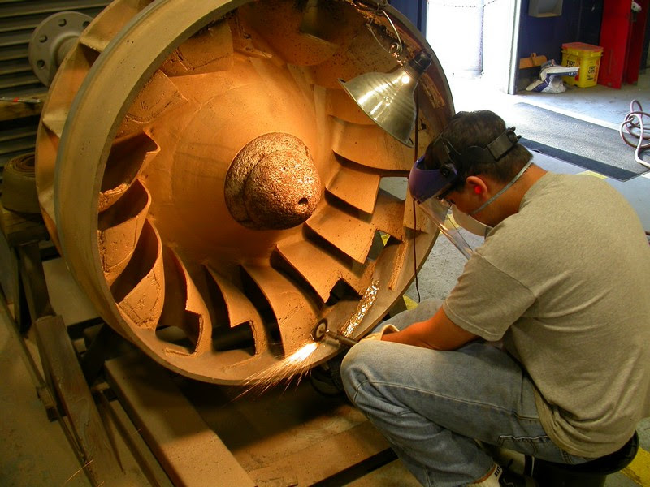
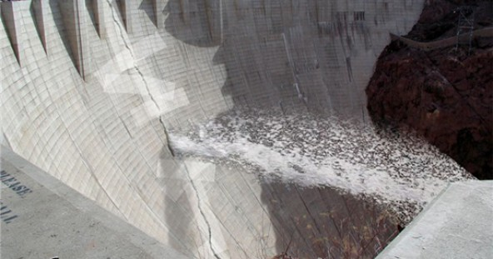
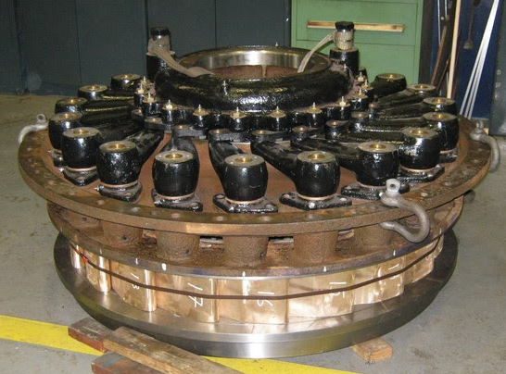
Causes of Failure
Bearing Failure
Cavitation
Sand/Salt Water Erosion
Transient Weather Conditions
Cracks
Notes:
http://noahpinionblog.blogspot.com/2017/01/cracks-in-anti-behavioral-dam.html

Slide 13
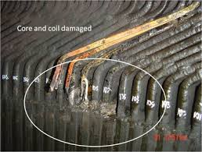
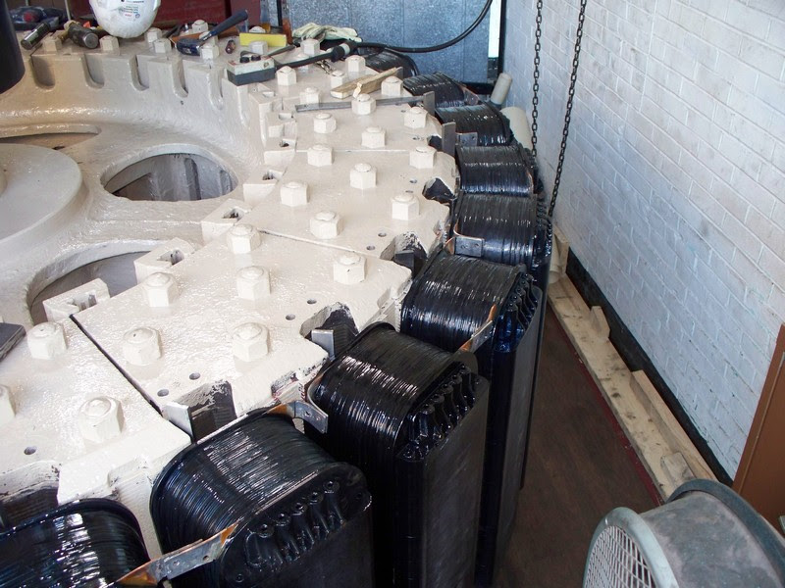
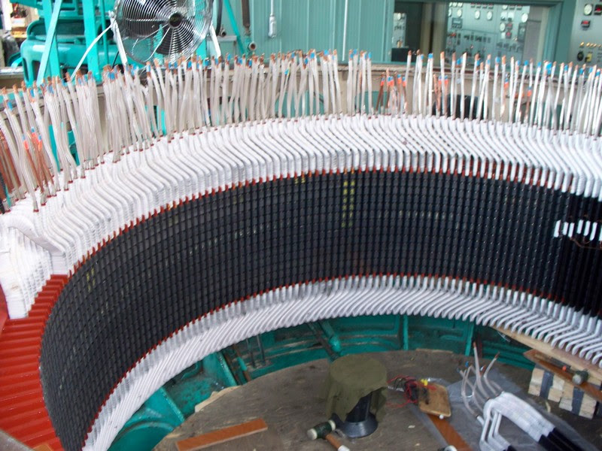
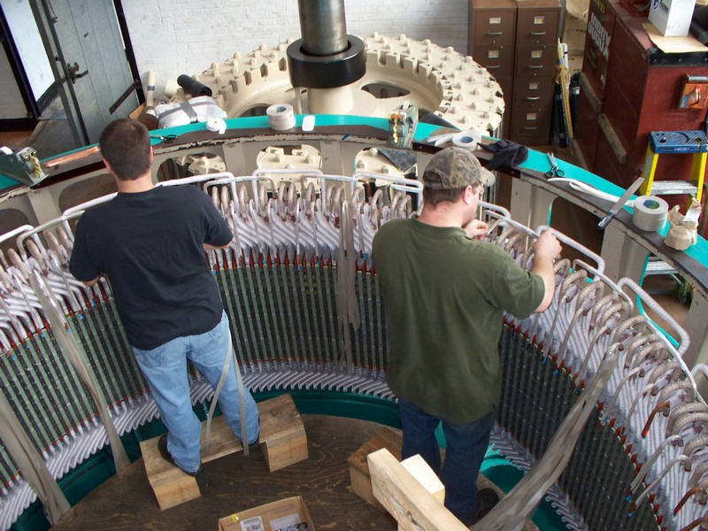
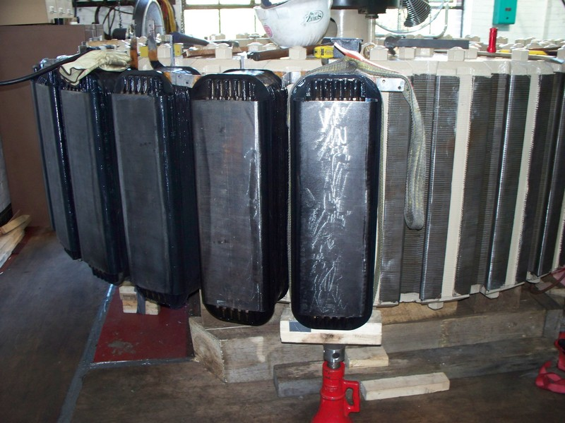
Causes of Failure
Injector/Deflector Malfunction
Generator Failures
Insulation Failure
Overheating/Hot Spots in Core
Shaft Misalignment/Rupture

Slide 14
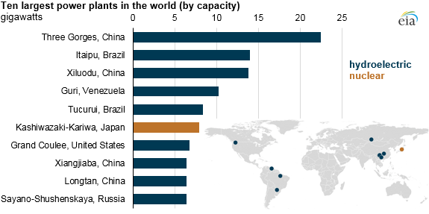
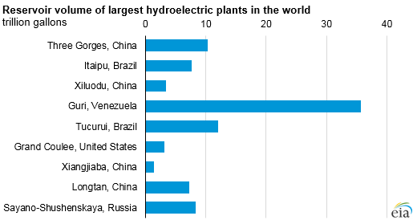
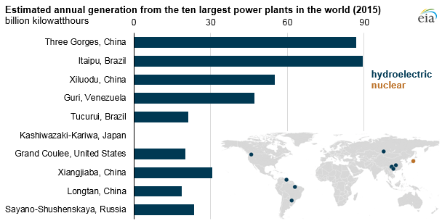
Largest Hydro Power Plant as of 2016
Notes:
https://www.eia.gov/todayinenergy/detail.php?id=28392

Slide 15
Largest Dams in the World
Three Gorges Dam
Located in China and is the world's largest Hydroelectric Dam
22,500 MW capacity
32 turbine generators
Six months during the year there is very little water available to generate power
Produces 15% of China’s electricity production
Notes:
http://www.power-technology.com/features/feature-the-10-biggest-hydroelectric-power-plants-in-the-world/

Slide 16
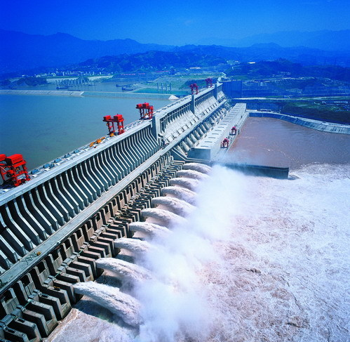
Three Gorges Dam

Slide 17
Largest Dams in the World
Itaipu Dam
in Brazil and Paraguay
14,000 MW Capacity
17.3% of Brazil’s energy consumption
72.5% of Paraguay’s energy consumption
20 turbine generators
Produces the most hydropower energy in the world
Water stream is less affected by seasonal change
Notes:
http://www.power-technology.com/features/feature-the-10-biggest-hydroelectric-power-plants-in-the-world/

Slide 18
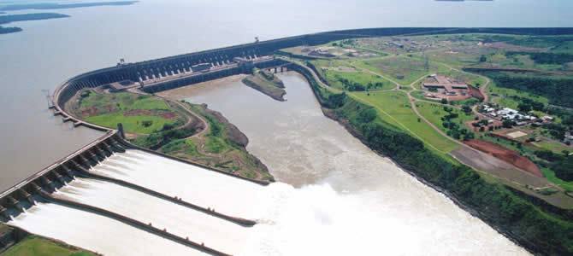
Itaipu Dam

Slide 19
Positive Effects of Hydroelectric Power
Hydroelectric power is renewable due to the fact that it relies on the flow of water coming from a reservoir
This is one of the cleanest forms of energy production because there is absolutely no emissions given off from this type of energy production because there are no fuels being burned in the process of the physical energy production itself. This makes it one of the safest types of energy available.
There is a recreational aspect to the benefits of hydroelectric power because these dams create bodies of water that can then be used for boating, fishing, swimming, etc.

Slide 20
Positive Effects of Hydroelectric Power
Having a larger water supply within the surrounding towns, especially helpful in areas where water resource from wells is scarce
Local jobs added due to facility maintenance and the actual construction of each facility
Increased irrigation- the lake behind the dams offers a supply of irrigation water that generally fulfills the needs of multiple states, especially in relation to the damming of the Colorado. The Hoover dam’s lake, Lake Mead, provides water for parts of Nevada, Arizona, California, and even Mexico.

Slide 21
Negative Effects of Hydroelectric Power
pollution during the creation of the dams and plants from the release of carbon dioxide due to transportation and necessary construction motorized vehicles and tools
Environmental damage- the varying depth levels of the reservoirs in which the dams create and are fed off of can be highly detrimental to aquatic wildlife. If the water level is not maintained, fish life will be endangered due to lack of oxygenated water and drastic temperature rise.
the creation of dams can seriously harm the surrounding environment also because the physical building of the dam directyly imposes on the habitat in whioch it ios placed, affecting not just that area but the surroundings towns and possibly other states.

Slide 22
Negative Effects of Hydroelectric Power
The creation of dams:
re-routes water supplies
erodes and destroys land
if there is a drought, the water supply feeding the hydroelectric power plant may run low which would result in a halt of energy production. Hydroelectric power strictly relies on a constant adequate supply of flowing water

Slide 23
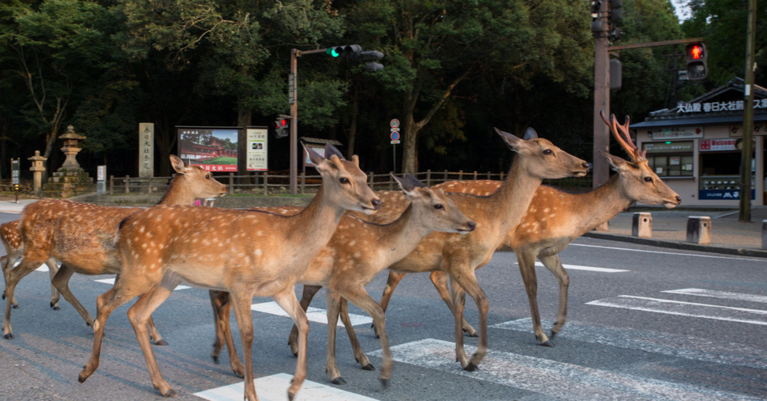
Negative Effects of Hydroelectric Power
Causes wildlife to relocate, leading to the overpopulation of other areas which can exceed carrying capacities of ecosystems already in place, leading to mass disruptions in habitat relations.

Slide 24
Dams and Fish
https://www.youtube.com/watch?v=DK5nUXkrz8o
The Snake River Dam network is seen as a forefront in the argument for the replenishment of native fish populations and acts a catalyst for the conversation of how Dams for Hydroelectric facilities are causing more harm than good in a sense.
The ecosystem that the snake river is a part of relies on the native salmon runs, but the dams have caused a breakdown of the population of Salmon.

Slide 25
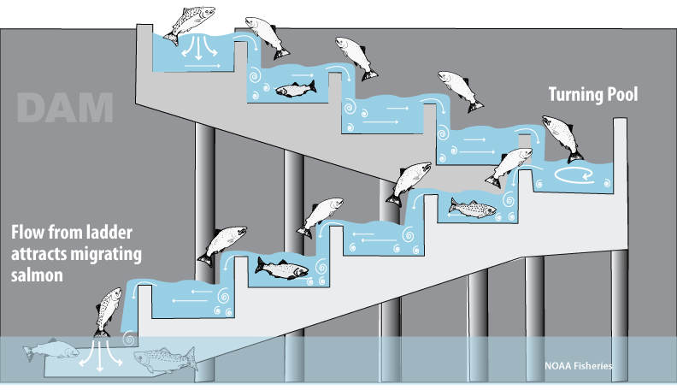
How a Fish Ladder Works
Notes:
http://www.westcoast.fisheries.noaa.gov/fish_passage/about_dams_and_fish/fish_ladders.html

Slide 26
Future of Hydroelectric Power
The EU has set a goal of receiving a total of 20% of its total energy from renewables and cutting greenhouse gas emissions by 20% also
By 2030 the United States would like hydropower to make 15% of its overall electrical energy. As of 2015 it was only at 7 %
There is very large potential in Africa for the creation of hydropower. 65% of the african population lives within close proximity to an adequate water source that can be transformed into hydropower

Slide 27
Future of Hydroelectric Power
Hydropower makes up 74% of renewable electricity generation in the world today, yet only provides for about 15% to 16% of the world's total power.
By 2050, the International Energy Agency has set a goal to double the production of hydropower electricity
One main concern with the future of hydroelectric power is that most areas that could be dammed have already been dammed, leading to the belief that soon the level of Hydroelectric power will become stagnant and no longer be a rising renewable energy resource.

