Slide 1
Wind Power Generation
Antonio
Andrew

Slide 2
History
Wind power is the operation of using the force of air flow to generate usable energy
As of May 2009, 80 countries are using wind power as a sustainable source of renewable energy on a commercial basis
In countries such as Denmark, Portugal and Spain, wind power penetration has been achieved at a relatively high percentage.
Denmark is at the top of the chain, having a percentage of about 21%
Over the past few years, energy produced by wind power has increased from 2.5% world wide.
Over 486.8 GW as the global capacity of wind power at the end of 2015

Slide 3
History
The use of wind power has been around since 5000 BC, as sailing ships were used as a source of transportation across the nile.
By 200 B.c. simple windmills in China were pumping water, while vertical axis windmills were grinding grain in persia and the middle east.
Eventually the word spread to more parts of Europe and carried over to the United States.

Slide 4
History
Before you know it, windmills were being used by colonies to pump water to farms
Danish scientist Poul la Cour produced the first wind turbine in the 1890s, which was used to generate electricity and hydrogen.
This was the first implementation of a modern day turbine
The world had then graduated to using wind turbines to generate electricity.

Slide 5
Wind Energy
Wind power is the use of air flow through wind turbines to mechanically power generators for electric power.
As a general rule, economic wind generators require windspeed of 10 mph (16 km/h) or greater

Slide 6
Continue
Wind power, as an alternative to burning fossil fuels, is plentiful, renewable, widely distributed, clean, produces no greenhouse gas emissions during operation, consumes no water, and uses little land.
An ideal location would have a near constant flow of non-turbulent wind throughout the year, with a minimum likelihood of sudden powerful bursts of wind.

Slide 7
01
02
03
04
05
Wind farms consist of many individual wind turbines which are connected to the electric power transmission network.
The increase in velocity with altitude is most dramatic near the surface and is affected by topography, surface roughness, and upwind obstacles such as trees or buildings
The wind blows faster at higher altitudes because of the reduced influence of drag
Onshore wind is an inexpensive source of electric power, competitive with or in many places cheaper than coal or gas plants.
Onshore turbine installations in hilly or mountainous regions tend to be on ridgelines generally three kilometers or more inland from the nearest shoreline.

Slide 8
Onshore
The advantages of having an onshore wind farm can also affect agriculture.
A wind farm is not globally accepted, due to it’s influence on environmental aesthetic.
However, the space between each wind turbine can be used for farming
Especially in larger wind farm areas
The addition of turbines is carefully considered and viable options are monitored for an extended period of time before construction

Slide 9
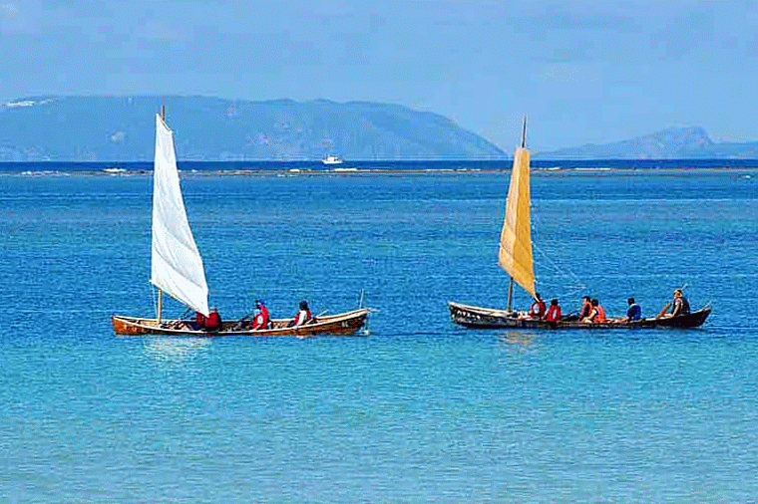
What has Wind Been Used For
Wind power has been used as long as humans have put sails into the wind. For more than two millennia wind-powered machines have ground grain and pumped water.
Wind power was widely available and not confined to the banks of fast-flowing streams, or later, requiring sources of fuel.

Slide 10
Wind power gives variable power which is very consistent from year to year but which has significant variation over shorter time scales.
An ideal location would have a near constant flow of non-turbulent wind throughout the year, with a minimum likelihood of sudden powerful bursts of wind
The wind blows faster at higher altitudes because of the reduced influence of drag.

Slide 11
Offshore Wind Power
Offshore wind power refers to the construction of wind farms in large bodies of water to generate electric power.
These installations can utilize the more frequent and powerful winds that are available in these locations and have less aesthetic impact on the landscape than land based projects.
Offshore wind turbines are less obtrusive than turbines on land, as their apparent size and noise is mitigated by distance
Because water has less surface roughness than land (especially deeper water), the average wind speed is usually considerably higher over open water

Slide 12
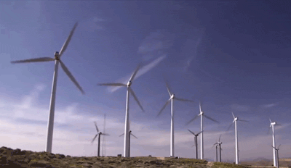
Continue
In a wind farm, individual turbines are interconnected with a medium voltage (usually 34.5 kV) power collection system and communications network.
Air is a fluid like any other except that its particles are in gas form instead of liquid and when air moves quickly, in the form of wind, those particles are moving quickly
Motion means kinetic energy, which can be captured, just like the energy in moving water can be captured by the turbine in a hydroelectric dam

Slide 13
Construction of a new high-voltage line may be too costly for the wind resource alone, but wind sites may take advantage of lines installed for conventionally fueled generation.
The rest is nearly identical to a hydroelectric setup: When the turbine blades capture wind energy and start moving, they spin a shaft that leads from the hub of the rotor to a generator
A transmission line is required to bring the generated power to (often remote) markets. For an off-shore station this may require a submarine cable.
At a substation, this medium-voltage electric current is increased in voltage with a transformer for connection to the high voltage electric power transmission system.

Slide 14
Where does it start
Worldwide there are now over two hundred thousand wind turbines operating, with a total nameplate capacity of 432 GW
Wind power all starts with the sun. When the sun heats up a certain area of land, the air around that land mass absorbs some of that heat
At a certain temperature, that hotter air begins to rise very quickly because a given volume of hot air is lighter than an equal volume of cooler air
When that lighter hot air suddenly rises, cooler air flows quickly in to fill the gap the hot air leaves behind that air rushing in to fill the gap is wind

Slide 15
The simplest possible wind-energy turbine consists of three crucial parts:
1. Rotor blades - The blades are basically the sails of the system; in their simplest form, they act as barriers to the wind (more modern blade designs go beyond the barrier method)
2. Shaft - The wind-turbine shaft is connected to the center of the rotor. When the rotor spins, the shaft spins as well
3. Generator - At its most basic, a generator is a pretty simple device
When the wind forces the blades to move, it has transferred some of its energy to the rotor
In this way, the rotor transfers its mechanical, rotational energy to the shaft, which enters an electrical generator on the other end

Slide 16
The Variabilities
Electric power generated from wind power can be highly variable at several different timescales: hourly, daily, or seasonally. Annual variation also exists, but is not as significant.
Because instantaneous electrical generation and consumption must remain in balance to maintain grid stability, this variability can present substantial challenges to incorporating large amounts of wind power into a grid system.

Slide 17
How to Calculate Power
To calculate the amount of power a turbine can actually generate from the wind, you need to know the wind speed at the turbine site and the turbine power rating
Most large turbines produce their maximum power at wind speeds around 15 meters per second (33 mph)
Considering steady wind speeds, it's the diameter of the rotor that determines how much energy a turbine can generate

Slide 18
Wind Energy

Slide 19
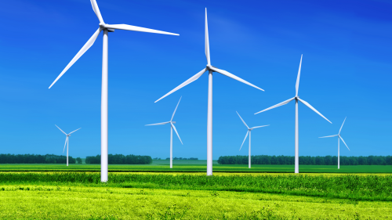
Wind is a form of solar energy and is a result of the uneven heating of the atmosphere by the sun, the irregularities of the earth's surface, and the rotation of the earth. Wind flow patterns and speeds vary greatly across the United States and are modified by bodies of water, vegetation, and differences in terrain. Humans use this wind flow, or motion energy, for many purposes: sailing, flying a kite, and even generating electricity.
Wind turbines operate on a simple principle. The energy in the wind turns two or three propeller-like blades around a rotor. The rotor is connected to the main shaft, which spins a generator to create electricity

Slide 20
Turbine Structure
Anemometer:
Measures the wind speed and transmits wind speed data to the controller.
Blades:
Lifts and rotates when wind is blown over them, causing the rotor to spin. Most turbines have either two or three blades.
Brake:
Stops the rotor mechanically, electrically, or hydraulically, in emergencies.
Controller:
Starts up the machine at wind speeds of about 8 to 16 miles per hour (mph) and shuts off the machine at about 55 mph. Turbines do not operate at wind speeds above about 55 mph because they may be damaged by the high winds.

Slide 21
Turbine Structure
Gear box:
Connects the low-speed shaft to the high-speed shaft and increases the rotational speeds from about 30-60 rotations per minute (rpm), to about 1,000-1,800 rpm; this is the rotational speed required by most generators to produce electricity. The gear box is a costly (and heavy) part of the wind turbine and engineers are exploring "direct-drive" generators that operate at lower rotational speeds and don't need gear boxes.
Generator:
Produces 60-cycle AC electricity; it is usually an off-the-shelf induction generator.
High-speed shaft:
Drives the generator.

Slide 22
Turbine Structure
Low-speed shaft:
Turns the low-speed shaft at about 30-60 rpm.
Nacelle:
Sits atop the tower and contains the gear box, low- and high-speed shafts, generator, controller, and brake. Some nacelles are large enough for a helicopter to land on.
Pitch:
Turns (or pitches) blades out of the wind to control the rotor speed, and to keep the rotor from turning in winds that are too high or too low to produce electricity.
Rotor:
Blades and hub together form the rotor.

Slide 23
Turbine Structure
Tower:
Made from tubular steel, concrete, or steel lattice. Supports the structure of the turbine. Because wind speed increases with height, taller towers enable turbines to capture more energy and generate more electricity.
Wind direction:
Determines the design of the turbine. Upwind turbines face into the wind while downwind turbines face away.
Wind vane:
Measures wind direction and communicates with the yaw drive to orient the turbine properly with respect to the wind.
Yaw drive:
Orients upwind turbines to keep them facing the wind when the direction changes. Downwind turbines don't require a yaw drive because the wind manually blows the rotor away from it.

