Slide 1
EE 350 / ECE 490 Analog Communication Systems
Ch. 1 – Introductory Topics

Slide 2
Syllabus
Course Number: EE 350 / ECE 490 | Course Name: Communication Systems
Course Time: Tue 6:00pm-9:00pm | Course Location: BNW 253
Schedule: 1/19/2009-5/4/2009 | Final Exam: 5/11/2009
Instructor: Ryan Munden
Office: MCA 212 | Hours: Tue/Thur 3:30-5:30 or by appt.
Office Phone: 203-254-4000x2764 | Mobile Phone: 203-710-0050
Email: rmunden@fairfield.edu | Email checked regularly, phone if urgent

Slide 3
Course Objectives
No. | Objective | Outcome
1 | To understand how the components of a communication system interact | Students will develop block diagrams for and develop specifications for communication systems
2 | To understand the design and operation of the basic building blocks for communication circuits | Students will design and analyze basic communication circuits, such as amplifiers, modulators, and oscillators.
3 | To understand the; fundamentals of noise generation and how it affects communication circuits | Students will develop circuit models for noise generation and will them to analyze the effect of noise on analog circuits

Slide 4
Course Particulars
Textbook:
Modern Electronic Communication (9th ed.) Jeffrey S. Beasley & Gary M. Miller. Pearson / Prentice Hall. ISBN-13: 9780132251136
Required Software:
1. MatLab Student Ed. (The Math Works) or Classroom Kit (SOE) MatLab Tutorial by B. Aliane
2. Circuit simulator – the book uses (and should include a CD student version of) Electronics Workbench Multisim, or LTSpice IV – A useful, free spice simulation package from Linear Technologies.
Web Resources:
Eidos – course materials and grades will be posted using Eidos as the course management website. http://eidos.fairfield.edu – you should have access if you are registered for the course.
Textbook Website – provides files, reviews, problems, and many resources to accompany studying with the textbook. http://wps.prenhall.com/chet_beasley_modeleccomm_9/
Performance Indicators and Grading:
Three exams will be given covering several concepts each. Exams will be take-home, but individual effort.
Class participation, Homework, Projects | 20%
Exams (2) | 80%
Total | 100%

Slide 5
Academic Policies
Exam grading:
The purpose of the exams is to convey your understanding of the material; therefore, it is important that you show your work. Even if you feel that the solution to a problem is obvious; you must still explain why it is obvious. Furthermore; if you are asked to solve a problem using a given technique; then please use that technique; otherwise, I have no way to judge your understanding of the technique being tested.
Homework policy:
Homework will be assigned from the book as your primary preparation for the exams. We will review select homework problems in class and you will be asked to work them on the board for a participation grade. We will also incorporate design problems / projects as appropriate to the material. These problems are designed to challenge you to think beyond what the book has told you, and do real engineering. There may be more than one correct answer. These will be the primary factors in your HW grade. If you know in advance that you will be missing class please contact me to make arrangemeIf you understand how to do the homework problems you will have an easier time with the Exams.

Slide 6
Academic Integrity
Working with classmates to study, resolve problems, and learn the material is expected and encouraged during normal course work. However, during individual evaluations (e.g. quizzes, exams, individual projects, etc.) you are expected to comply with all standards of academic honesty. You will be graded fairly, and so your work should fairly represent your knowledge, abilities, and effort, not that of others. Any breach of integrity (including but not limited to: copying solutions, internet solutions, copying from peers, claiming work or designs without proper citation, etc.), will not only impact your ability to learn the material and my ability to help you through proper feedback, it will result in academic penalty. Any individual found in breach of this code will fail the afflicted assignment and will be asked to meet privately; any other offenses will be referred to the Dean for further action, and could result in penalties as severe as expulsion from the University.

Slide 7
Schedule
Week | Date | Topic | Text | Objective
1 | 19-Jan | Introductory Topics | 1 | 1,3
2 | 26-Jan | Amplitude Modulation: Transmission | 2 | 2
3 | 2-Feb | Amplitude Modulation: Reception | 3 | 2
4 | 9-Feb | Single-Sideband Communications | 4 | 1,2
- | 16-Feb | Monday classes meet - NO CLASS
5 | 23-Feb | Frequency Modulation: Transmission | 5 | 2,3
6 | 2-Mar | Frequency Modulation: Reception | 6 | 2
- | 9-Mar | Spring Break – NO CLASS
7 | 16-Mar | Communication Techniques Midterm Exam Distributed | 7 | 2,3
8 | 23-Mar | Digital Communications: Coding Techniques | 8 | 2
9 | 30-Mar | Transmission Lines Midterm Exam Due | 12 | 2
10 | 6-Apr | Wave Propagation | 13 | 2
11 | 13-Apr | Antennas | 14 | 1,2
12 | 20-Apr | Waveguides and Radar | 15 | 2
13 | 27-Apr | Television Final Exam Distributed | 17 | 2
14 | 4-May | Selected Topics | TBD | 2
15 | 11-May | Final Exam Due

Slide 8
Outline
Introduction
The dB in Communications
Noise
Noise Designation and Calculation
Noise Measurement
Information and Bandwidth
LC Circuits
Oscillators
Troubleshooting

Slide 9
Objectives
Describe a basic communication system and explain the concept of modulation
Develop an understanding of the use of the decibel (dB) in communication systems
Define electrical noise and explain its effect at the first stages of a receiver
Calculate the thermal noise generated by a resistor
Calculate the signal-to-noise ratio and noise figure for an amplifier
Describe several techniques for making noise measurements
Explain the relationship among information, bandwidth, and time of transmission
Analyze nonsinusoidal repetitive waveforms via Fourier Analysis
Analyze the operation of various RLC circuits
Describe the operation of common LC and crystal oscillators

Slide 10
Modulation

Slide 11
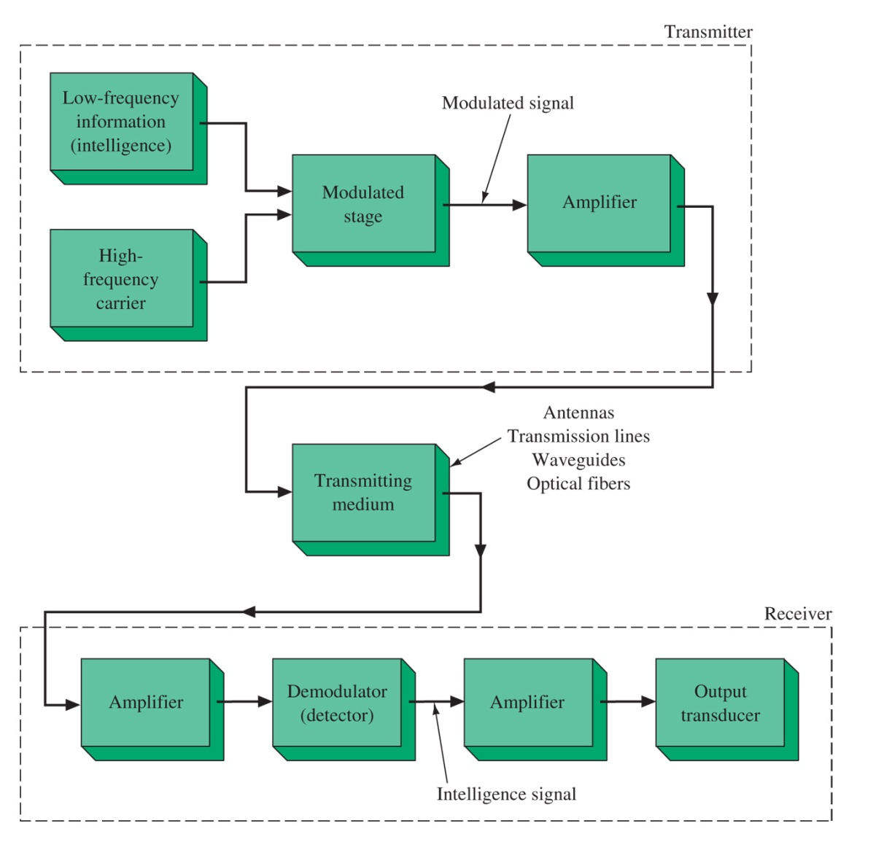
Figure 1-1 A communication system block diagram.
Communication Systems

Slide 12
The dB in Communications
0-dBm is measured relative to a standard of 1mW on a 600 Ω load.
Other loads such as 75 Ω (video) or 50 Ω (radio) can also be denoted as dBm(75/50/600) showing the reference load and denoting 1mW of power.

Slide 13
Noise
External Noise:
Human-made noise up to about 500 MHz
Atmospheric Noise: up to about 20 MHz
Space Noise (Solar and Cosmic): 8MHz to 1.5 GHz
Intrinsic Noise:
Thermal Noise (Johnson or White noise)
Shot Noise
1/f (flicker or pink) noise
Transit Time noise

Slide 14
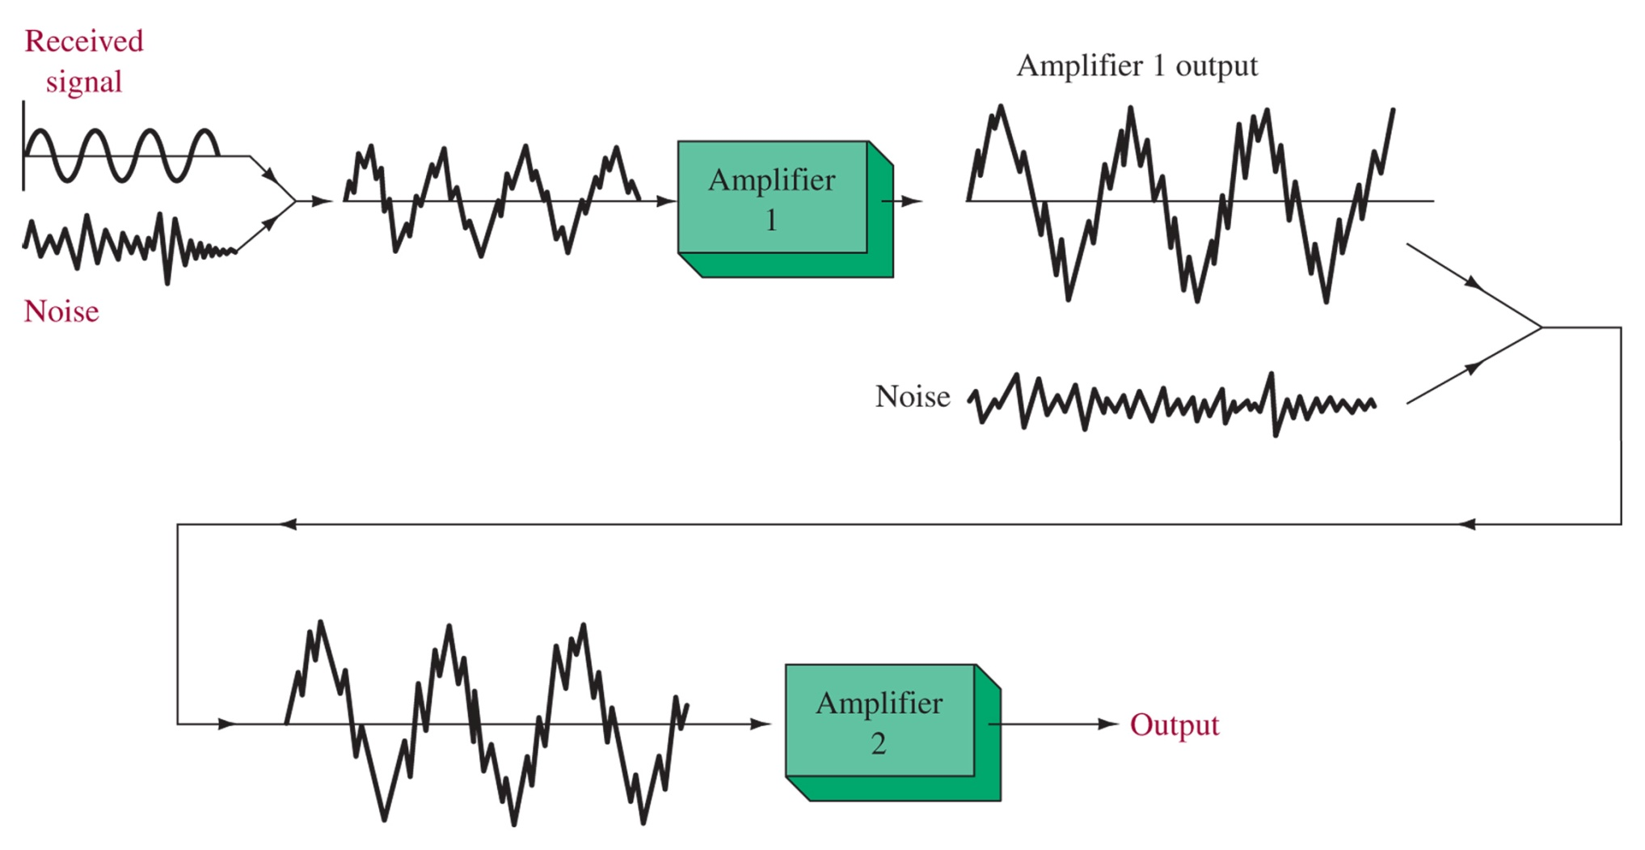
Figure 1-2 Noise effect on a receiver s first and second amplifier stages.
Noise Amplification

Slide 15
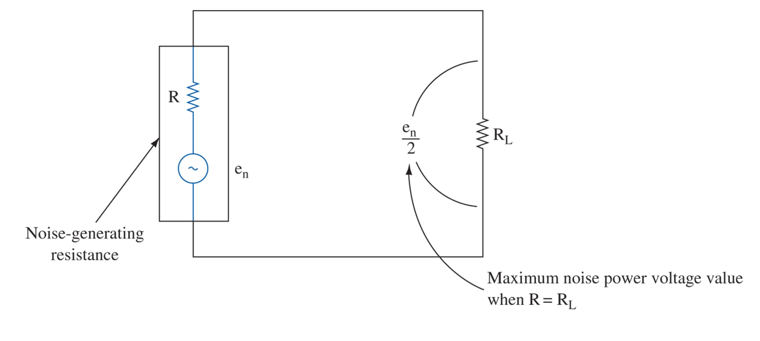
Figure 1-3 Resistance noise generator.

Slide 16
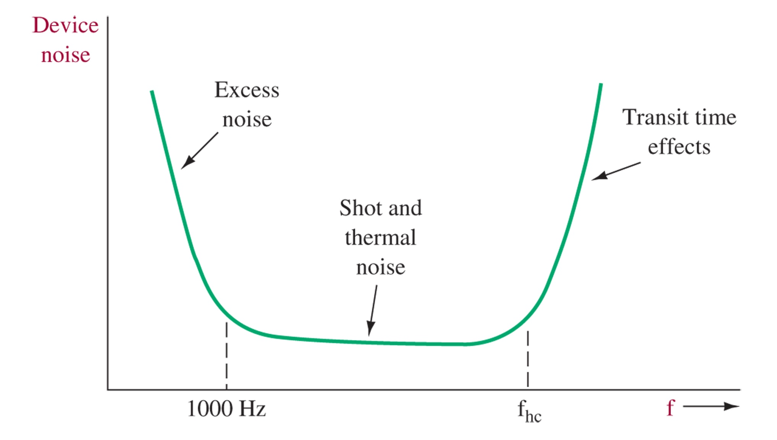
Figure 1-4 Device noise versus frequency.
Noise spectrum

Slide 17
Noise Designation
Signal to Noise Ratio
Noise Figure

Slide 18
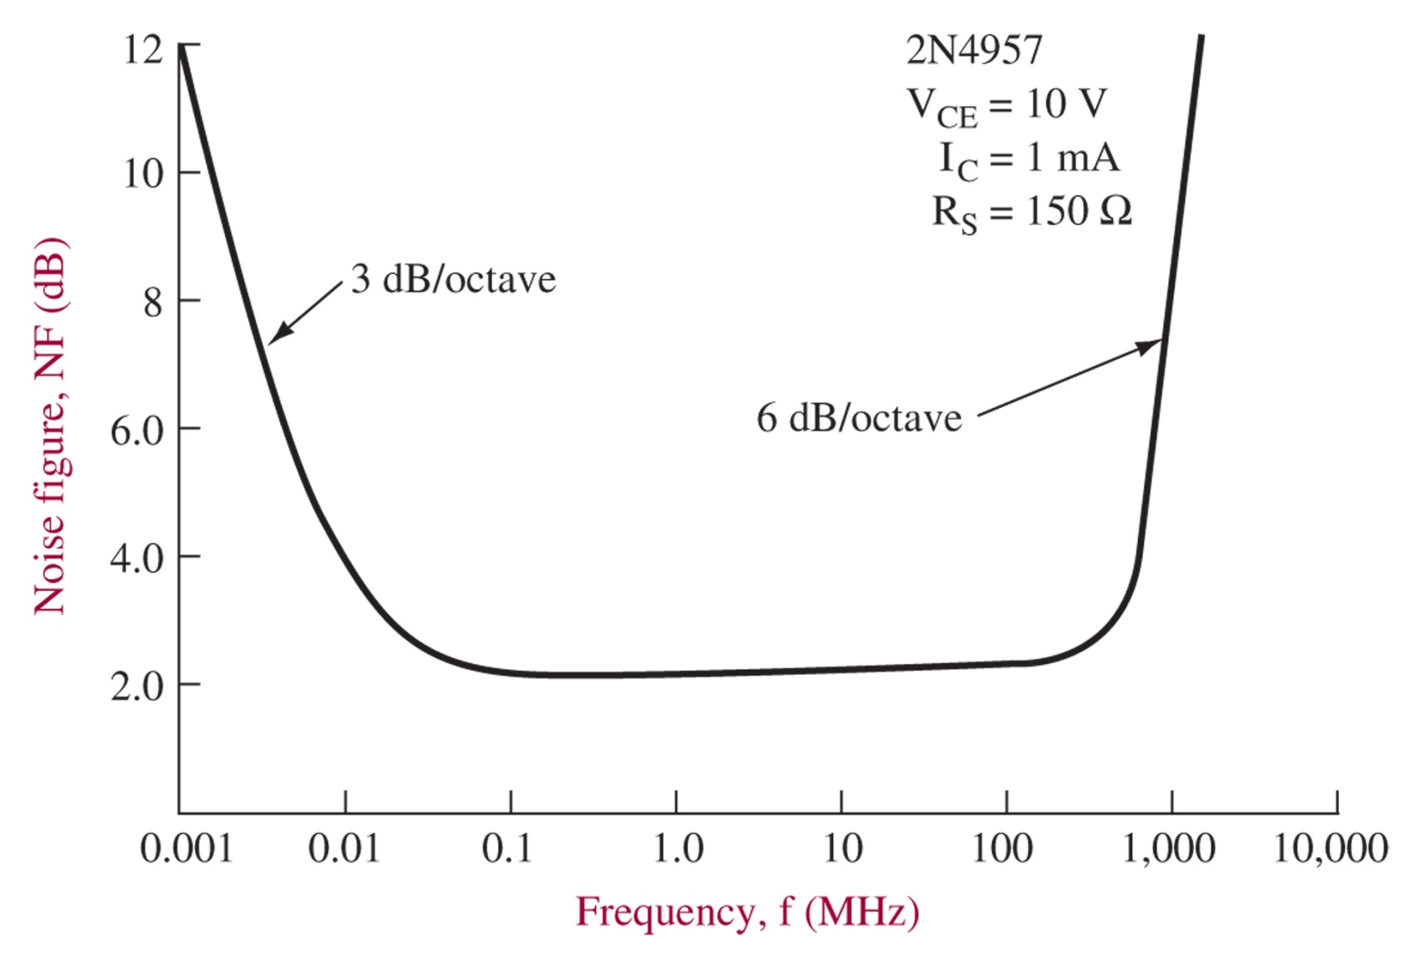
Figure 1-5 NF versus frequency for a 2N4957 transistor. (Courtesy of Motorola Semiconductor Products, Inc.)
Noise Figure Spectrum

Slide 19
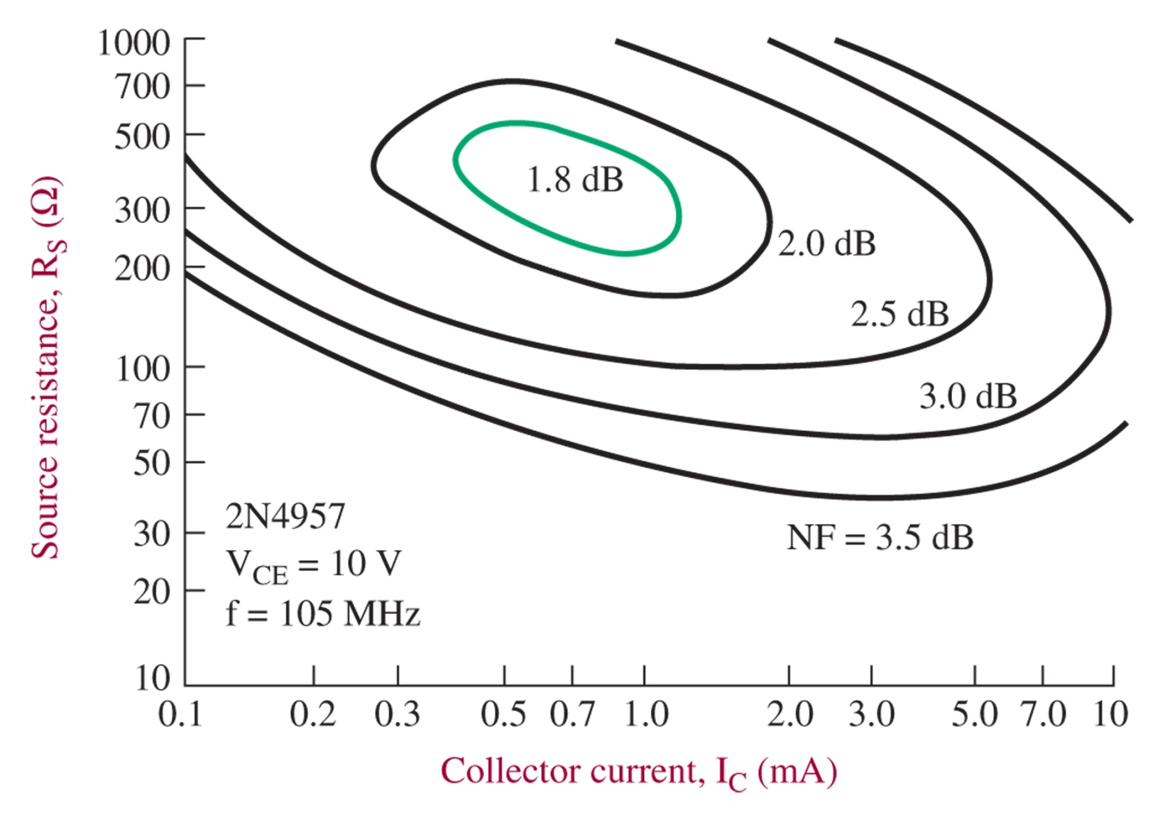
Figure 1-6 Noise contours for a 2N4957 transistor. (Courtesy of Motorola Semiconductor Products, Inc.)
Noise Contours

Slide 20
Noise Effects
Reactance noise bandwidth typically larger than BW
Noise of First Stage in Cascaded amplifier dominates by Friiss’s Formula
Equivalent Noise Temperature Teq = To(NR-1)
SINAD used for total degradation of receivers

Slide 21
Figure 1-7 Scope display of the same noise signal at two different intensity settings. (Courtesy of Electronic Design.)
Noise Measurement

Slide 22
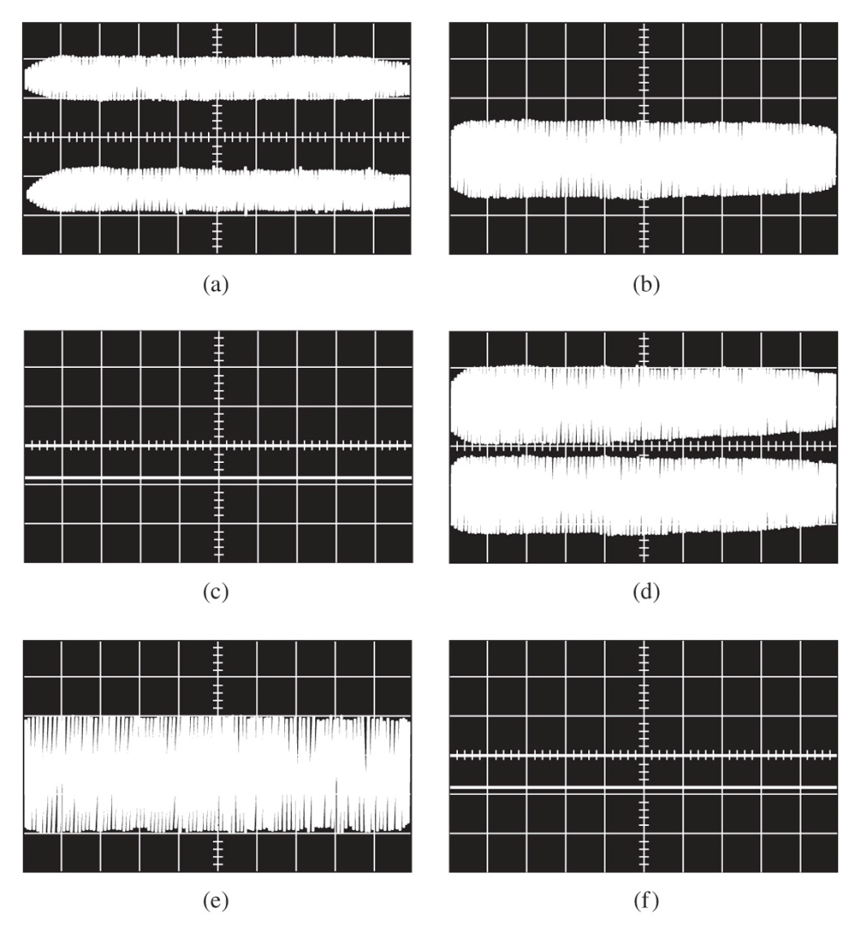
Figure 1-8 (a) With the tangential method, the noise signal is connected to both channels of a dual-channel scope used in the alternate-sweep mode. (b) The offset voltage is adjusted until the traces just merge. (c) The noise signal is then removed. The difference in the noise-free traces is twice the rms noise voltage. (d, e, f) This is repeated at a different intensity to show that the method is independent of intensity. Scope settings are: horizontal = 500 ms/cm, vertical = 20 mV/cm. (Courtesy of Electronic Design.)

Slide 23
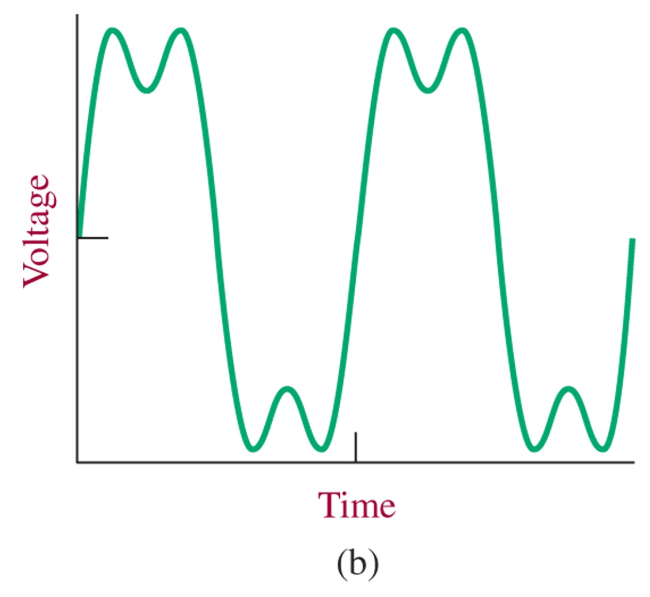
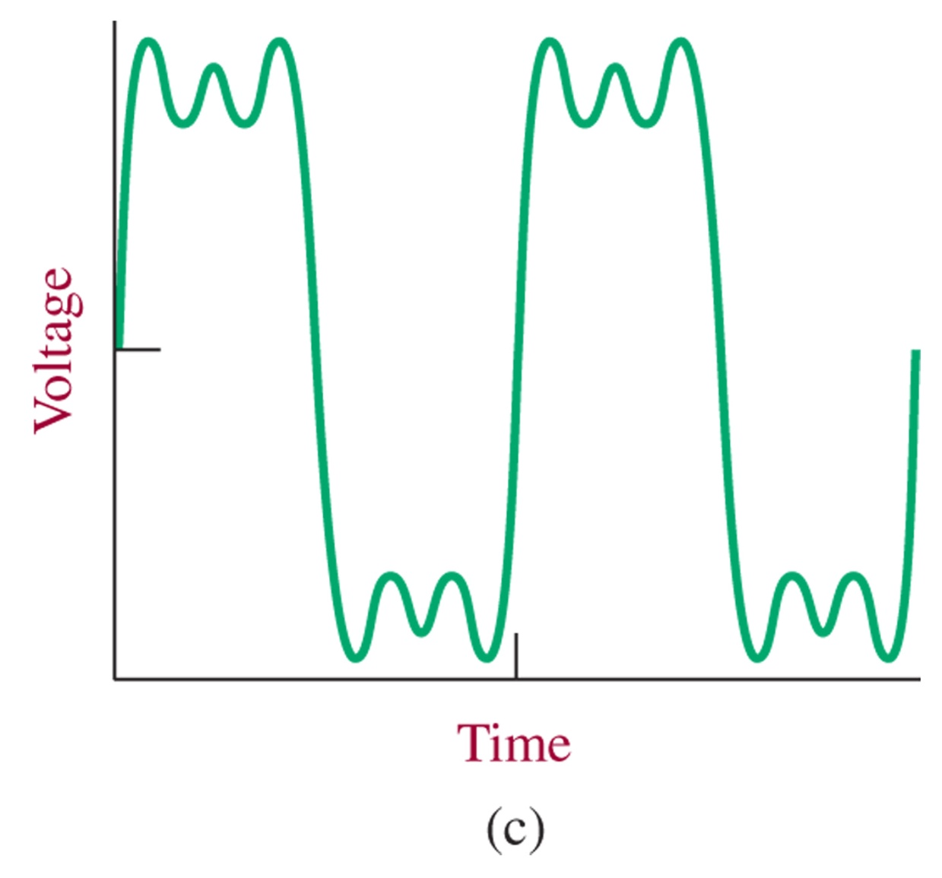
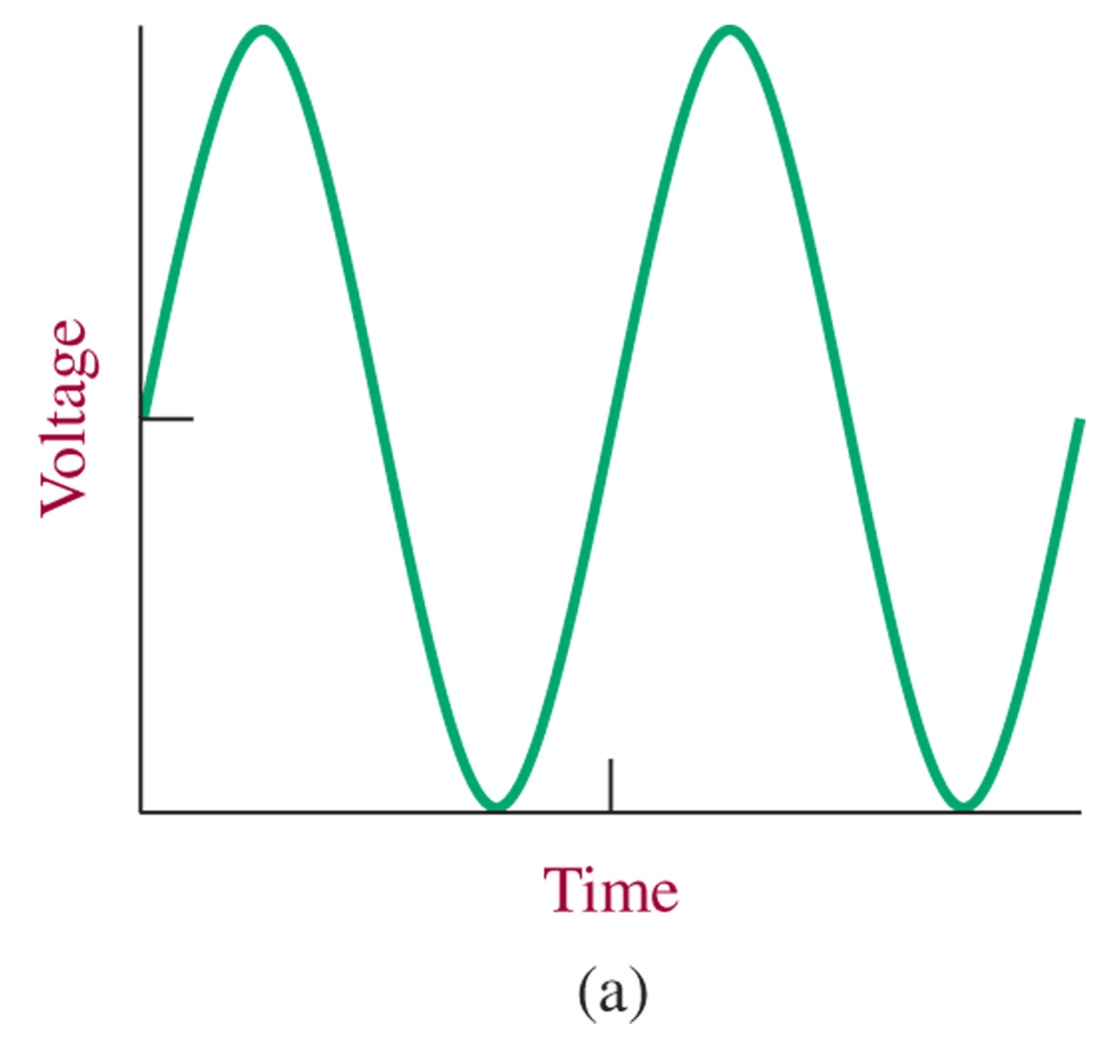
Figure 1-9 (a) Fundamental frequency (sin ωt); (b) the addition of the first and third harmonics (sinωt + 1/3 sin 3ωt); (c) the addition of the first, third, and fifth harmonics (sin ωt + 1/3 sin 3ωt + 1/5 sin 5ωt).
Fourier Analysis
Square wave construction

Slide 24
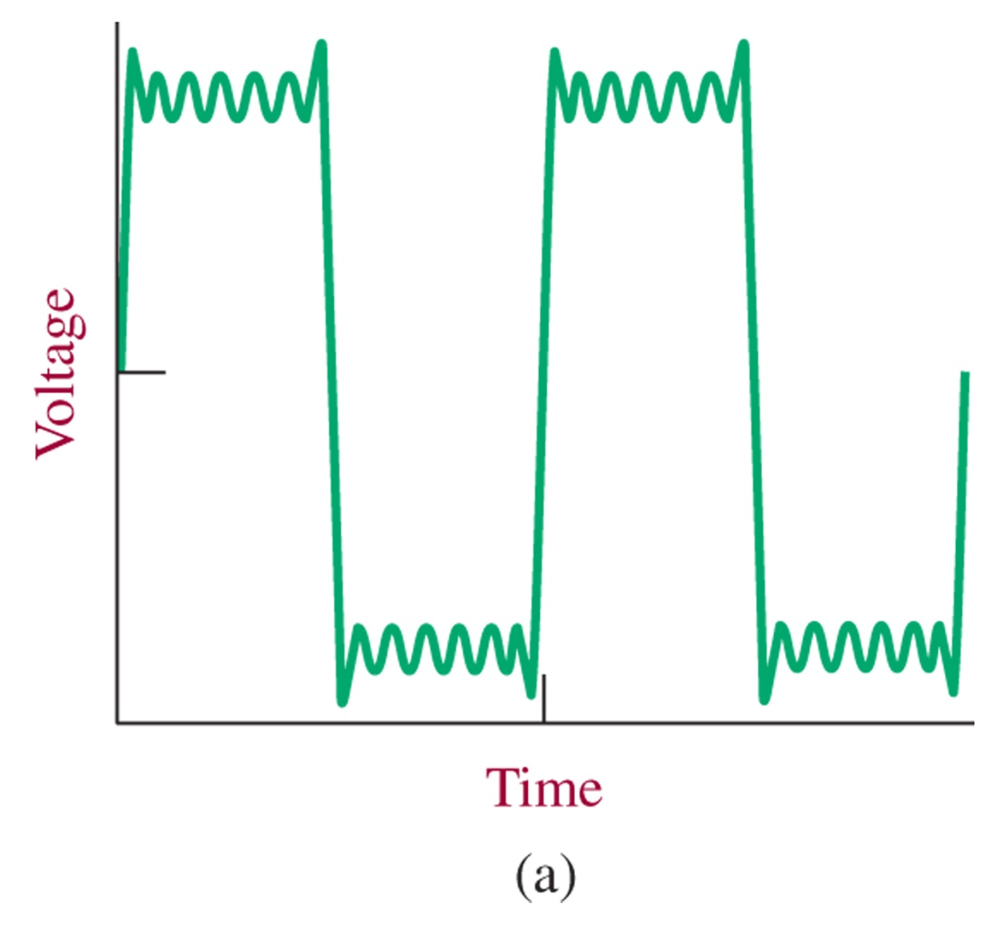
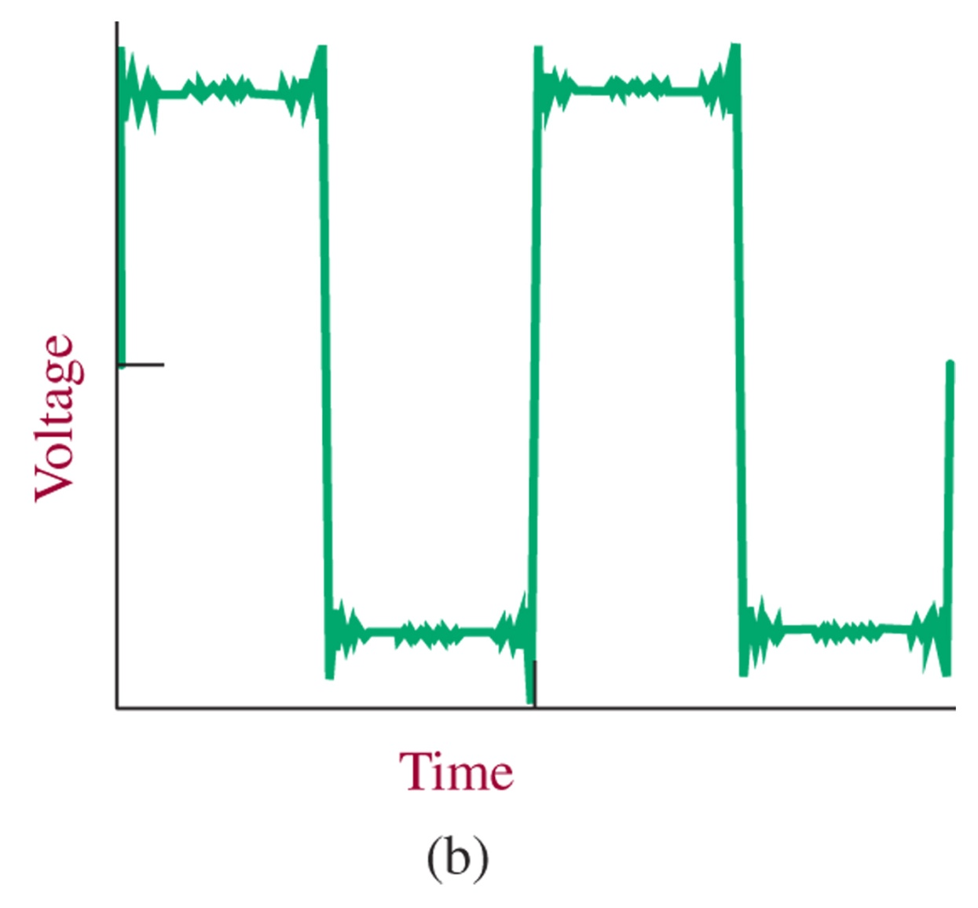
Figure1-10 Square waves containing: (a) 13 harmonics; (b) 51 harmonics.
Fourier Analysis
Higher harmonics in square wave

Slide 25
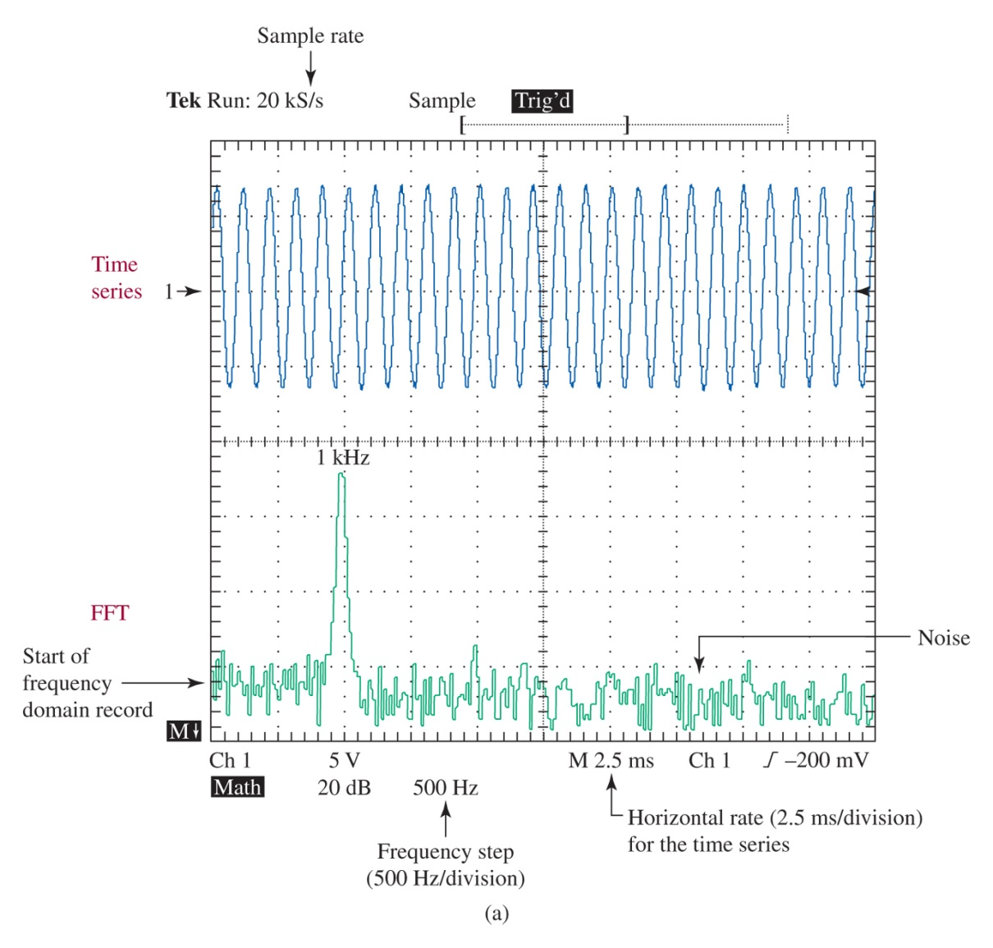
Figure 1-11 (a) A 1-kHz sinusoid and its FFT representation; (b) a 2-kHz sinusoid and its FFT representation.
Measuring Frequency Spectra

Slide 26
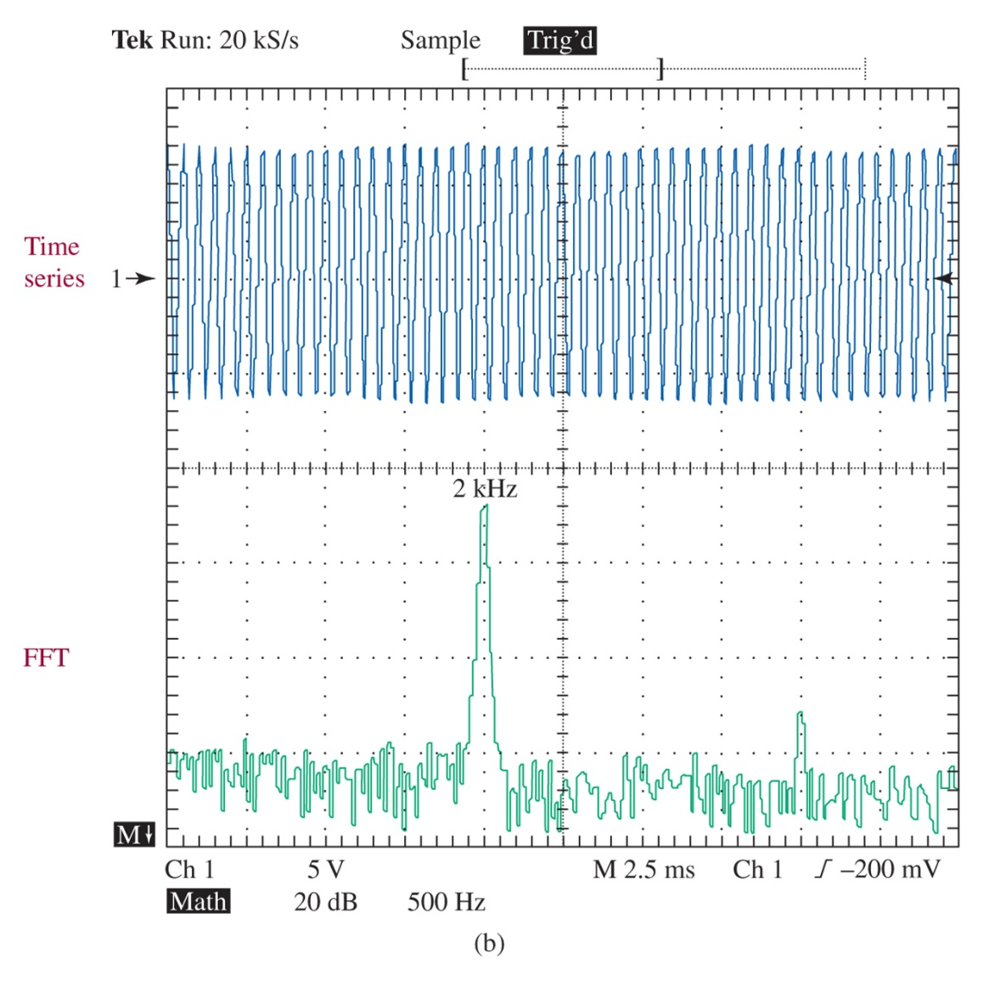
Figure 1-11 (continued) (a) A 1-kHz sinusoid and its FFT representation; (b) a 2-kHz sinusoid and its FFT representation.

Slide 27
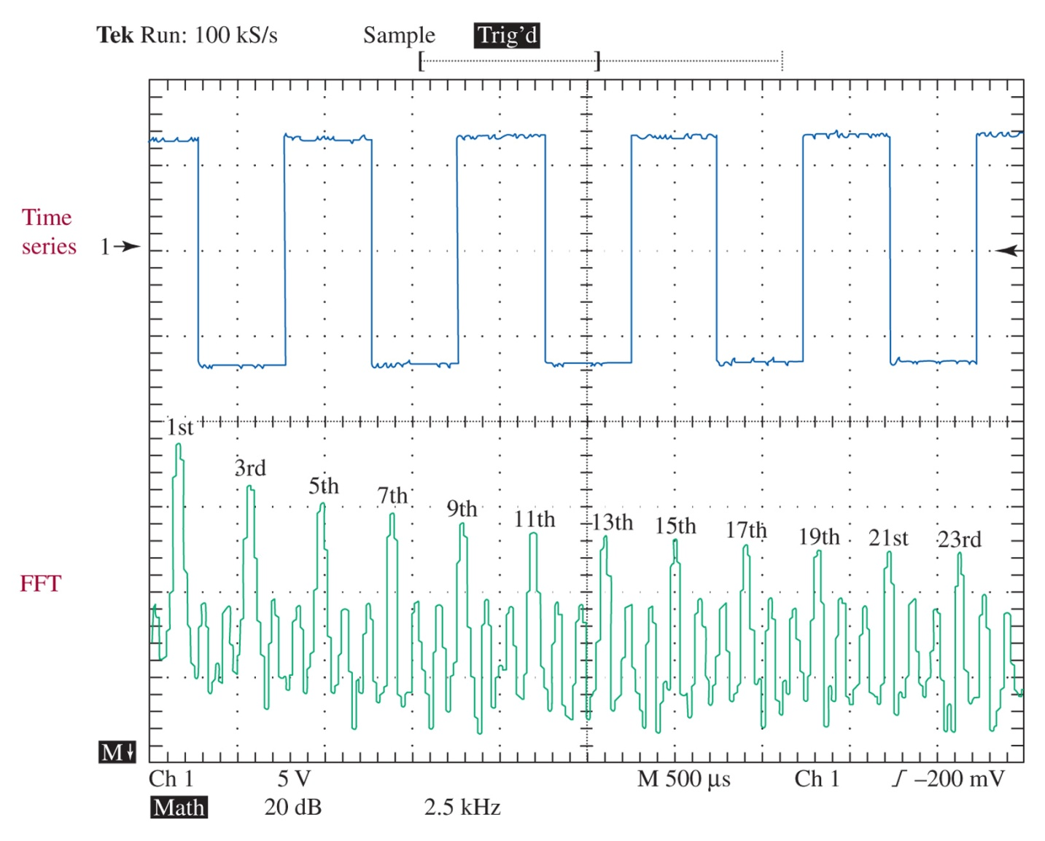
Figure 1-12 A 1-kHz square wave and its FFT representation.

Slide 28
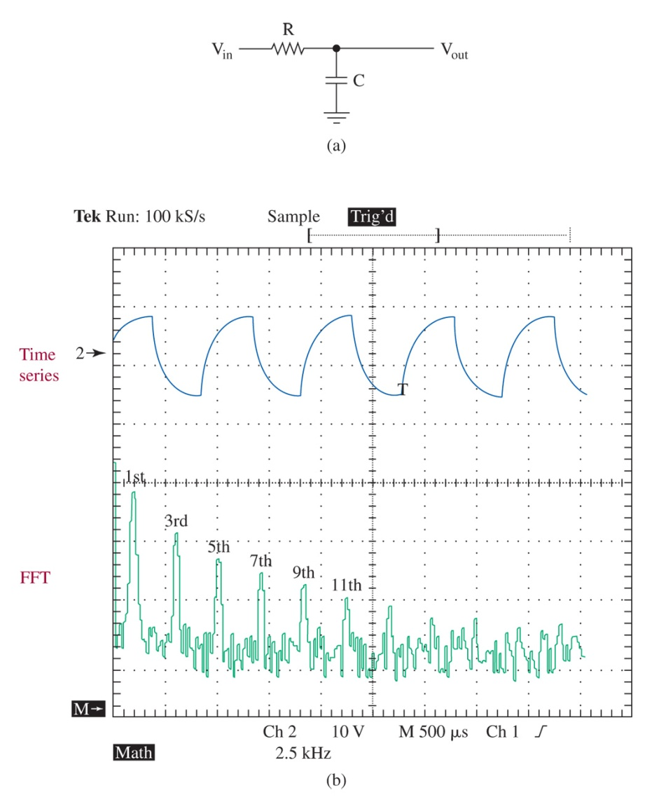
Figure 1-13 (a) A low-pass filter simulating a bandwidth-limited communications channel; (b) the resulting time series and FFT waveforms after passing through the low-pass filter.

Slide 29
Figure 1-14 Series RLC circuit.
RLC Circuits

Slide 30
Figure 1-15 Series RLC circuit effects.
Resonance

Slide 31
Figure 1-16 (a) LC bandpass filter and (b) response.
Series LC Bandpass Filter

Slide 32
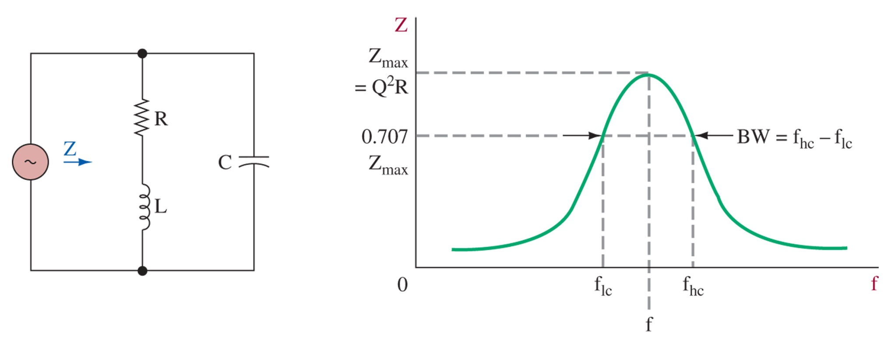
Figure 1-18 Parallel LC circuit and response.
Parallel LC Bandpass

Slide 33
LC Filters
Filters can be designed using multiples poles
Butterworth
Chebyshev
Cauer (elliptical)
Bessel (Thomson)

Slide 34
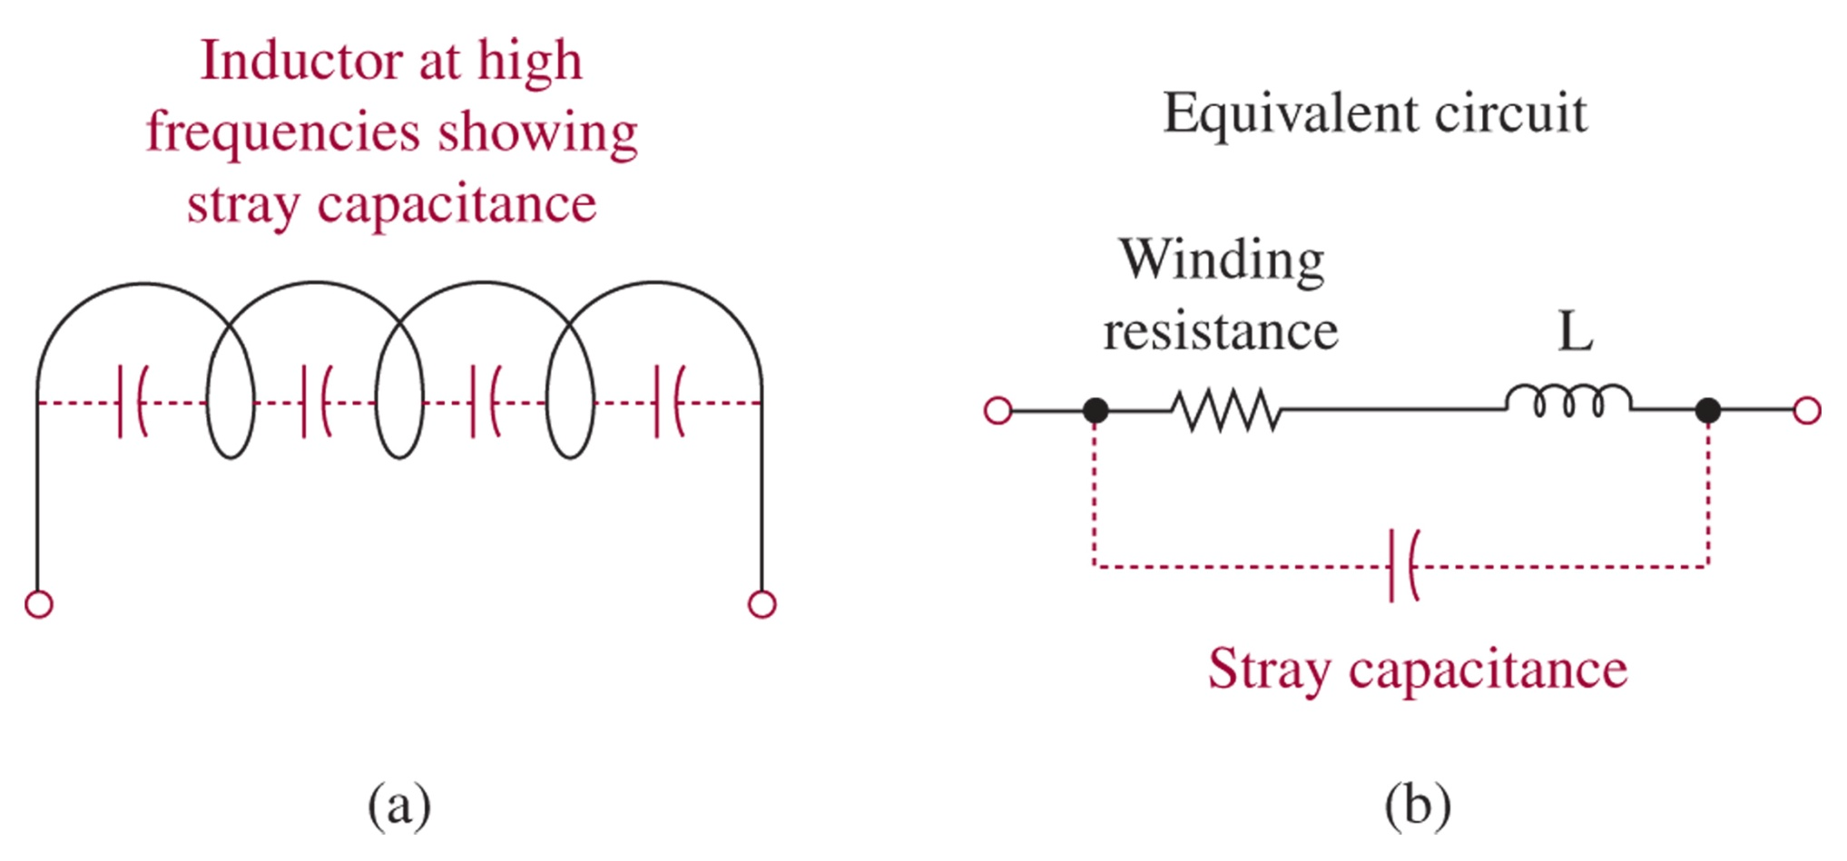
Figure 1-19 Inductor at high frequencies.
High Frequency Effects

Slide 35
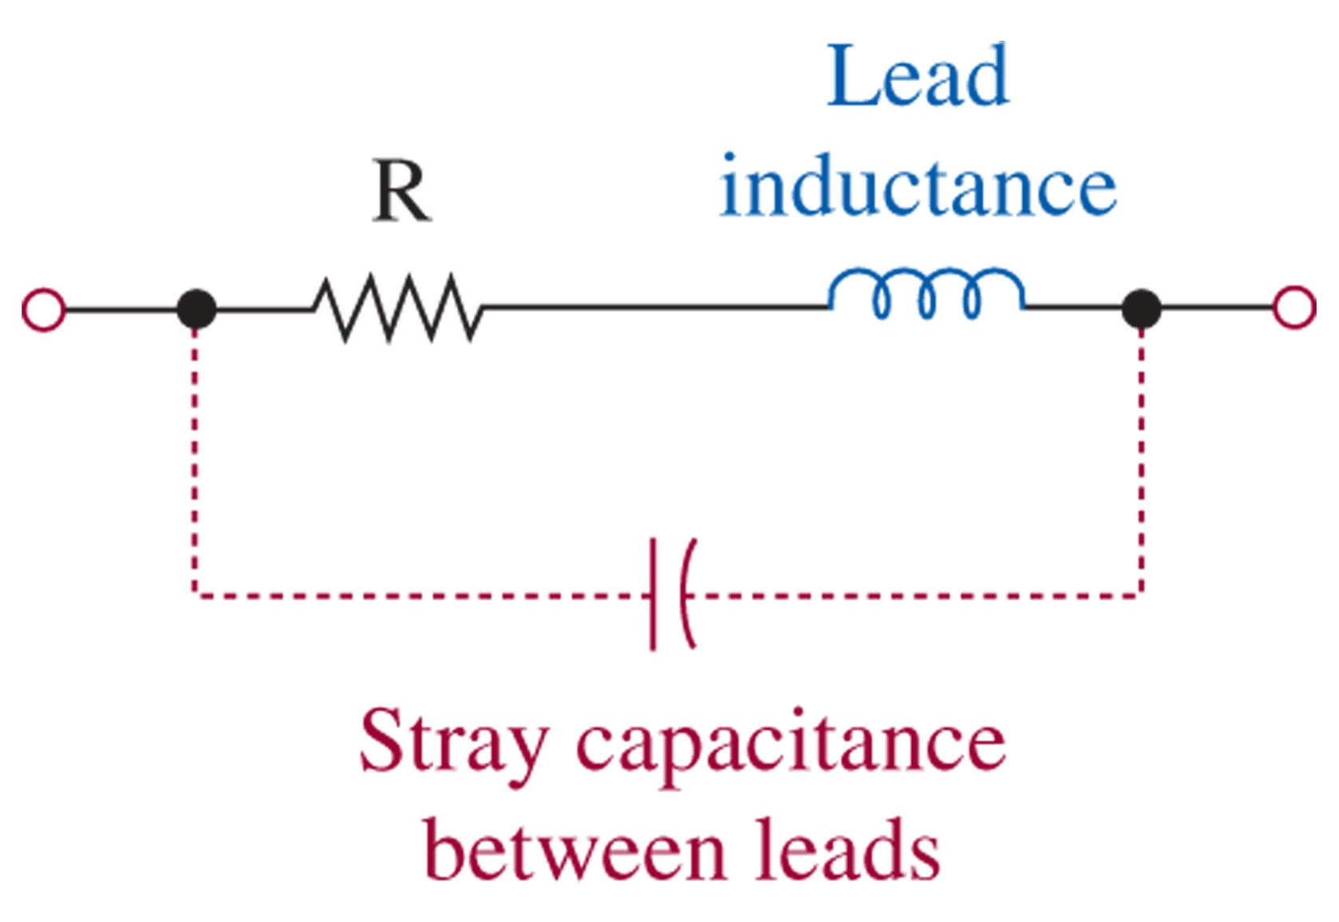
Figure 1-20 Resistor at high frequencies.

Slide 36
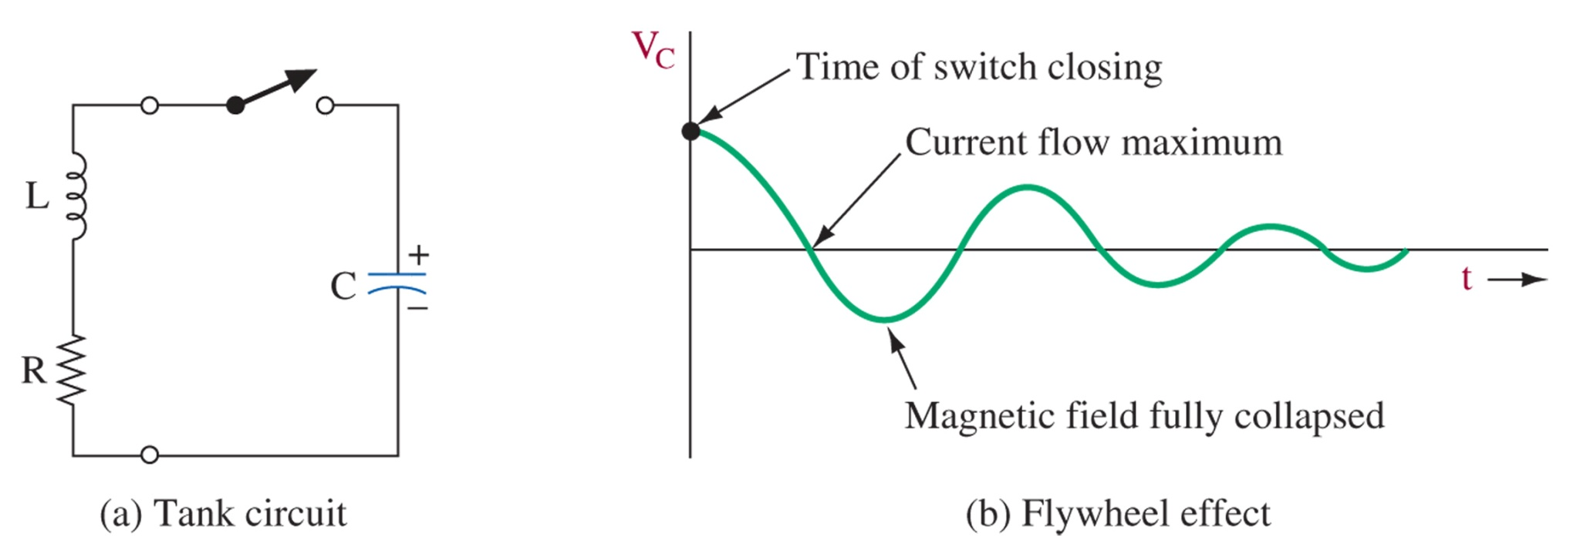
Figure 1-21 Tank circuit flywheel effect.
LC Oscillator
Barkhausen Criteria
The loop gain must be 1 or greater
The loop phase shift must be zero degrees

Slide 37
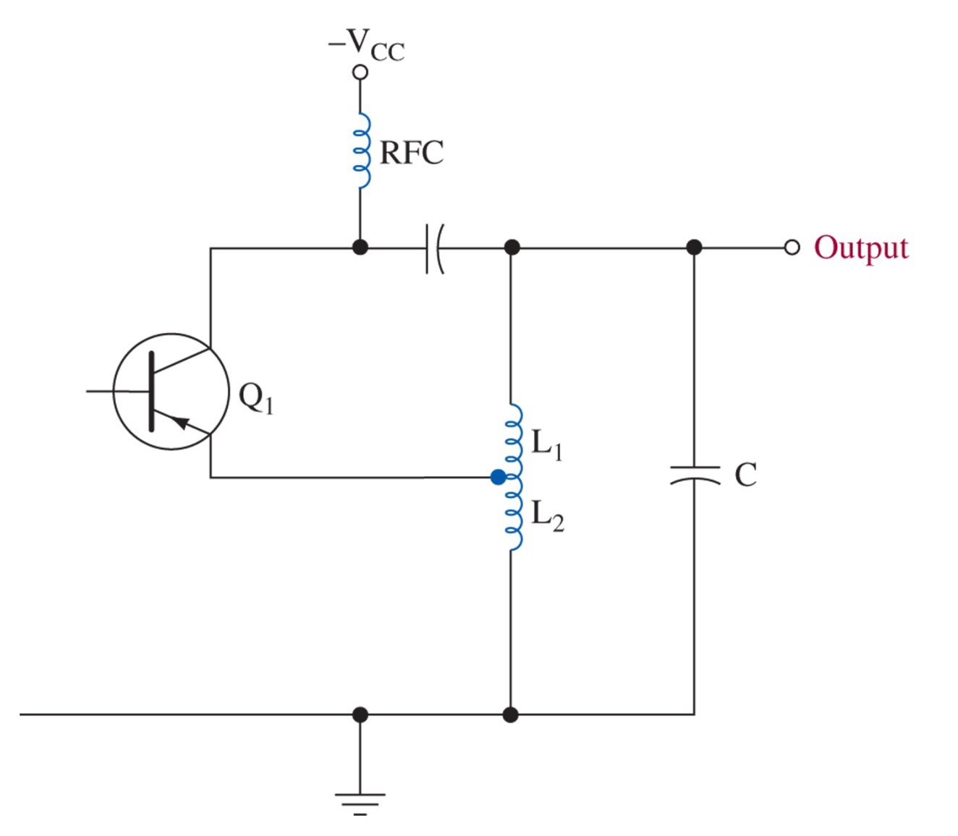
Simplified Hartley oscillator.

Slide 38
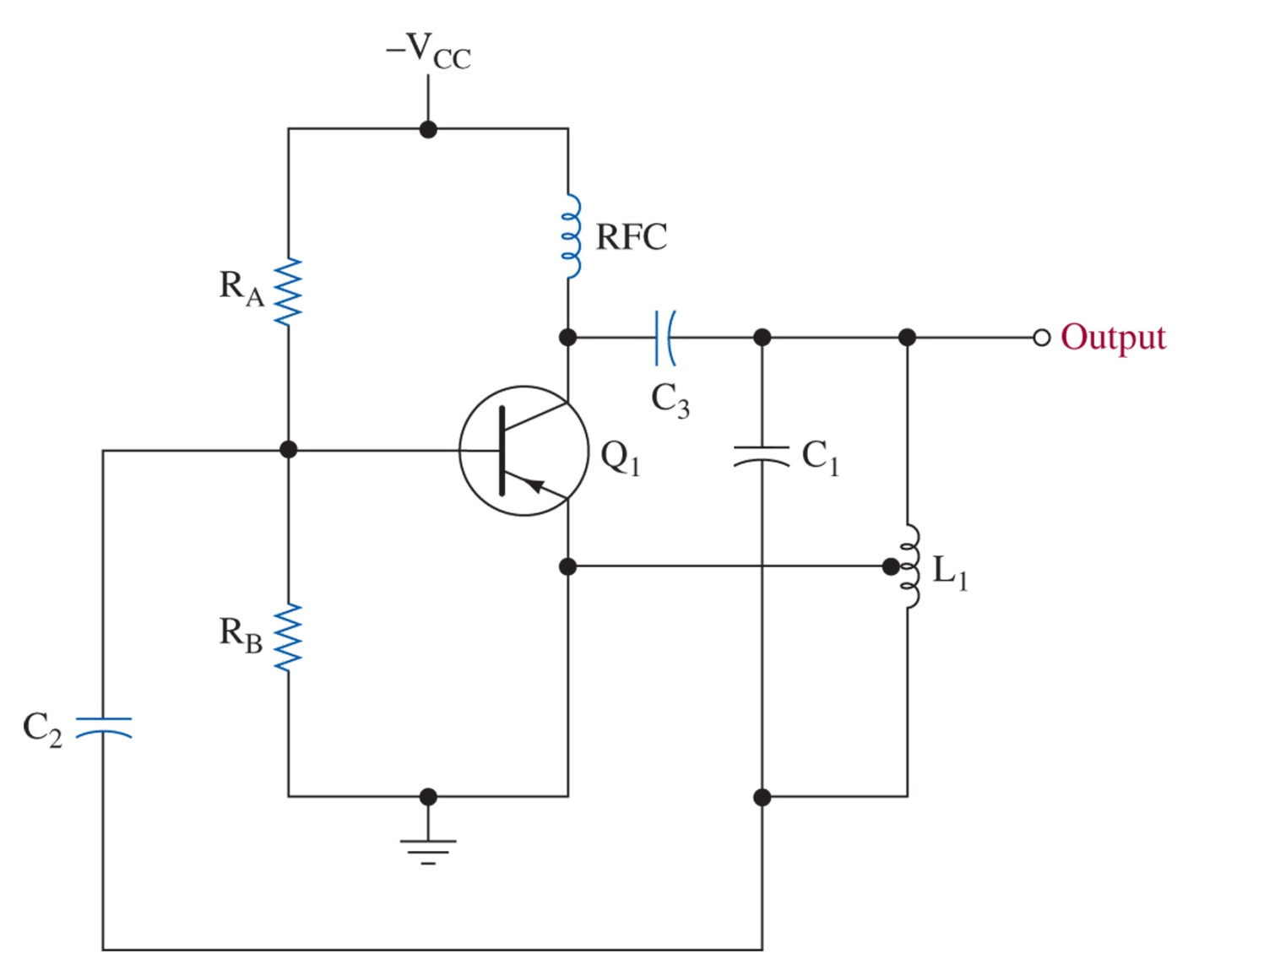
Figure 1-23 Practical Hartley oscillator.

Slide 39
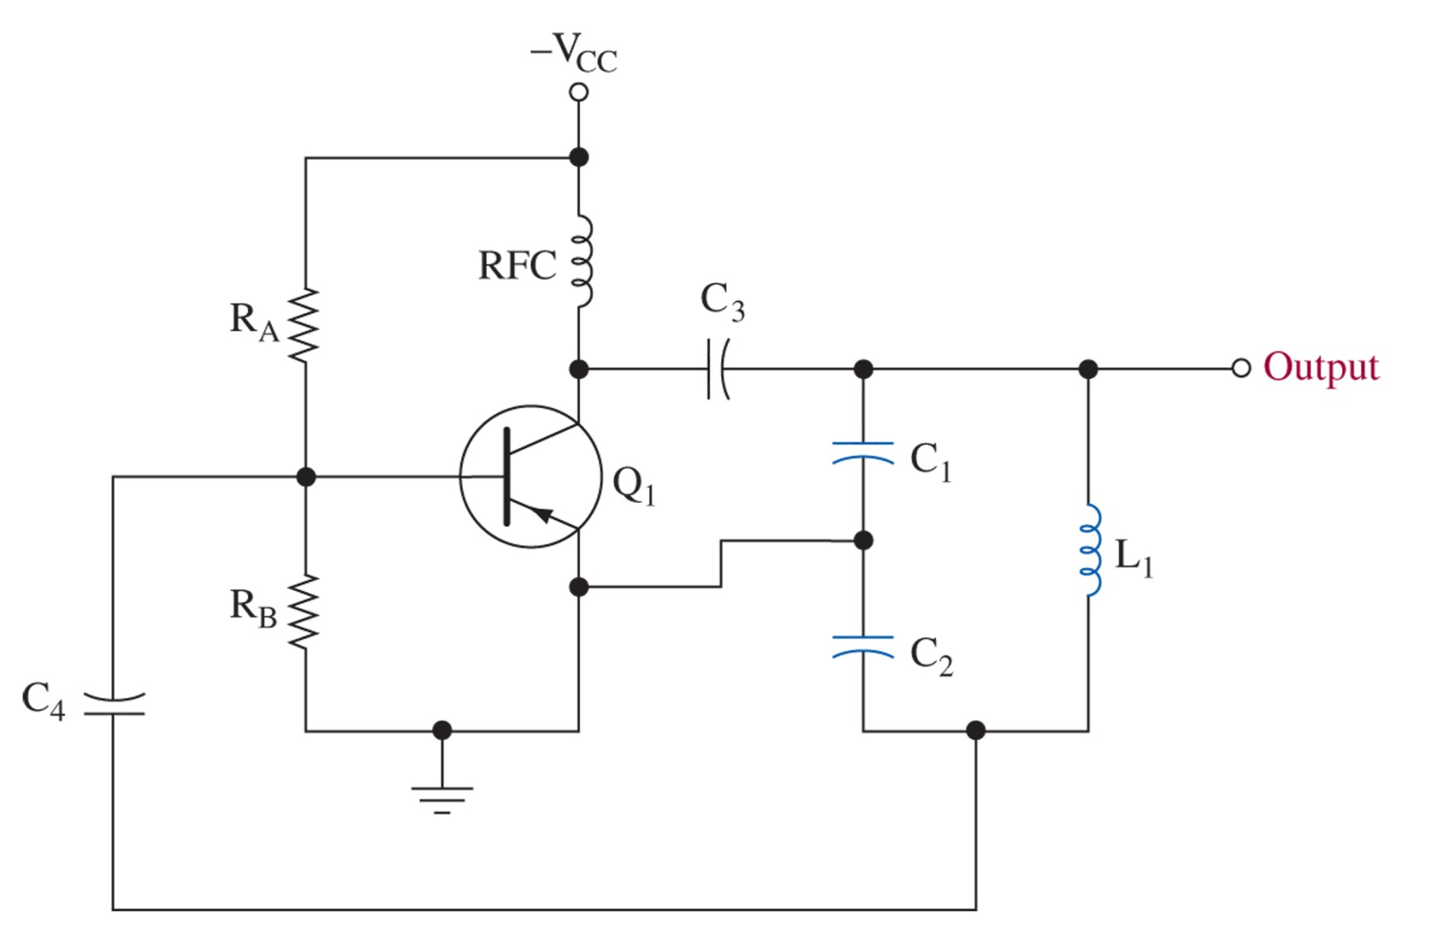
Figure 1-24 Colpitts oscillator.

Slide 40
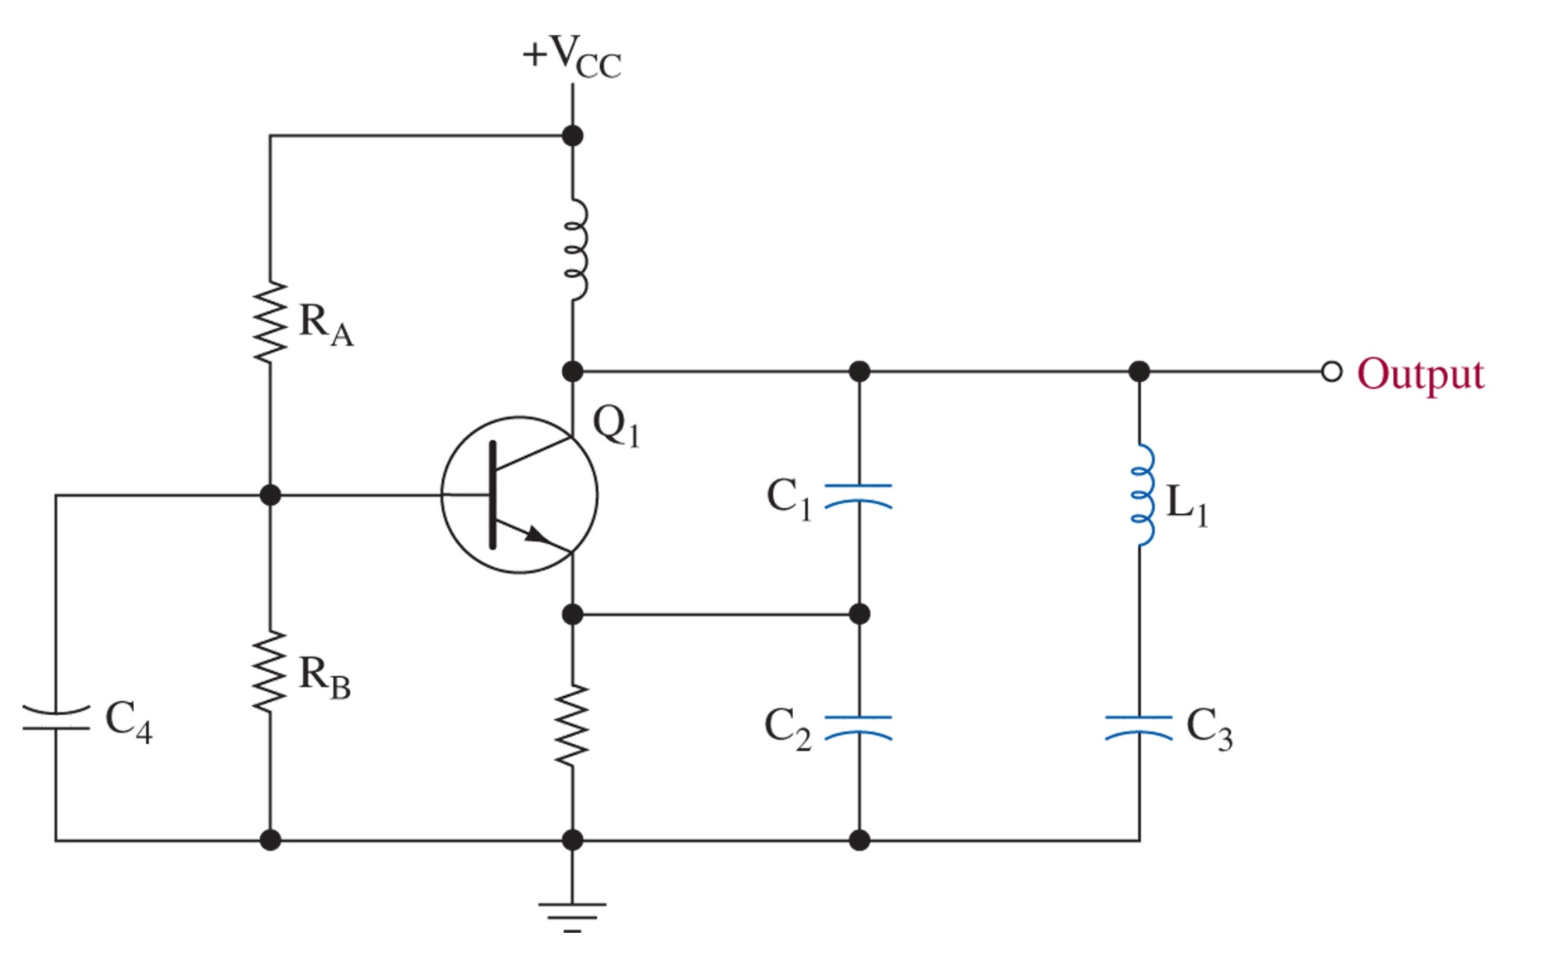
Figure 1-25 Clapp oscillator.

Slide 41
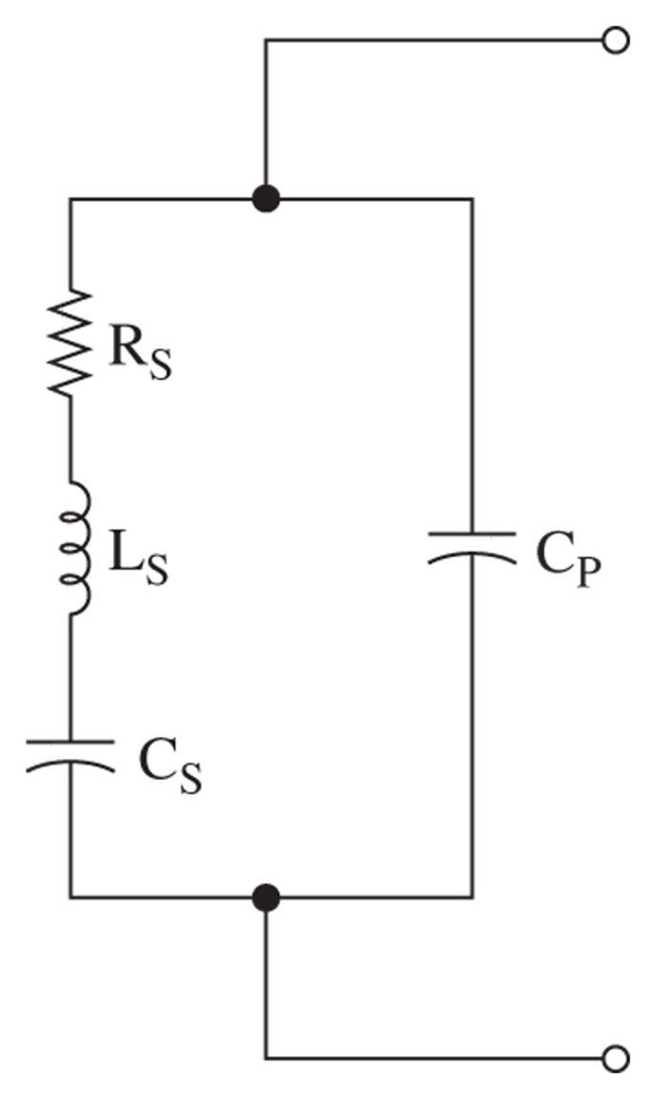
Figure 1-26 Electrical equivalent circuit of a crystal.

Slide 42
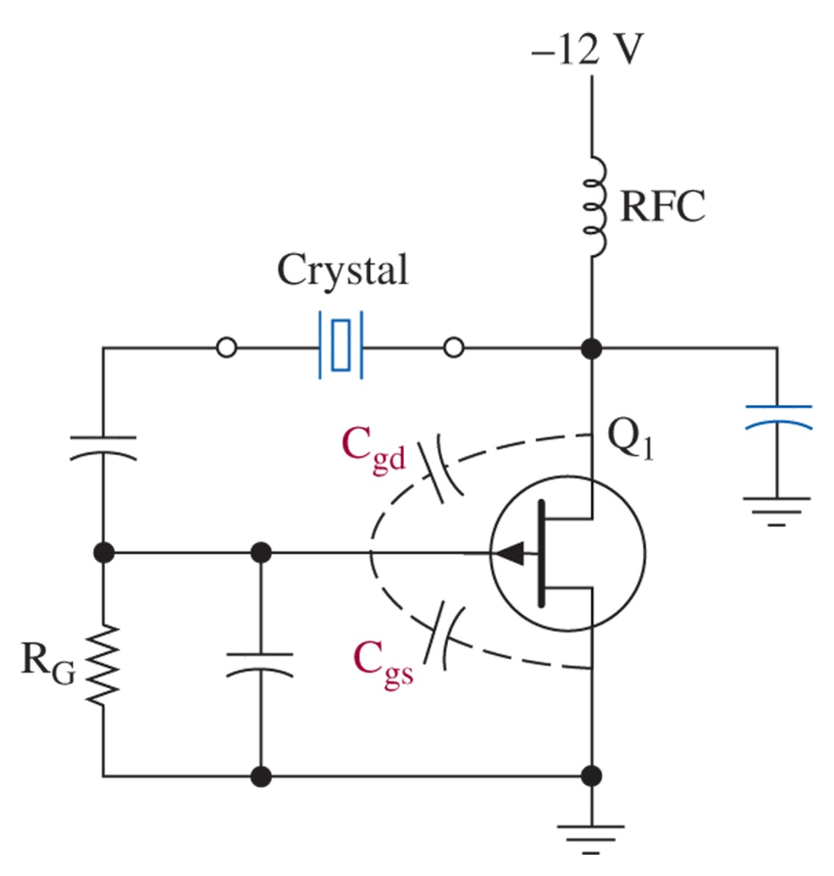
Figure 1-27 Pierce oscillator.

Slide 43
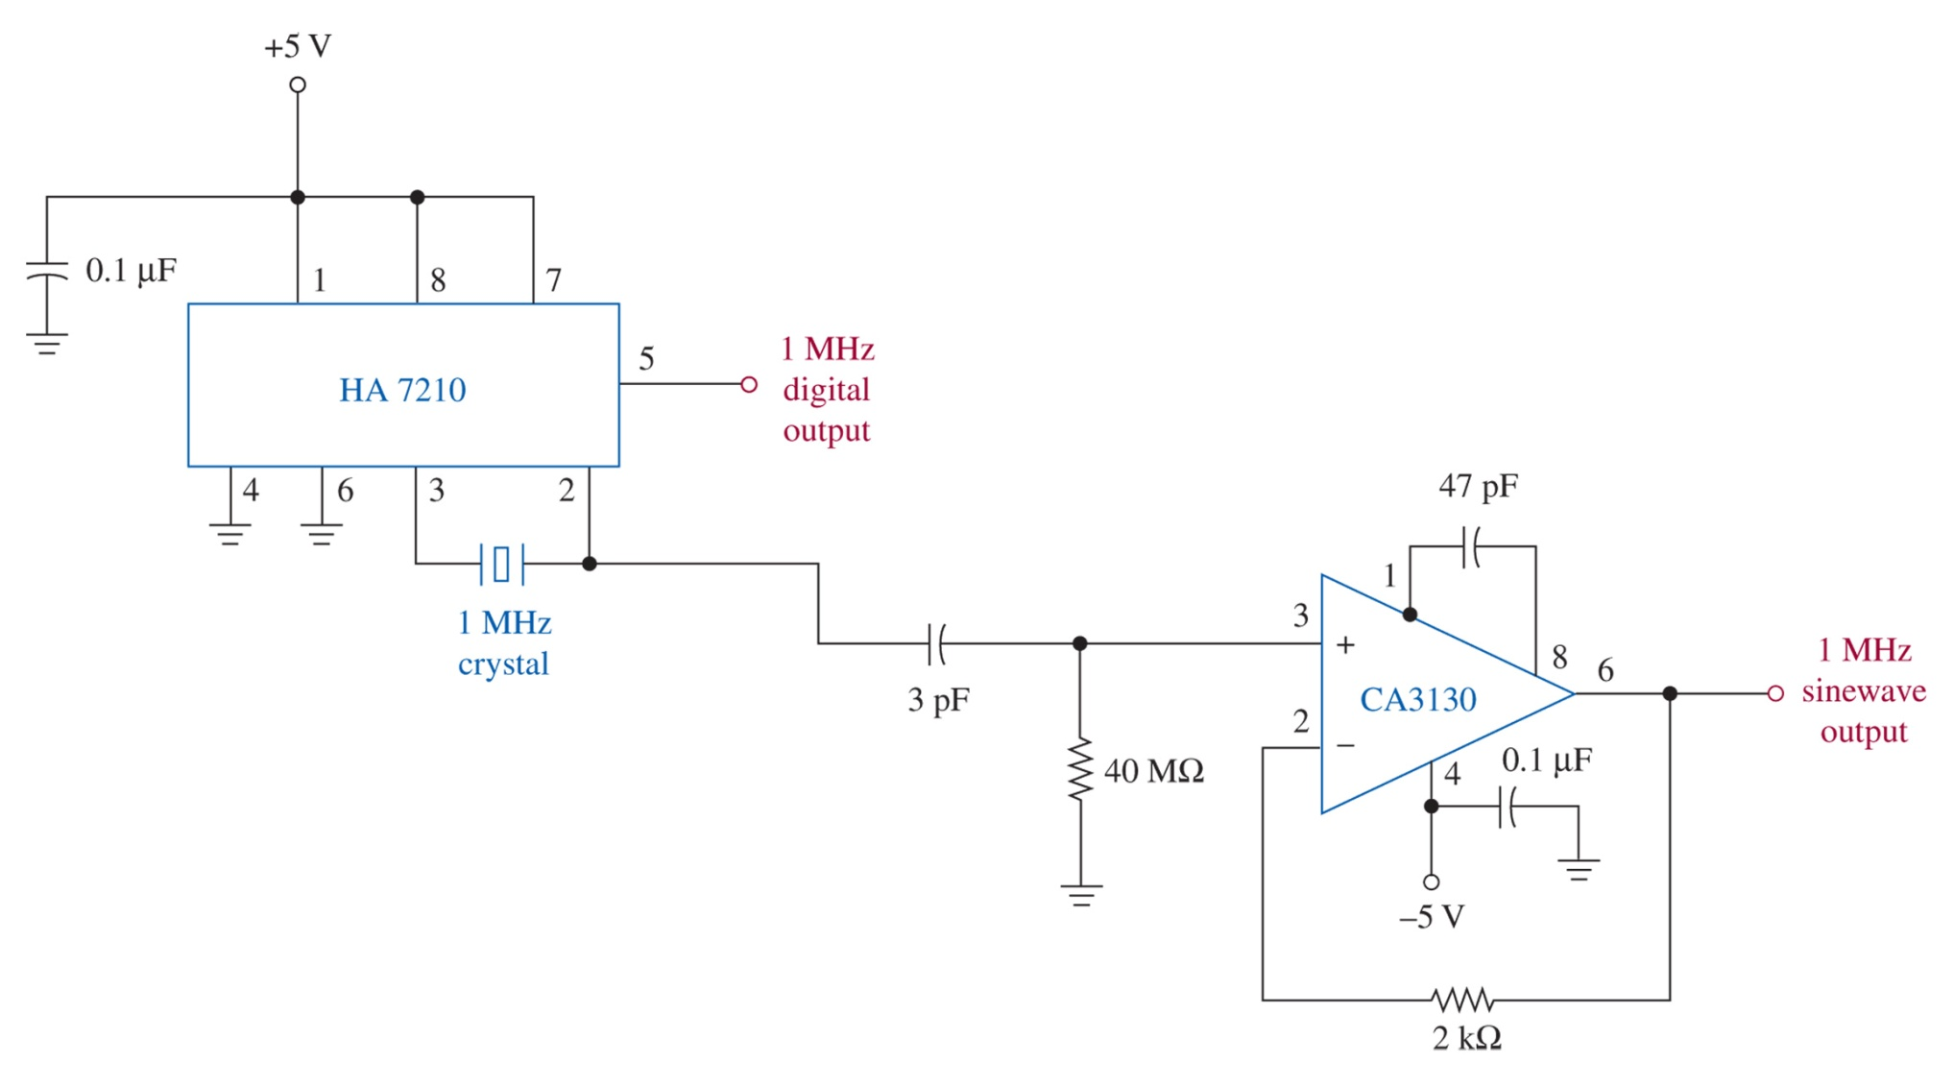
Figure 1-28 IC crystal oscillator.

Slide 44
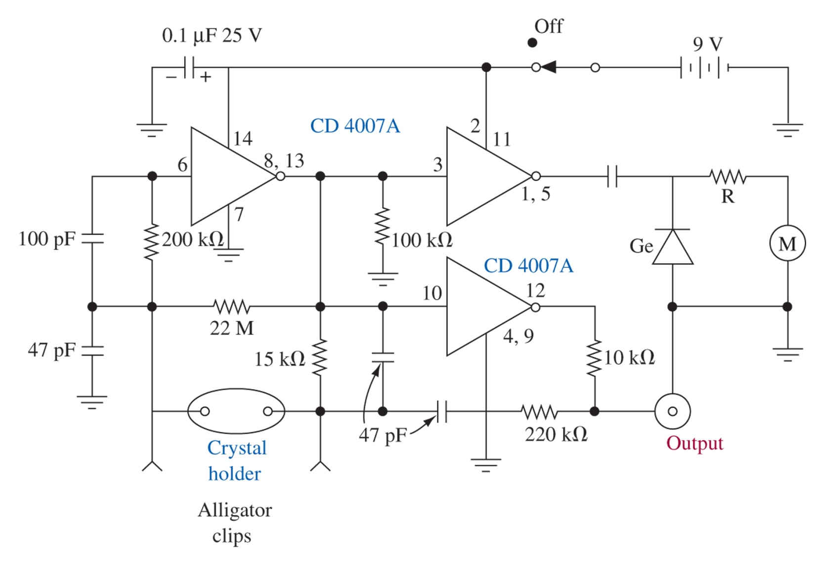
Figure 1-29 Crystal test circuit.

Slide 45
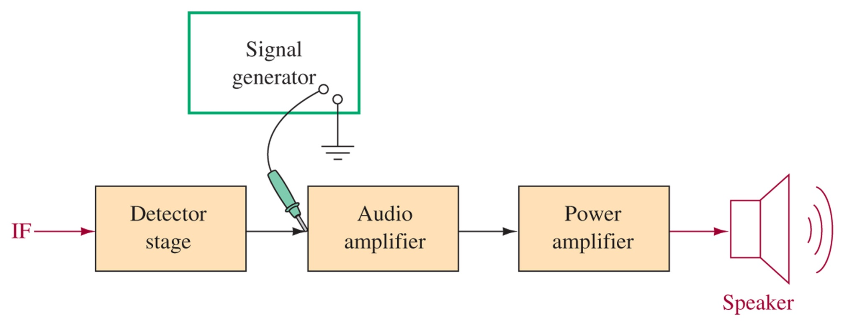
Figure 1-30 Signal injection.

Slide 46
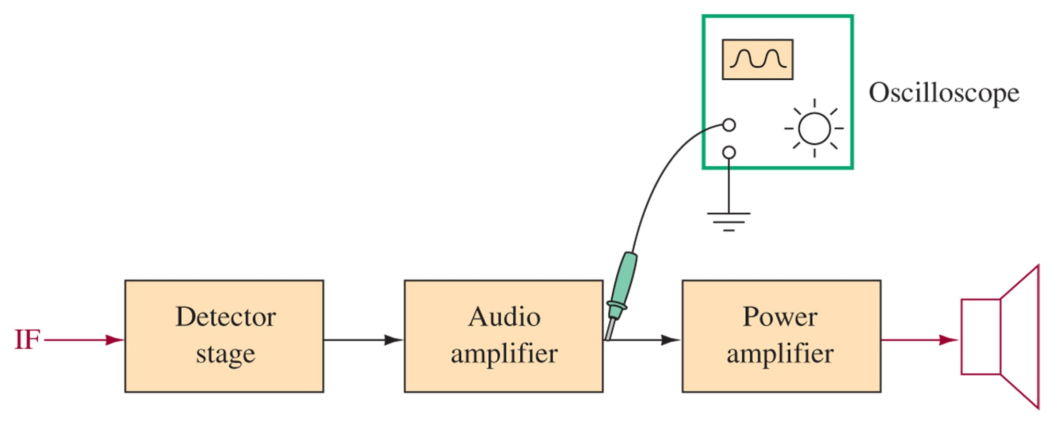
Figure 1-31 Signal tracing.

Slide 47
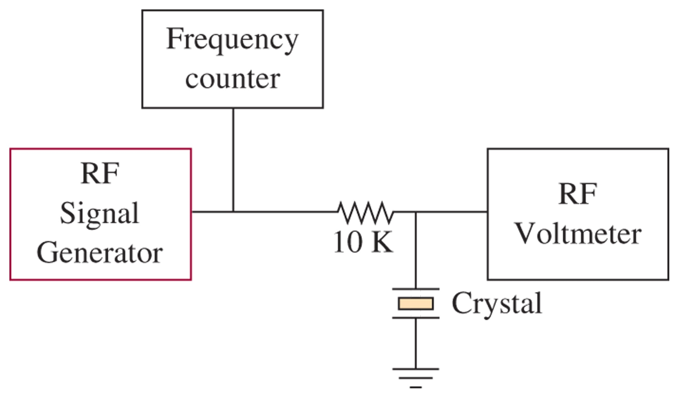
Figure 1-32 Crystal test.

Slide 48
Figure 1-33 Clapp oscillator.

Slide 49
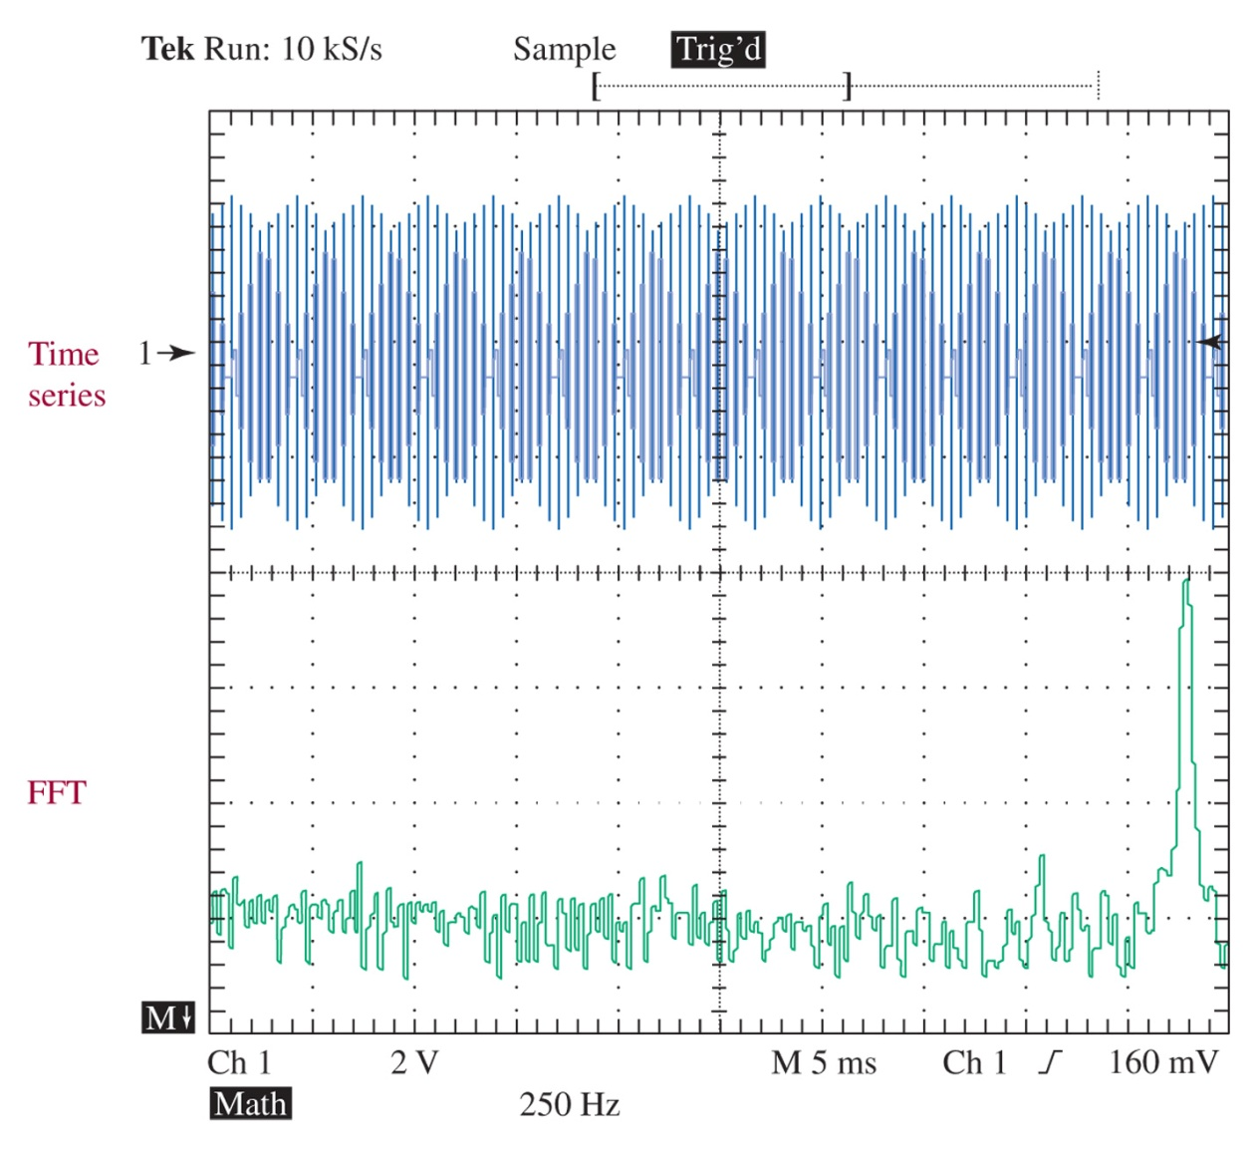
Figure 1-34 The time series (top) and the FFT (bottom) for a 12.375-kHz sinusoid with the sample rate set to 10 kS/s.

Slide 50
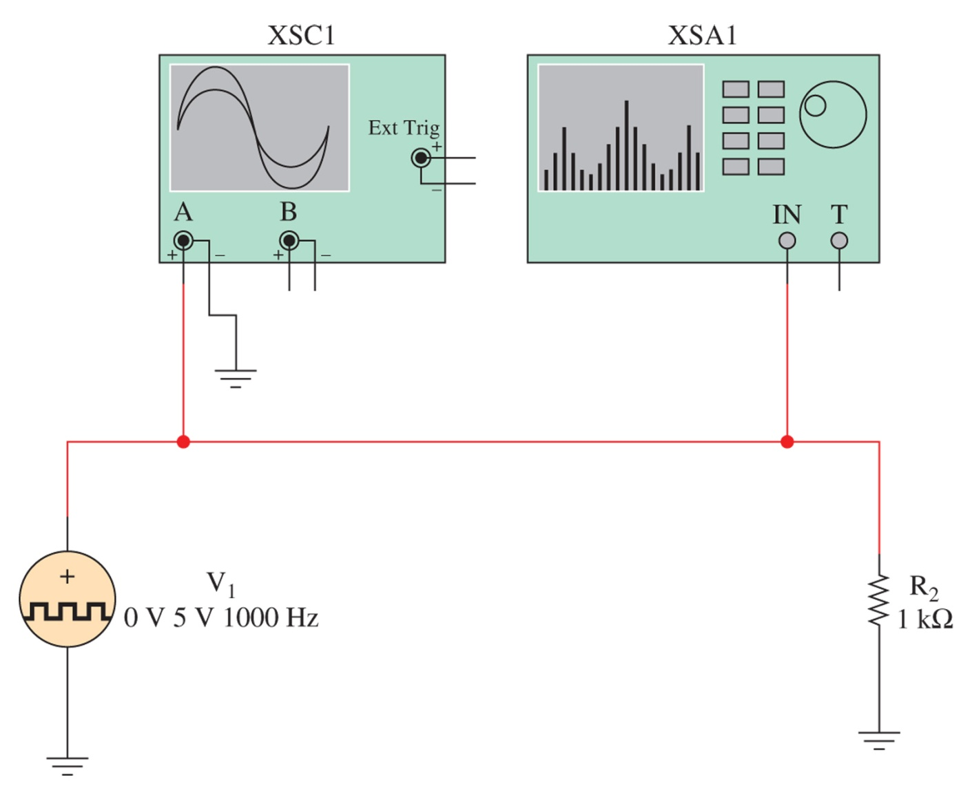
Figure 1-35 The Multisim component view of the test circuit used to demonstrate the frequency spectra for a square wave.

Slide 51
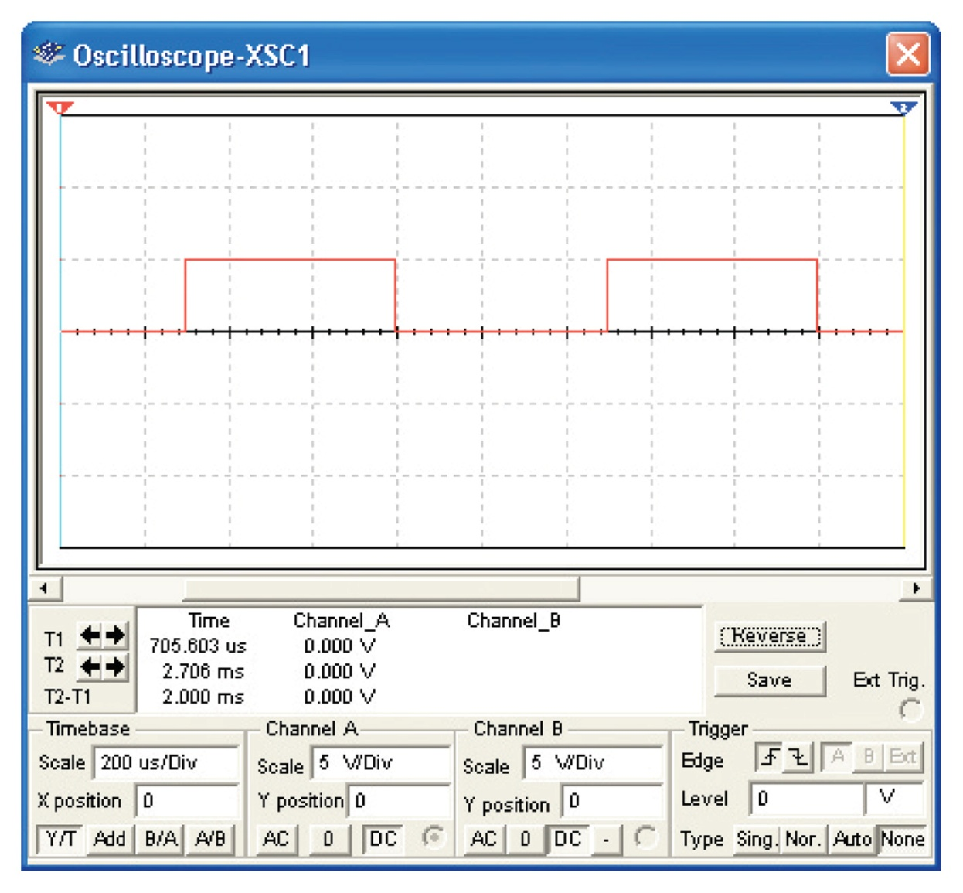
Figure 1-36 The Multisim oscilloscope image of the square wave from the function generator.

Slide 52
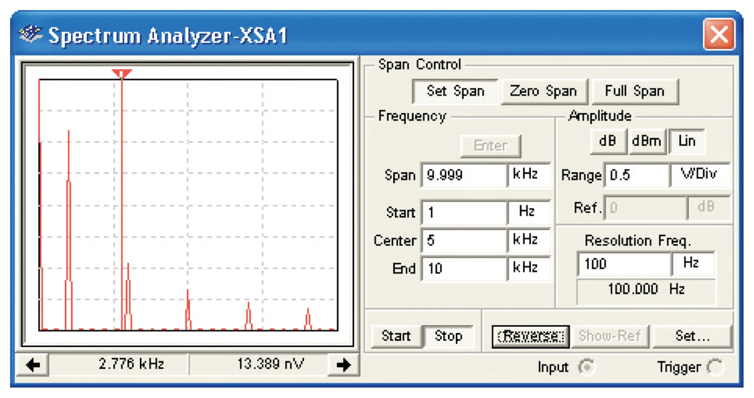
Figure 1-37 The Multisim spectrum analyzer view of a 1-kHz square wave.

Slide 53
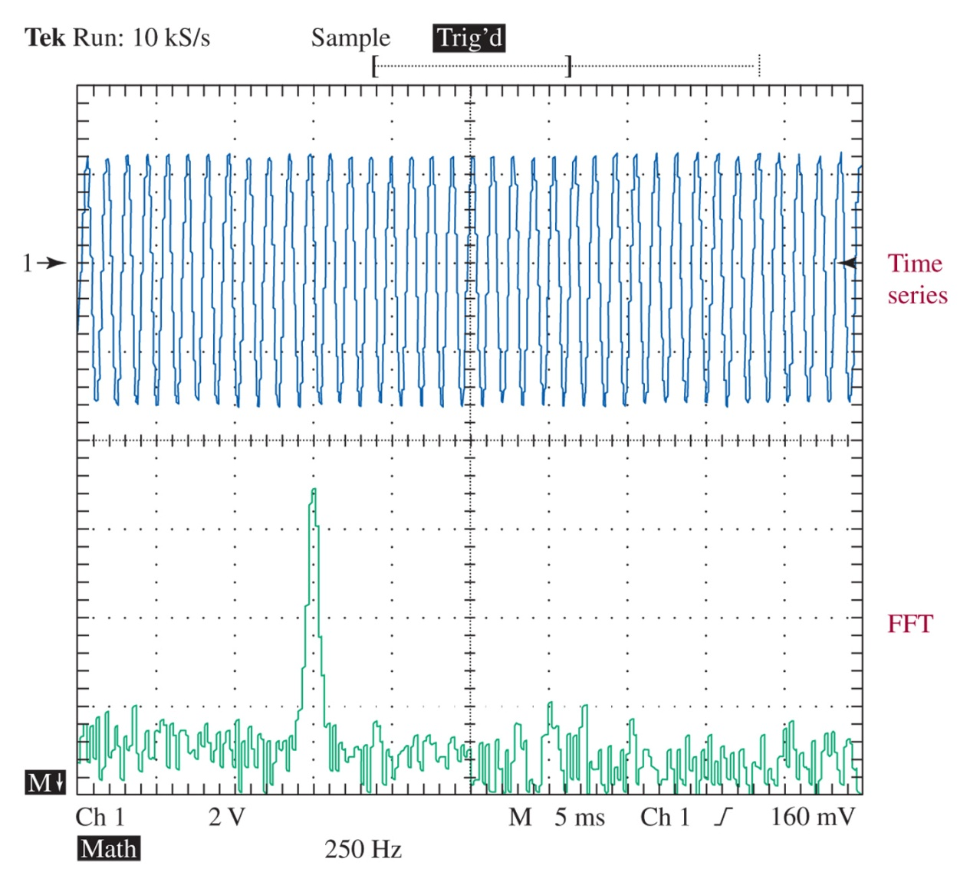
Figure 1-38 FFT for Problem 46.

Slide 54
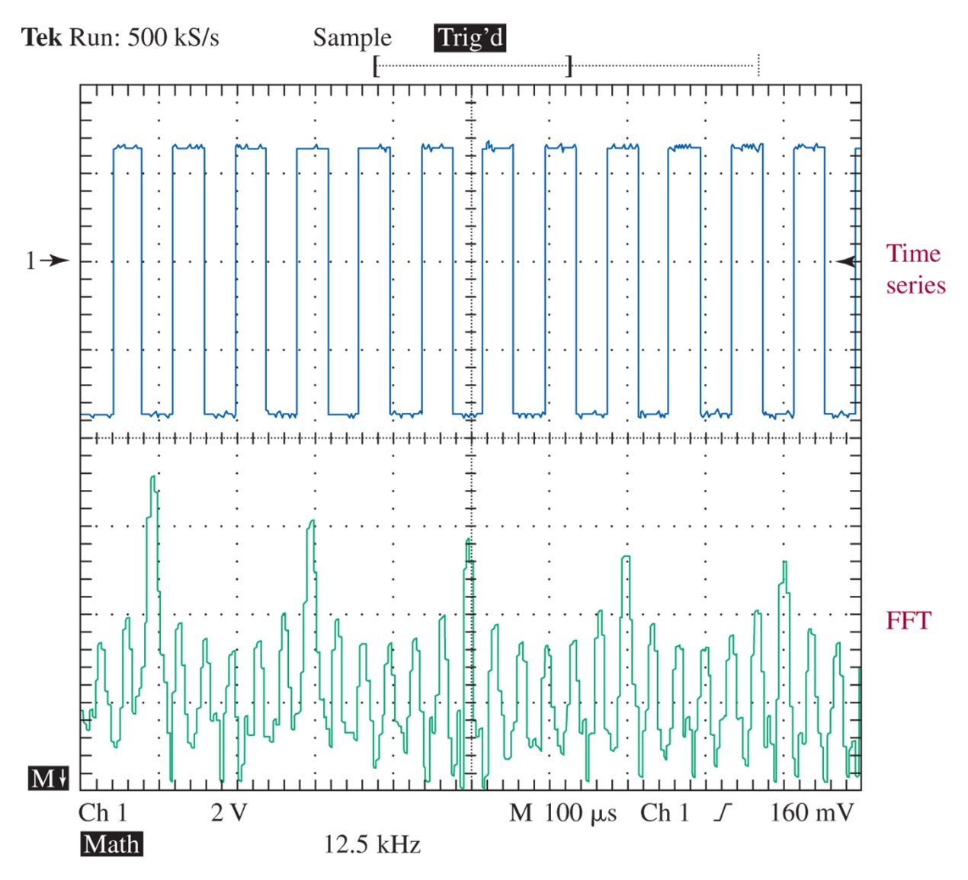
Figure 1-39 FFT for Problem 47.

