Slide 1
EE 350 / ECE 490 Analog Communication Systems
Ch. 5 – Frequency Modulation (FM) Transmission

Slide 2
Objectives
Define angle modulation and describe the two categories
Explain a basic capacitor microphone FM generator and the effects of voice amplitude and frequency
Analyze an FM signal with respect to modulation index, sidebands, and power
Describe the noise suppression capabilities of FM and how they relate to the capture effect and preemphasis
Provide various schemes and circuits used to generate FM
Explain how a PLL can be used to generate FM
Describe the multiplexing technique used to add stereo to the standard FM broadcast systems

Slide 3
5-1 Angle Modulation
FM First postulated in 1931, first implemented by Major E.H. Armstrong in 1936, broadcast began in 1939.
Phase Modulation (PM) – phase angle of carrier varies with intelligence amplitude
Frequency Modulation (FM) – frequency of carrier varies with intelligence amplitude.
FM used for transmission, PM used to generate FM

Slide 4
5-2 A Simple FM Generator
Figure 5-1 Capacitor microphone FM generator.
Frequency of sound waves determines the rate of frequency change
Amplitude of sound waves determines the amount of frequency change

Slide 5
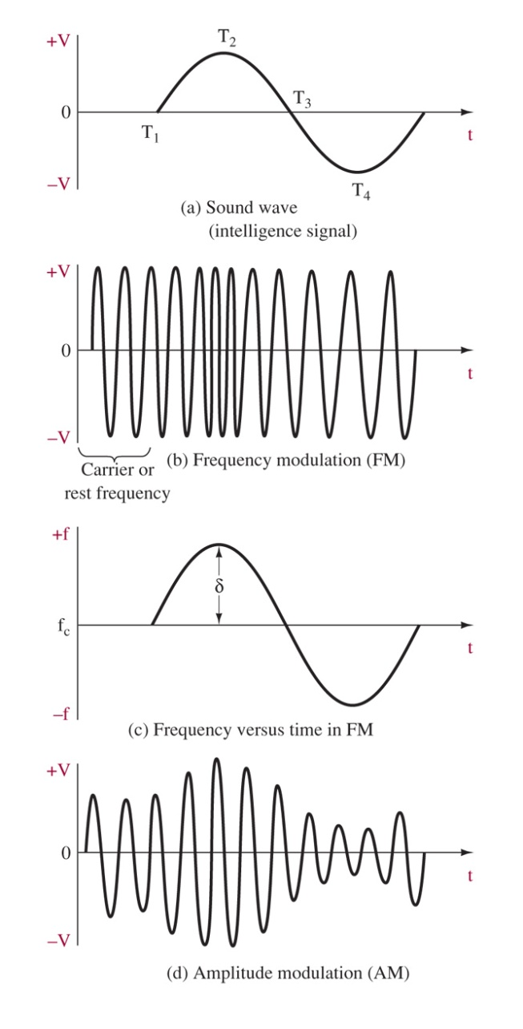
Figure 5-2 FM representation.
Remember!
Intelligence amplitude determines amount of frequency deviation
Intelligence frequency determines the rate of frequency deviation

Slide 6
5-3 FM Analysis
For PM
m_{p} is the modulation index for PM
For FM
m_{f} is the modulation index for FM

Slide 7
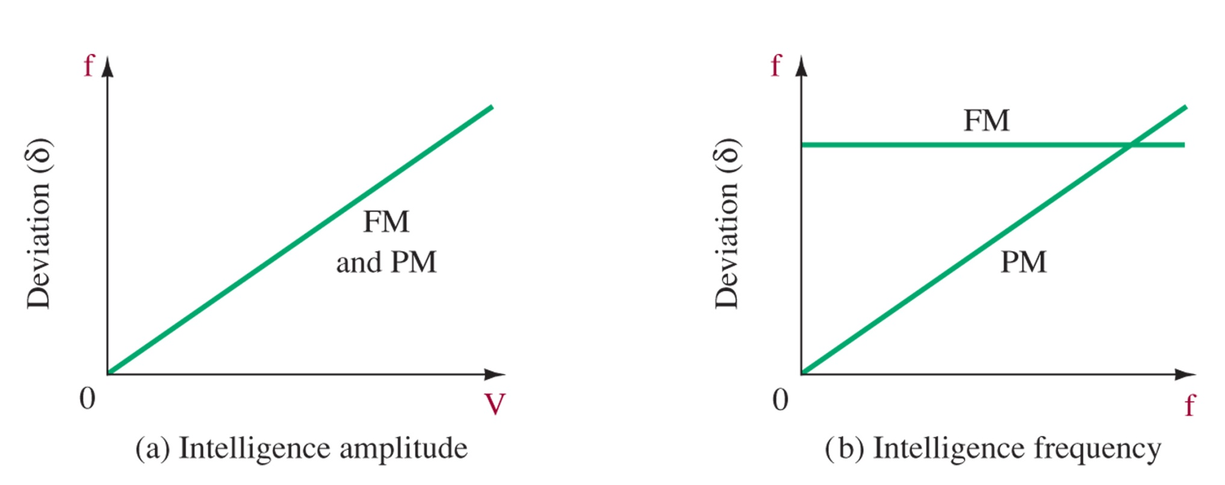
Figure 5-3 Deviation effects on FM/PM by intelligence parameters: (a) intelligence amplitude; (b) intelligence frequency.

Slide 8
FM Mathematical Solution
Bessel Functions!
An infinite number of sidebands!
But at m_{f} =0.25, only J₀ and J₁ are appreciable, and FM has same bandwidth as AM (see Table 5-2)

Slide 9
Carson’s Rule
Deviation IS NOT Bandwidth
Bessel functions can be used to find the best bandwidth, but you need the table to look up significant sidebands
Carson’s Rule is a good approximation, including about 98% of total power

Slide 10
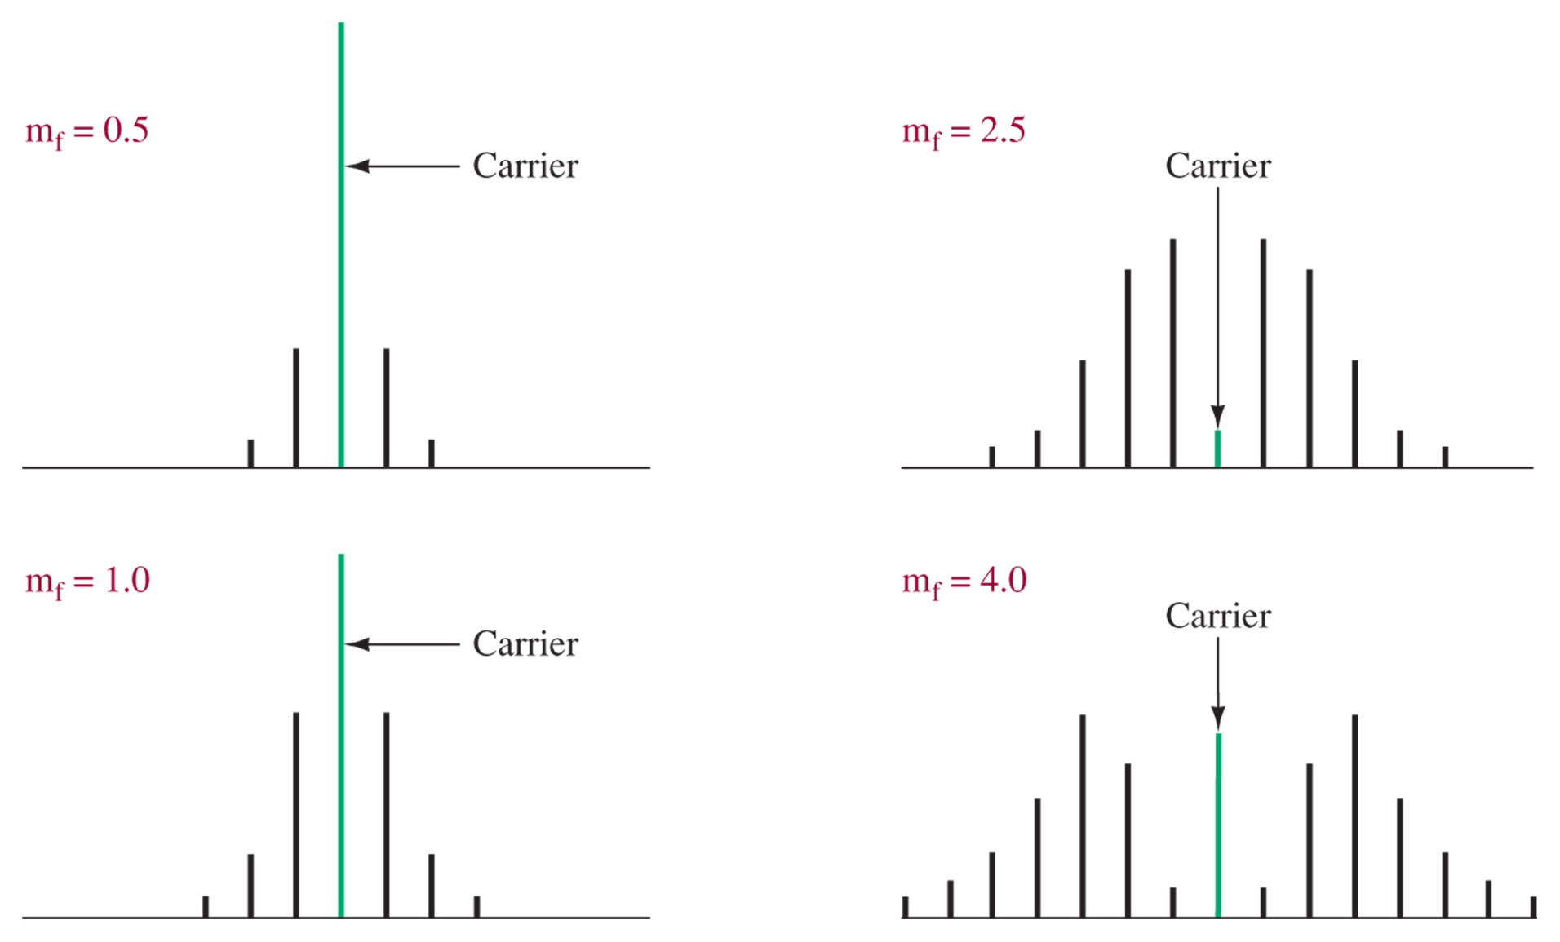
Figure 5-4 Frequency spectrum for FM (constant modulating frequency, variable deviation).
As the modulation index increases, the energy is spread among different frequency components. At some (i.e. 2.4) the carrier strength drops to zero.

Slide 11
Broadcast FM
Figure 5-5 Commercial FM bandwidth allocations for two adjacent stations.
Unlike AM, full modulation is by definition of the permissible band, not by a fundamental feature, such as AM’s modulation index = 1.
We can call FM modulation index deviation ratio (DR)
DR (broadcast FM radio) = 75 kHz / 15 kHz = 5
DR (TV NTSC) = 25 kHz / 15 kHz = 1.67
DR >= 1 are wideband, DR < 1 is narrowband (NBFM)
NBFM is useful for communication systems, like police, taxis, etc. for voice

Slide 12
5-4 Noise Suppression
Since noise changes the amplitude of the signal, this affects the intelligence in AM, resulting in noise
In FM, the amplitude is constant, so a spike in amplitude due to noise can be removed by a limiter

Slide 13
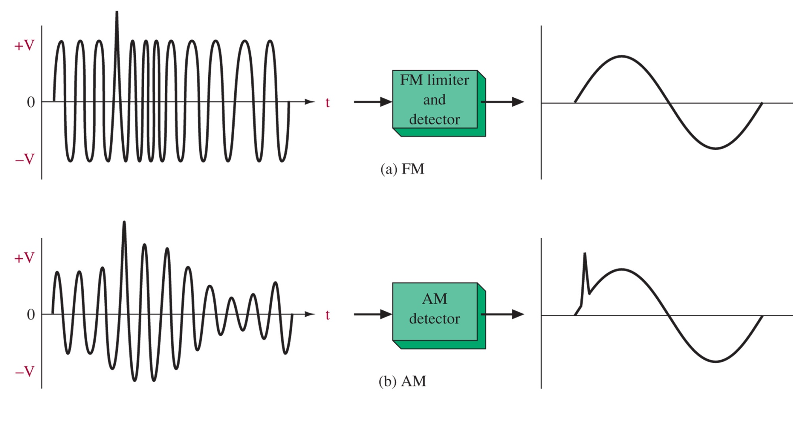
Figure 5-6 FM, AM noise comparison.

Slide 14
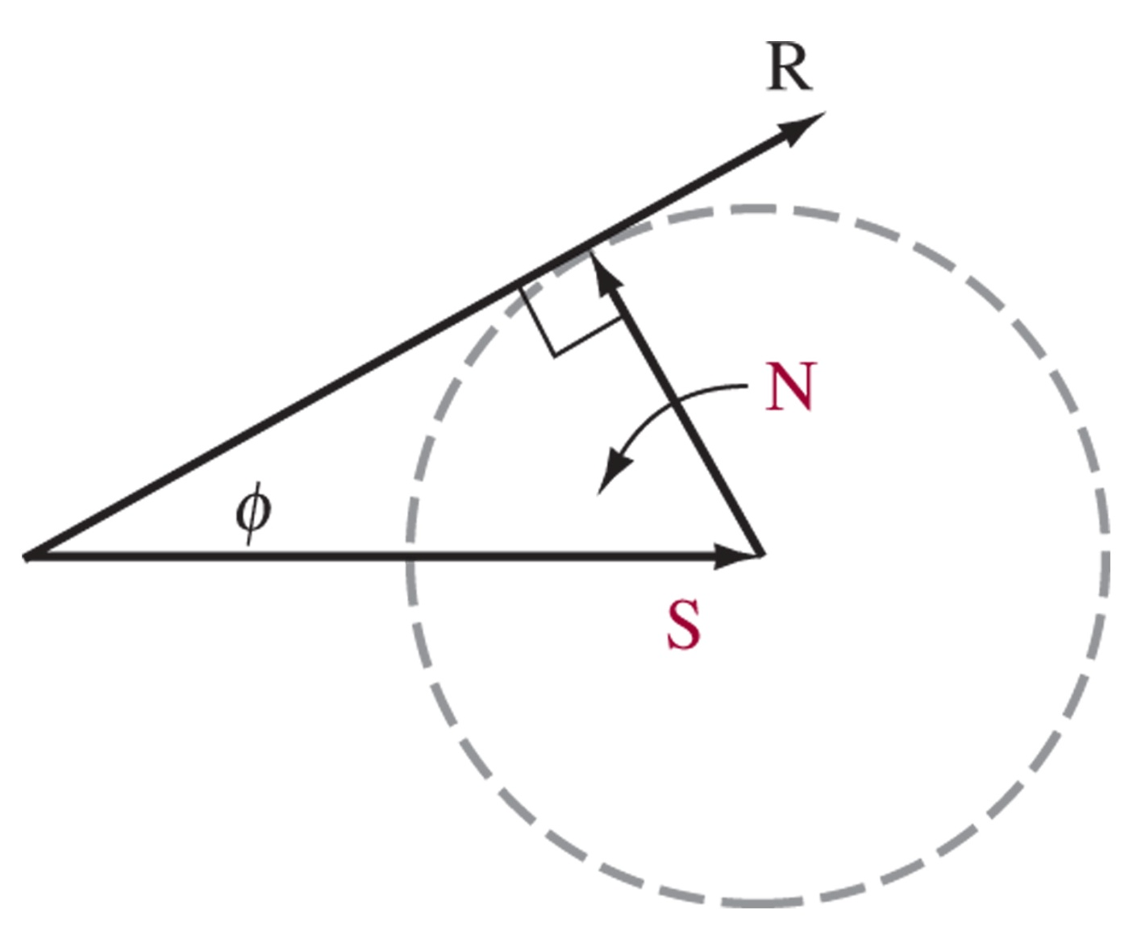
FM Noise Analysis
FM noise still introduces a phase shift, which can cause frequency deviation
Figure 5-7 Phase shift (φ) as a result of noise.
For S/N of 2:1 (as pictured): in AM this would be terrible, for FM, not so bad even in worst case.

Slide 15
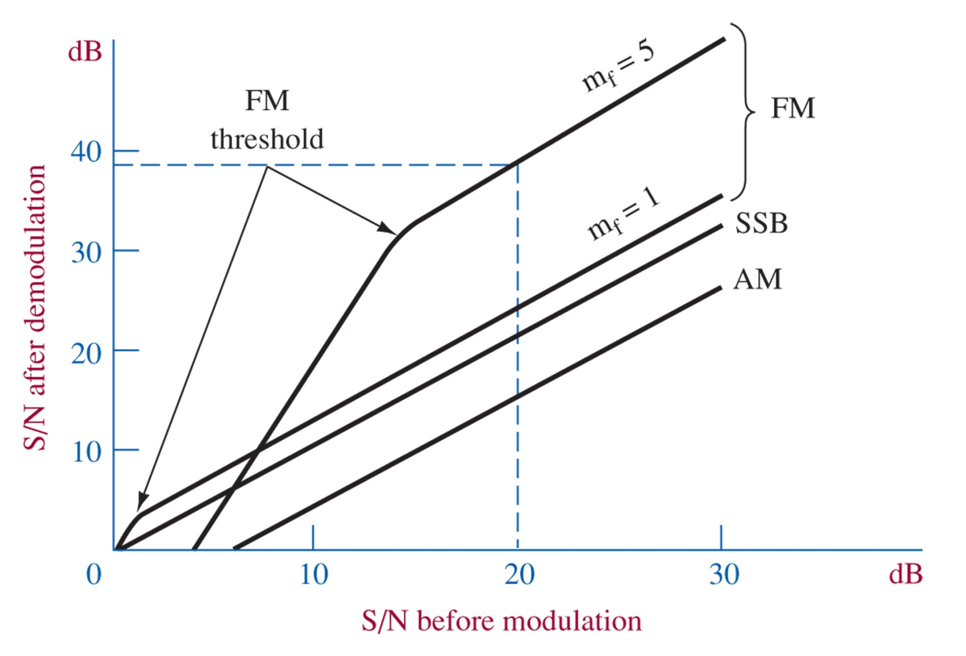
Capture Effect
Figure 5-8 S/N for basic modulation schemes.
FM receivers have a typical capture ratio of 1dB, which eliminates low power signals
FM receivers can improve SNR, above the threshold

Slide 16
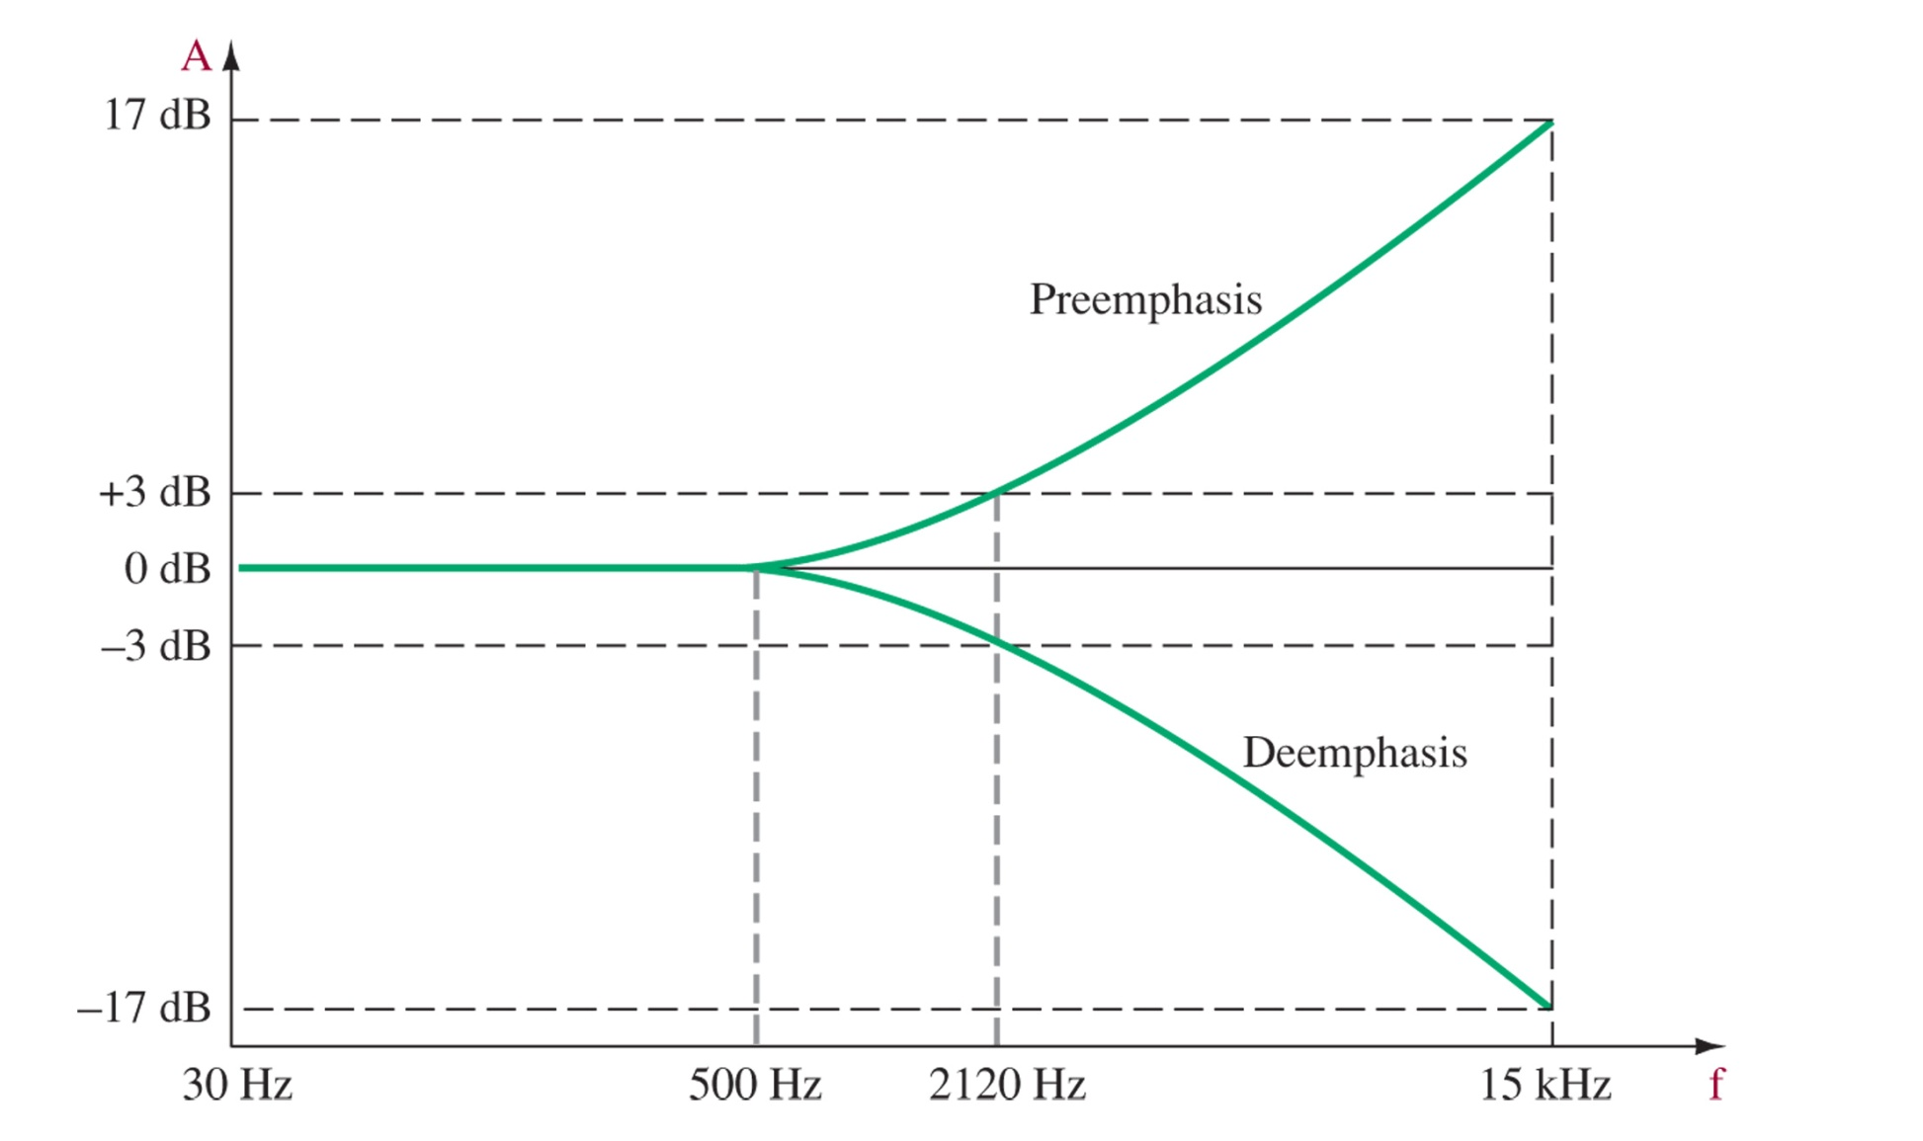
Preemphasis
Figure 5-9 Emphasis curves (τ = 75 μs).
Since SNR improvement is less at high frequencies, broadcasters apply preemphasis, or frequency dependent amplification, before modulation
Standard curve for FCC FM Broadcast (75 us time constant)

Slide 17
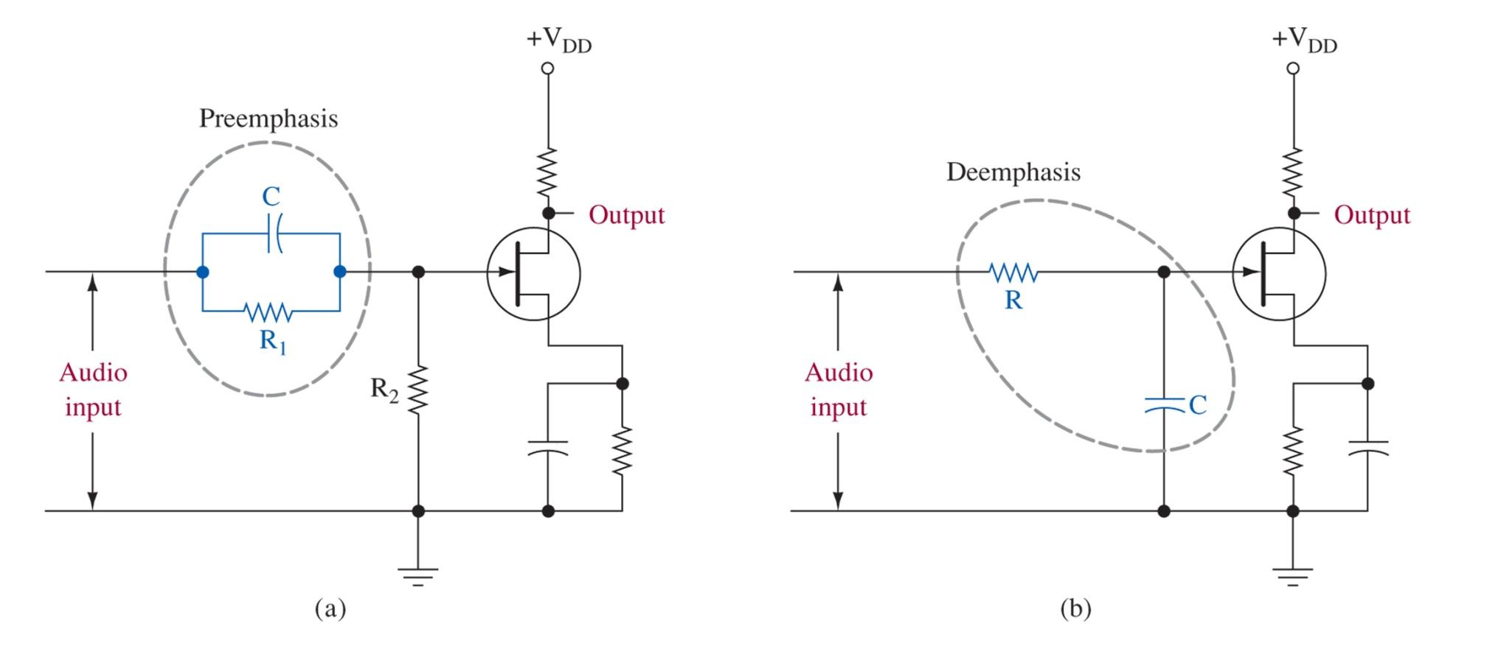
Figure 5-10 Emphasis circuits.
R and C must match the time constant => 2120 Hz to reproduce the original levels

Slide 18
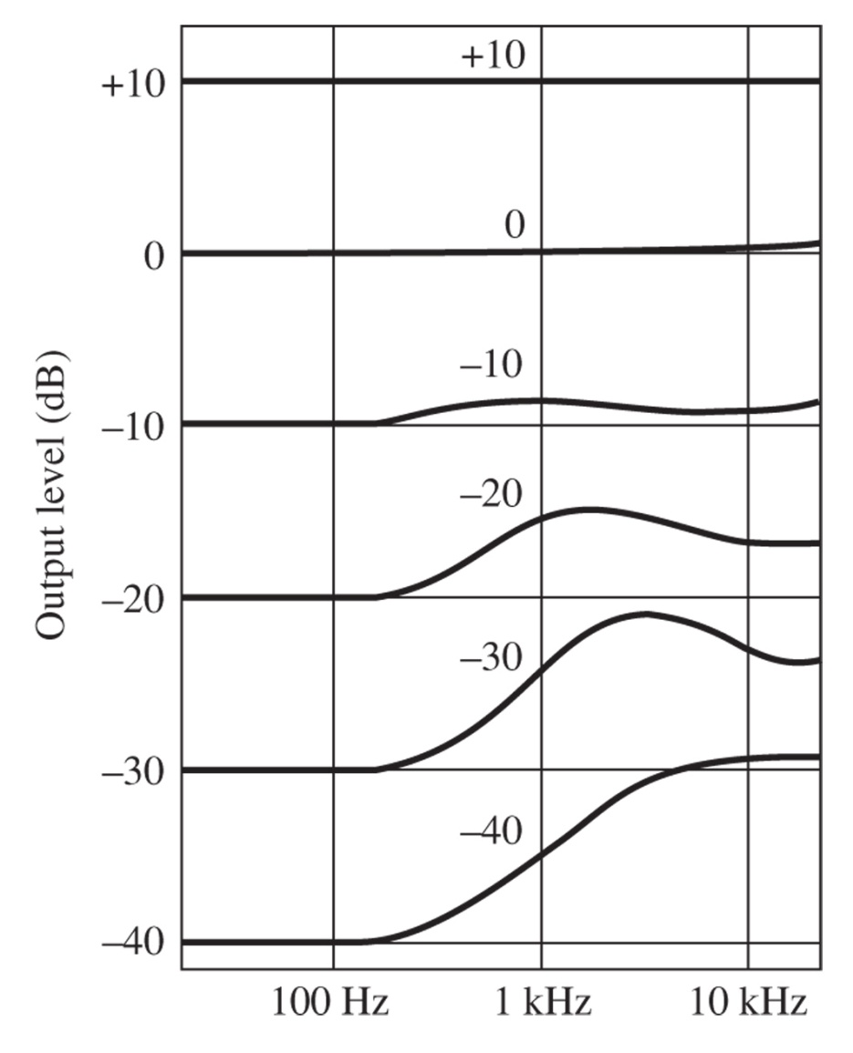
Figure 5-11 Dolby dynamic preemphasis.
Broadcasters can use a 25 us time constant, with the Dolby system
Dolby applies dynamic gain to lower level, high frequency signals
This is helpful for transmissions with very strong high frequency components

Slide 19
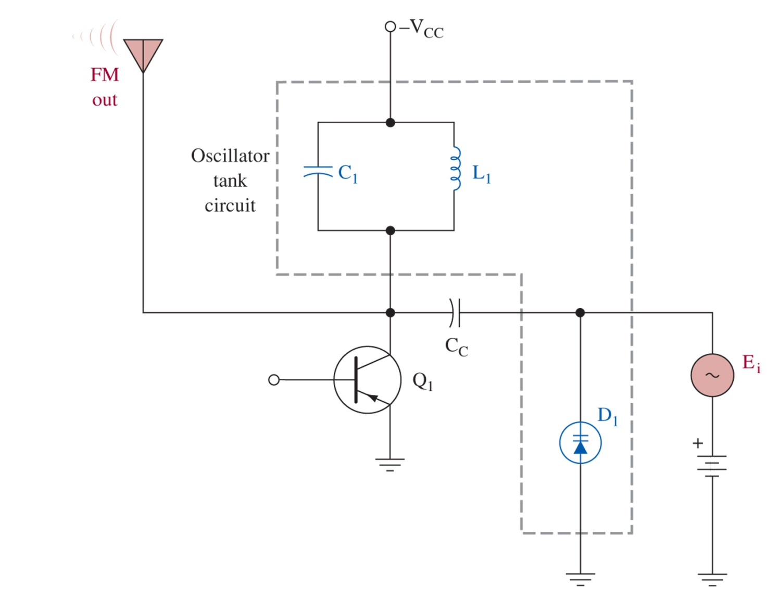
5-5 Direct FM Generation
Figure 5-12 Varactor diode modulator.
L1, C1, D1 set up the unbiased carrier frequency. Ei shifts this by varying the capacitance of D1 through the reverse bias.

Slide 20
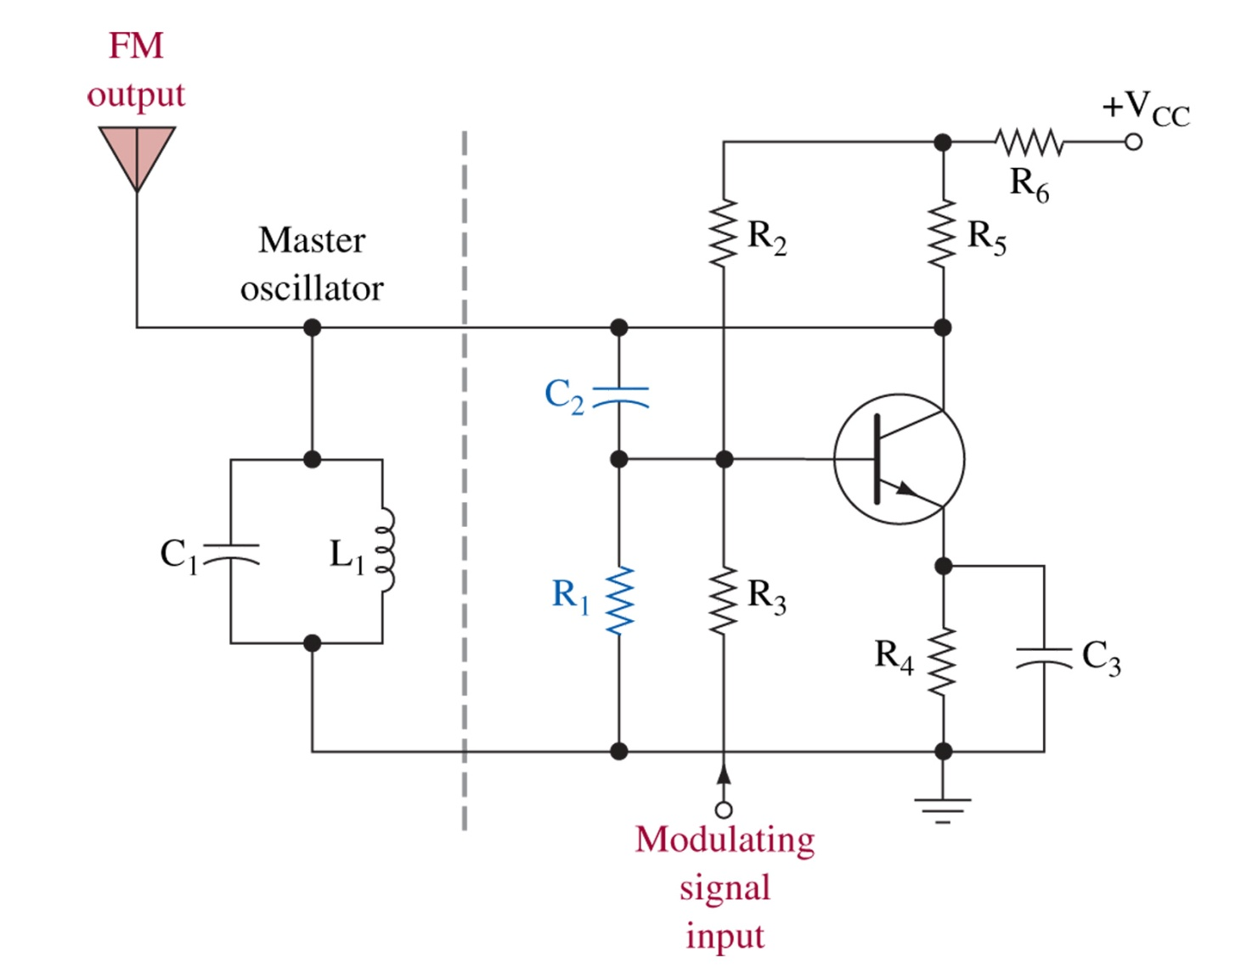
Figure 5-13 Reactance modulator.
In the reactance modulator, the impedance of the active device is varied by the modulating signal.

Slide 21
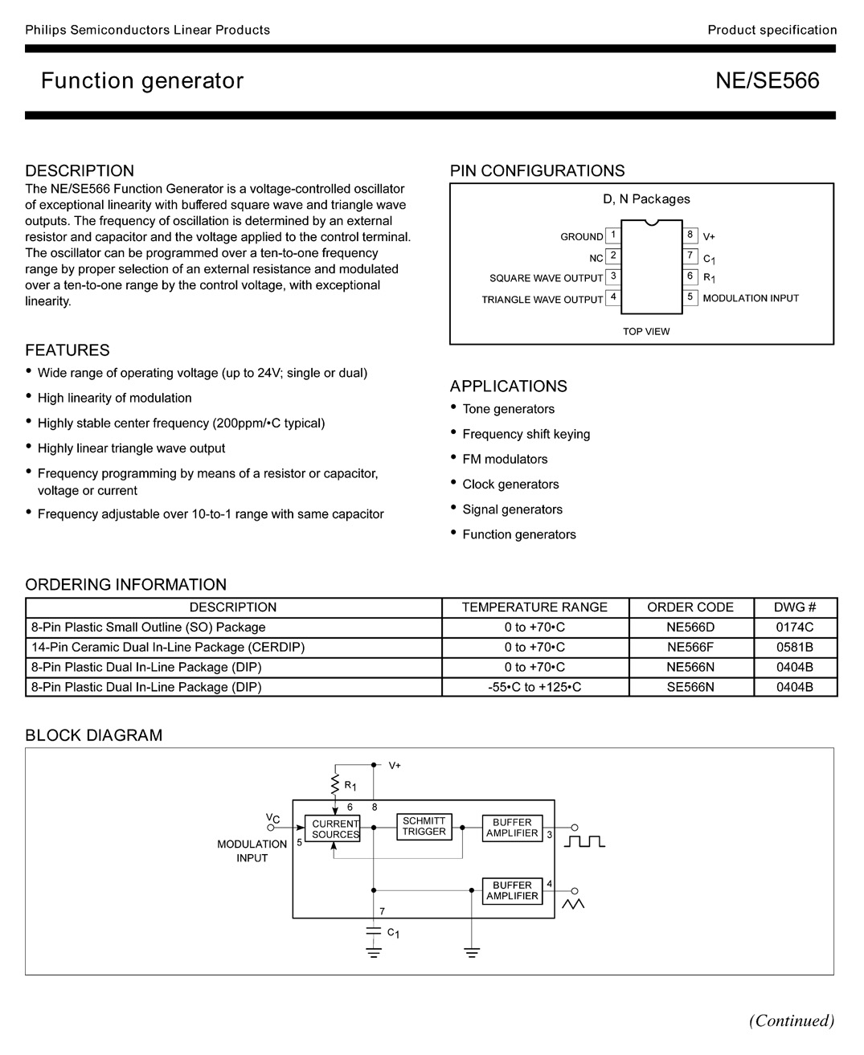
LIC VCO FM Generation
Thanks to LIC a direct FM generation scheme is easily obtained by using a Voltage Controlled Oscillator Circuit
Figure 5-14 The NE/SE566 VCO specifications. (Courtesy of Philips Semiconductors.)

Slide 22
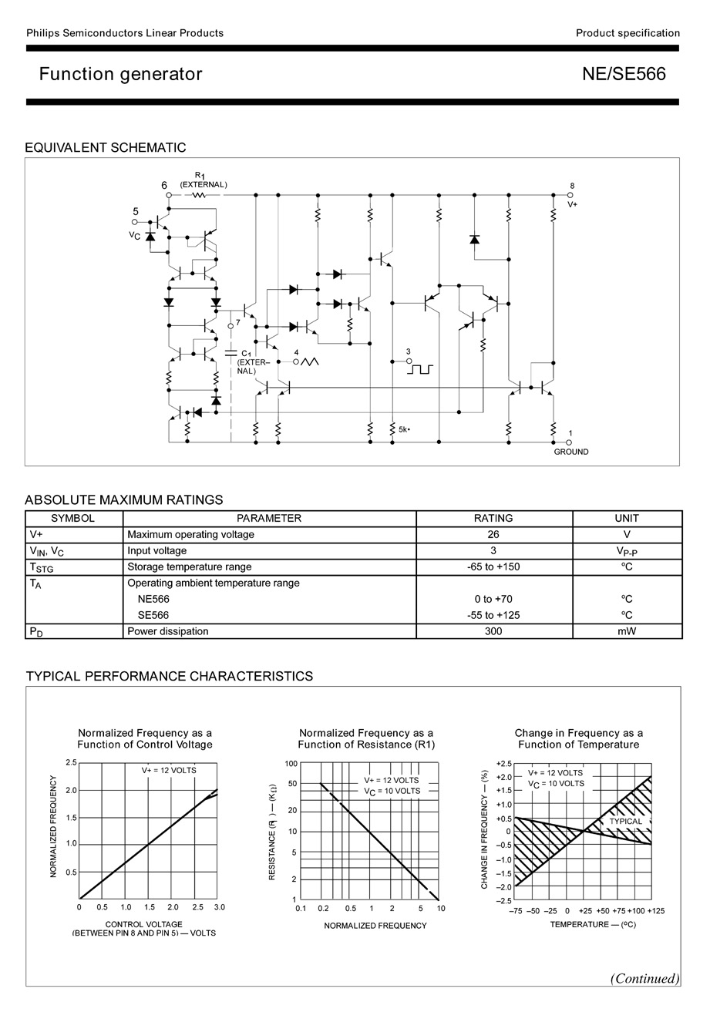
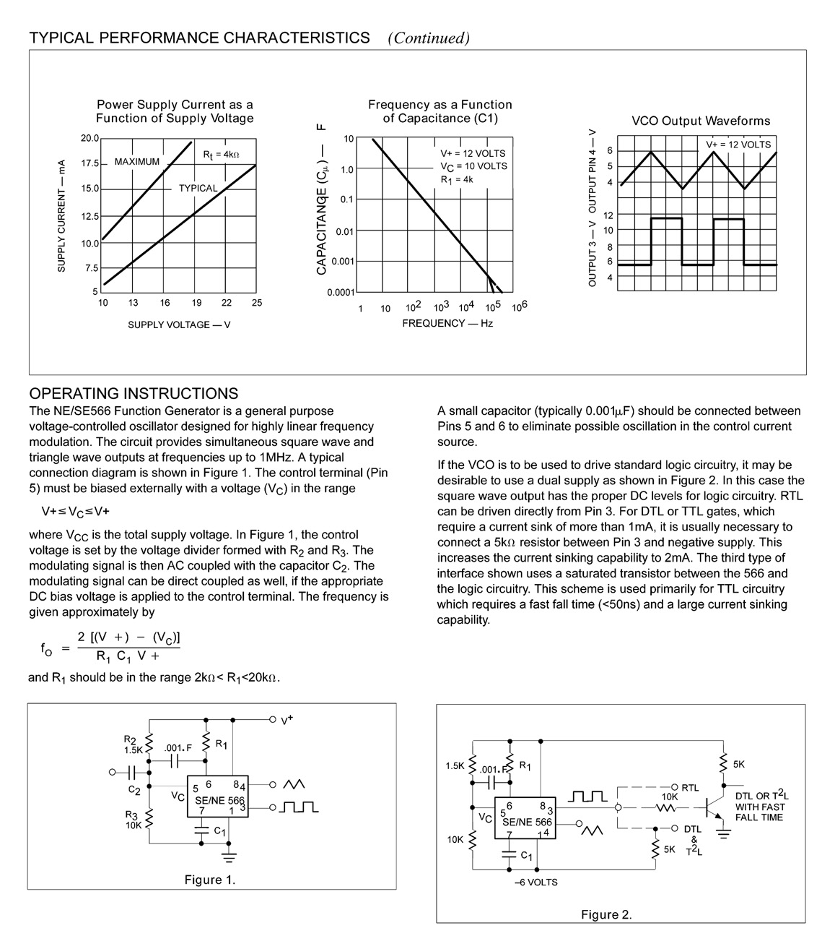
Figure 5-14 (continued) The NE/SE566 VCO specifications. (Courtesy of Philips Semiconductors.)
Figure 1 shows a FM generator, using an LC tank produces a sinusoidal FM signal

Slide 23
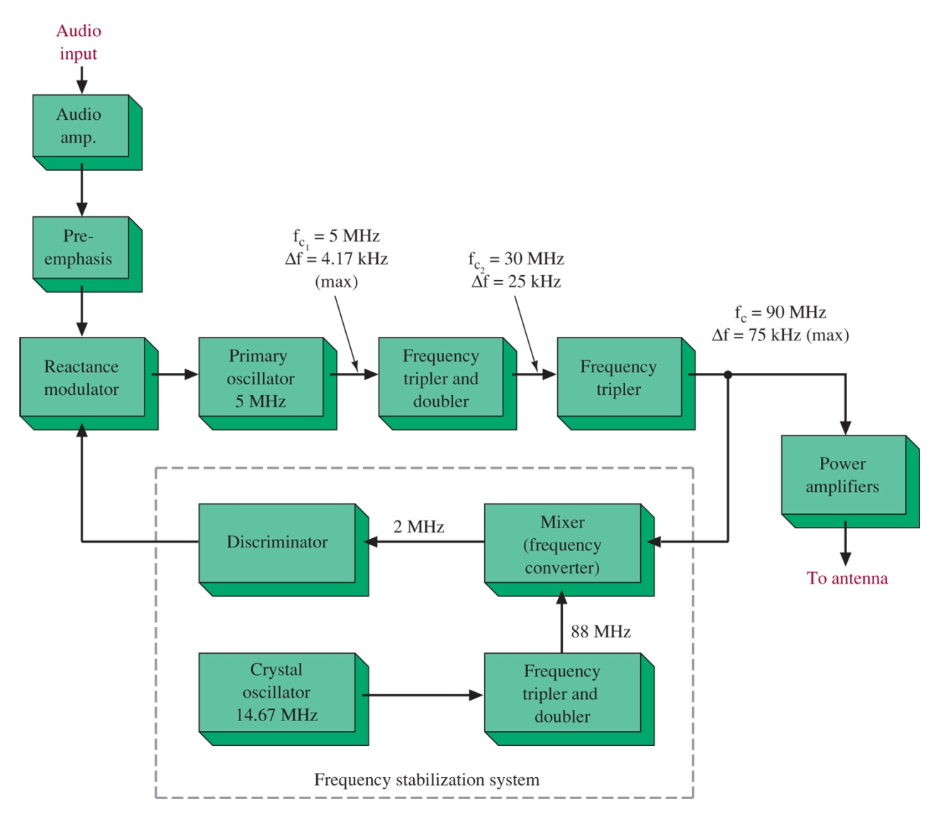
Crosby Modulator
Previous methods did not use a crystal for precise control of frequency.
We need an Automatic Frequency Control to stabilize the transmitter
Crosby systems use frequency multipliers to reach the transmission frequency.
Figure 5-15 Crosby direct FM transmitter.

Slide 24
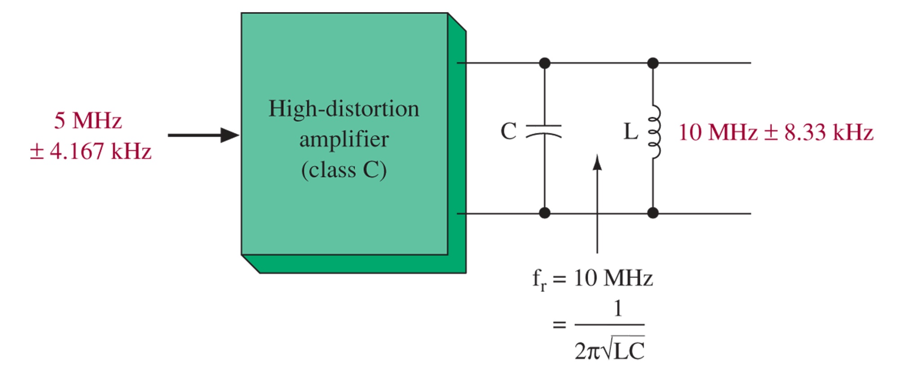
Figure 5-16 Frequency multiplication (doubler).

Slide 25
5-6 Indirect FM Generation
Armstrong type modulator
Directly modulates the crystal oscillator by phase modulation (which indirectly varies the frequency)
Matches accuracy of crystal without AFC or degradation of Crosby systems

Slide 26
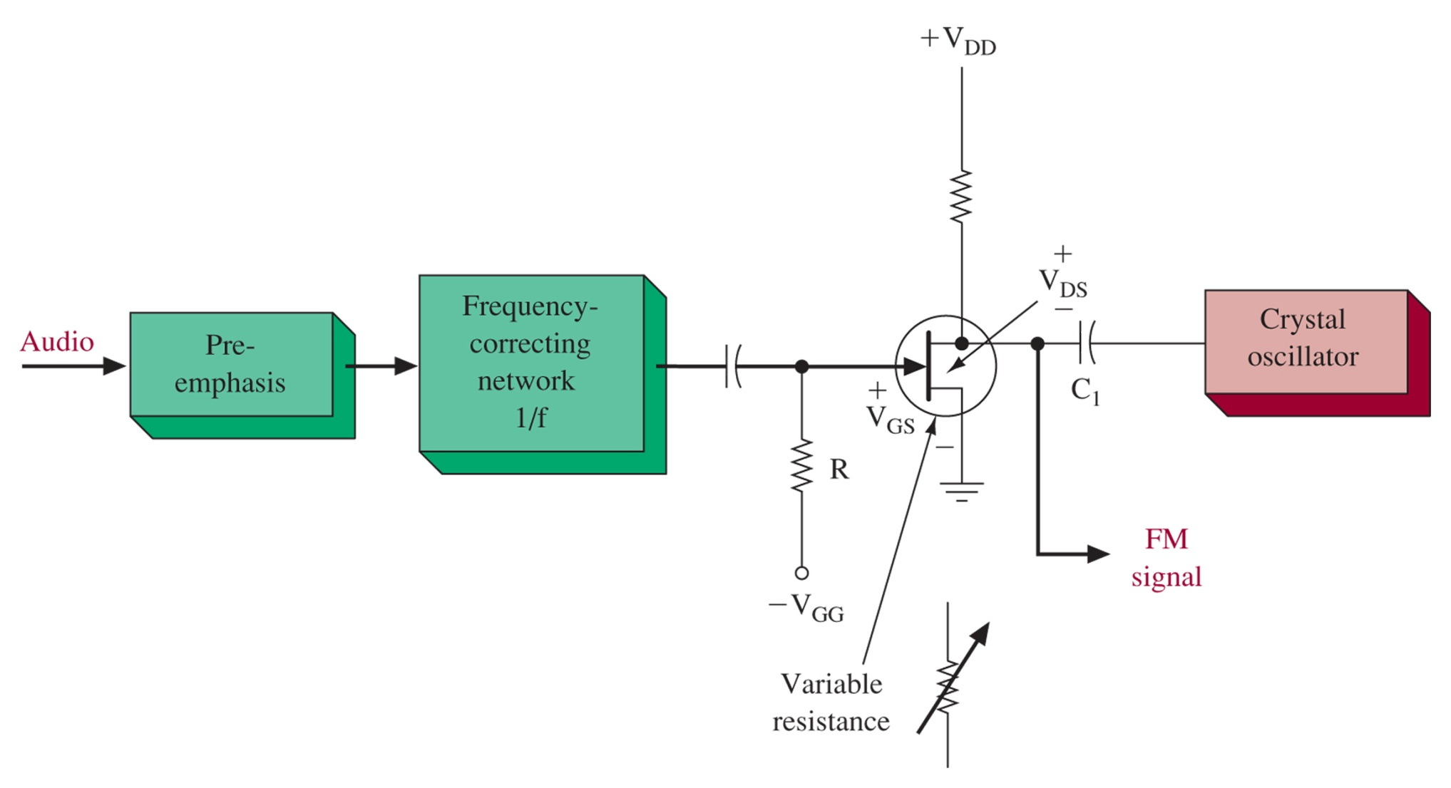
Figure 5-17 Indirect FM via PM (Armstrong modulator).
After preemphasis, 1/f RC low-pass (integrator) corrects frequency shift
Phase shift is then added to crystal oscillator by JFET resistance and C1.

Slide 27
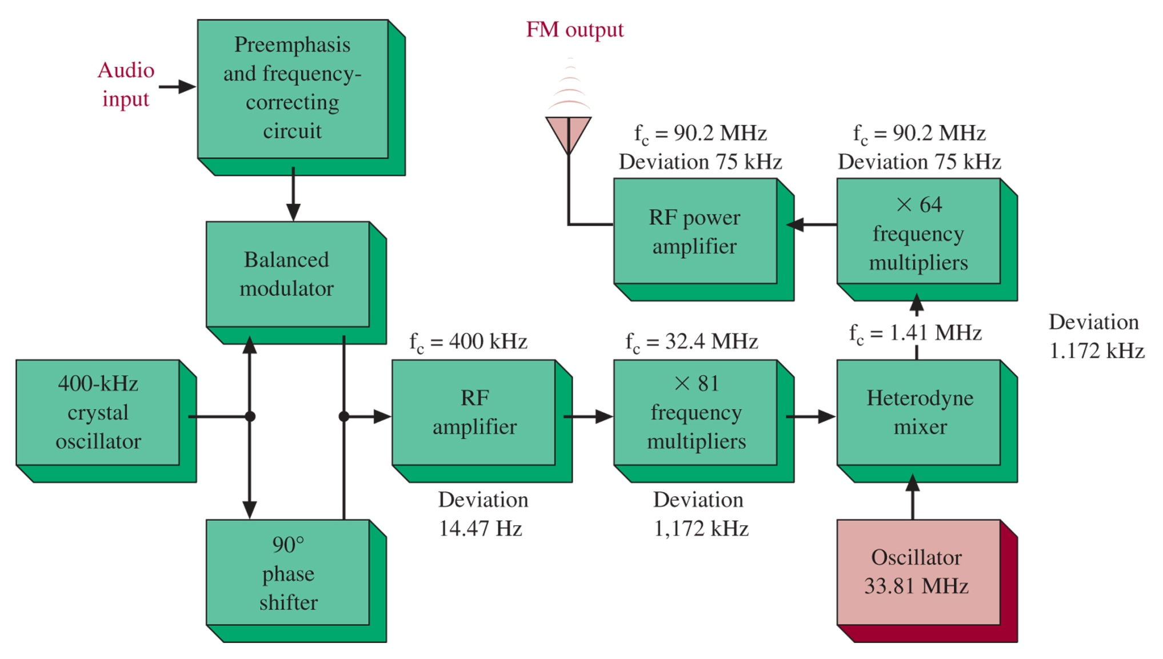
Figure 5-18 Wideband Armstrong FM.
Deviation and carrier are multiplied initially, but the het mixer shifts the carrier with out changing the deviation, prior to the next stages of frequency multiplication.

Slide 28
Figure 5-19 The pump chain for the wideband Armstrong FM system.

Slide 29
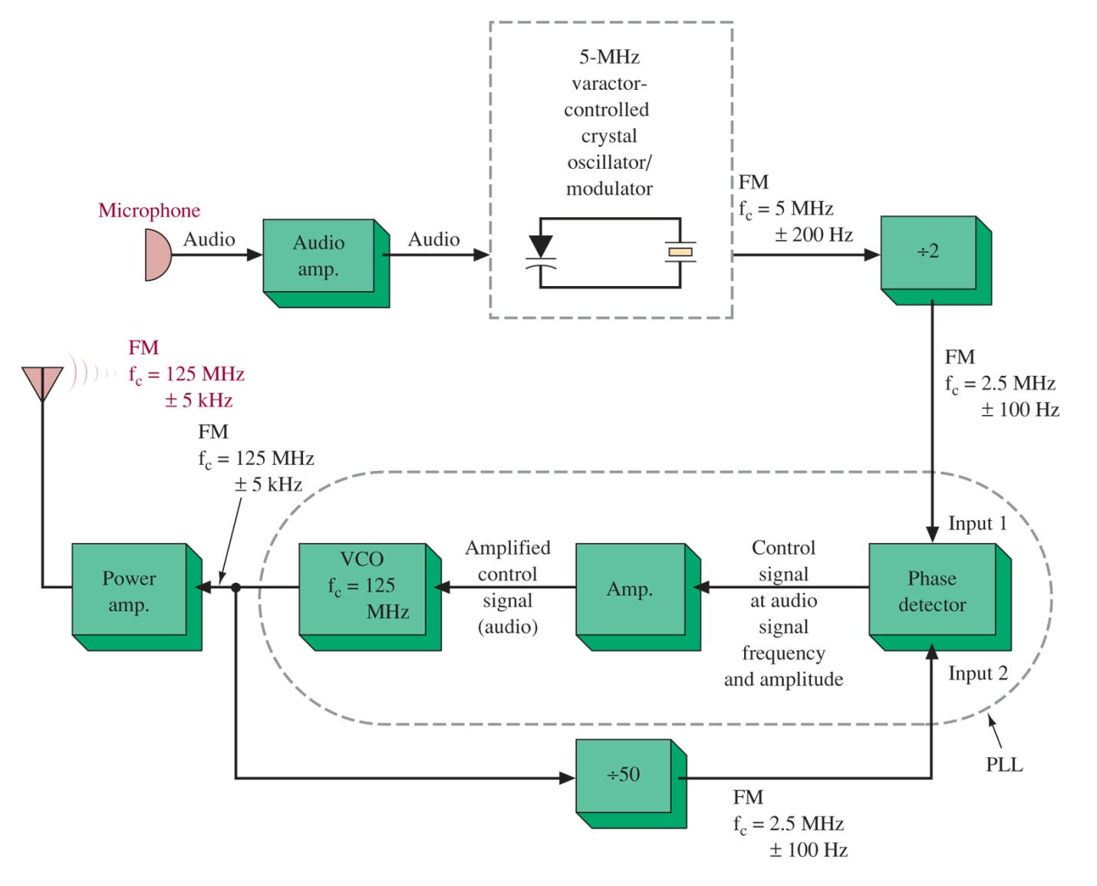
5-7 Phase-Locked-Loop FM Transmitter
Figure 5-20 PLL FM transmitter block diagram.

Slide 30
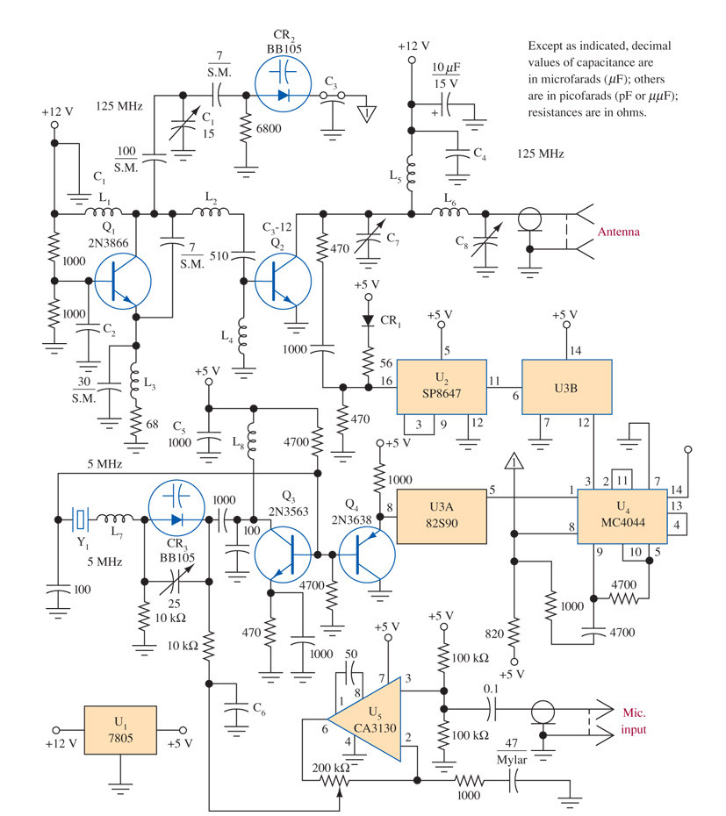
Figure 5-21 PLL FM transmitter schematic.

Slide 31
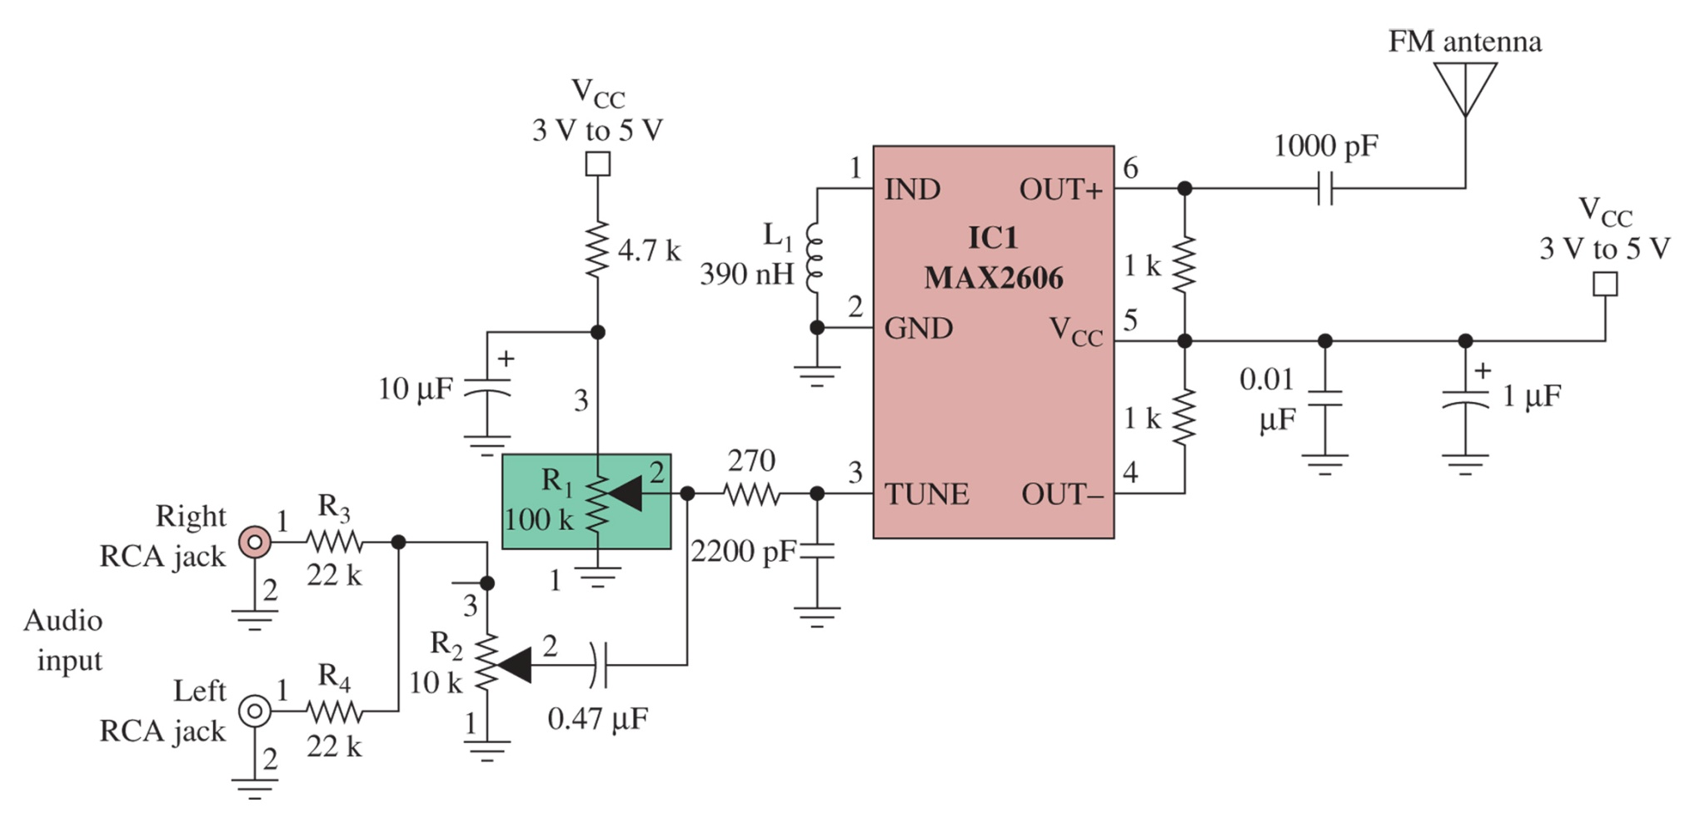
Figure 5-22 The MAX 2606 single-chip FM transmitter.

Slide 32
5-8 Stereo FM
Information is doubled, so either time or bandwidth must be doubled (Hartley’s law)
Using Frequency Multiplexing avoids this problem

Slide 33
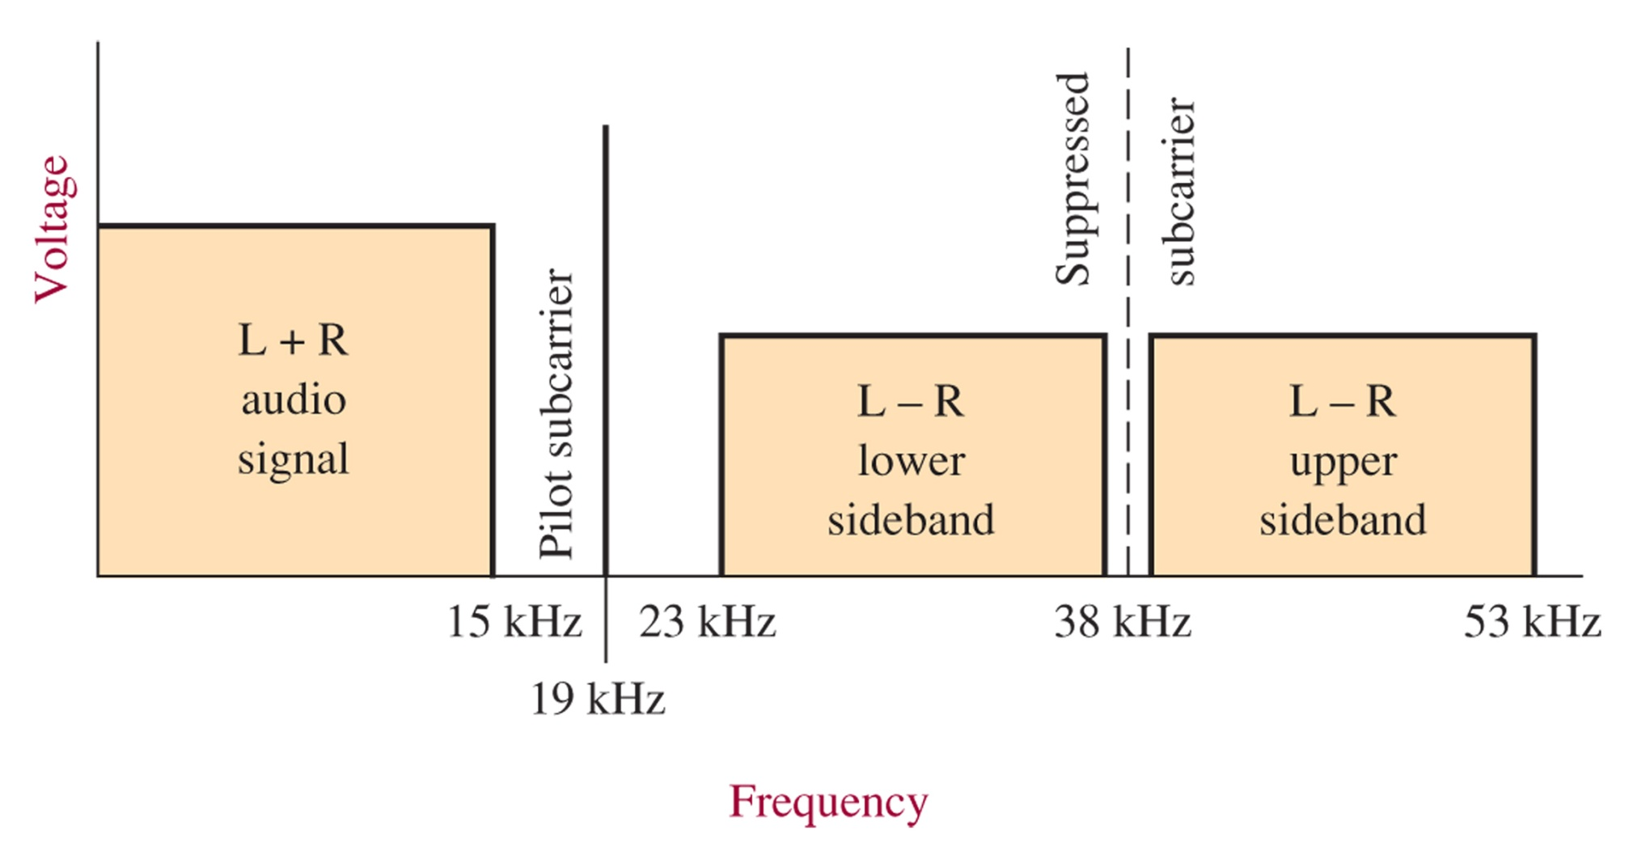
Figure 5-23 Composite modulating signals.
A ”time domain” view of FM stereo as two filtered interleaved PAM streams is an equivalent signal (without 19kHz)
Multiplexing allows transmission of a L+R and L-R sub-bands on one carrier

Slide 34
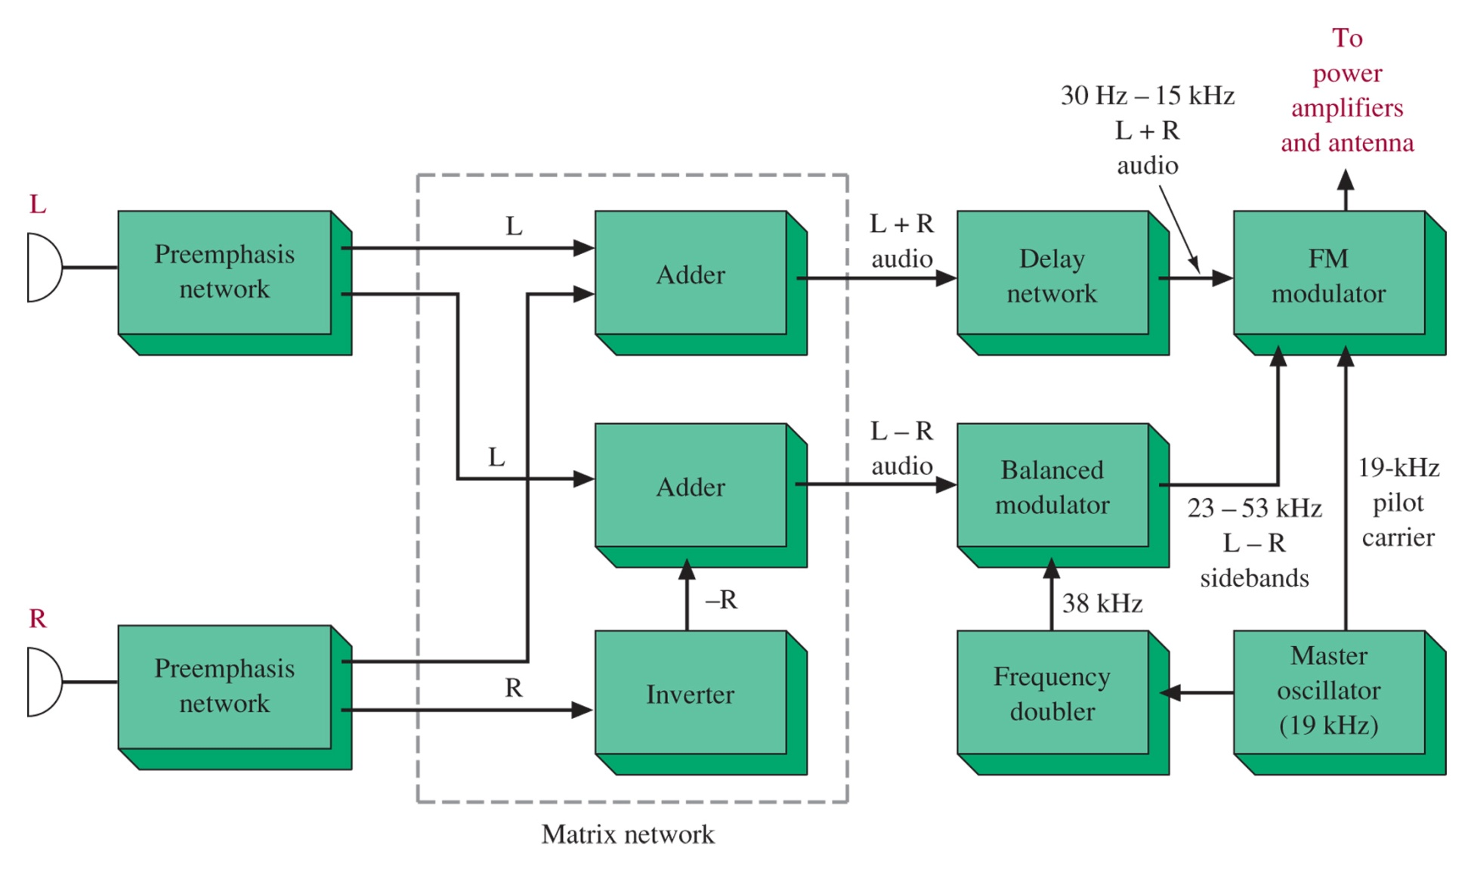
Figure 5-24 Stereo FM transmitter.

Slide 35
5-9 FM Transmissions
Noncommercial broadcast at 88-90 MHz
Commercial broadcast w/ 200 kHz channel bandwidths from 90-108 MHz
Television audio signals with 50-kHz channel bandwidths at 54 to 88 MHz, 174 to 216 MHz, and 470 to 806 MHz
Narrowband public service channels from 108 to 174 MHz and in excess of 806 MHz
Narrowband amateur radio channels at 29.6 MHz, 52 to 53 MHz, 144 to 147.99 MHz, 440 to 450 MHz, and in excess of 902 MHz

Slide 36
Practical FM Transmission
Above 30 MHz due to ionosphere
Line-of-sight transmission (range of 70 – 80 miles)
Superior noise over SSB / AM
Uses low-level modulation and Class C power amplifiers for efficient transmission

Slide 37
5-10 Troubleshooting
Automotive Mobile
Fixed Base Station
Handheld portable
Both Wideband (broadcast) and Narrowband (communications)

Slide 38
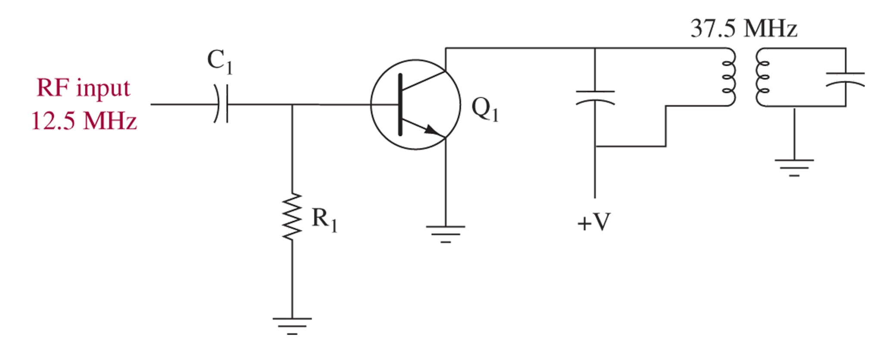
FM Transmitter System
Figure 5-25 Multiplier stage.
No RF output
Incorrect Frequency
Incorrect Deviation

Slide 39
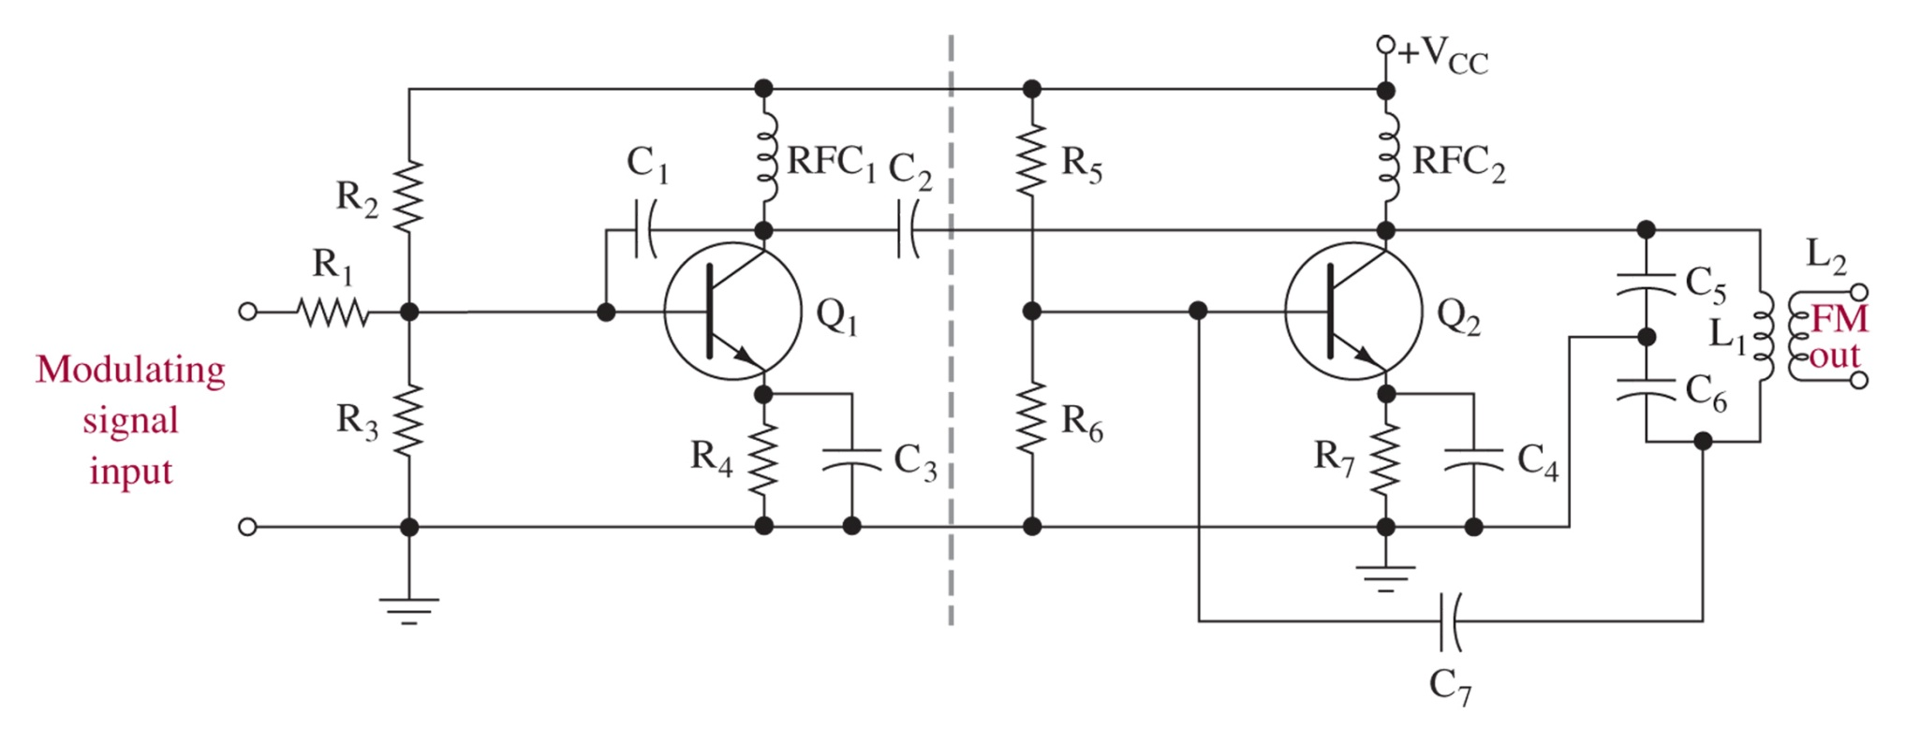
Figure 5-27 Reactance modulator.

Slide 40
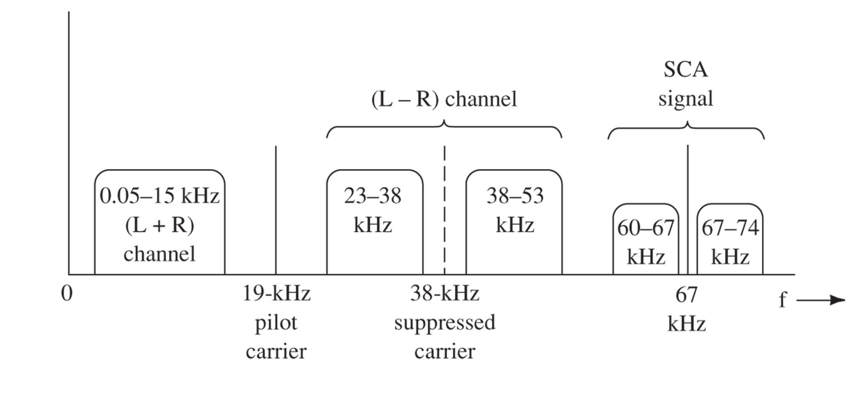
Figure 5-28 Spectrum of a wideband FM modulating signal.
The SCA (Subsidiary Communications Authorization) is used to transmit the voice ID of the station. It cannot be heard on normal radios, but special equipment can shift it down to the audible range, and is used to broadcast backgroung music, weather, etc.

Slide 41
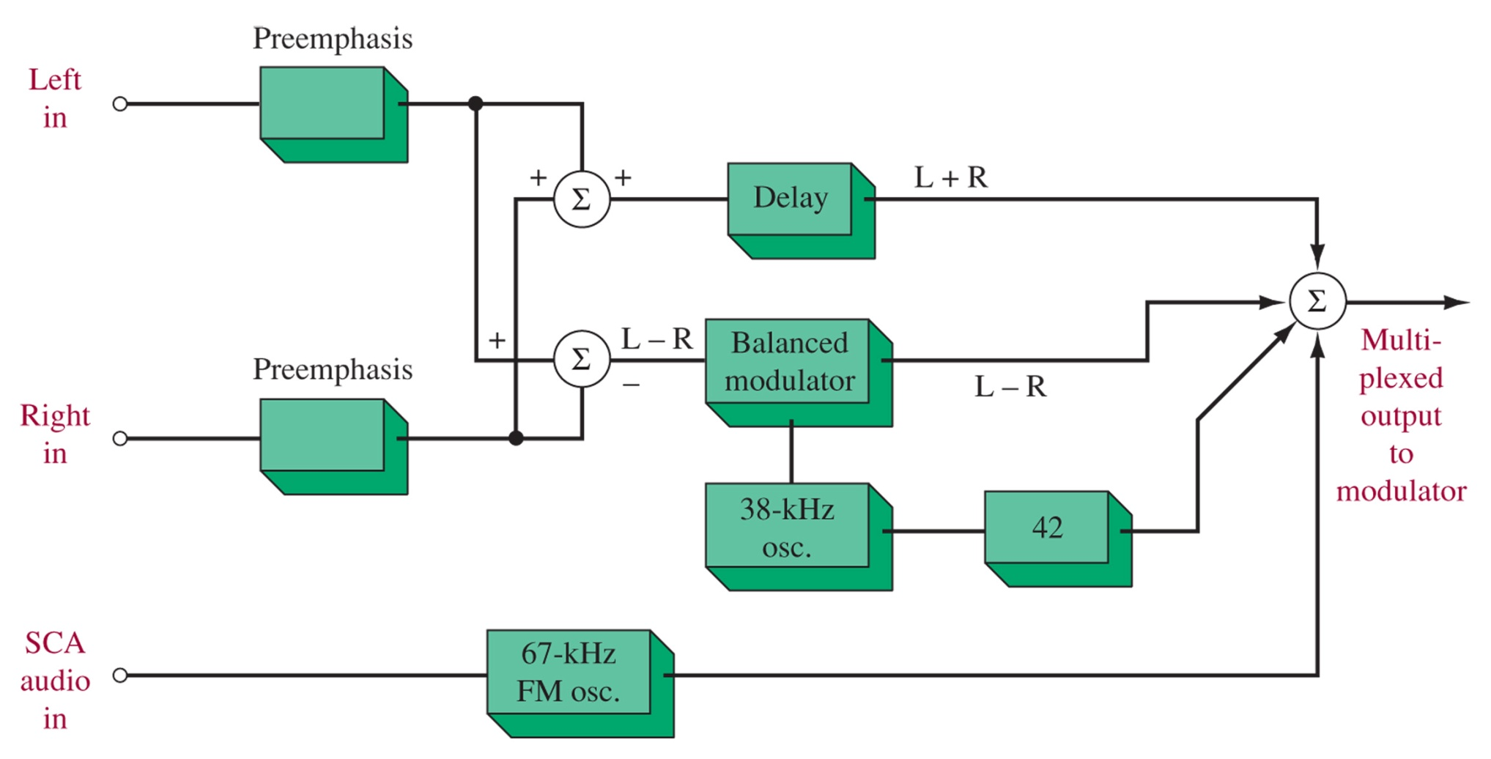
Figure 5-29 Generating a stereo/SCA FM modulating signal.

Slide 42
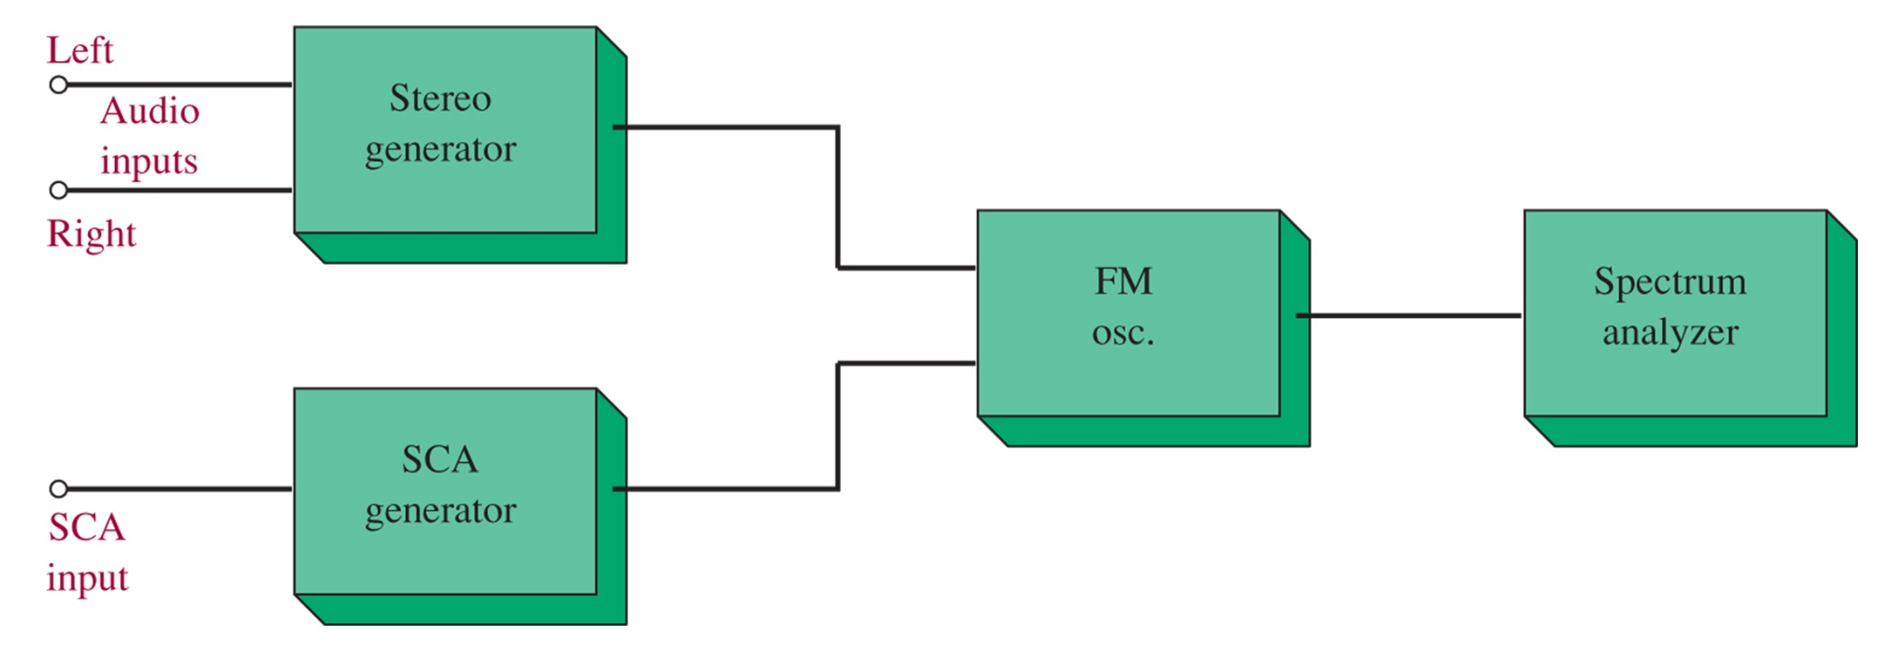
Figure 5-30 Troubleshooting the stereo/SCA generator.

Slide 43
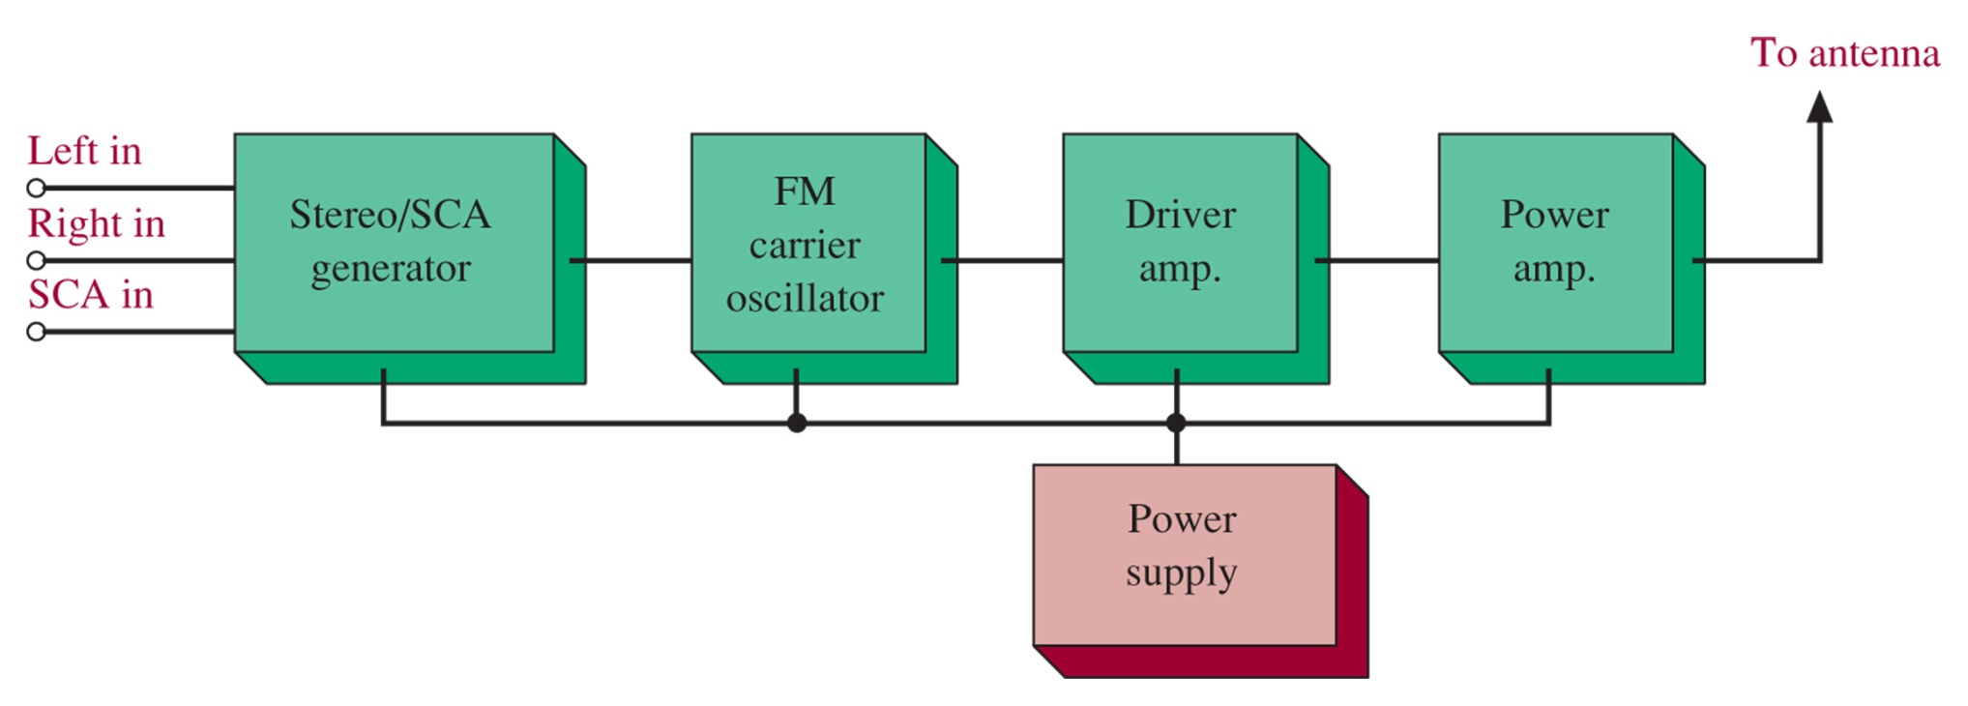
Figure 5-31 The wideband FM transmitter.
The carrier will use an AFC system with a crystal reference oscillator. This circuit is usually in a thermostatic oven to avoid temperature drift.

Slide 44
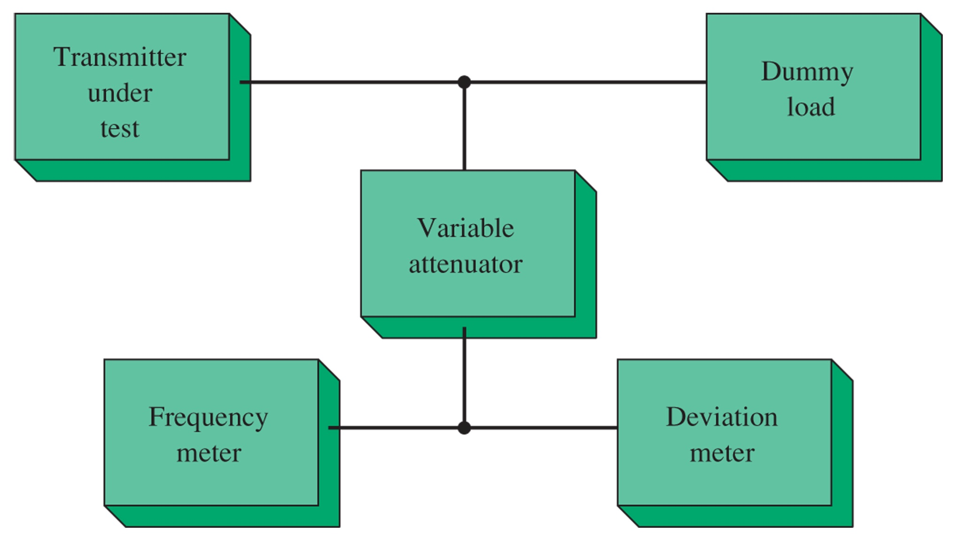
Figure 5-32 Measuring the FM transmitter s carrier frequency and deviation.
Always impedance match the dummy load and test the carrier with the modulation turned off.

Slide 45
5-11 Troubleshooting with Multisim

Slide 46
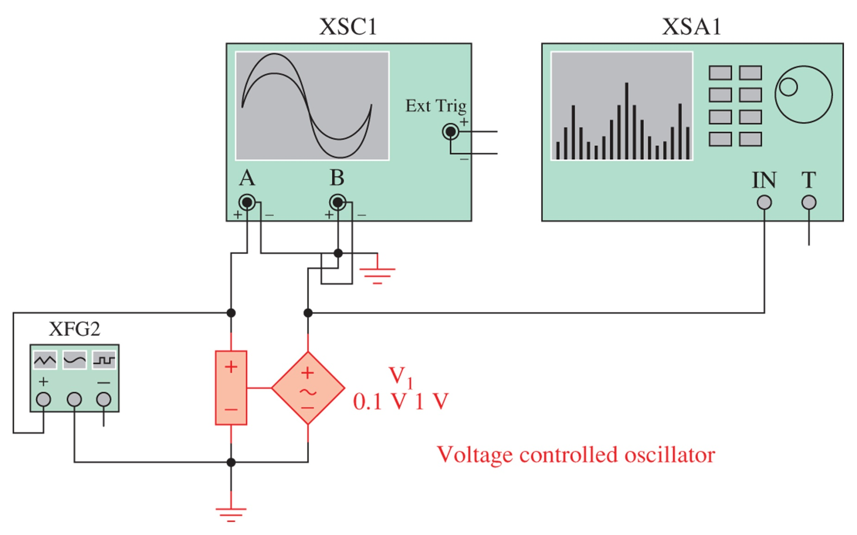
Figure 5-33 A frequency-modulation circuit using a voltage-controlled oscillator, as implemented in an Electronics WorkbenchTM Multisim circuit.

Slide 47
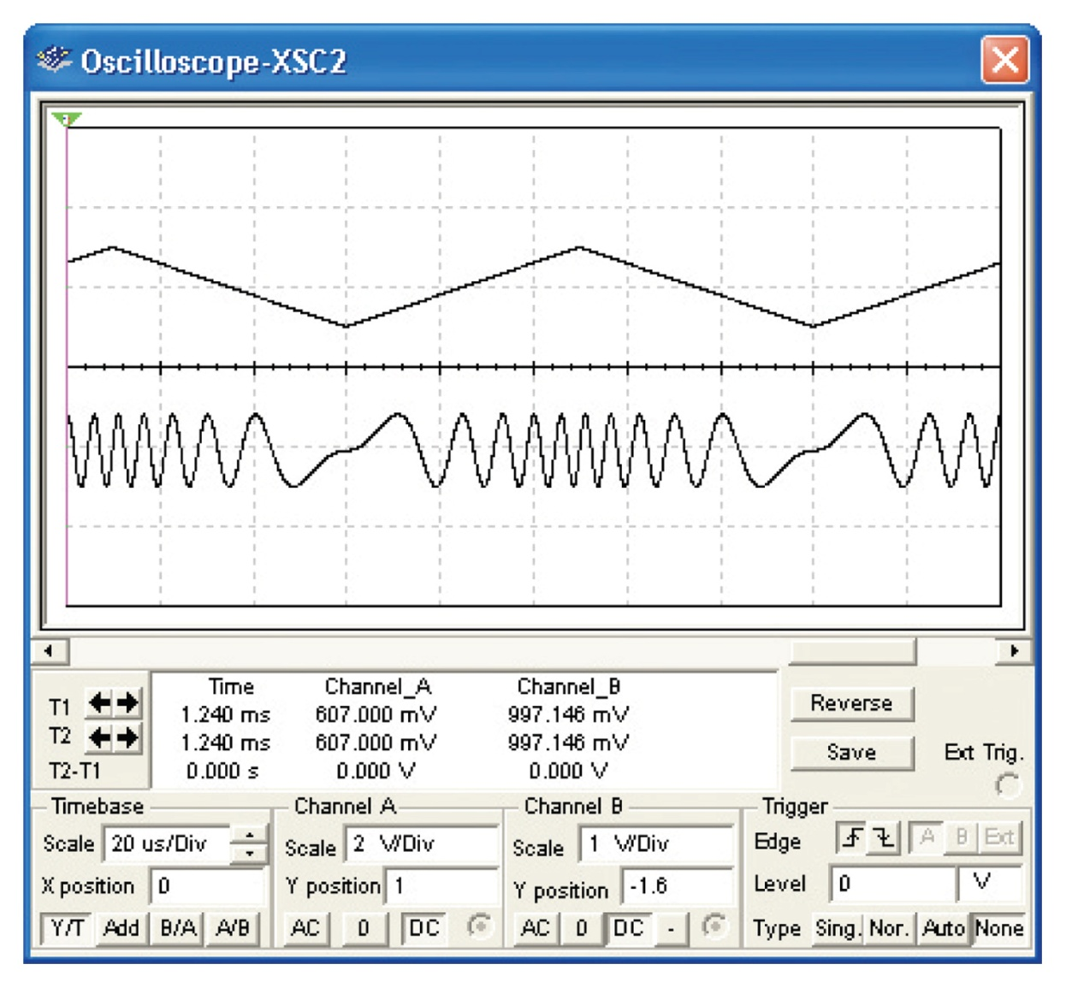
Figure 5-34 The oscilloscope display of the 10-kHz triangle wave and the output of the VCO.

Slide 48
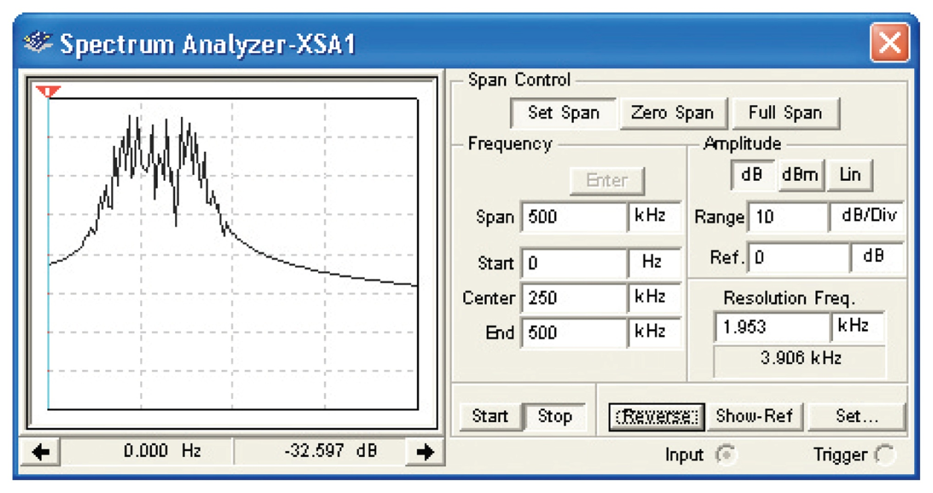
Figure 5-35 The output of the voltage-controlled oscillator as viewed with a spectrum analyzer.

