Slide 1
EE 350 / ECE 490
Analog Communication Systems
Ch. 2 – Amplitude Modulation:
Transmitters

Slide 2
Objectives
Describe the process of modulation
Sketch an AM waveform with various modulation indexes
Explain the difference between a sideband and side frequency
Analyze various power, voltage, and current calculations in AM systems
Understand circuits used to generate AM
Determine high- and low-level modulation systems from schematics and block diagrams
Perform AM transmitter measurements using meters, oscilloscopes, and spectrum analyzers

Slide 3
2-1 Introduction
Direct transmission of intelligible signals would result in catastrophic interference, because all signals would be at the same frequency
Most intelligible signals are at low frequency which makes efficient transmission and reception impractical due to large antenna size

Slide 4
2-2 Amplitude Modulation Fundamentals
To transmit we must combine our intelligence signal with a carrier signal

Slide 5
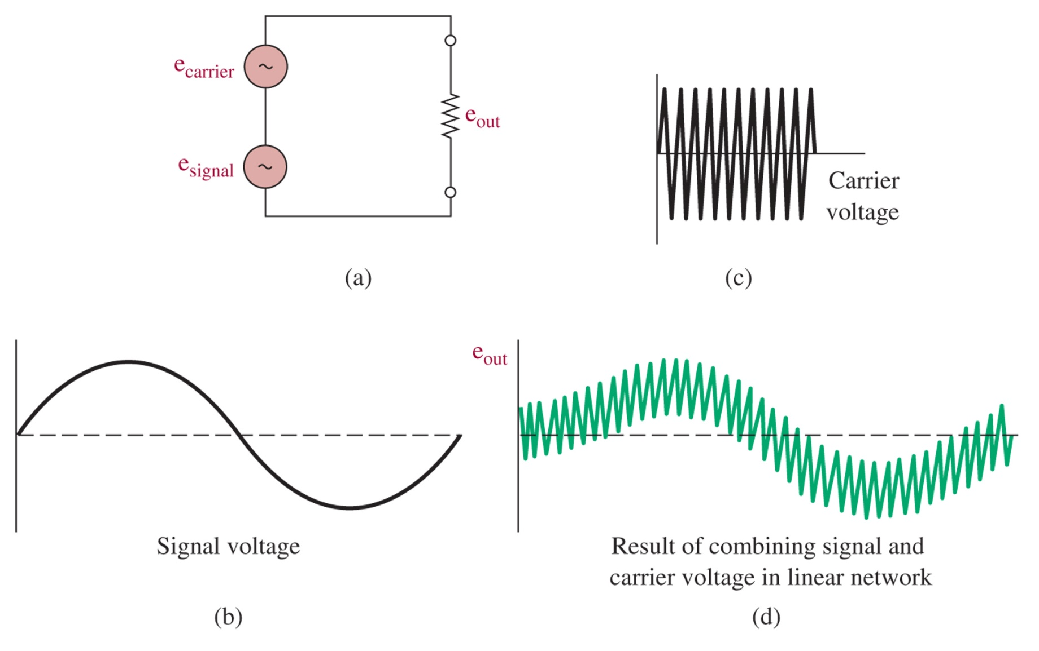
Figure 2-1 Linear addition of two sine waves.

Slide 6
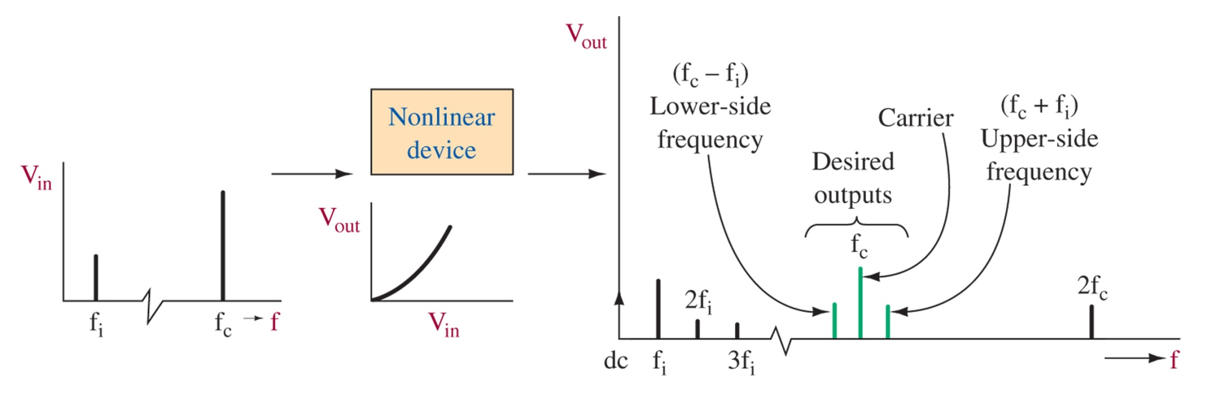
Figure 2-2 Nonlinear mixing.
Nonlinear Signal Combination:
DC level
Components at 2 original frequencies
Sum and Difference of Original frequencies
Harmonics of Original Frequencies
We only want the parts in the middle:
lower-side frequency
Carrier frequency
Upper-side frequency

Slide 7
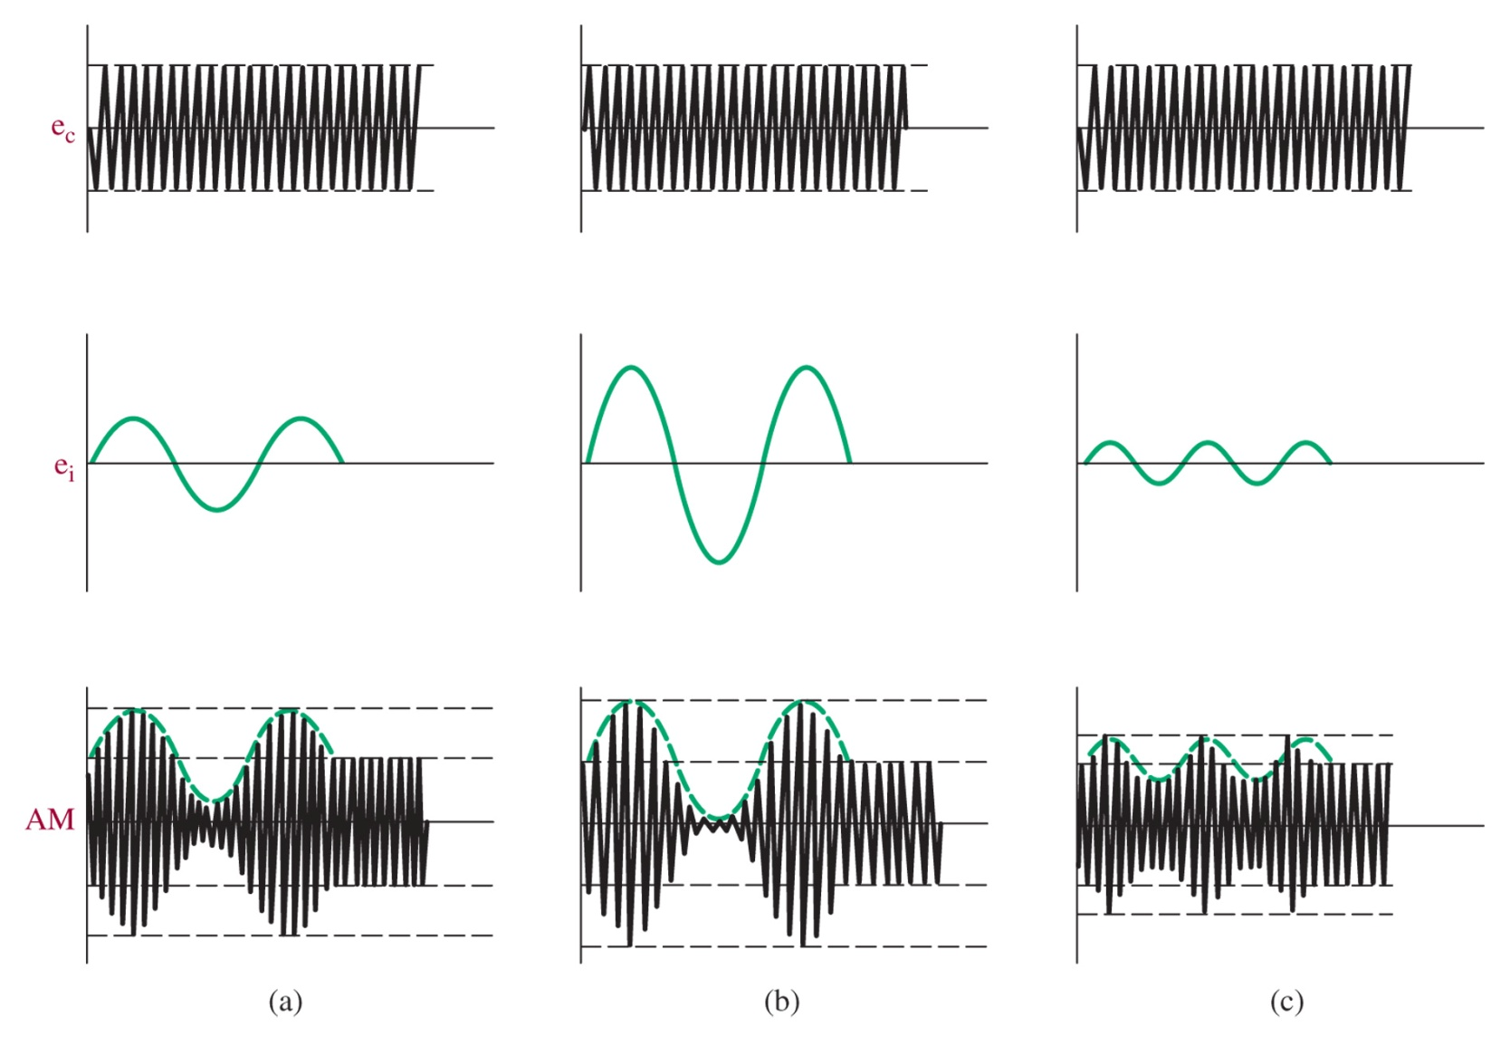
Figure 2-3 AM waveform under varying intelligence signal (e_{i}) conditions. (a) is the base, (b) is a larger modulation amplitude, and (c) is a smaller amplitude and higher frequency of modulation

Slide 8
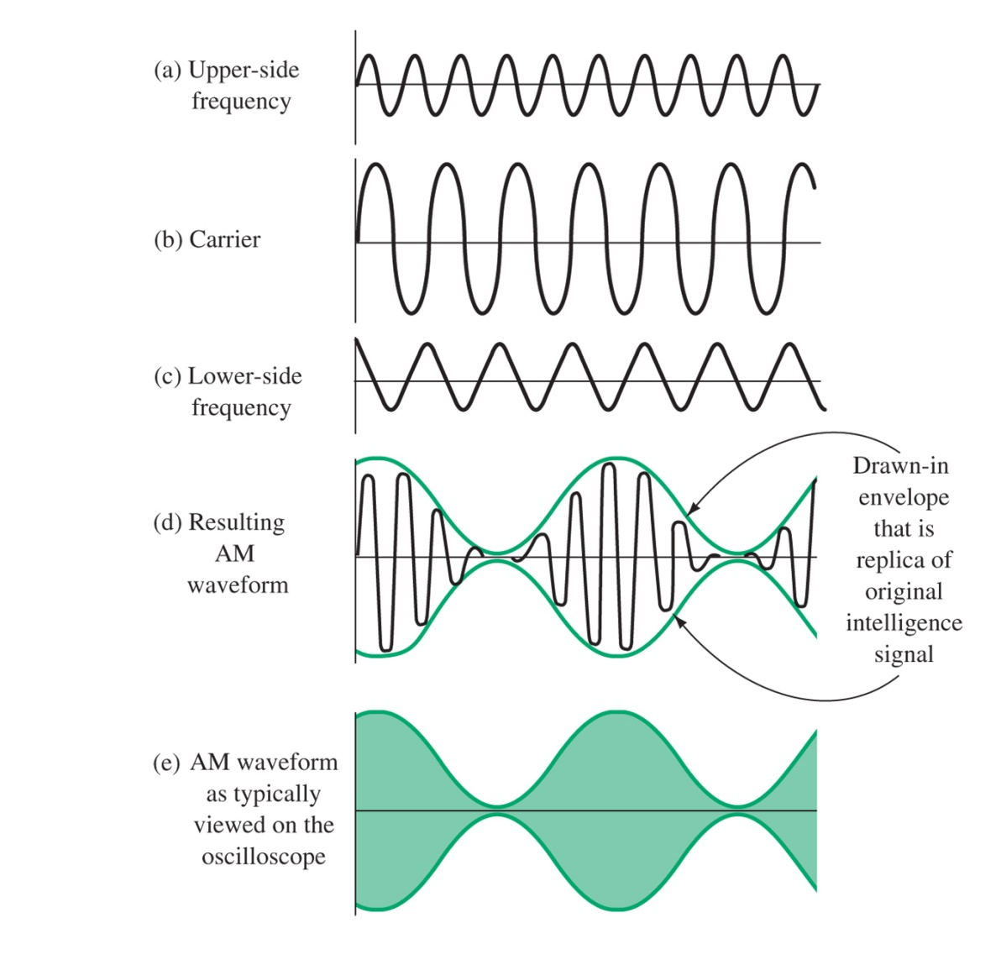
Figure 2-4 Carrier and side-frequency components result in AM waveform.

Slide 9
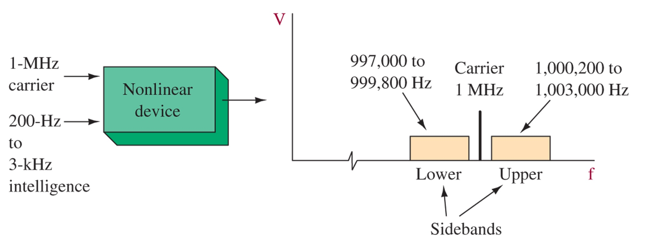
Figure 2-5 Modulation by a band of intelligence frequencies.
In practice the modulation signal is over a band of frequencies, like the human voice, therefore modulation produces sidebands instead of side frequencies

Slide 10
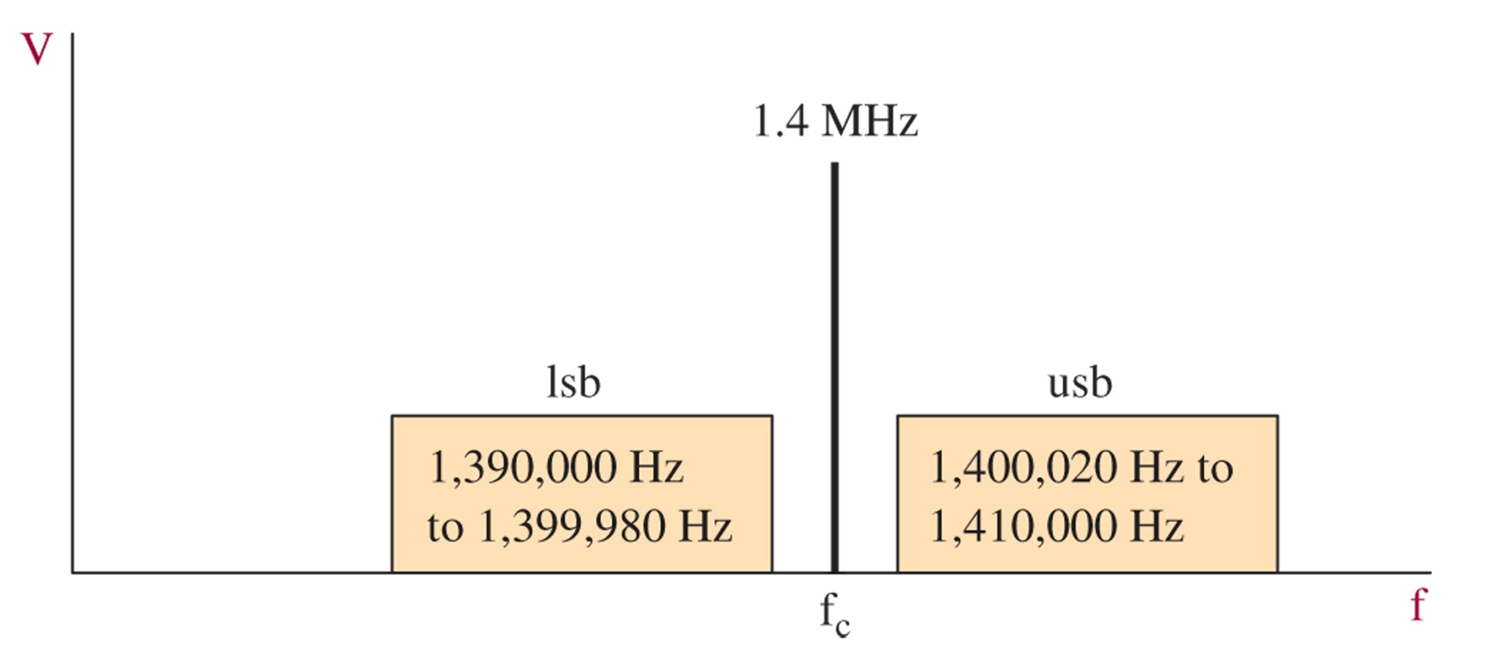
Figure 2-6 Solution for Example 2-1.

Slide 11
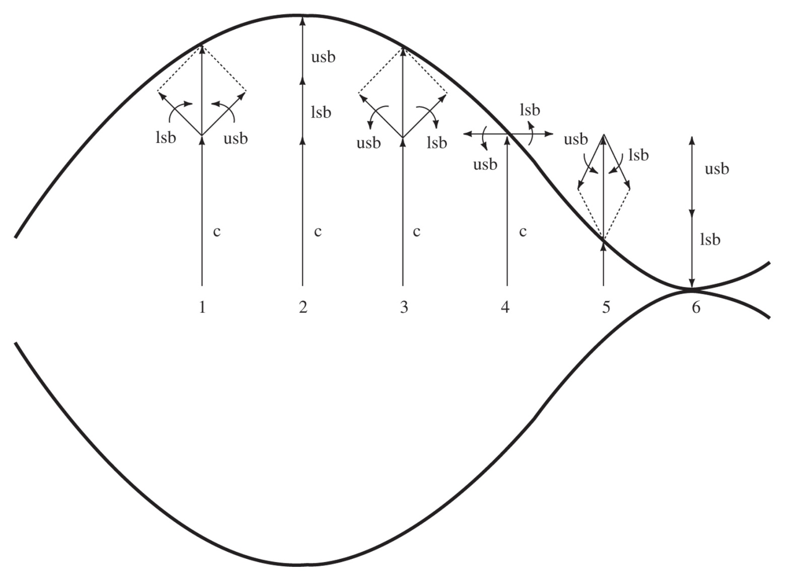
Figure 2-7 AM representation using vector addition of phasors.
Think of usb and lsb as rotating in opposite directions, relative to the carrier phasor. This leads to the modulation of the carrier, a max when the usb and lsb are in phase, a minimum when they are out of phase.

Slide 12
2-3 Percentage Modulation

Slide 13
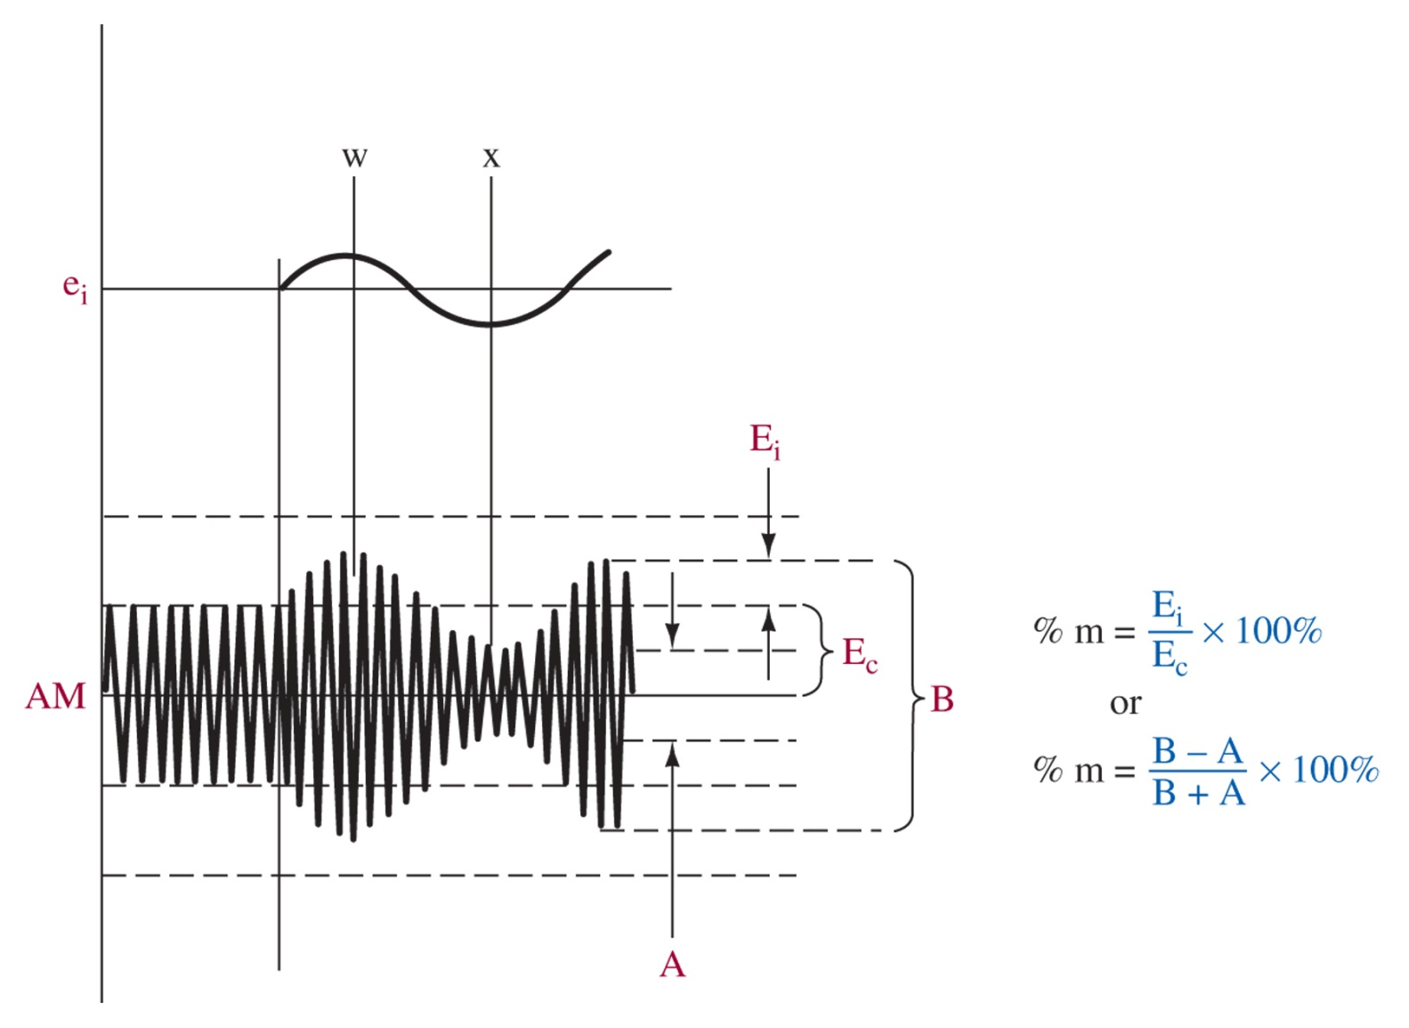
Figure 2-8 Percentage modulation determination.

Slide 14
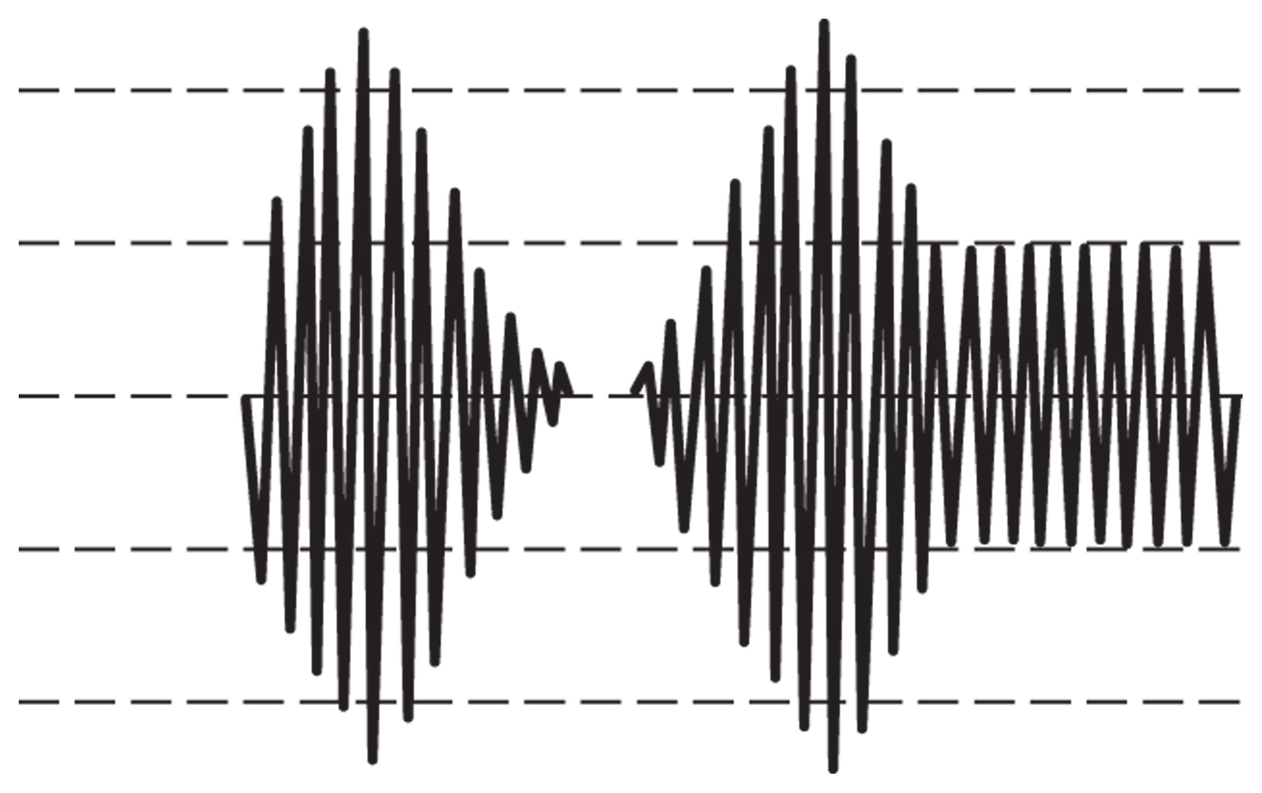
Figure 2-9 Overmodulation.
If the modulation amplitude is greater than the carrier amplitude, this results in overmodulation which causes sideband splatter

Slide 15
2-4 AM Analysis
From this we can conclude that the bandwidth required for AM transmission is twice the bandwidth of the intelligence signal

Slide 16
Modulation to Power relation
Modulation index, m | Carrier Power (kW) | Power in one Sideband (W) | Total sideband power (W) | Total Transmitted Power, Pt (W)
1.0 | 1 | 250 | 500 | 1.5
0.5 | 1 | 62.5 | 125 | 1.125

Slide 17
2-5 Circuits for AM Generation
Must need a nonlinear device to generate the necessary modulation
Diodes are not often used because they are passive and provide no gain
Transistors or other amplifiers are better suited since they do provide gain
There are many possible configurations

Slide 18
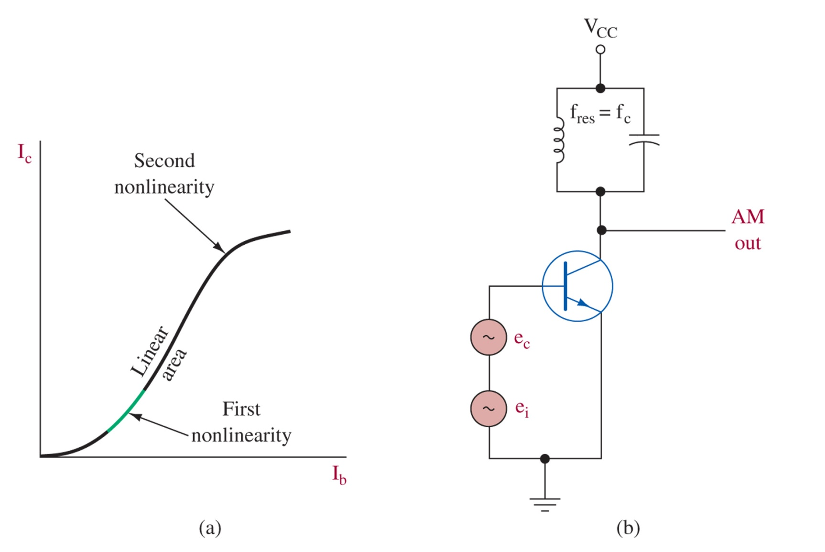
Figure 2-10 Simple transistor modulator.
ei and ec provide the bias into the nonlinear region, the LC resonator is tuned to the carrier frequency to force the signal to the output at those frequencies while suppressing other frequencies we do not want to transmit. This is base modulation.

Slide 19
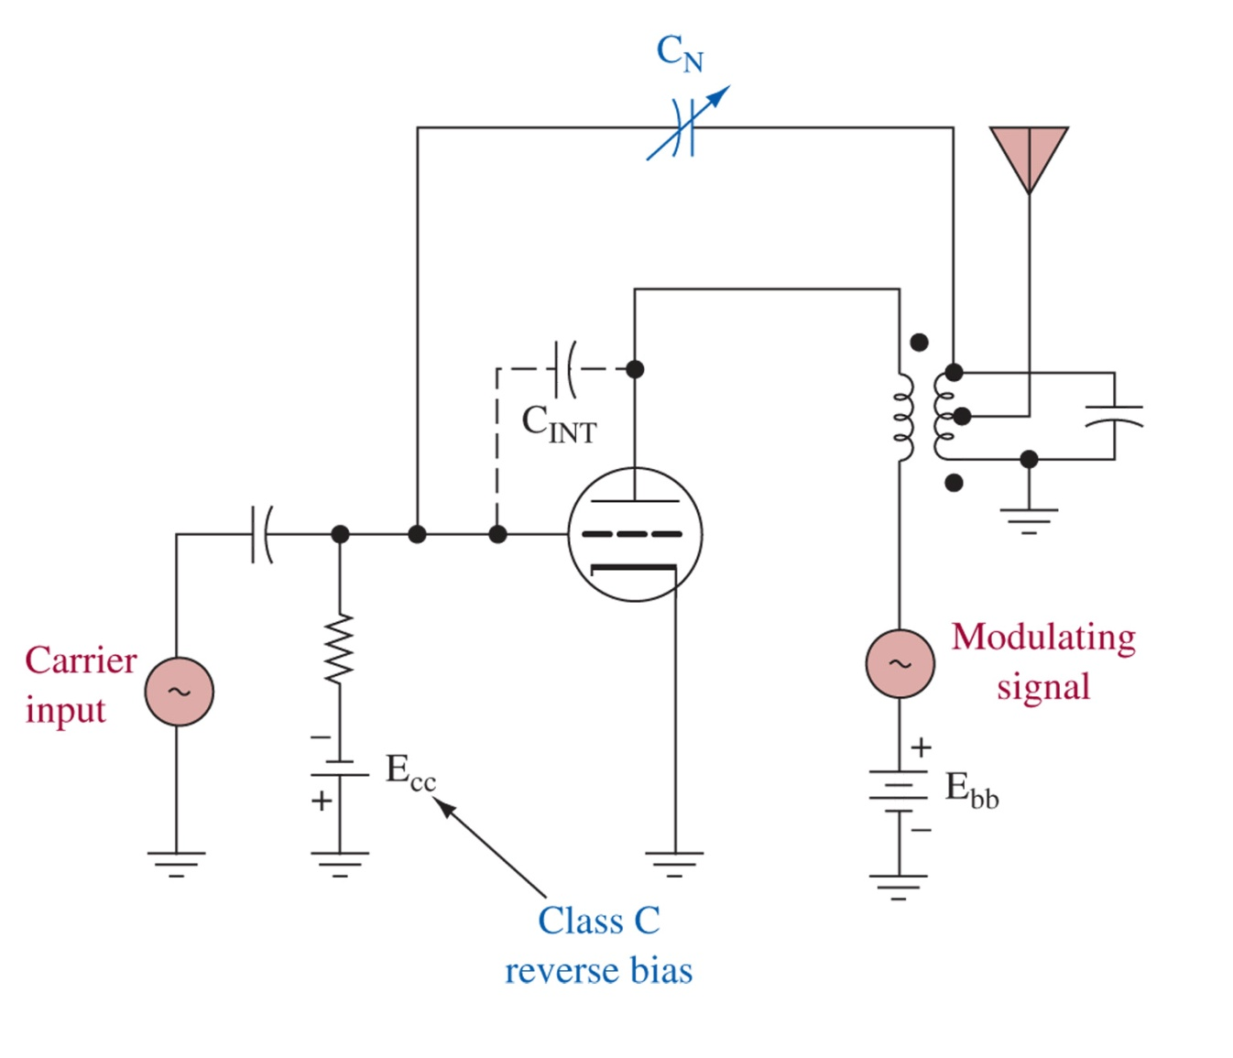
Figure 2-11 Plate-modulated class C amplifier.
Modulating signal added just before the antenna, this is best for high power transmitters, such as this vacuum tube radio transmitter where class C amplification is used for the carrier.

Slide 20
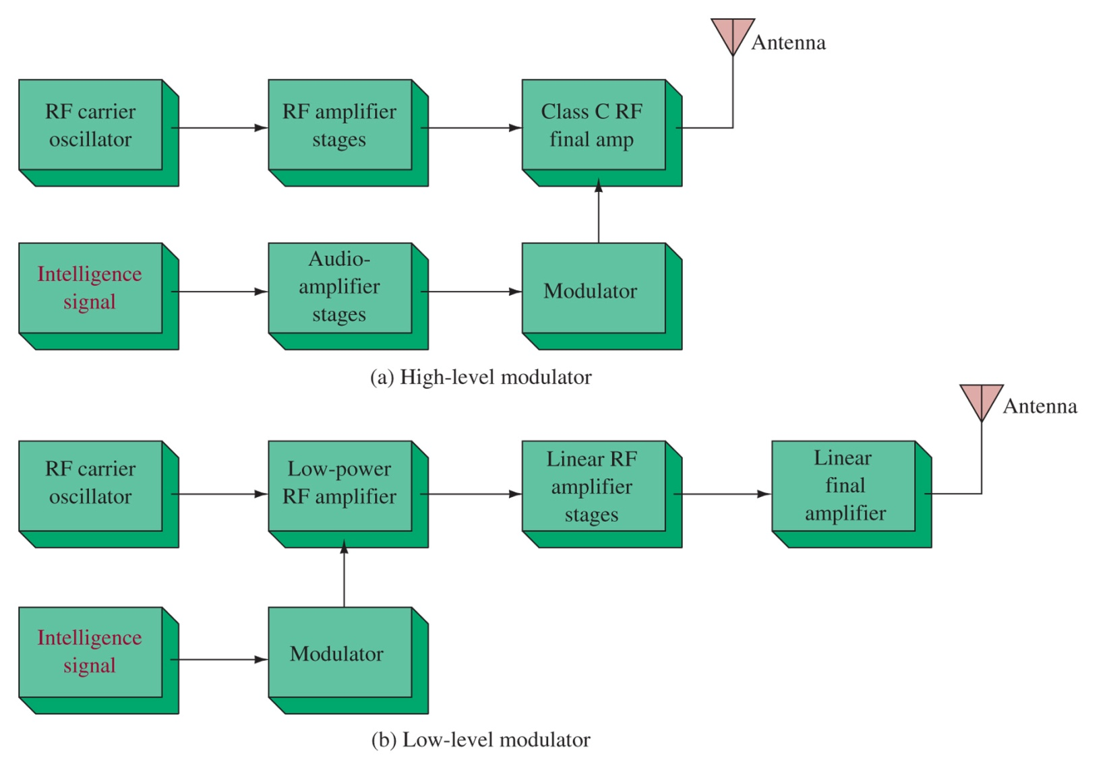
Figure 2-12 (a) High- and (b) low-level modulation.

Slide 21
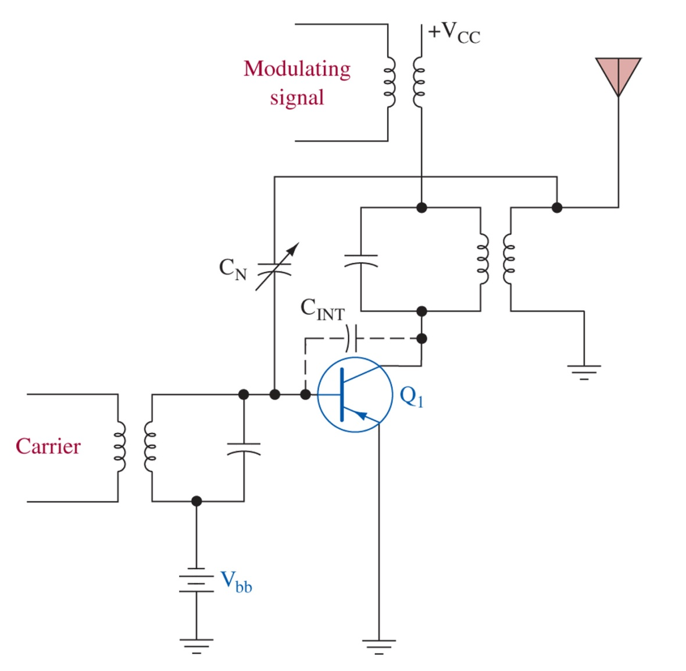
Figure 2-13 Collector modulator.
Take care to cancel or prevent self-oscillation, neutralization capacitors assist in both linear and class C amplifiers.

Slide 22
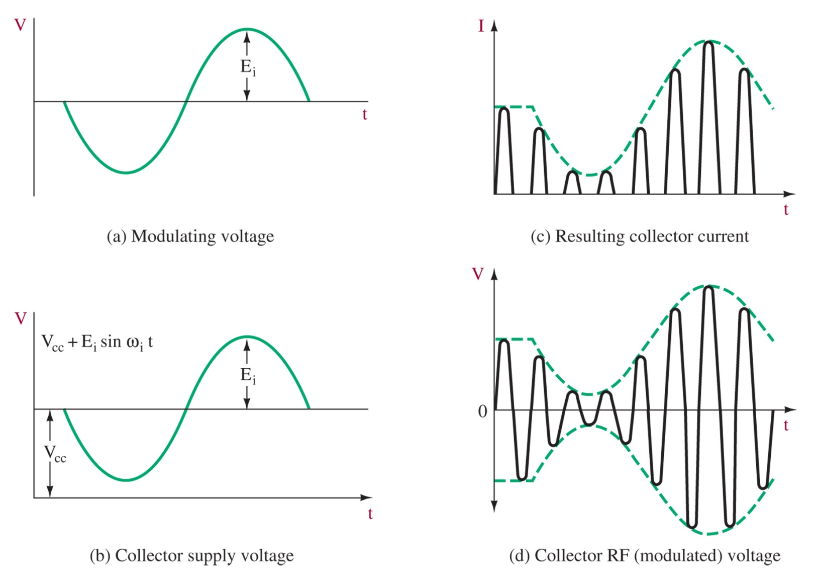
Figure 2-14 Collector modulator waveforms.

Slide 23
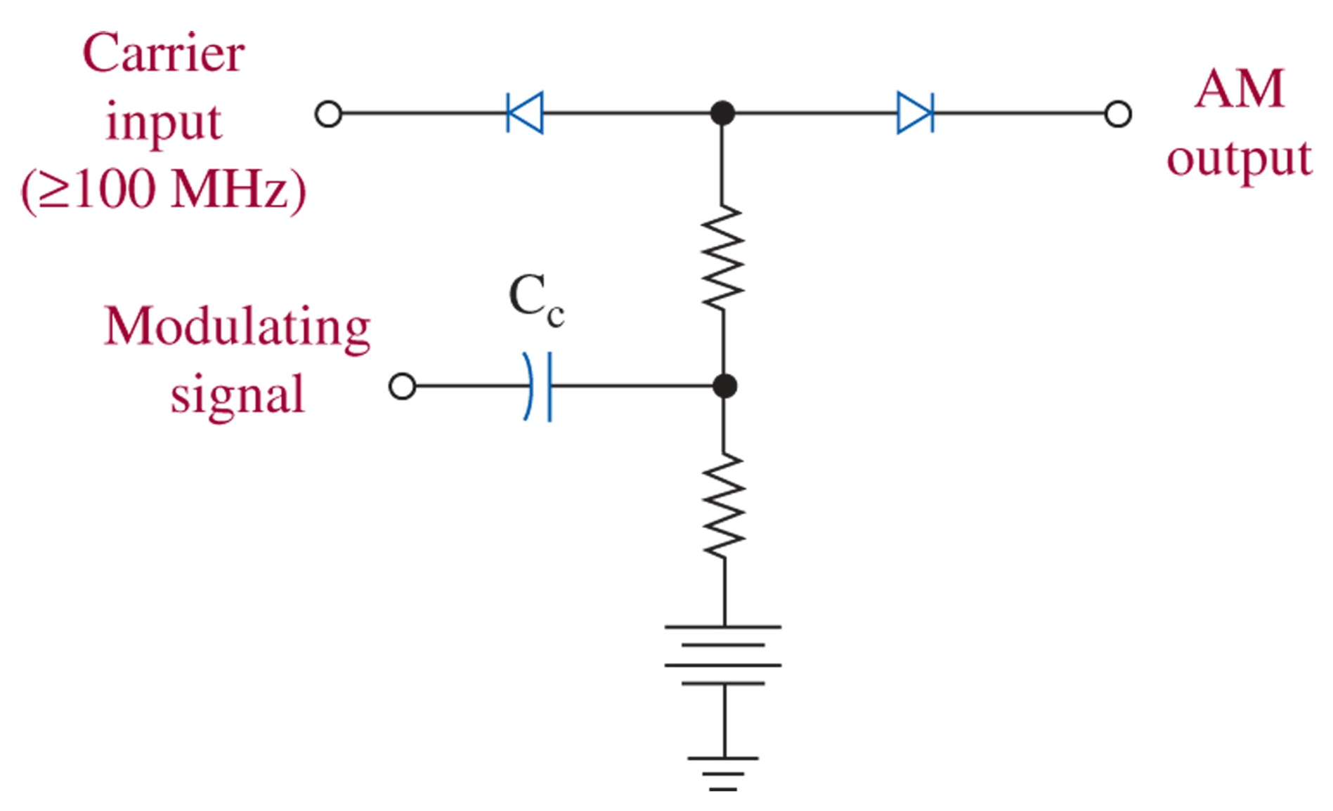
Figure 2-15 PIN diode modulator.
Due to cost, PIN diodes (which have variable resistance above 100 MHz based on forward bias) are used almost exclusively

Slide 24
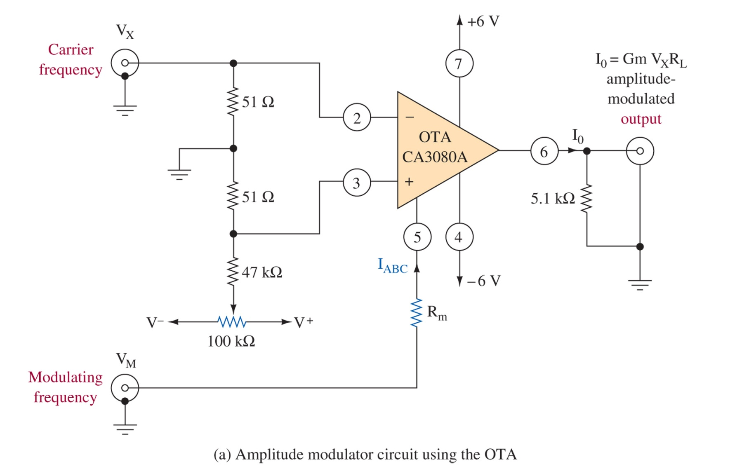
Figure 2-16 LIC amplitude modulator and resulting waveforms. (Courtesy of RCA Solid State Division.)
For low level circuits, linear IC amps can be used such as this operational transconductance amplifier. It is similar to the con

Slide 25
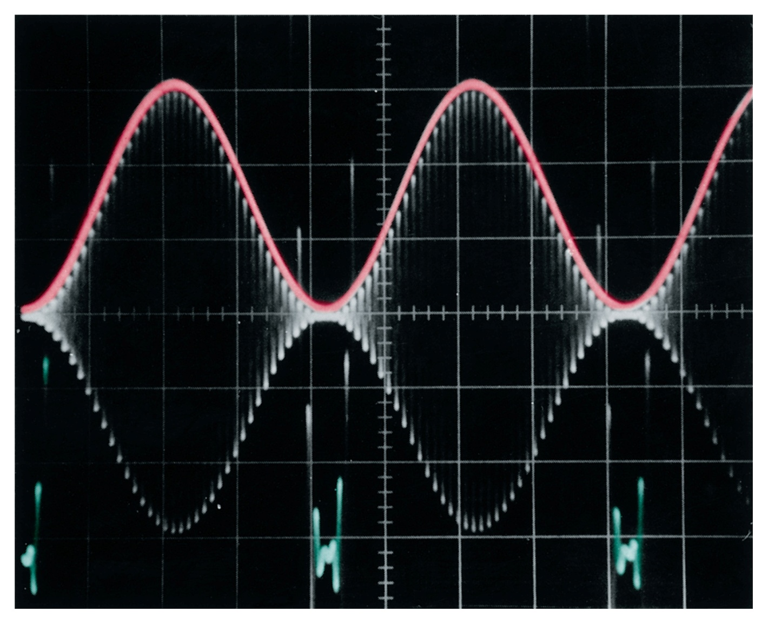
Figure 2-16 (continued) LIC amplitude modulator and resulting waveforms. (Courtesy of RCA Solid State Division.)

Slide 26
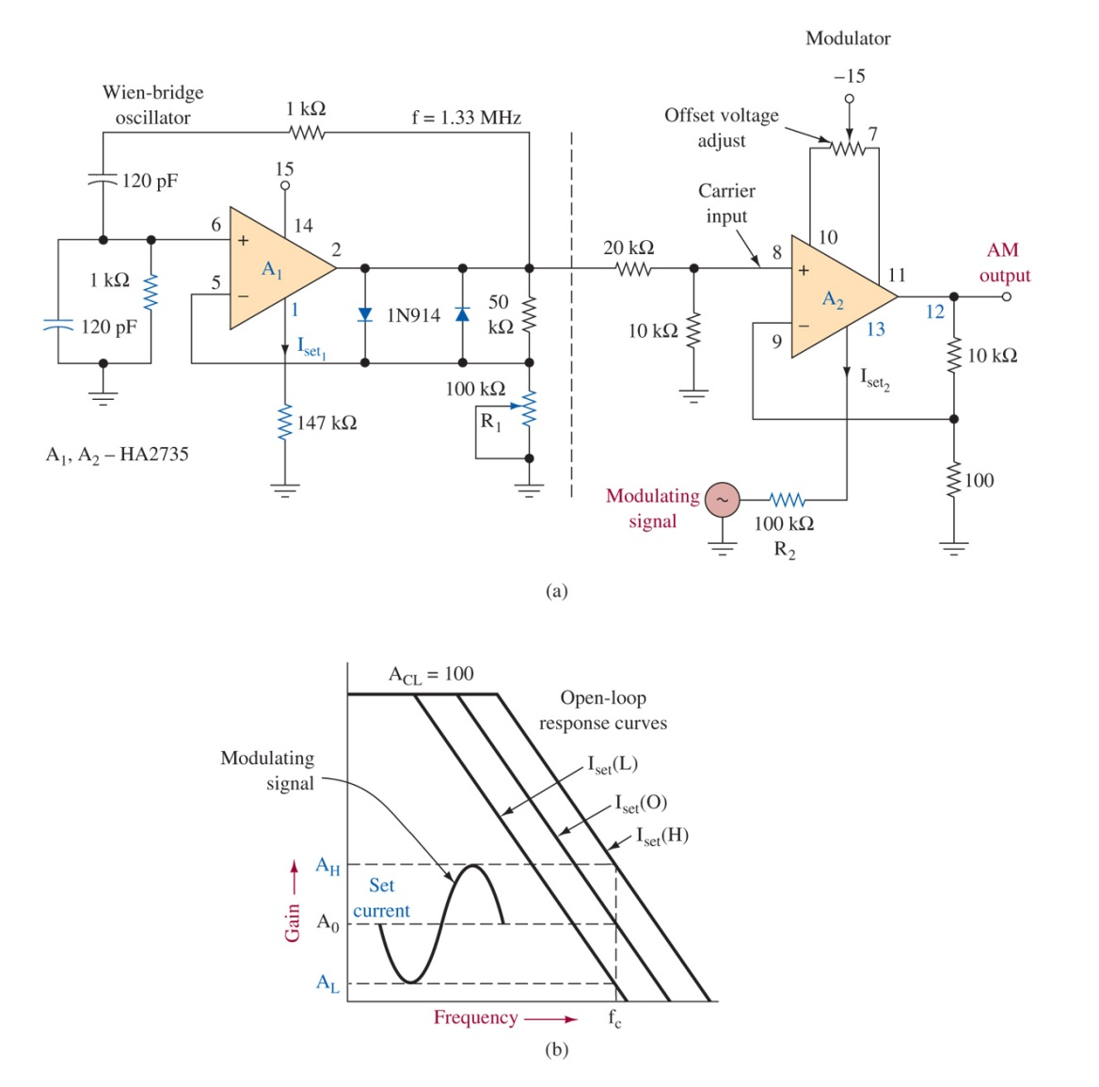
Figure 2-17 LIC modulator. Two op amps are used to generate the carrier, and perform modulation

Slide 27
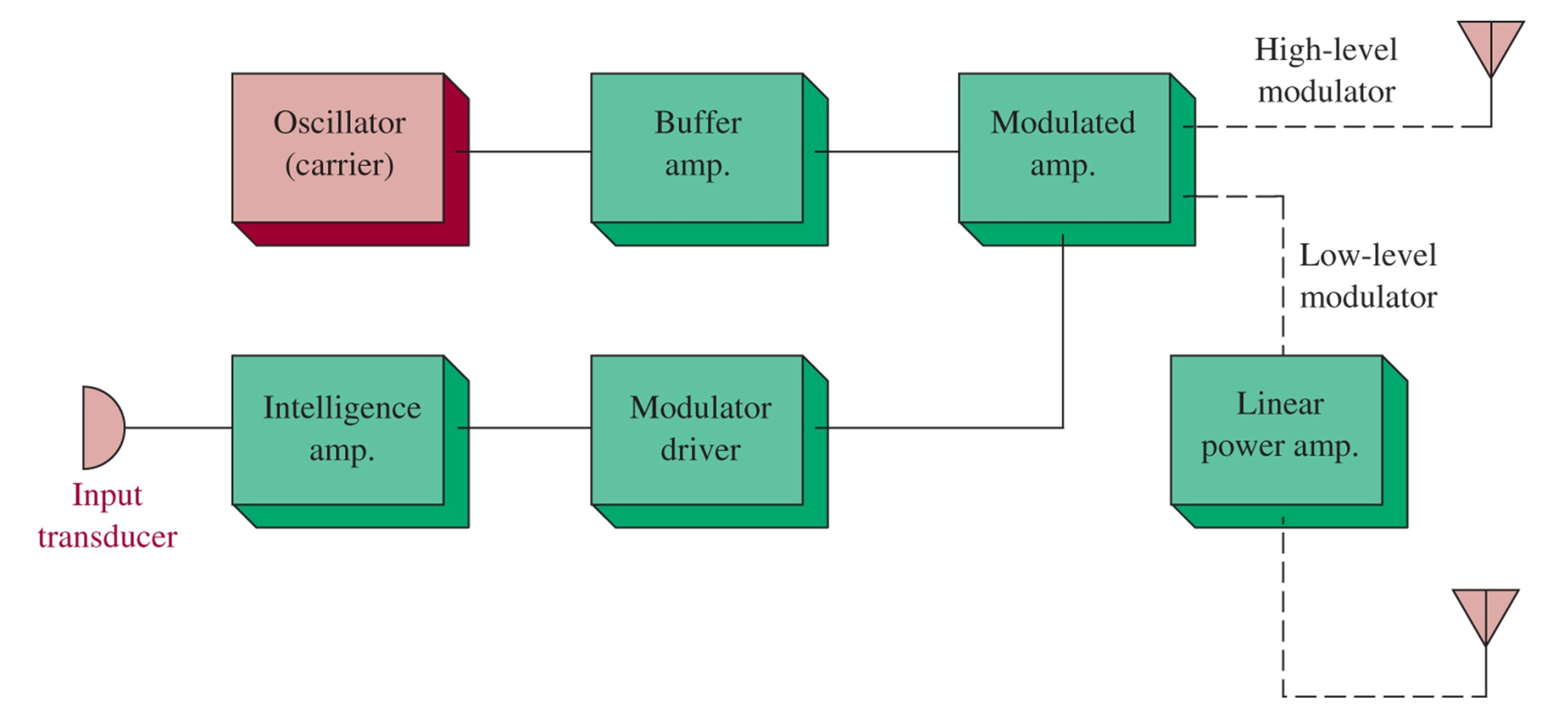
Figure 2-18 Simple AM transmitter block diagram.
2-6 AM Transmitter Systems

Slide 28
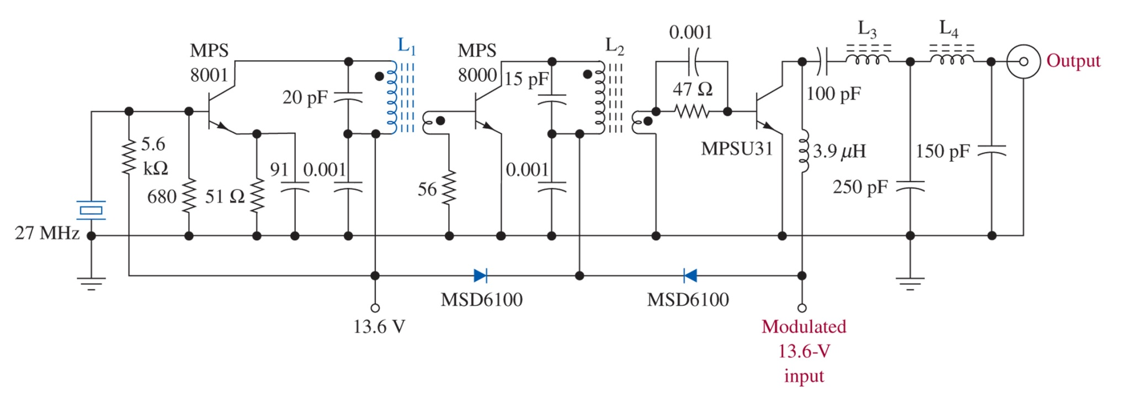
Figure 2-19 Class D citizen s band transmitter. (Courtesy of Motorola Semiconductor Products Sector.)

Slide 29
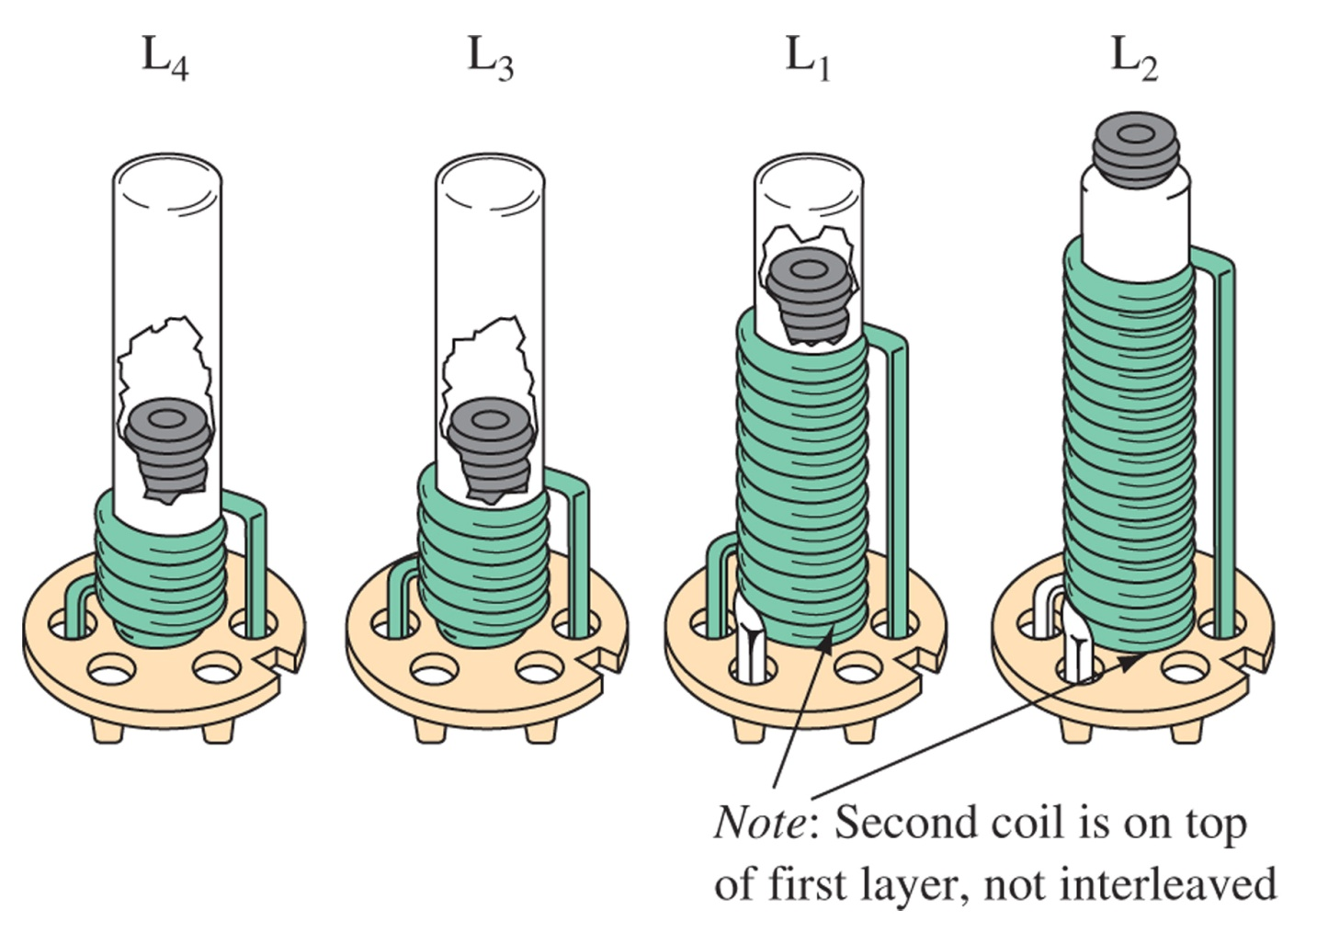
Figure 2-20 Coil description for transmitter shown in Figure 2-19: Conventional transformer coupling is employed between the oscillator and driver stages (L₁) and the driver and final stages (L₂). To obtain good harmonic suppression, a double-pi matching network consisting of (L₃) and (L₄) is utilized to couple the output to the antenna. All coils are wound on standard 1/4-in. coil forms with No. 22 AWG wire. Carbonyl J 1/4- × 3/8-in.-long cores are used in all coils. Secondaries are overwound on the bottom of the primary winding. The cold end of both windings is the start (bottom), and both windings are wound in the same direction. L₁—Primary: 12 turns (close wound); secondary: 2 turns overwound on bottom of primary winding. L₂ — Primary: 18 turns (close wound); secondary: 2 turns overwound on bottom of primary winding. L₃ —7 turns (close wound). L₄ —5 turns (close wound).

Slide 30
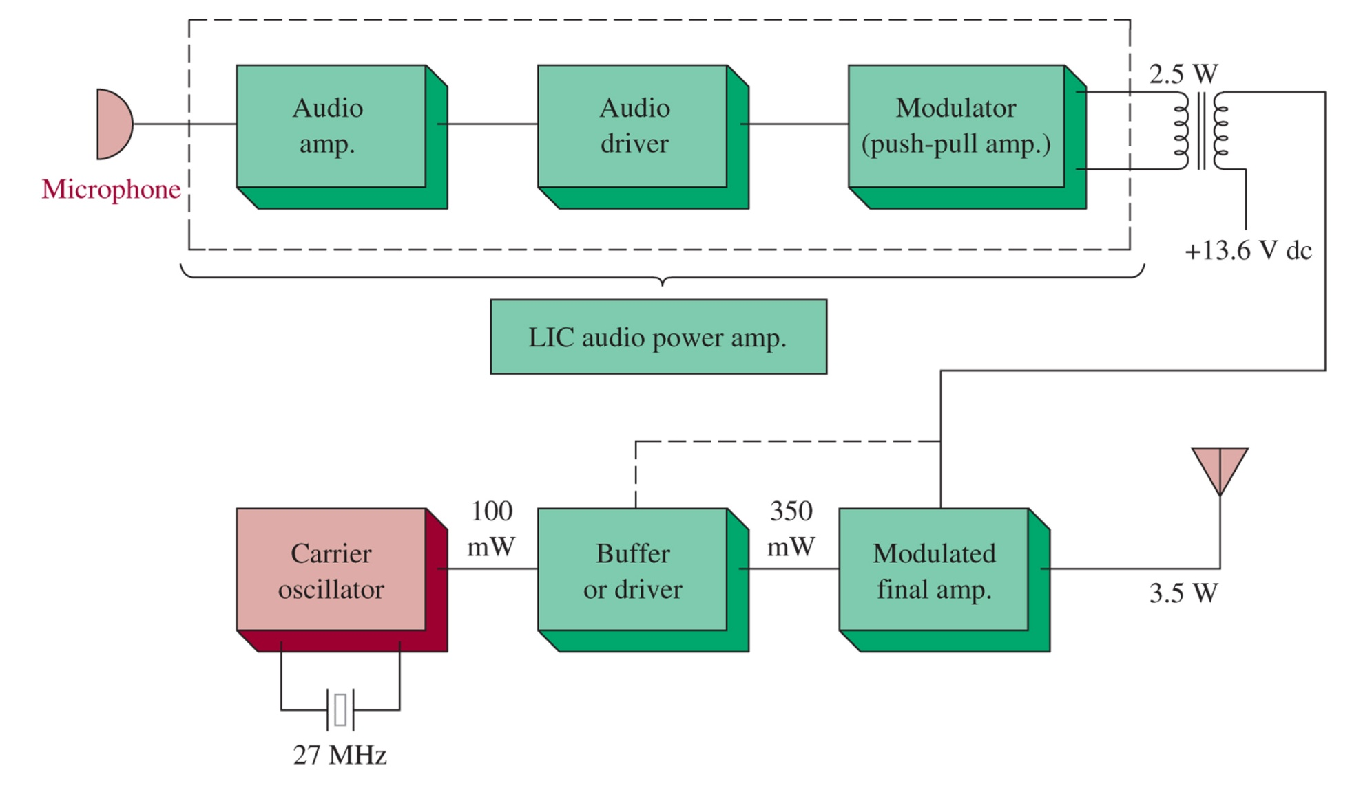
Figure 2-21 Citizen s band transmitter block diagram.

Slide 31
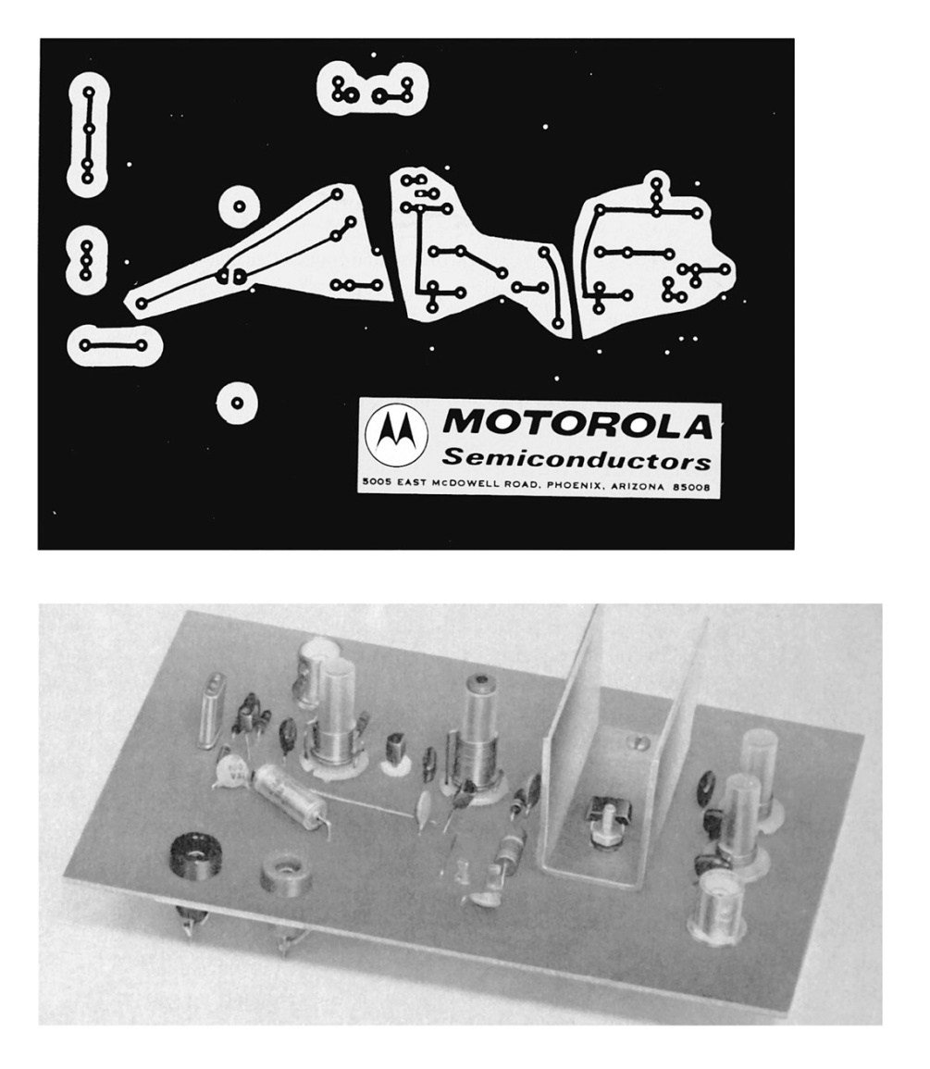
Figure 2-22 Citizen s band transmitter PC board layout and complete assembly pictorial. (Courtesy of Motorola Semiconductor Products, Inc.)

Slide 32
2-7 Transmitter Measurements

Slide 33
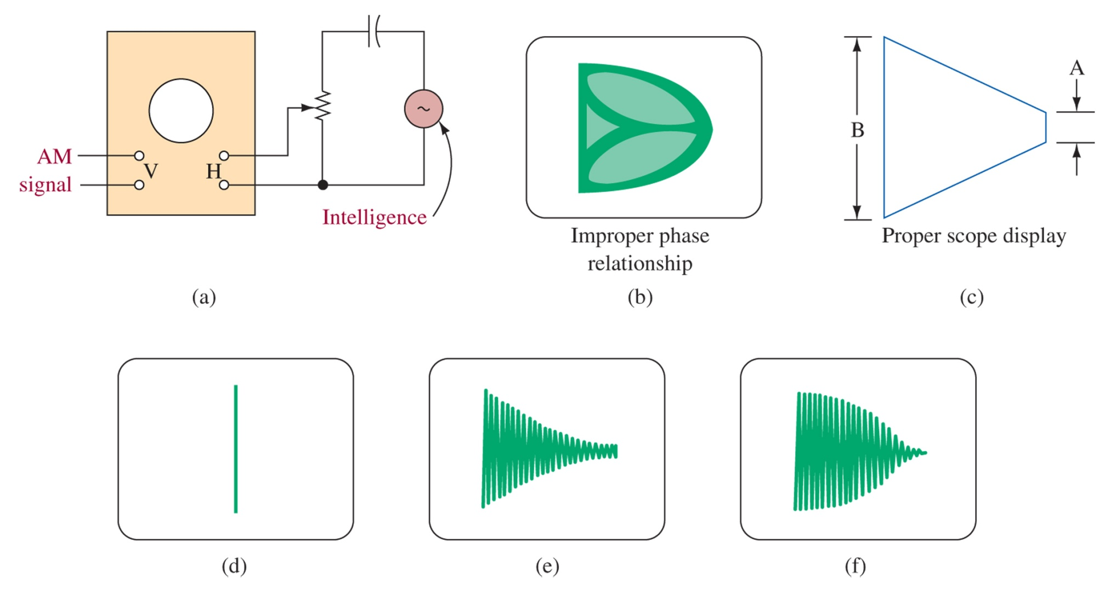
Figure 2-23 Trapezoidal pattern connection scheme and displays.
M=0
Poor linearity
Low excitation

Slide 34
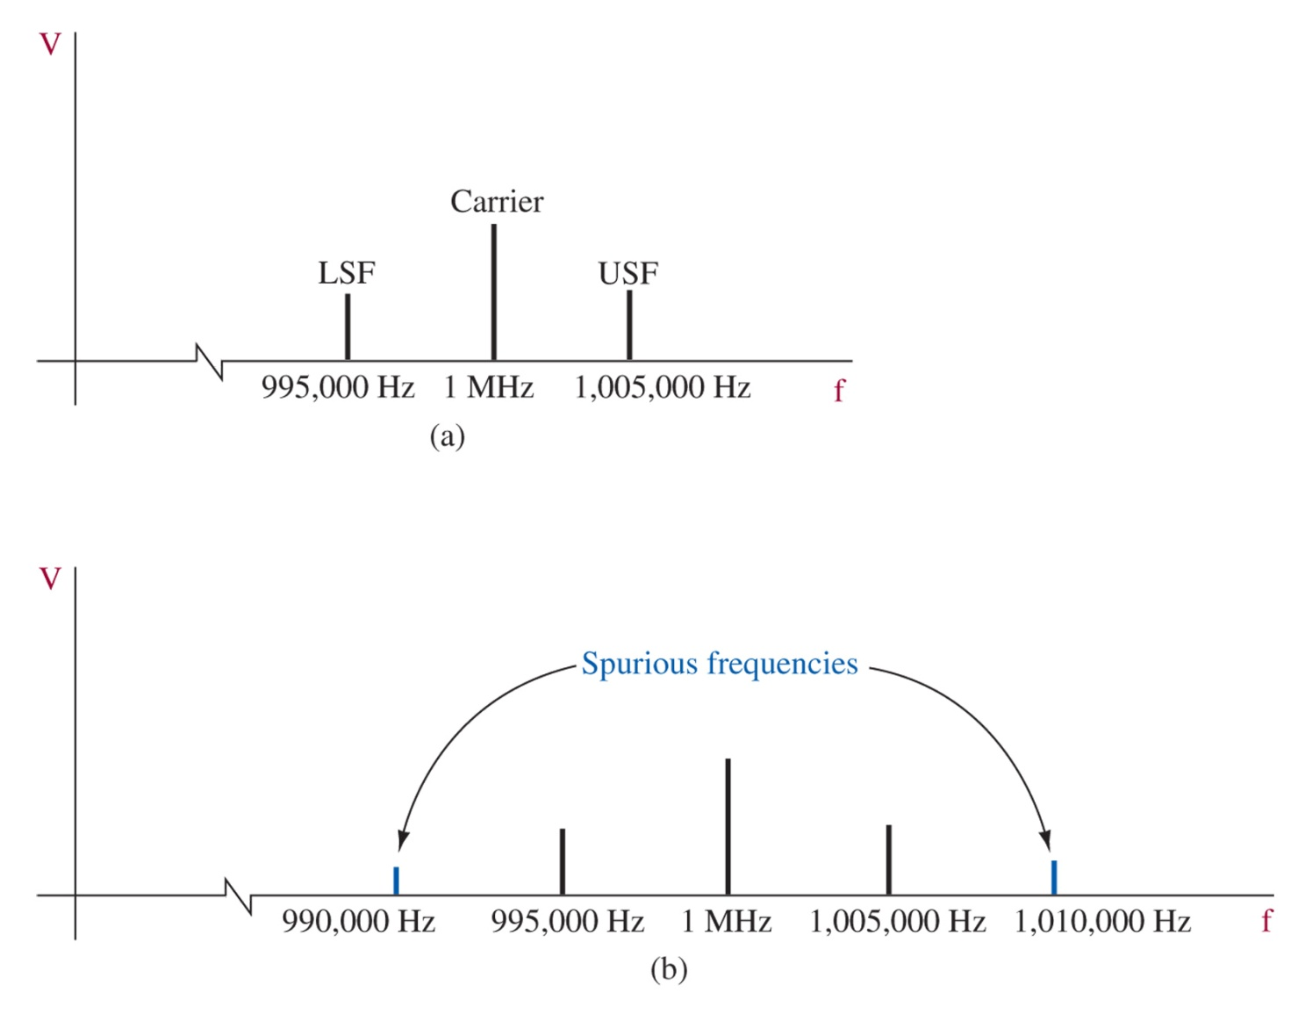
Figure 2-24 Spectrum analysis of AM waveforms.

Slide 35
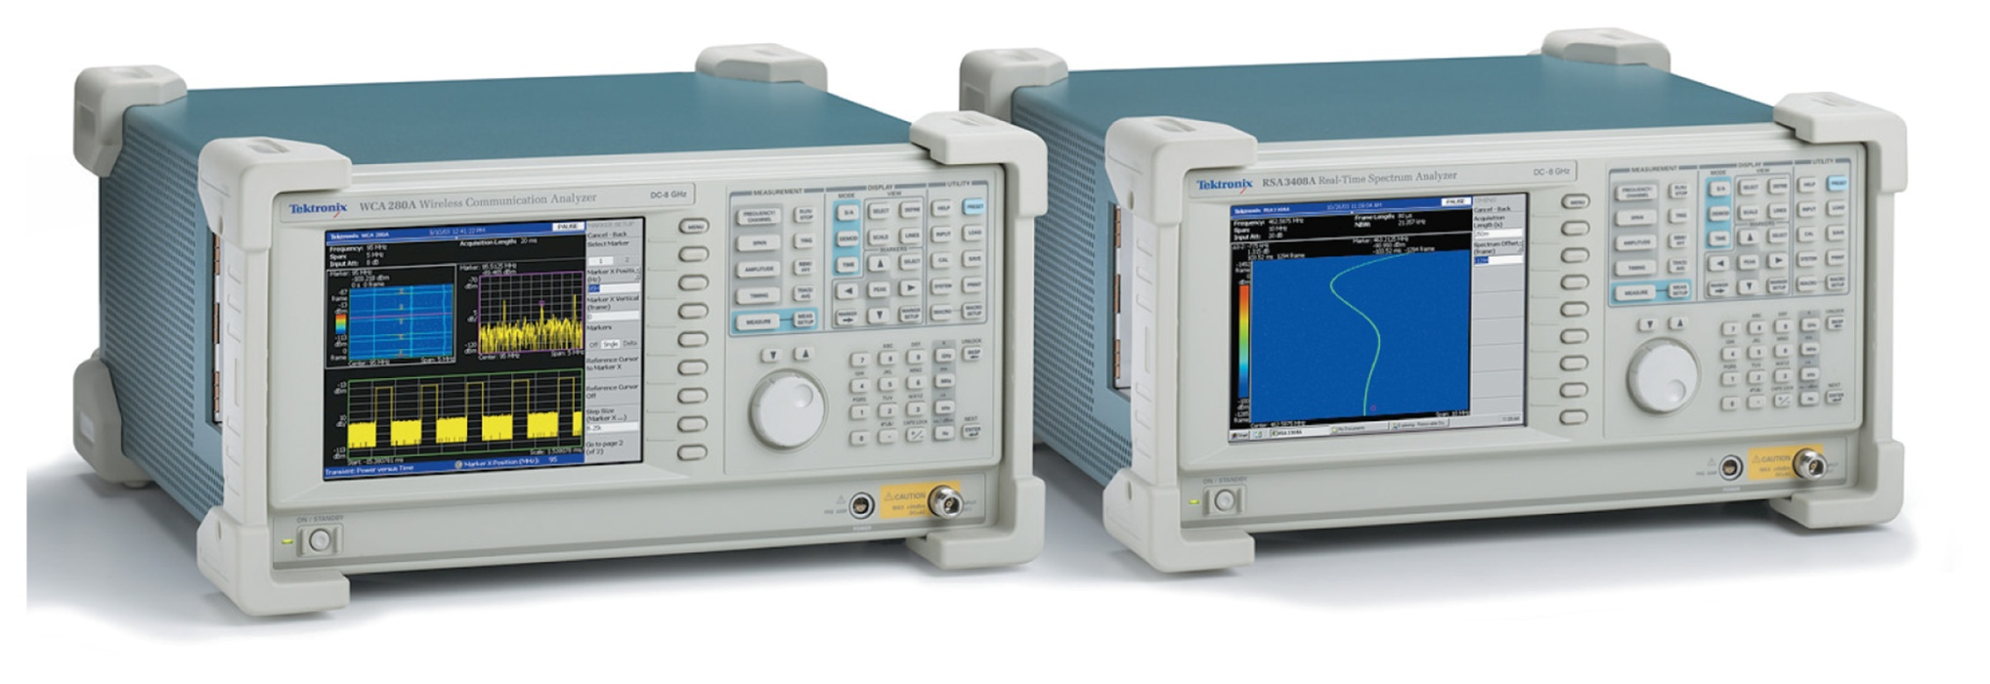
Figure 2-25 Spectrum analyzer and typical display. (Courtesy of Tektronix, Inc.)

Slide 36
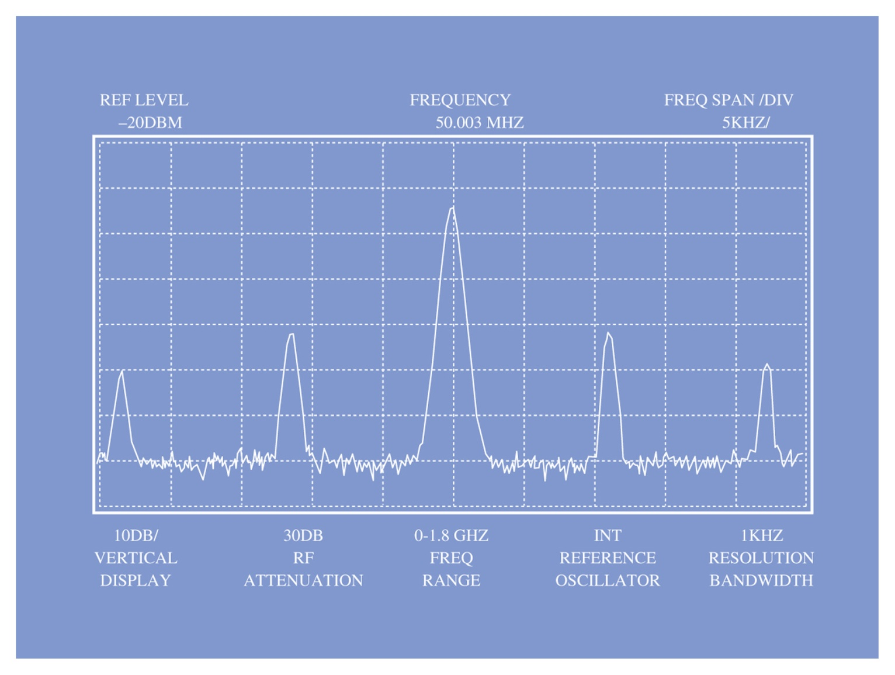
Figure 2-25 (continued) Spectrum analyzer and typical display. (Courtesy of Tektronix, Inc.)

Slide 37
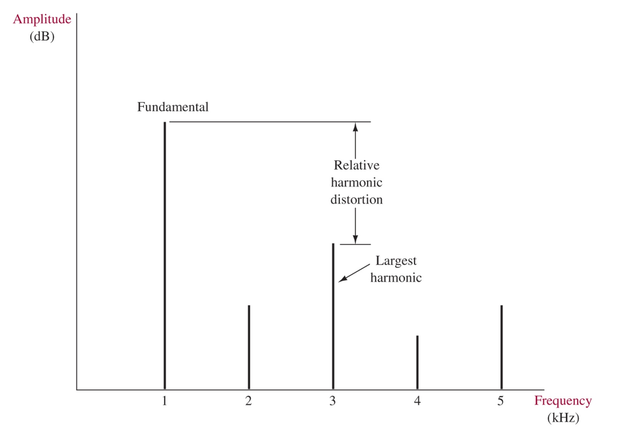
Figure 2-26 Relative harmonic distortion.

Slide 38
2-8 Troubleshooting

Slide 39
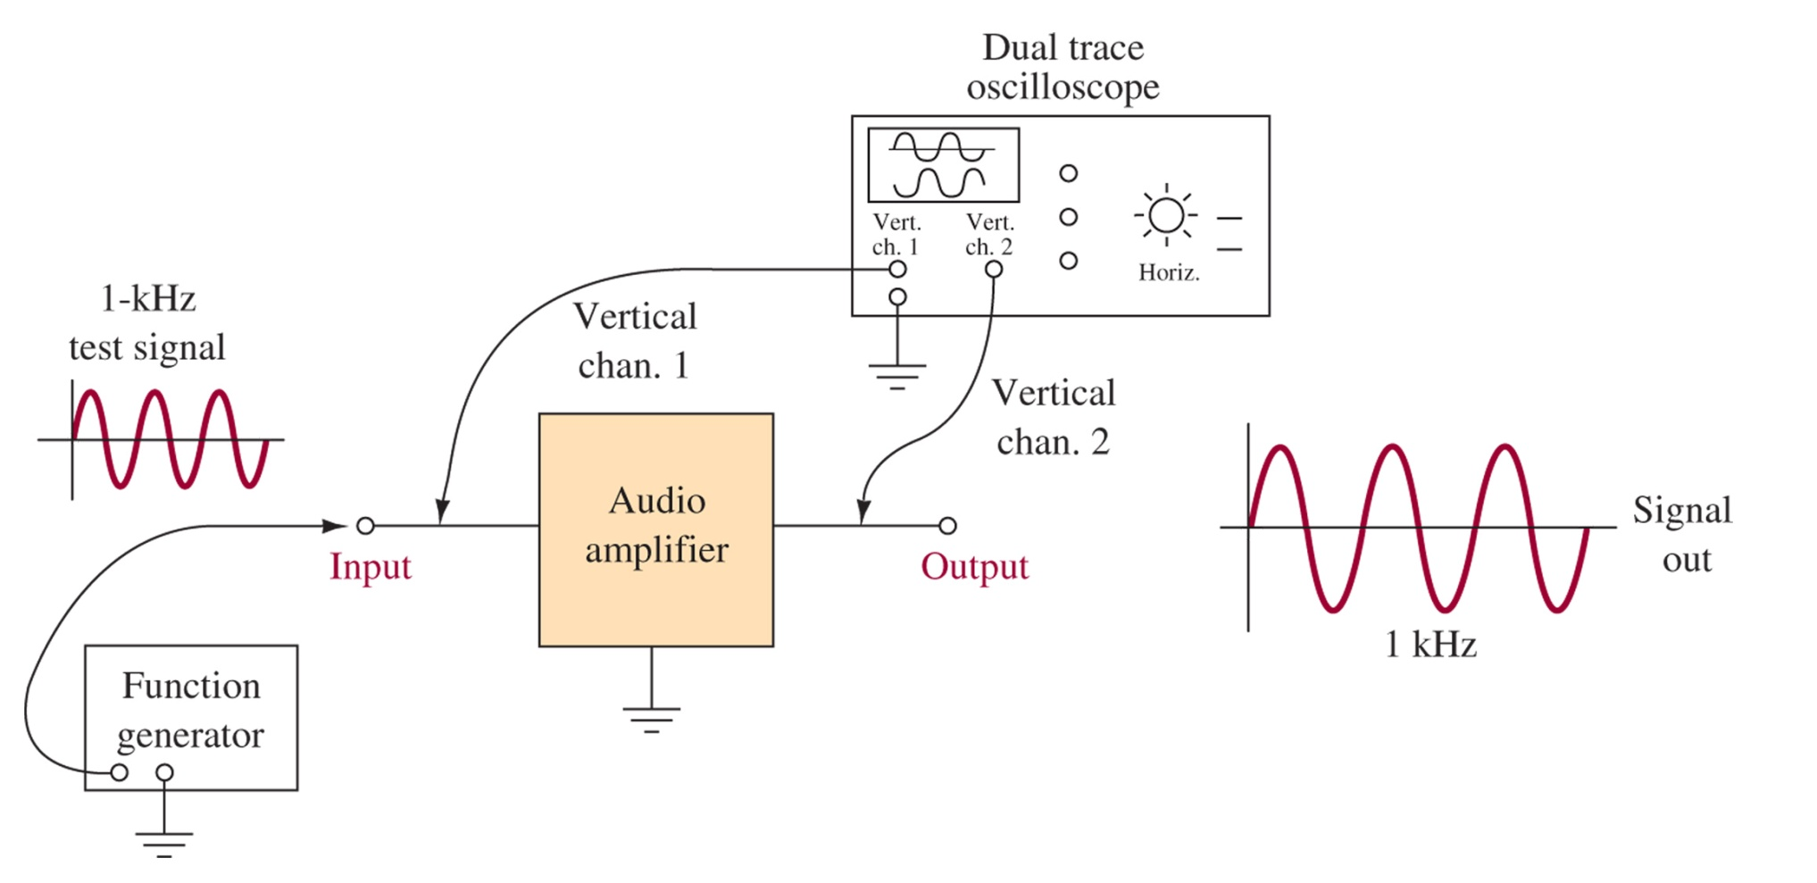
Figure 2-27 Comparing input and output signals.

Slide 40
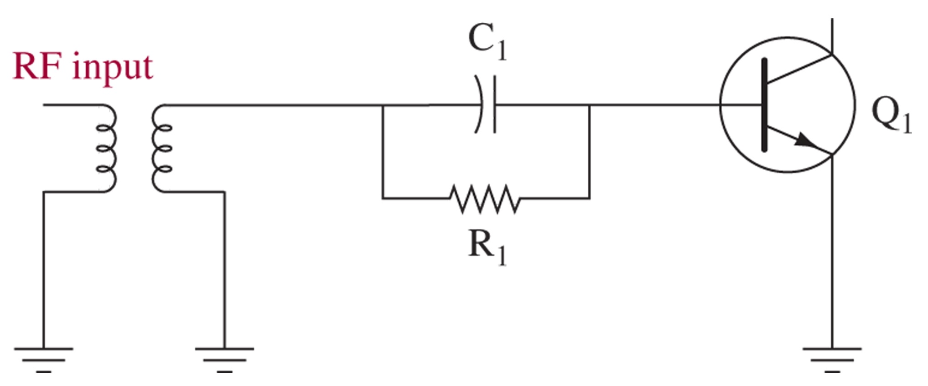
Figure 2-28 Self-bias circuit.

Slide 41
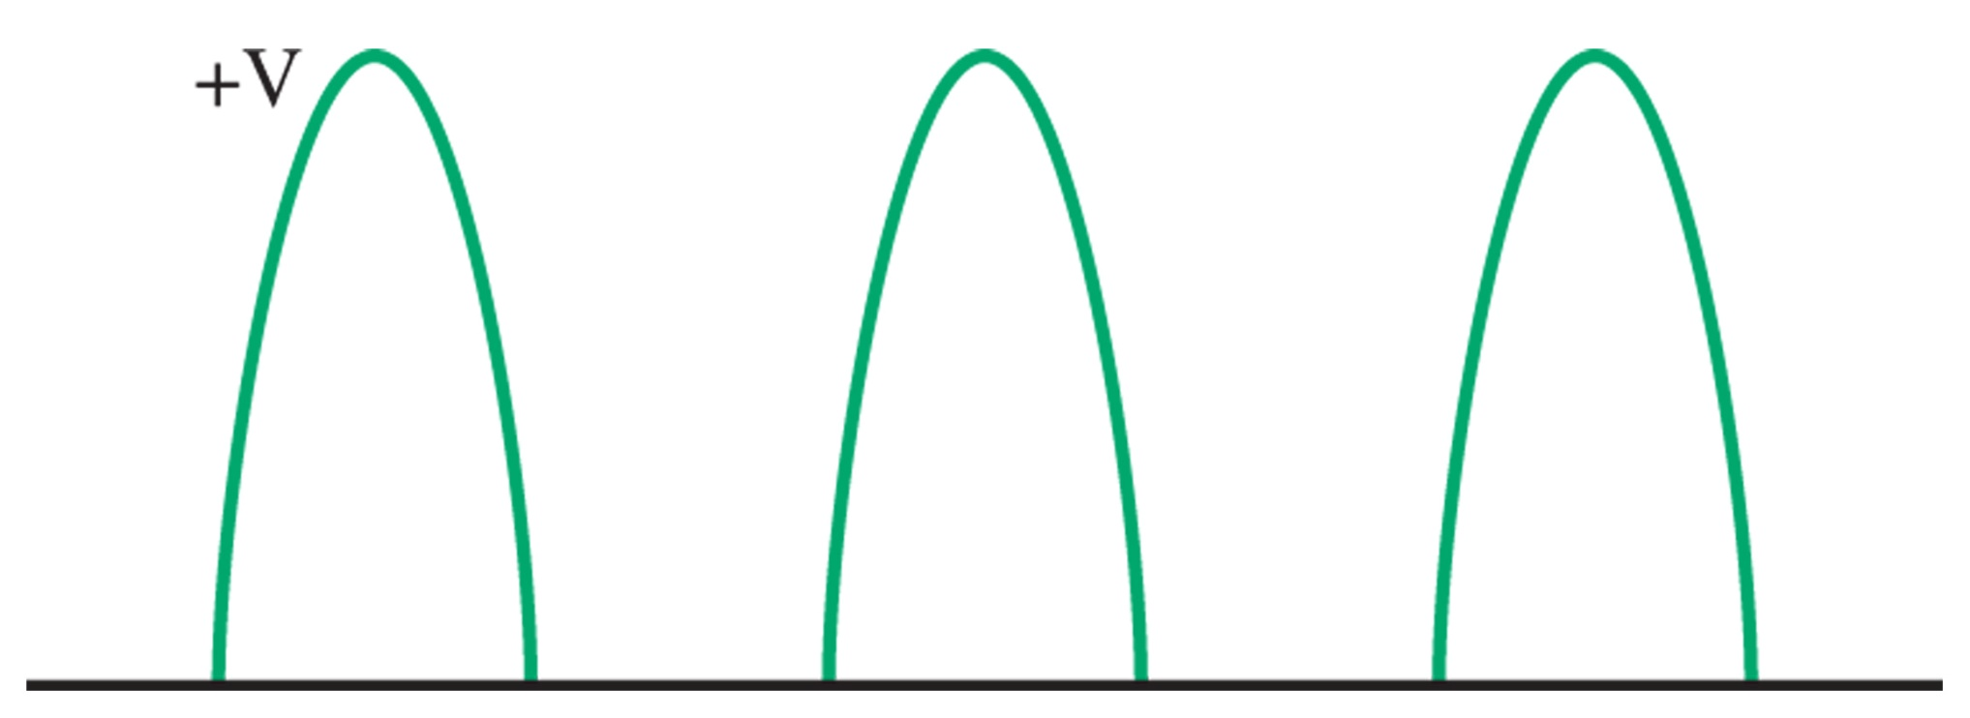
Figure 2-29 Voltage at Q₁ base.

Slide 42
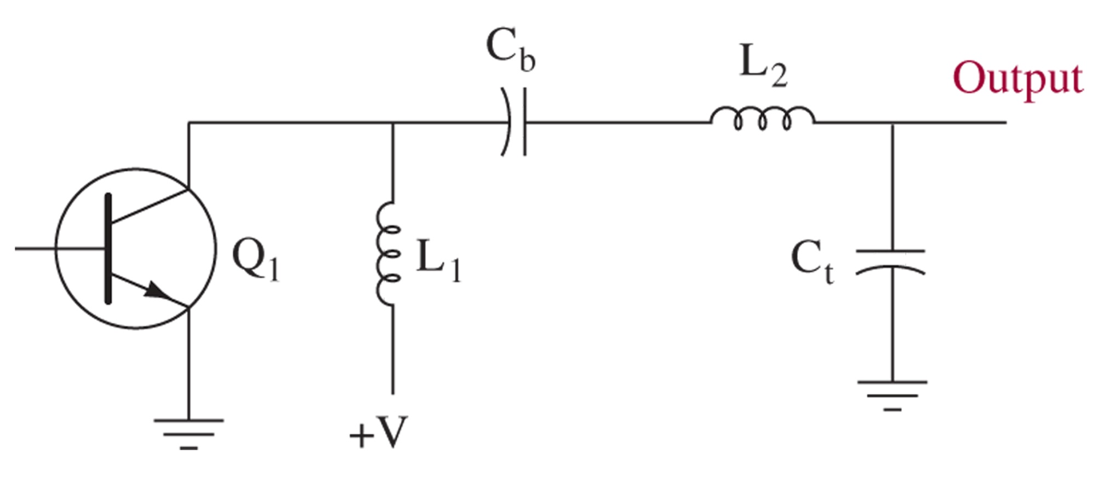
Figure 2-30 Output components.

Slide 43
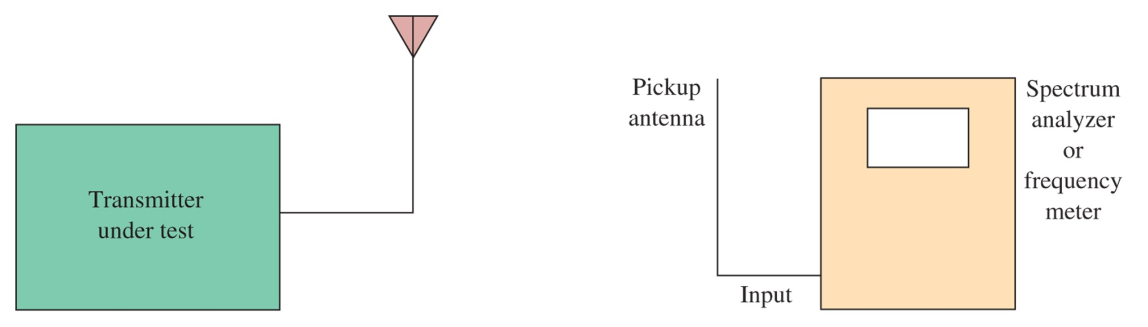
Figure 2-31 Determining a transmitter s output frequency.

Slide 44
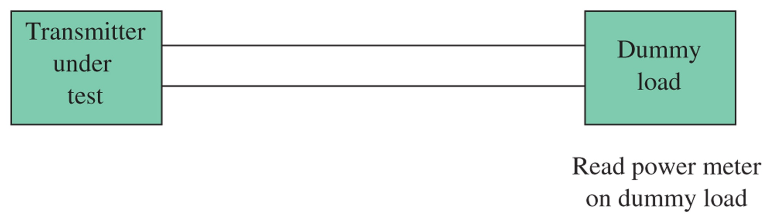
Figure 2-32 Checking the output power of an AM transmitter.

Slide 45
2-9 Troubleshooting w/ Multisim

Slide 46
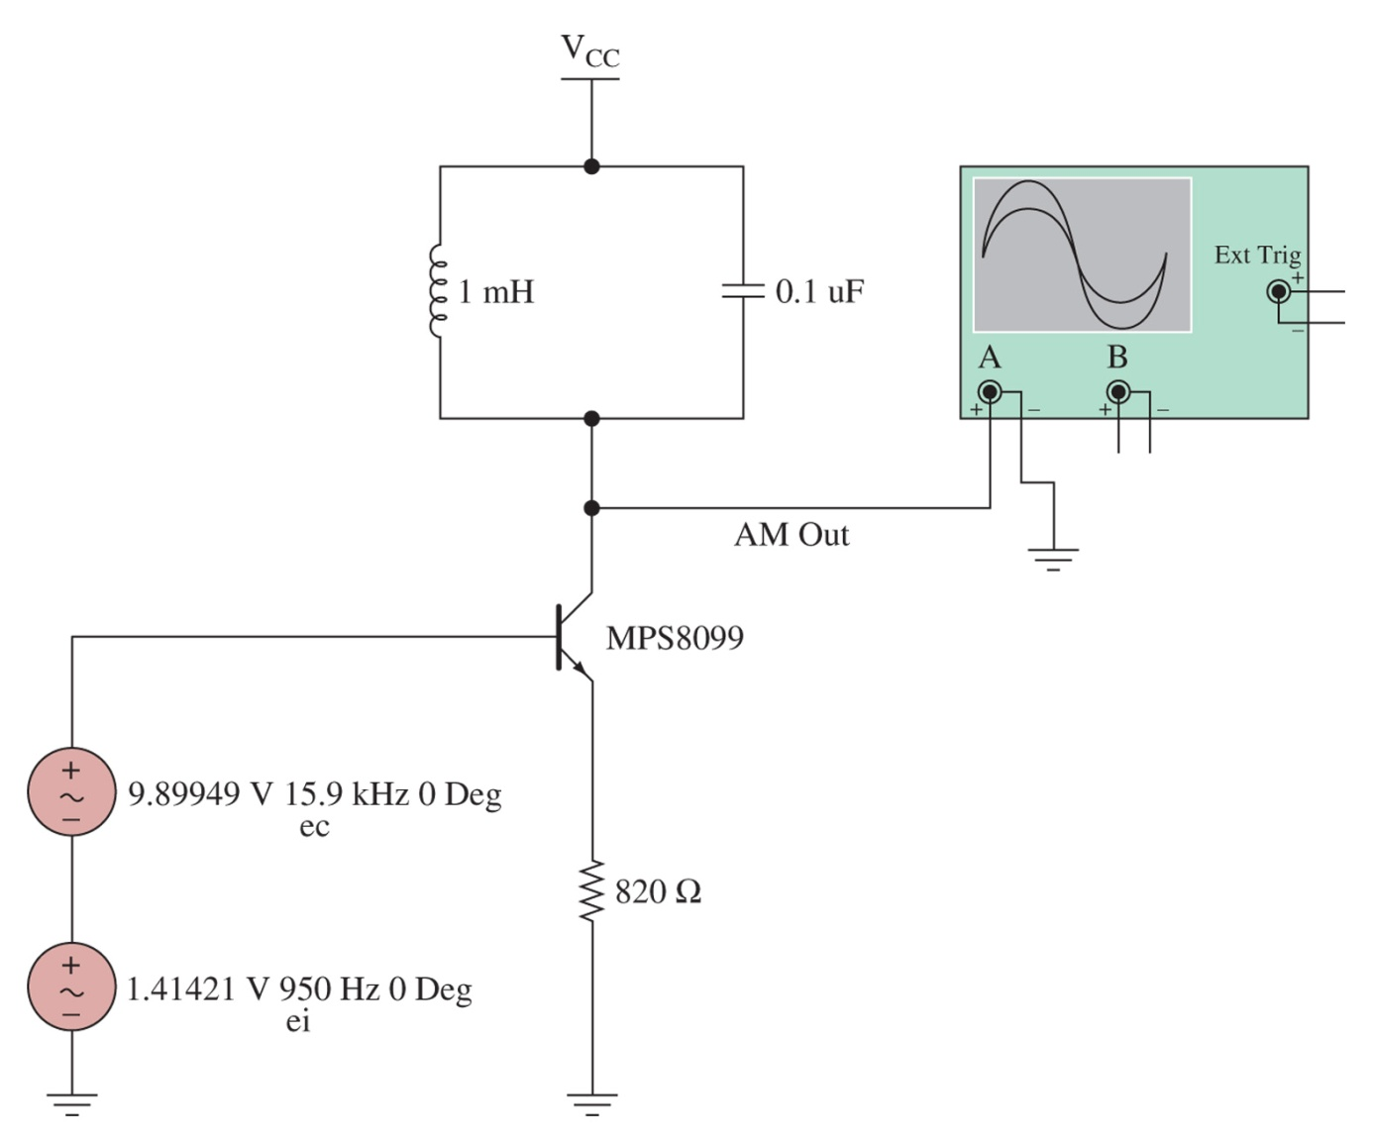
Figure 2-33 The Multisim component view for the simple transistor amplitude modulator circuit.

Slide 47
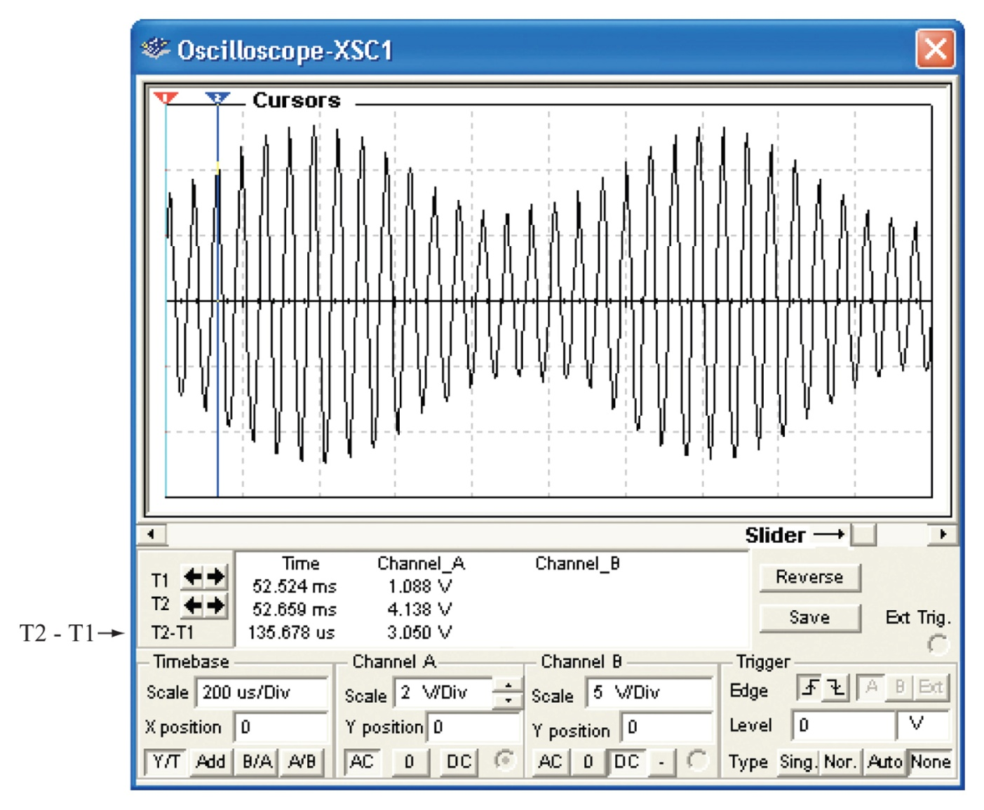
Figure 2-34 The Multisim oscilloscope control panel.

Slide 48
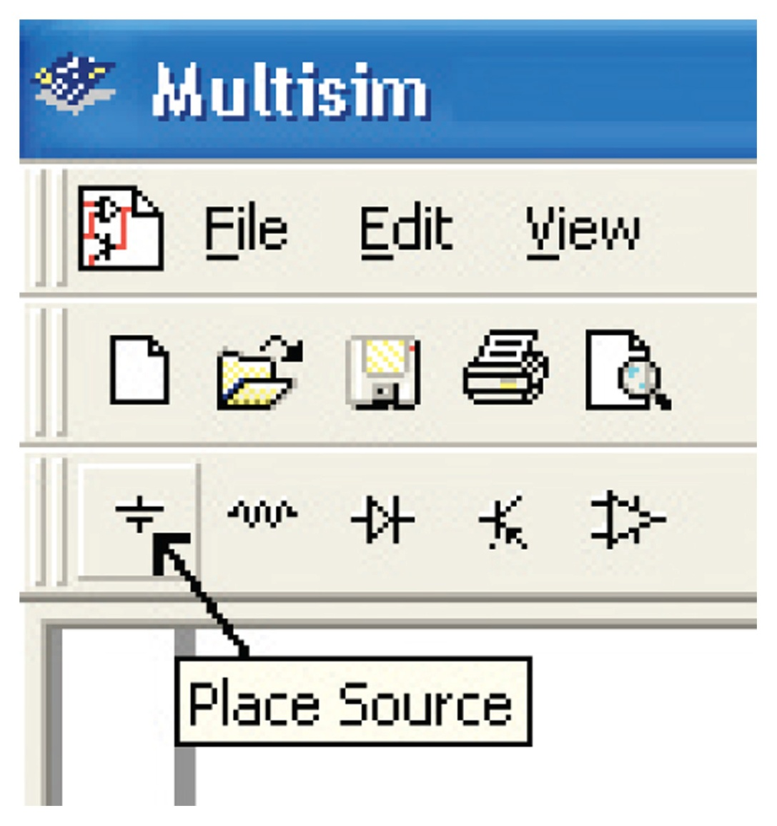
Figure 2-35 The Sources icon in Electronics WorkbenchTM Multisim.

Slide 49
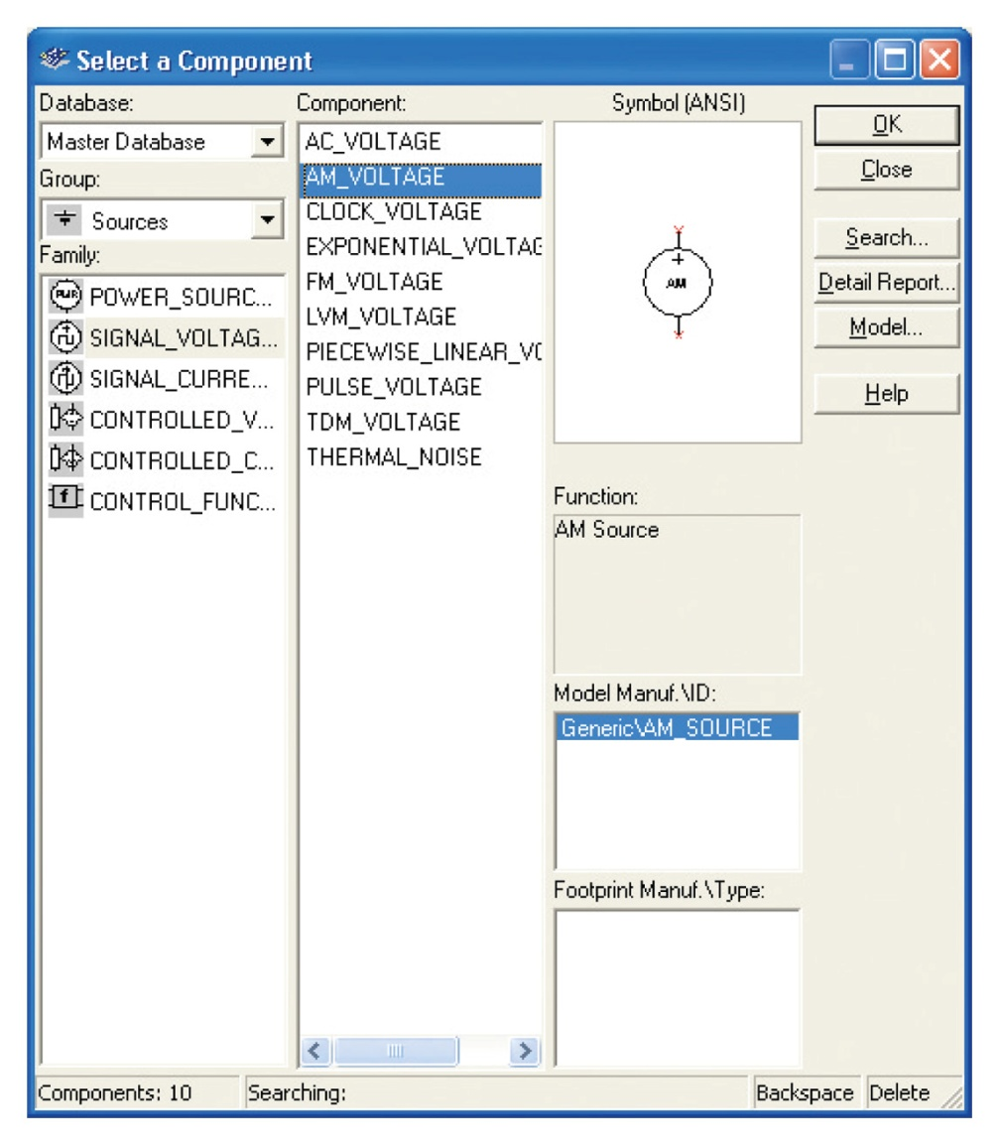
Figure 2-36 A partial list of the sources provided by Multisim and the location of the AM Sources icon.

Slide 50
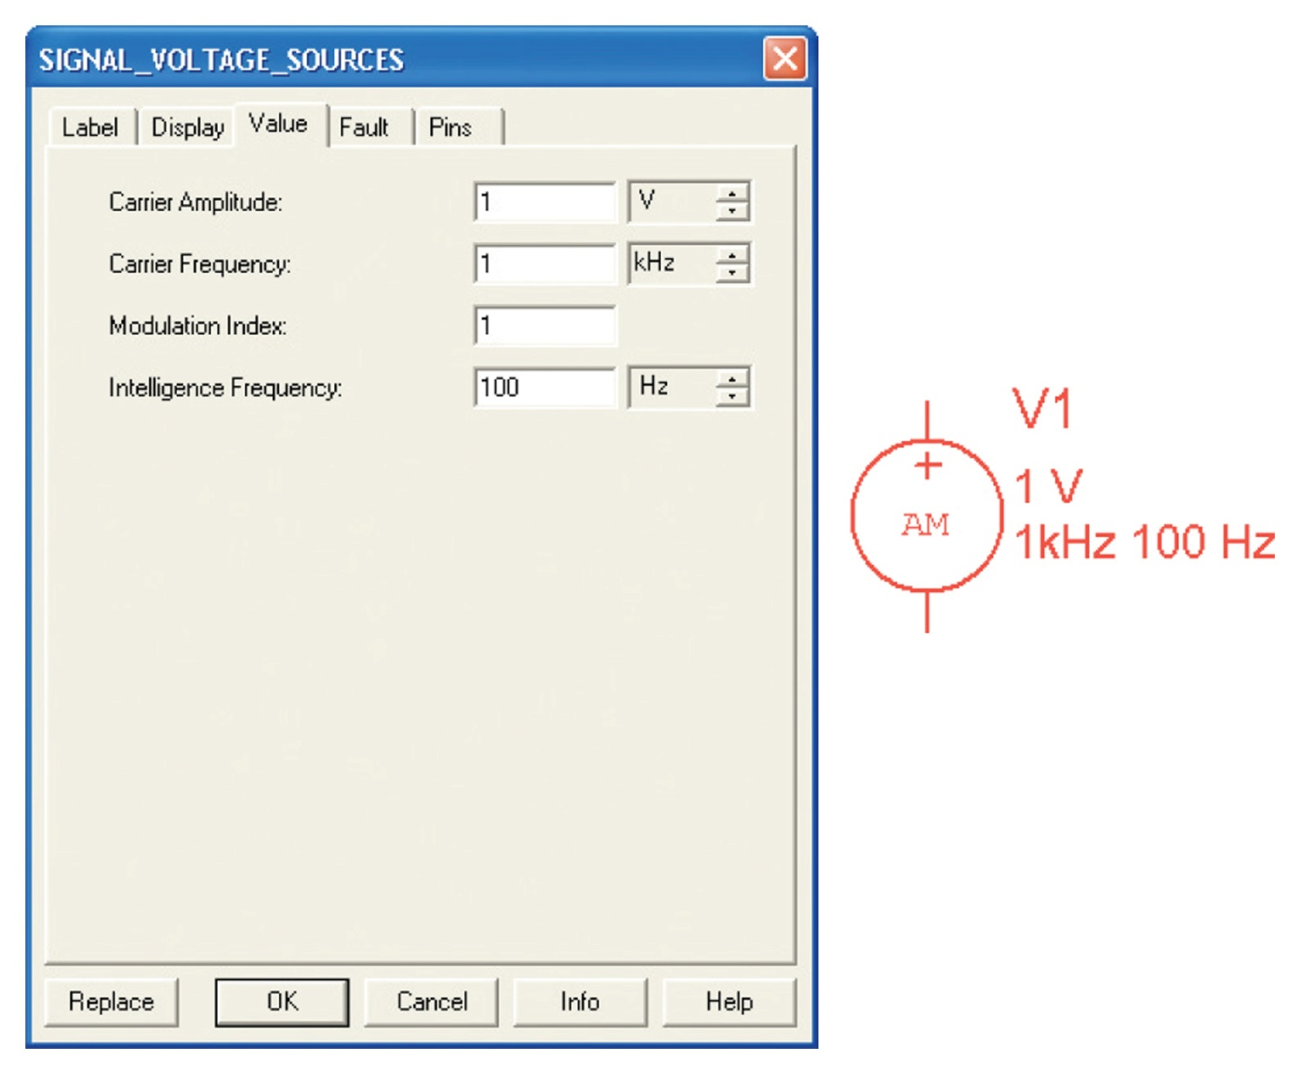
Figure 2-37 The AM Source and the menu for setting its parameters.

Slide 51
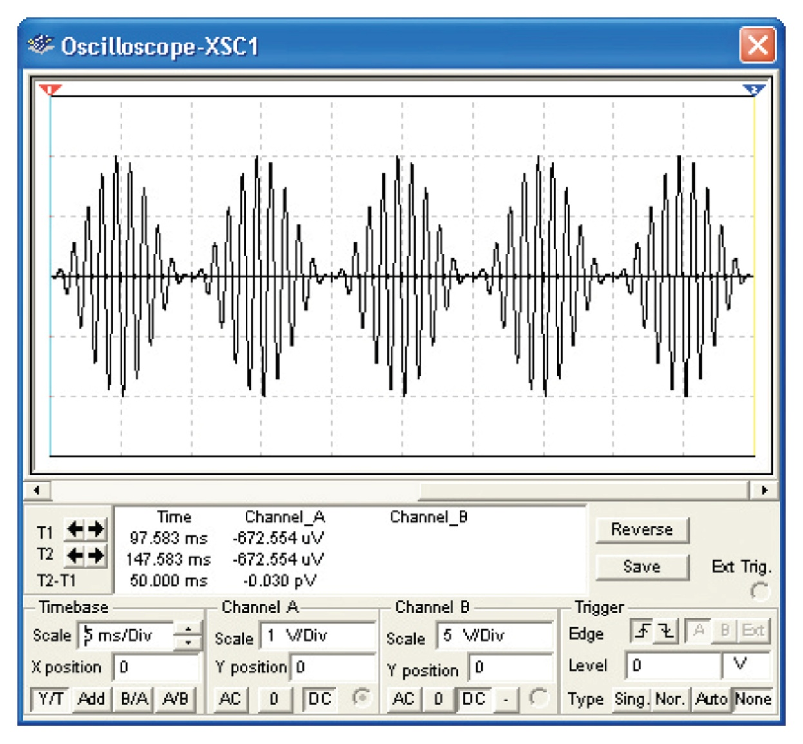
Figure 2-38 The output of the AM Source.

