Slide 1
EE 350 / ECE 490
Analog Communication Systems
Ch. 3 – Amplitude Modulation:
Receivers

Slide 2
Objectives
Define the sensitivity and selectivity of a radio receiver
Describe the operation of a diode detector in n AM receiver
Sketch block diagrams for TRF and superheterodyne receivers
Understand the generation of image frequencies and describe how to suppress them
Recognize and analyze RF and IF amplifiers
Describe the need for automatic gain control and show how it can be implemented
Analyze the operation of a complete AM receiver system
Perform a test analysis on the power levels (dBm) at each stage of an AM receiver system

Slide 3
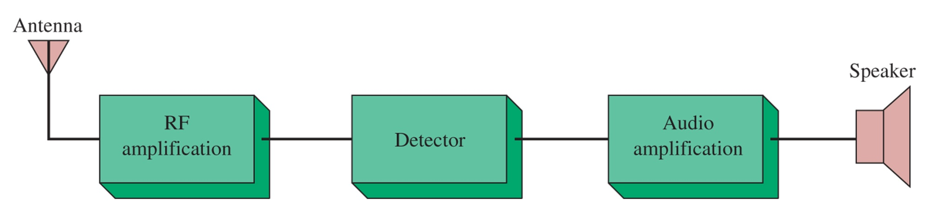
3-1 Receiver Characteristics
Figure 3-1 Simple radio receiver block diagram.
Low-noise RF amplifier from antenna, tuned to desired carrier and side-band frequencies
Circuit to separate intelligence from RF
Amplification of intelligence to drive speaker

Slide 4
Sensitivity & Selectivity
Sensitivity is the minimum input needed to generate a discernible output. May be millivolts (for cheap) or nanovolts (for high-end). Must be able to distinguish the signal from the noise floor, and not inject more noise into the signal during amplification.
Selectivity is the ability to differentiate between the desired signal and other frequencies (interference and noise). You can be too selective, which will limit your bandwidth and cause loss of fidelity.

Slide 5
TRF Sensitivity
Tuned Radio Frequency (TRF) sensitivity varies when spanning the broadcast spectrum from 550 kHz to 1550 kHz
Q for bandwidth at center frequency
However, at the two extremes the bandwidth
Is too selective or not enough

Slide 6
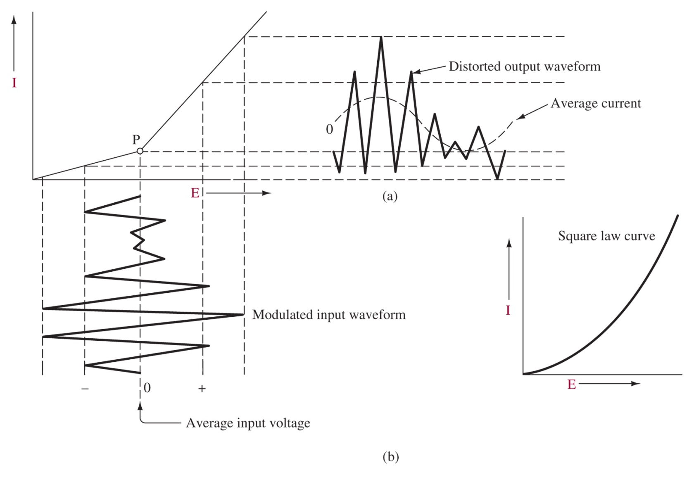
3-2 AM Detection
Figure 3-2 Nonlinear device used as a detector.
Passing the AM signal through a nonlinear device generates sum and difference frequencies, which are the intelligence.

Slide 7
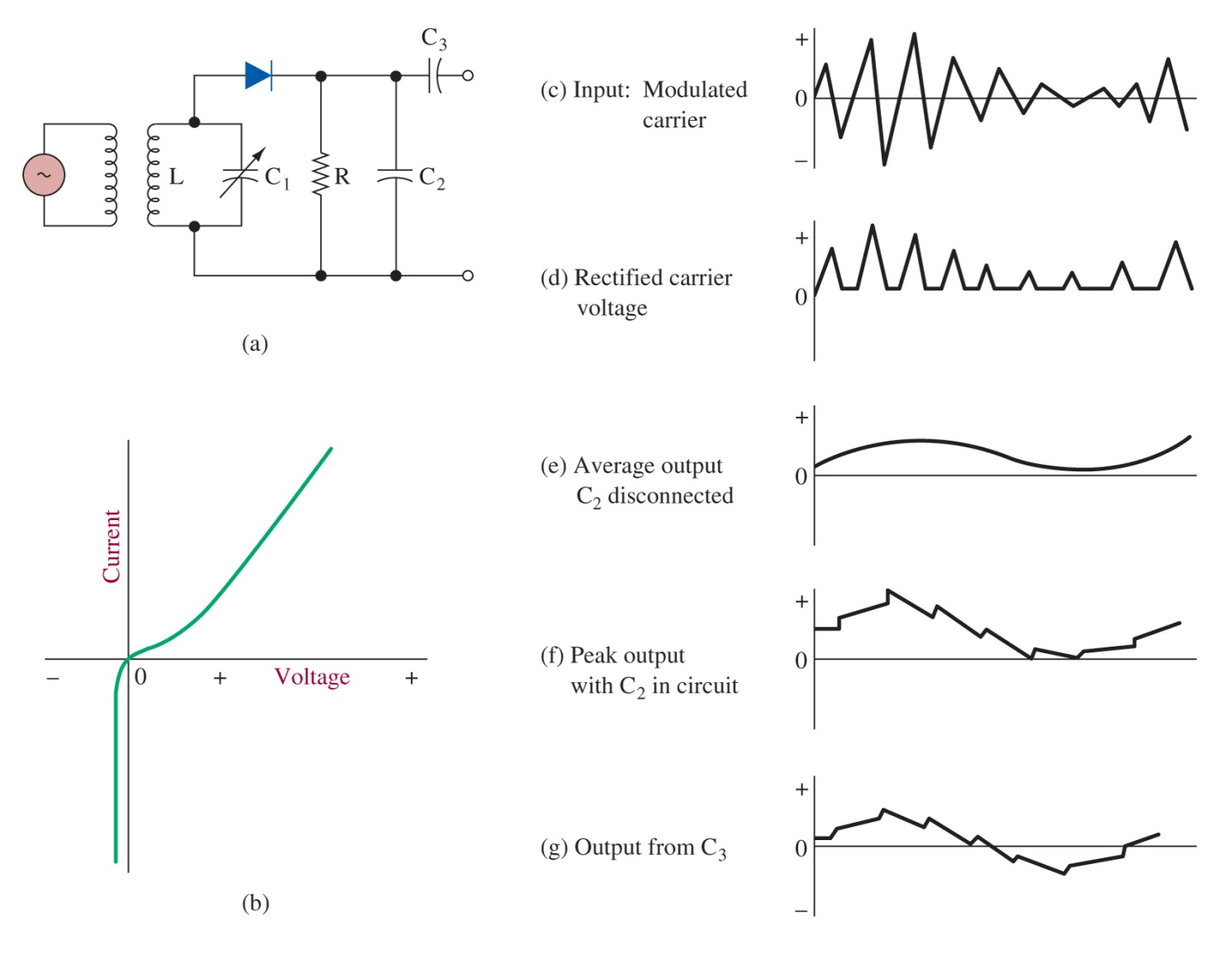
Figure 3-3 The Diode detector is a nearly ideal nonlinear device
Advantages:
High power signals
Acceptable distortion
Highly efficient
DC voltage for AGC
Disadvantages:
Diode absorbs power from tuned circuit reducing Q and selectivity
No amplification

Slide 8
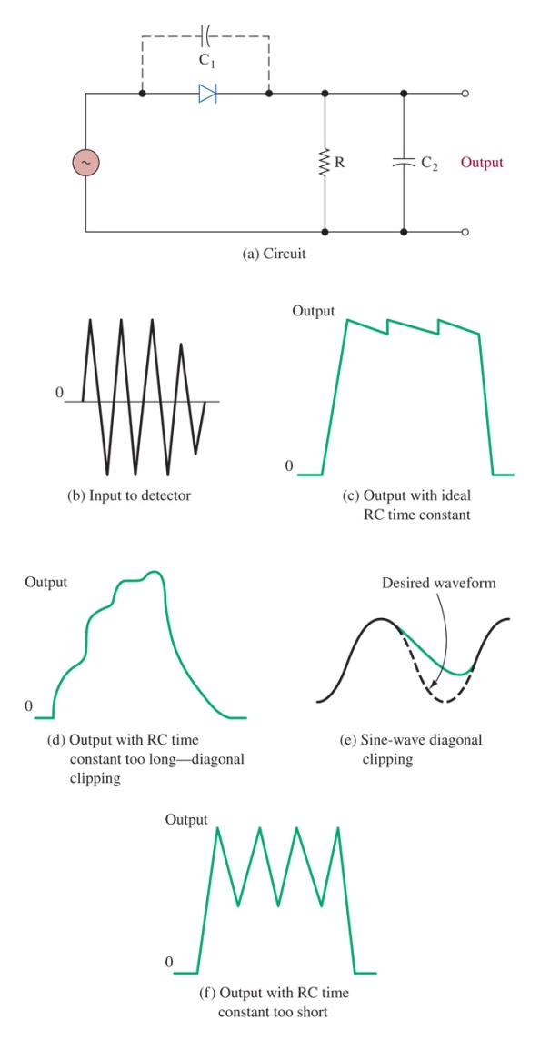
Diagonal Clipping
Figure 3-4 Diode detector component considerations. Dashed lines indicate average voltage during pulse.
R must be chosen such that RC is not too long or too short. C2 cannot be so small that it would be comparable to C1.

Slide 9
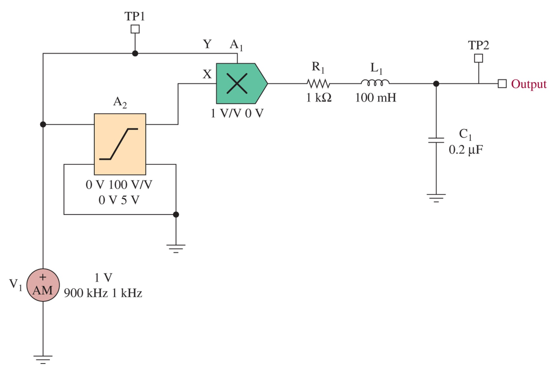
Synchronous Detection
Low distortion <1%
Better at following fast-modulation waveforms
Gain
3 dB better S/N
Figure 3-5(a) A synchronous AM detector circuit as implemented in Electronics WorkbenchTM Multisim.
Called product or heterodyne detectors.

Slide 10
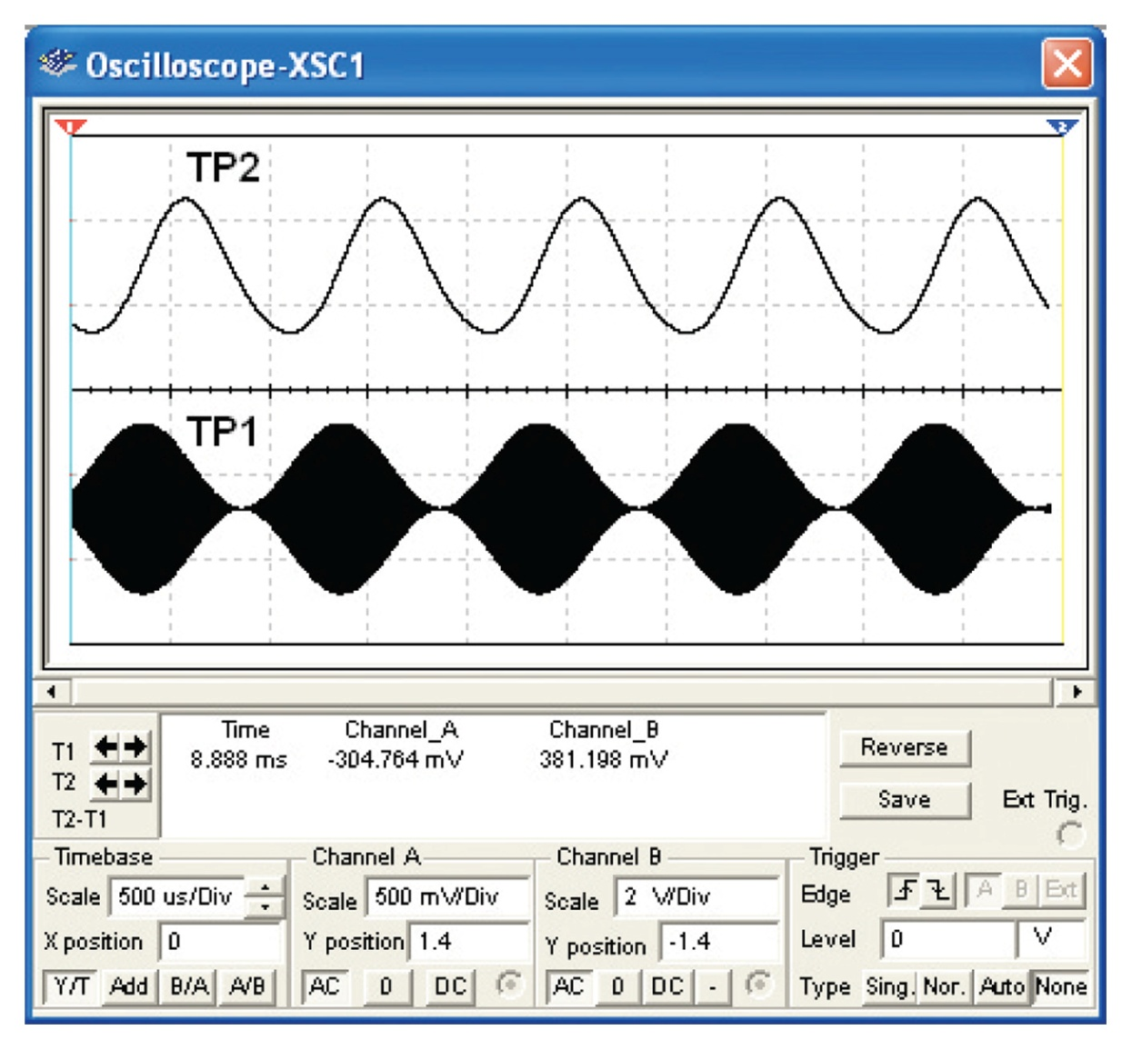
Figure 3-5(b) The waveforms obtained from TP1 and TP2 for the synchronous AM detector provided in Figure 3-5(a).

Slide 11
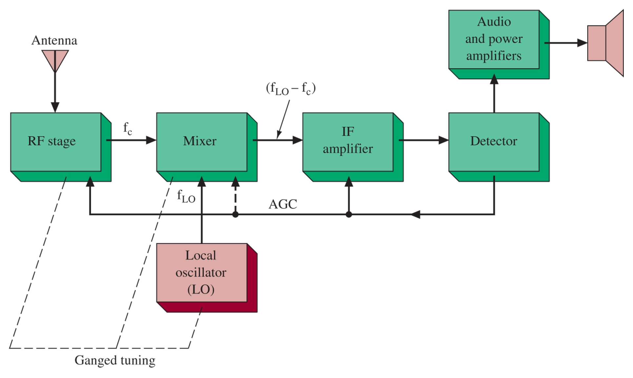
3-3 Superheterodyne Receivers
Invented by Armstrong.
The mixer is a nonlinear device, which generates sum and difference frequencies between the LO and carrier
Figure 3-6 Superheterodyne receiver block diagram.

Slide 12
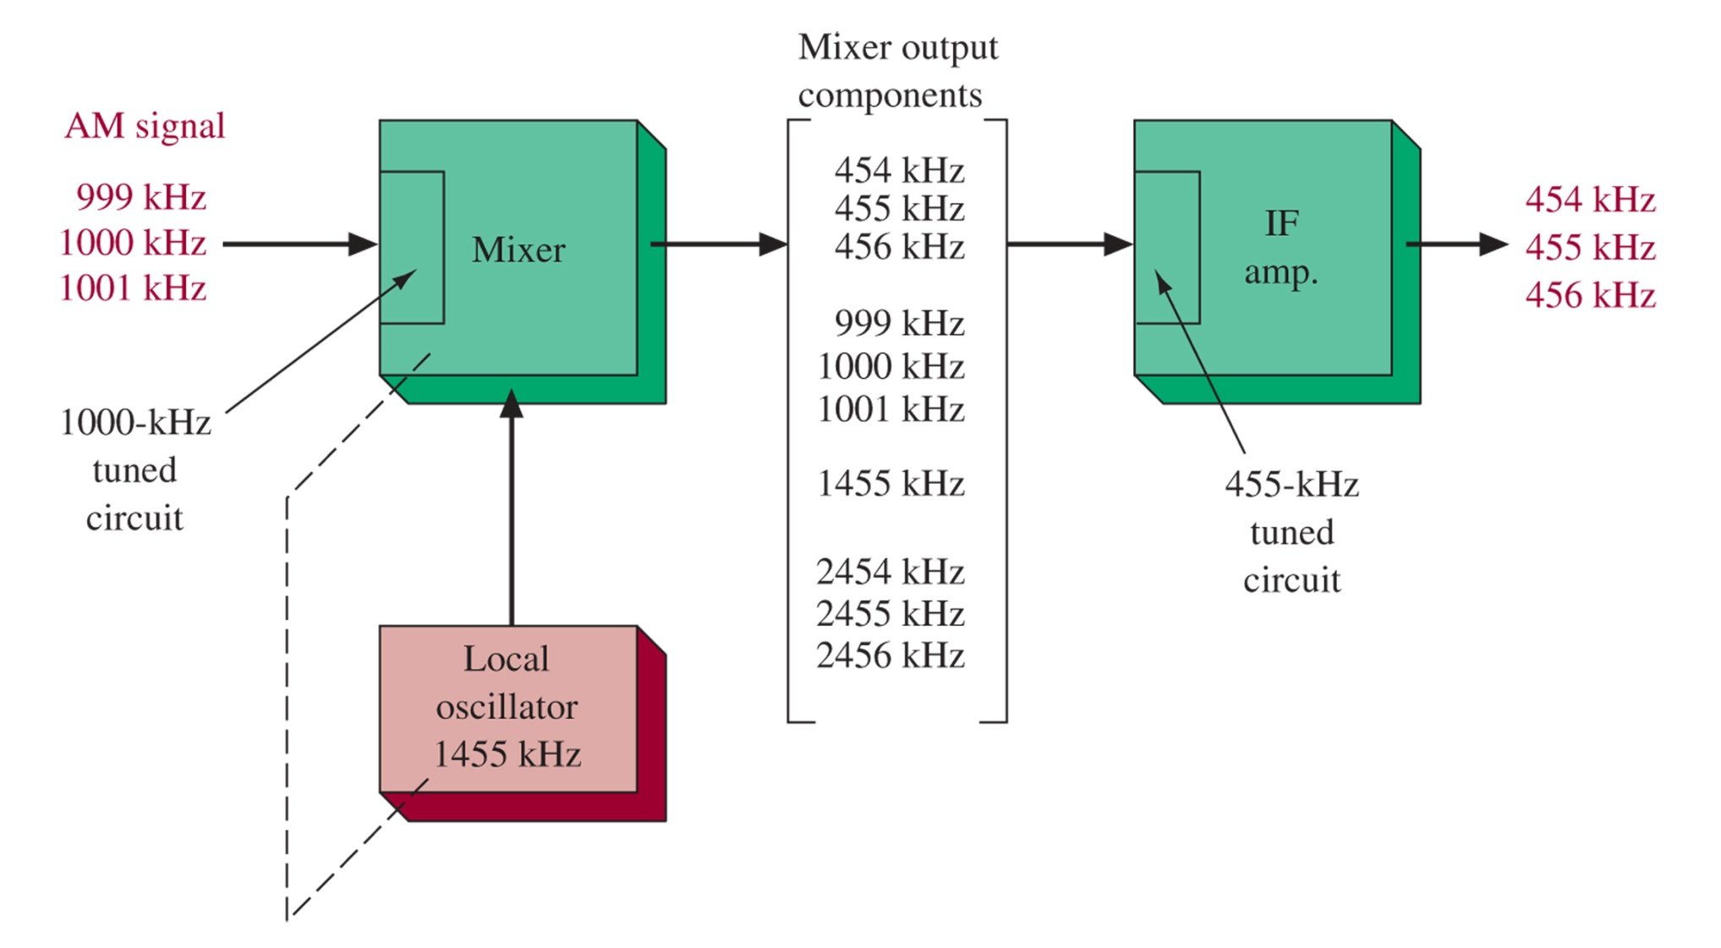
Figure 3-7 Frequency conversion process.
The Mixer outputs are replicas of the AM signal, but with different carrier frequencies. The intelligence is the same.
The Intermediate Frequency (IF) amplifier can be designed and tuned to 455kHz (standard for AM) rather than having to vary like the TRF receiver.

Slide 13
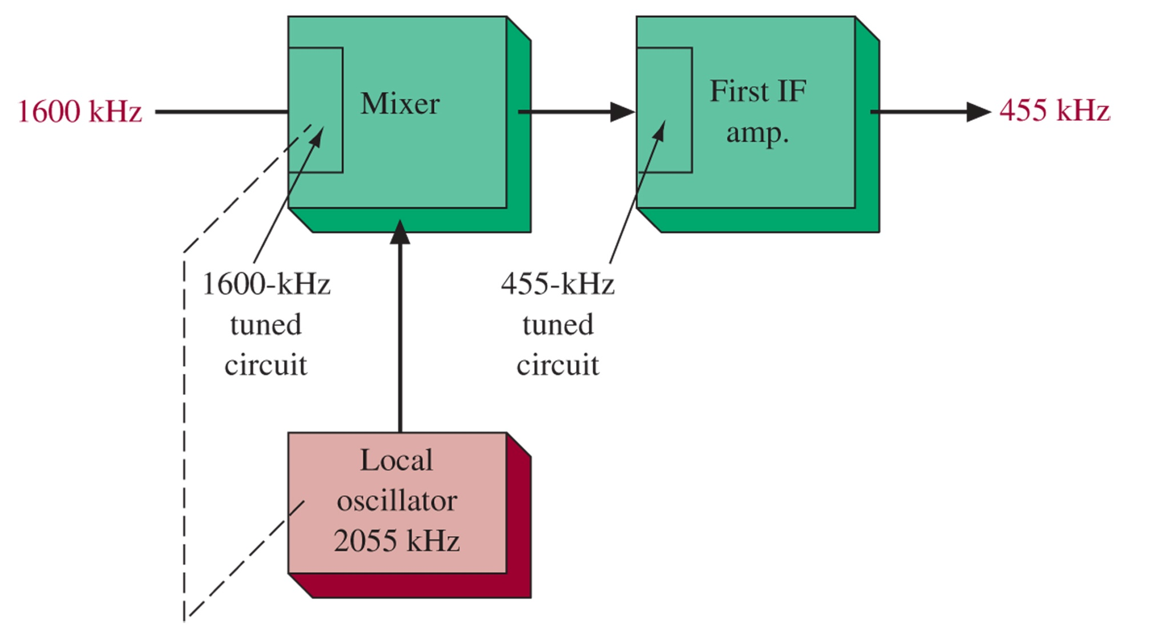
Figure 3-8 Frequency conversion.
By tuning the local oscillator together with the RF amplifier and mixer (ganging) the IF can always be maintained at the same 455 kHz.

Slide 14
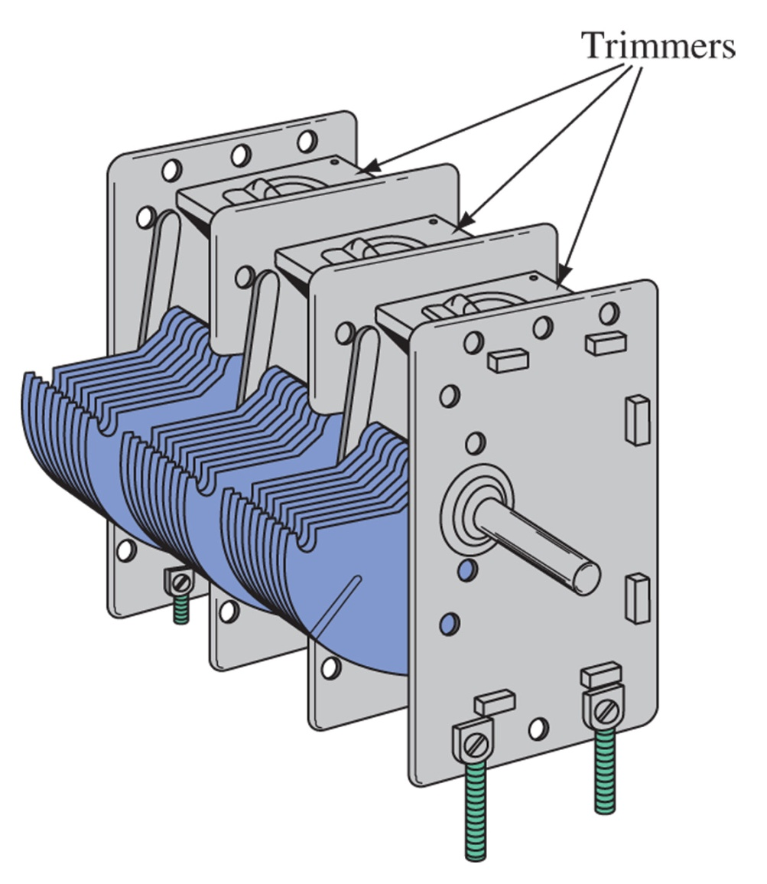
Figure 3-9 Variable ganged capacitor. Three capacitor elements on a common variable rotor to vary all three simultaneously. Each can be trimmed to fine tune their relative capacitance

Slide 15
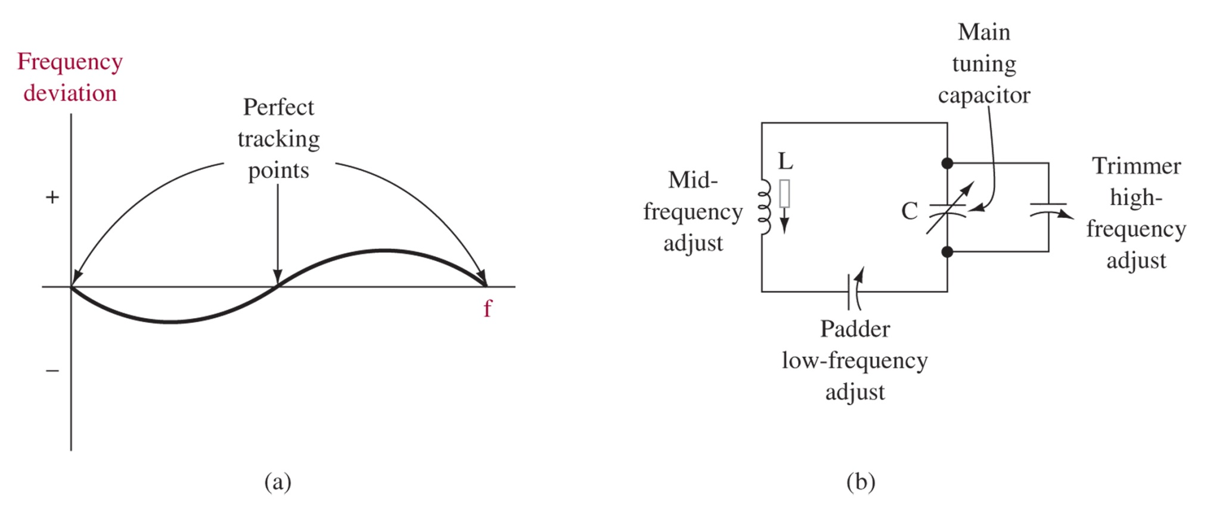
3-4 Superheterodyne Tuning
Figure 3-10 Tracking considerations.
Tracking at all frequencies is nearly impossible so the circuit is tuned at three frequencies, resulting minor imperfections between those three points.

Slide 16
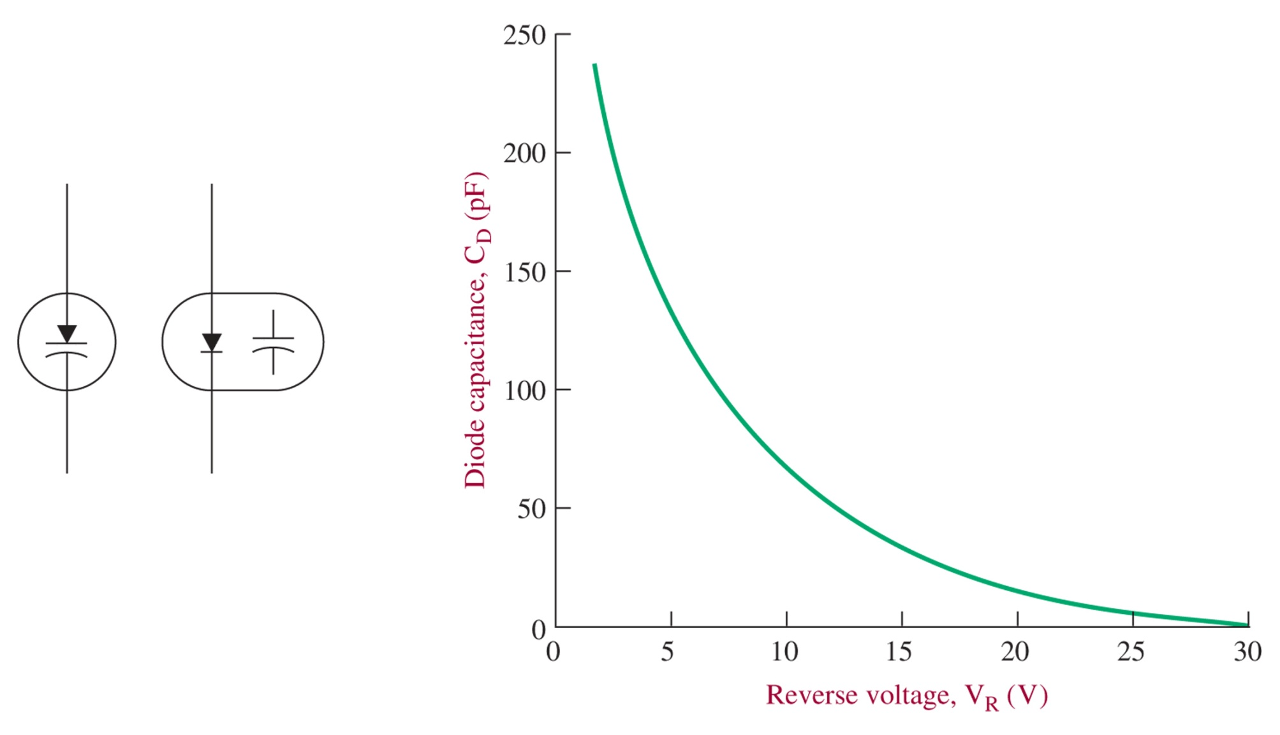
Electronic Tuning
Figure 3-11 Varactor diode symbols and C/V characteristic.
Reverse biased diodes can be used as variable capacitors instead of ganged capacitors. These are known as varactor diodes, varicap diodes, or VVC diodes.

Slide 17
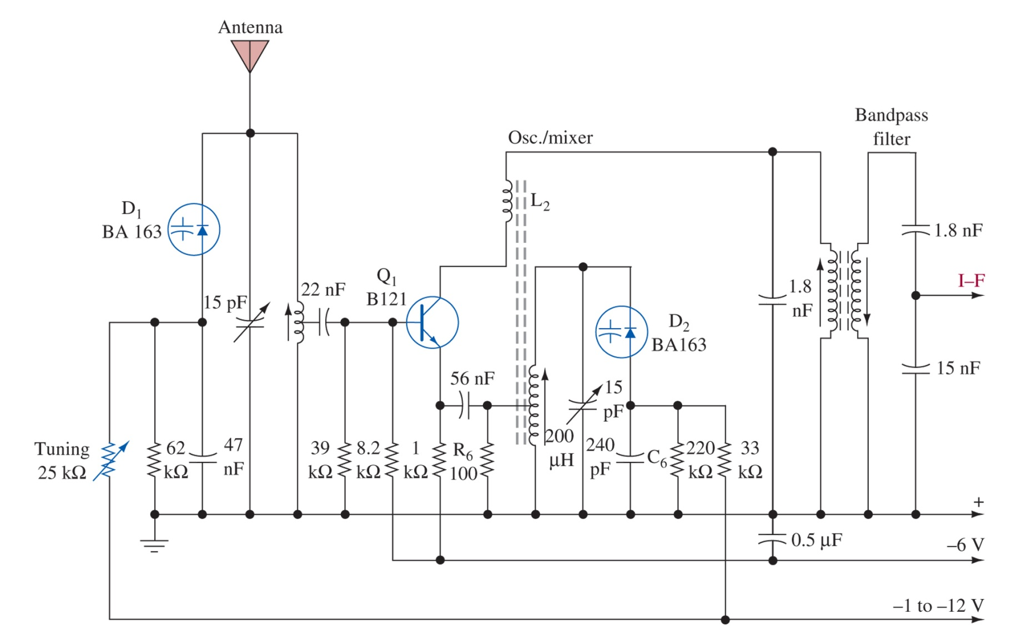
Figure 3-12 Broadcast-band AM receiver front end with electronic tuning.

Slide 18
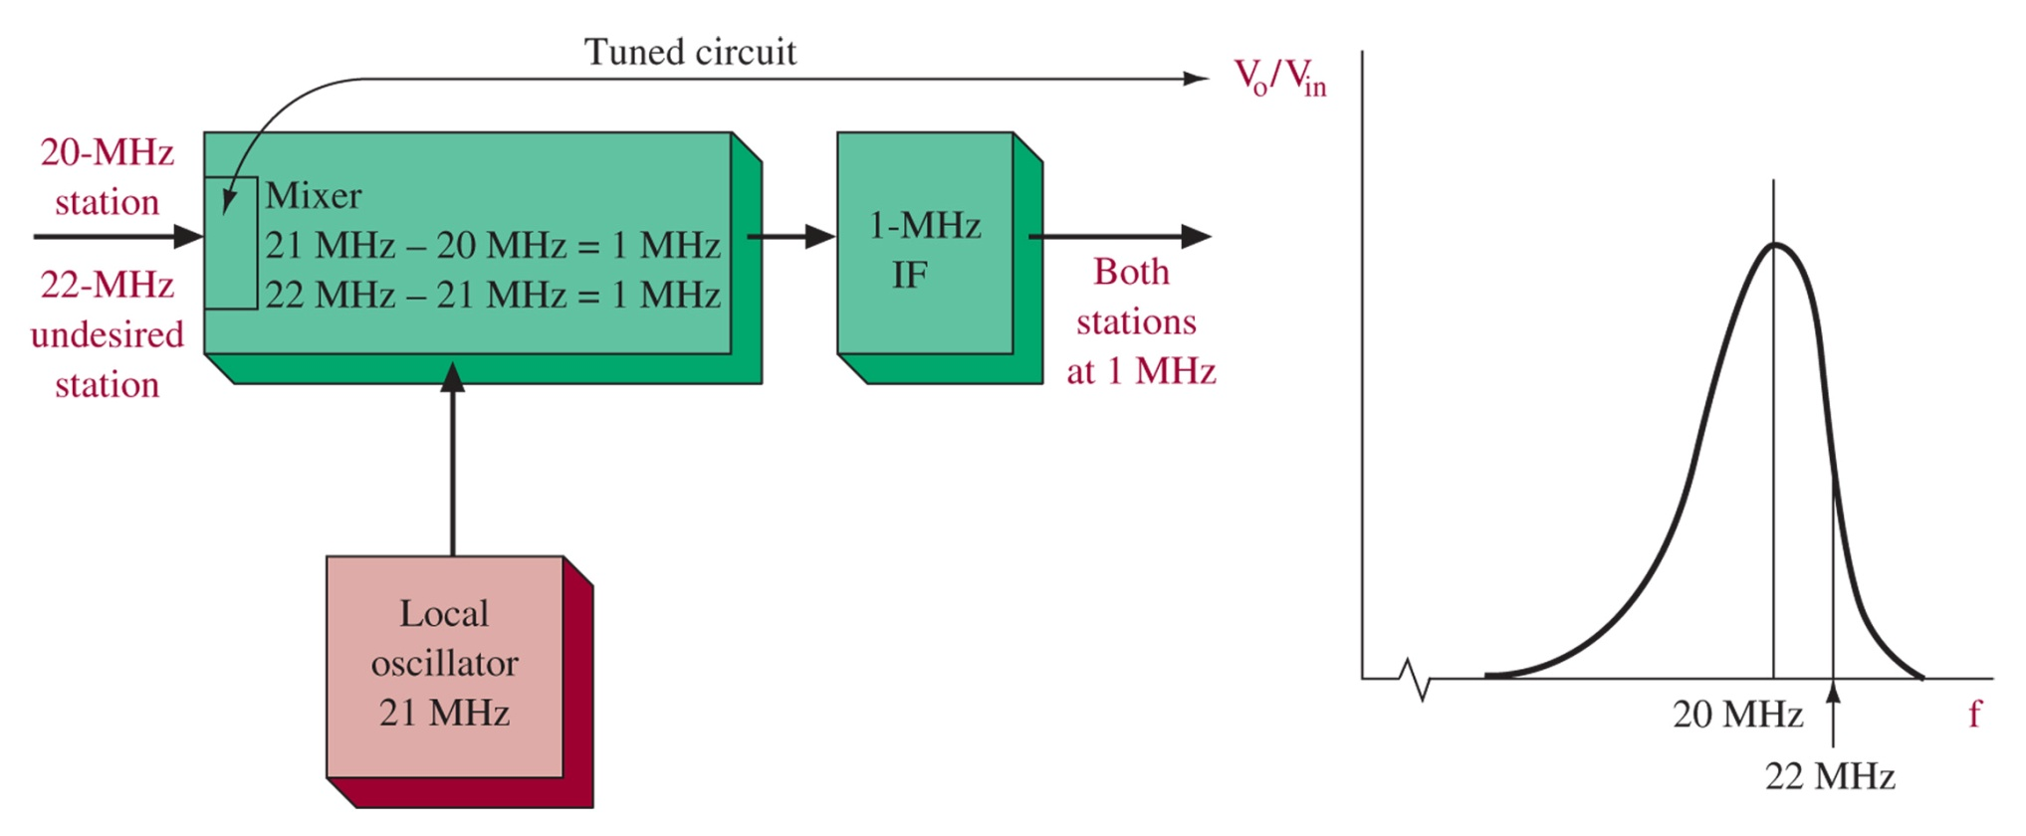
3-5 Superheterodyne Analysis
The image is not the only possible spurious response. Others are due to harmonics of the signal and LO mixing to create energy in the IF BW. (e.g. The “Half IF” spur.
Figure 3-13 Image frequency illustration. Since the attenuation of the mixer input is not perfect, it is possible for other frequencies to be passed. These may be mixed into our desired signal and presented to the IF amplifier.

Slide 19
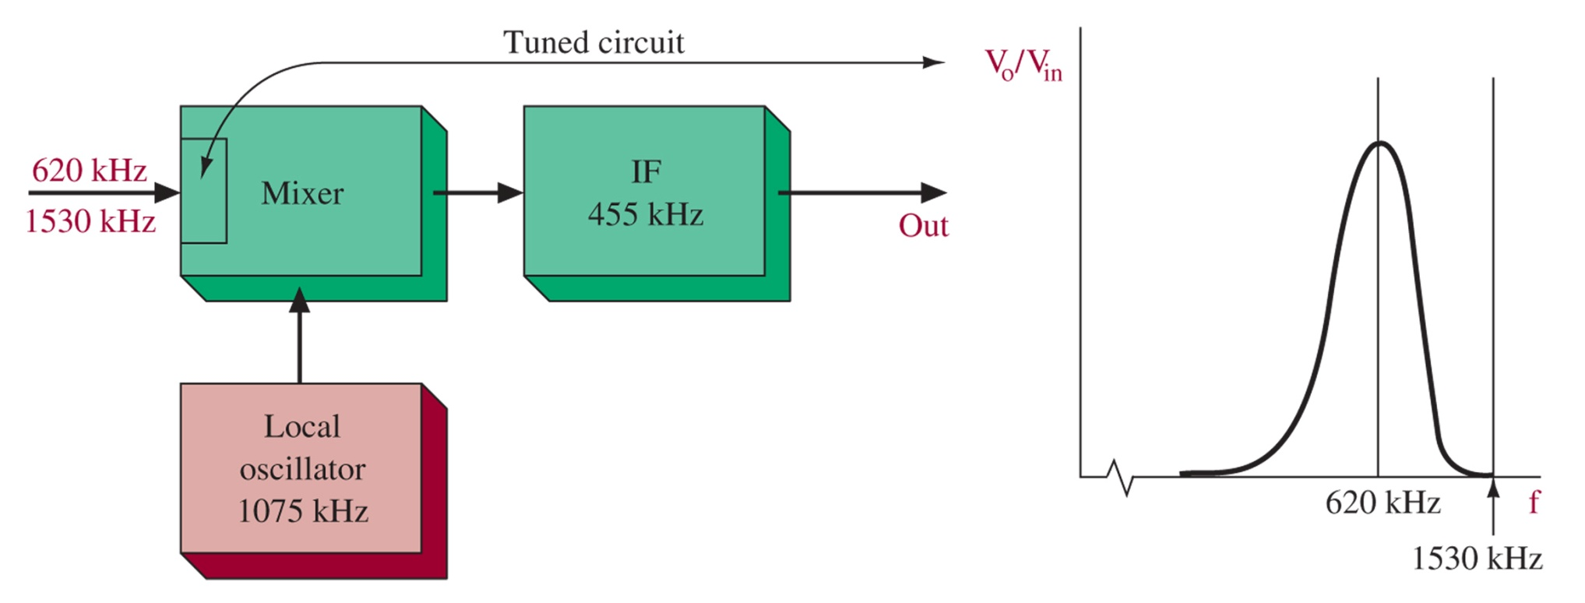
Figure 3-14 Image frequency not a problem in AM.
Image frequencies are not as much of a problem in AM broadcast due to the attenuation at the likely image frequencies. Higher frequency communication systems can suffer however, and so use tuned circuits at the RF and mixer inputs to increase image attenuation prior to mixing.

Slide 20
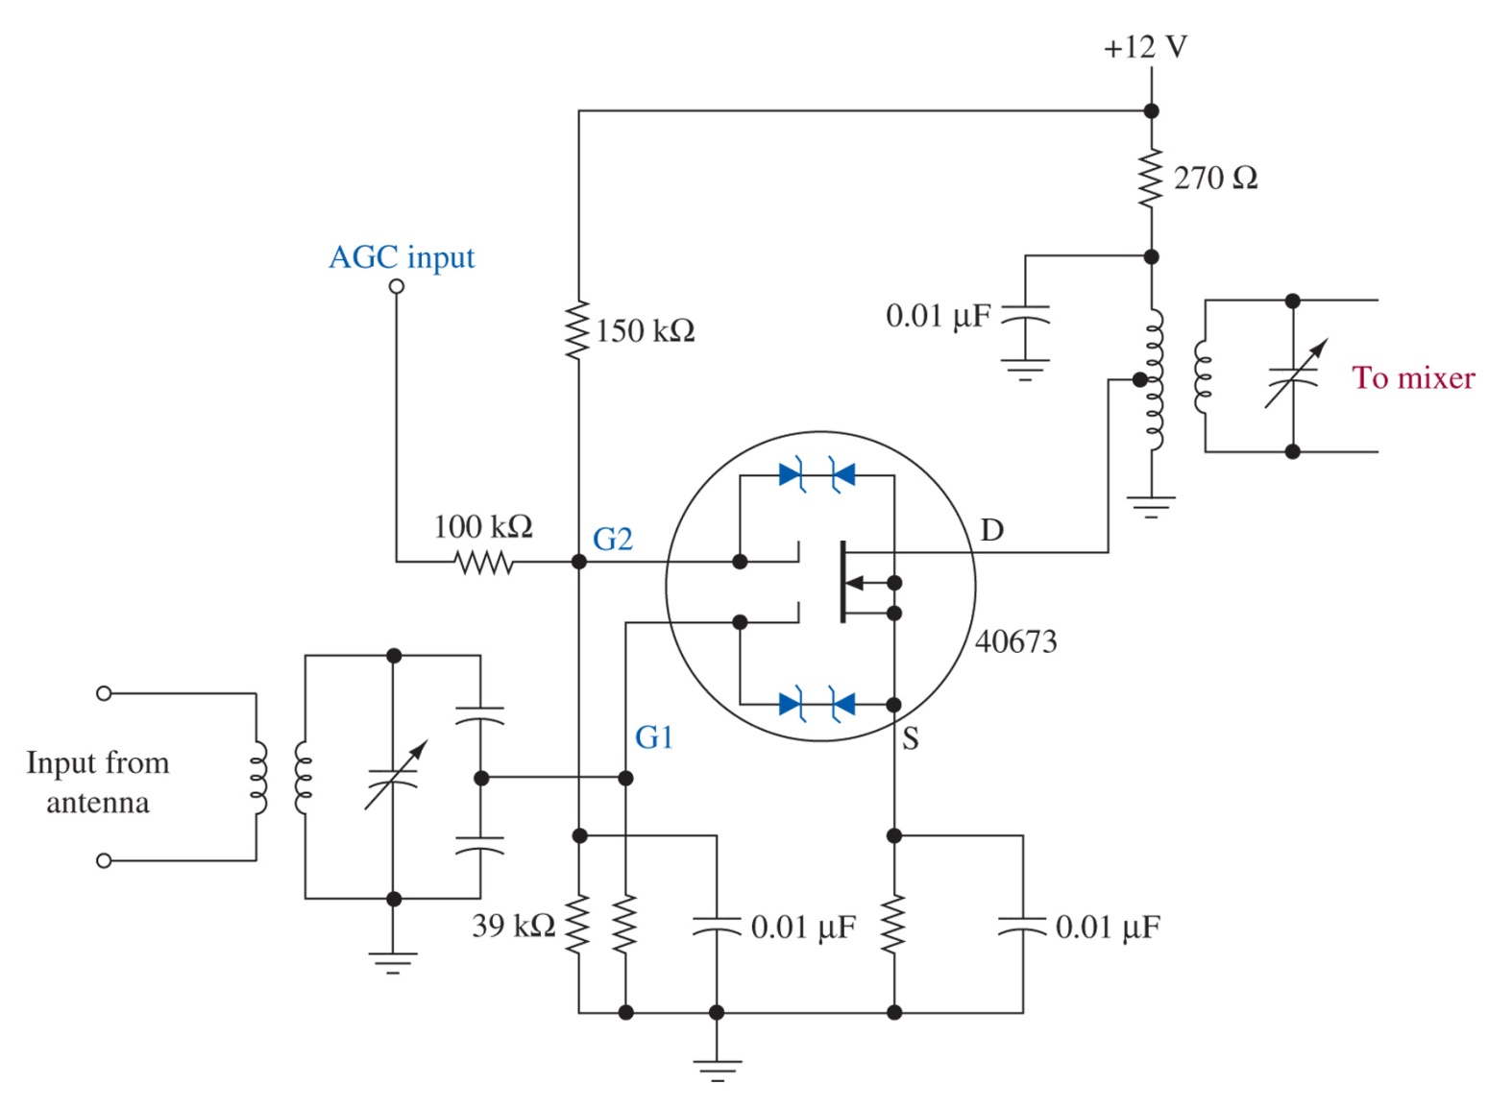
RF Amplifiers
RF Amp advantages:
Image freq. rejection
More gain
Improved noise
FET advantages:
High input impedance
Dual-gate FETs for AGC
I/O square-law relationship lowers distortion
Figure 3-15 Dual-gate MOSFET RF amplifier.

Slide 21
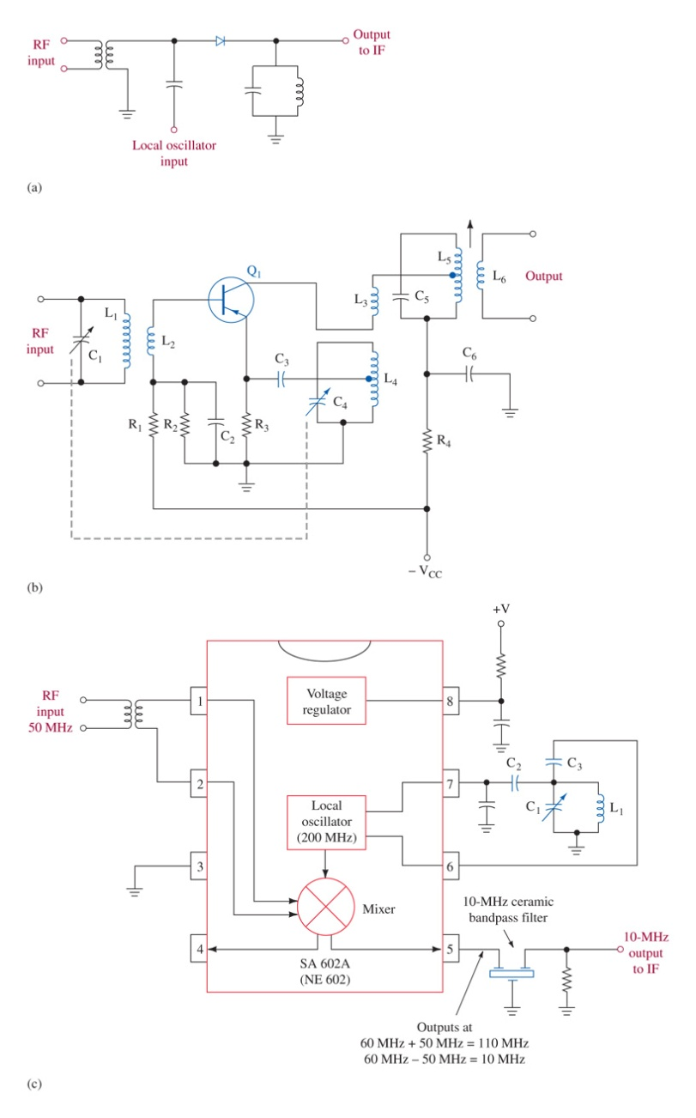
Mixer / LO
Diodes are the simplest mixers. Schottky Diodes can be used up to 100 GHz.
LICs make implementation simpler
Transistors can be used to mix and generate LO
Figure 3-16 Typical mixer circuits.

Slide 22
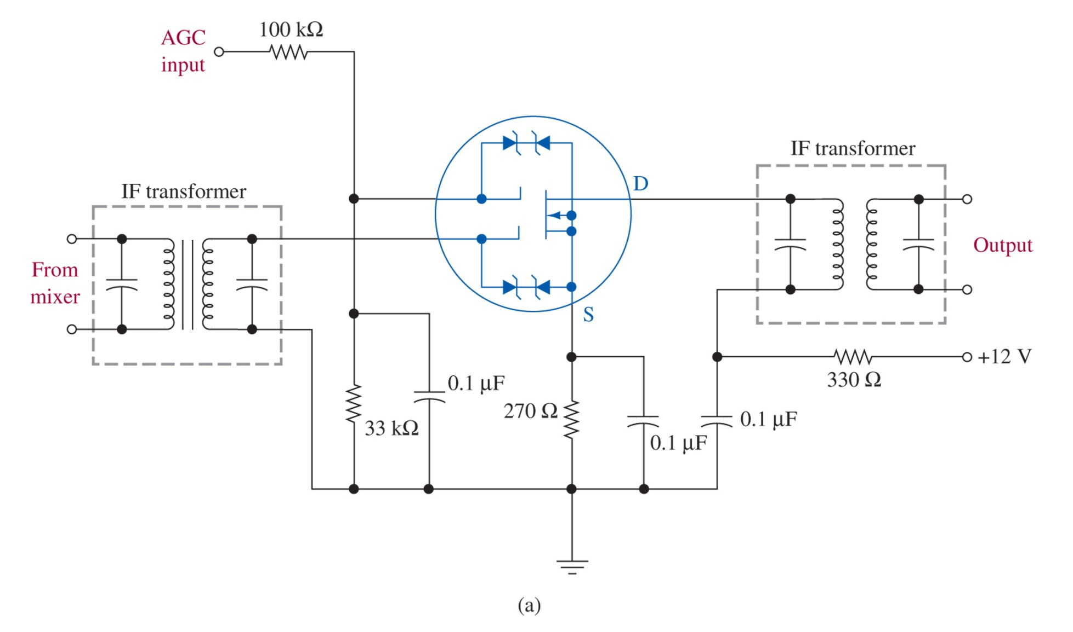
Transistor IF Amplifier
Figure 3-17 Typical IF amplifiers. Transistor IF amp using 40673 Dual-Gate MOSFET. Notice the dual tuning circuits at the input and output. These are sold as blocks for common IF frequencies, with a variable transformer for fine-tuning. AGC is injected at the second gate.

Slide 23
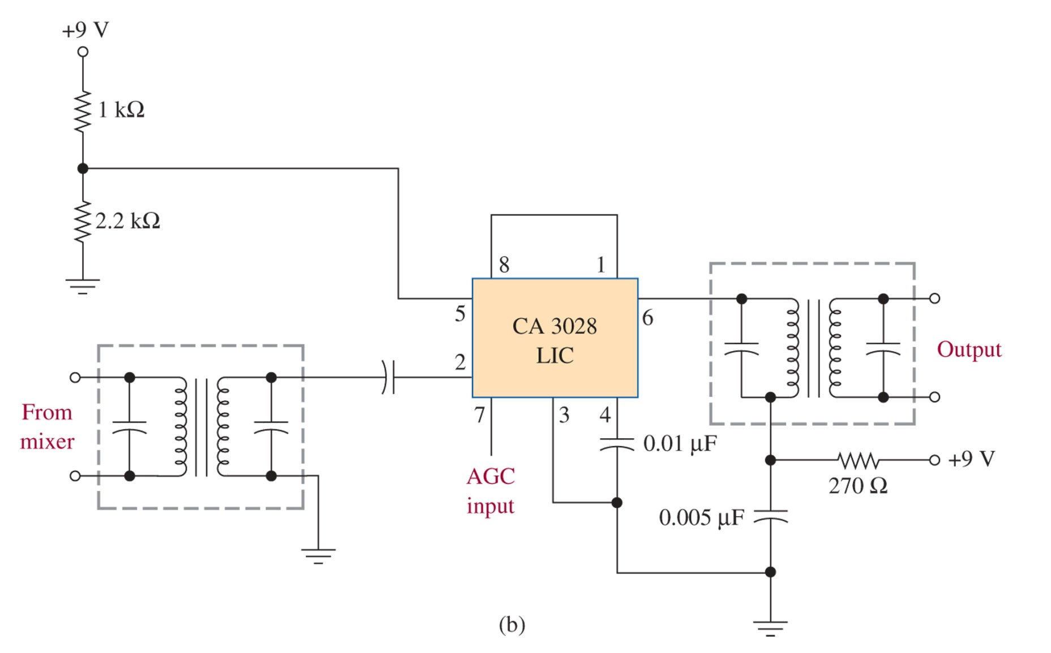
LIC IF Amplifer

Slide 24
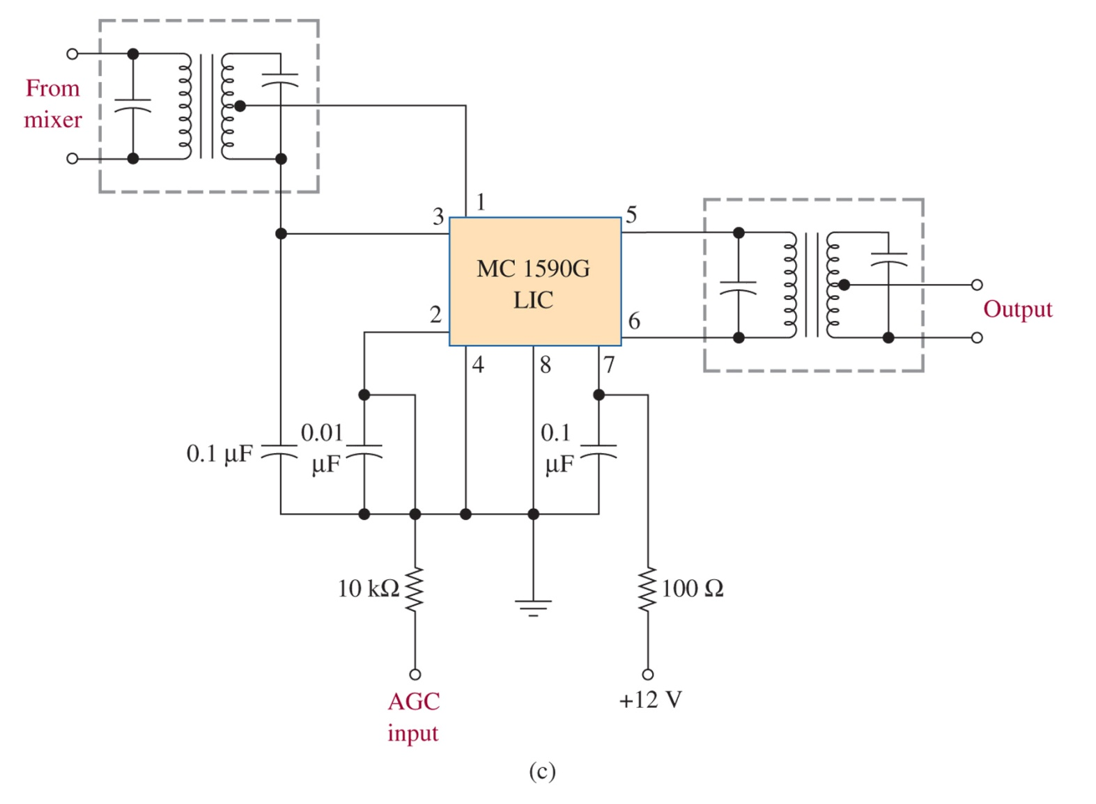
LIC IF Amplifier
Figure 3-17 (continued) Typical IF amplifiers.

Slide 25
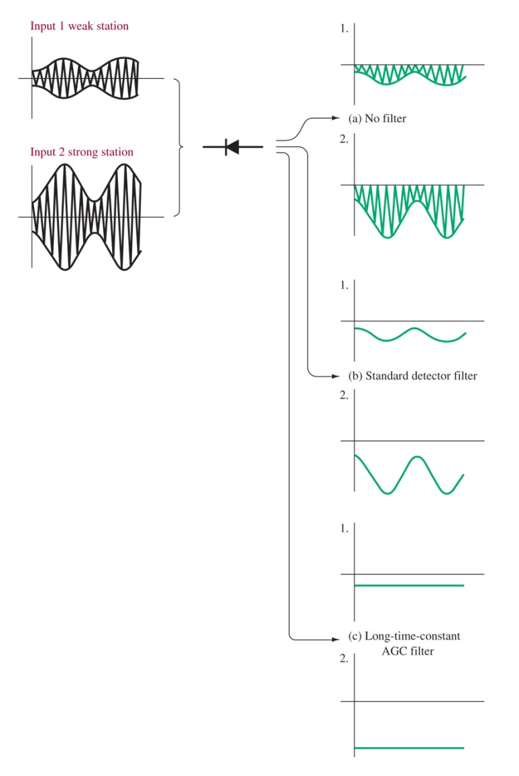
3-6 Automatic Gain Control (AGC)
Why you need AGC:
Tuning would be difficult, you’d miss weak stations, and strong stations would blow out your speakers
Signal changes constantly due to atmospheric effects
When mobile you need the radio to compensate for changing locations
Figure 3-18 Development of AGC voltage.

Slide 26
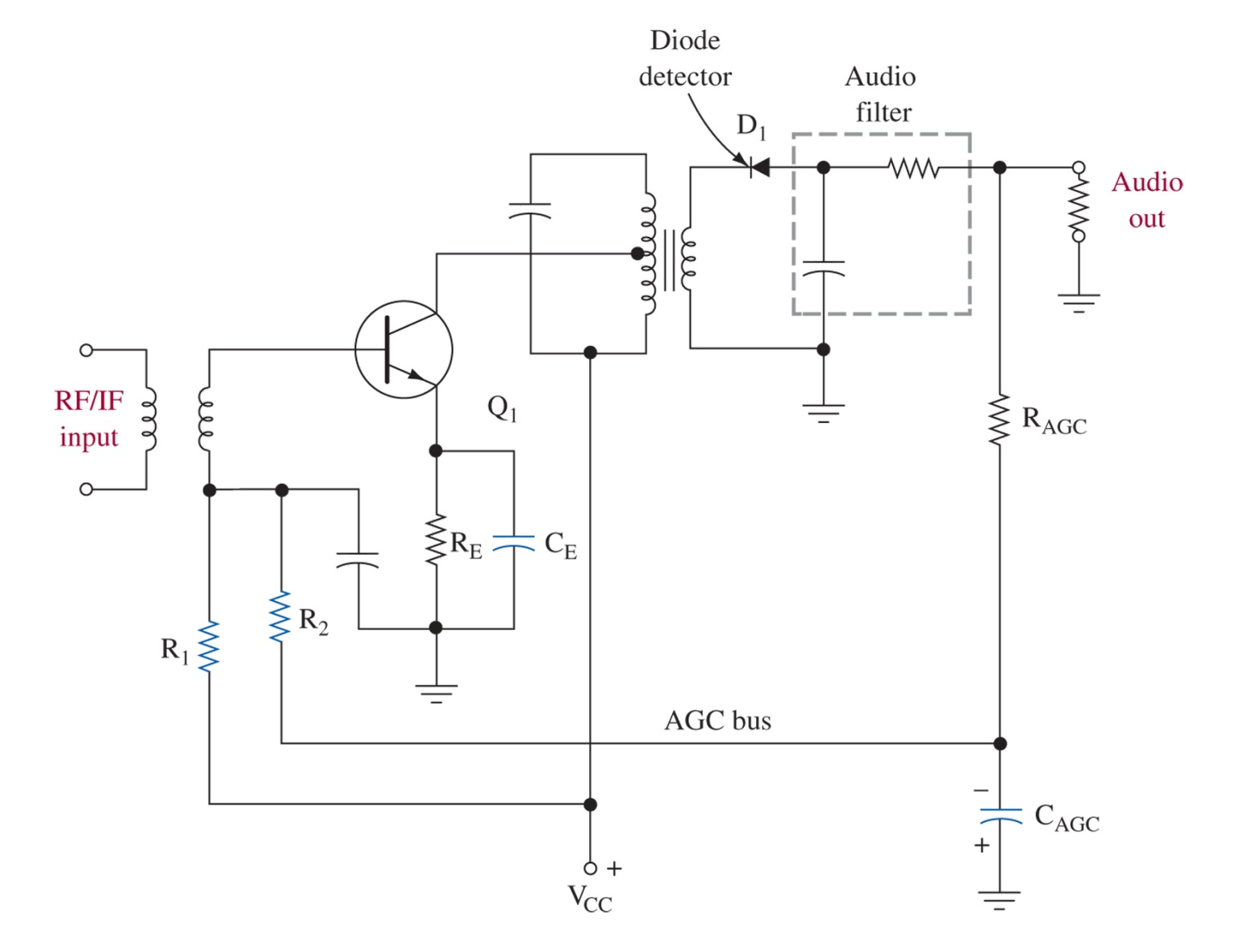
Controlling Transistor Gain
Figure 3-19 AGC circuit illustration.

Slide 27
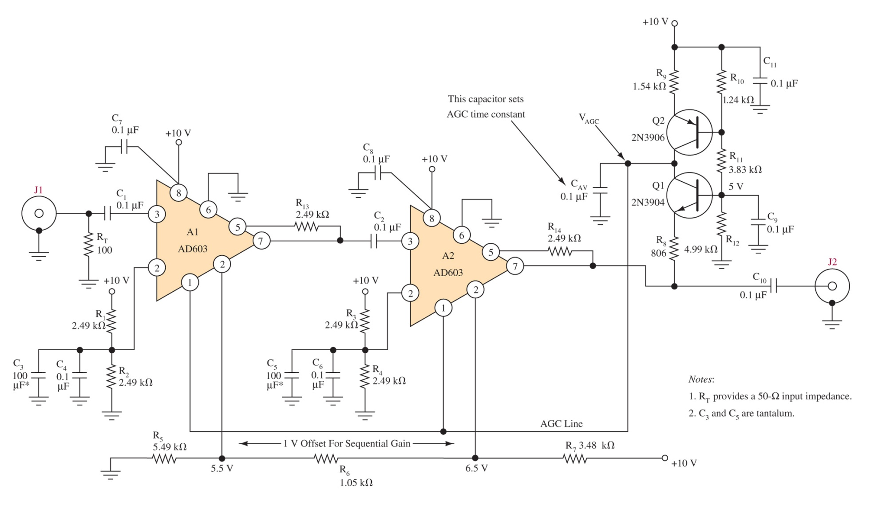
IF/AGC Amplifier
Figure 3-20 Wide-range IF/AGC amplifier. (Reprinted with permission from Electronic Design, Penton Publishing Company.)

Slide 28
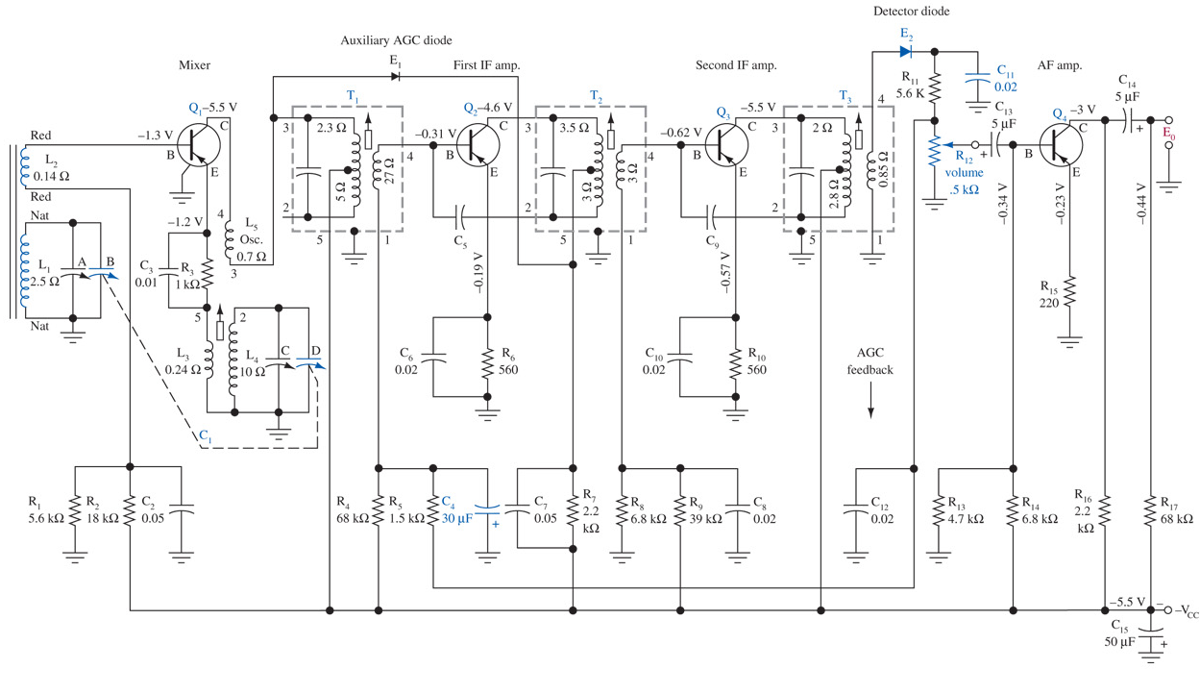
3-7 AM Receiver System
Figure 3-21 AM broadcast superheterodyne receiver.

Slide 29
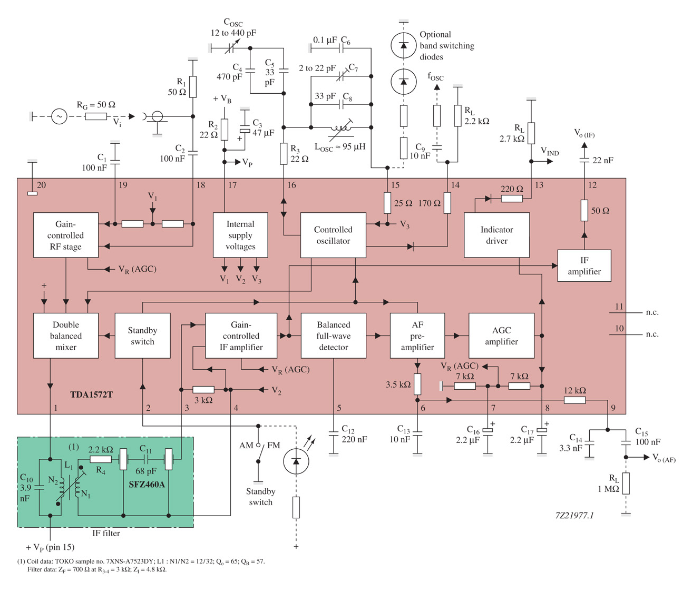
LIC AM Receiver
Figure 3-22 TDA1572T AM receiver. (Courtesy of Philips Semiconductors.)

Slide 30
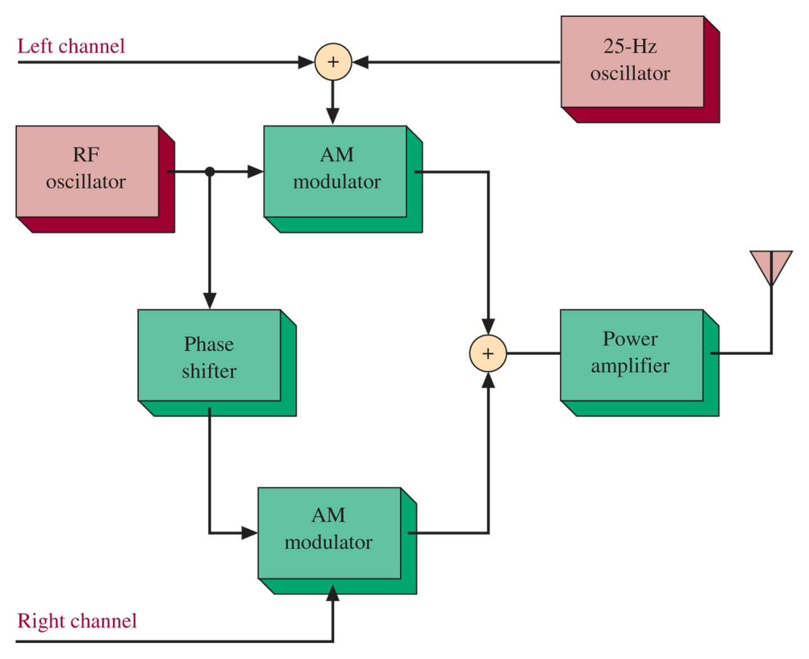
AM Stereo
Figure 3-23 AM stereo block diagram showing the Motorola C-Quam Stereo method

Slide 31
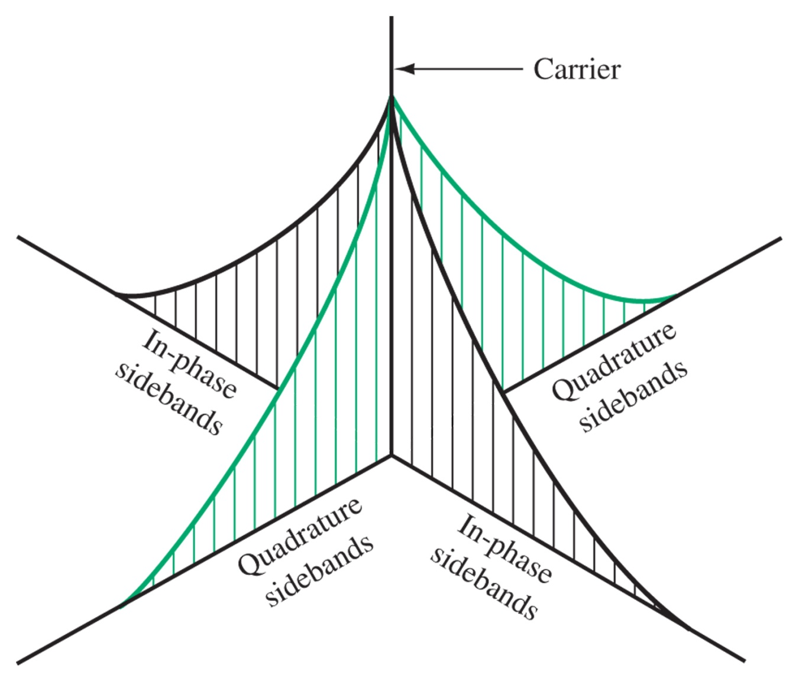
AM Stereo Phase
Figure 3-24 Phase relationships in AM stereo.

Slide 32
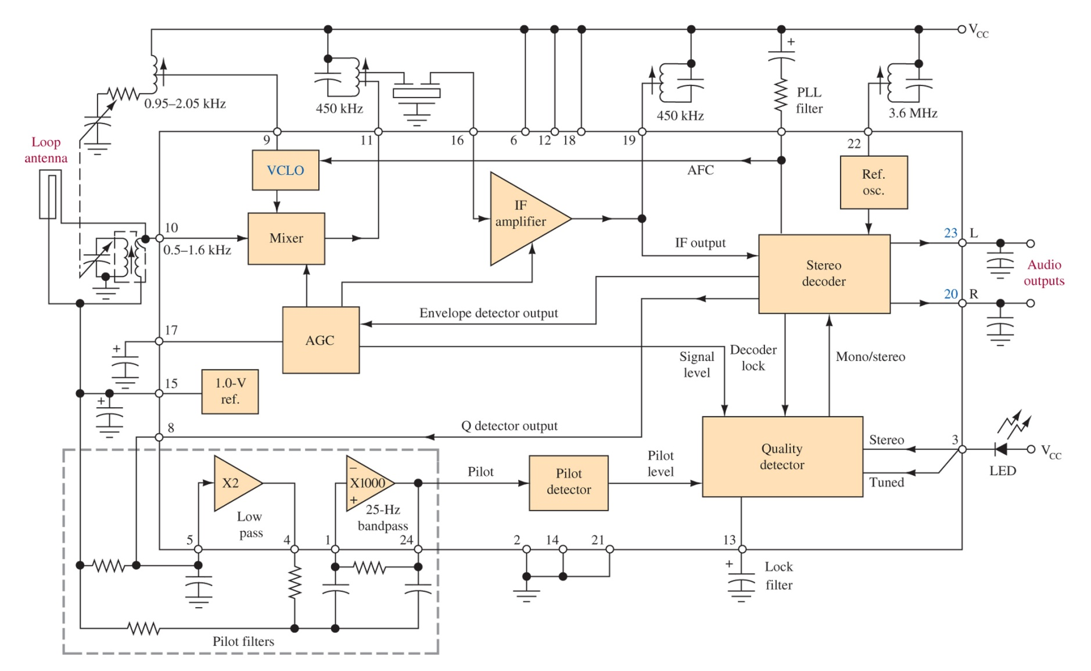
Figure 3-25 C-Quam receiver system. (Courtesy of Motorola, Inc.) MC13024, uses PLL and VCLO

Slide 33
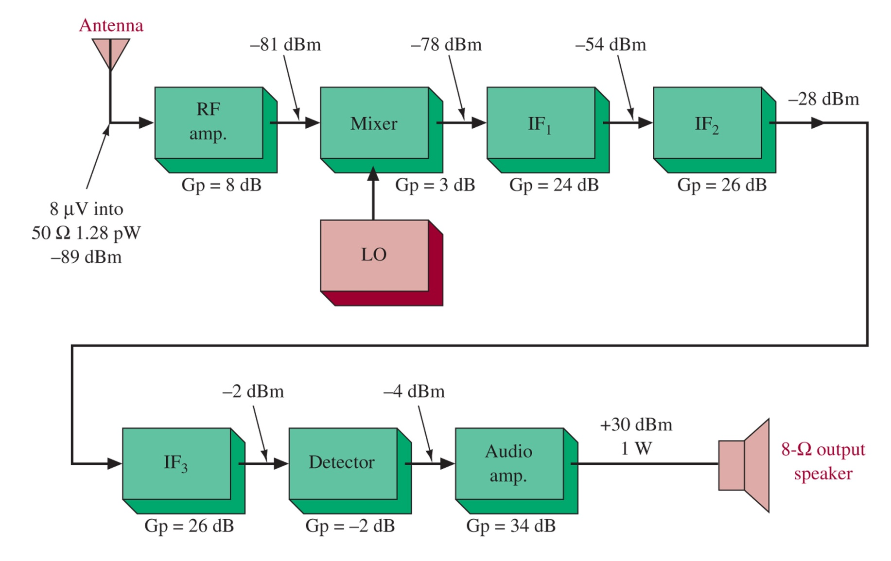
Receiver Analysis
Figure 3-26 Receiver block diagram. Using dBm or dBW is very convenient for dealing with subsequent stages of amplification

Slide 34
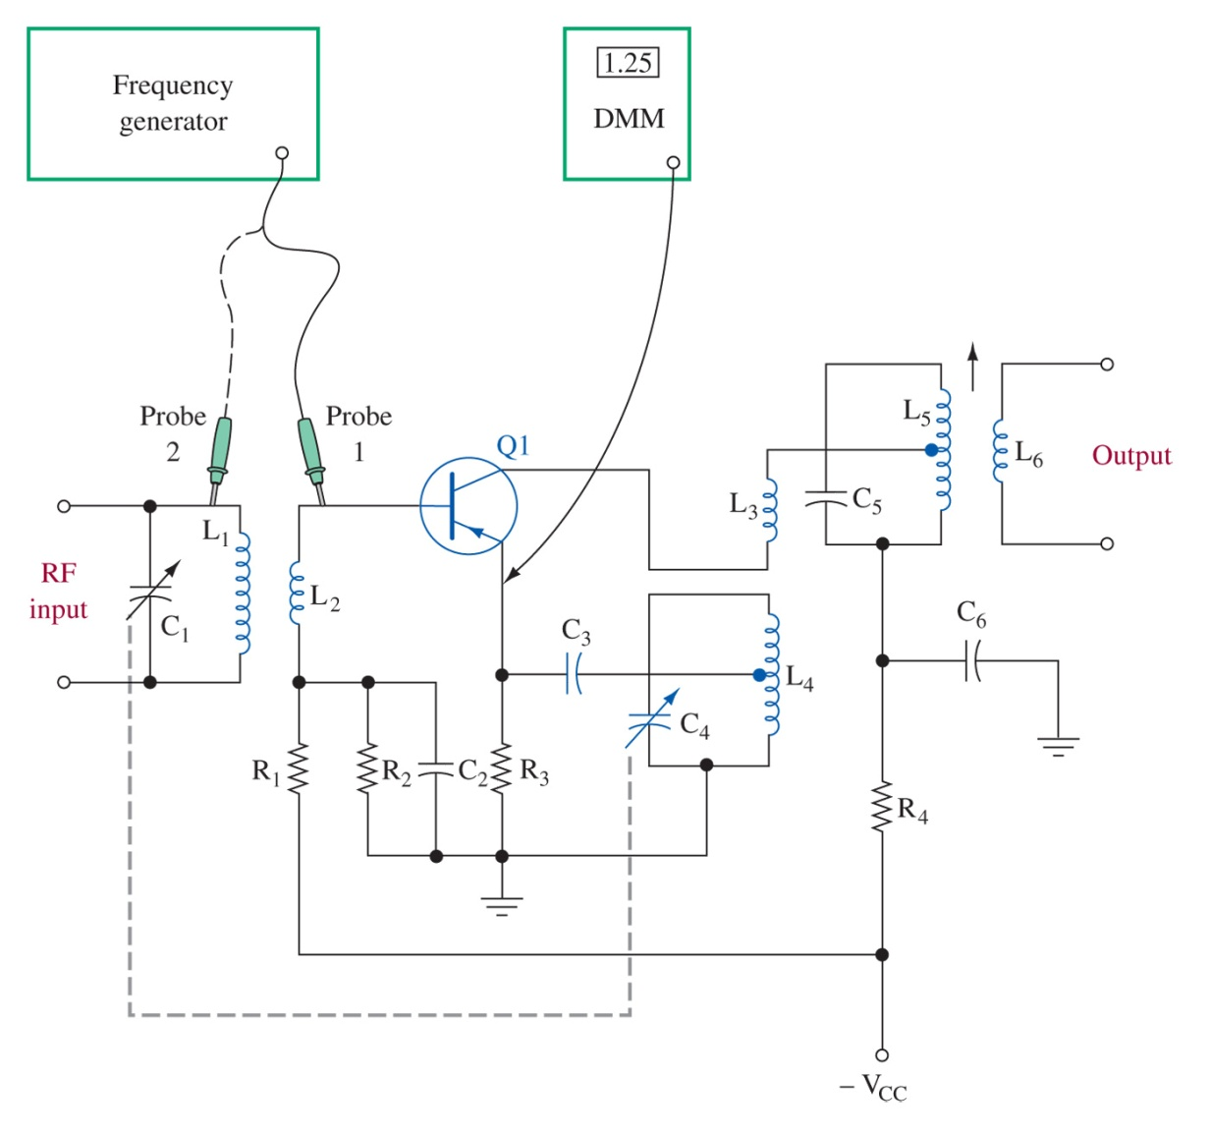
3-8 Troubleshooting
Figure 3-27 Troubleshooting a self-excited mixer.

Slide 35
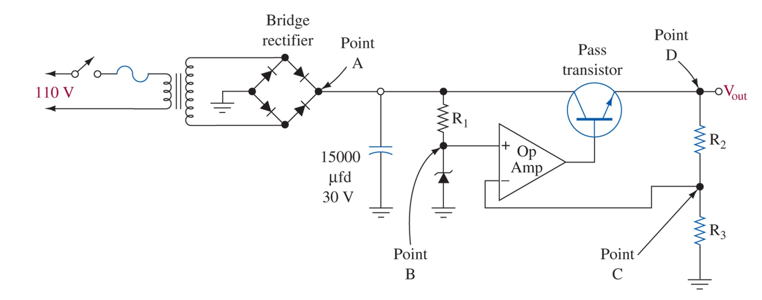
Figure 3-28 Regulated power supply.

Slide 36
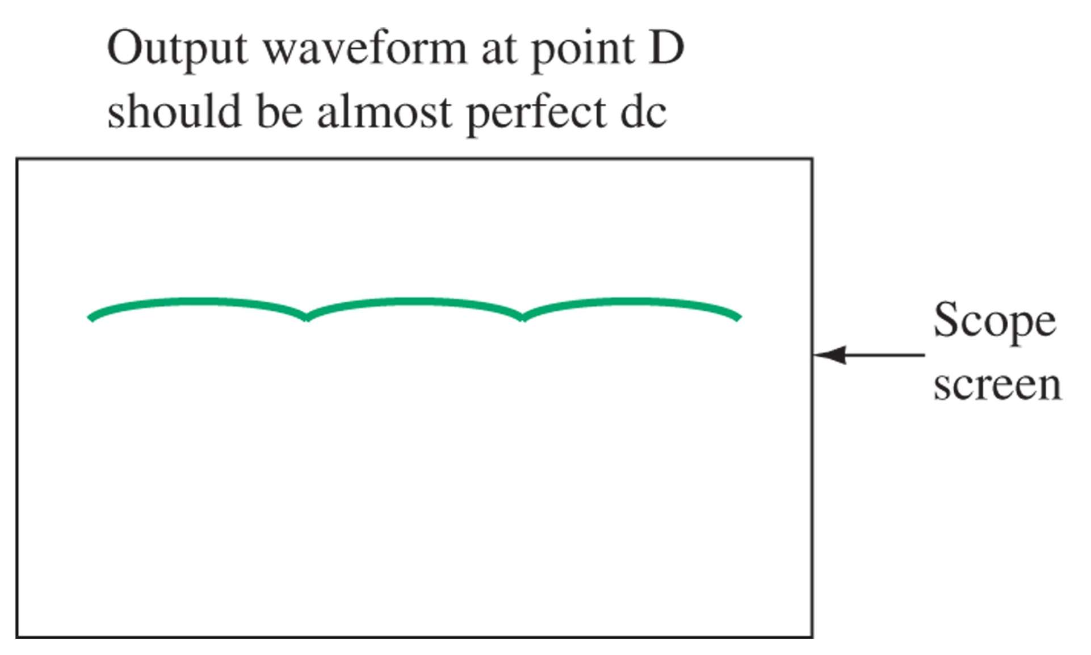
Figure 3-29 Bridge rectifier and filter operating properly.

Slide 37
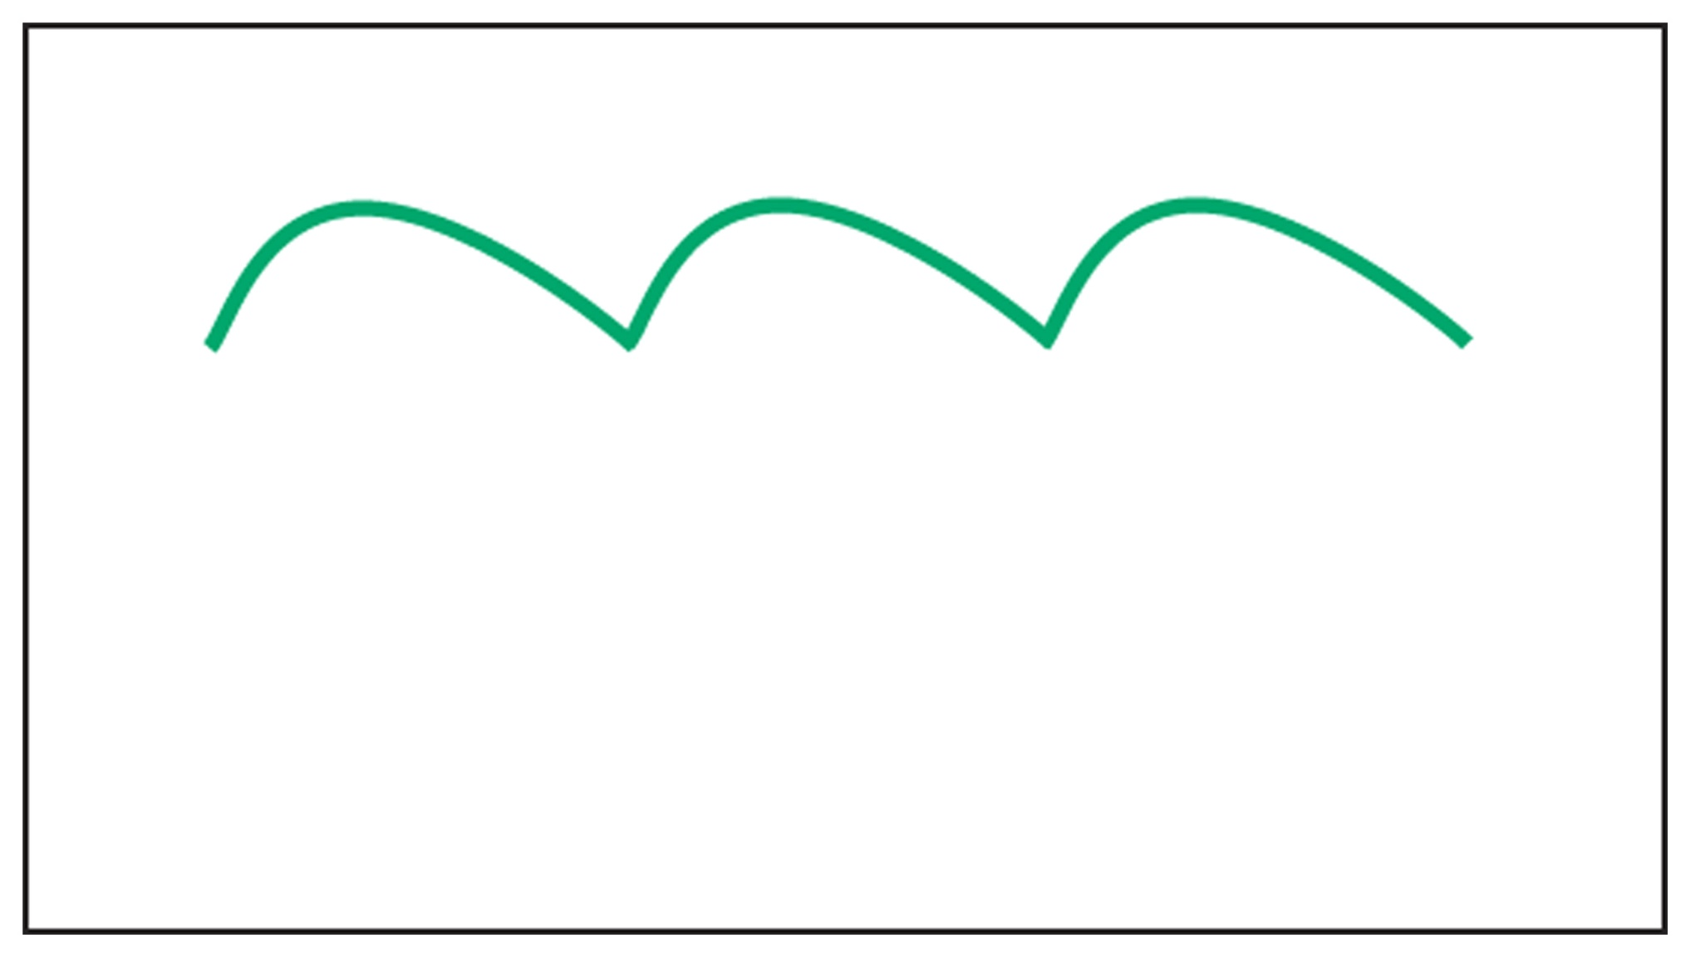
Figure 3-30 Ripple increase caused by open diode.

Slide 38
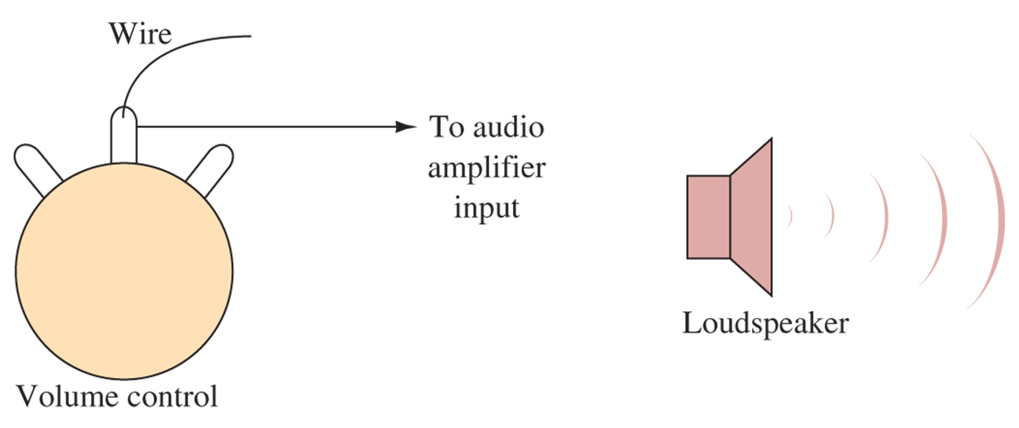
Figure 3-31 Testing an audio amplifier.

Slide 39
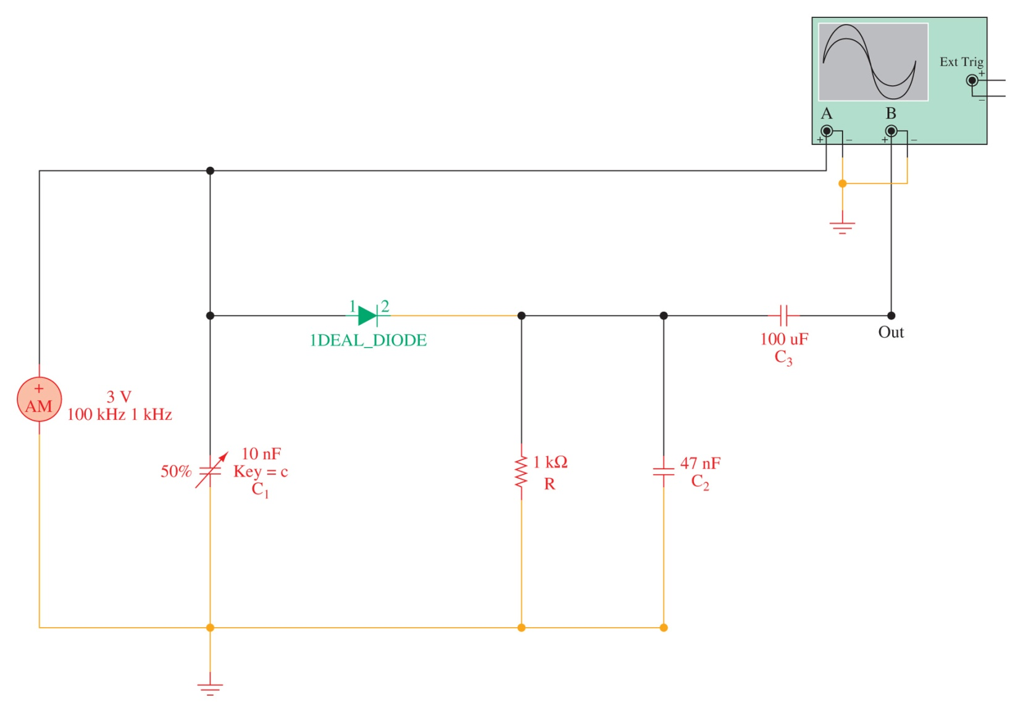
3-9 Troubleshooting with Multisim
Figure 3-32 An AM diode detector circuit as implemented with Electronics WorkbenchTM Multisim.

Slide 40
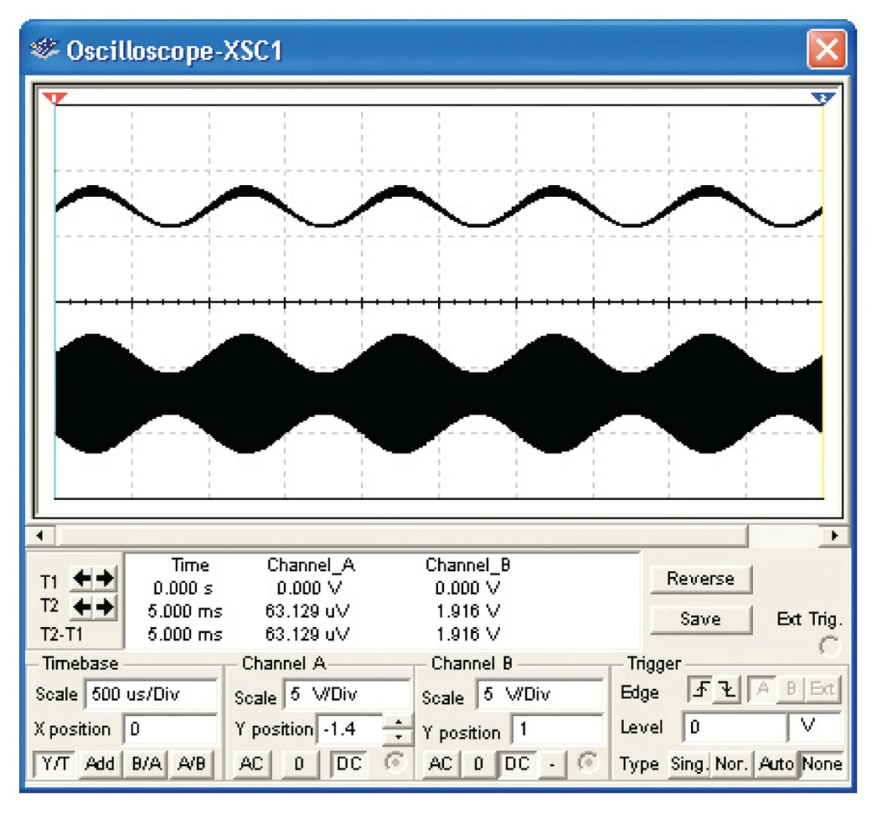
Figure 3-33 Oscilloscope output traces from the diode detector.

