Slide 1
EE 350 / ECE 490
Analog Communication Systems
Ch. 4 – Single Side-band
Communications

Slide 2
Objectives
Describe how an AM generator coud be modified to provide SSB
Discuss the various types of SSB and explain their advantages compared to AM
Explain circuits that are used to generate SSB in the filter method and describe the filters that can be used
Analyze the phase-shift method of SSB generation and give its advantages
Describe several methods used to demodulate SSB systems
Provide a complete block diagram for an SSB transmitter/receiver
Determine the frequencies at all points in an SSB receiver when receiving a single audio tone

Slide 3
4-1 Single-Sideband characteristics
First discovered 1914, patented 1923
FCC required majority of transmissions in the 2- to 30-MHz band to be SSB in 1977
Types:
SSB – just one sideband – amateur radio, maximum range w/ minimum power
SSBSC – one SB plus some carrier – allows better fidelity and AGC
ISB – different sidebands – military communications
Vestigial sideband – vestige of sideband plus carrier included with full sideband – television
ACSSB – amplitude-compandored SSB uses compressed speech signal at transmitter

Slide 4
SSB Power distribution
In AM the transmitted power is spread between the carrier and two sidebands
All the intelligence is in only one sideband
A 4W AM signal has 4W carrier + 1 W x 2 sidebands = 6W total w/ all intelligence in 1 W
Peak envelope power (PEP)
SSB of 150 Vp-p -> (150/2*.707)^2 / 50 Ohms = 56.2 W PEP
Normal voice is only ¼ or 1/3 of PEP on average, so lower power components can be used
SSB offers 10-12dB power savings over AM due to selective fading improvement, noise reduction, and power savings.

Slide 5
4-2 Sideband generation: The balanced modulator

Slide 6
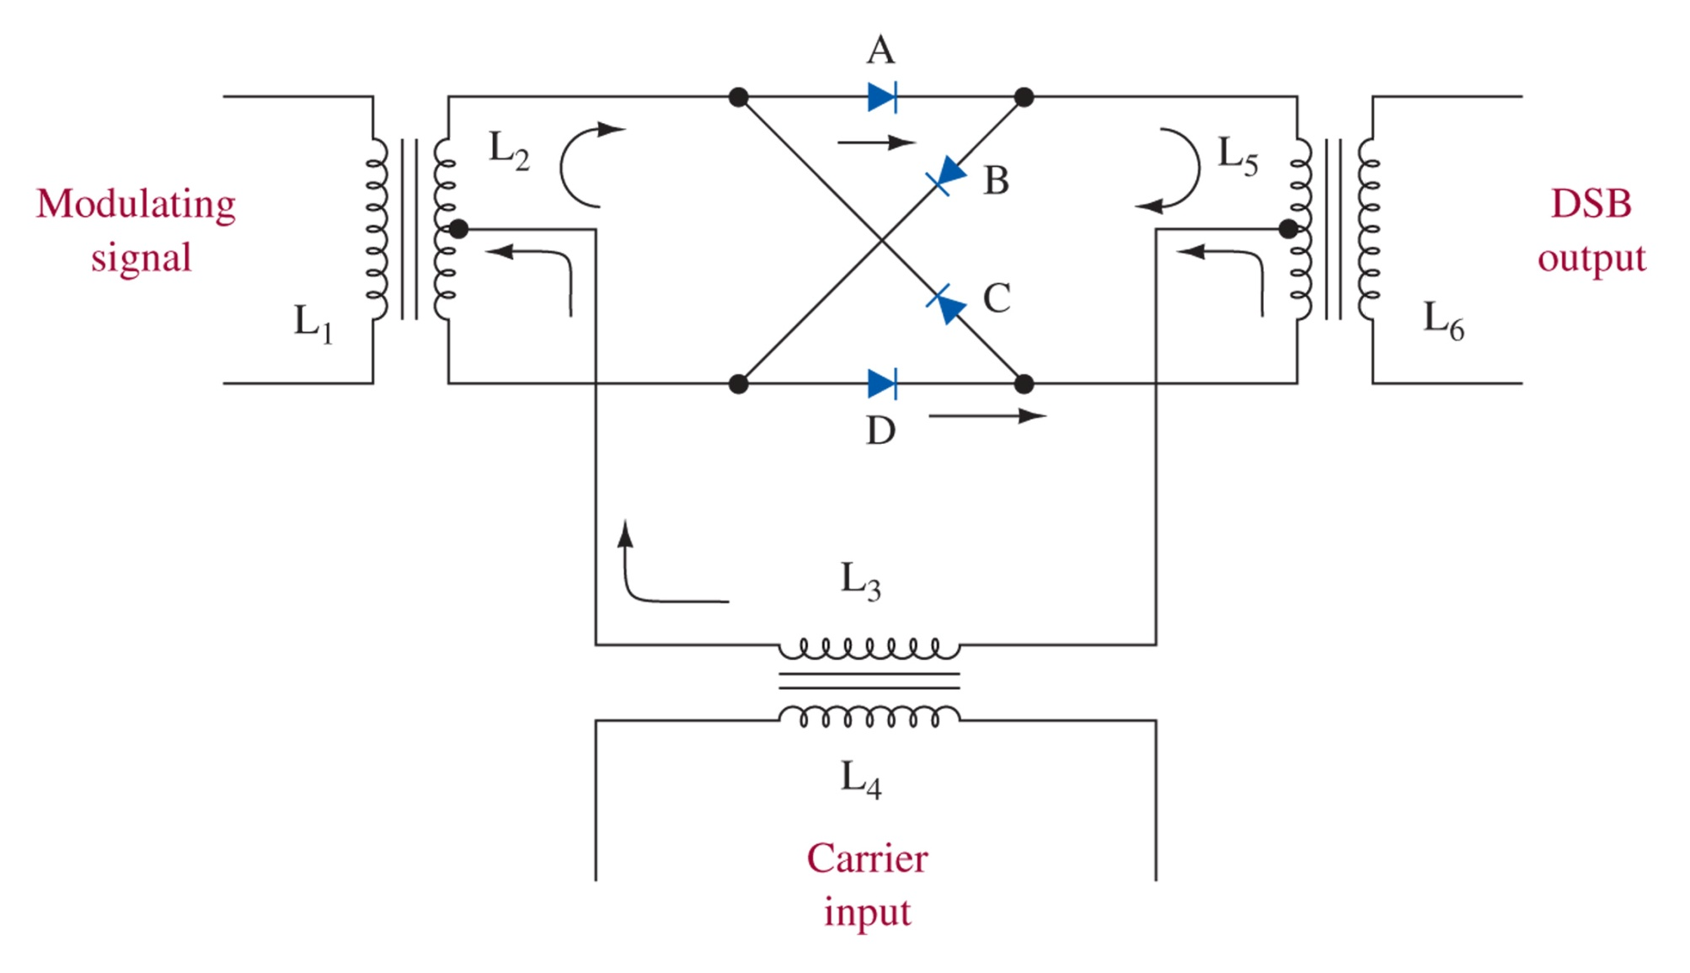
Figure 4-1 Balanced ring modulator.
Carrier – always cancels itself out
Modulator – won’t pass to L5 alone
Both – Carrier sets diode conduction, allowing passage of modulating signal through diodes, generating sidebands at L5 (DSBSC)
Can yield 60 dB suppression of carrier with matched diodes

Slide 7
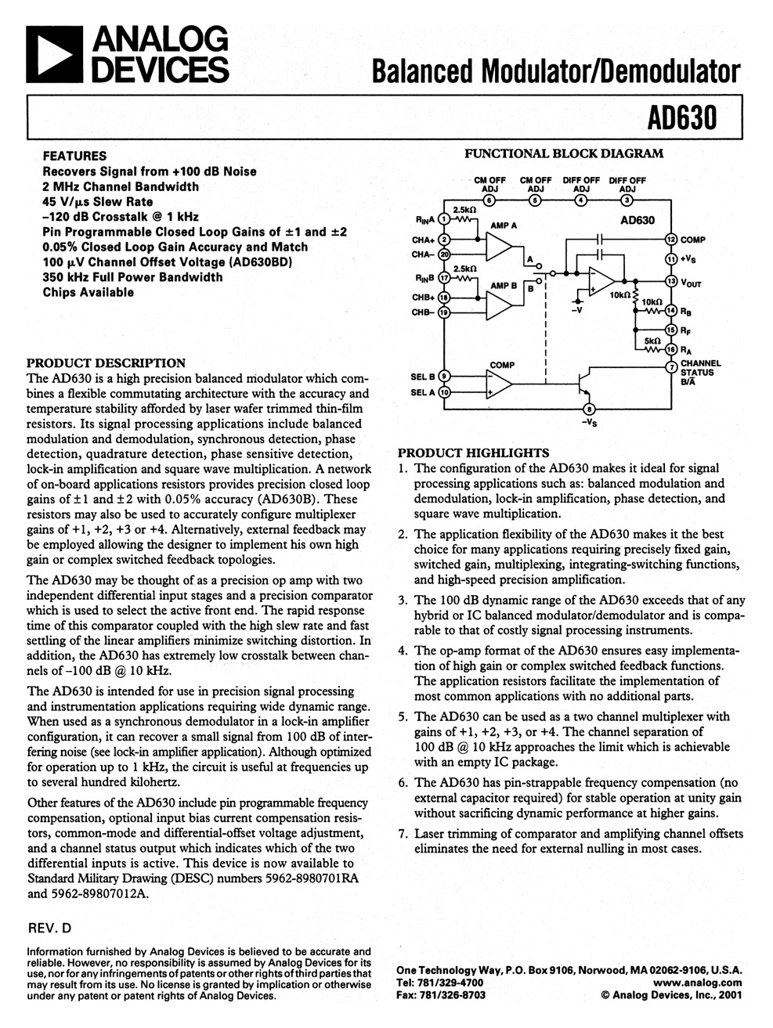
Figure 4-2 The Analog Devices AD630 balanced modulator/demodulator.

Slide 8
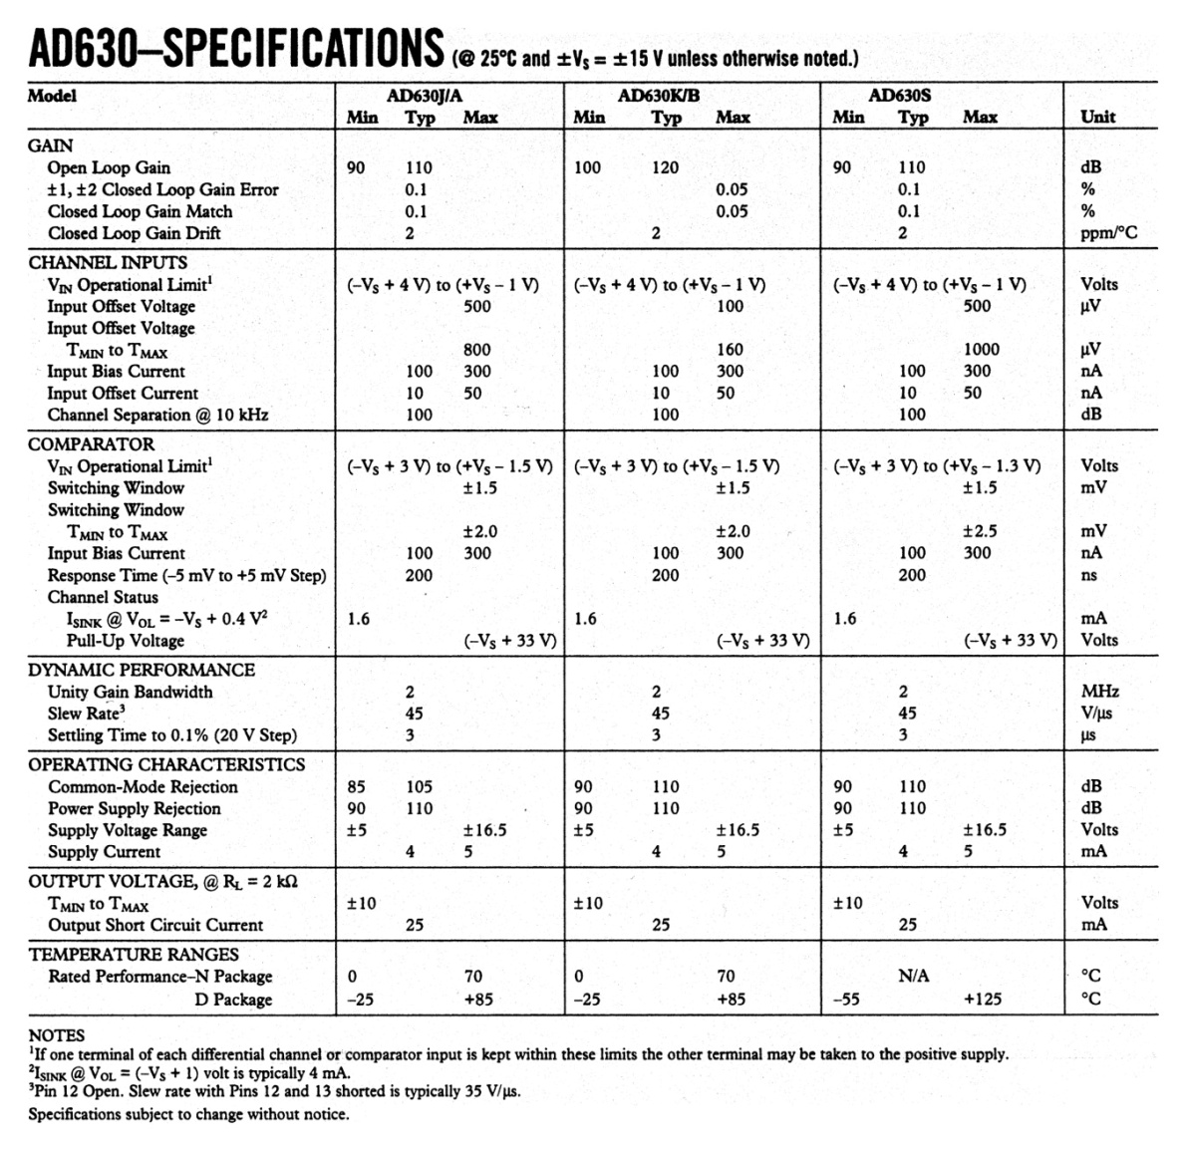
Figure 4-2 (continued) The Analog Devices AD630 balanced modulator/demodulator. (Courtesy of Analog Devices.)

Slide 9
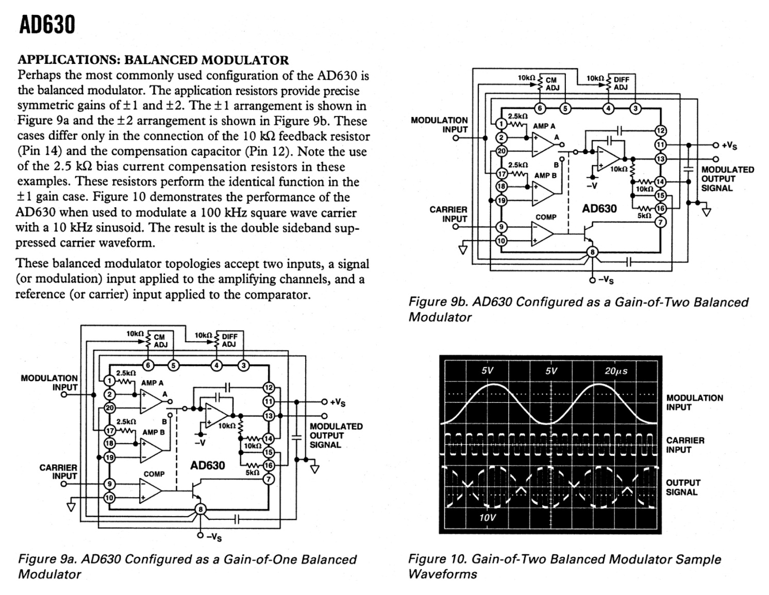
Figure 4-2 (continued) The Analog Devices AD630 balanced modulator/demodulator. (Courtesy of Analog Devices.)

Slide 10
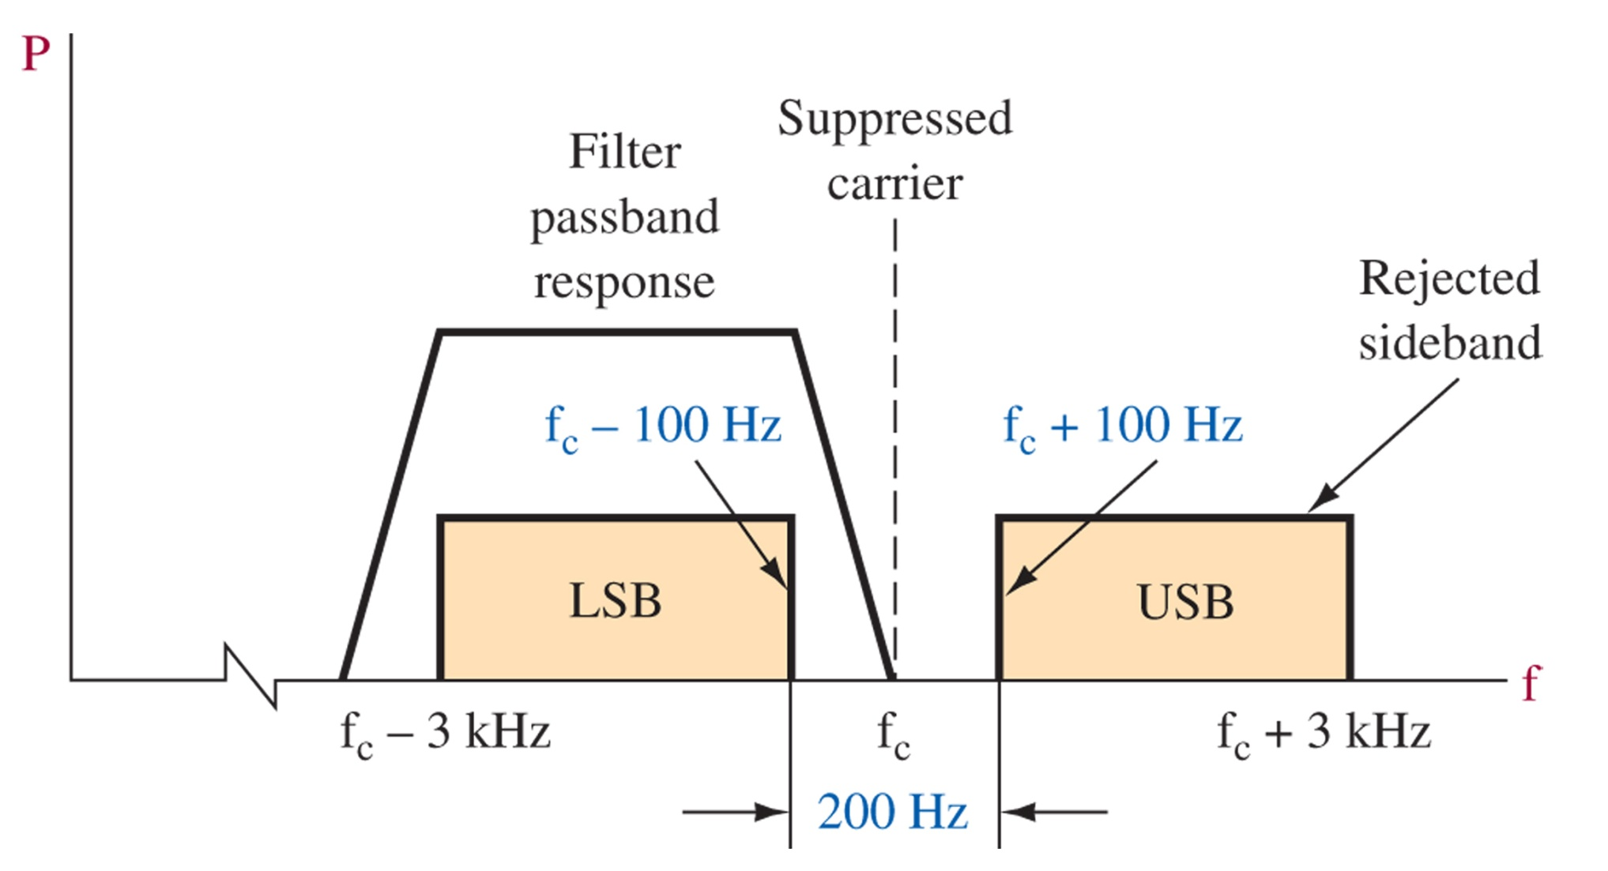
4-3 ssb filters
Need sharp filter to cancel one sideband while preserving the other
Figure 4-3 Sideband suppression.

Slide 11
Required q
1-MHz carrier and 80-dB sideband suppression
100-kHz carrier and 80-dB sideband suppression
Generating at 100-kHz, suppressing the sideband, then shifting to higher frequencies is more practical

Slide 12
Filters
LC filters are not high enough Q
We need to use something more efficient:
Crystal Filters
Ceramic Filters
Mechanical Filters

Slide 13
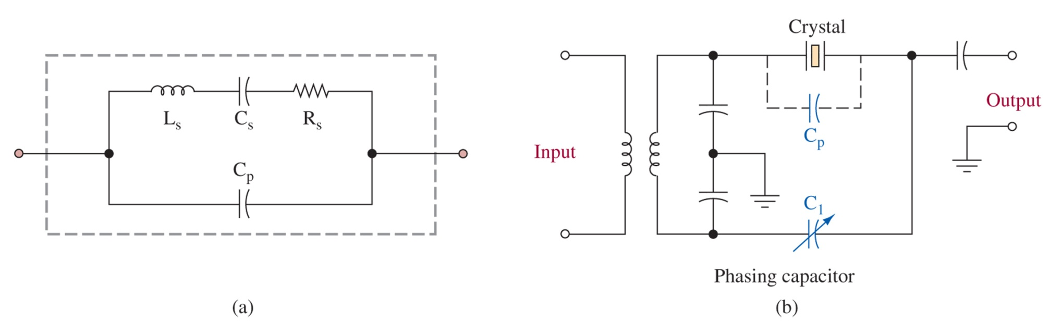
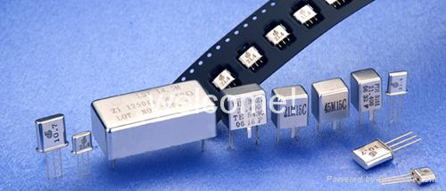
Figure 4-4 Crystal equivalent circuit (a) and filter (b).
The crystal provides the series LRC resonance, but the package gives stray capacitance. By tuning C1 in (b) you can match Cp while having them 180-deg out of phase cancelling unwanted frequencies.

Slide 14
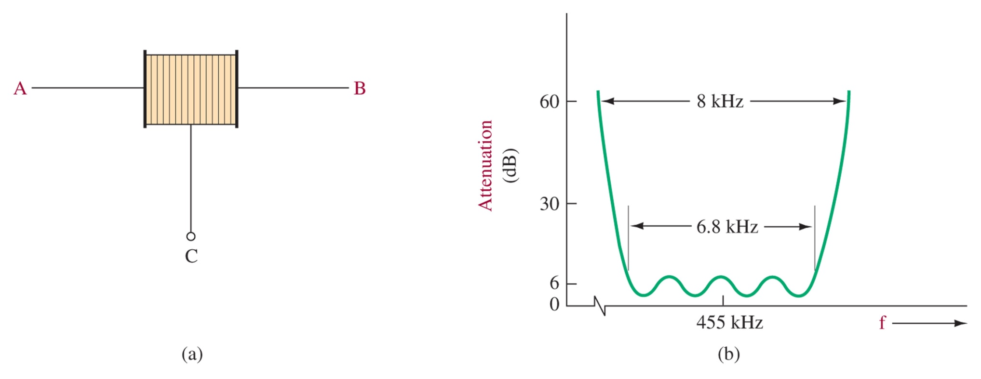
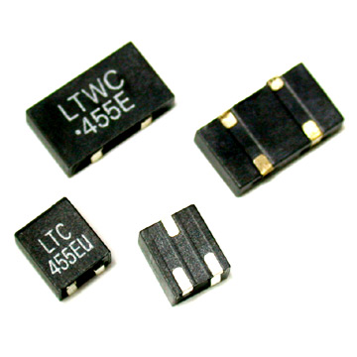
Figure 4-5 Ceramic filter and response curve.
Ceramic filters are piezoelectric, lead zirconate-titanate, with Q up to 2000.
Cheaper, smaller, and more rugged than crystals.
Defined by shape factor and ripple amplitude as shown in (b)

Slide 15
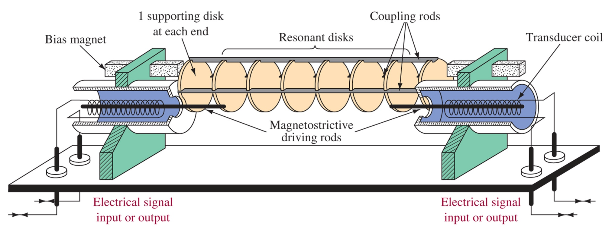
Figure 4-6 Mechanical filter.
Filters with bandwidths between 0.5 and 35 kHz are possible by coupling the mechanical vibrations of tuned discs.
The disc tuning chooses the center frequency.

Slide 16
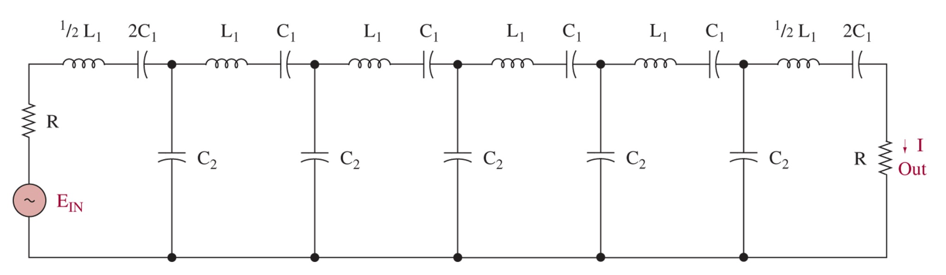
Figure 4-7 Electrical analogy of a mechanical filter.

Slide 17
4-4 ssb transmitters
Generationd and transmission carried out in several steps

Slide 18
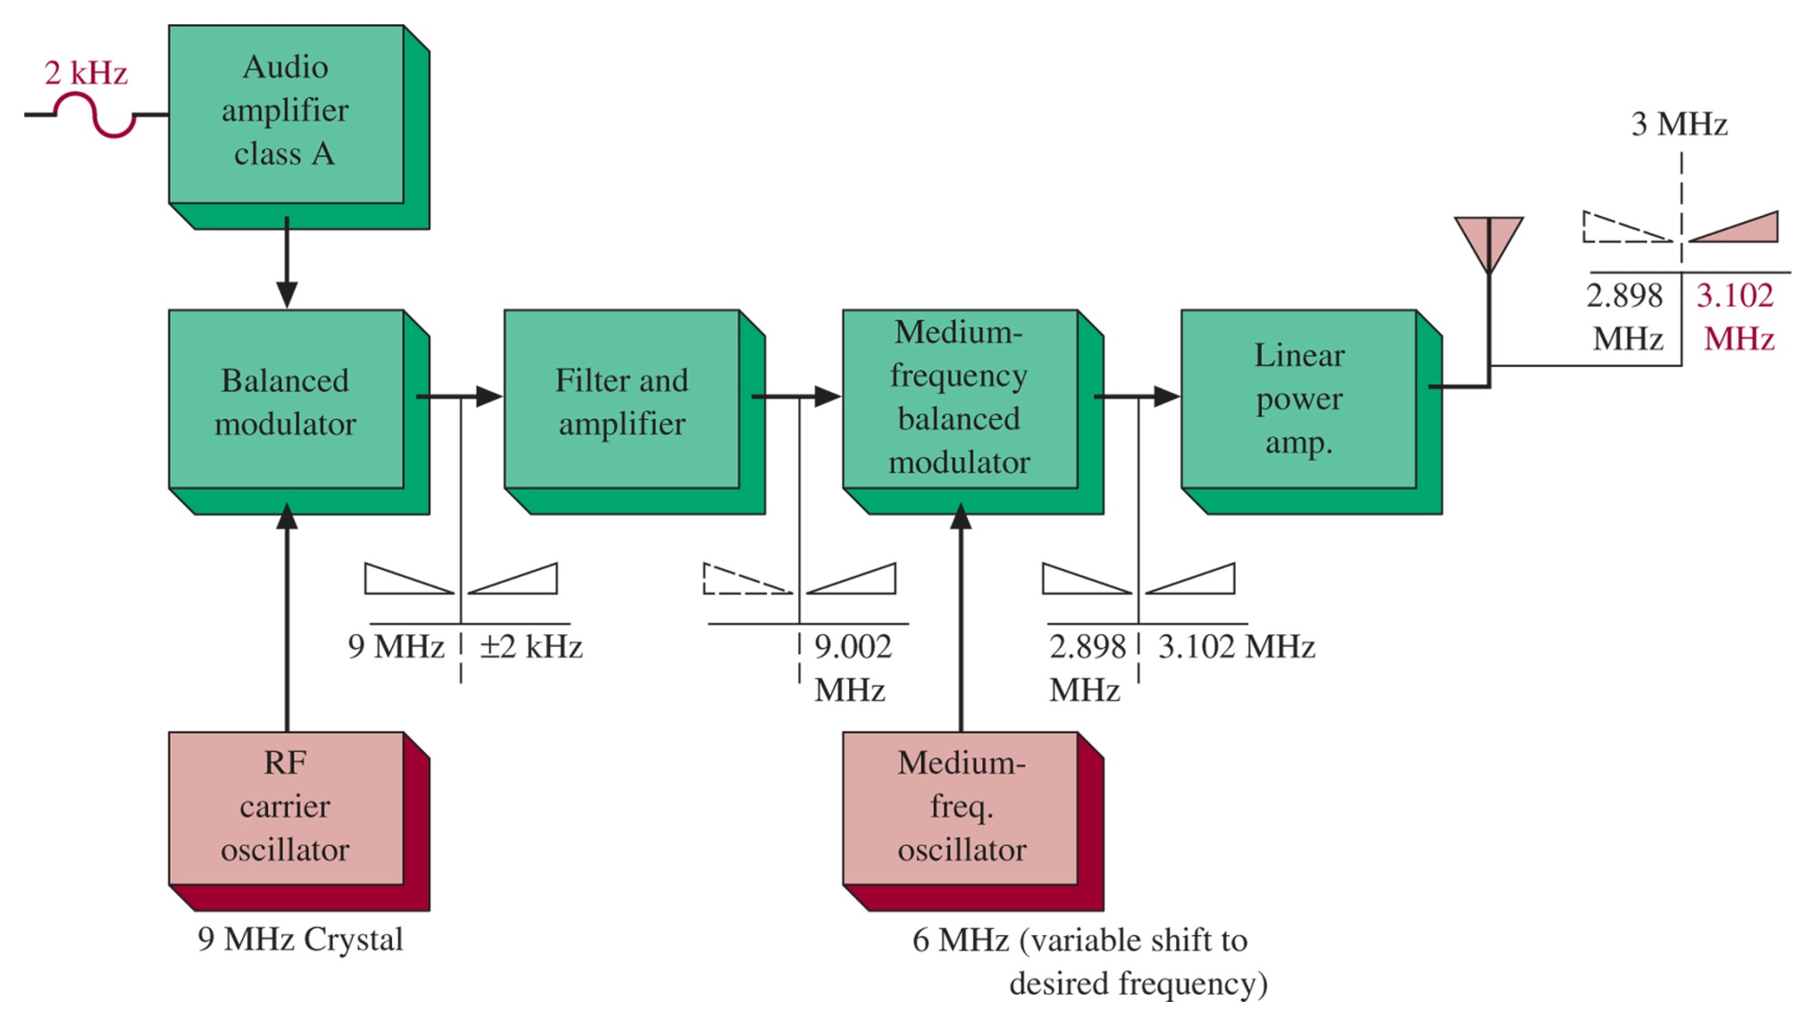
Figure 4-8 SSB transmitter block diagram.

Slide 19
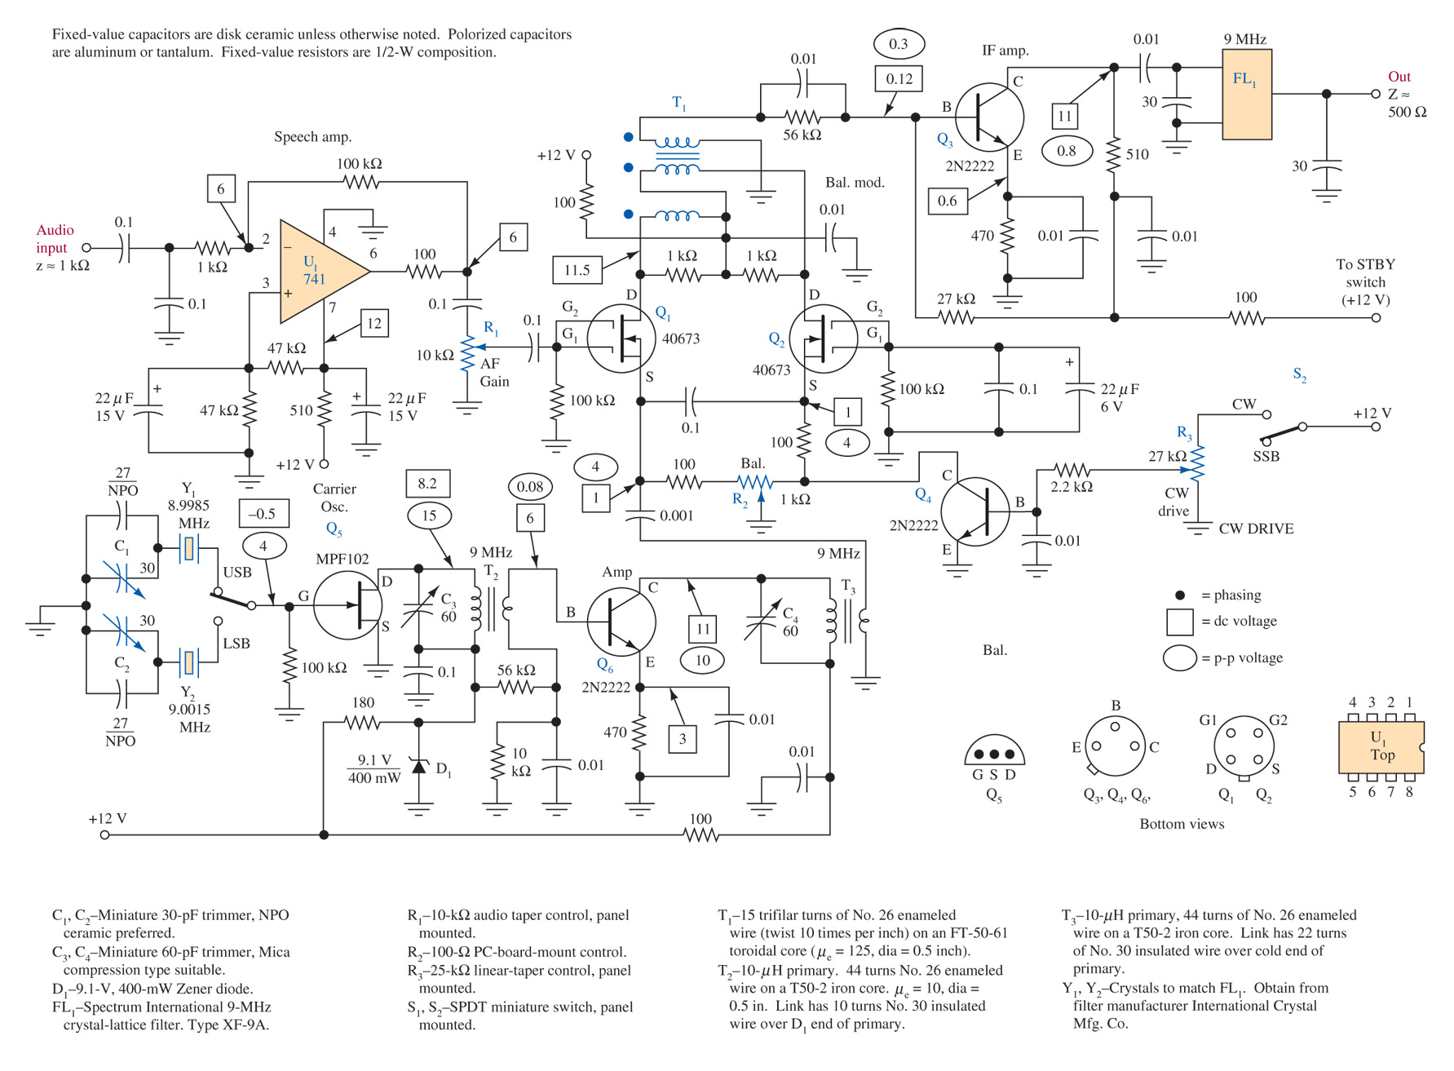
Figure 4-9 SSB generator-filter method. (From the ARRL Handbook, courtesy of the American Radio Relay League.)

Slide 20
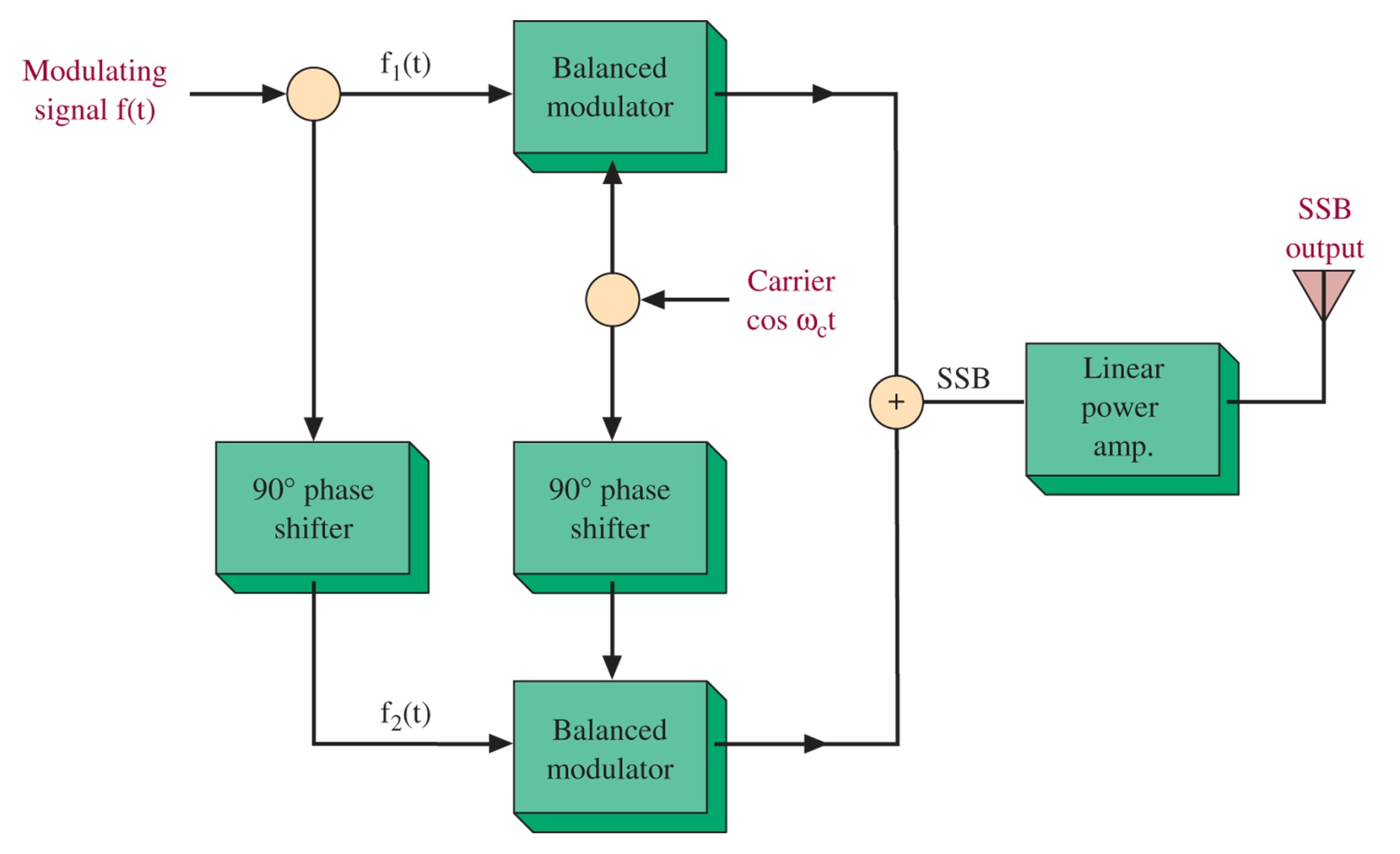
Figure 4-10 Phase-shift SSB generator.
Easier switching between sidebands
SSB generation directly at transmission frequency, eliminating IF modulator
Lower intelligence frequencies can be used because high-Q filter is not necessary
More possible as new LIC circuits become common-place

Slide 21
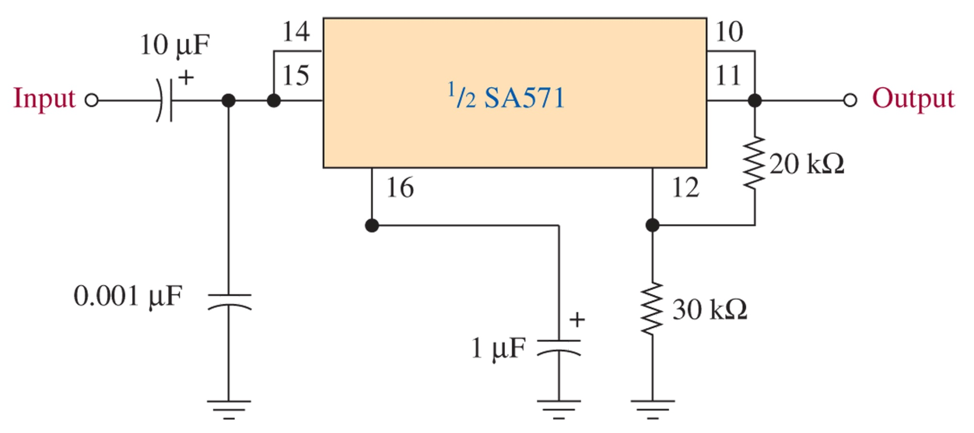
Figure 4-11 Amplitude expandor circuit.
The amplitude expandor increases low level signals and decreases high level signals around 0-dBm, reducing the overall power used, while preserving low level signals

Slide 22
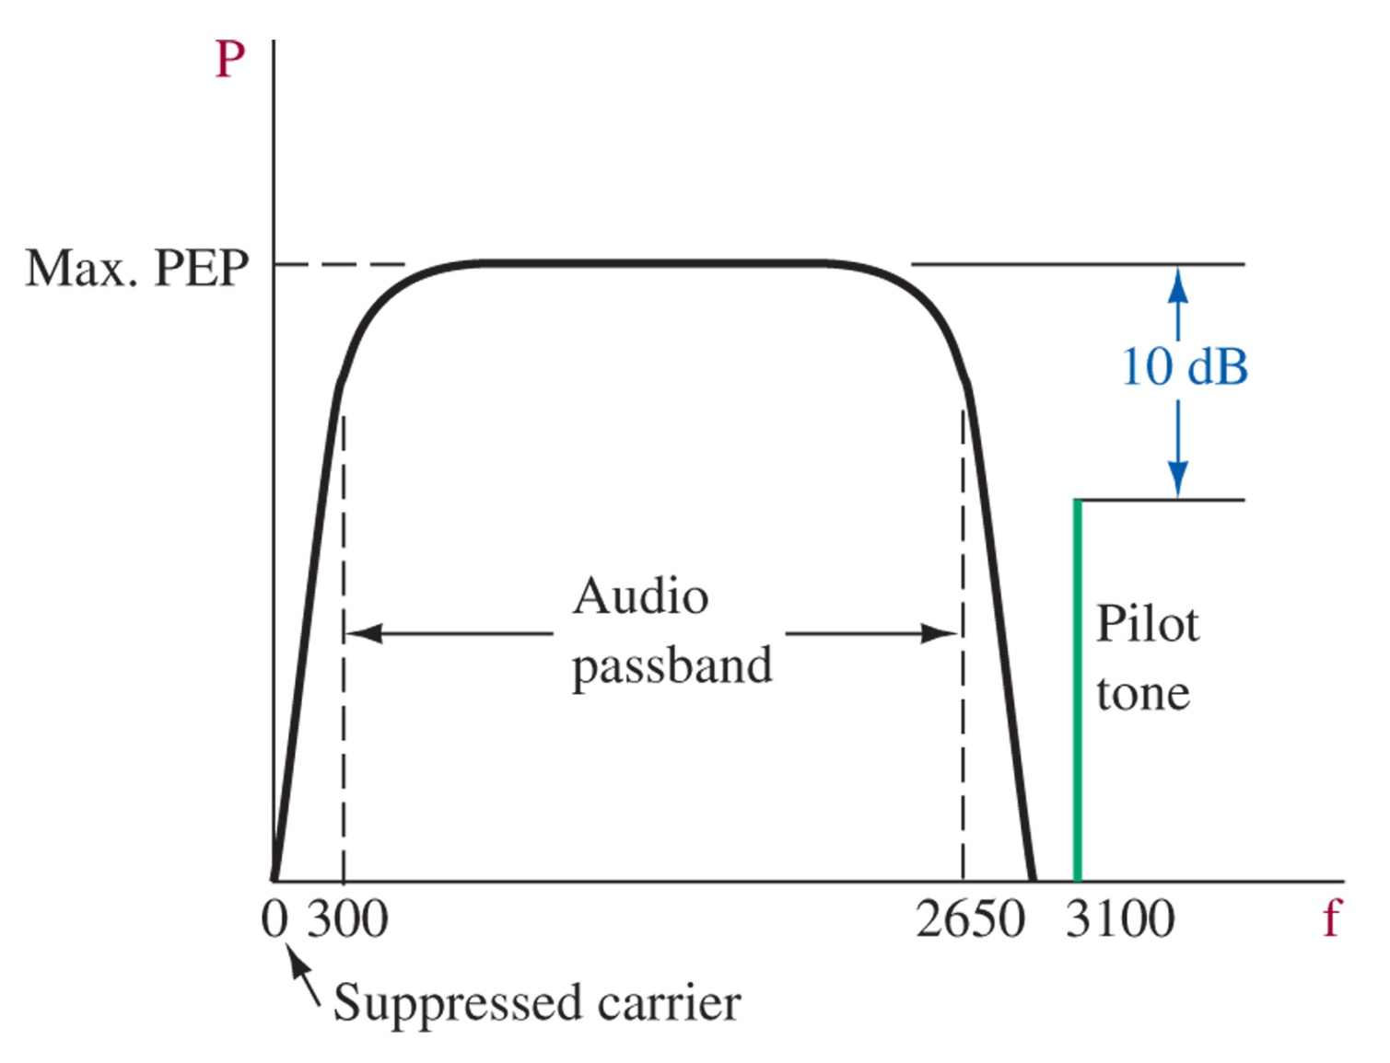
Figure 4-12 ACSSB signal.
The pilot tone is used to lock reference oscillator via a PLL, and can be used for AGC

Slide 23
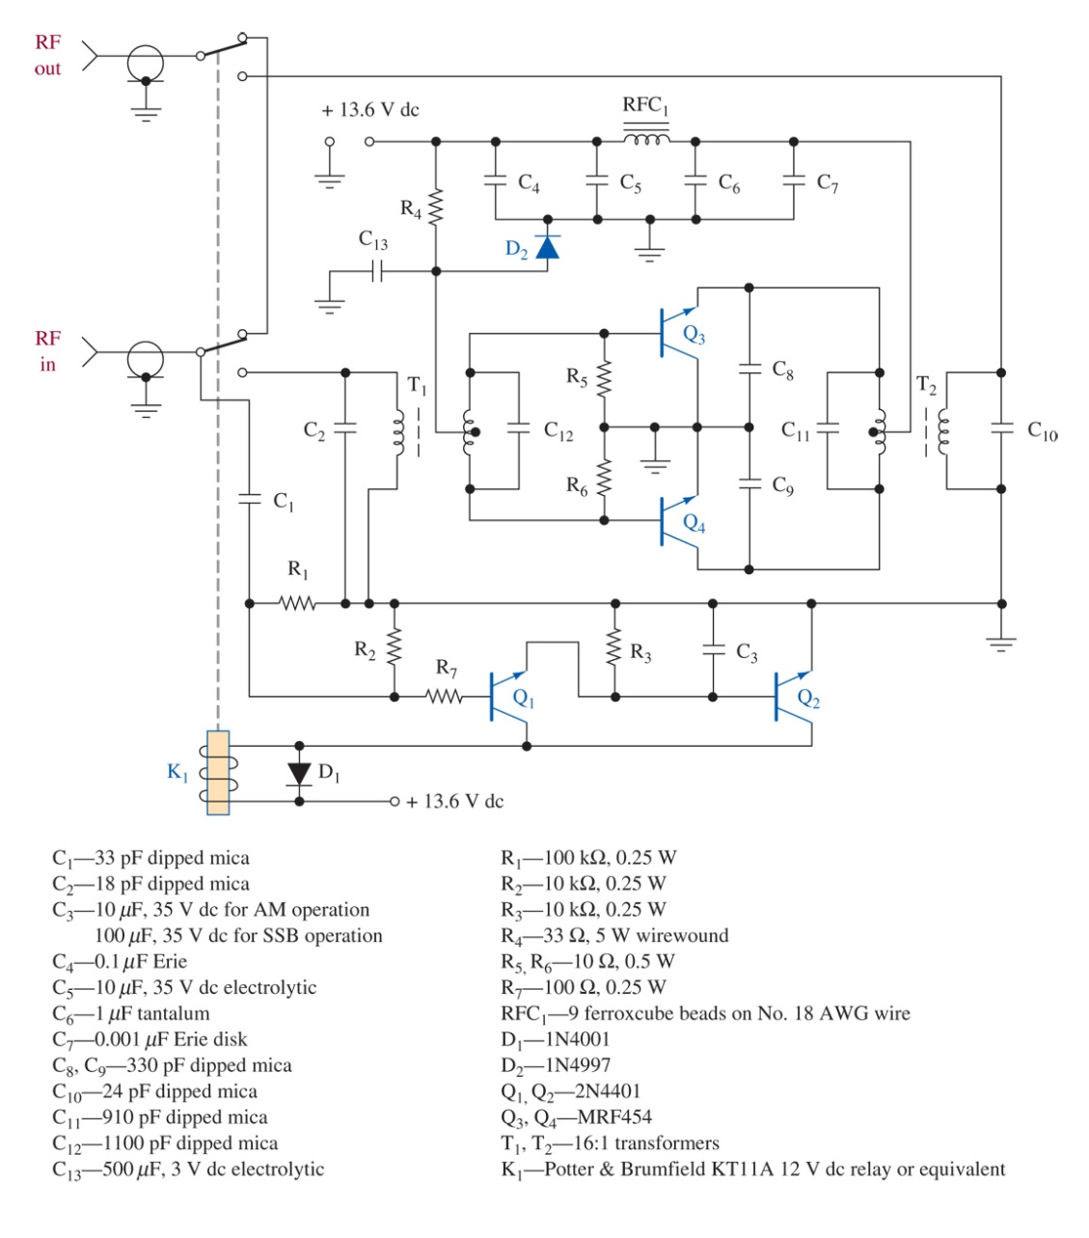
Figure 4-13 Linear power amplifier. (Courtesy of Microwaves and RF.)

Slide 24
4-5 ssb demodulation

Slide 25
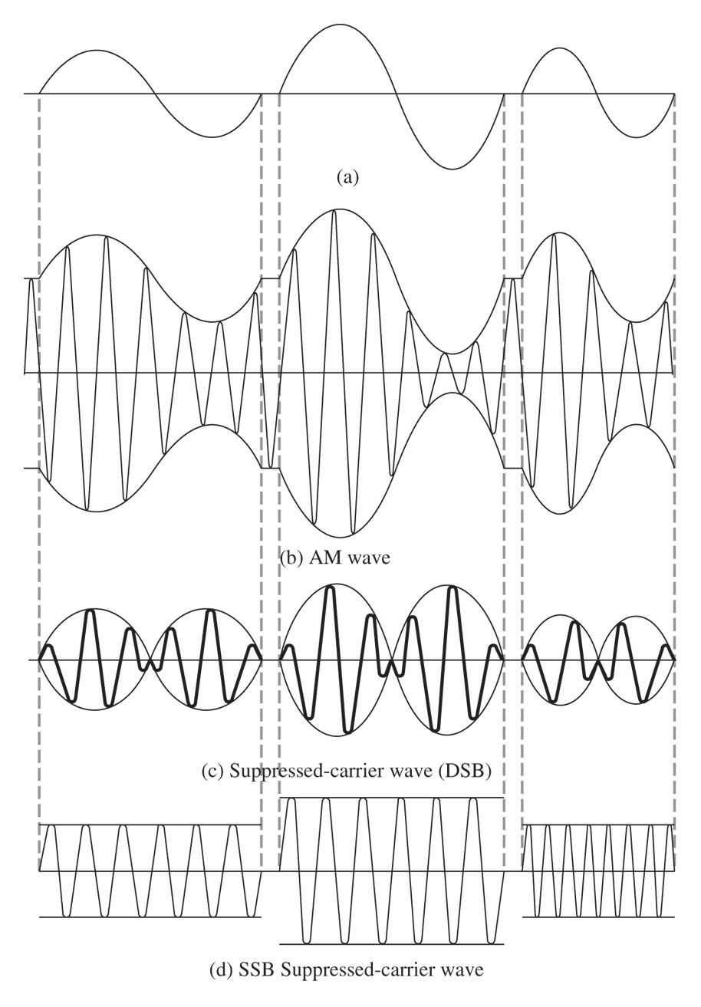
Figure 4-14 AM, DSB, and SSB waves from sinusoidal modulating signals.

Slide 26
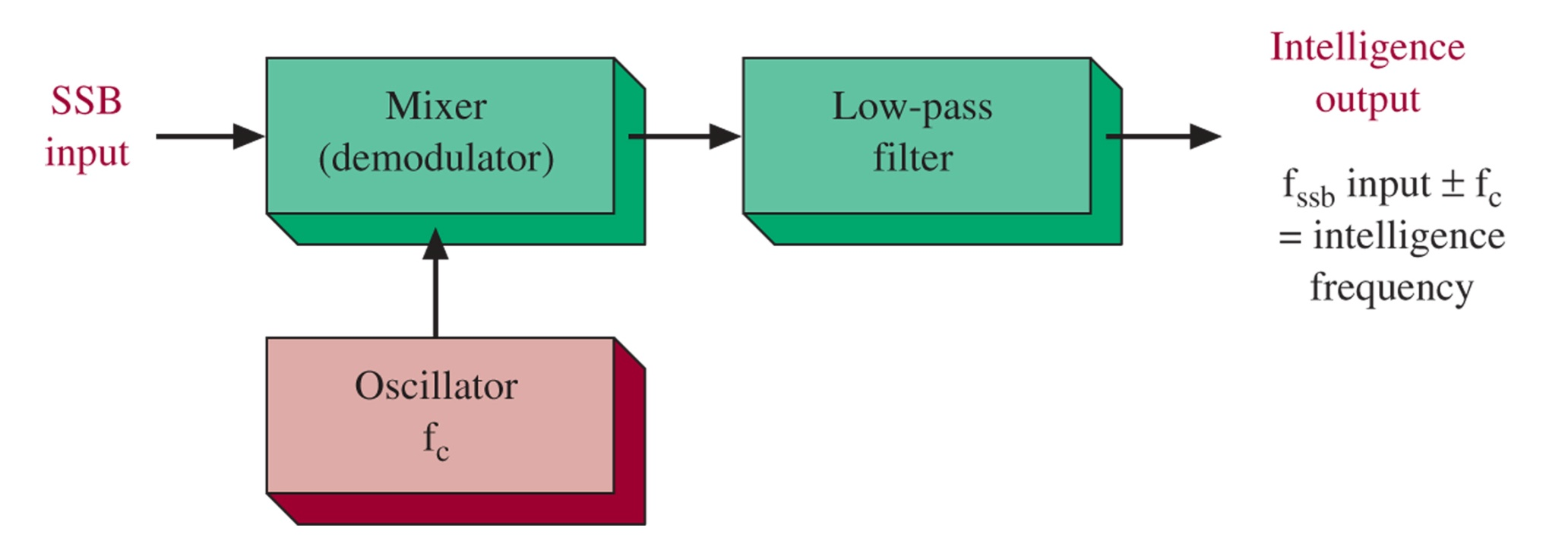
Figure 4-15 Mixer used as SSB demodulator.

Slide 27
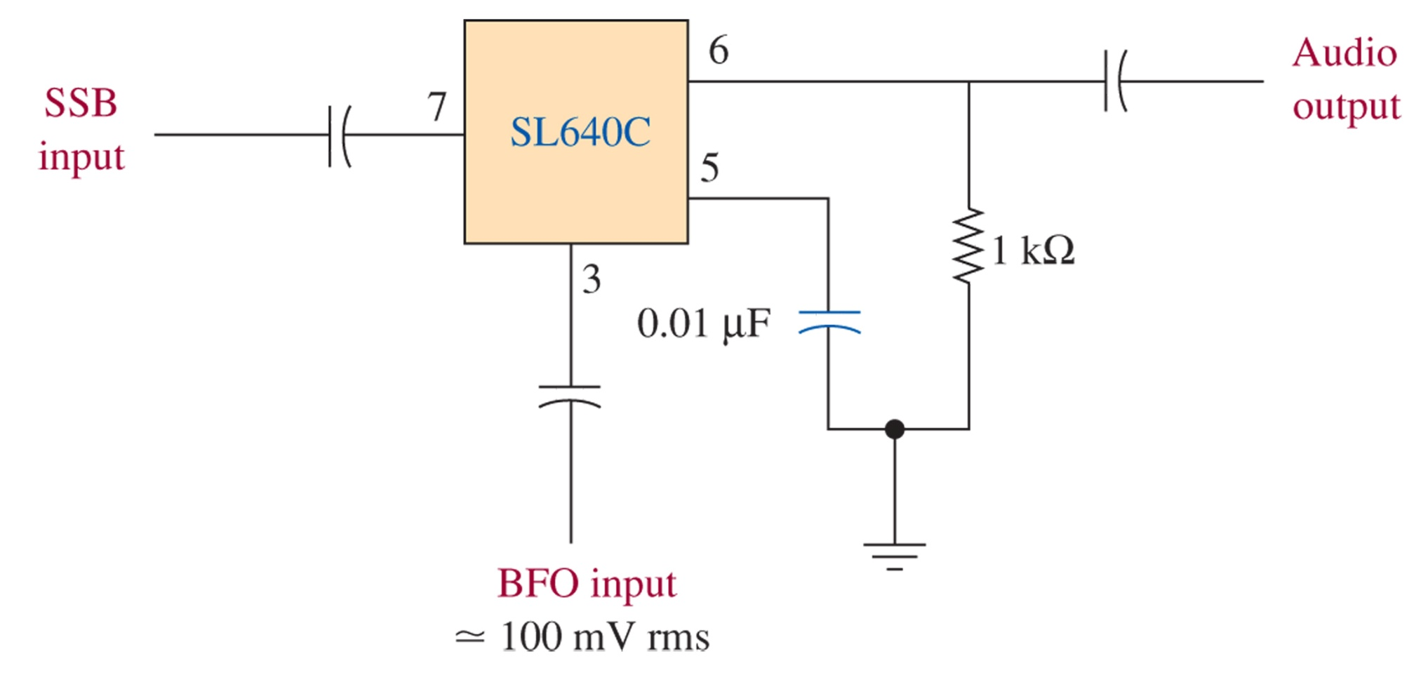
Figure 4-16 SL640C SSB detector.

Slide 28
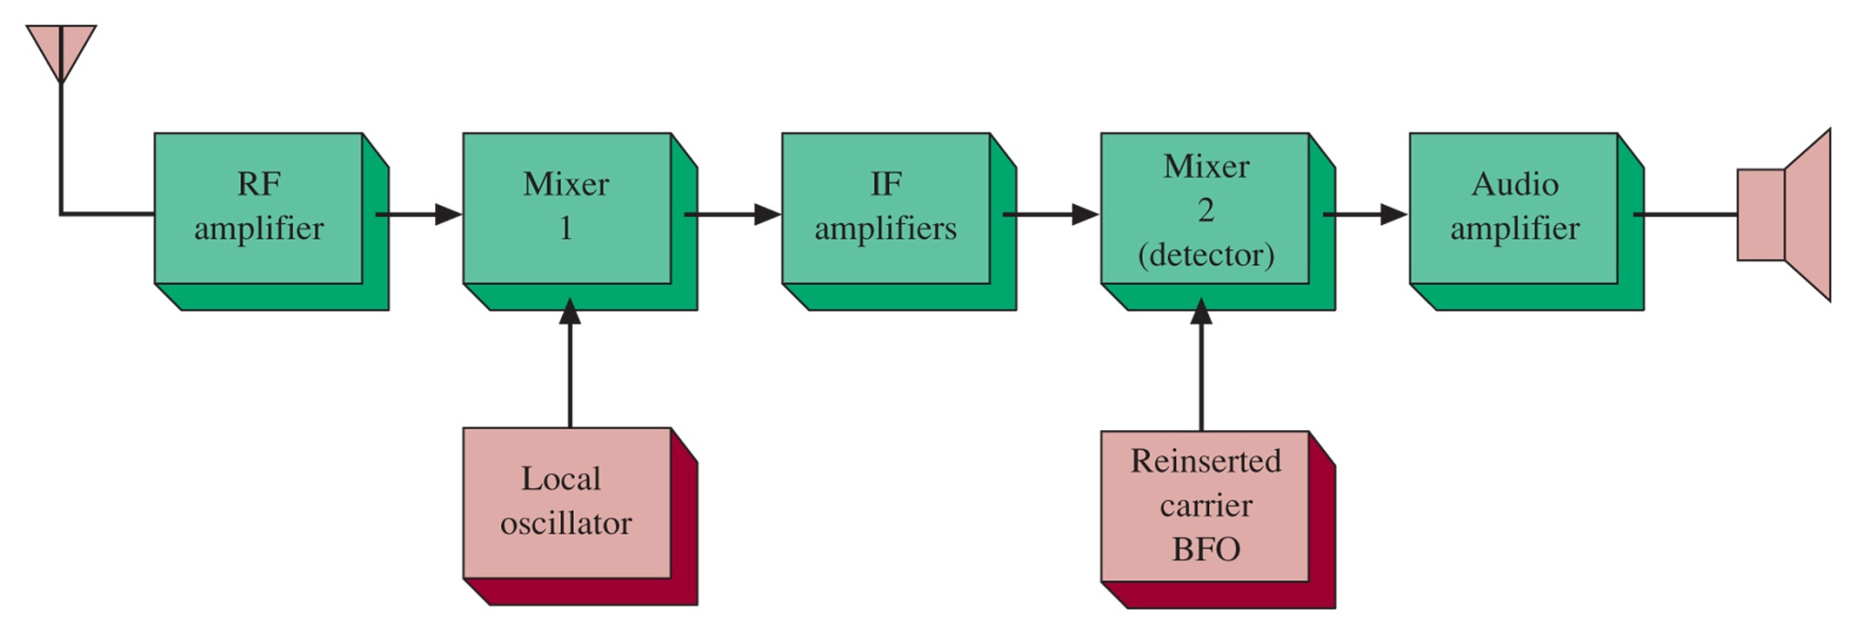
4-6 ssb receivers
Figure 4-17 SSB receiver block diagram.

Slide 29
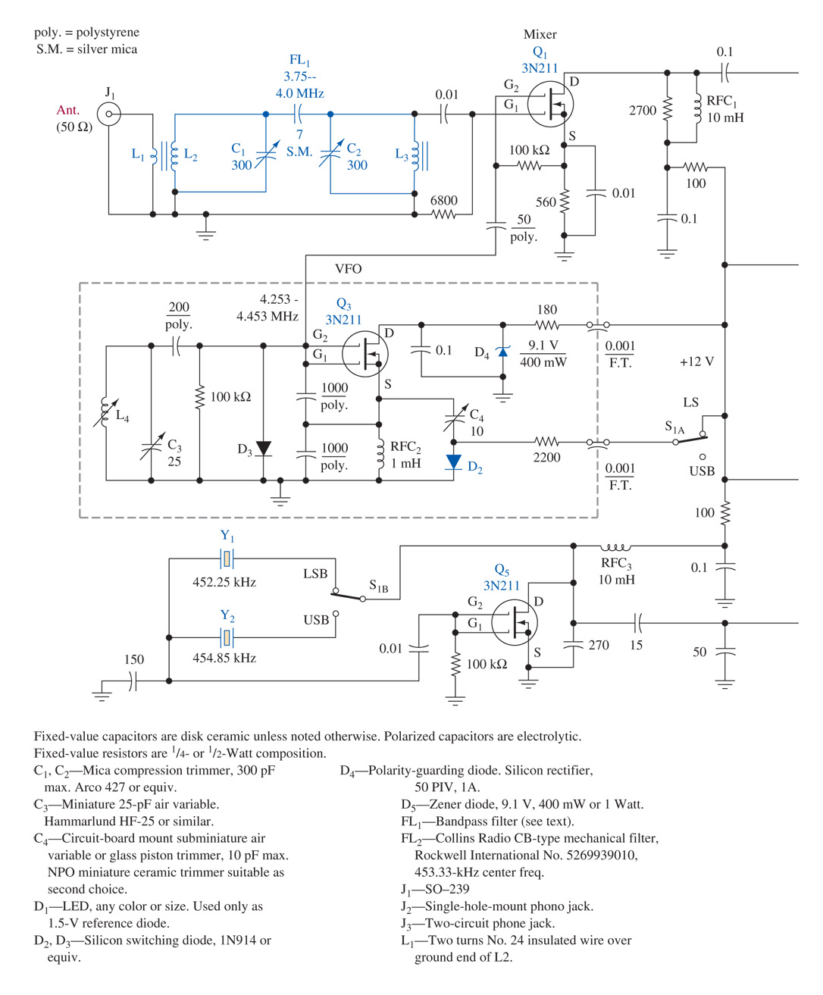
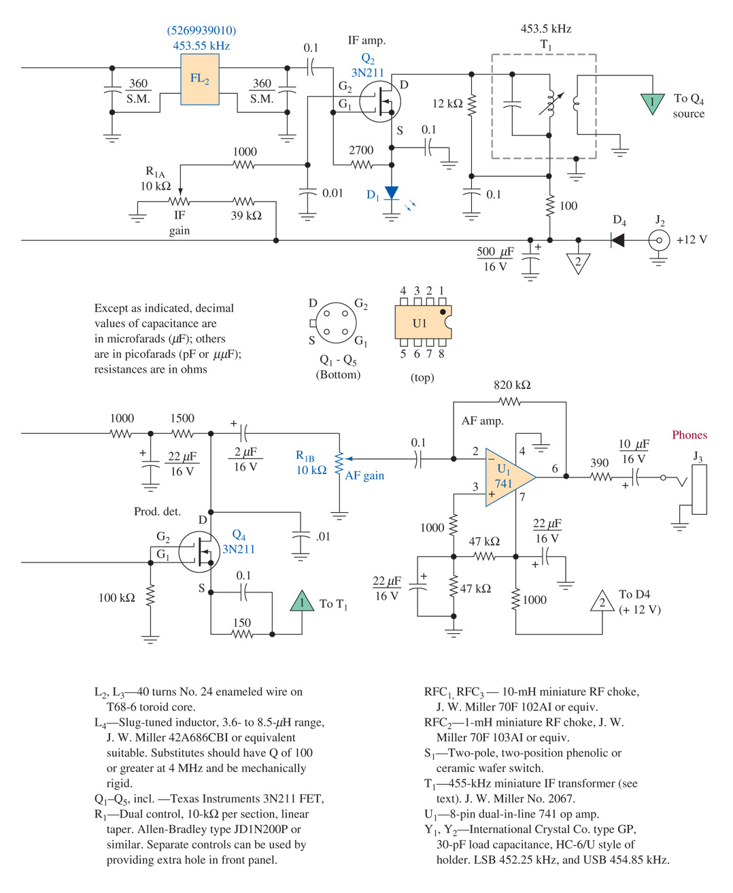
Figure 4-18 SSB receiver. (From the ARRL Handbook, courtesy of the American Radio Relay League.)

Slide 30
Figure 4-18 (continued) SSB receiver. (From the ARRL Handbook, courtesy of the American Radio Relay League.)

Slide 31
4-7 troubleshooting

Slide 32
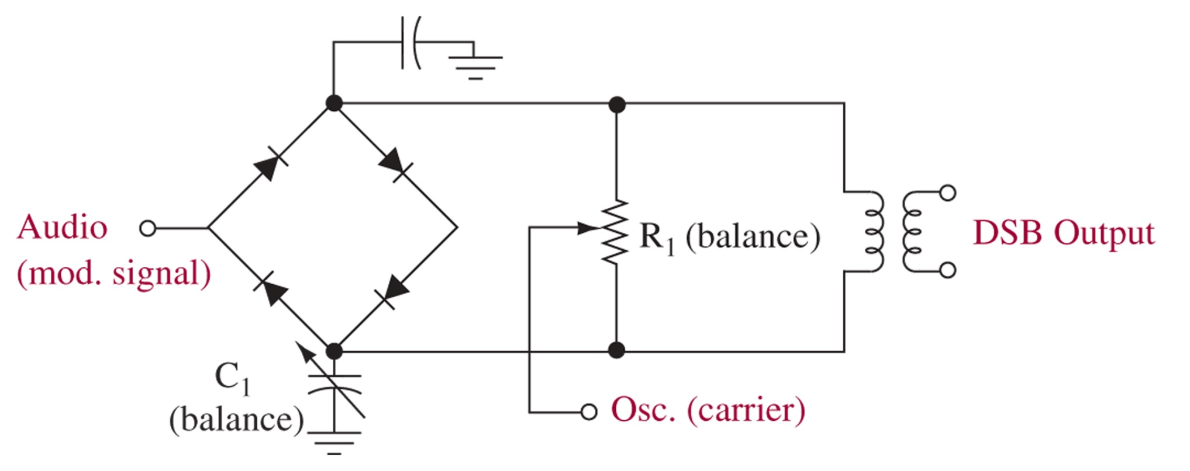
Figure 4-19 Balanced modulator.

Slide 33
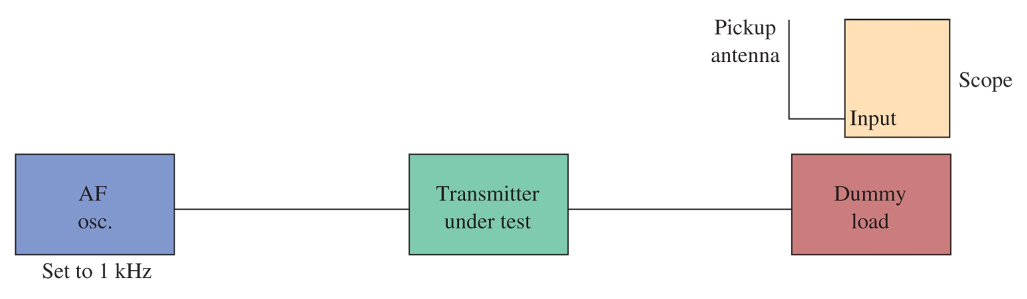
Figure 4-20 Checking for carrier leakthrough with an oscilloscope.

Slide 34
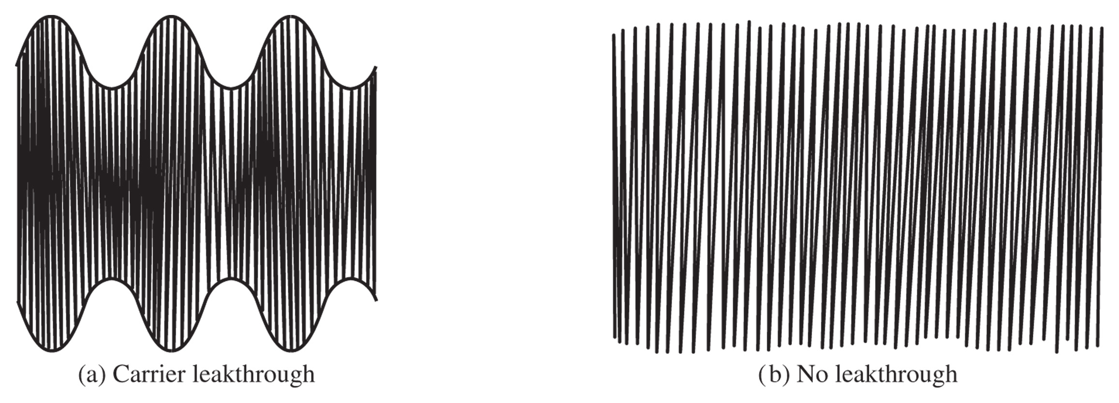
Figure 4-21 Single-sideband signal with and without carrier leakthrough.

Slide 35
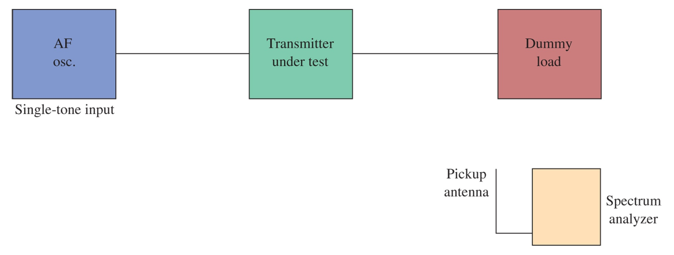
Figure 4-22 Checking carrier suppression with a spectrum analyzer.

Slide 36
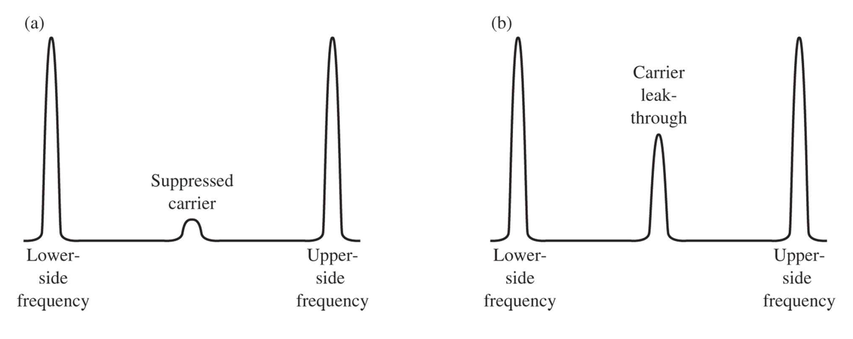
Figure 4-23 Carrier suppression as seen on a spectrum analyzer.

Slide 37
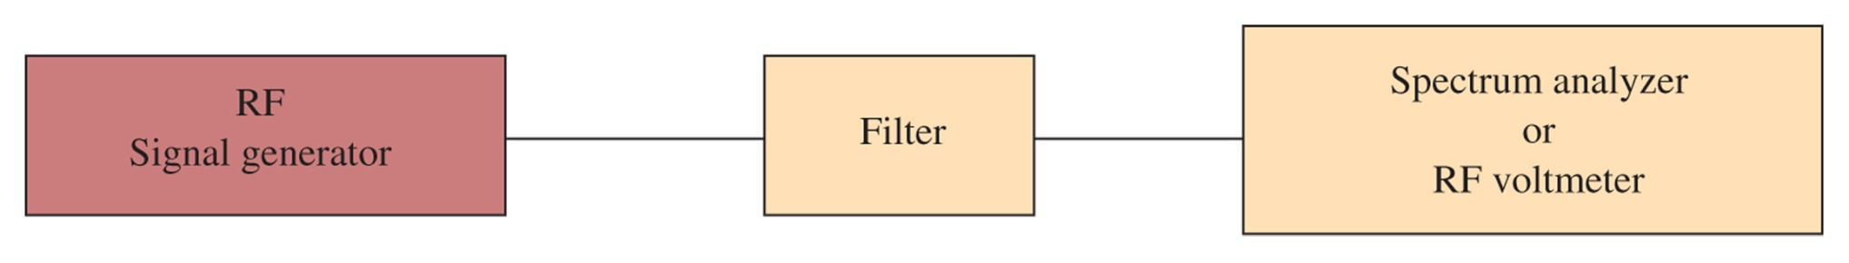
Figure 4-24 Filter testing.

Slide 38
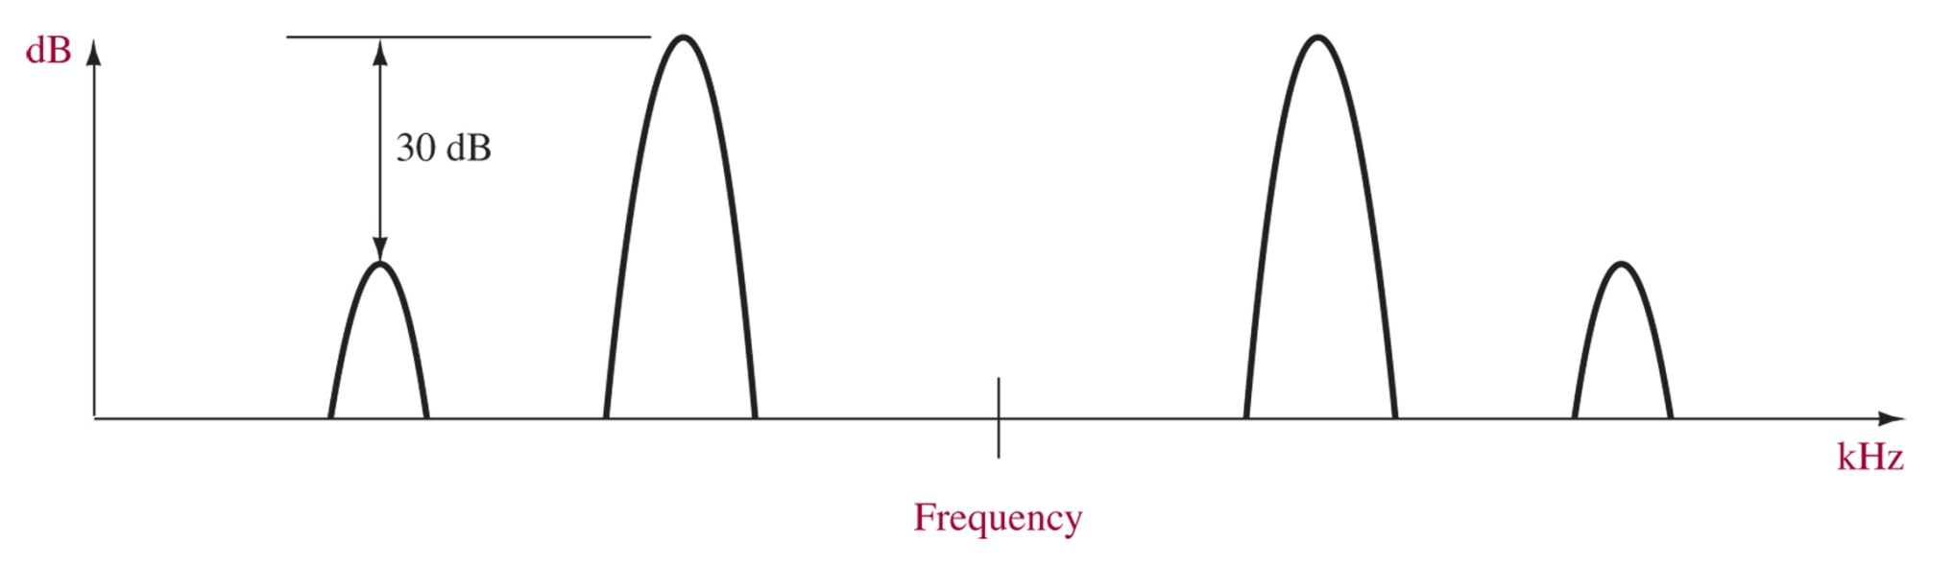
Figure 4-25 Two-tone test.

Slide 39
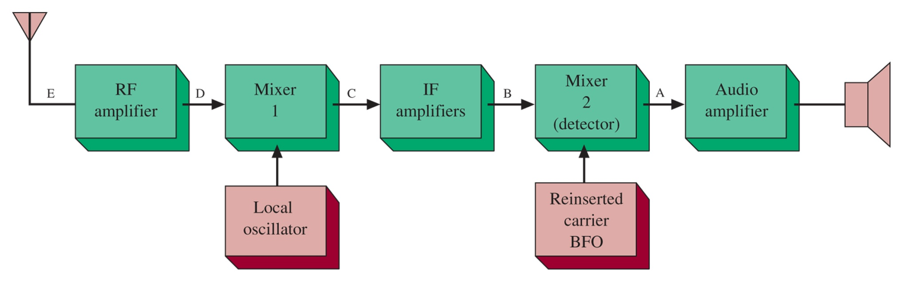
Figure 4-26 SSB receiver block diagram.

Slide 40
4-8 troubleshooting with multisim

Slide 41
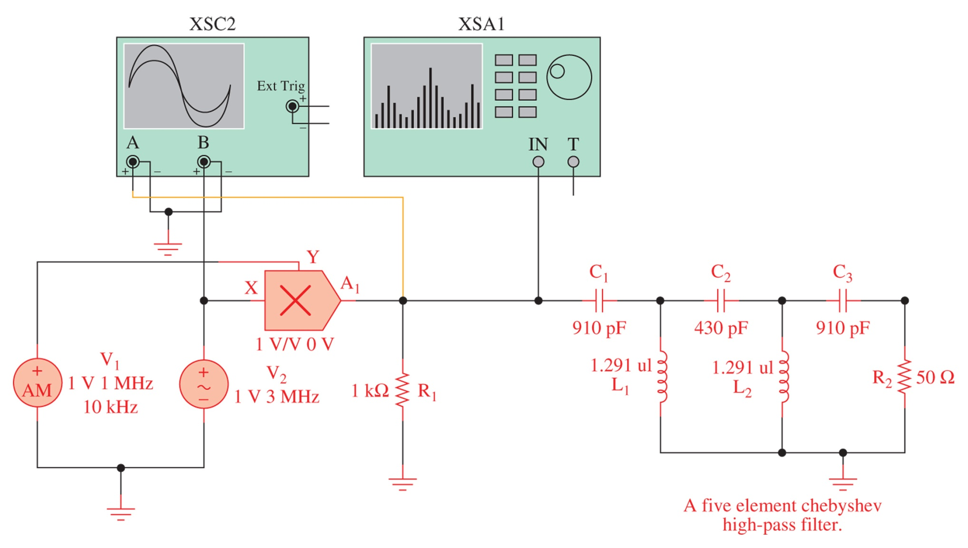
Figure 4-27 A multiplier plus SSB filter as implemented with Electronics WorkbenchTM Multisim.

Slide 42
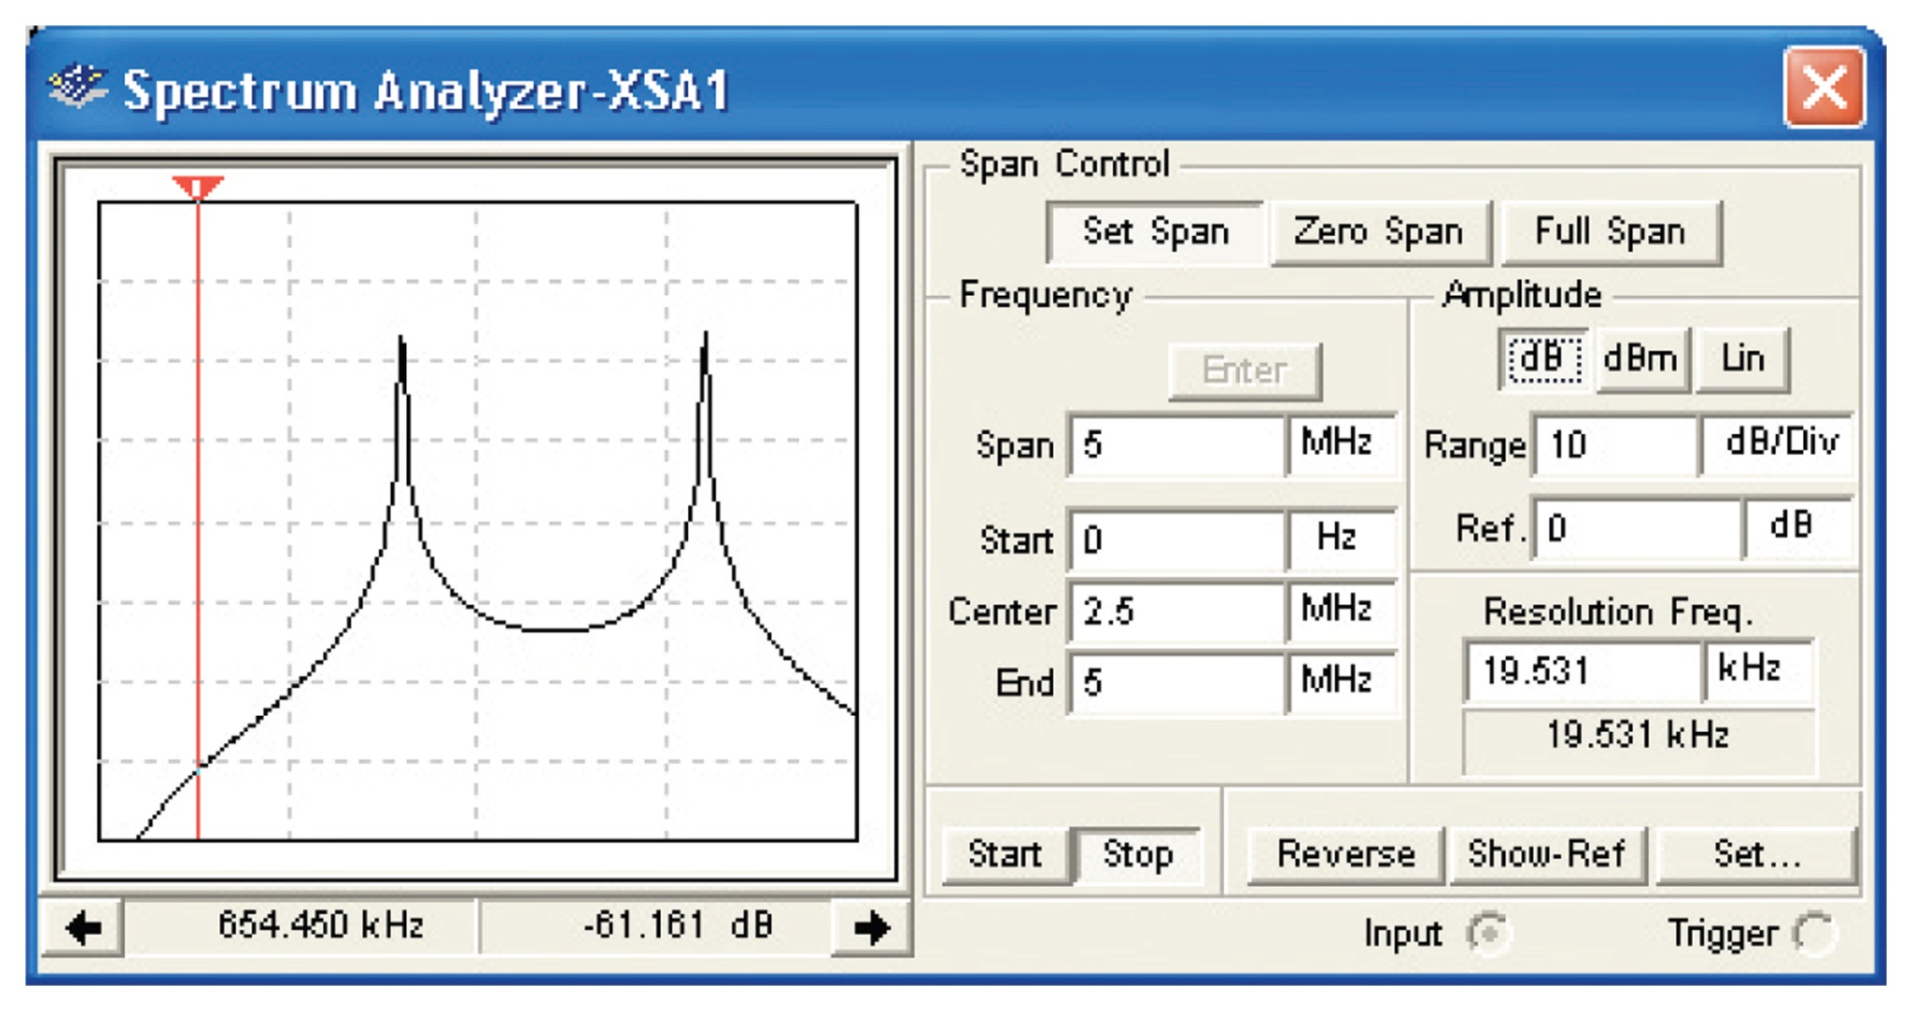
Figure 4-28 The double-sideband output spectrum for the multiplier circuit.

Slide 43
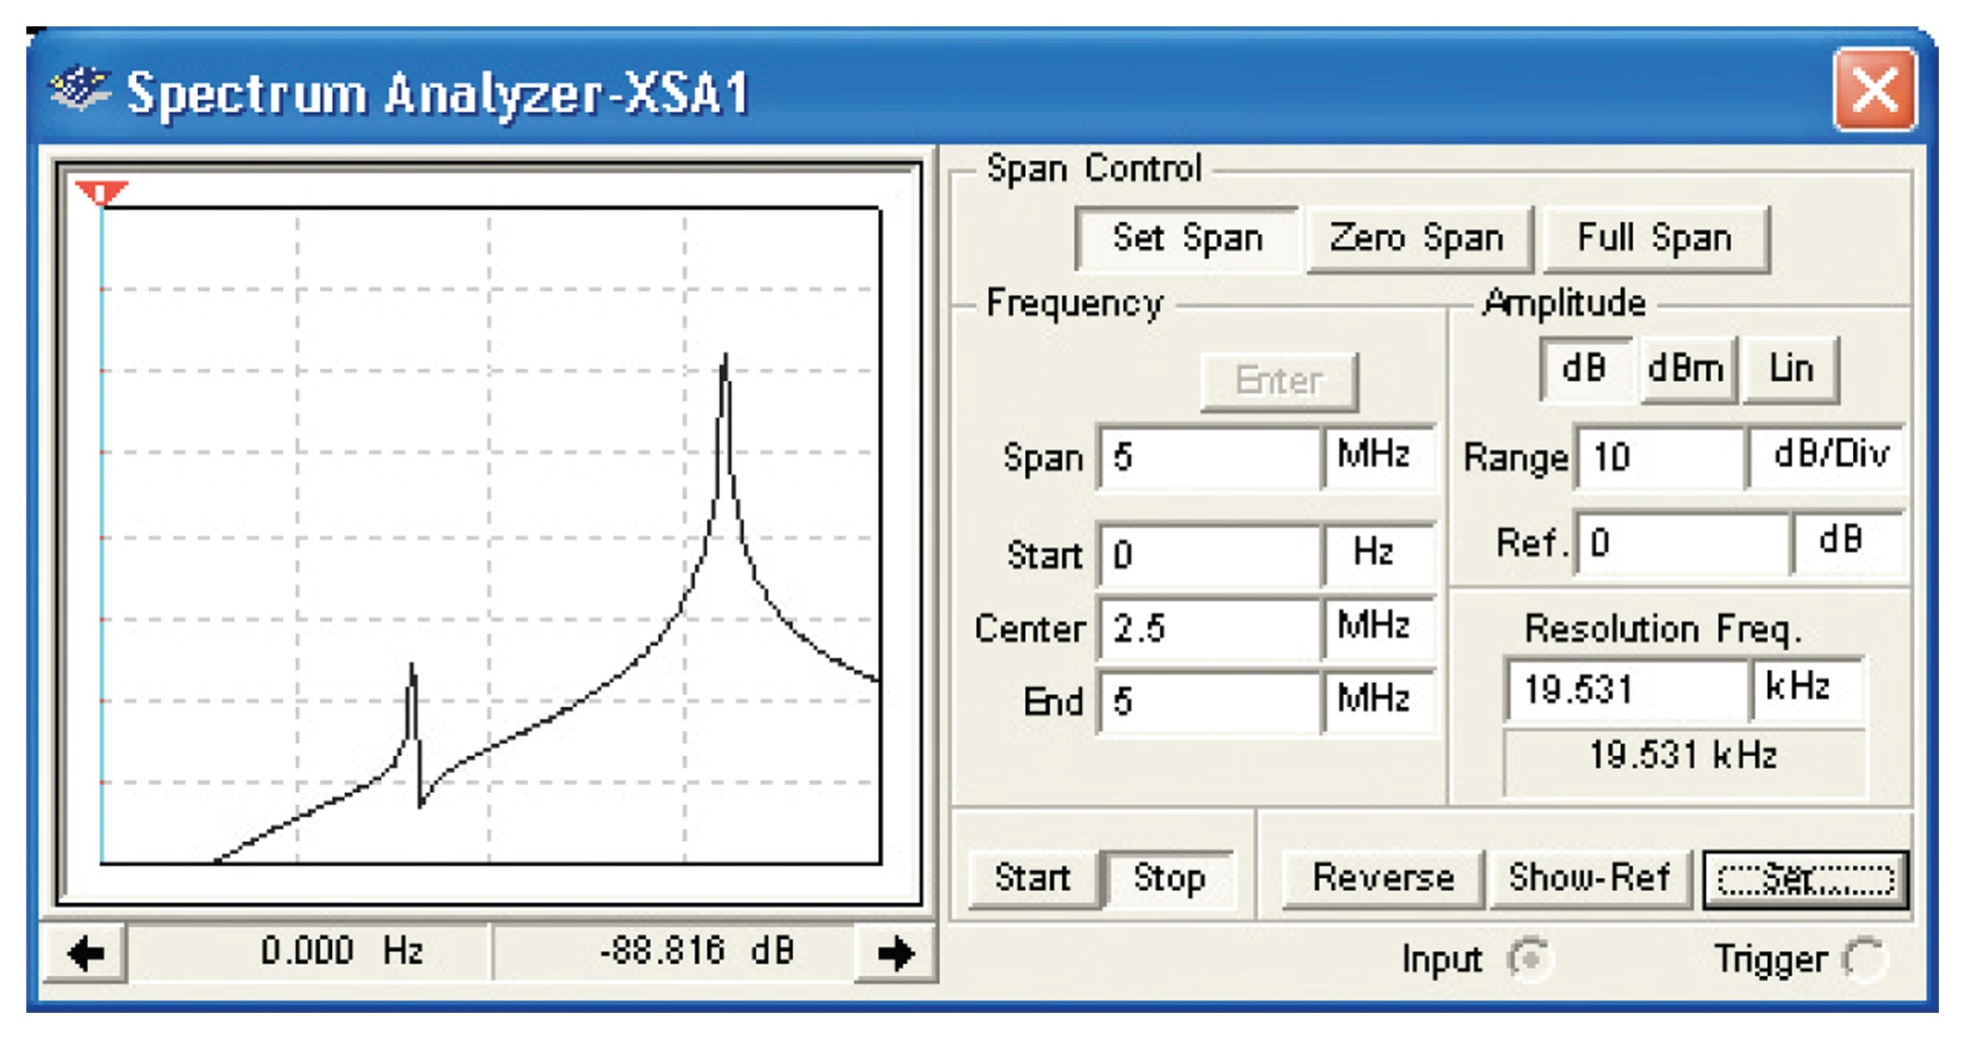
Figure 4-29 The multiplier circuit with the lower sideband removed.

