Slide 1
EE 350 / ECE 490 Analog Communication Systems
Ch. 6 – Frequency Modulation (FM) Reception

Slide 2
Objectives
Describe the operation of an FM receiving system and highlight the difference compared to AM
Sketch a slope detector schematic and explain how it can provide the required response to the modulating signal amplitude and frequency
Provide various techniques and related circuits used in FM discriminators
Explain the operation of the PLL and describe how it can be utilized as an FM discriminator
Provide the block diagram of a complete stereo broadcast band receiver and explain its operation
Analyze the operation of an LIC used as a stereo decoder
Analyze and understand a complete FM receiver schematic

Slide 3
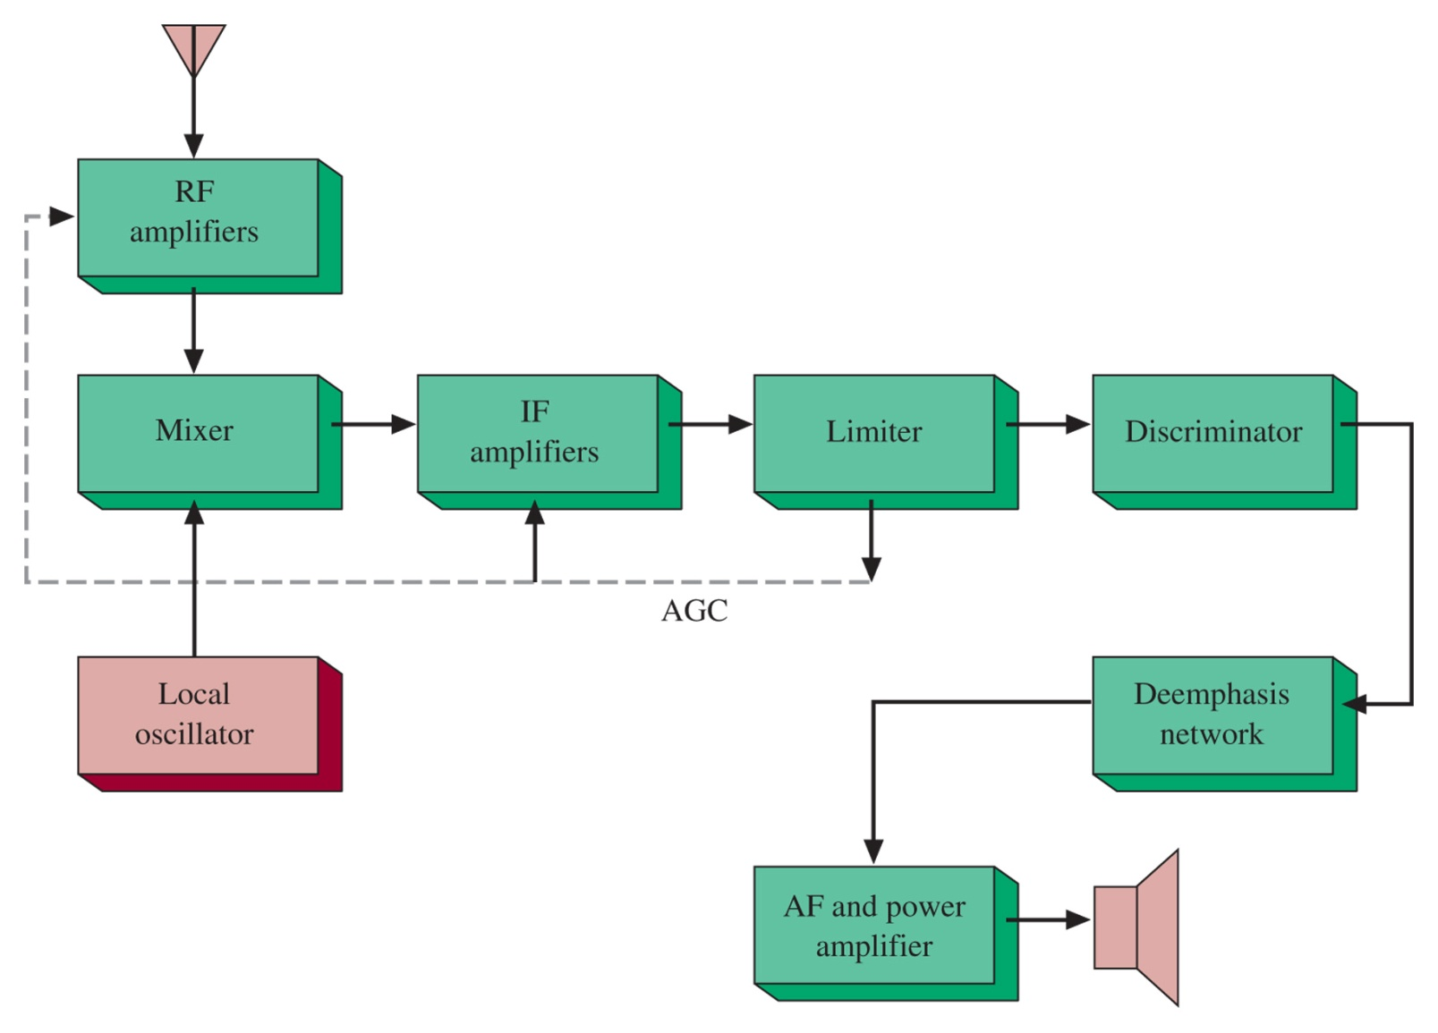
6-1 Block Diagram
Figure 6-1 FM receiver block diagram.

Slide 4
Similarities
The block diagram appears very similar to previous receivers (AM / SSB)
Mixer, Local Oscillator, and IF amp are nearly identical
Universal standard intermediate frequency is 10.7 MHz (AM is 455 kHz).
AGC may not be needed due to limiter
AFC is not necessary in new designs due to more stable Local Oscillators

Slide 5
6-2 RF Amplifiers
AM can avoid RF amplifiers because of generally larger input voltages
RF often operates on 1uV signal, but needs to be amplified to increase above the noise figure
RF amplifiers also limit local oscillator reradiation

Slide 6
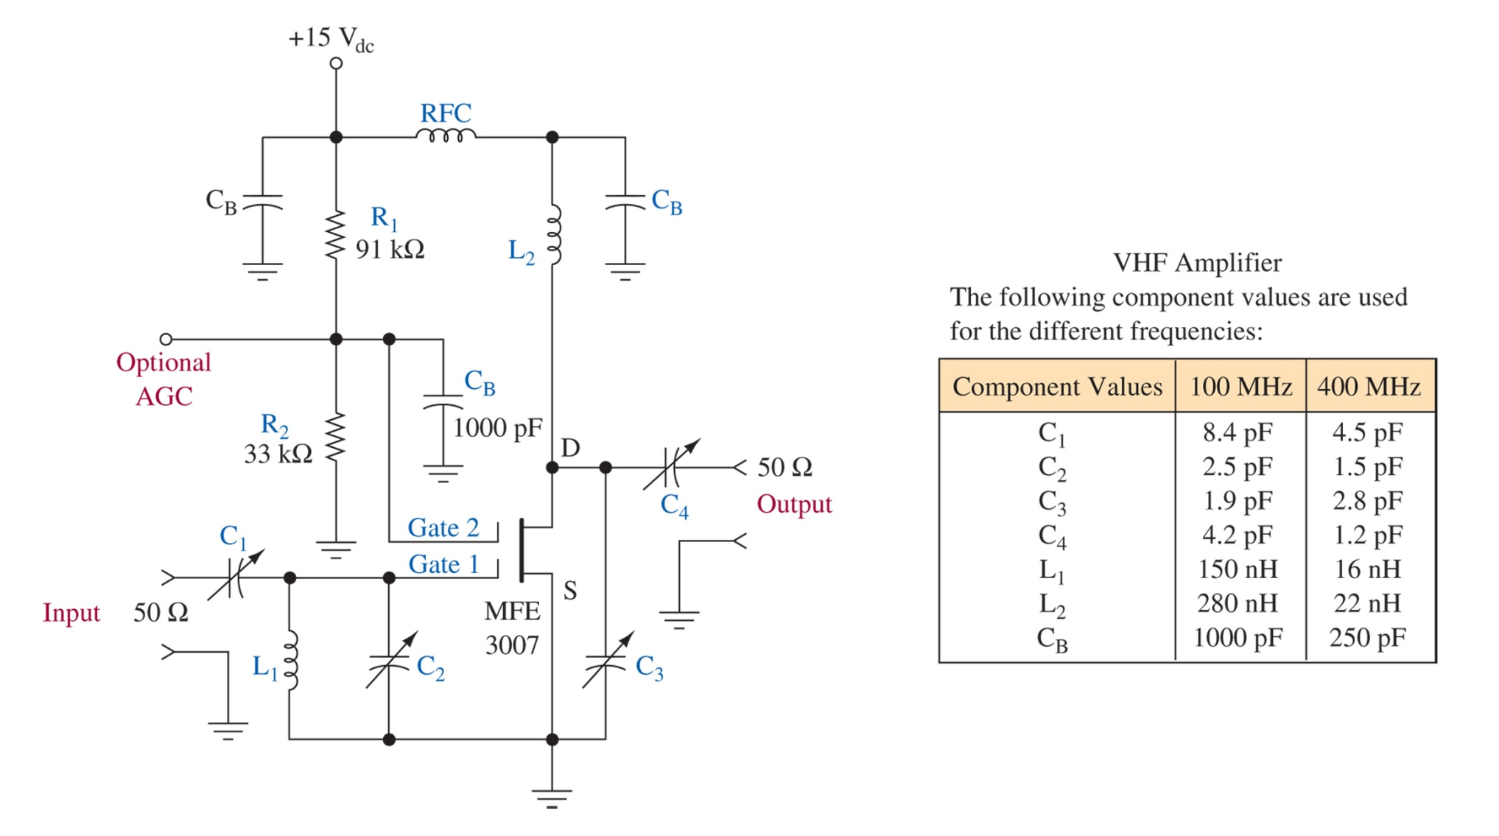
Figure 6-2 MOSFET RF amplifier. (Courtesy of Motorola Semiconductor Products, Inc.)

Slide 7
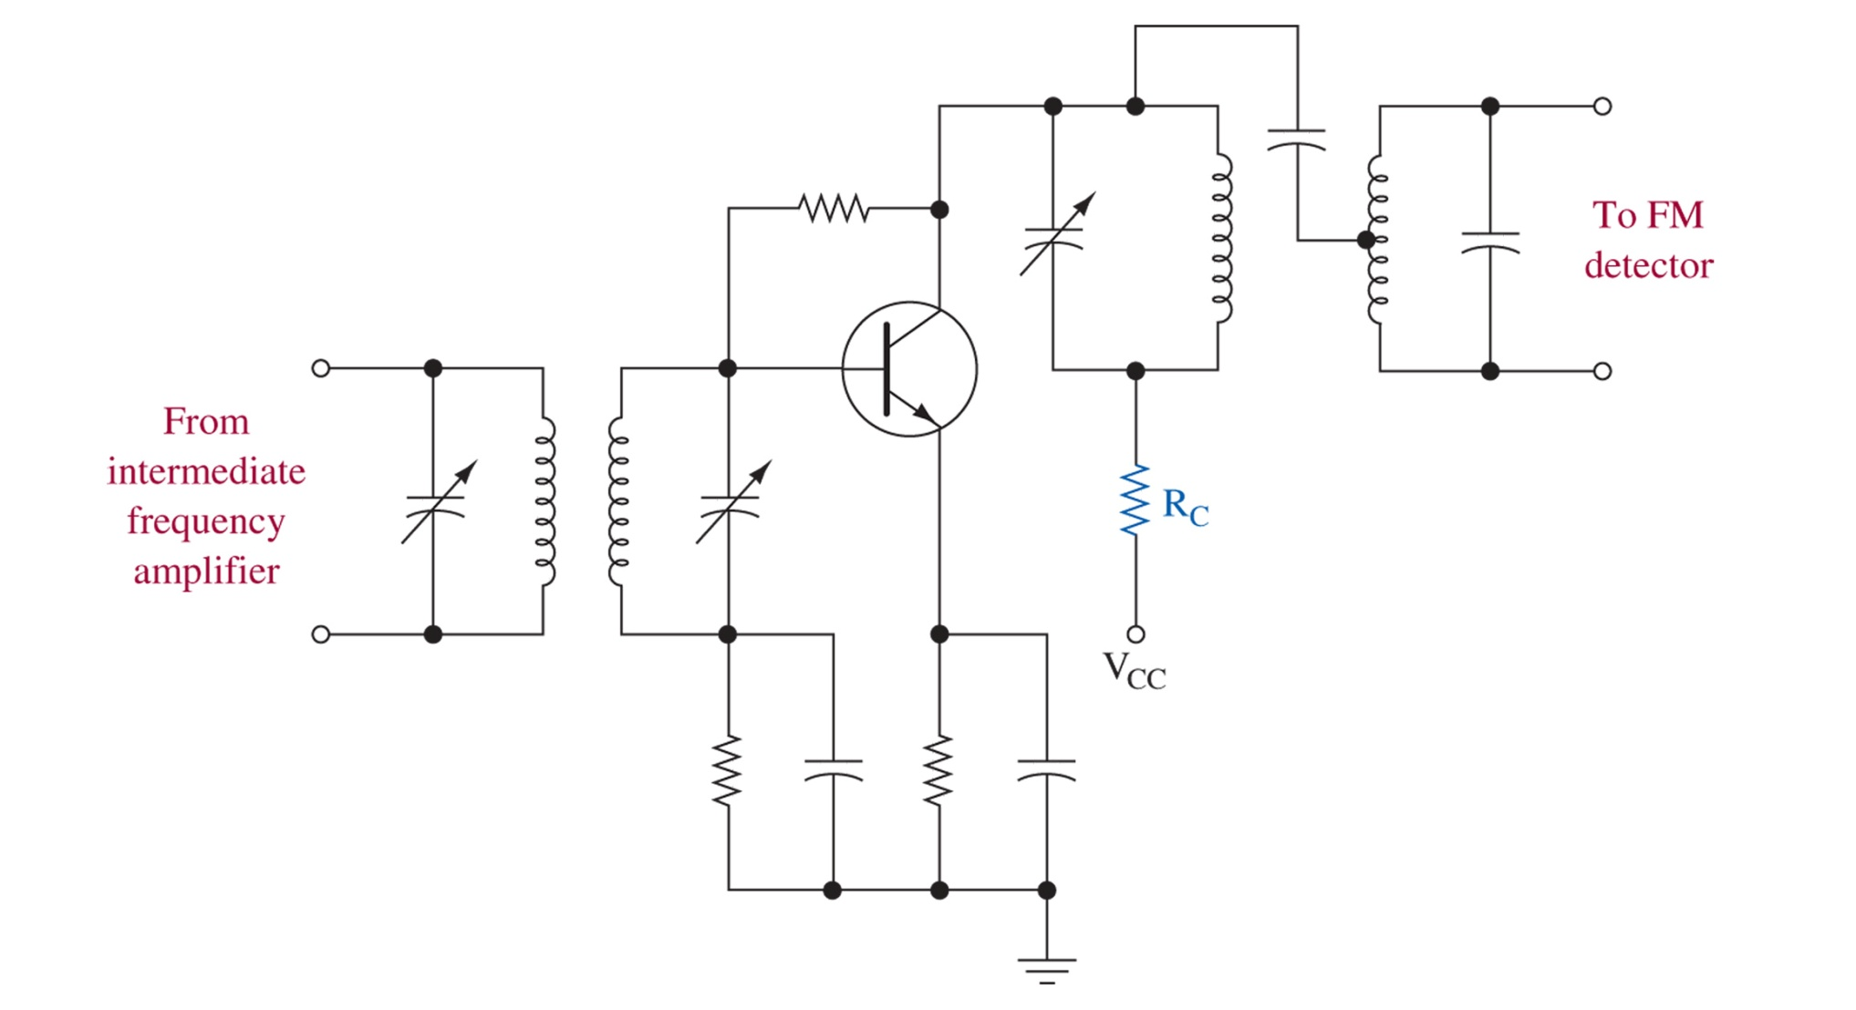
6-3 Limiters
RC reduces the collector voltage to allow transistor overdrive
Figure 6-3 Transistor limiting circuit.

Slide 8
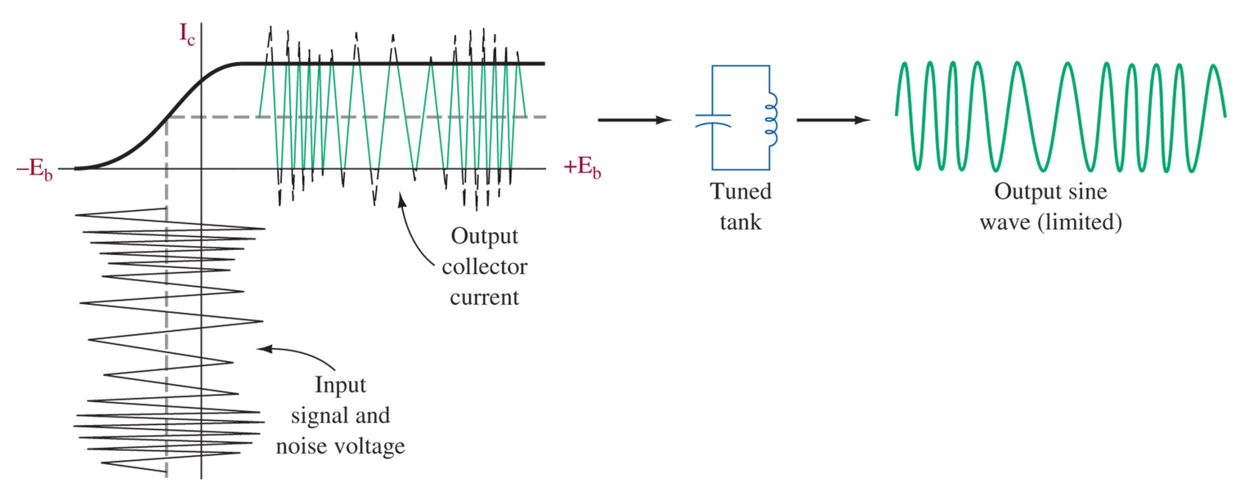
Figure 6-4 Limiter input/output and flywheel effects.

Slide 9
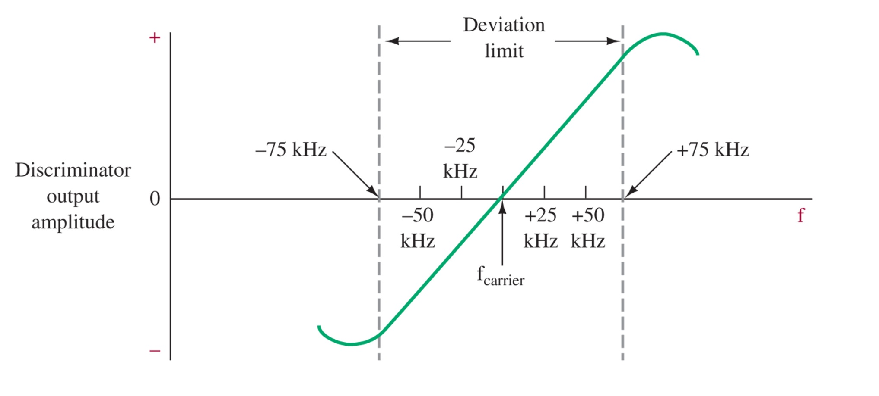
6-4 Discriminators
Figure 6-5 FM discriminator characteristic.

Slide 10
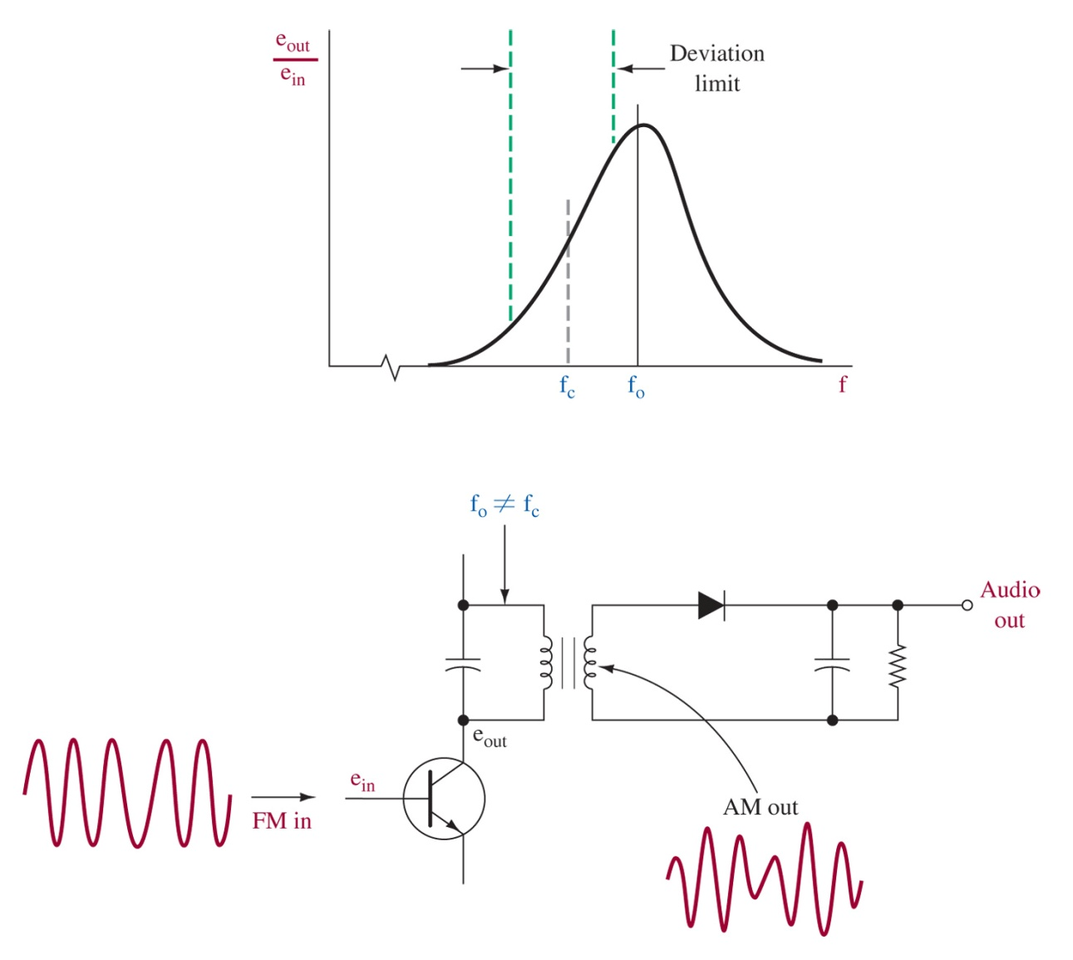
Figure 6-6 Slope detection.
Slope detection turns FM into AM, but is not always very linear

Slide 11
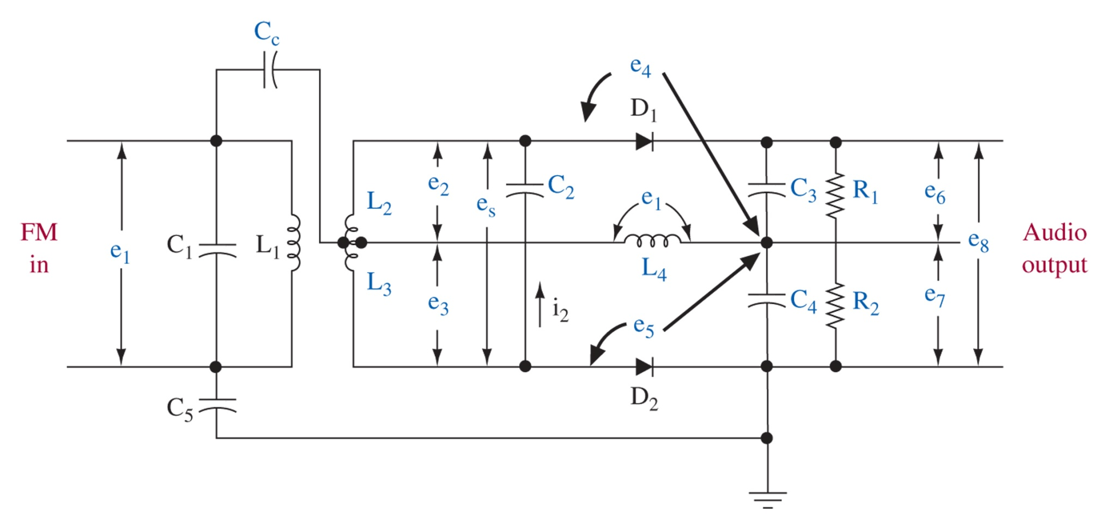
Figure 6-7 Foster-Seely discriminator.

Slide 12
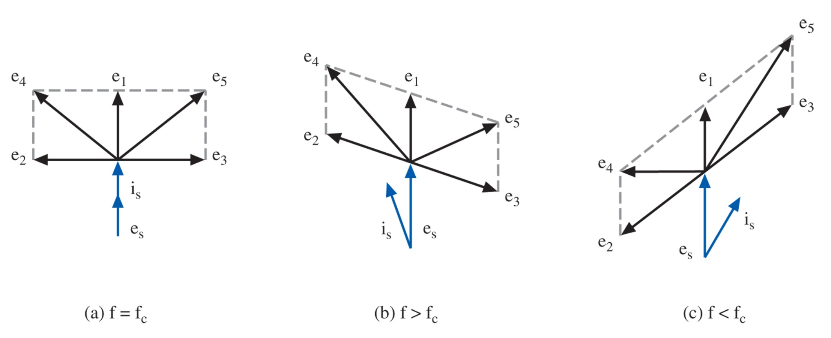
Figure 6-8 Discriminator phase relations.

Slide 13
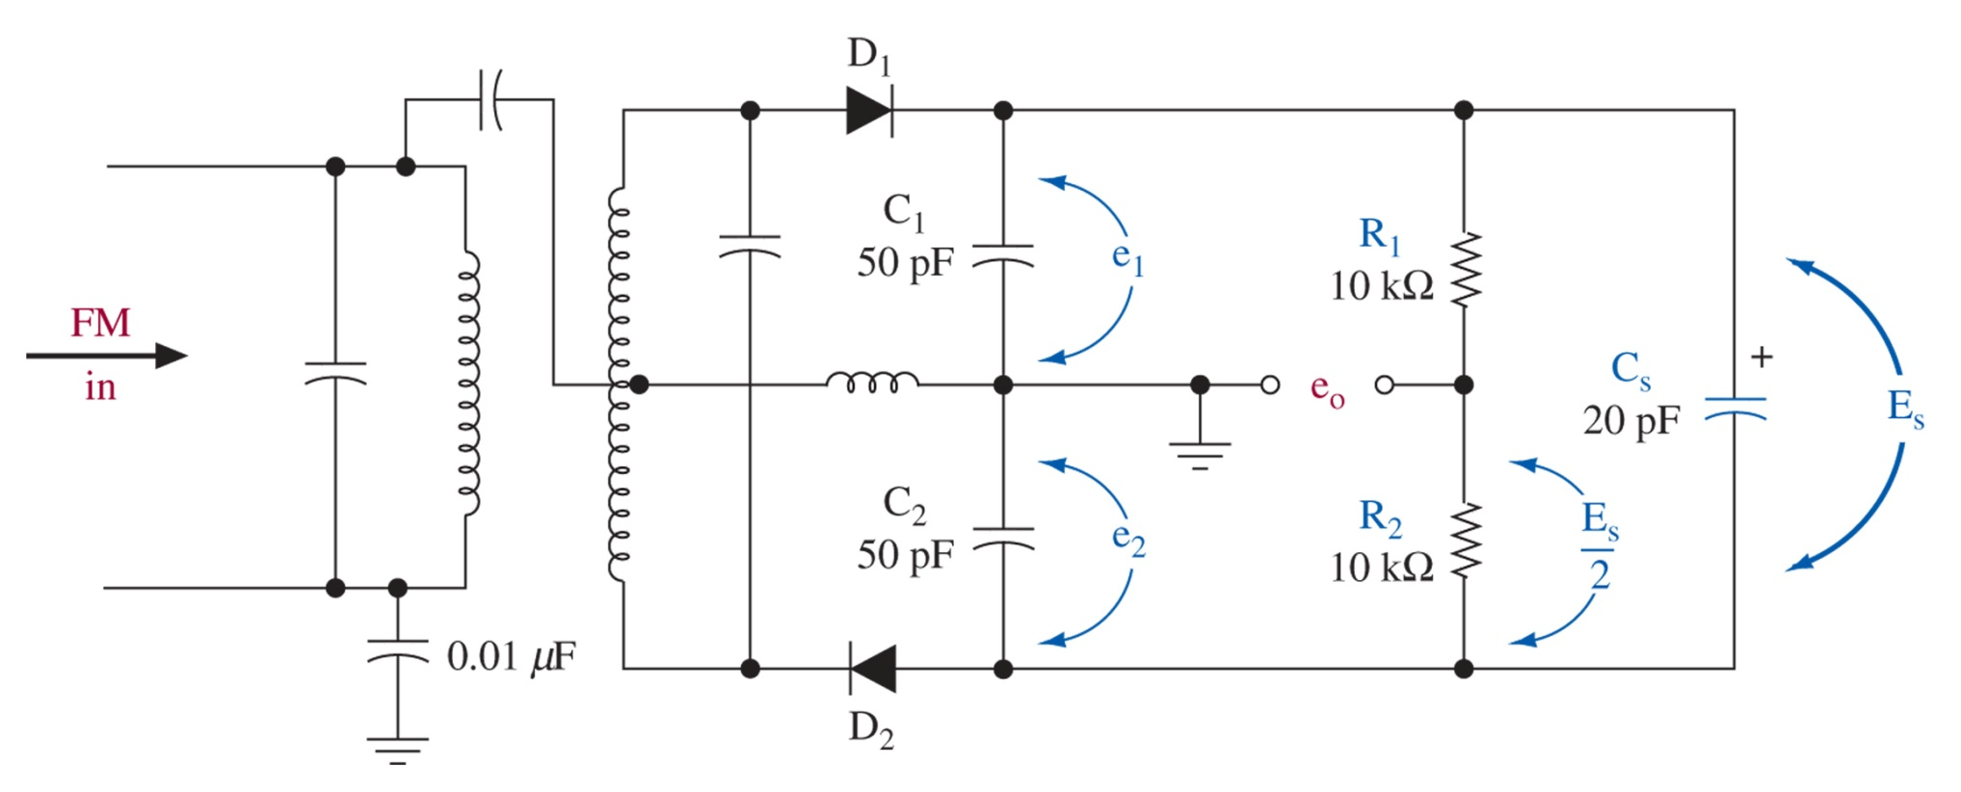
Figure 6-9 Ratio detector.

Slide 14
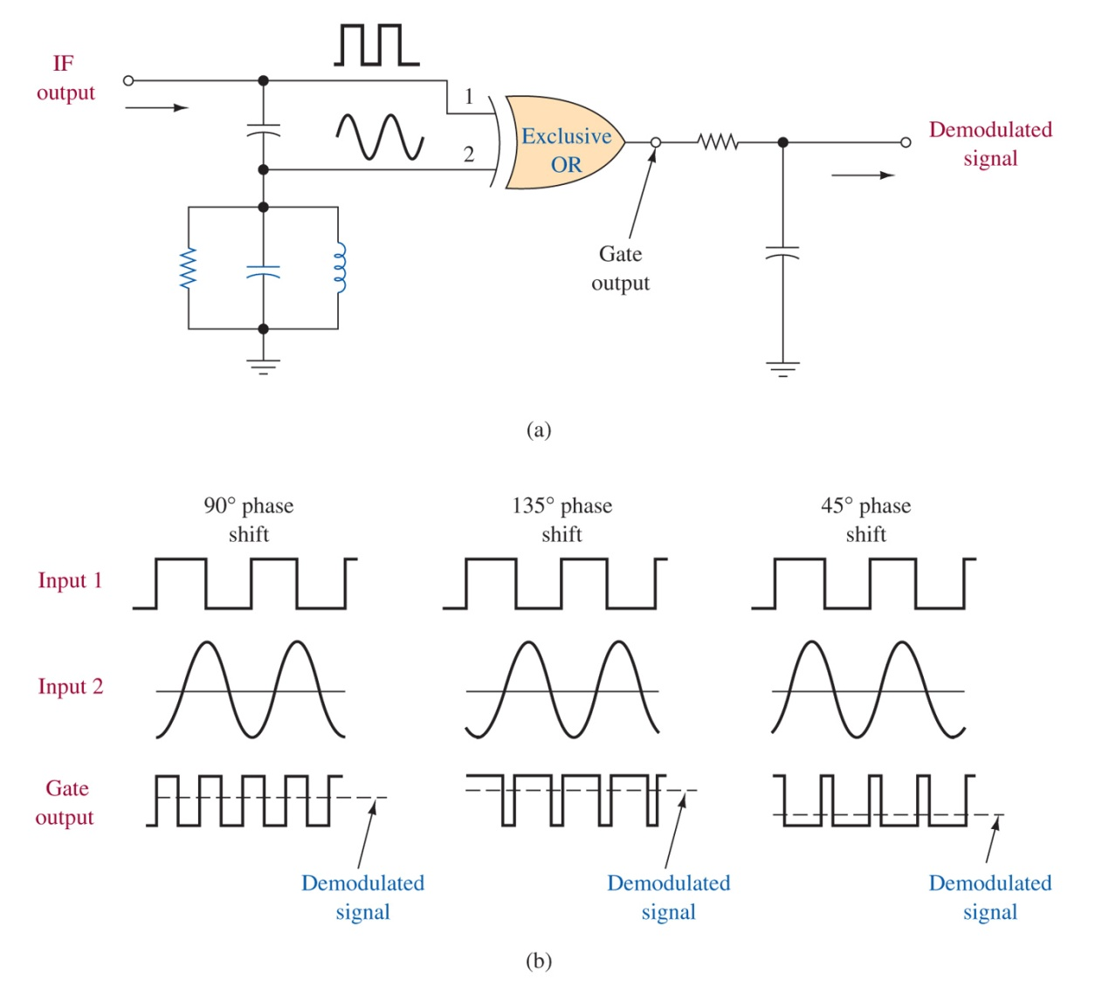
Figure 6-10 Quadrature detection.

Slide 15
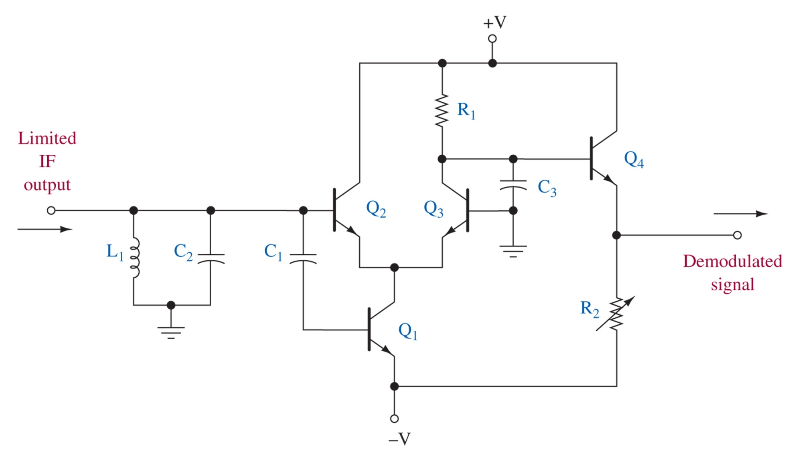
Figure 6-11 Analog quadrature detector.

Slide 16
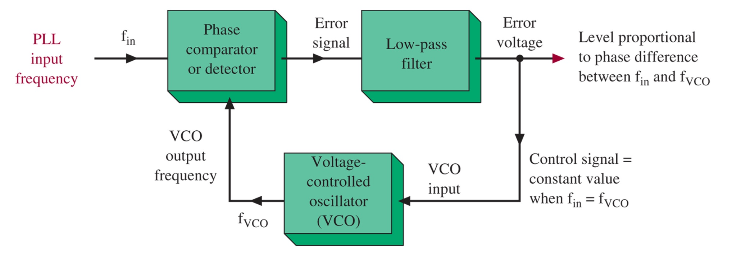
6-5 Phase-Locked Loop
Figure 6-12 PLL block diagram.

Slide 17
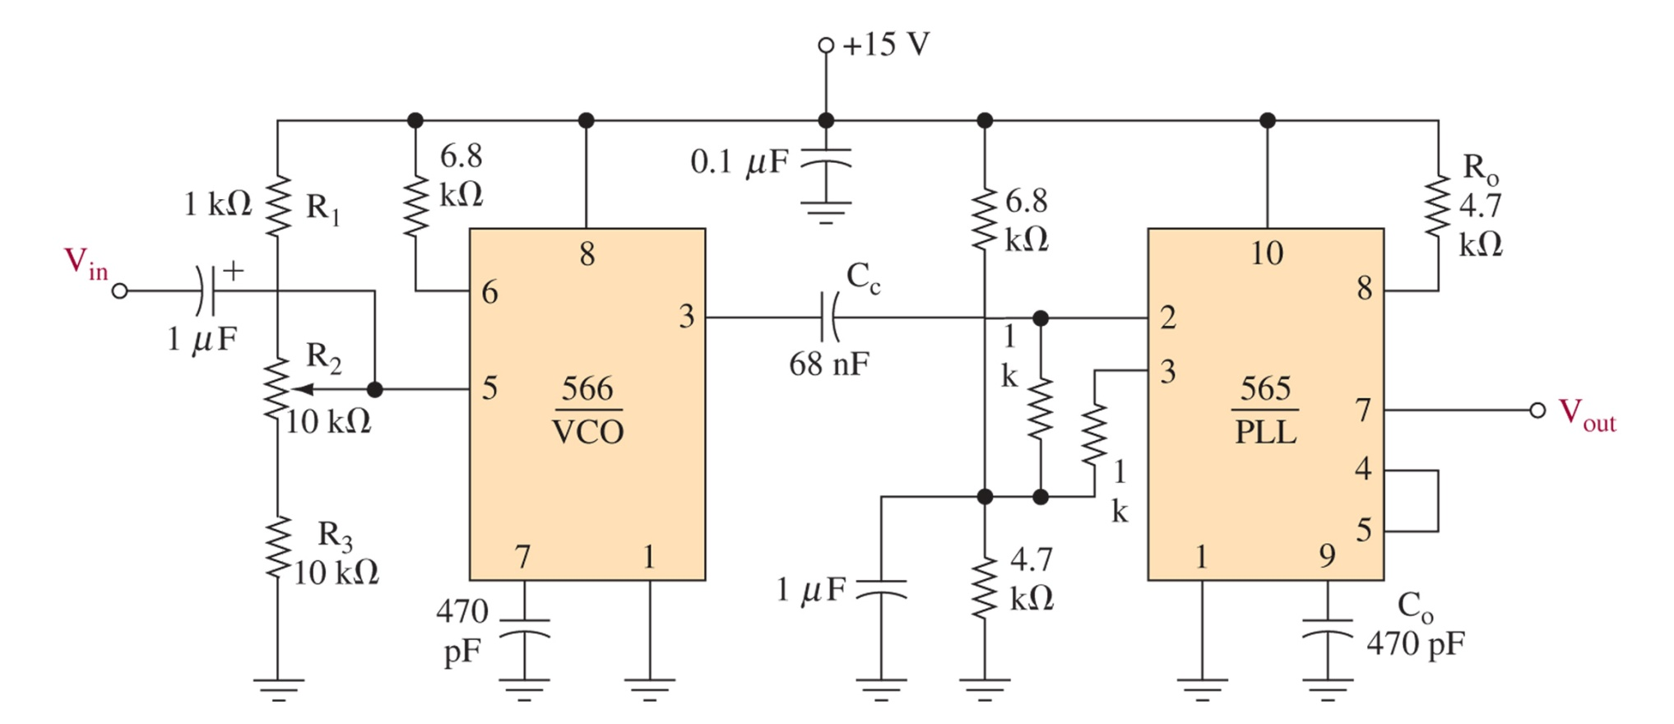
Figure 6-13 An example of an FM receiver using the LM565 PLL.

Slide 18
PLL calculations
1. Free-Running Frequency
2. Loop Gain (KoKD)
3. Hold-In Range

Slide 19
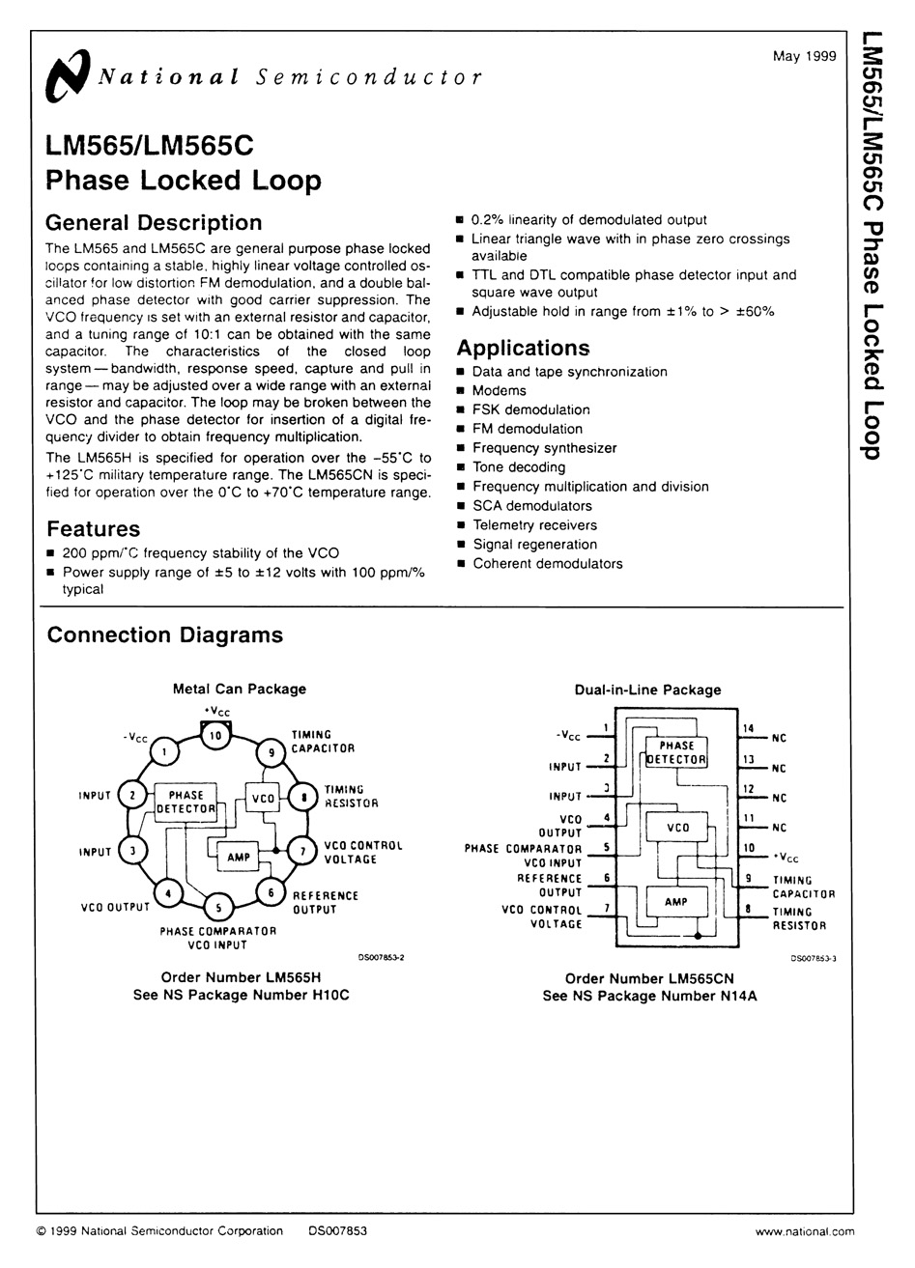
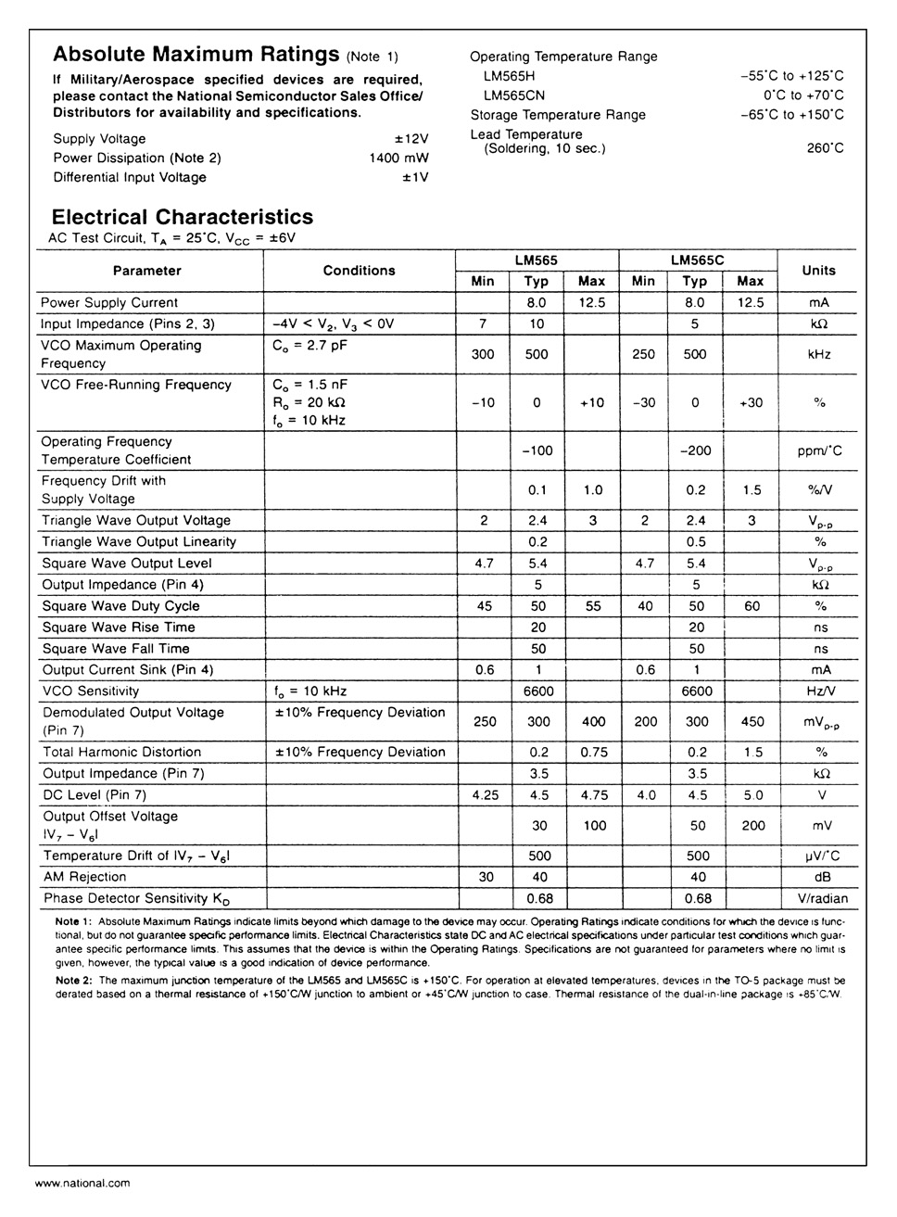
Figure 6-14 The LM565 phase-locked-loop data sheets. (Reprinted with permission of National Semiconductor Corporation.)

Slide 20
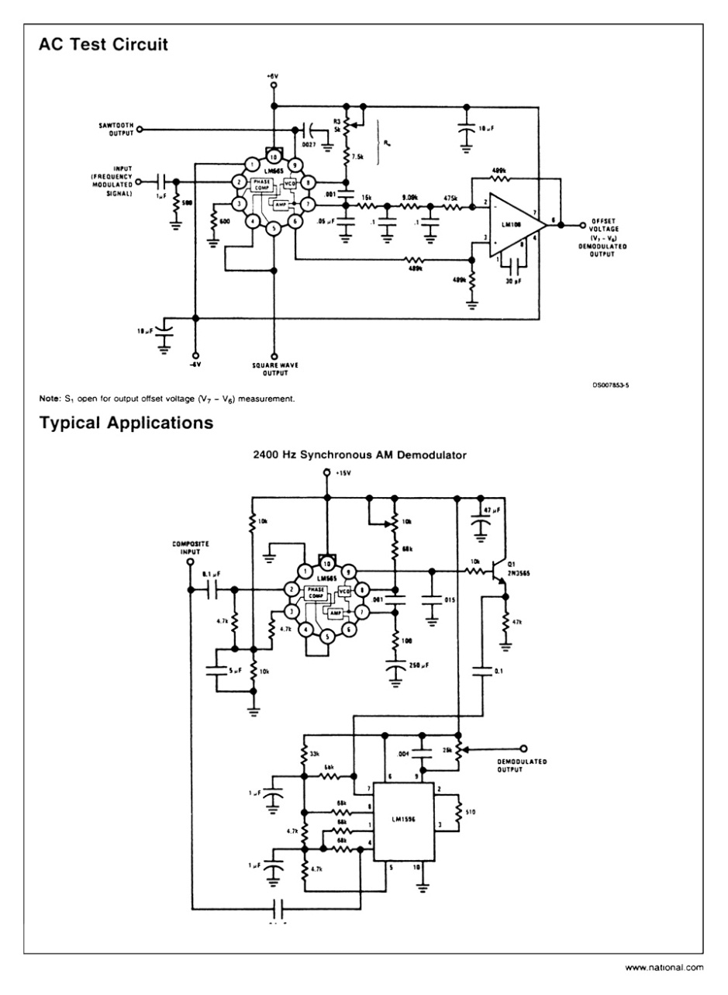
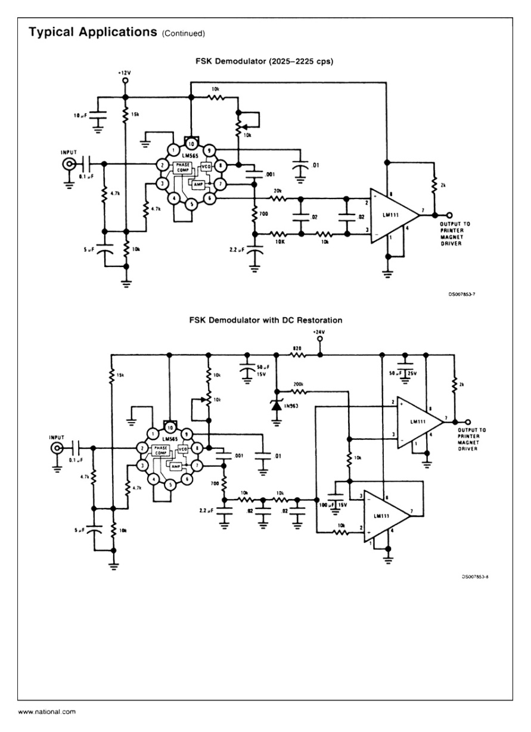
Figure 6-14 (continued) The LM565 phase-locked-loop data sheets. (Reprinted with permission of National Semiconductor Corporation.)

Slide 21
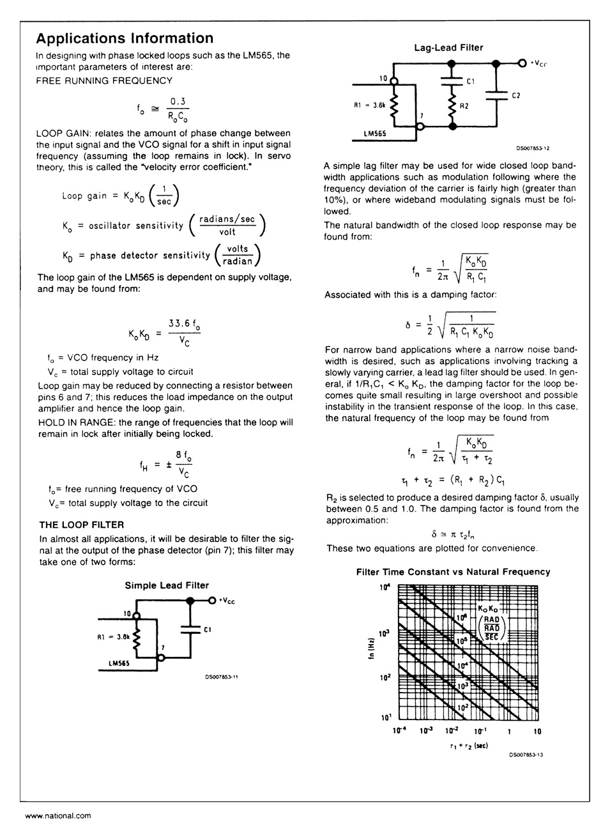
Figure 6-14 (continued) The LM565 phase-locked-loop data sheets. (Reprinted with permission of National Semiconductor Corporation.)

Slide 22
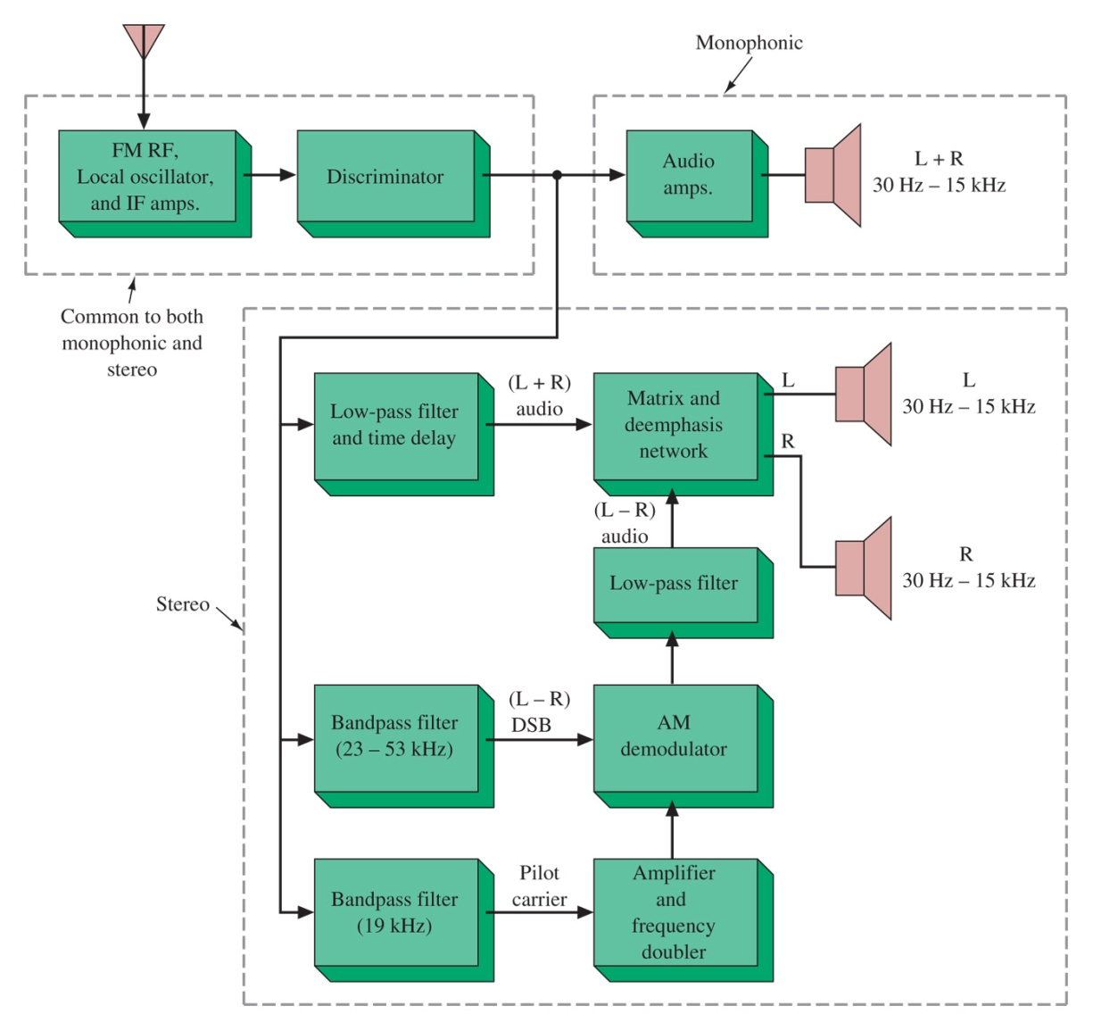
6-6 Stereo Demodulation
No difference until after the discriminator
Monophonic receivers just ignore the higher frequency components
Stereo requires additional circuitry to separate out the higher frequency components via several filter stages
Figure 6-15 Monophonic and stereo receivers.

Slide 23
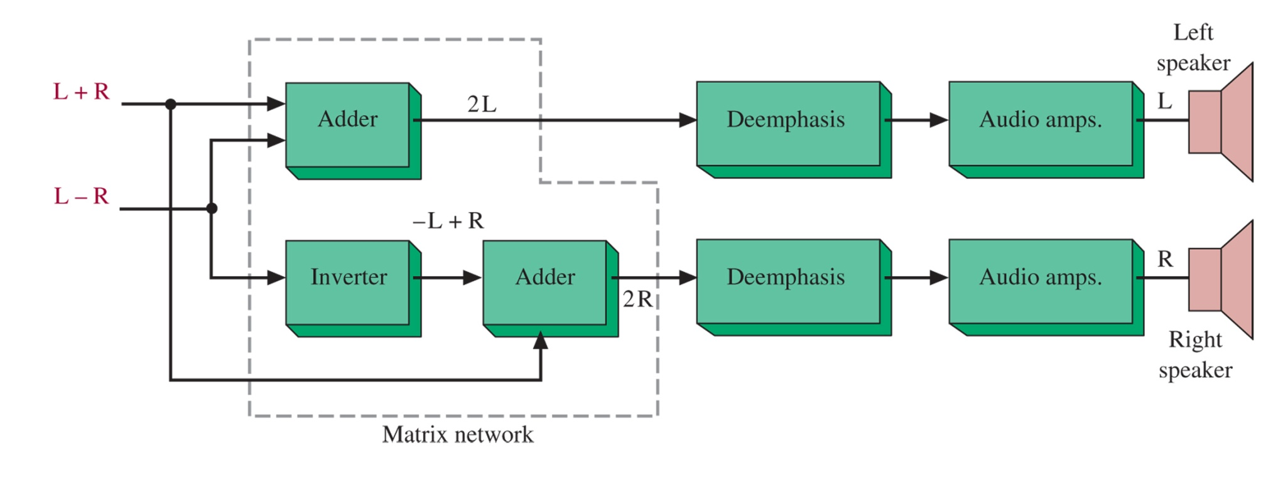
Matrix Network for Stereo
Figure 6-16 Stereo signal processing.

Slide 24
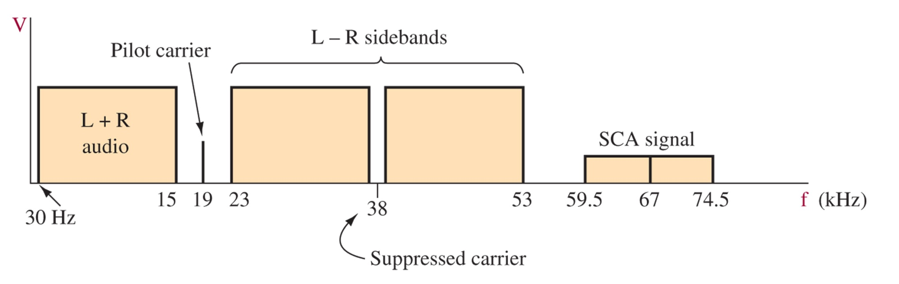
Figure 6-17 Composite stereo and SCA modulating signal.
SCA can be used and frequency multiplexed into an FM signal as well.
Usually narrowband (+/- 7.5 kHz) and a 67 kHz carrier

Slide 25
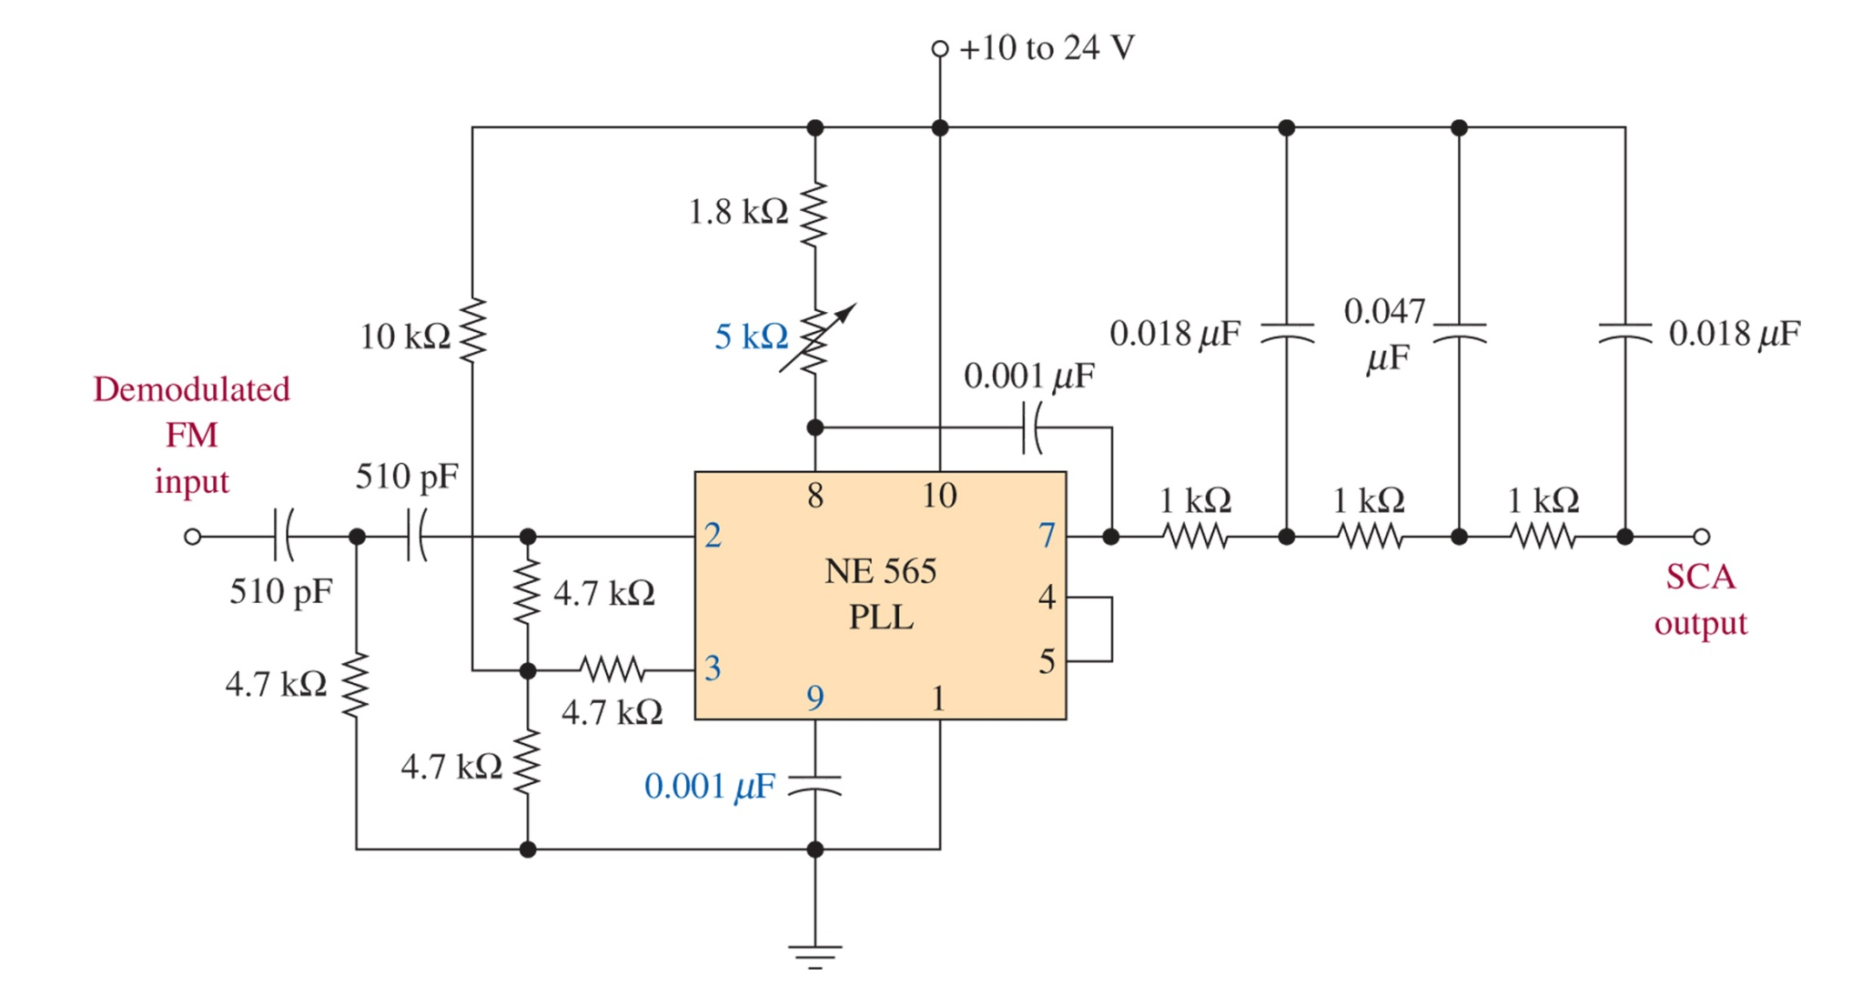
Figure 6-18 SCA PLL decoder.

Slide 26
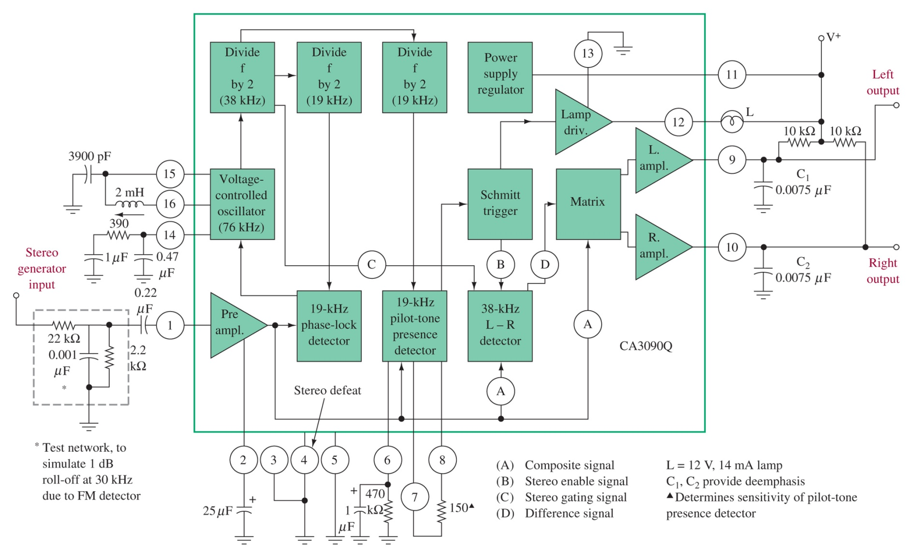
Figure 6-19 CA3090 stereo decoder. (Courtesy of RCA.)

Slide 27
6-7 FM Receivers
Now available as single chips (Philips TEA5767/68)
Still practical as a modular setup

Slide 28
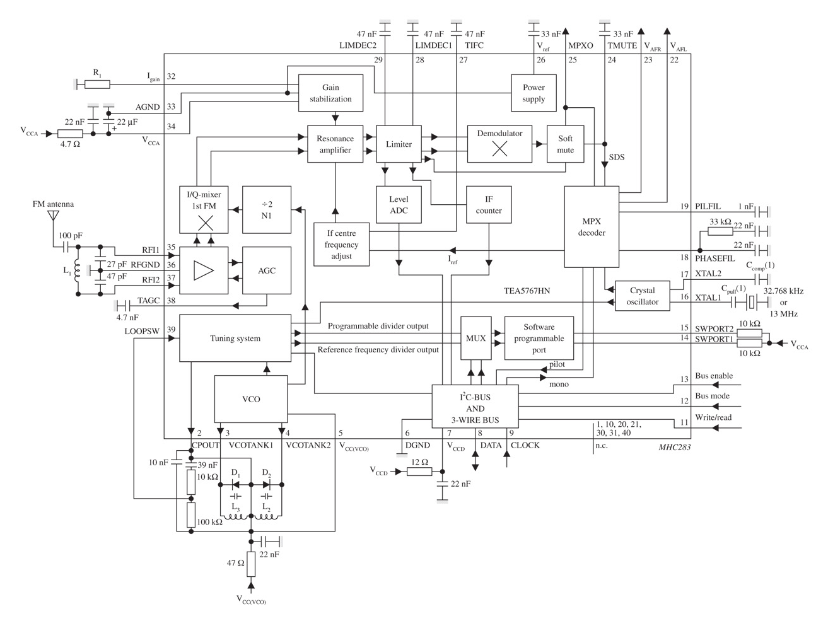
Figure 6-20 Block diagram of the Philips Semiconductors TEA5767 single-chip FM stereo radio.

Slide 29
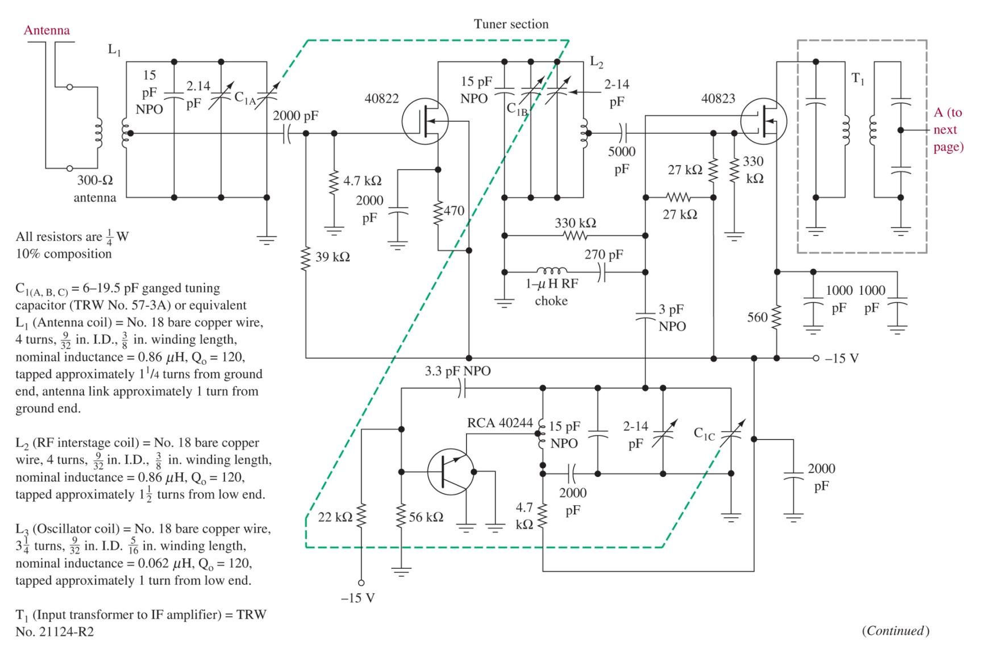
Figure 6-21 Complete 88- to 108-MHz stereo receiver.
Antenna
RF amplifier
Mixer
Local Oscillator

Slide 30
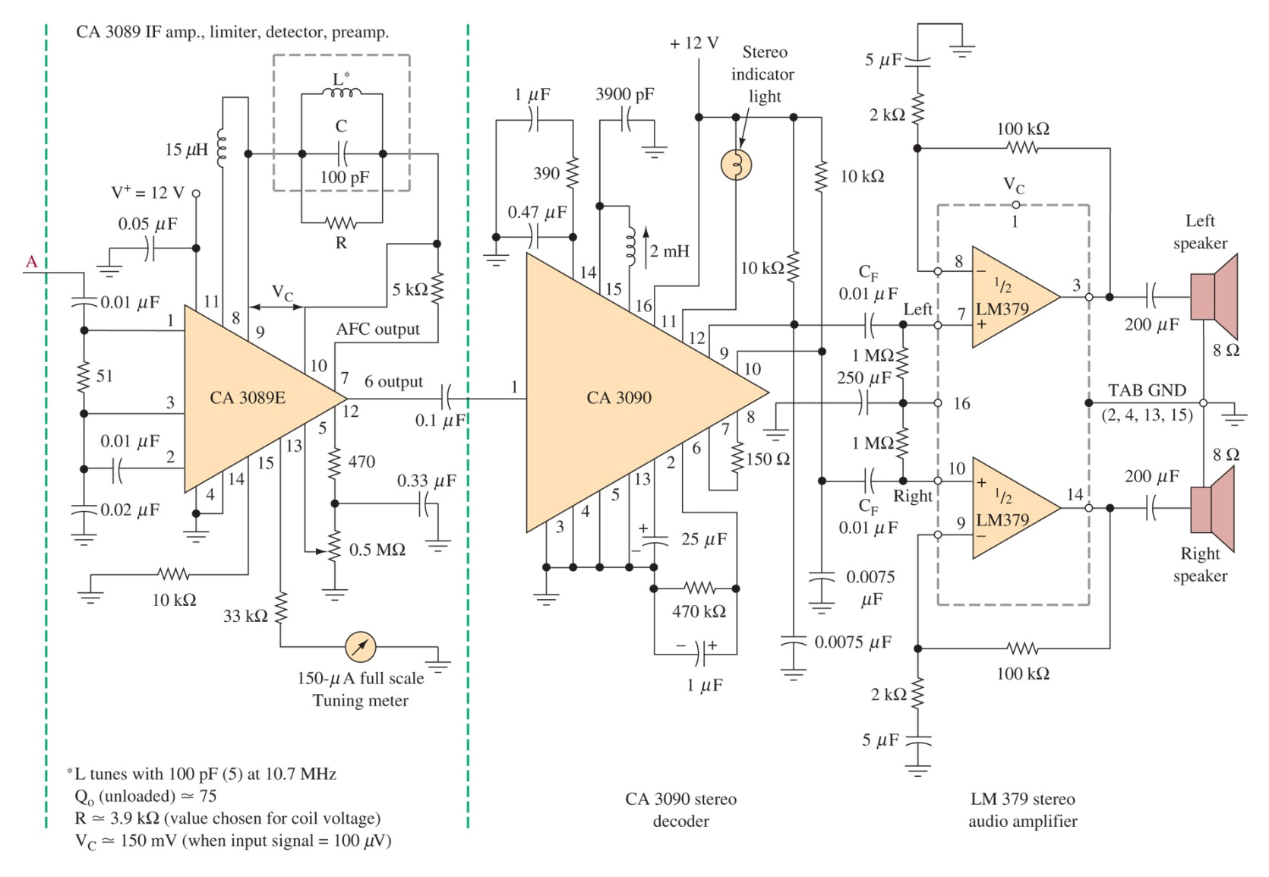
Figure 6-21 (continued) Complete 88- to 108-MHz stereo receiver.

Slide 31
6-8 Troubleshooting

Slide 32
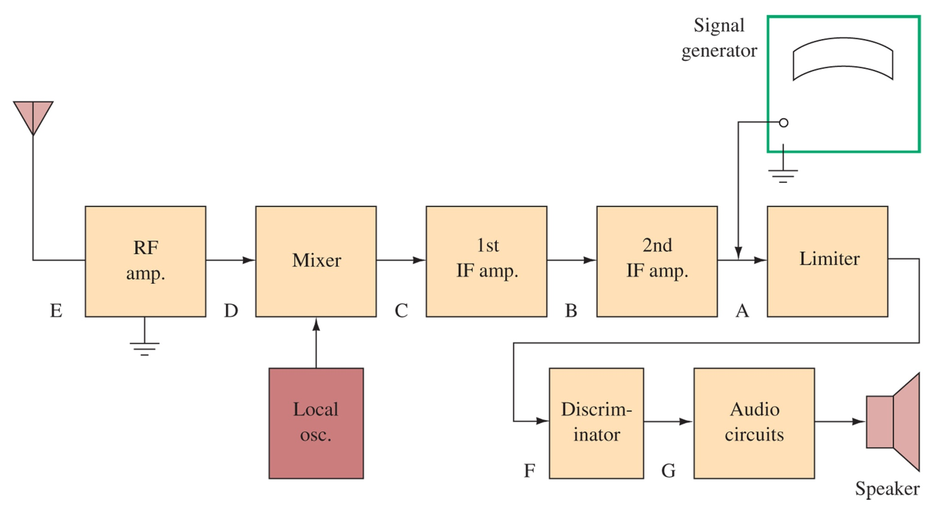
Figure 6-22 Typical FM receiver.

Slide 33
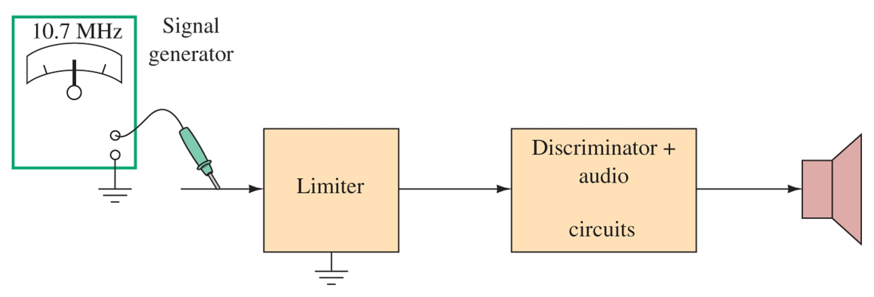
Figure 6-23 Testing by wobbling the signal.

Slide 34
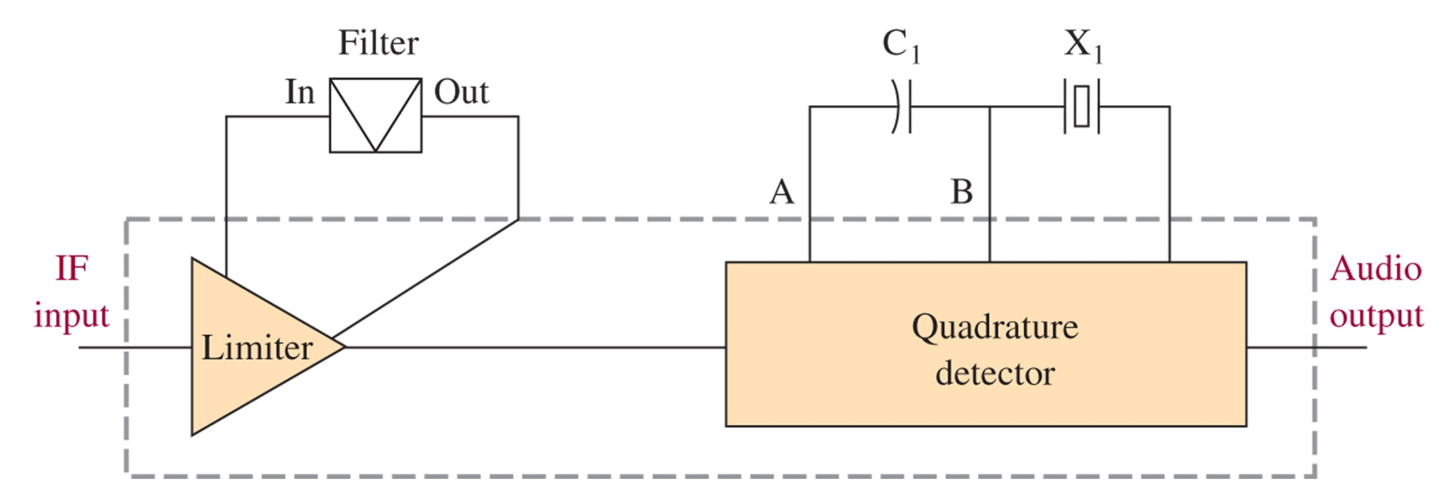
Figure 6-24 Quadrature detector.

Slide 35
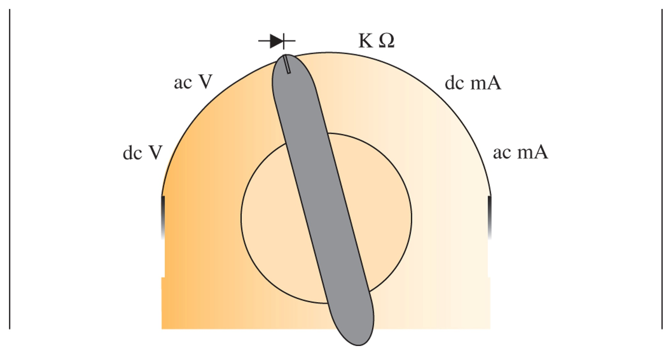
Figure 6-25 Diode test range.

Slide 36
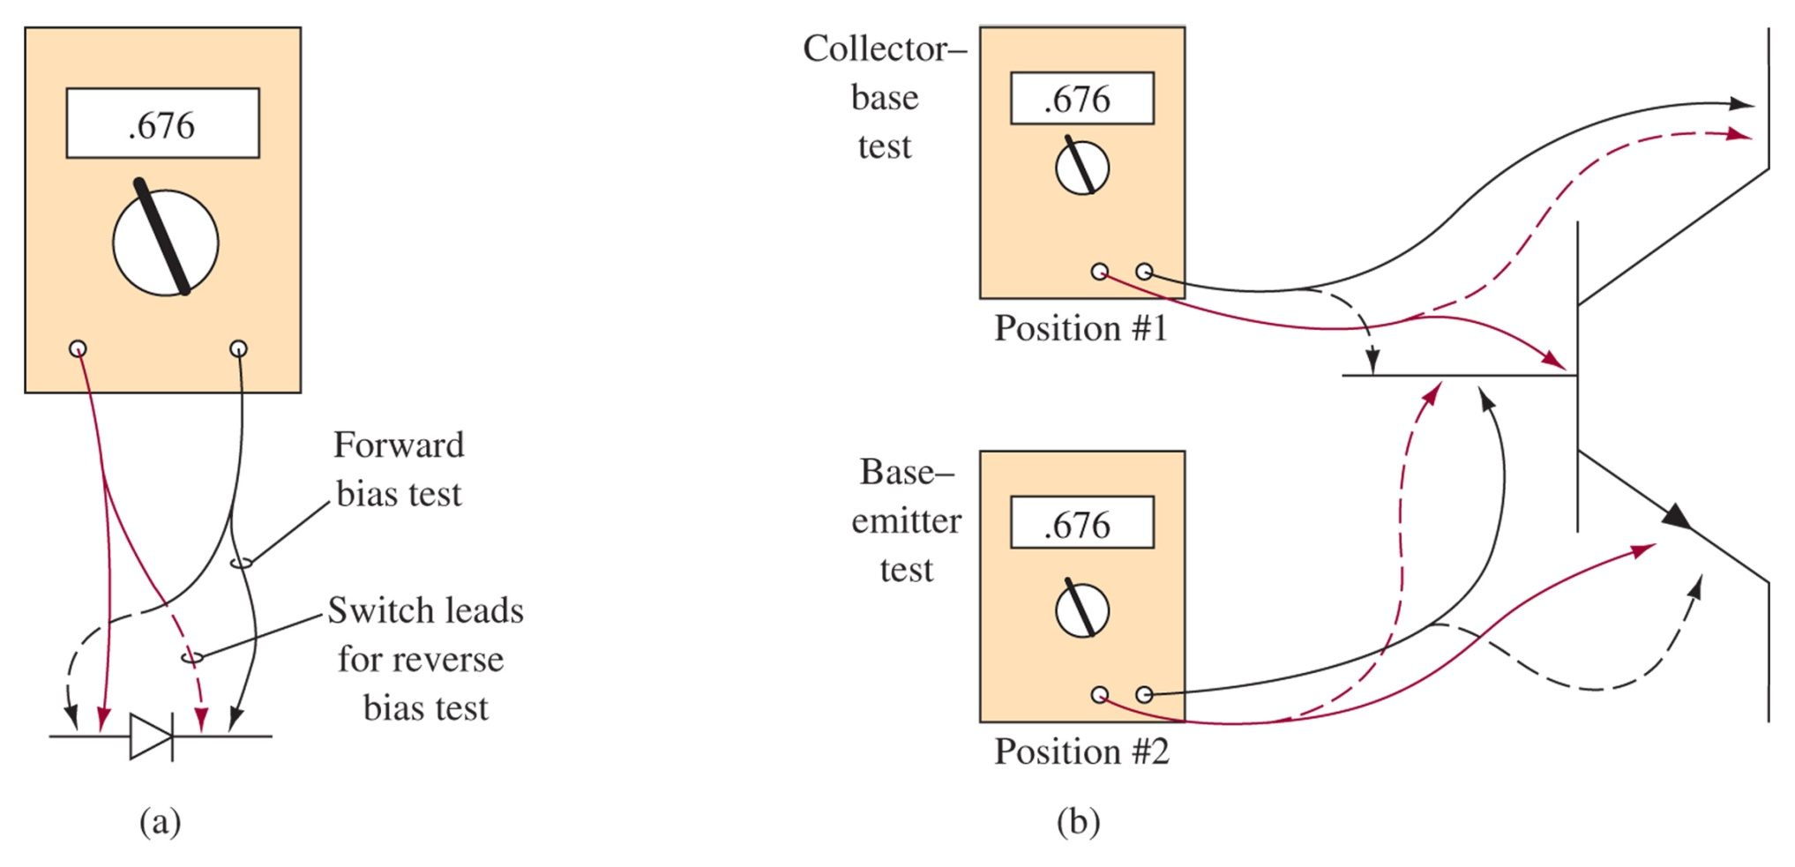
Figure 6-26 Diode and transistor testing.

Slide 37
6-9 Troubleshooting w/ Multisim

Slide 38
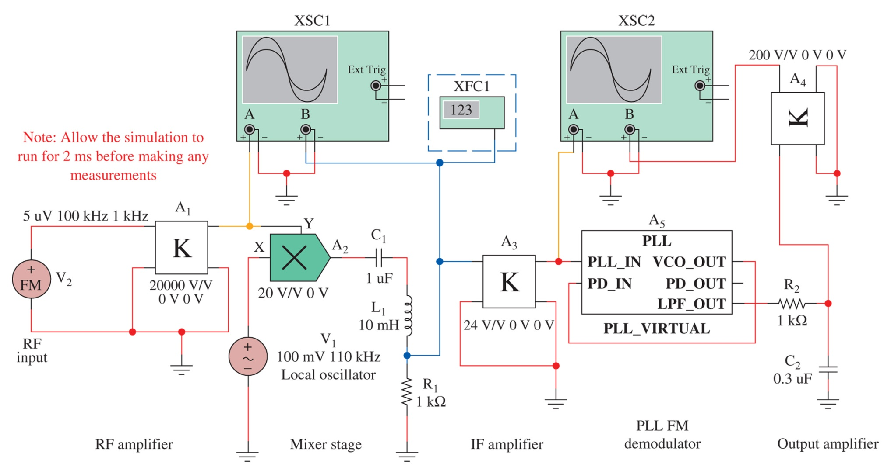
Figure 6-27 An implementation of an FM receiver using Multisim.

Slide 39
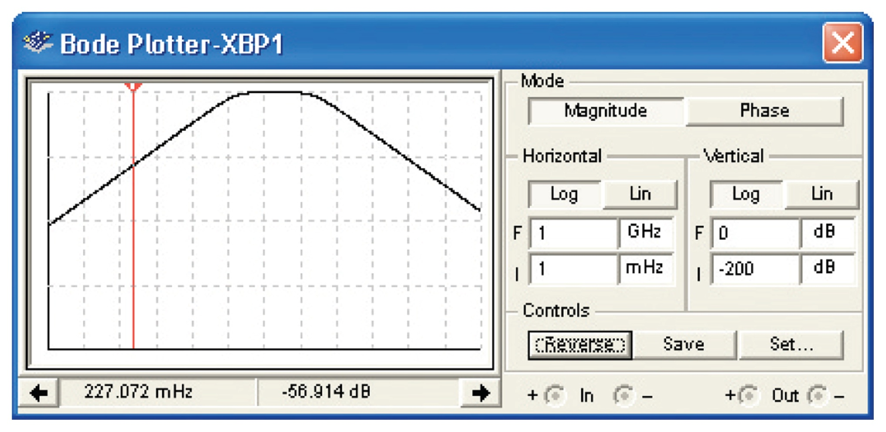
Figure 6-28 The frequency plot of the bandpass filter.

