Slide 1
EE 350 / ECE 490 Analog Communication Systems
Ch. 7 – Communications Techniques

Slide 2
Objectives
Describe double conversion and up-conversion and explain their advantages
Analyze the advantages of delayed AGC and auxiliary AGC
Explain the features and their operation that a high-quality receiver may include as compared to a basic receiver
Analyze and explain the relationships among noise, receiver sensitivity, dynamic range, and the third-order intercept
Troubleshoot and amplifier suspected of excessive IMD
Explain the operation of a frequency synthesizer
Describe the operation of a DDS system and provide advantages and drawbacks compared to analog synthesizers
Explain how the performance of electronic communication circuitry is affected at high frequencies

Slide 3
7-1 Introduction
Transceivers combine transmitters and receivers in one package, allowing them to share some common components
Oscillators, power supplies, and audio amplifiers are often shared

Slide 4
7-2 Frequency Conversion

Slide 5
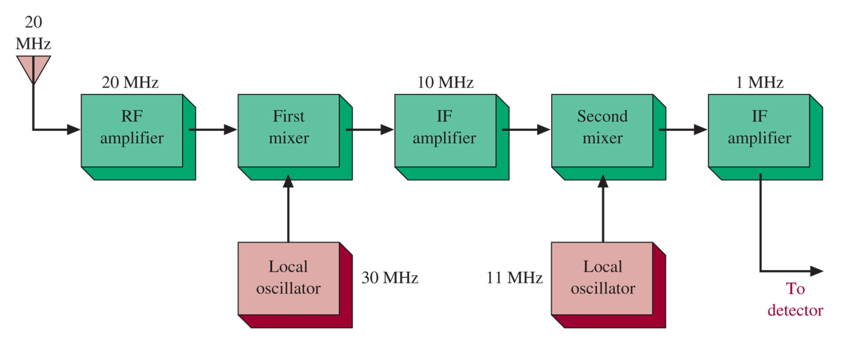
Double Conversion
Figure 7-1 Double-conversion block diagram.

Slide 6
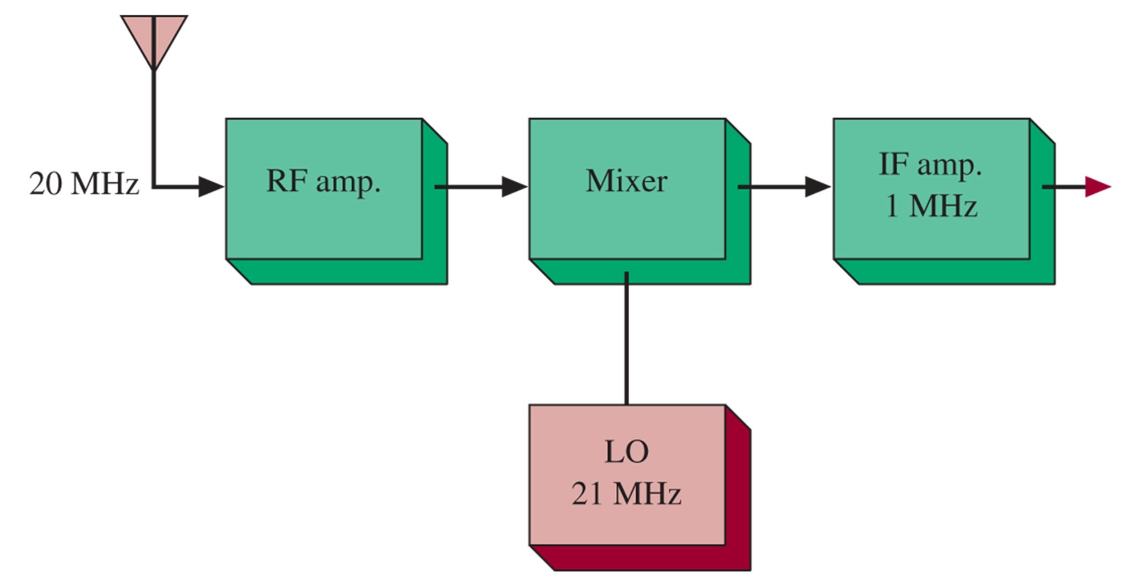
Figure 7-3 System for Example 7-2.
What is the image frequency?

Slide 7
Figure 7-2 Image frequency rejection.

Slide 8
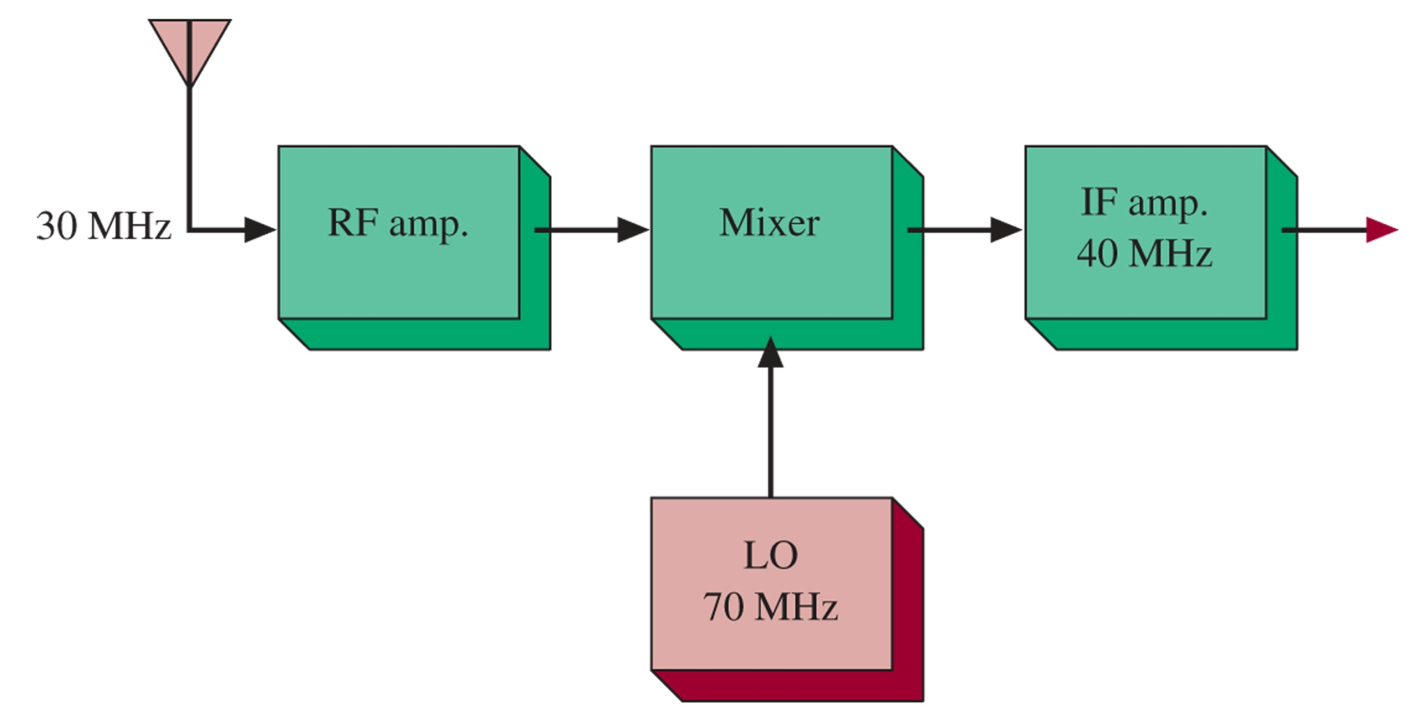
Up-conversion
Figure 7-4 Up-conversion system.
Why would we want to increase the frequency?

Slide 9
Preselector Image Rejection

Slide 10
7-3 Special Techniques
Delayed AGC
Auxiliary AGC
Variable Sensitivity
Variable Selectivity
Noise Limiter
Metering
Squelch

Slide 11
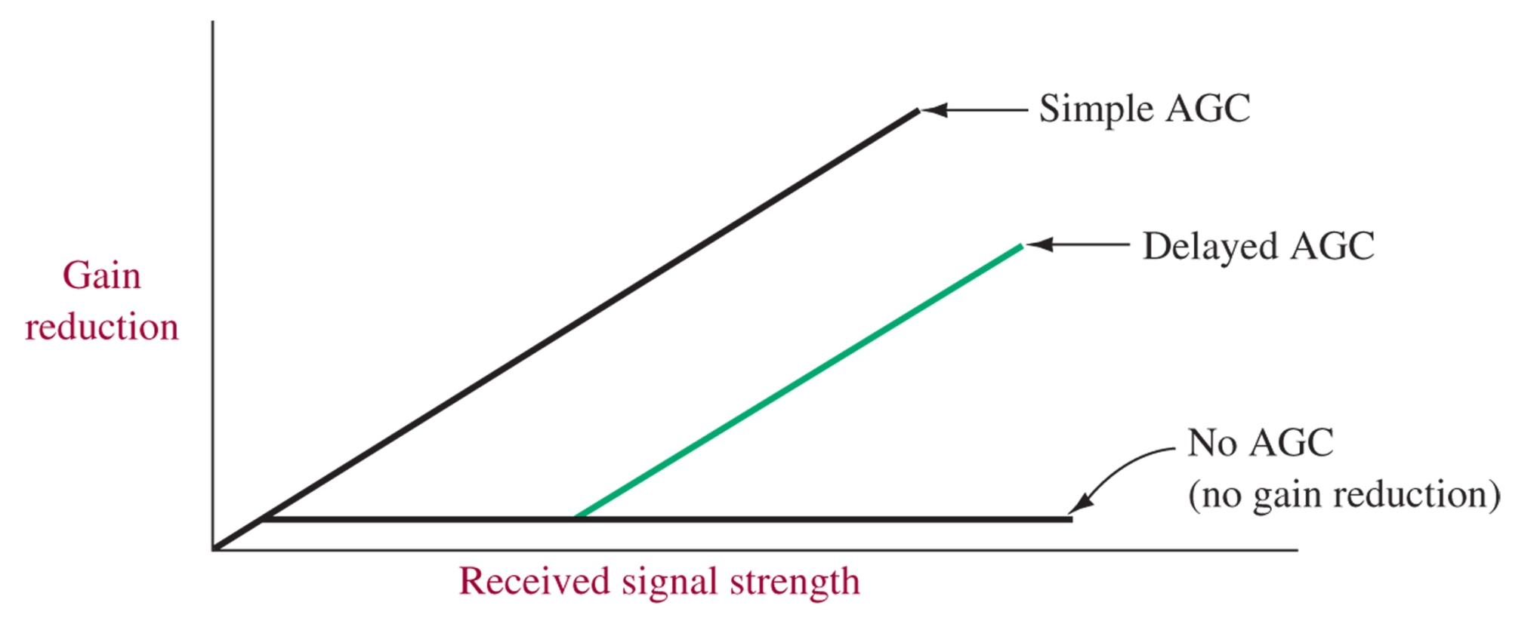
Delayed AGC
Figure 7-5 AGC characteristics.
Prevents AGC from reducing the gain of very weak signals

Slide 12
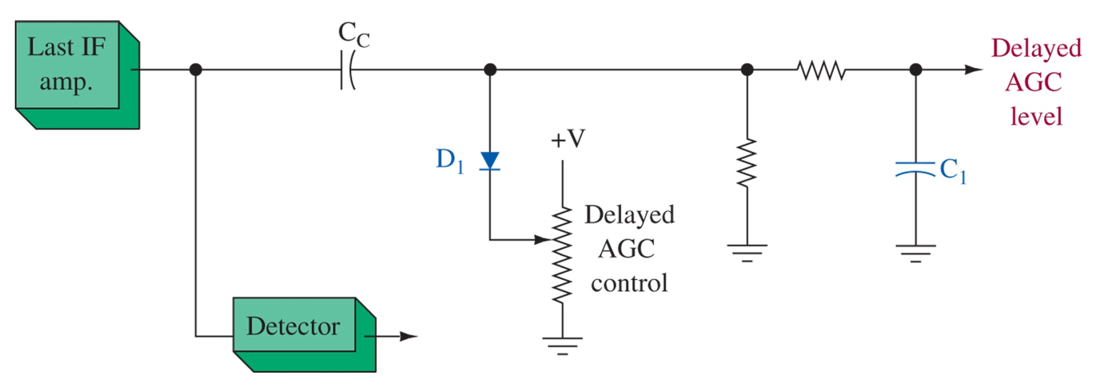
Figure 7-6 Delayed AGC configuration.

Slide 13
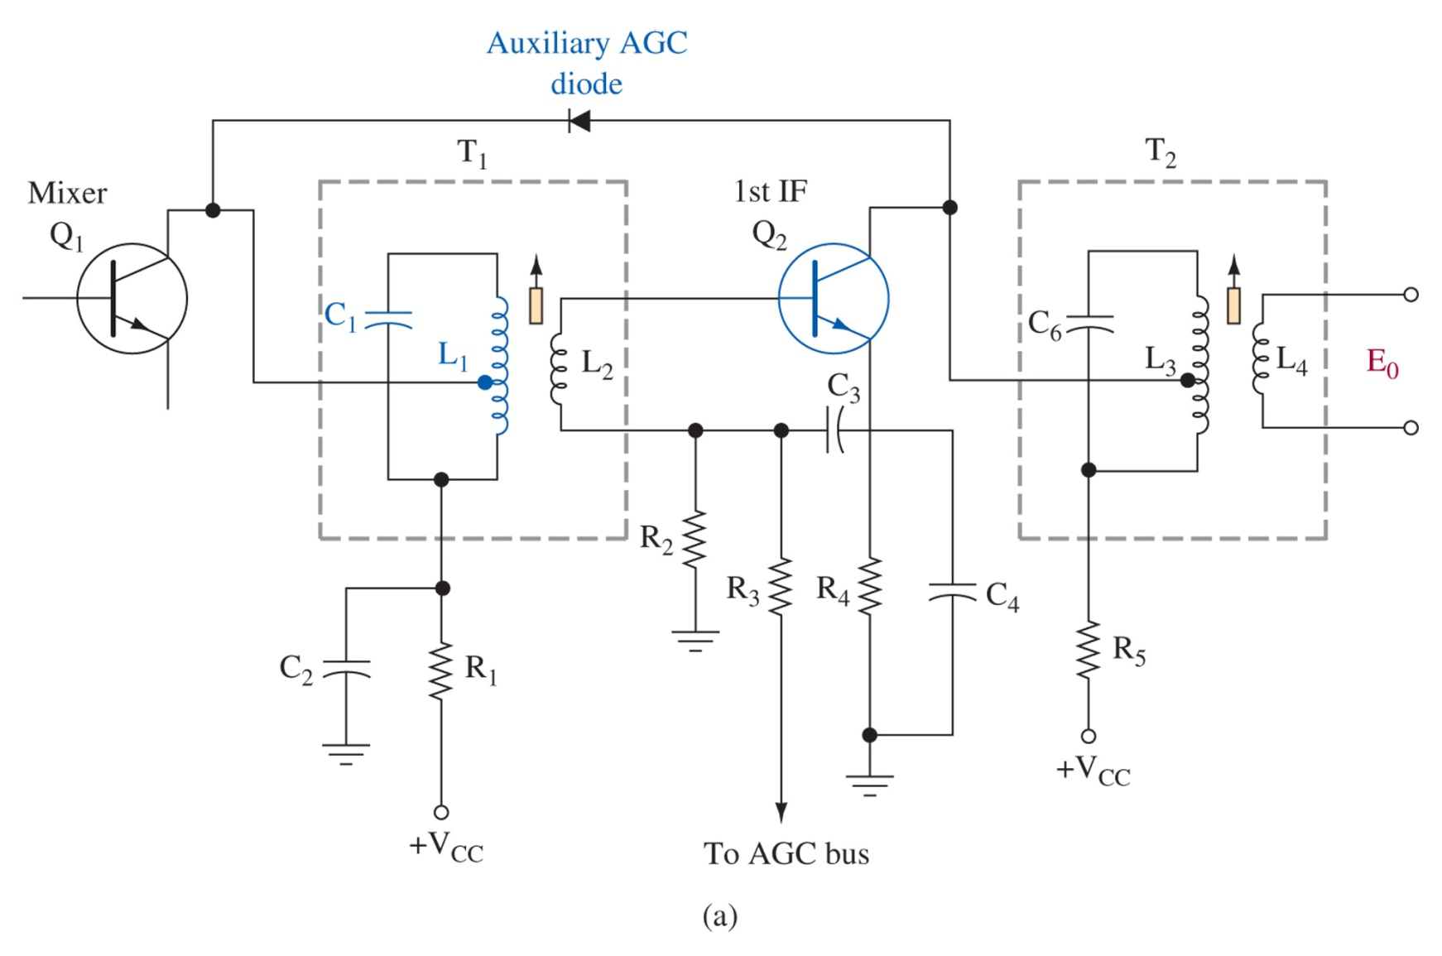
Auxiliary AGC
Figure 7-7 (a) Auxiliary AGC; (b) the Analog Devices AD8369 variable gain amplifier IC;
Prevents very large signals from swamping the receiver. Sensitivity can also be hand adjusted to provide additional control

Slide 14
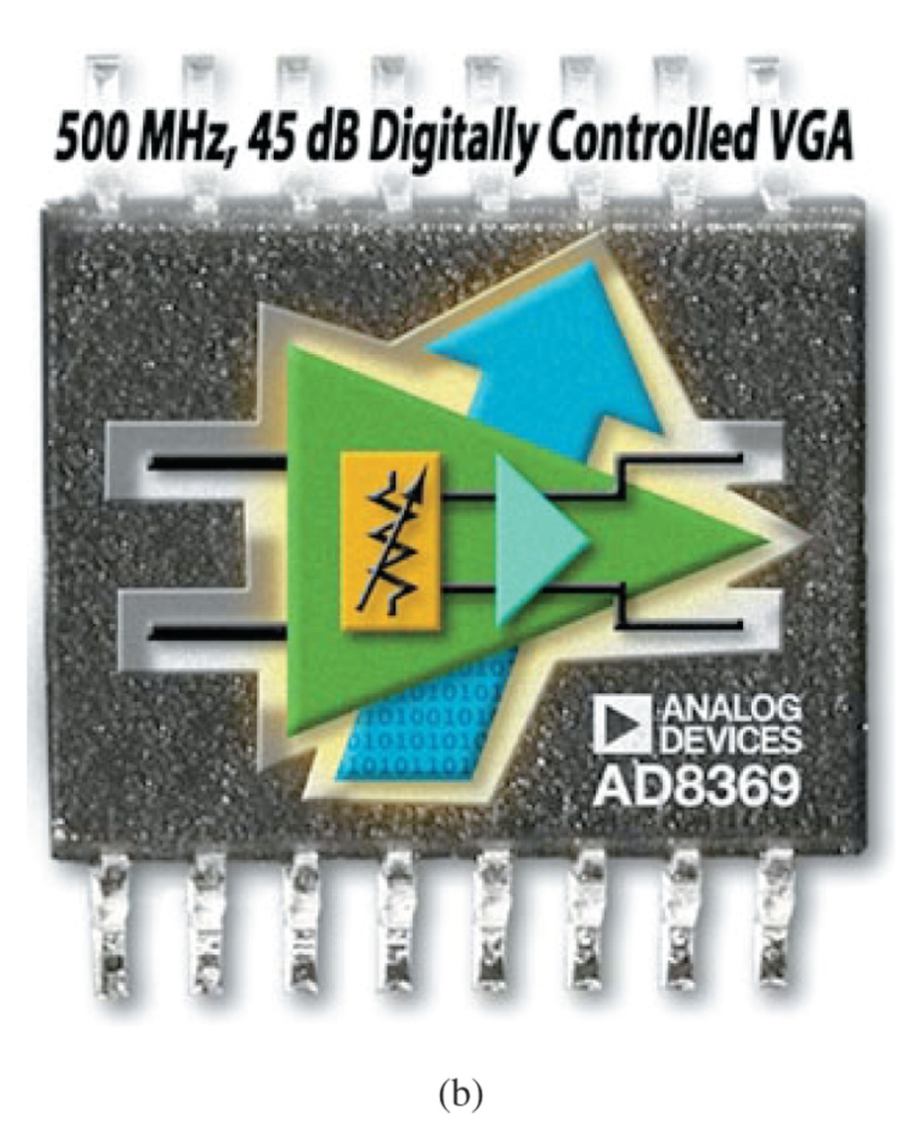
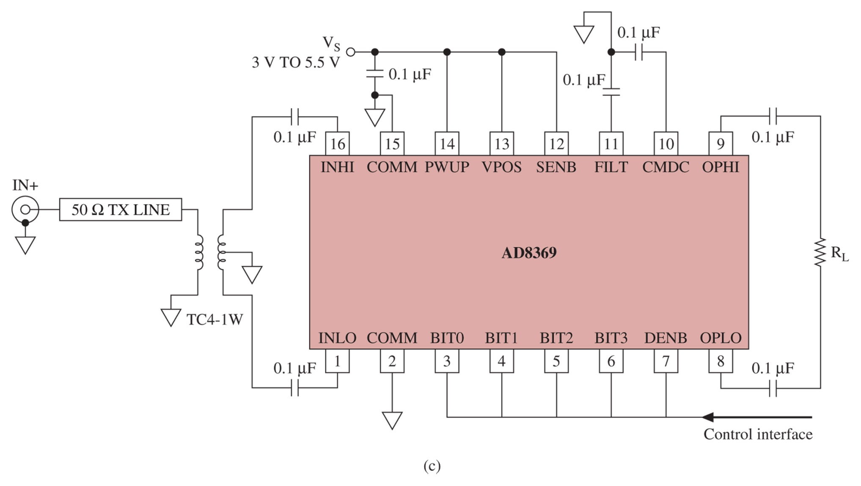
Figure 7-7 (continued) (b) the Analog Devices AD8369 variable gain amplifier IC;

Slide 15
Variable Selectivity
Figure 7-8 Variable bandwidth tuning (VBT).
Allows operation over several selectable bandwidths

Slide 16
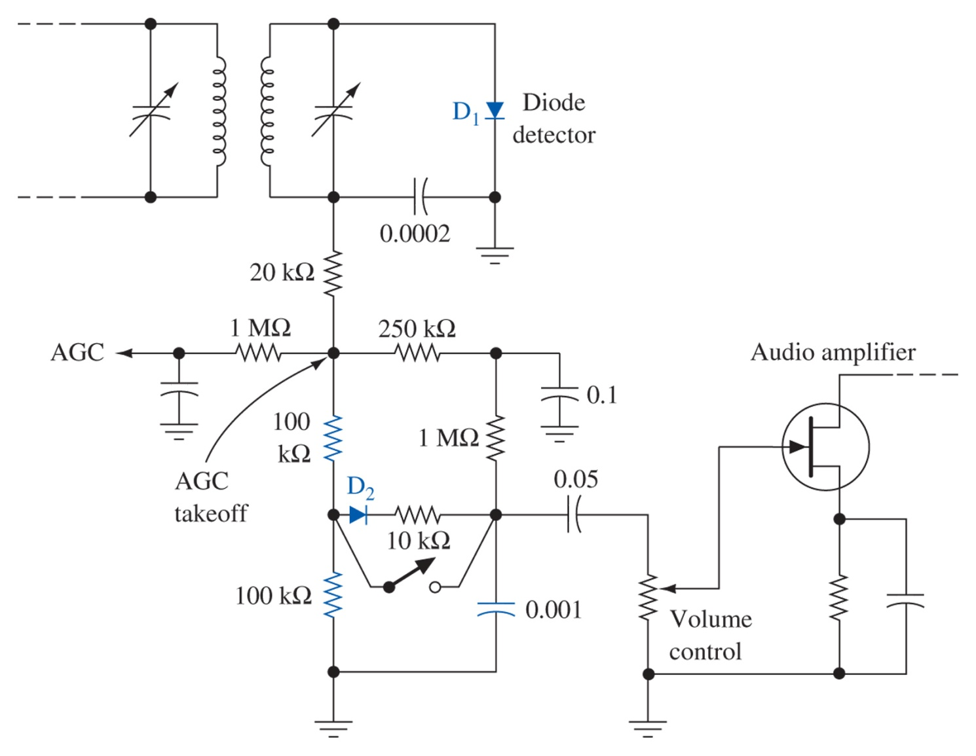
Noise Limiting
Figure 7-9 Automatic noise limiter.

Slide 17
Metering
Simple meter, or LED bar graph
Attached to the AGC bias level
As signal improves, AGC decreases, and bar graph illuminates

Slide 18
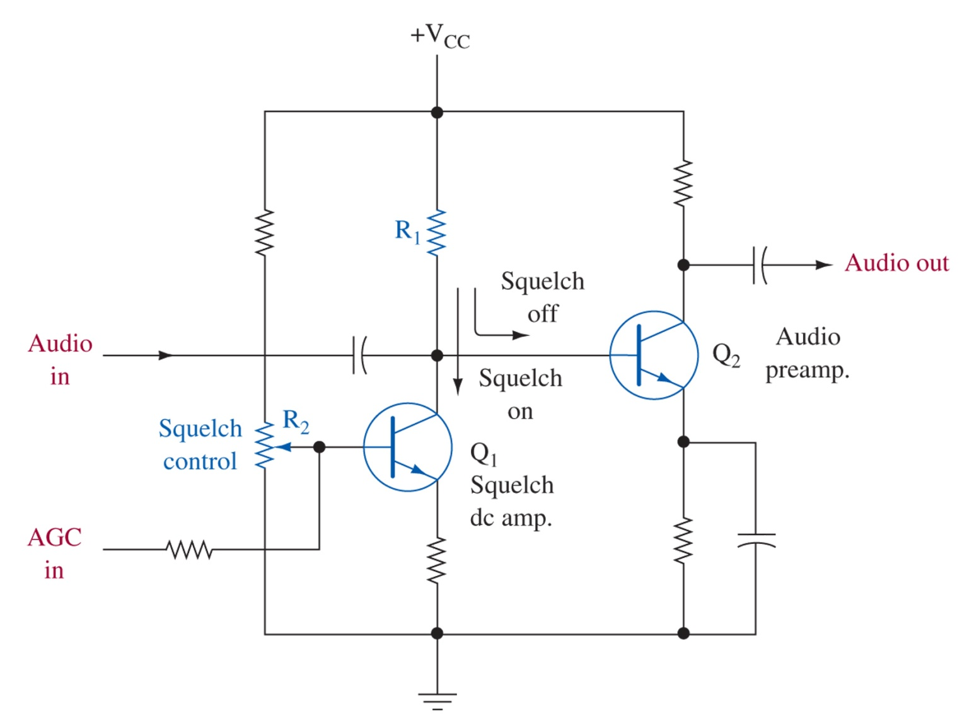
Squelch
Figure 7-10 Squelch circuit.

Slide 19
7-4 Receiver Noise, Sensitivity, and Dynamic Range Relationships
S = sensitivity = -174dBm + NF + 10log10(delta f) + desired S/N

Slide 20
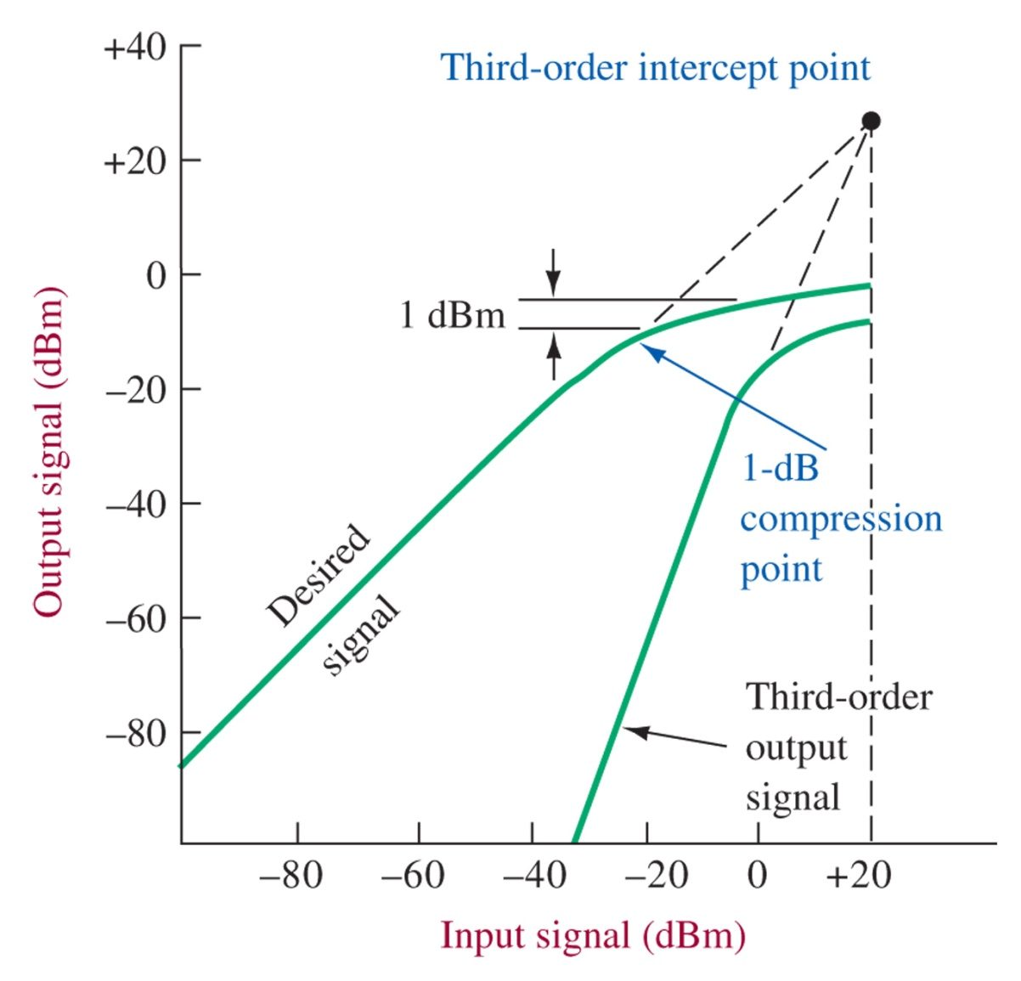
Figure 7-11 Third-order intercept and compression point illustration.

Slide 21
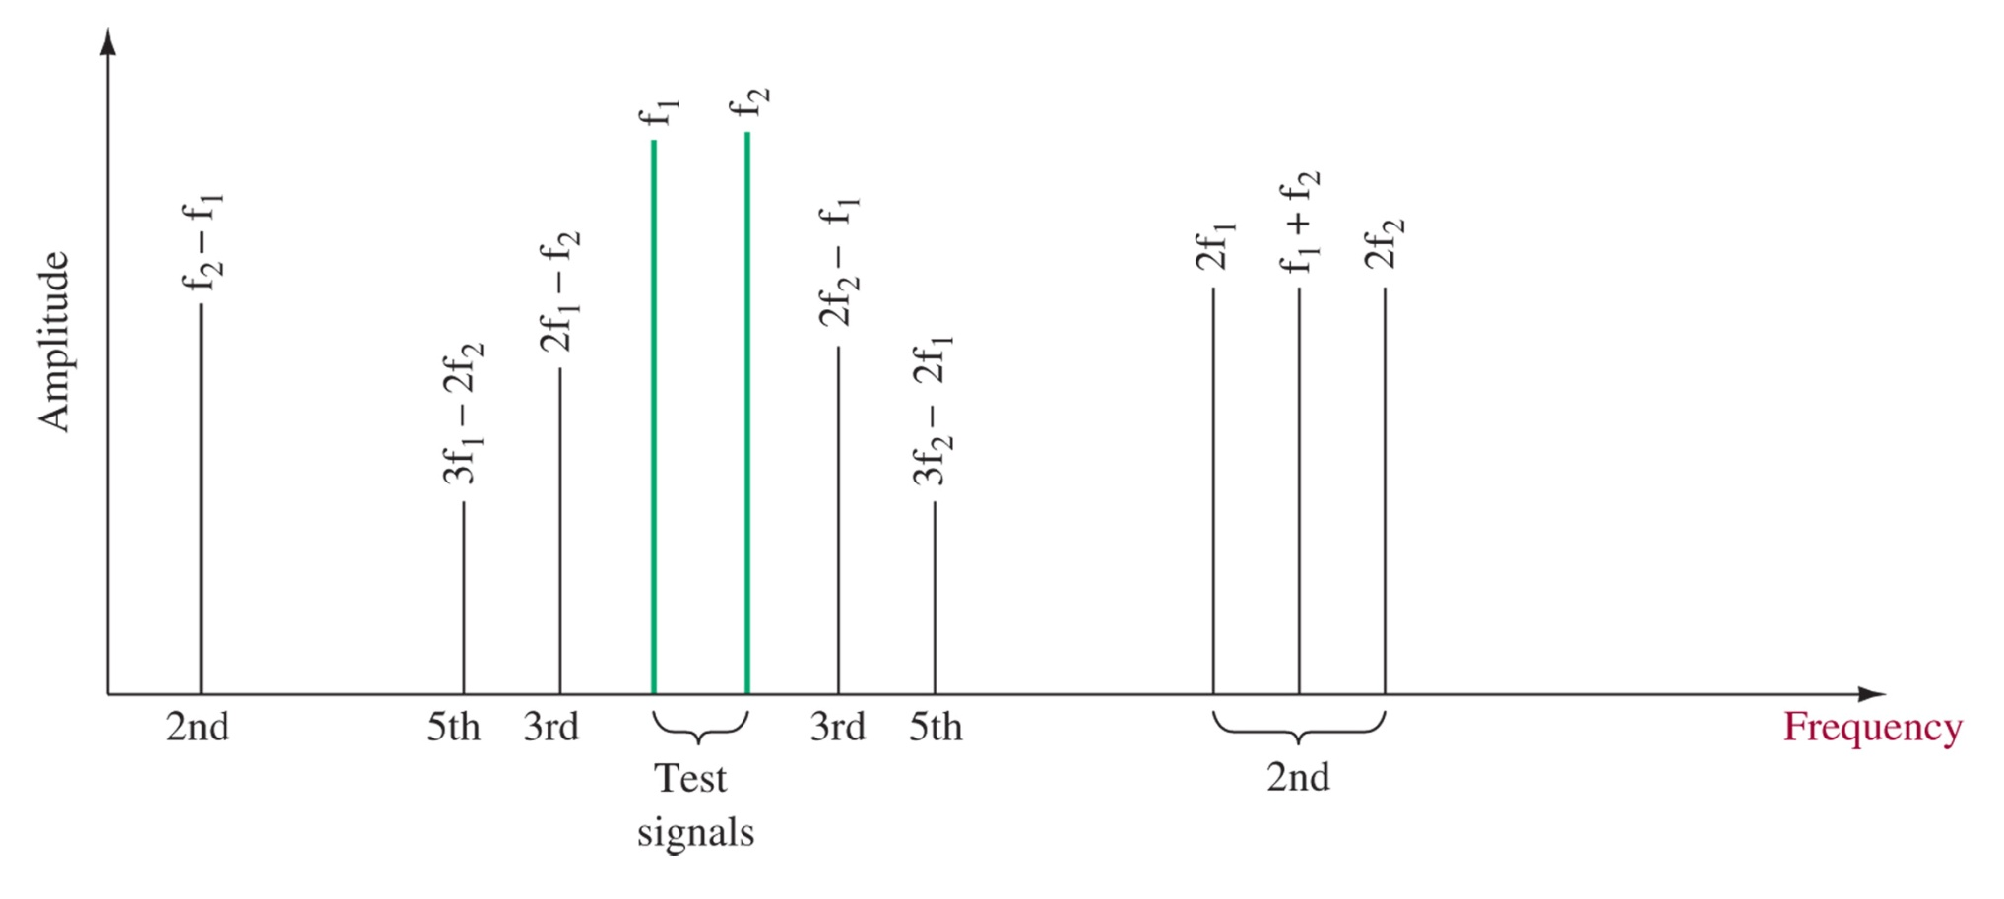
Figure 7-12 IMD products (second-, third-, and fifth-order for two test signals).

Slide 22
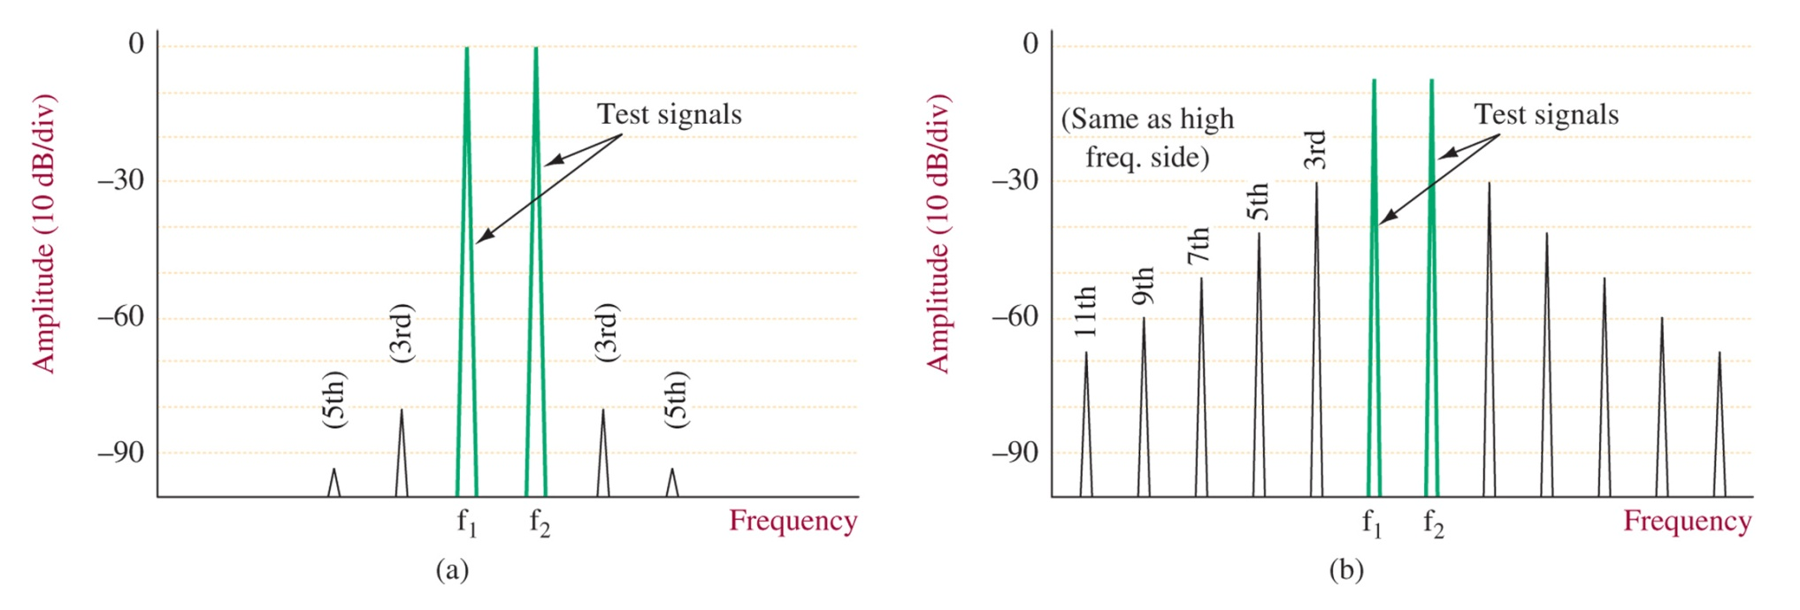
Figure 7-13 IMD testing: (a) mixer; (b) Class AB linear power amplifier.

Slide 23
7-5 Frequency Synthesis

Slide 24
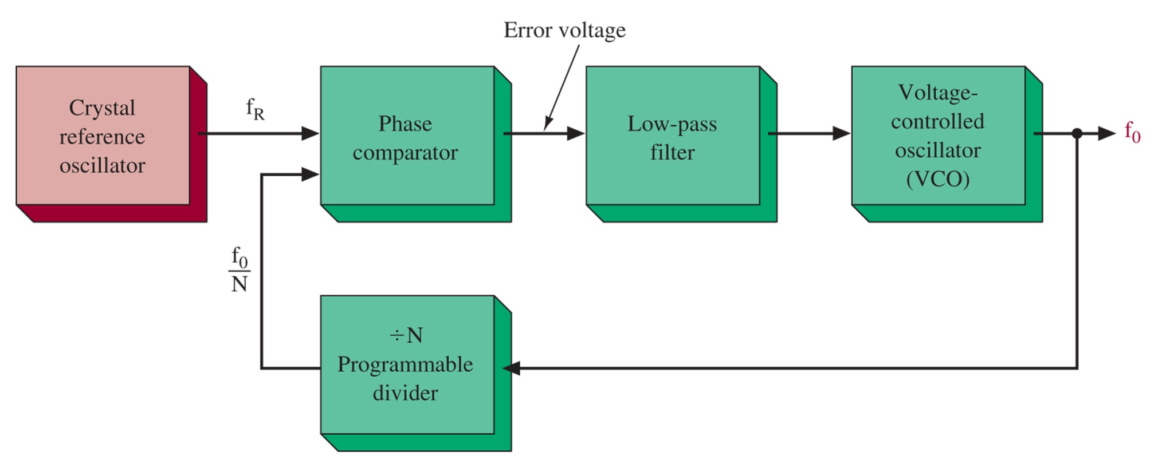
Figure 7-14 Basic frequency synthesizer.

Slide 25
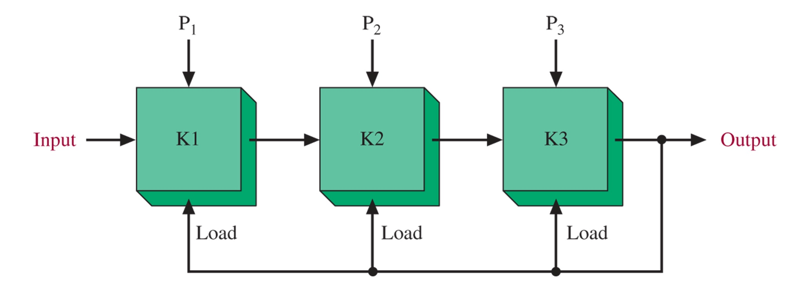
Figure 7-15 Typical programmable divider.

Slide 26
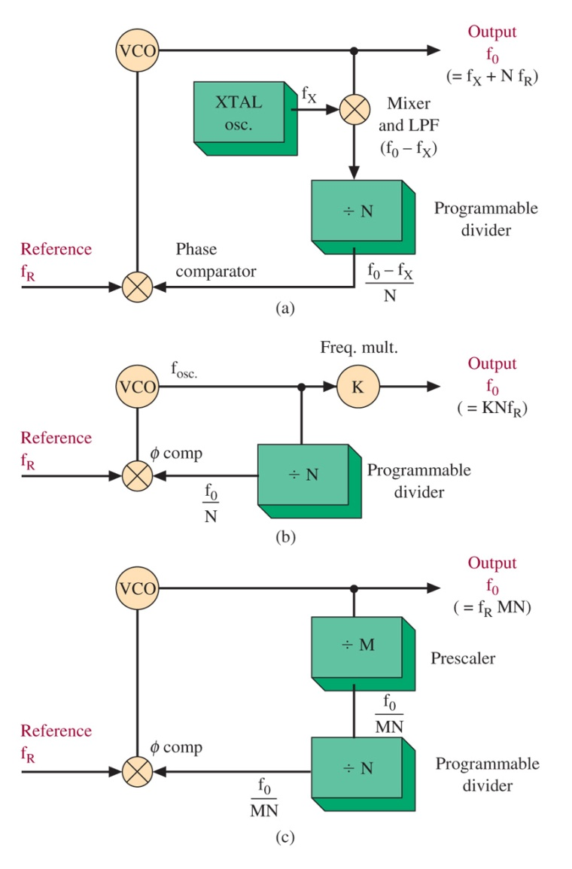
Figure 7-16 Synthesizer alternatives.

Slide 27
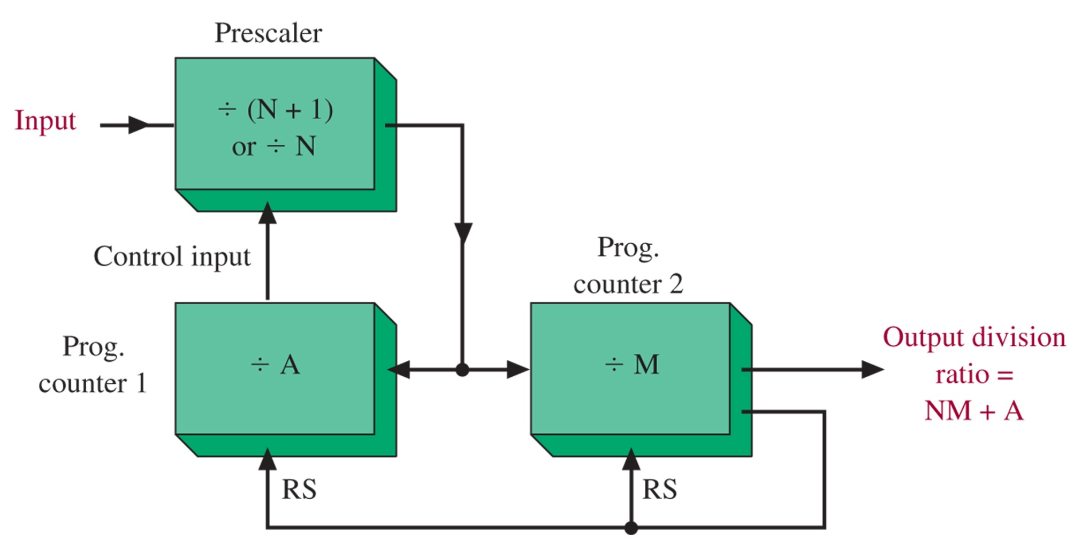
Figure 7-17 Divider system with two-modulus prescaler.

Slide 28
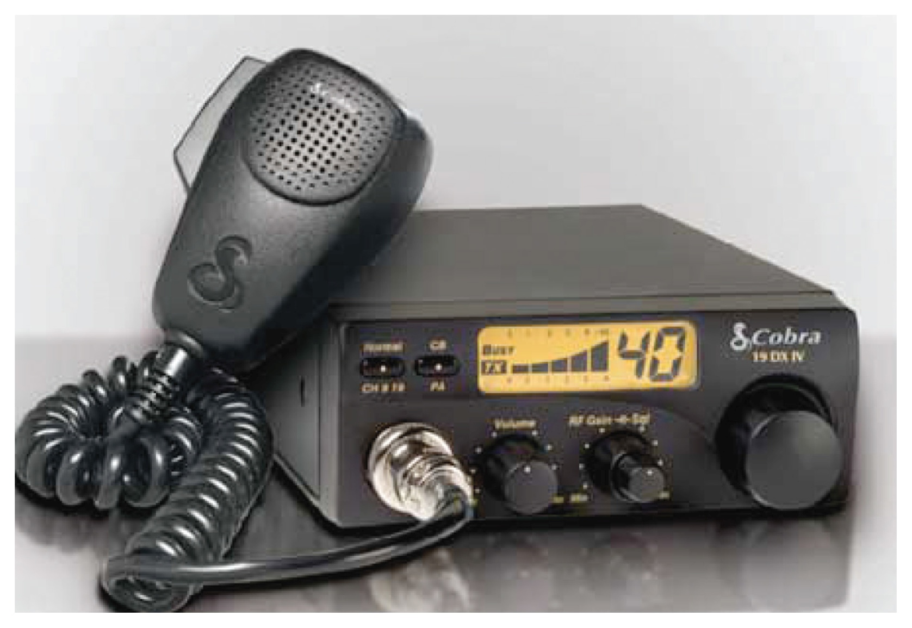
Figure 7-18 The Cobra 19 DX IV CB radio. (Courtesy of Cobra Electronics Corporation.)

Slide 29
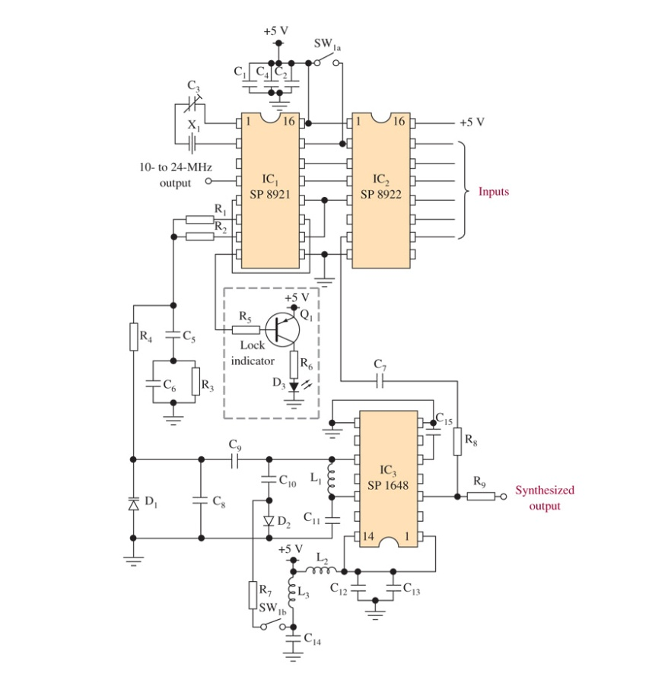
Figure 7-19 CB synthesizer circuit.

Slide 30
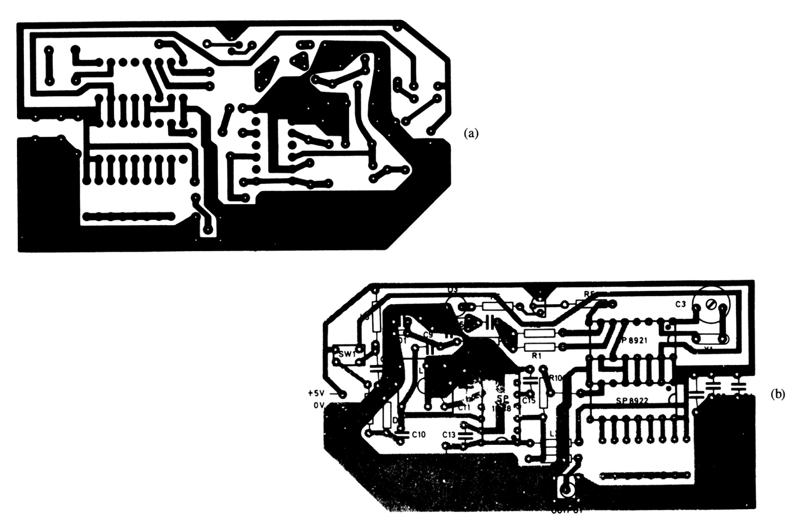
Figure 7-20 Printed circuit board details: (a) printed circuit layout for CB synthesizer; (b) component layout for CB synthesizer.

Slide 31
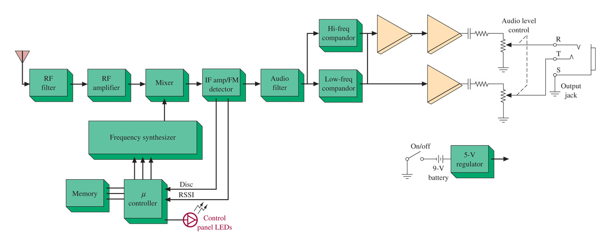
Figure 7-21 UCR110 block diagram. (Courtesy of Lectrosonics, Inc.)

Slide 32
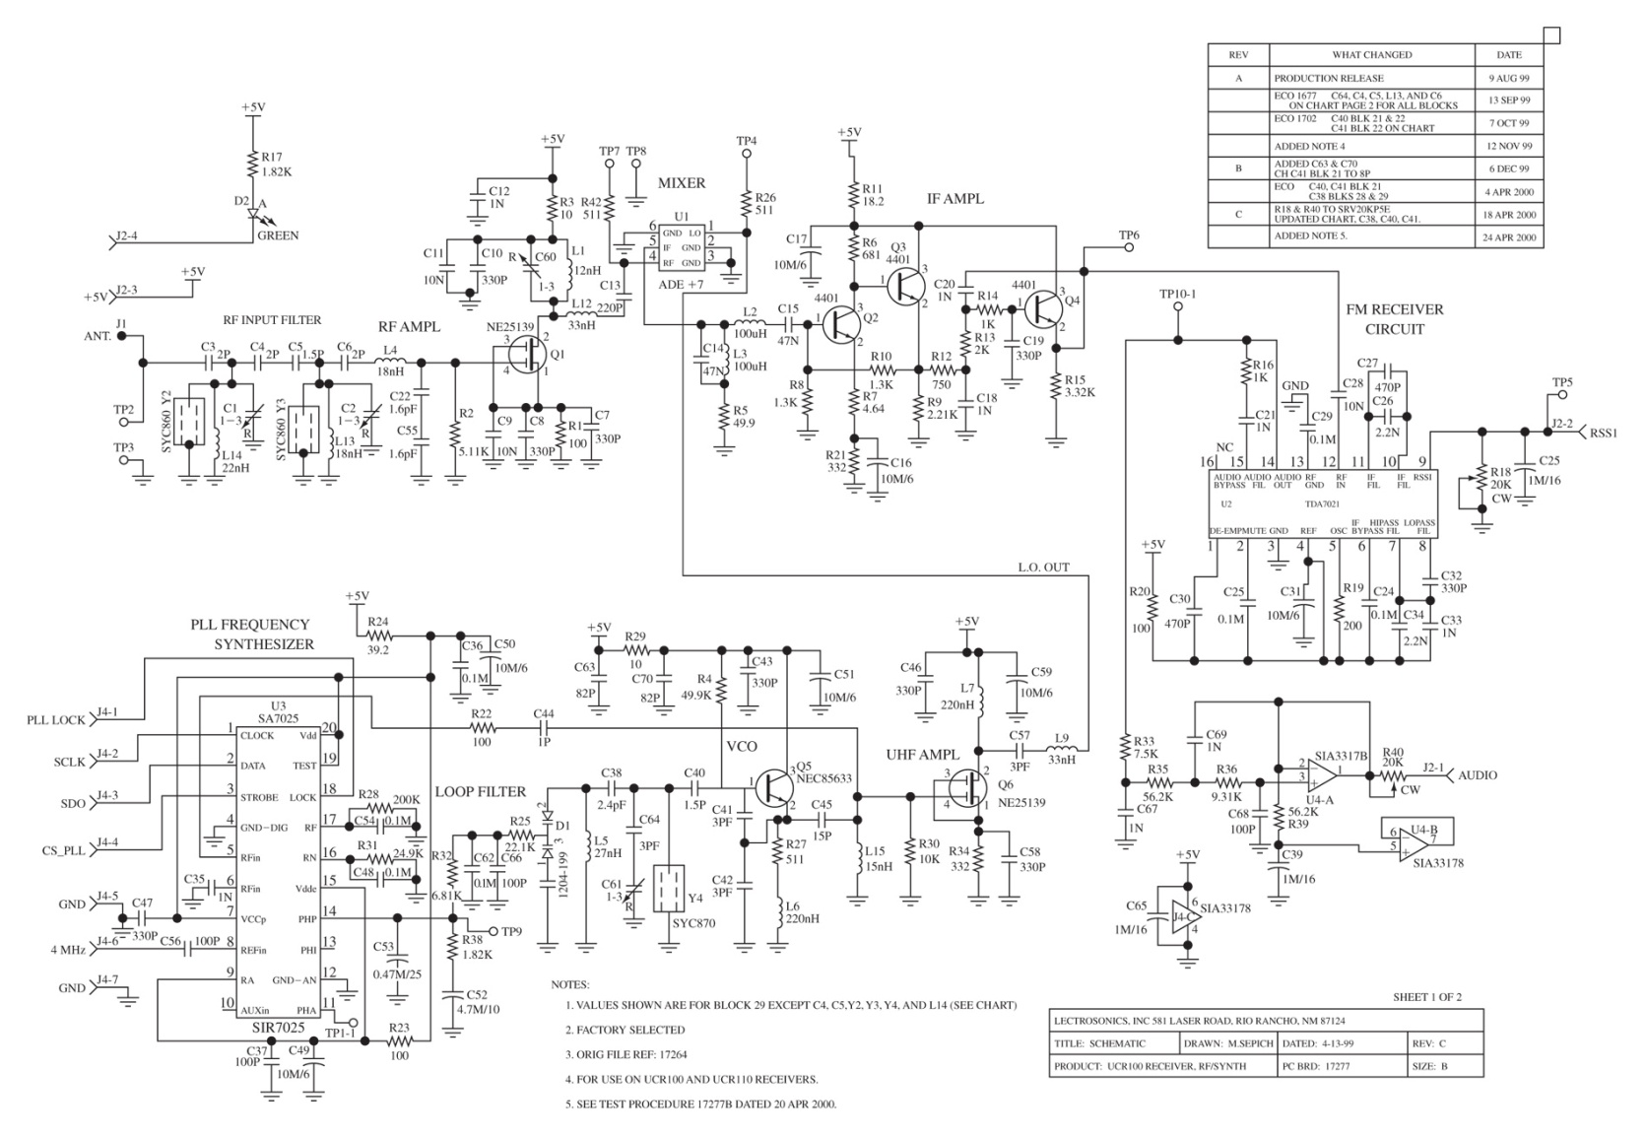
Figure 7-22 The schematic of a UHF multifrequency receiver. (Courtesy of Lectrosonics, Inc.)

Slide 33
7-6 Direct Digital Synthesis

Slide 34
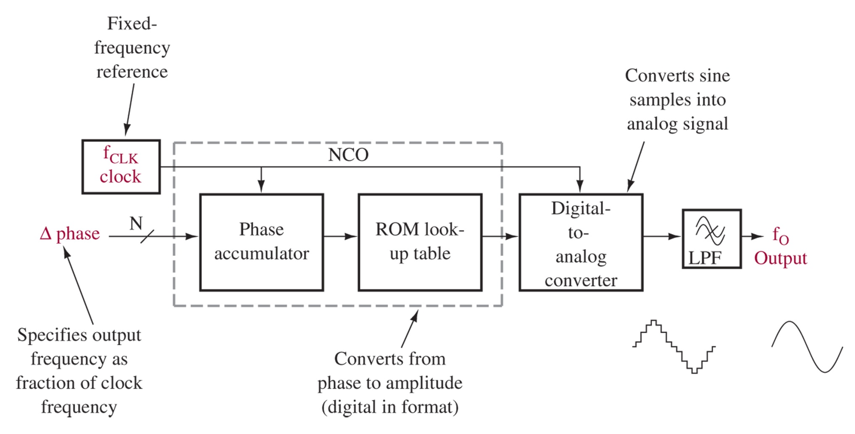
Figure 7-23 DDS block diagram.

Slide 35
7-7 High Frequency Communication Modules

Slide 36
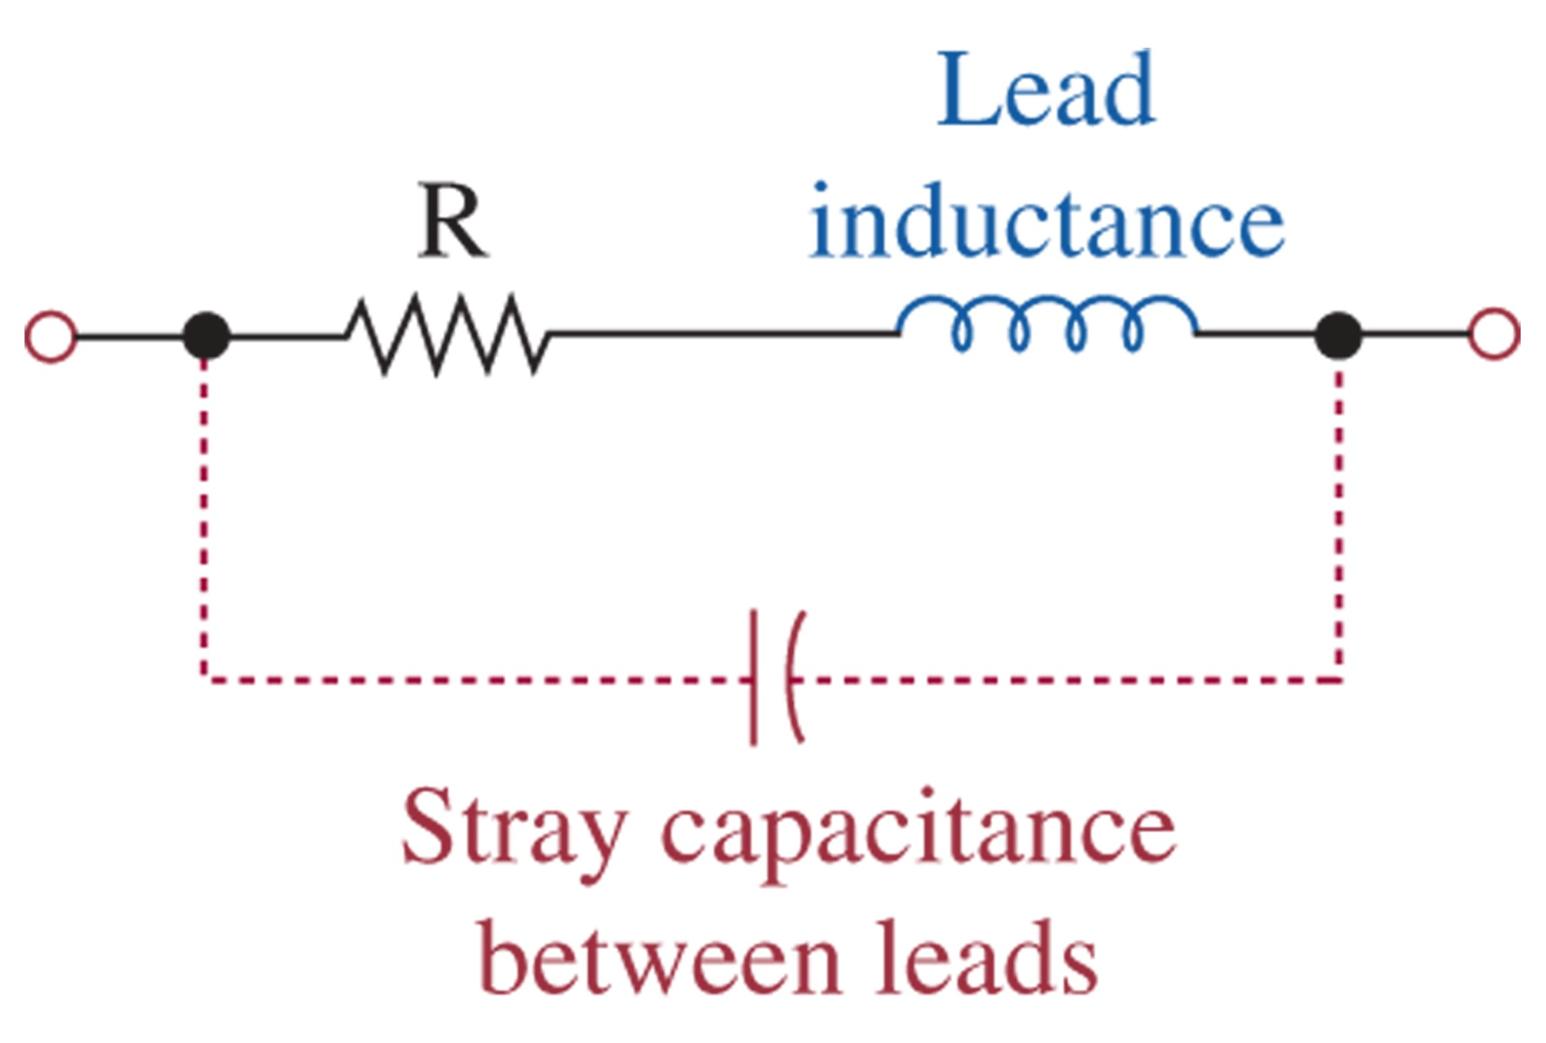
Figure 7-24 The resistor at high frequencies.

Slide 37
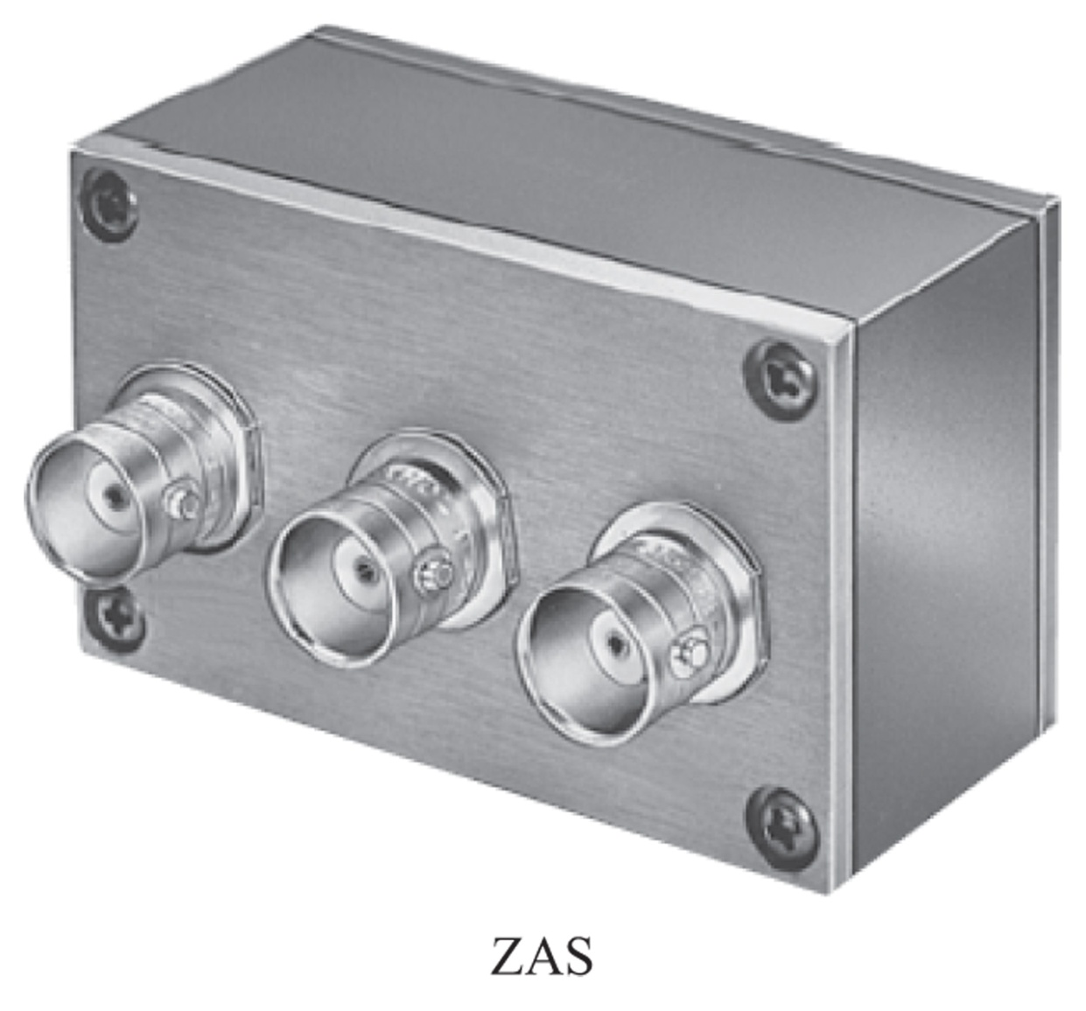
Figure 7-25 The ZAS-3 attenuator. (Courtesy of Mini-Circuits®: www.minicircuits.com.)

Slide 38
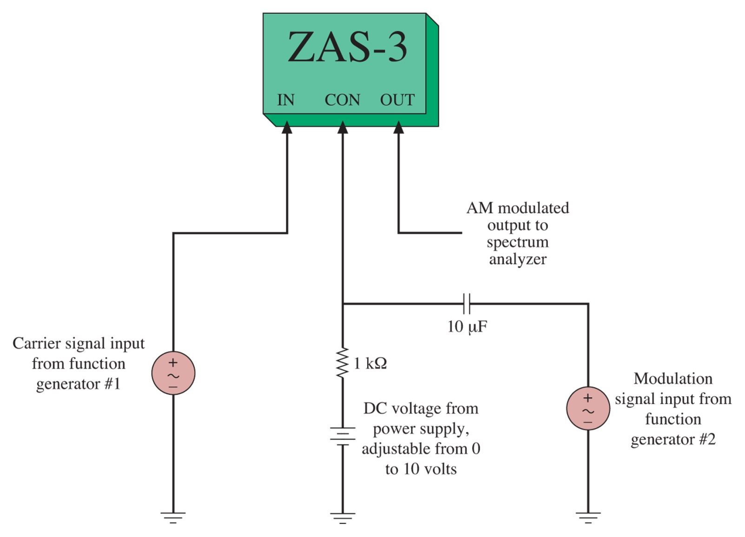
Figure 7-26 The connections for the ZAS-3 attenuator when used as an AM modulator.

Slide 39
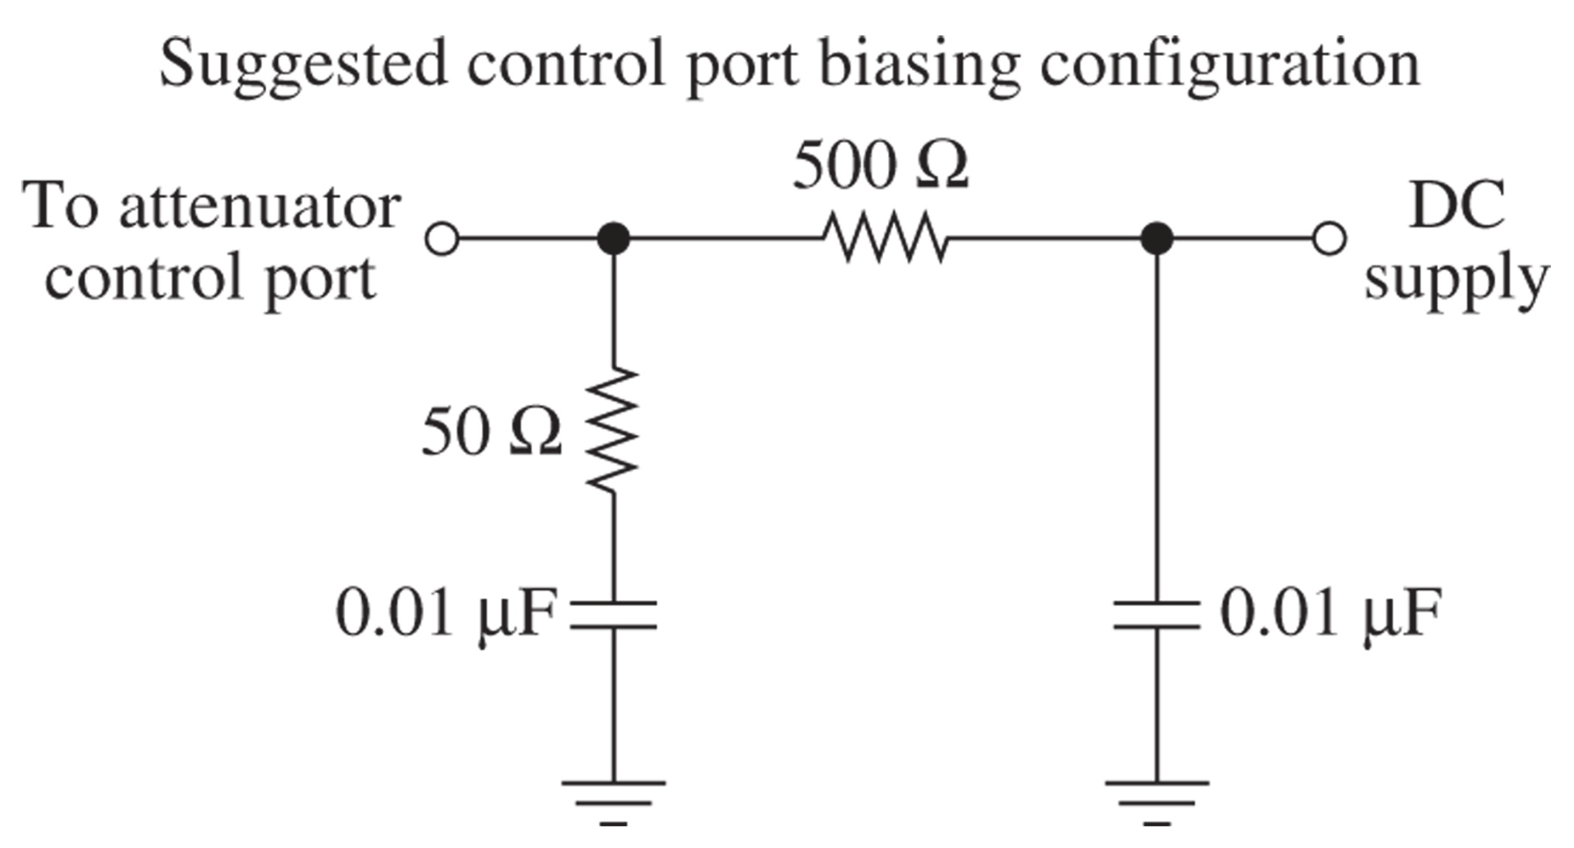
Figure 7-27 The suggested biasing for the ZAS-3 control port. (Courtesy of Mini-Circuits®: www.minicircuits.com.)

Slide 40
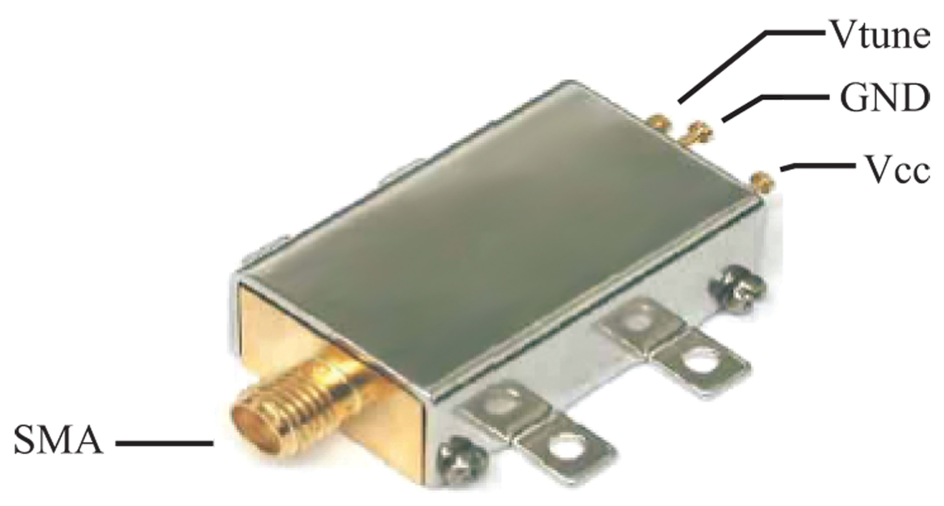
Figure 7-28 The Mini-Circuits ZX95-100 voltage controlled oscillator. (Courtesy of Mini-Circuits®: www.minicircuits.com.)

Slide 41
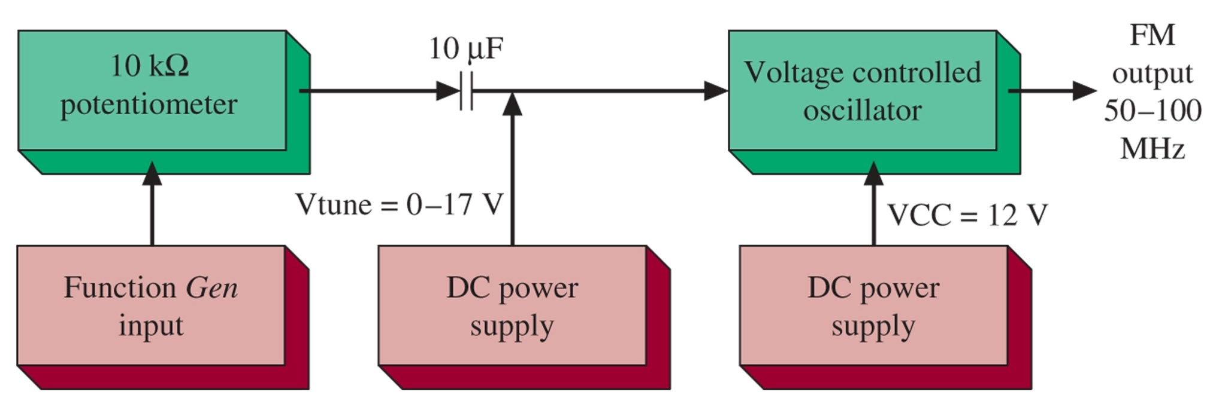
Figure 7-29 The suggested connection diagram for using the ZX95-100 for generating an FM signal. (Courtesy of Mini-Circuits®: www.minicircuits.com.)

Slide 42
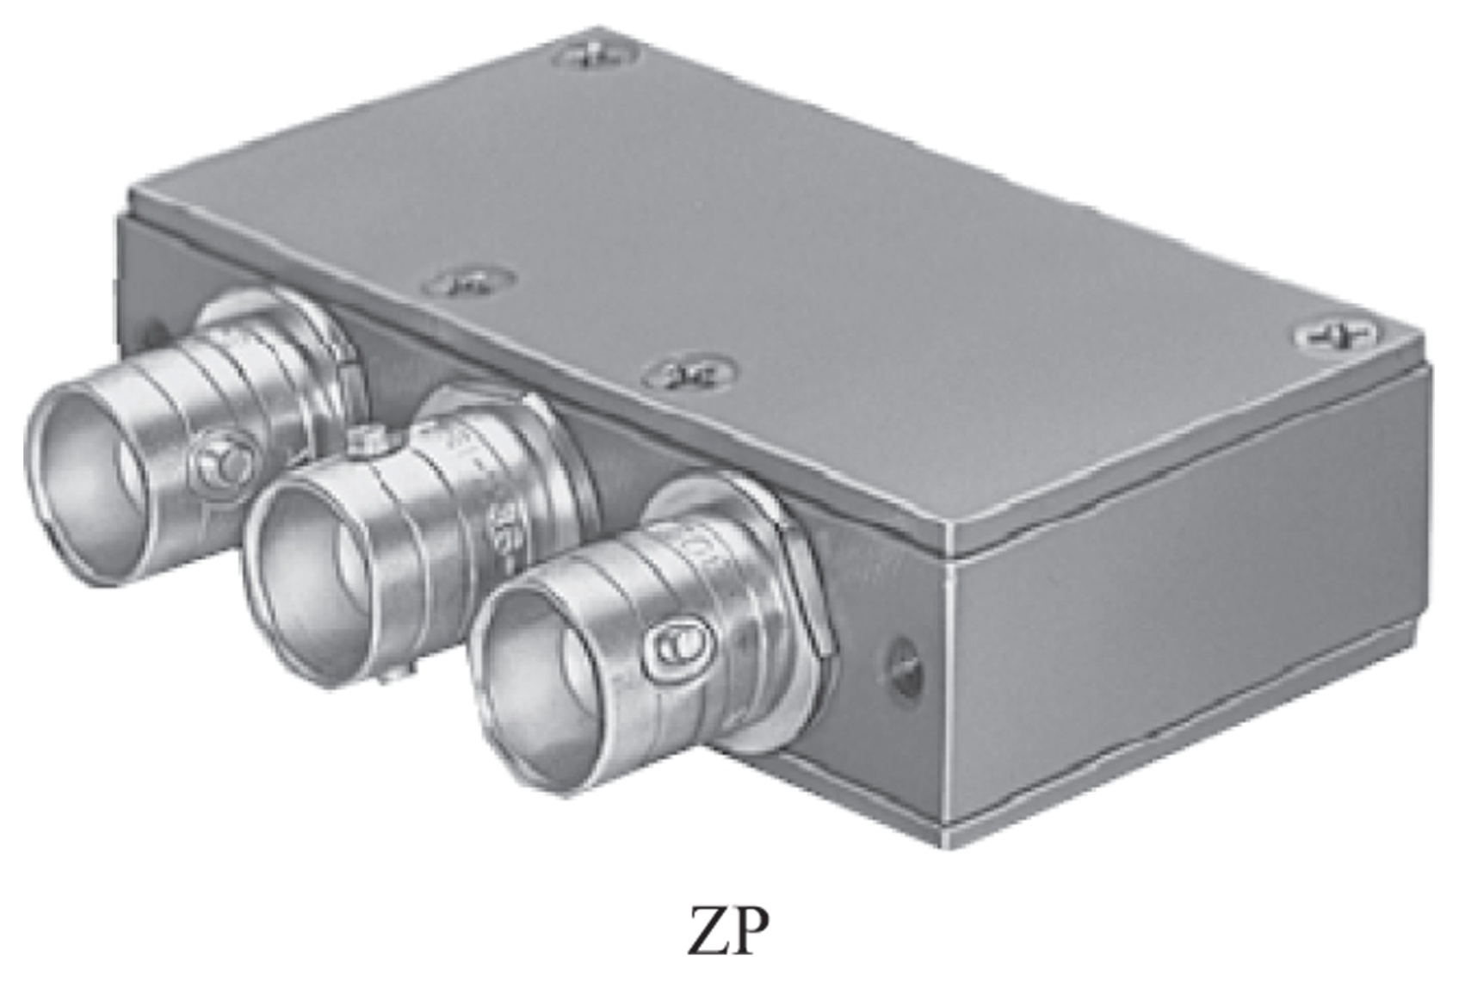
Figure 7-30 The Mini-Circuits® ZP-3 mixer circuit. (Courtesy of Mini-Circuits®: www.minicircuits.com.)

Slide 43
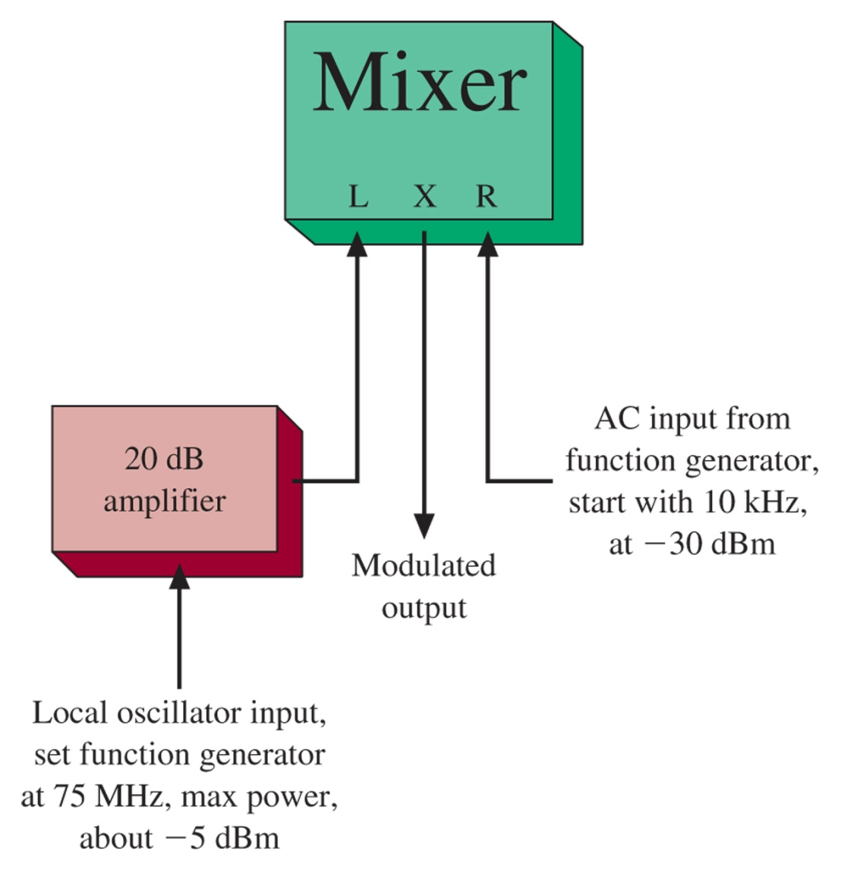
Figure 7-31 The suggested connection diagram for the ZP-3.

Slide 44
7-8 Troubleshooting

Slide 45
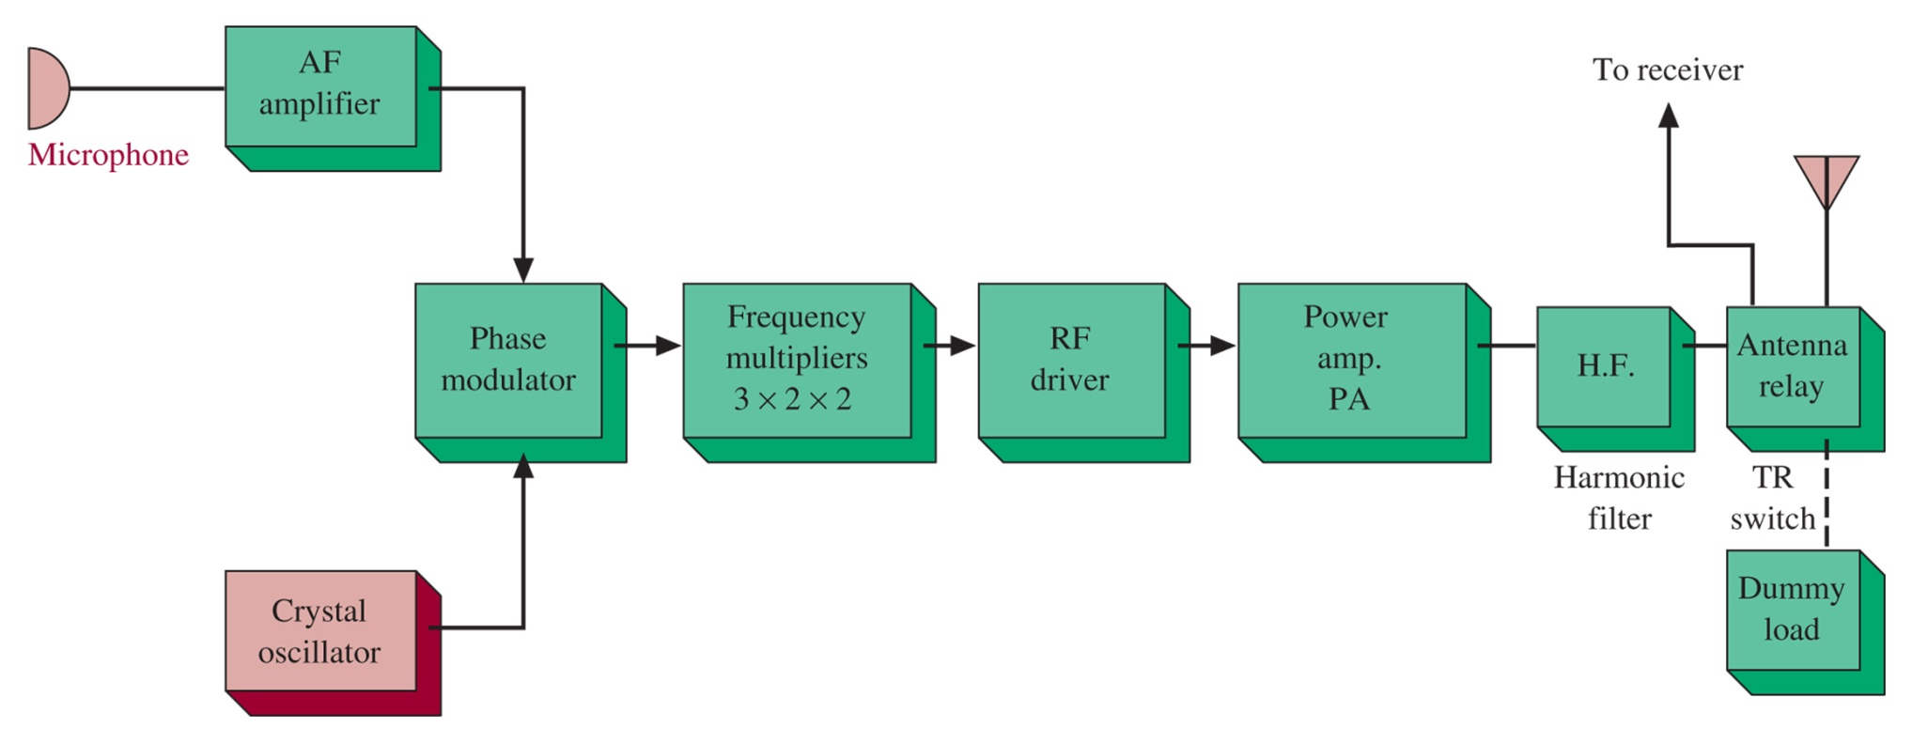
Figure 7-32 Block diagram of a mobile FM transceiver, transmitter portion.

Slide 46
7-9 Troubleshooting w/ Multisim

Slide 47
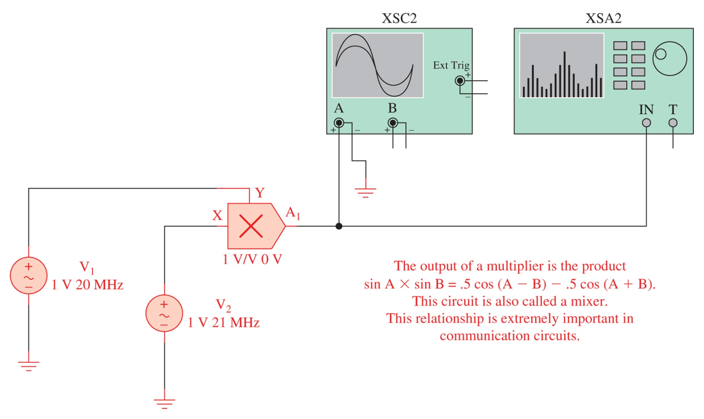
Figure 7-33 The mixer circuit as implemented with Multisim.

Slide 48
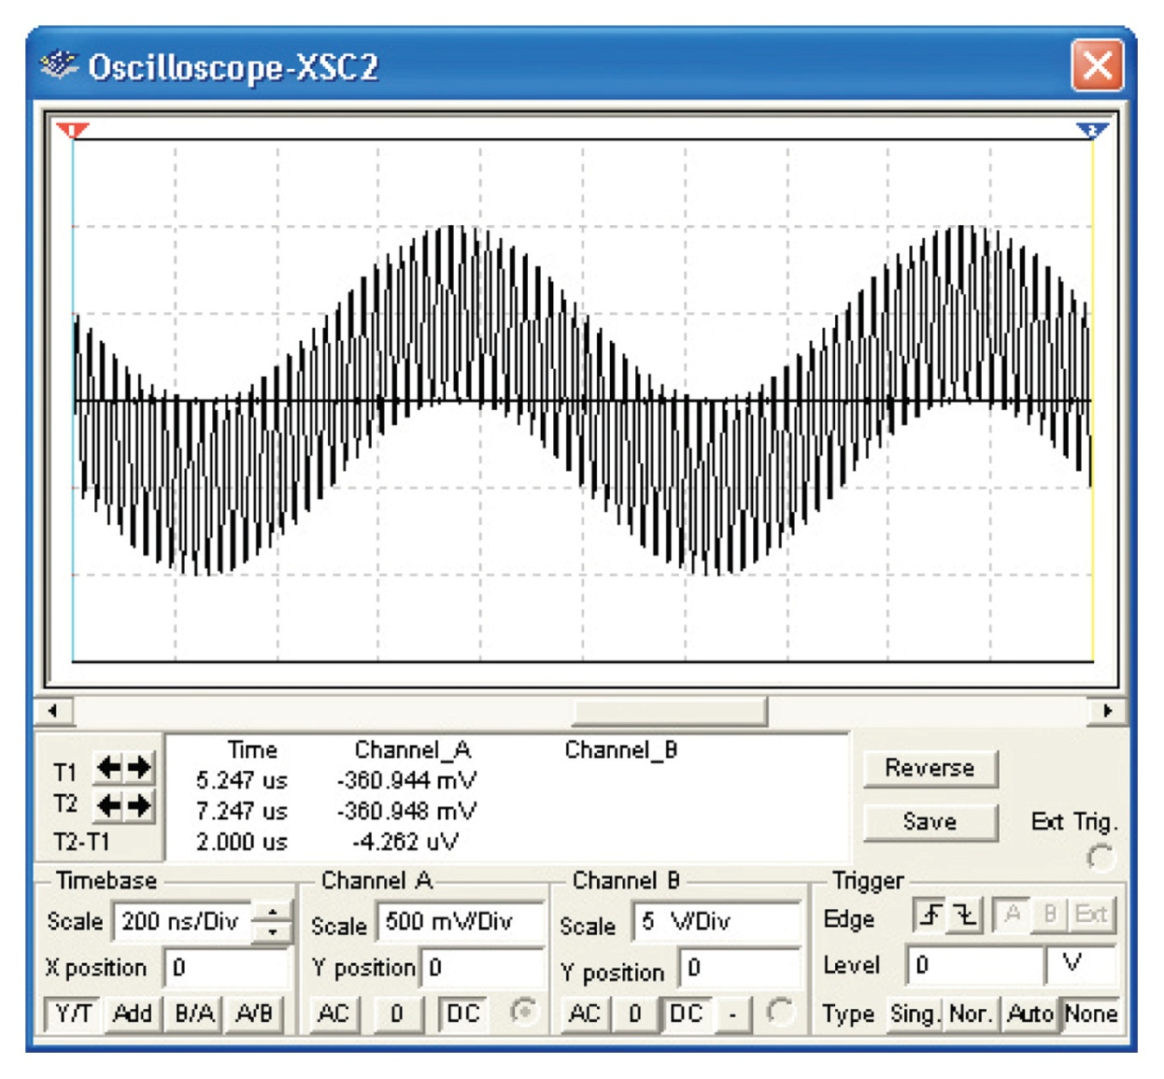
Figure 7-34 The output of the mixer as viewed with an oscilloscope. The input frequencies to the mixer are 20 and 21 MHz.

Slide 49
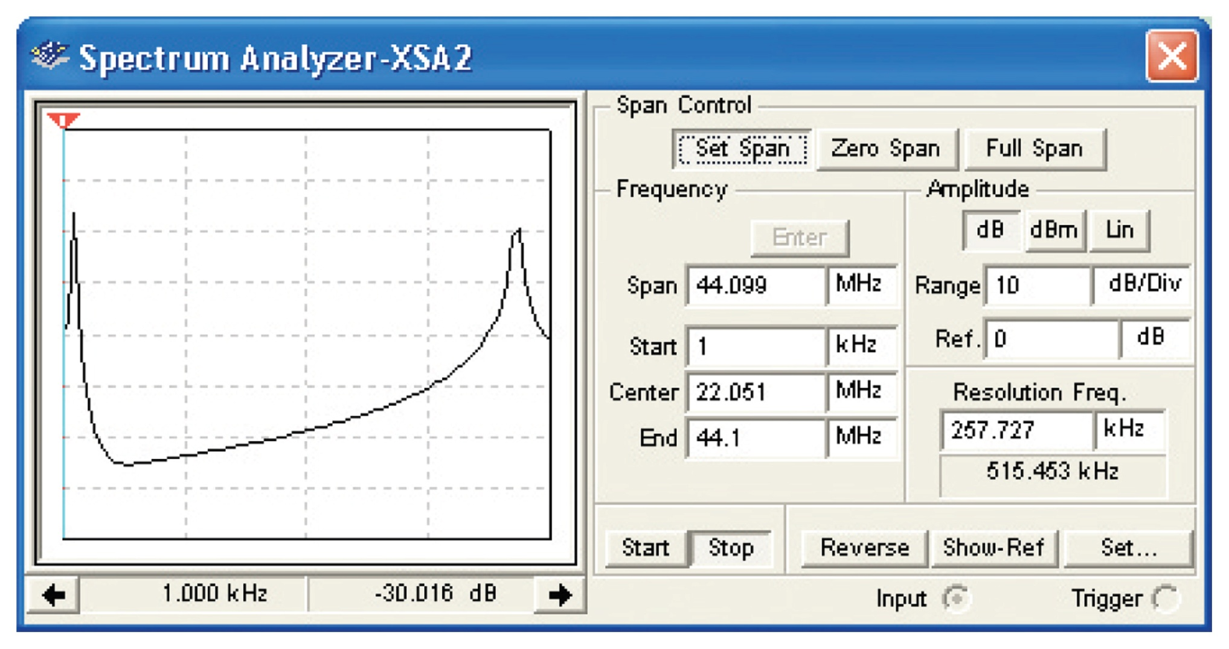
Figure 7-35 The output of the mixer as viewed by a spectrum analyzer.

Slide 50
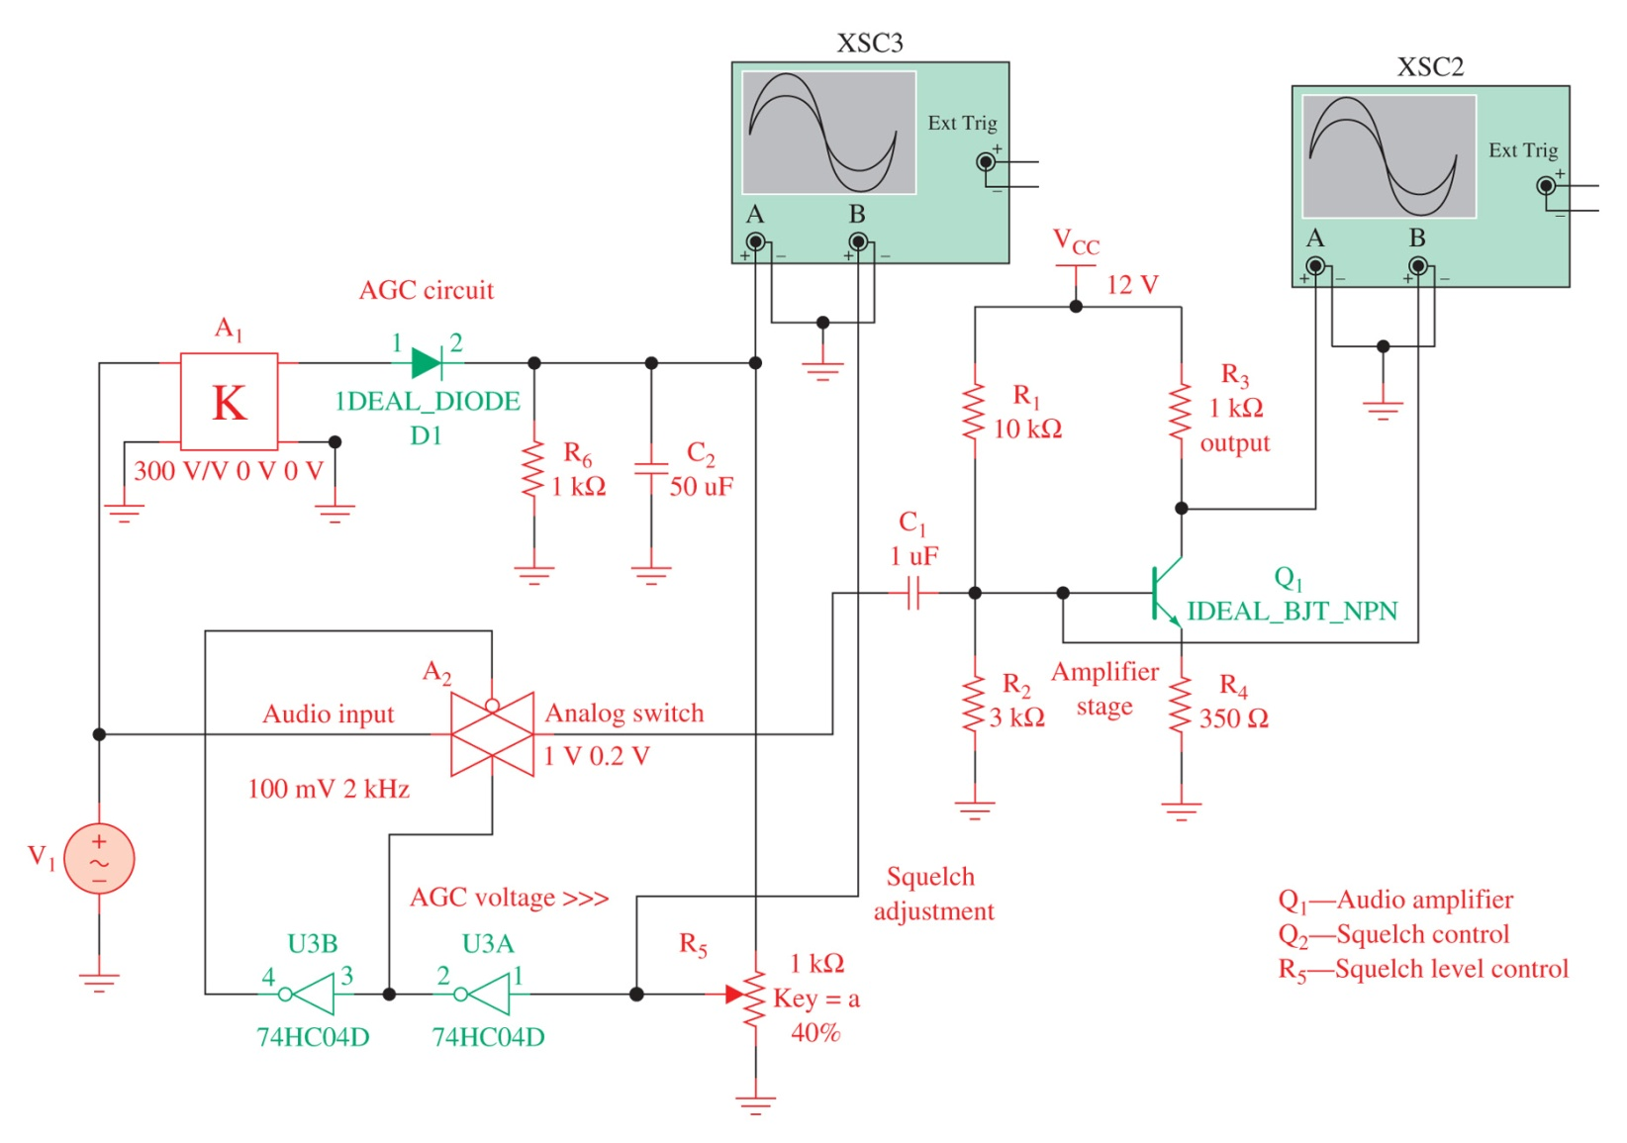
Figure 7-36 An example of a squelch circuit as implemented with Multisim.

