Slide 1
EE 350 / ECE 490 Analog Communication Systems
Ch. 8 – Digital Communcations Coding Techniques

Slide 2
Objectives
Describe the quantization process in a PCM system in terms of how it is created, how to determine the Nyquist sampling frequency, and how to define quantization levels
Determine the dynamic range and signal-to-noise ratio of a PCM system
Describe the common digital signal encoding formats
Understand the concept of Hamming distance as applied to the technique of error detection and correction
Describe the various techniques for code error detection and correction, including parity, block check character, cyclic redundancy check, Hamming code, and Reed-Solomon codes
Describe Digital Signal Processing, the purpose of the difference equation, and illustrate the computational process of a DSP algorithm

Slide 3
8-1 Introduction
Many advantages to Digital communications despite additional complexity and cost
Regeneration – signals only need to be understood as logical 0 or 1, noise resistant
Digital Signal Processing can happen at transmitter or receiver
Algorithms can manipulate the signal via hardware or software

Slide 4
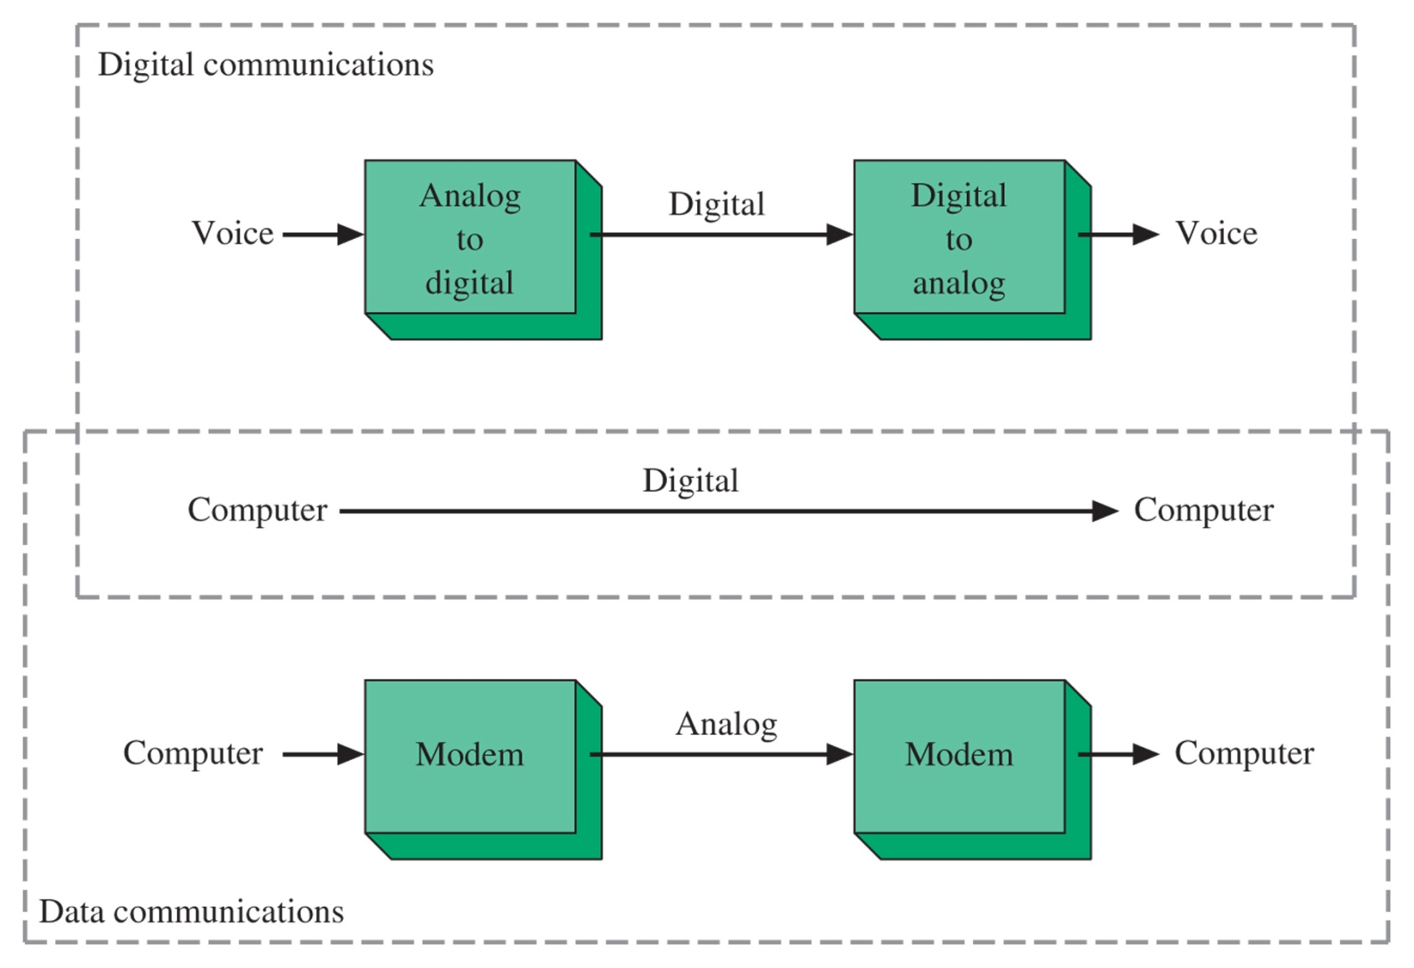
Figure 8-1 Digital/data communications.

Slide 5
8-2 Alphanumeric Codes
Many ways to represent data or signals in digital
ASCII is the most common
EBCDIC is used in some computers
Baudot Code (historical)
Gray Code (telemetry, slow changes)

Slide 6
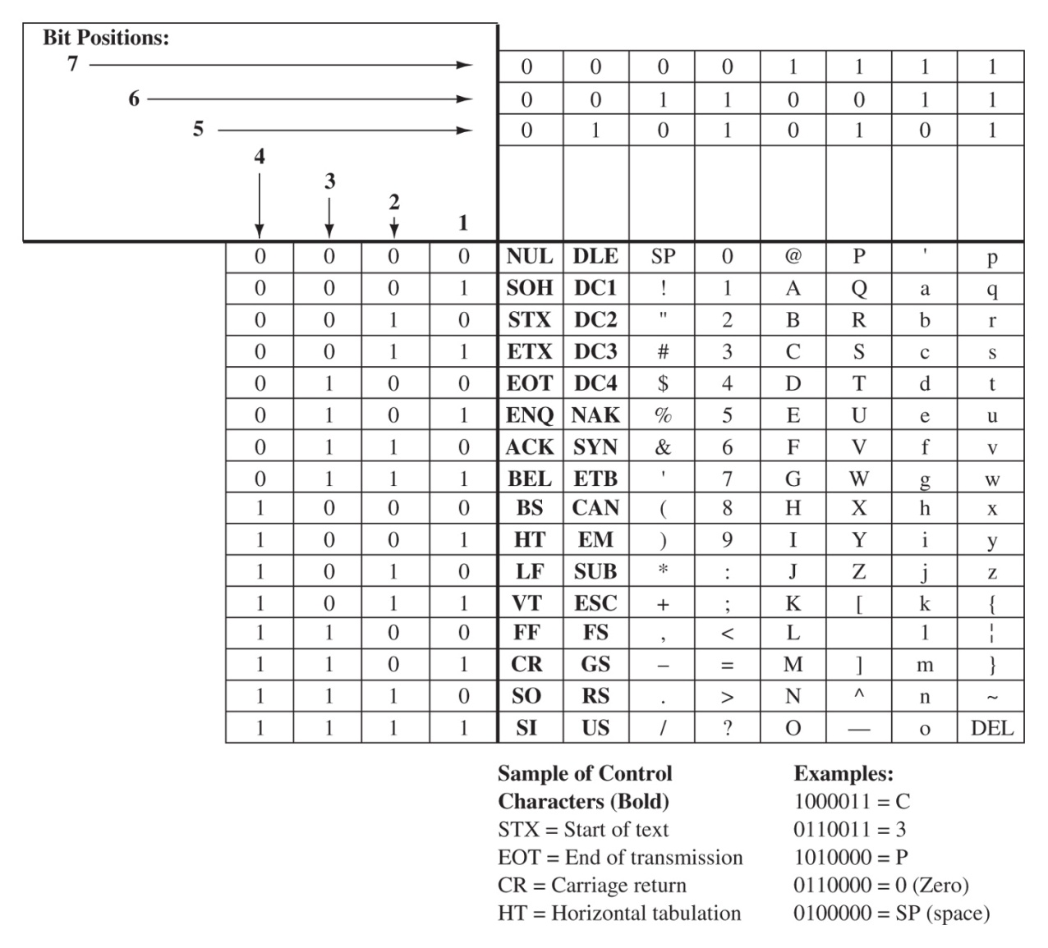
ASCII
2⁷ 7-bit words (128 char)
8th bit used to check parity
Uses Binary Coded Decimal
Lsb transmitted first
1000001 = A
0110110 = 6
Figure 8-2 American Standard Code for Information Interchange (ASCII).

Slide 7
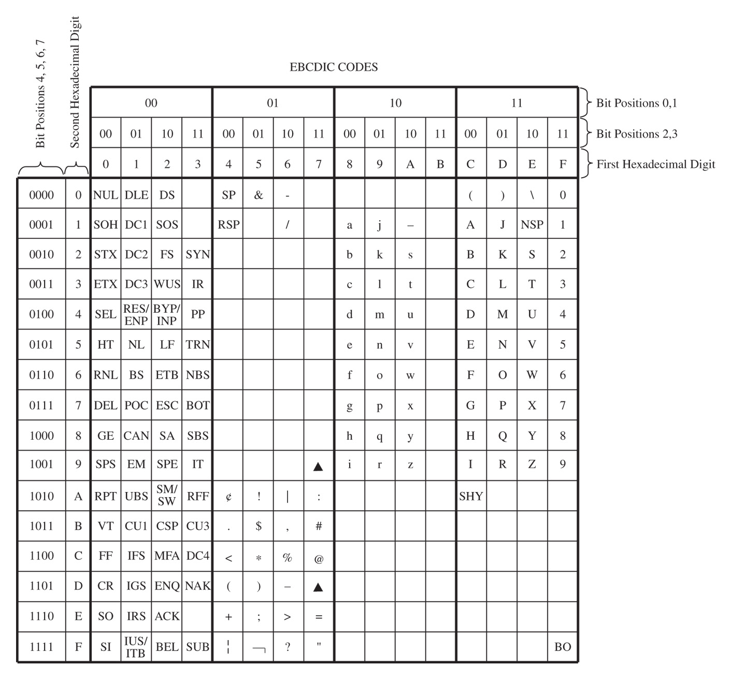
EBCDIC
Uses 8-bit codes
Only uses the 0-9 positions for letters and numbers
Figure 8-3 The Extended Binary-Coded Decimal Interchange Code.

Slide 8
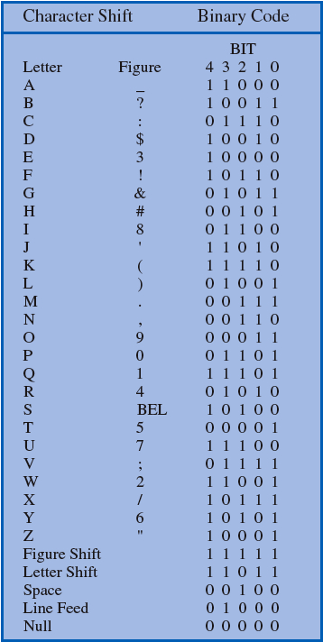
Baudot
Old code designed for teletype
Uses only 5-bits per code
Sends Shift sequence to indicate Figures or Letters follow
Figure 8-4 The Baudot code.

Slide 9
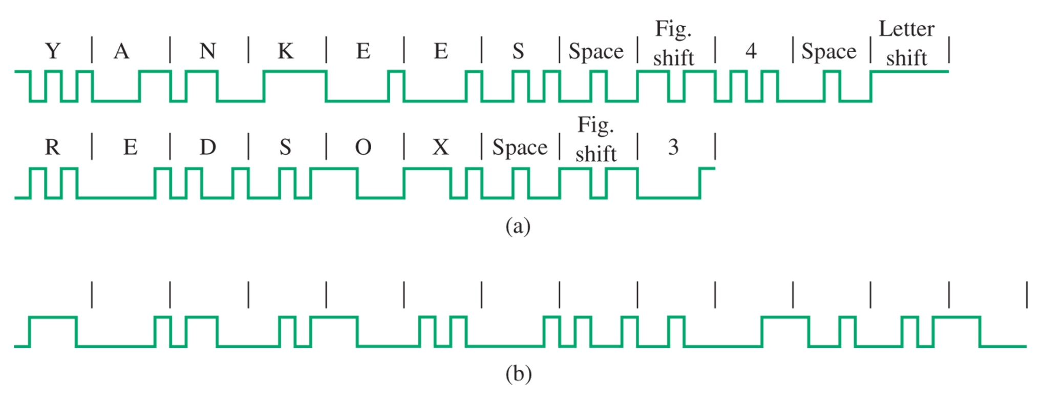
Figure 8-5 Baudot code examples.

Slide 10
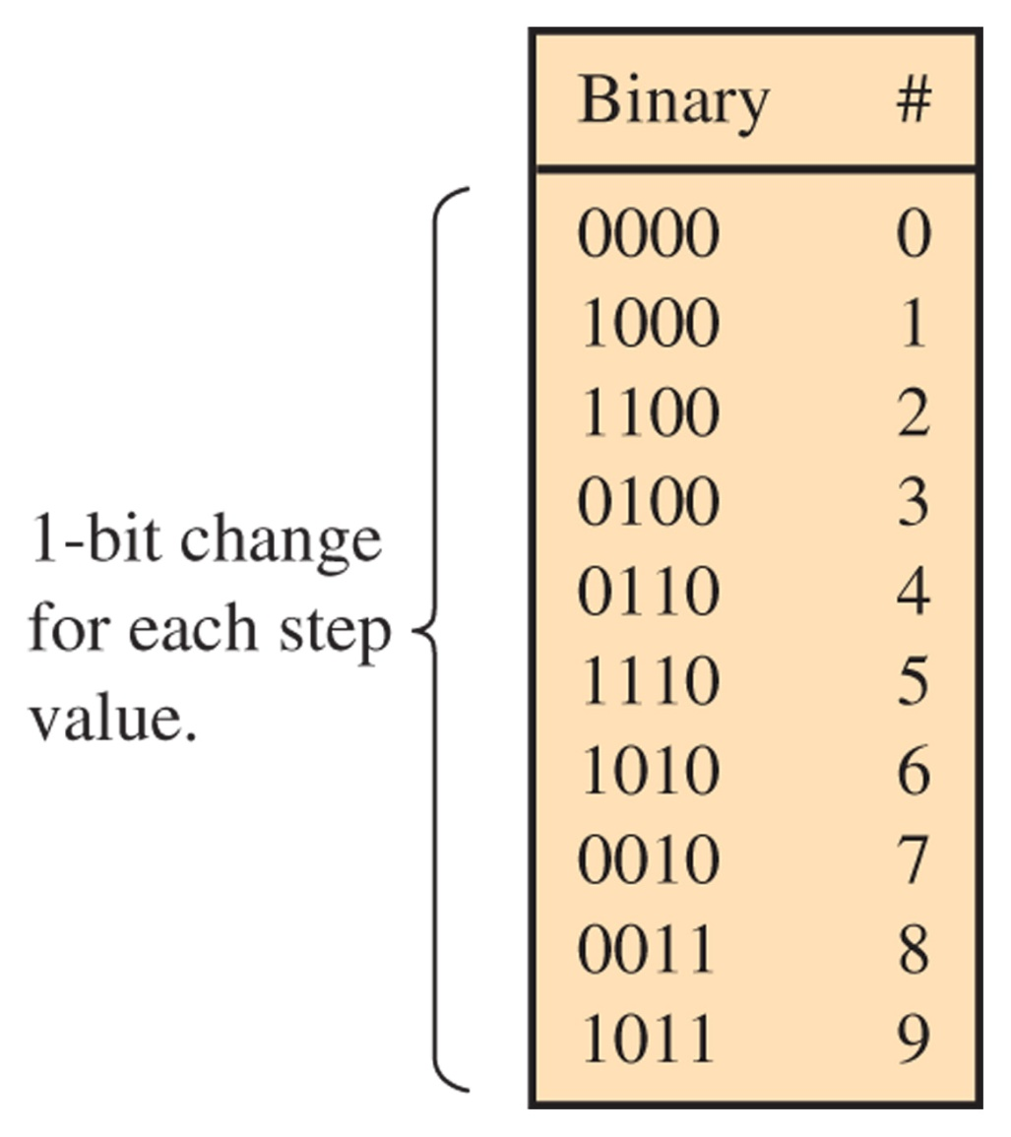
Gray Code
Used for slow changing data signals, telemetry or low probability of error.
Only one bit flip from per decimal sequence.
Useful for detecting errors in slow changing systems.
Figure 8-6 The Gray code.

Slide 11
8-3 Pulse-Code Modulation
Most common technique for representing analog signals by a digital word

Slide 12
Figure 8-7 Block diagram of the PCM process.

Slide 13
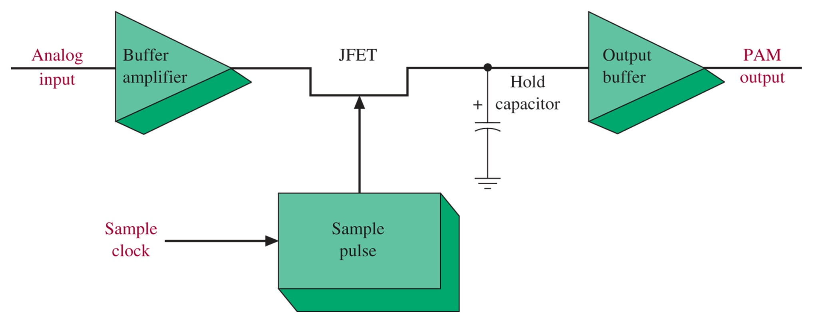
Sample-and-Hold

Slide 14
Pulse-Amplitude Modulation

Slide 15
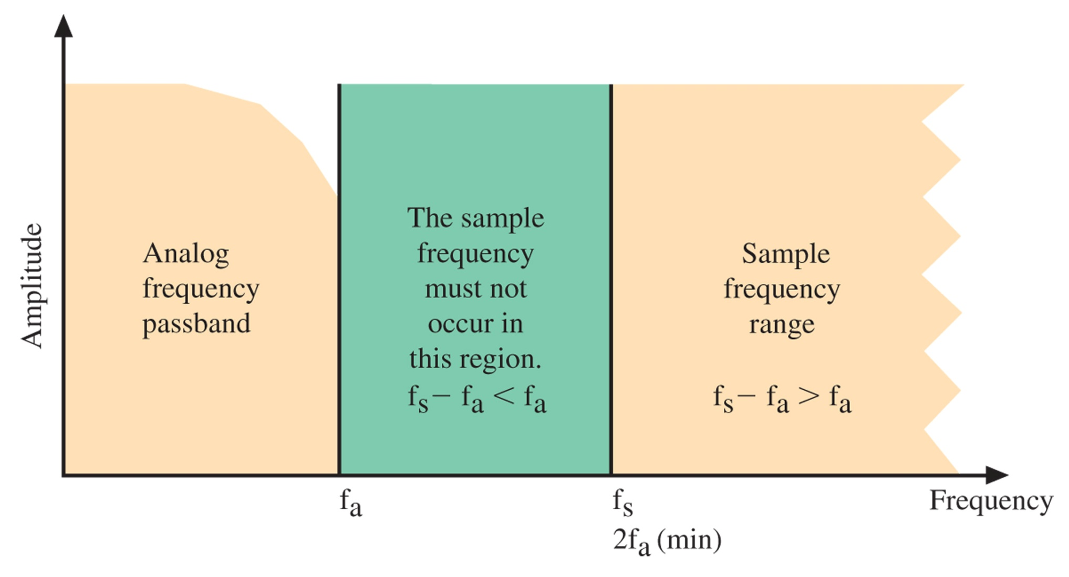
Sample Frequency
Nyquist Rate:
To eliminate aliasing or foldover distortion a low-pass anti-aliasing filter must be used on the signal prior to sampling

Slide 16
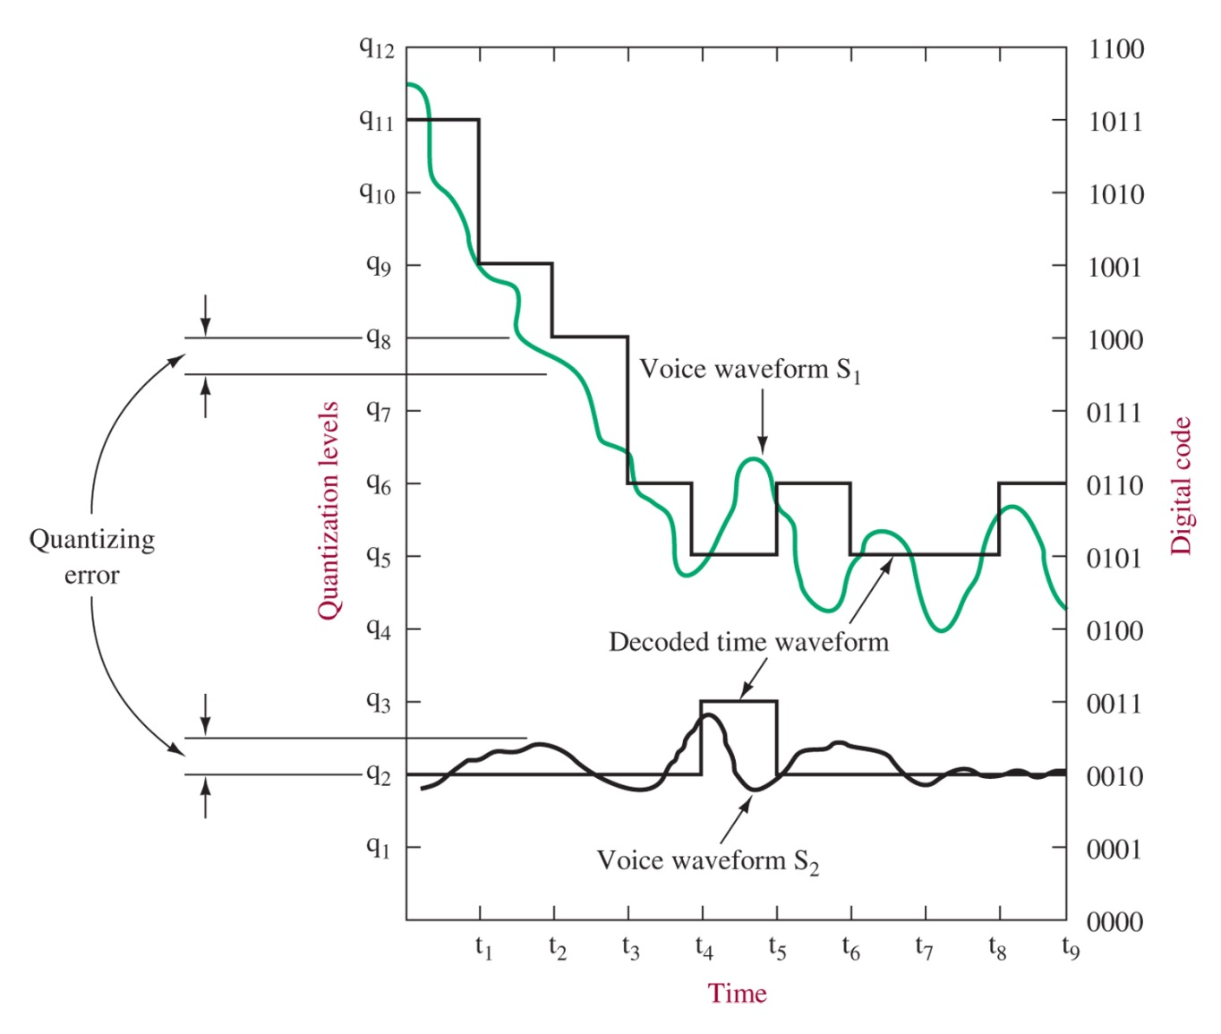
Quantization
Figure 8-12 PCM encoding. (From the November 1972 issue of the Electronic Engineer, with the permission of the publisher.)

Slide 17
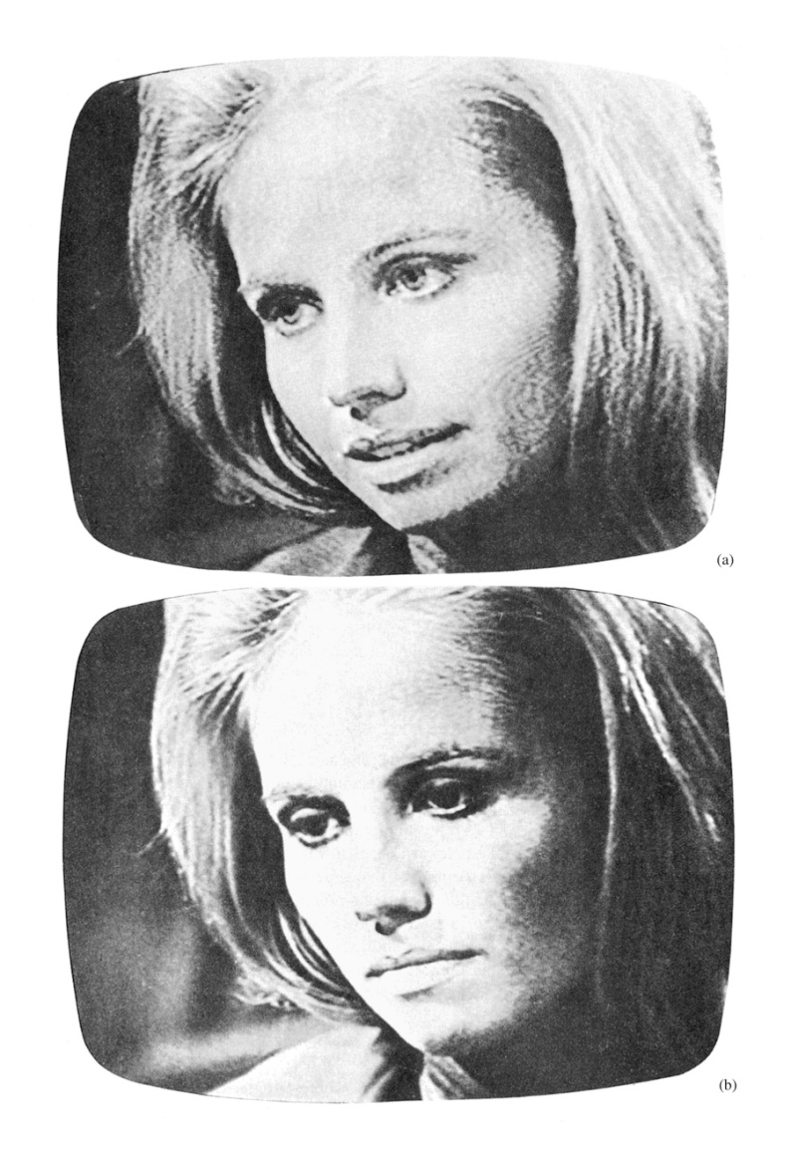
Resolution
Figure 8-13 PCM TV transmission: (a) 5-bit resolution; (b) 8-bit resolution.

Slide 18
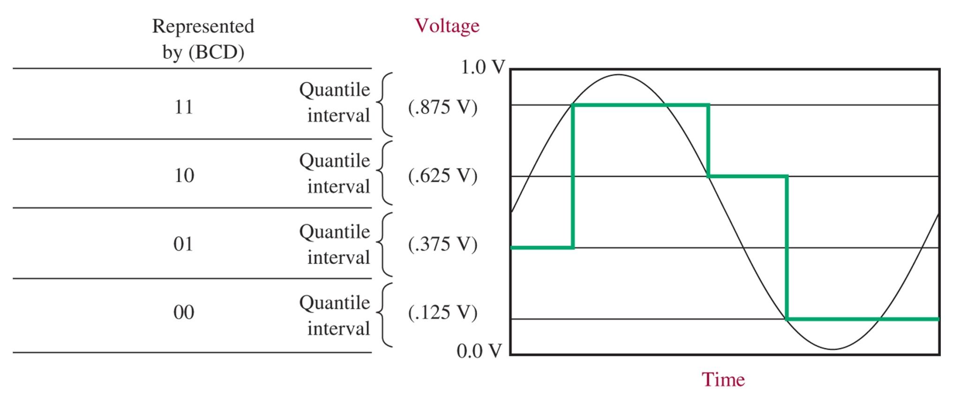
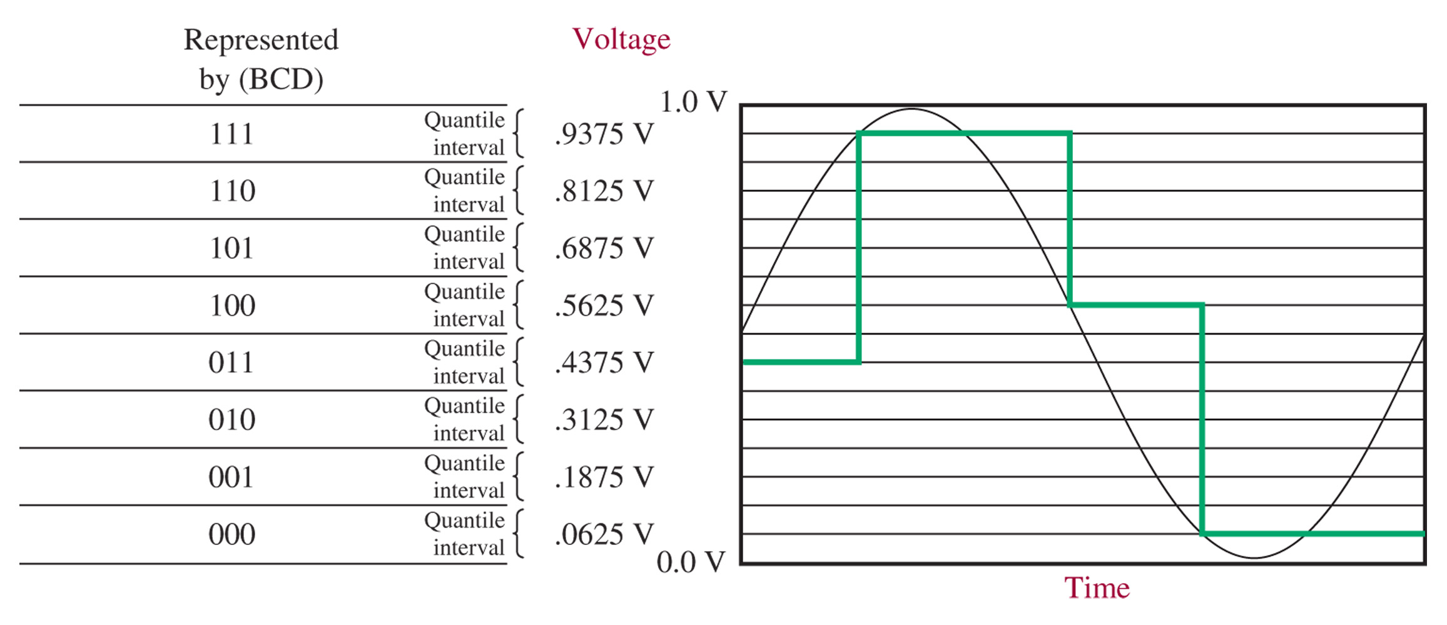
Resolution
2-bit
3-bit

Slide 19
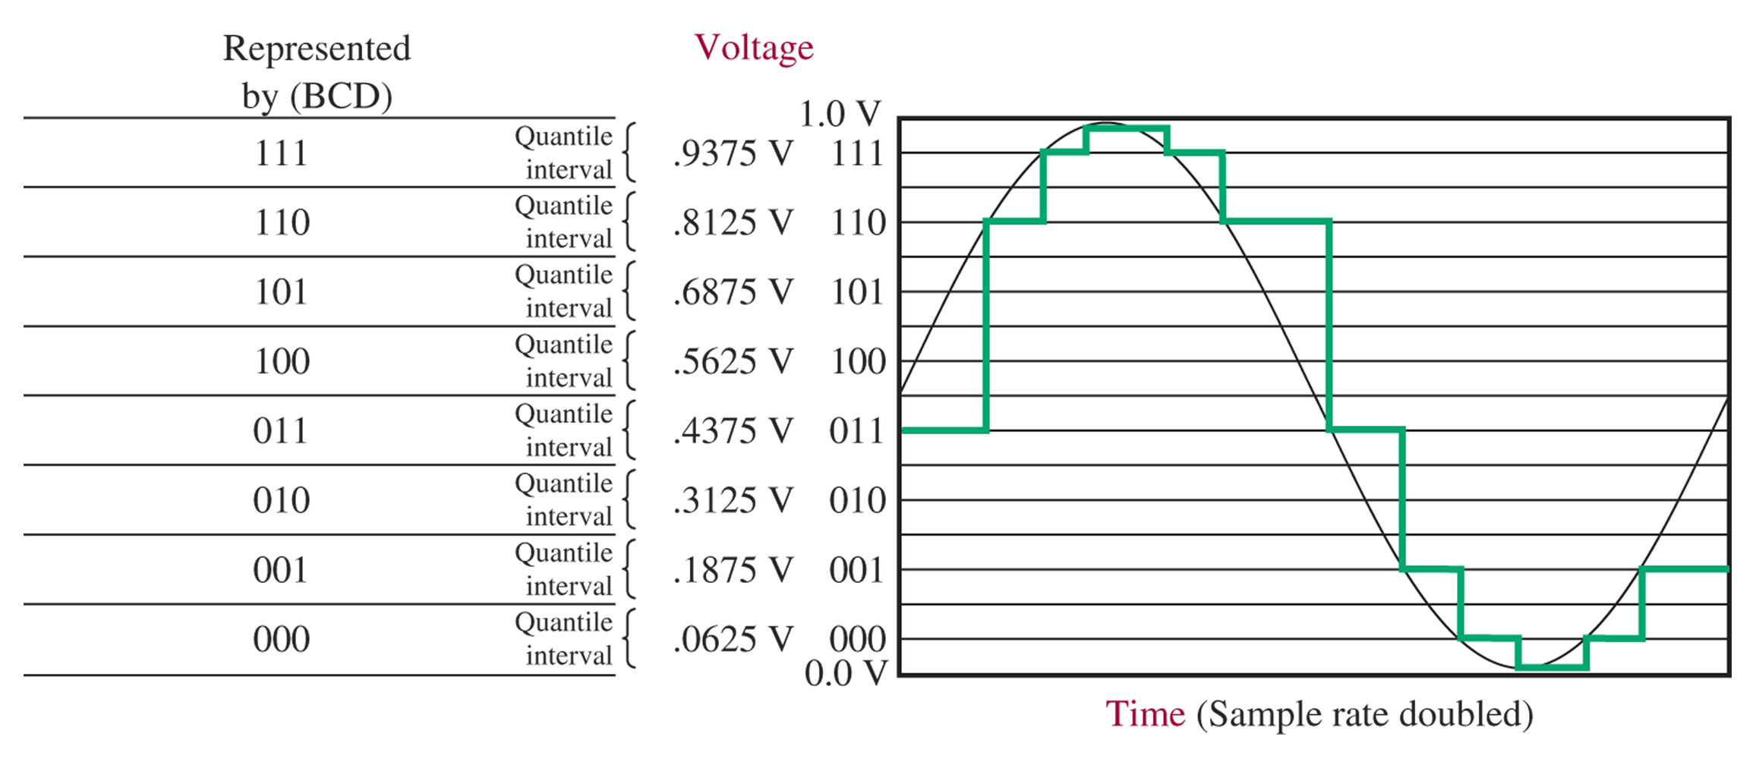
Increased Sampling Rate
Figure 8-16 An example of 3-bit quantization with increased sample rate.
Oversampling (far above Nyquist rate) is necessary if the bandwidth is well-defined

Slide 20
Dynamic Range
Dynamic Range:
Signal-to-Noise ratio:
Signal-to-quantization-noise level:

Slide 21
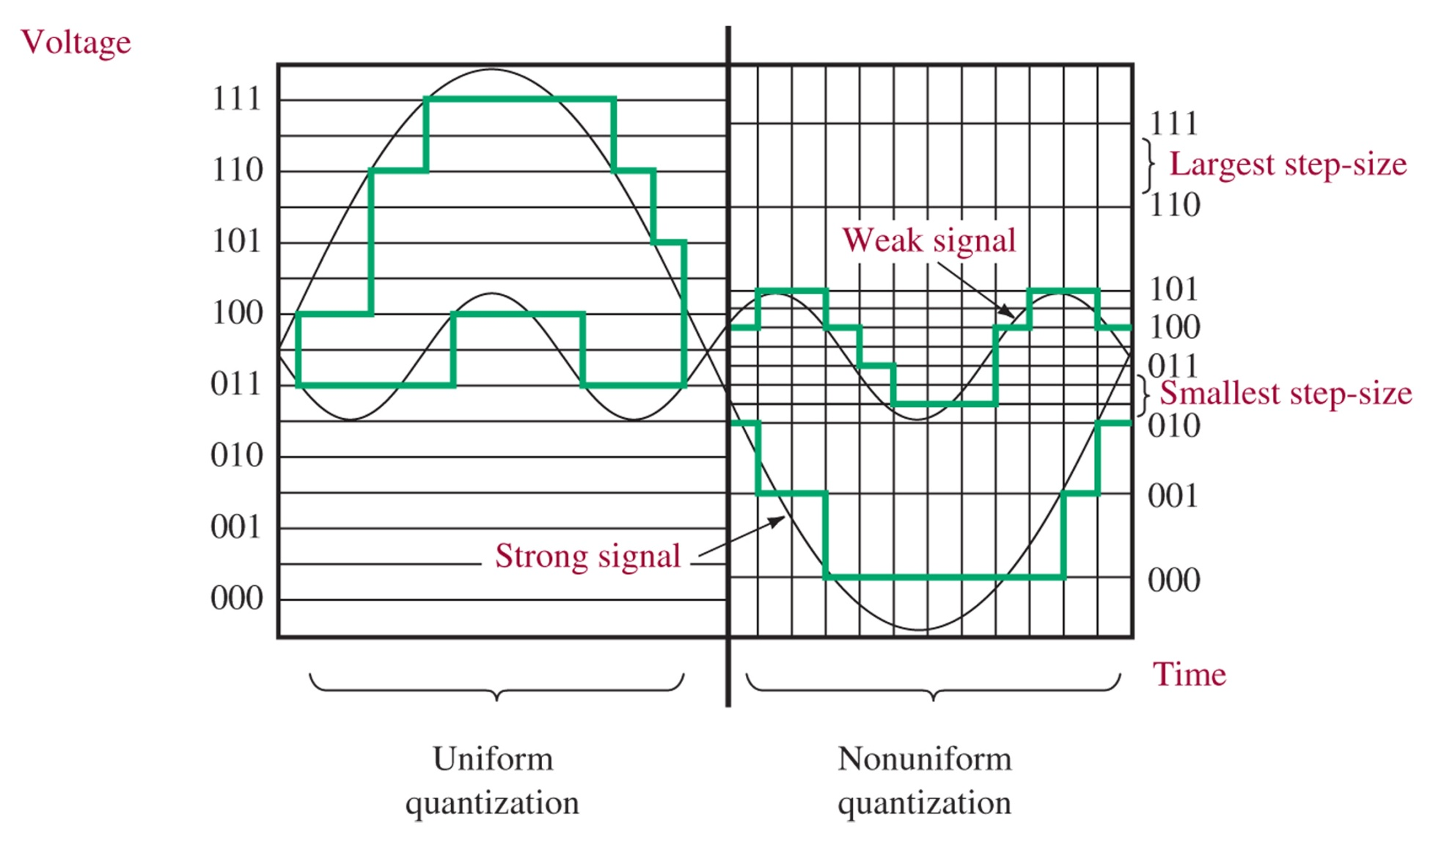
Companding
Figure 8-17 Uniform (left) and nonuniform (right) quantization.

Slide 22
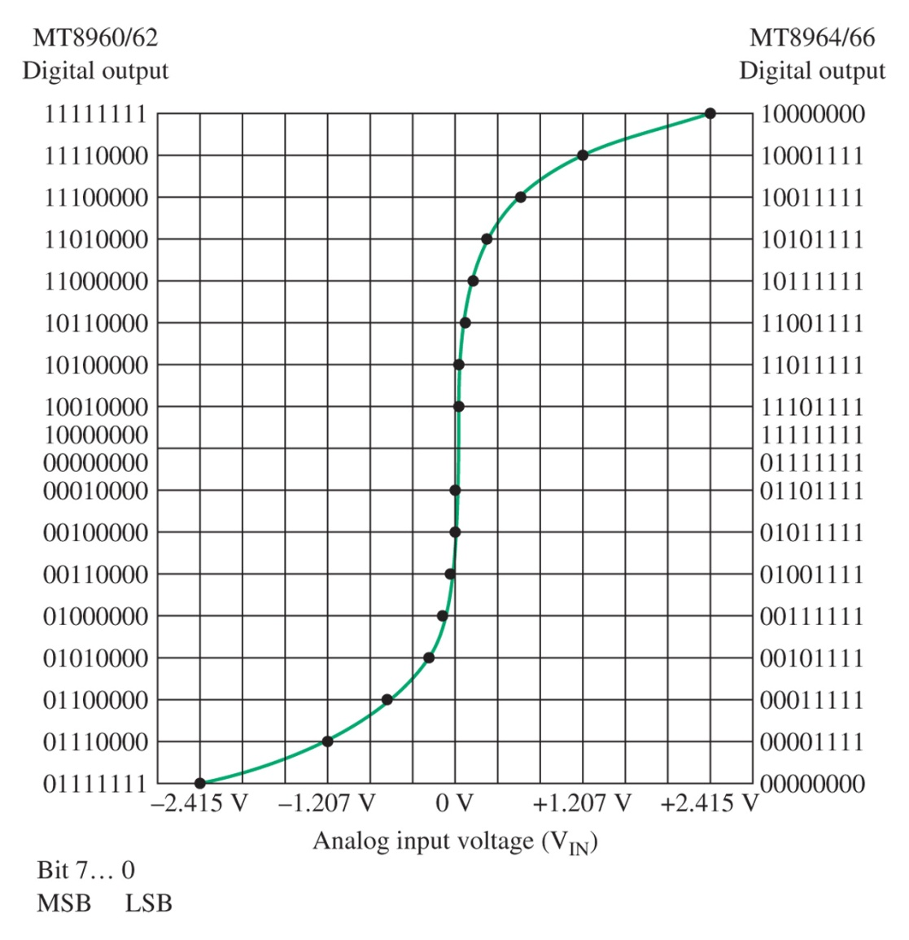
Amplitude Companding
Figure 8-19 μ-law encoder transfer characteristic.

Slide 23
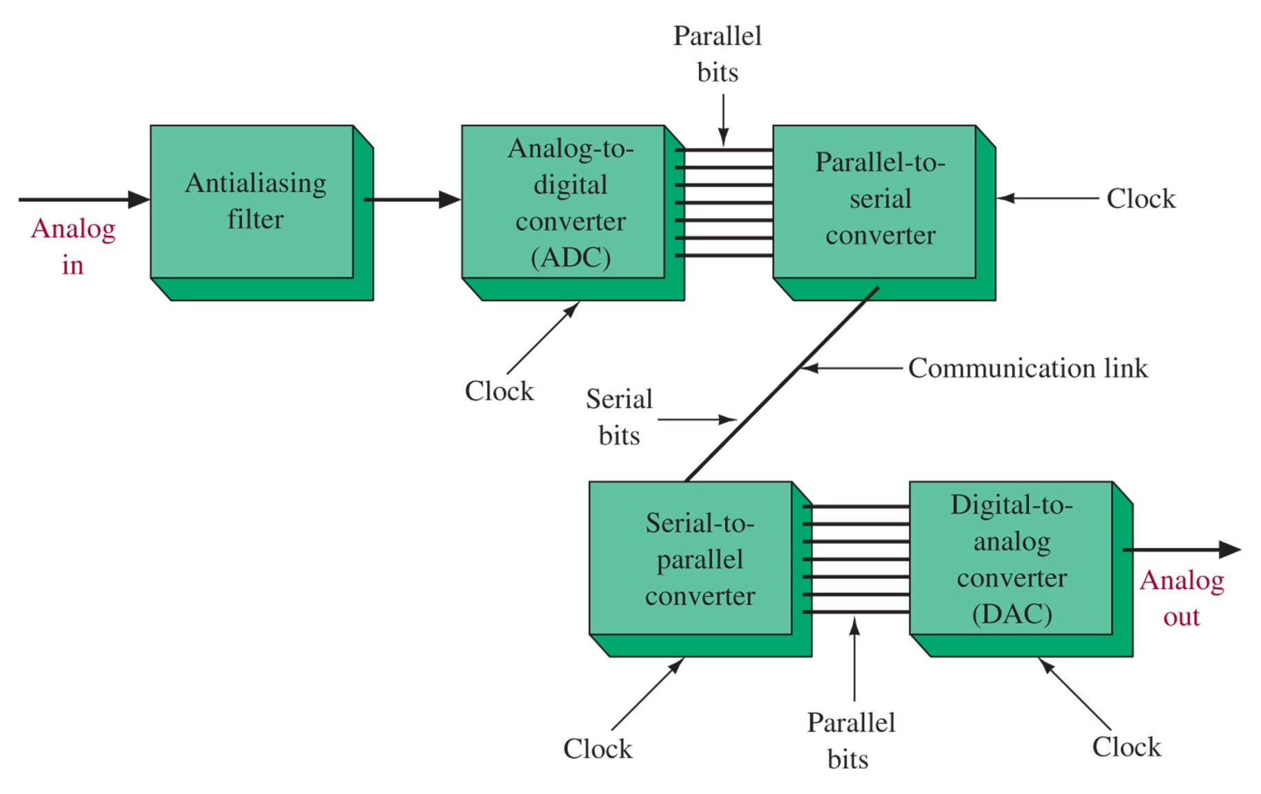
Figure 8-20 PCM communication system.
ADC on transmitter side
DAC on receiver side

Slide 24
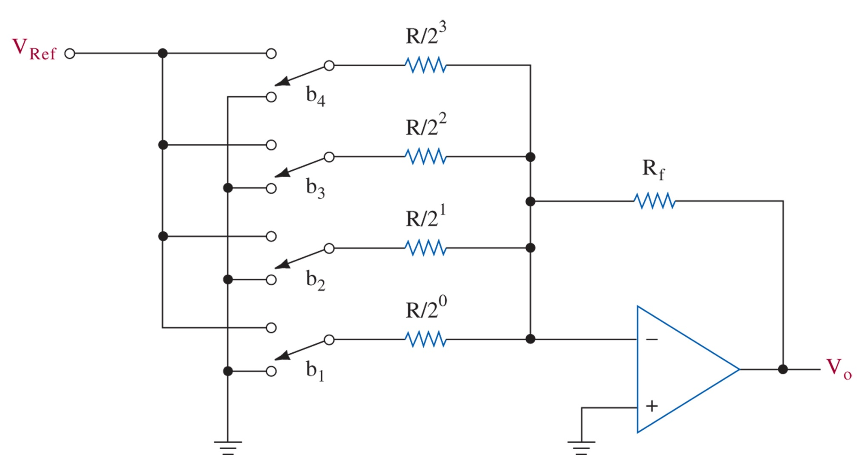
Figure 8-22 Binary-weighted resistor DAC.

Slide 25
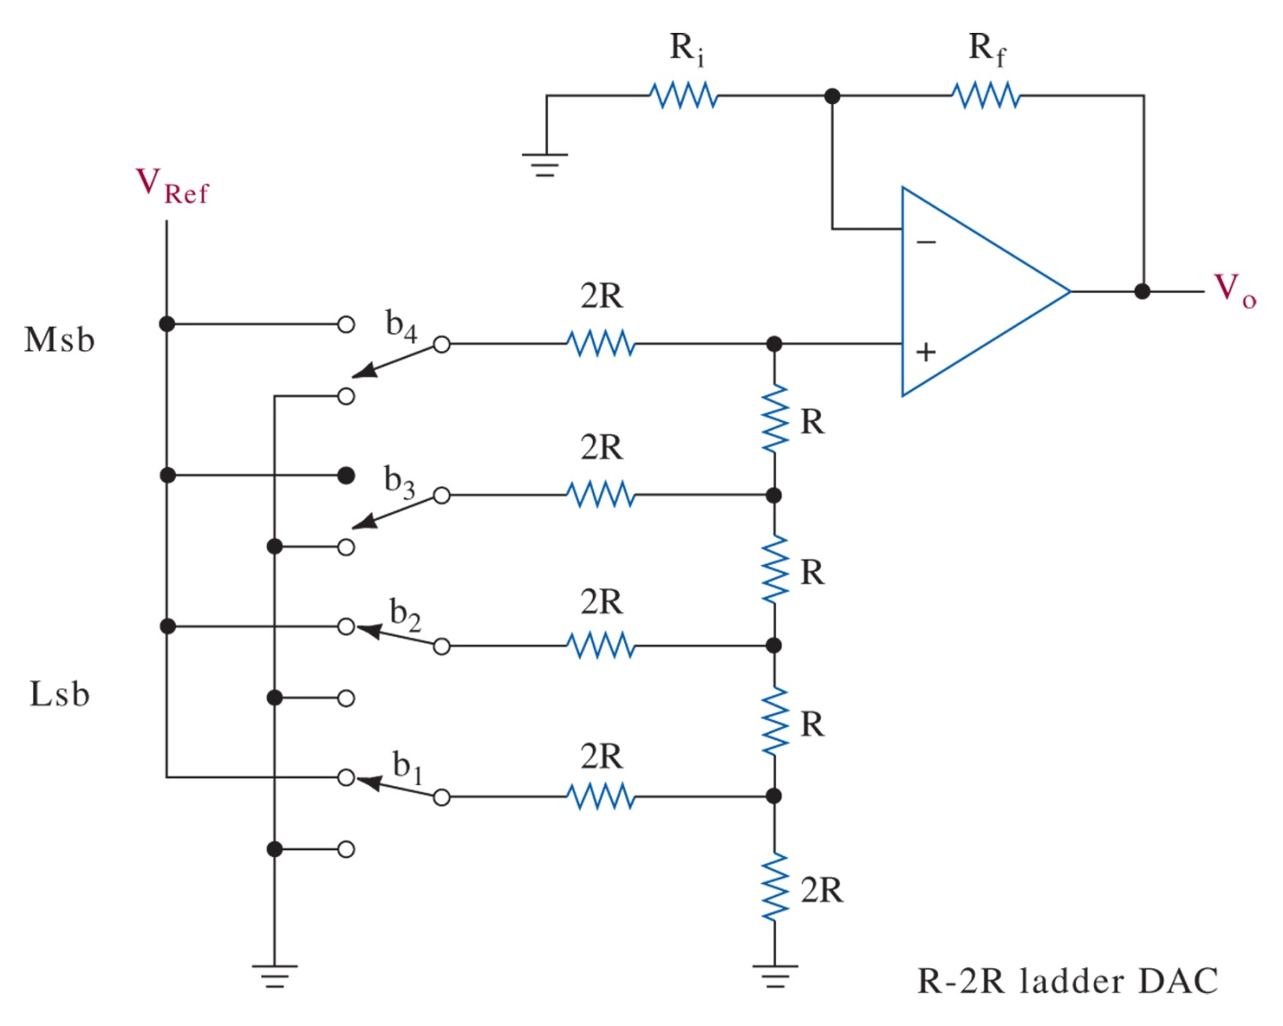
Figure 8-23 R-2R ladder DAC.

Slide 26
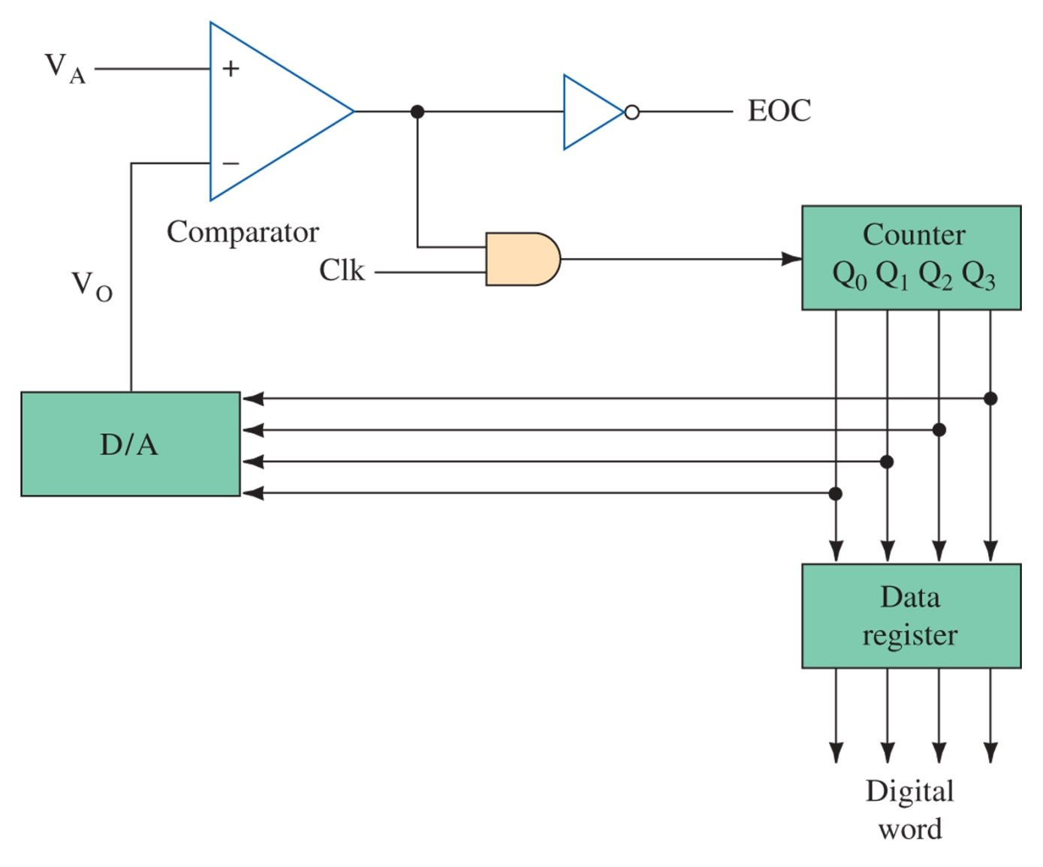
ADC
Figure 8-24 4-bit ramp analog-to-digital converter.

Slide 27
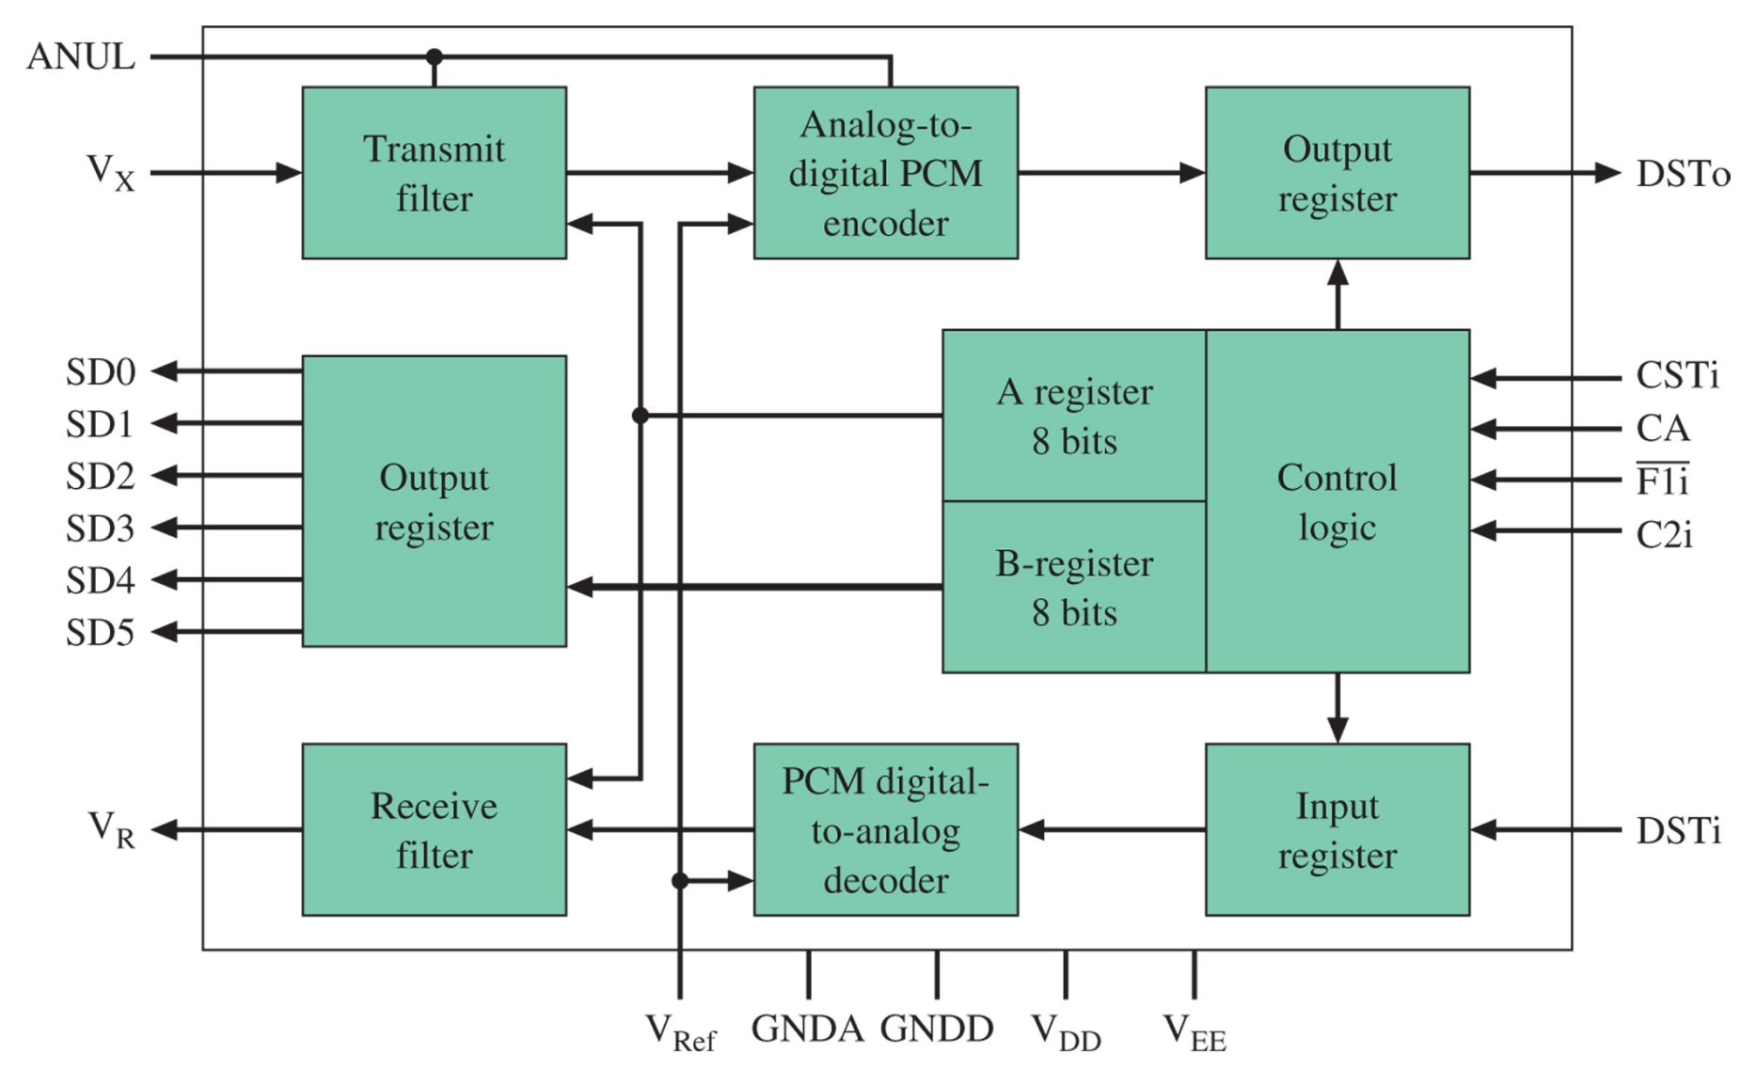
Figure 8-25 Codec block diagram.

Slide 28
8-4 Digital Signal Encoding Formats
Transmission of binary (+5V-hi, 0.0V-low) typically used only for short runs
Data bits are generally encoded in various formats to improve transmission:
NRZ – nonreturn-to-zero
RZ – return-to-zero
Phase-encoded and delay modulation
Multilevel binary

Slide 29
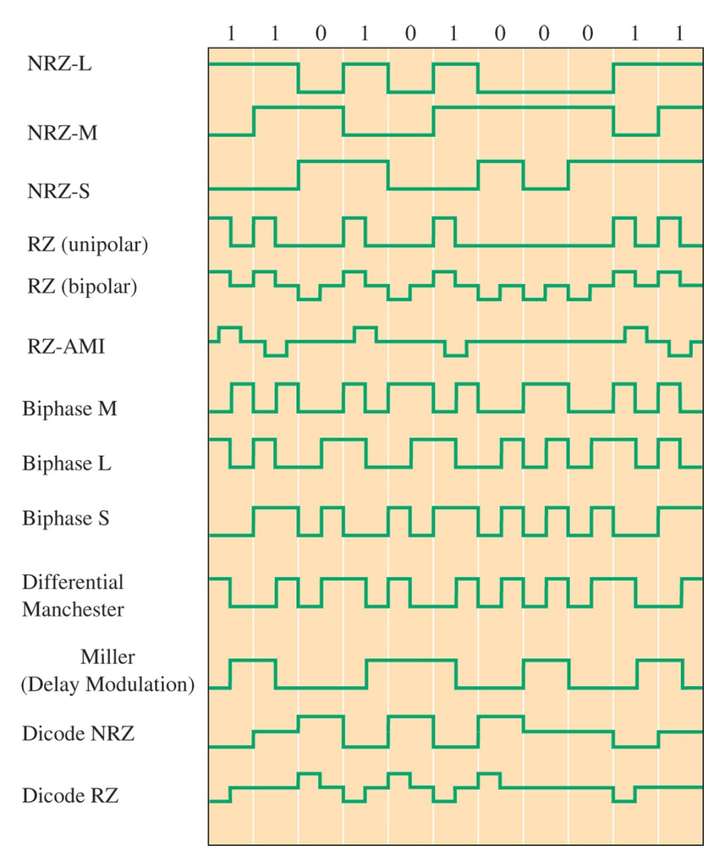
Figure 8-26 Digital signal encoding formats.
Can develop DC
Reduces DC
Provide self-clocking
Multilevel binary

Slide 30
8-5 Coding Principles
How can we detect and correct for errors in the data?
Digital data is naturally error-resistant, but bit changes can occur
We need to detect bit-flips (o to 1, or 1 to 0)

Slide 31
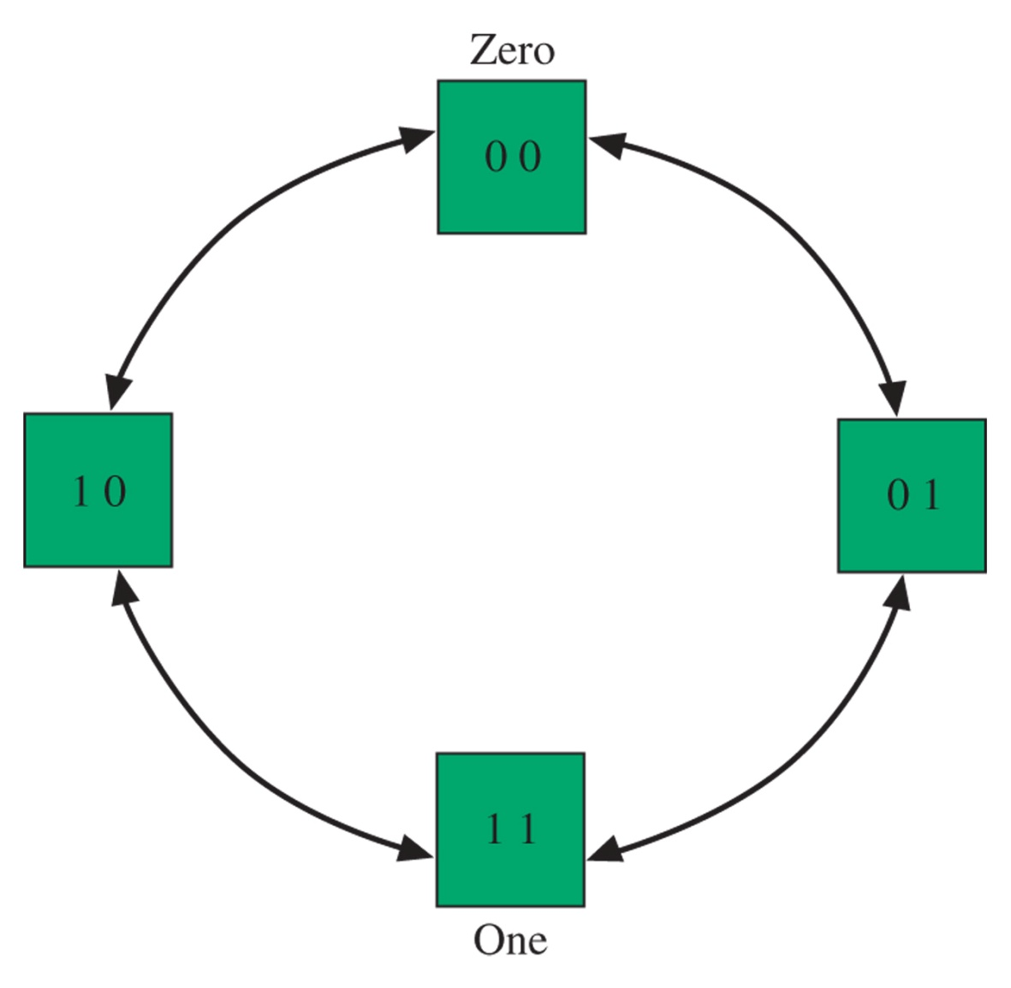
Hamming distance
Increasing the “logical” distance between states provides error-detection
With Dmin = 2, we still cannot correct the error
Figure 8-27 Coding for a zero (00) and a one (11) for a minimum distance, D_{min}, of 2.

Slide 32
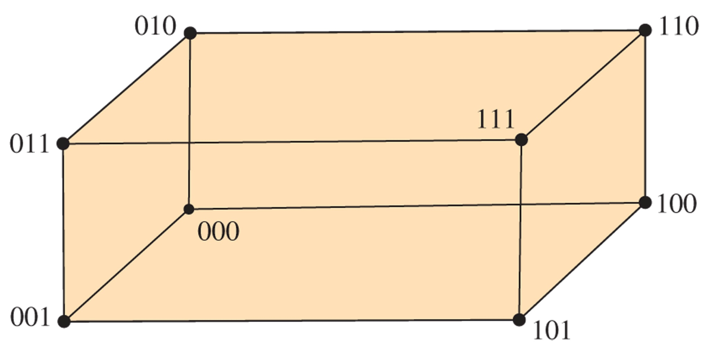
Error Correction
Figure 8-28 A code message for a zero (000) and a one (111) with a minimum distance, D_{min}, of 3.
When Dmin = 3, we can actually correct a 1 bit flip. 011 could be assumed to be a 1.

Slide 33
8-6 Code Error Detection and Correction
Parity
Block Check Character
Cyclic Redundancy Check
CRC Code-Dividing Circuit
Reed-Solomon Codes

Slide 34
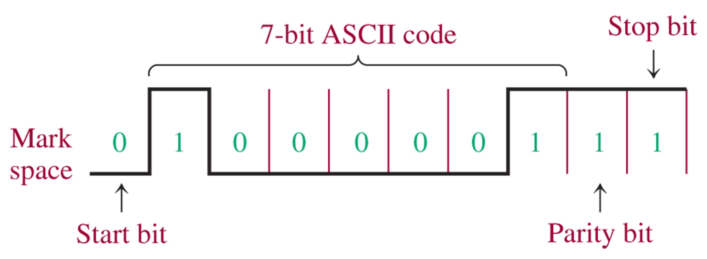
Parity
Figure 8-29 ASCII code for A with odd parity. Note that lsb b₁ is the first bit of the digital word transmitted.

Slide 35
Figure 8-30 Serial parity generator and/or checker.
XOR function
Apply the sequential bits to each XOR input, output is 1 if odd # of 1’s, 0 if even # of 1’s. (Add an inverter for odd parity)

Slide 36
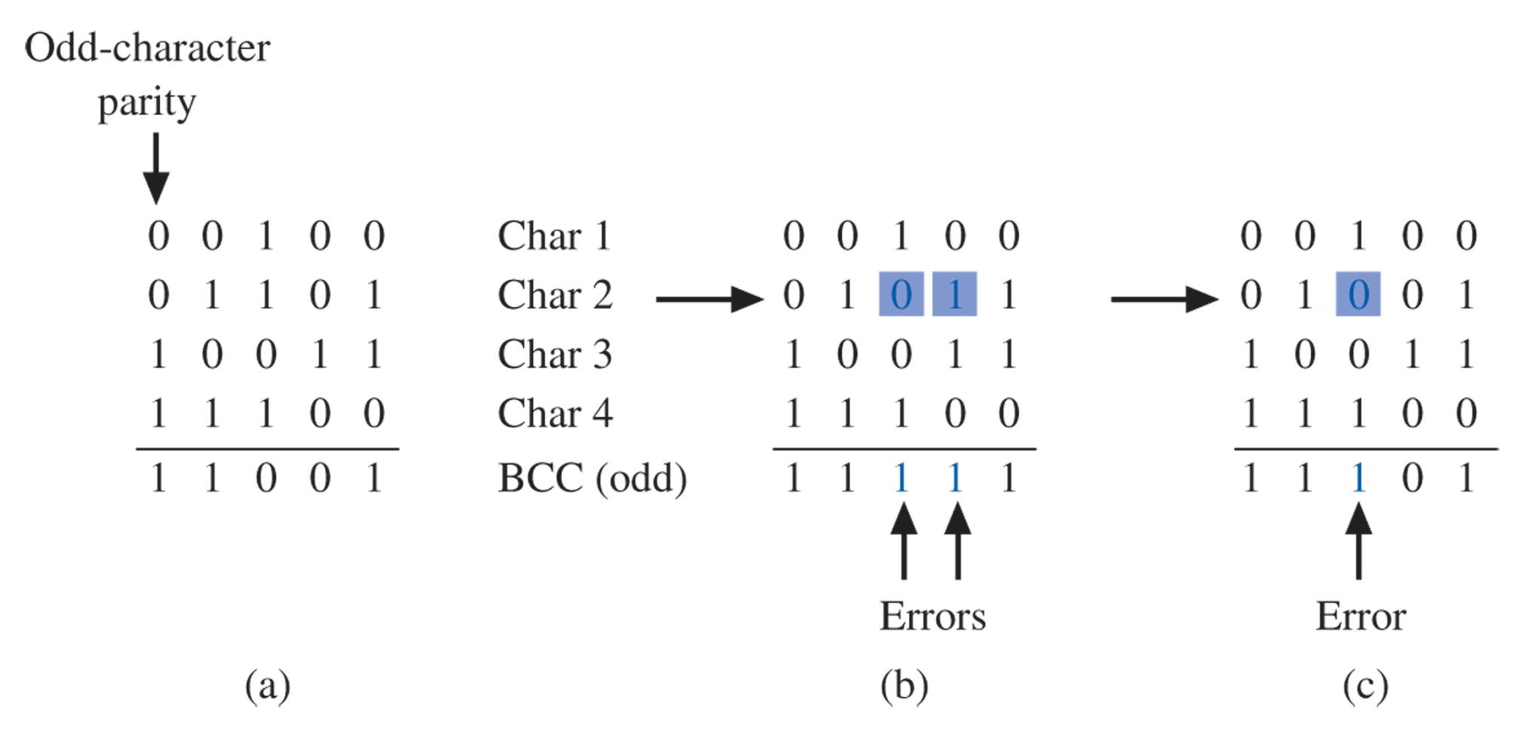
Figure 8-31 LRC error detection.

Slide 37
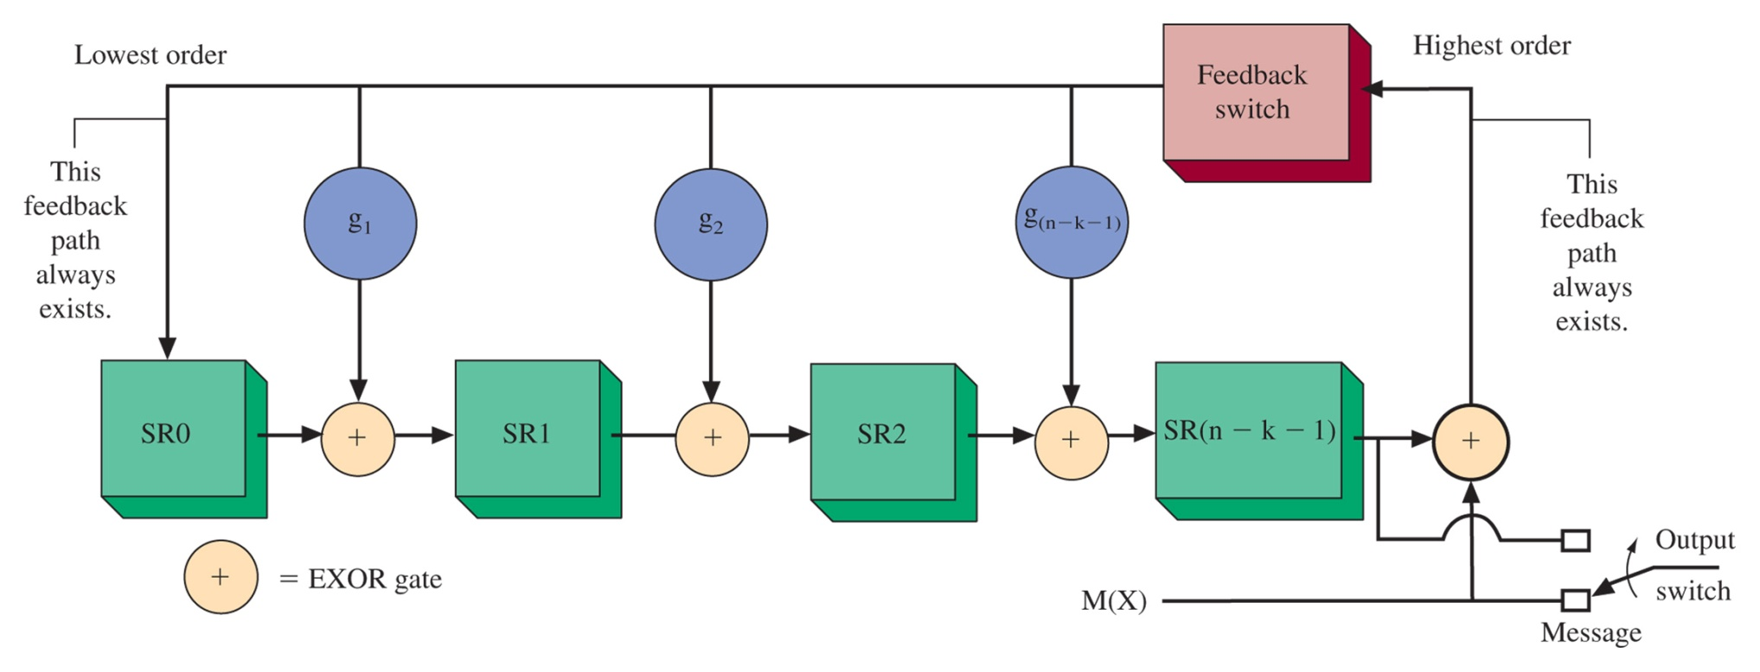
Figure 8-32 CRC code generator for an (n, k) cyclic code.

Slide 38
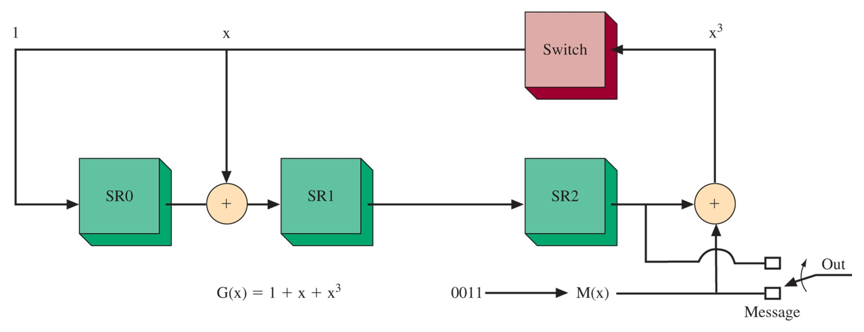
Figure 8-33 CRC code generator for a (7, 4) cyclic code using a generator polynomial G(x) = x³ + x + 1.

Slide 39
Figure 8-34 A CRC divide circuit for the general form of G(x) = g₀ + g₁x + g₂x² + ··· + g_{r}x^{r}.

Slide 40
Figure 8-35 A CRC divide circuit for G(x) = 1 + x + x³.

Slide 41
8-7 Digital Signal Processing

Slide 42
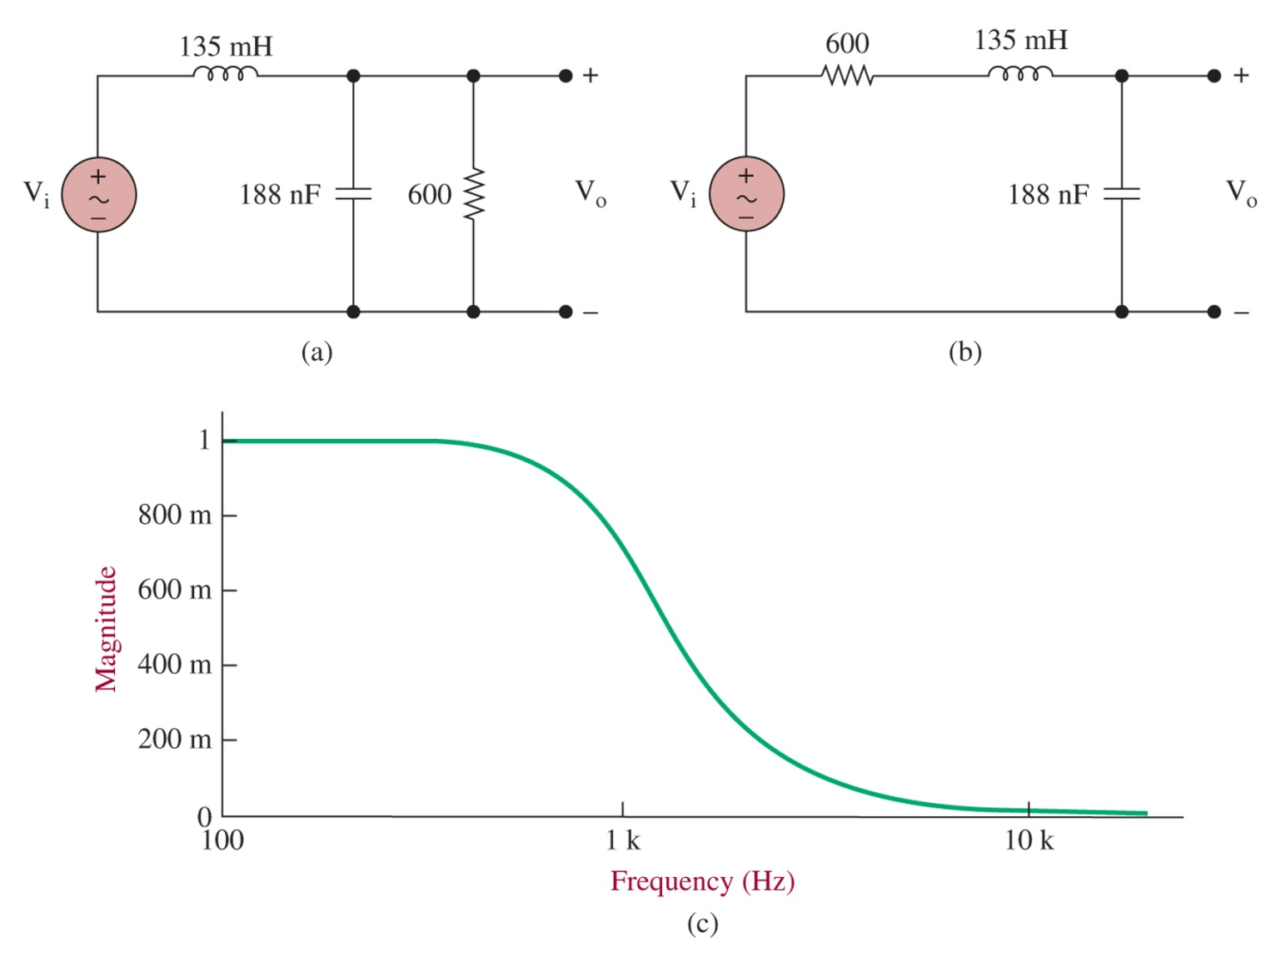
Figure 8-36 (a), (b) Passive implementations for a second-order low-pass Butterworth filter and (c) a plot of the frequency response.

Slide 43
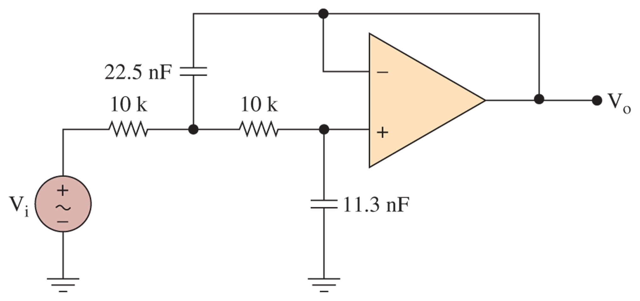
Figure 8-37 A second-order low-pass Butterworth active filter.

Slide 44
Figure 8-38 The block diagram for a digital signal processing circuit.

Slide 45
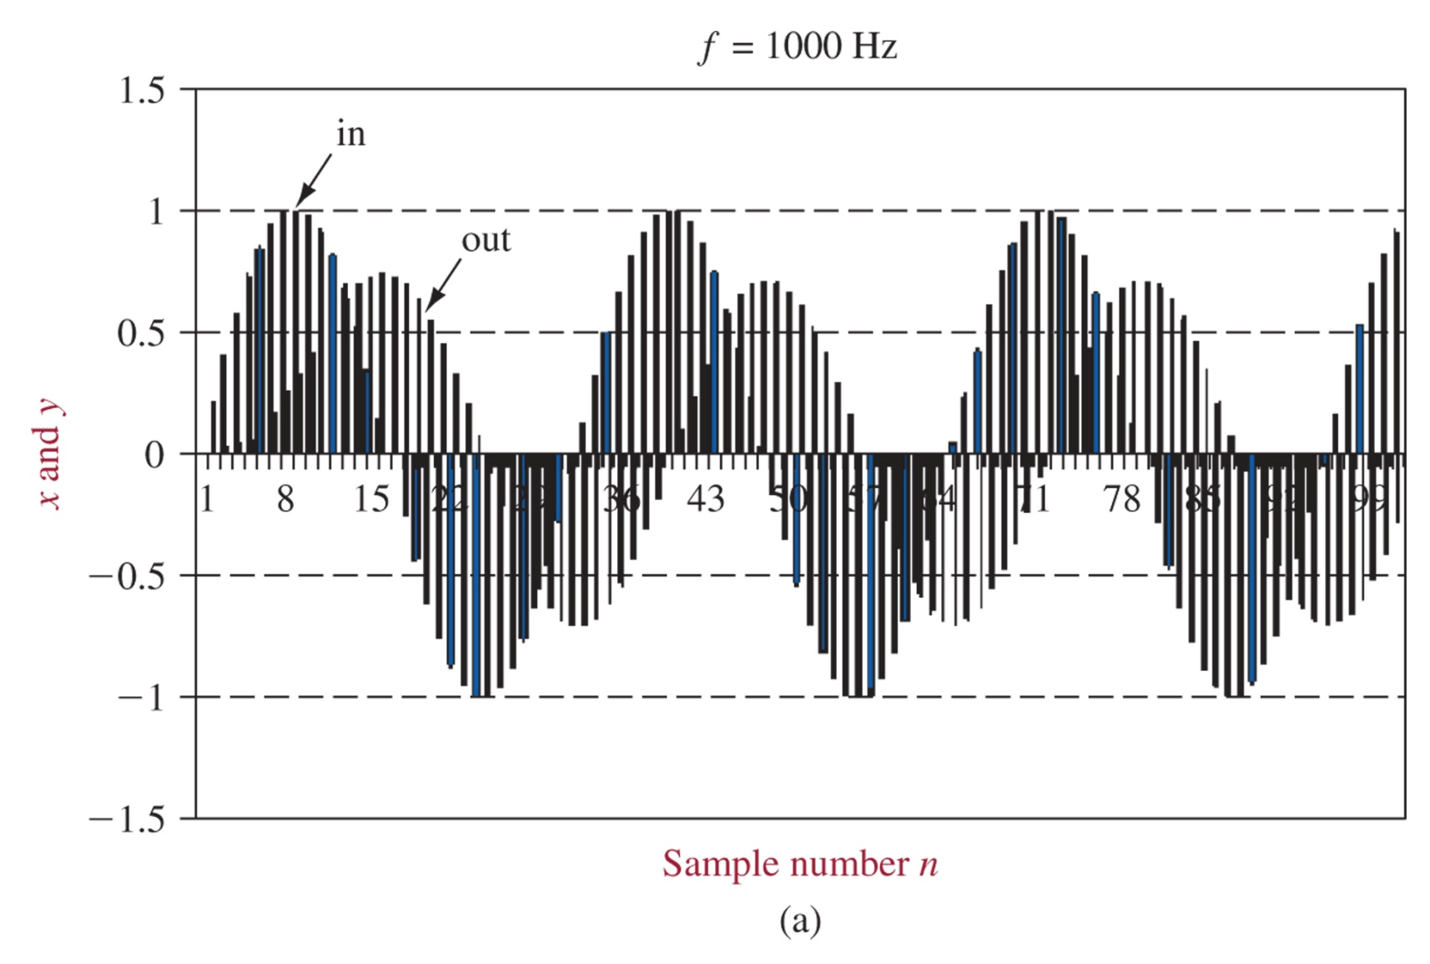
Figure 8-39 Input and output sequences for a second-order Iow-pass Butterworth filter at 3 frequencies: (a) 1000, (b) 2000 Hz, and (c) 500.

Slide 46
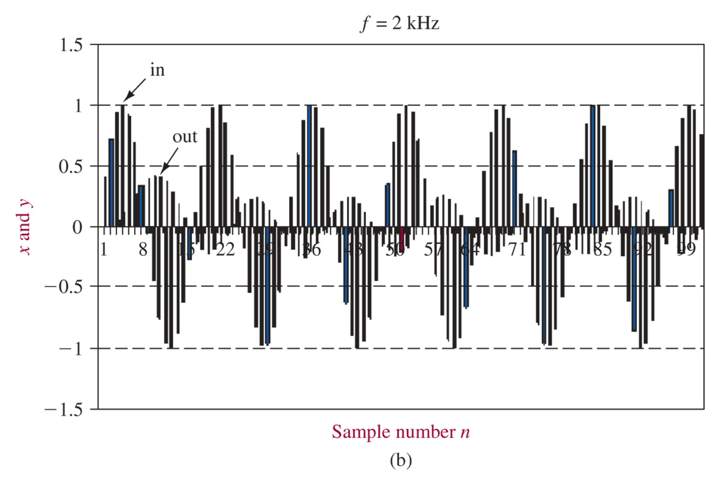
Figure 8-39 (continued) Input and output sequences for a second-order Iow-pass Butterworth filter at 3 frequencies: (a) 1000, (b) 2000 Hz, and (c) 500.

Slide 47
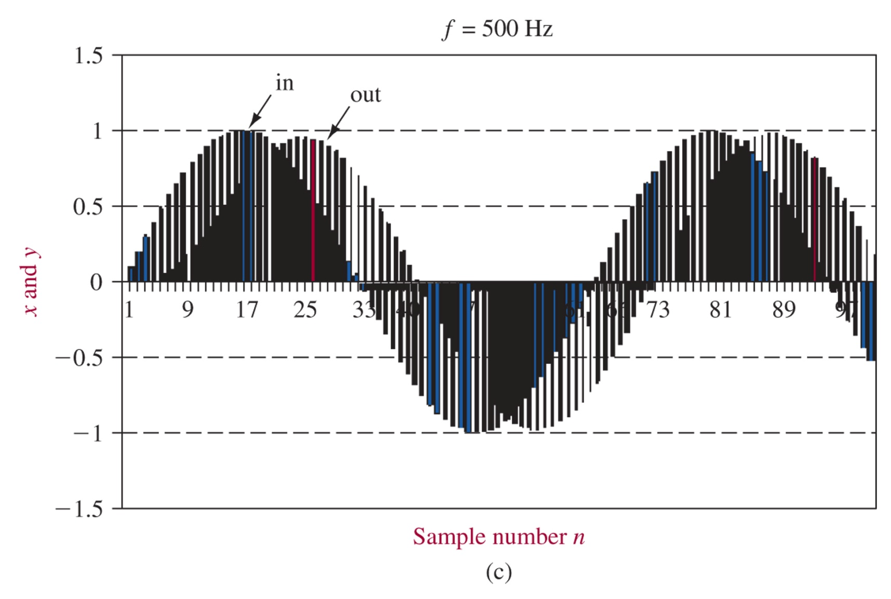
Figure 8-39 (continued) Input and output sequences for a second-order Iow-pass Butterworth filter at 3 frequencies: (a) 1000, (b) 2000 Hz, and (c) 500.

Slide 48
8-8 Troubleshooting

Slide 49
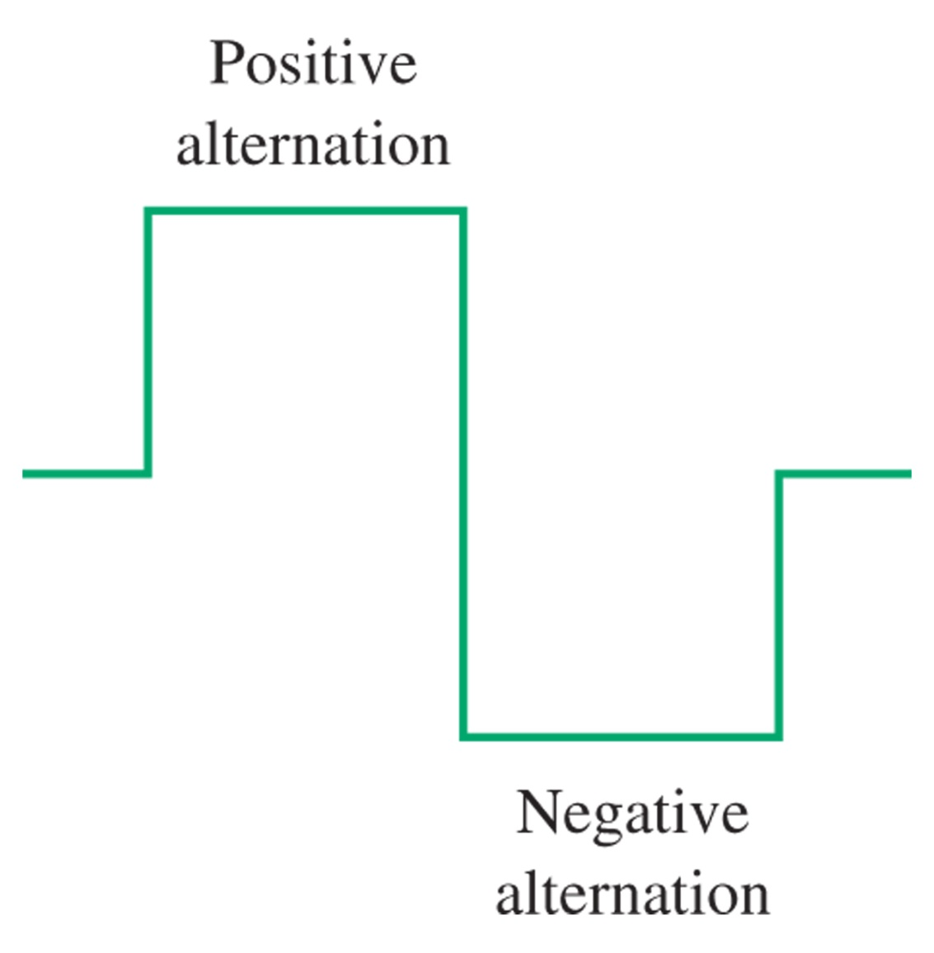
Figure 8-40 Ideal square wave with 50 percent duty cycle.

Slide 50
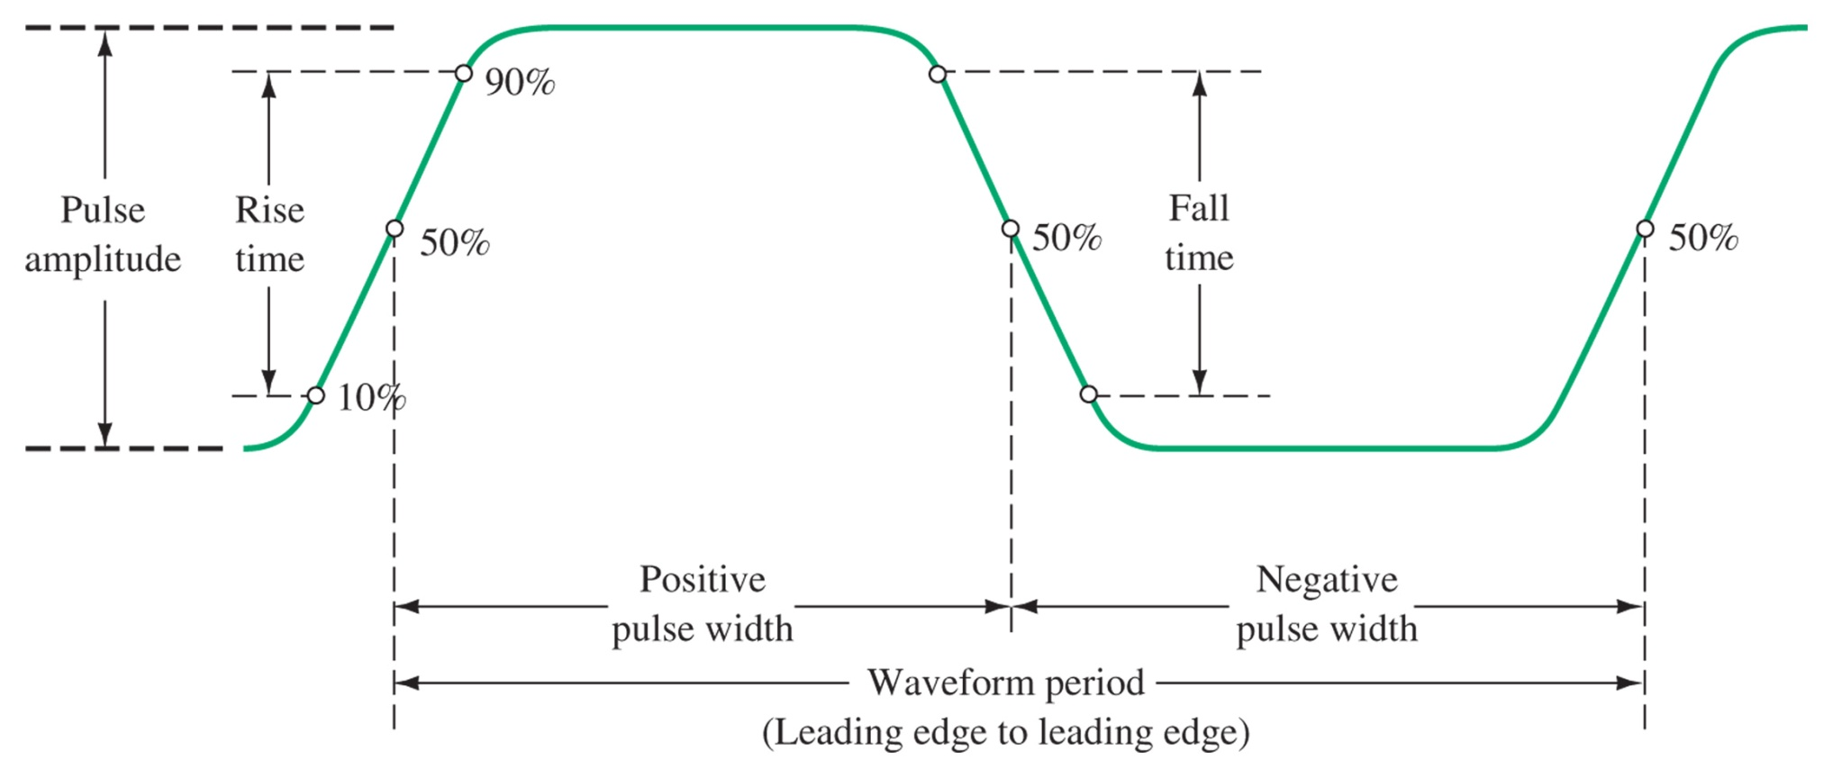
Figure 8-41 Illustration of noise on a pulse.

Slide 51
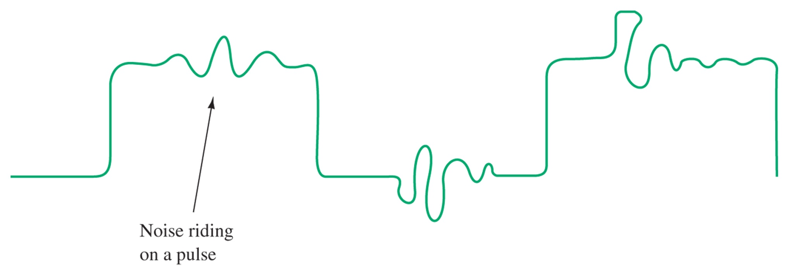
Figure 8-42 Nonideal square wave.

Slide 52
Figure 8-43 Effects of impedance mismatches: (a) impedance is too low; (b) impedance is too high (ringing); (c) impedance is matched.

Slide 53
Figure 8-44 Effects of frequency on data pulses: (a) good pulses; (b) low- frequency attenuation; (c) high-frequency attenuation.

Slide 54
8-9 Troubleshooting w/ Multisim

Slide 55
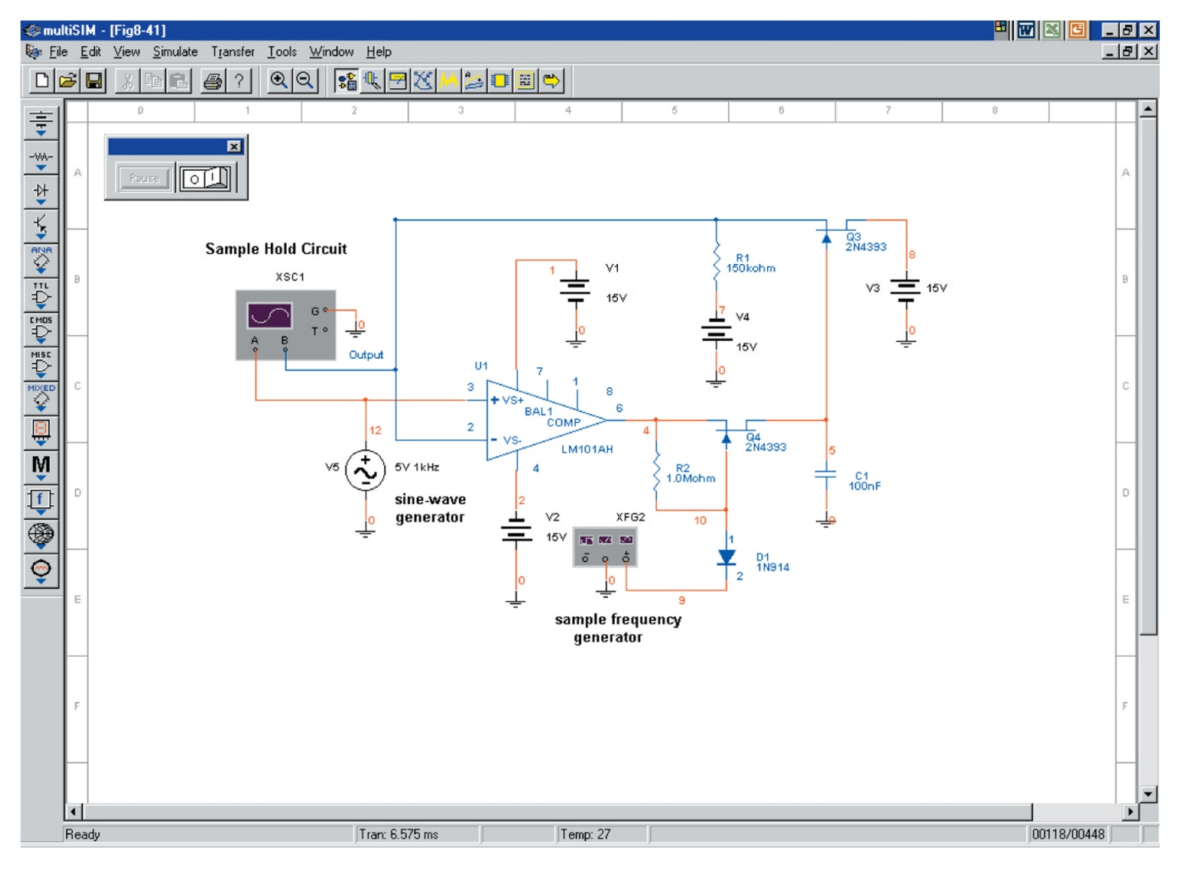
Figure 8-45 A sample-and-hold circuit as implemented in Electronics WorkbenchTM Multisim.

Slide 56
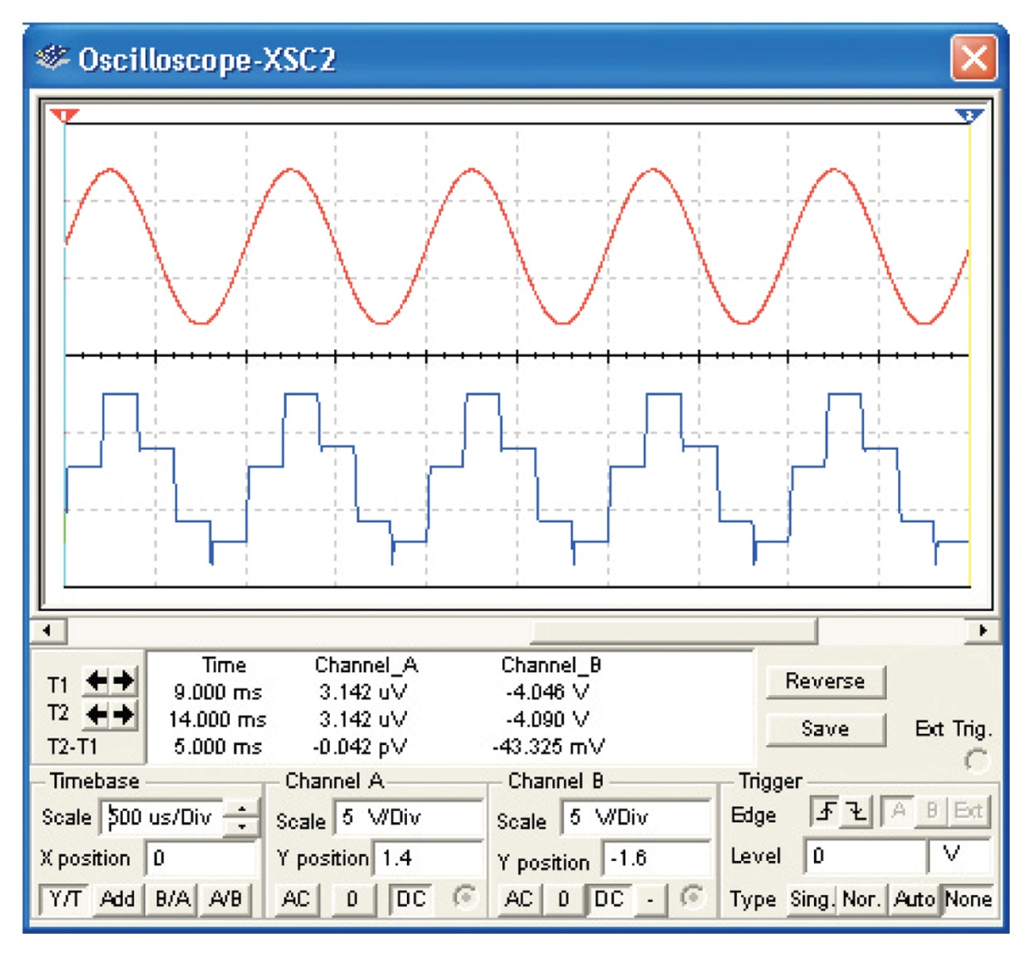
Figure 8-46 The oscilloscope traces for the sample-and-hold circuit.

Slide 57
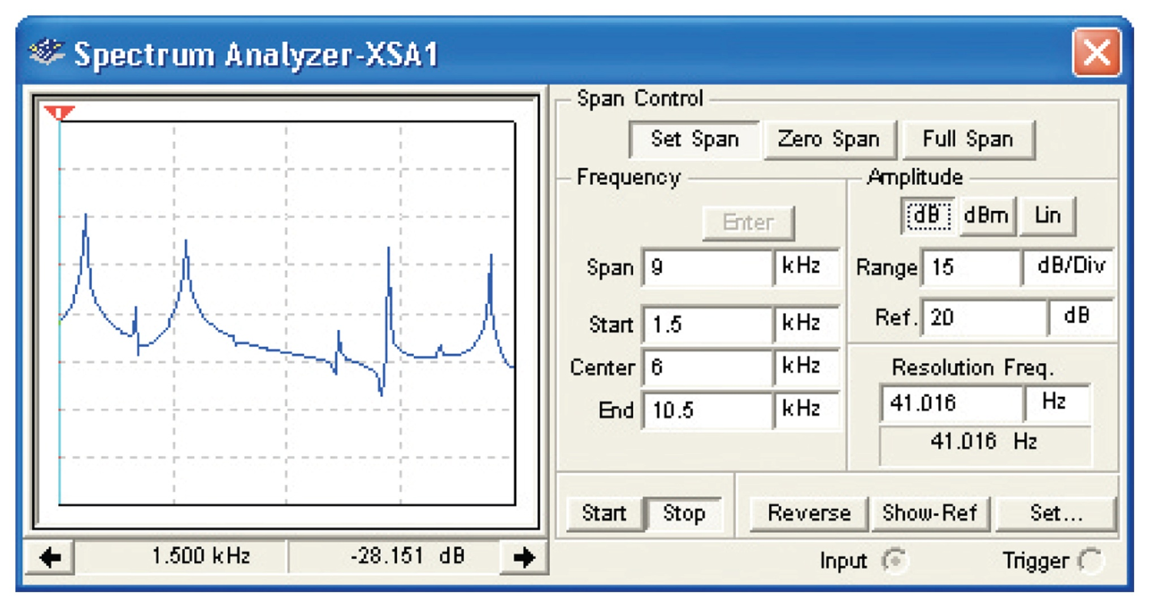
Figure 8-47 The spectrum of a signal that contains aliased frequencies due to improper selection of the sampling frequency.

