Slide 1
EE 350 / ECE 490
Analog Communication Systems
Ch. 13 – Wave Propagation

Slide 2
Objectives
Discuss the makeup of an electromagnetic wave and the characteristics of an isotropic point source
Explain the processes of wave reflection, refraction, and diffraction
Describe ground- and space-wave propagation and calculate the ghosting effect in TV reception
Calculate the approximate radio horizon based on antenna height
Discuss the effects of the ionosphere on sky-wave propagation
Describe the important aspects of satellite communication
Define the importance of figure of merit and link budget analysis

Slide 3
13-1 Electrical to Electromagnetic Conversion
Transducers convert energy between forms
To send signals through the air, Electricity is converted into Electromagnetic energy by the antenna
Light and RF are both EM waves, only the frequency is different
You can compare a radio wave emitted or detected by an antenna to a photon emitted by an LED and detected by a photodiode

Slide 4
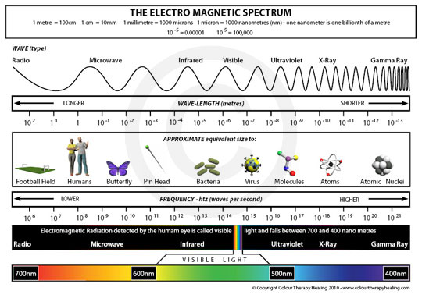

Slide 5
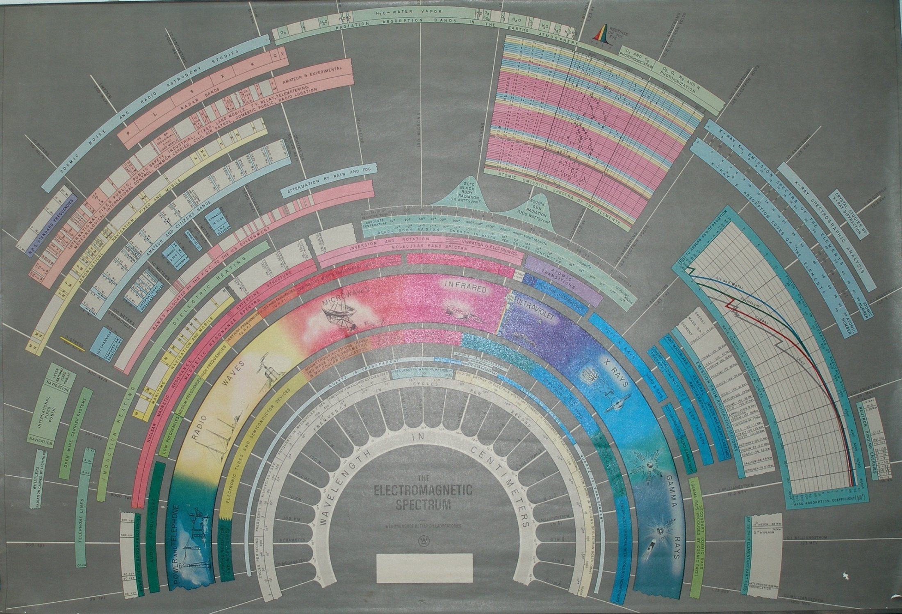

Slide 6
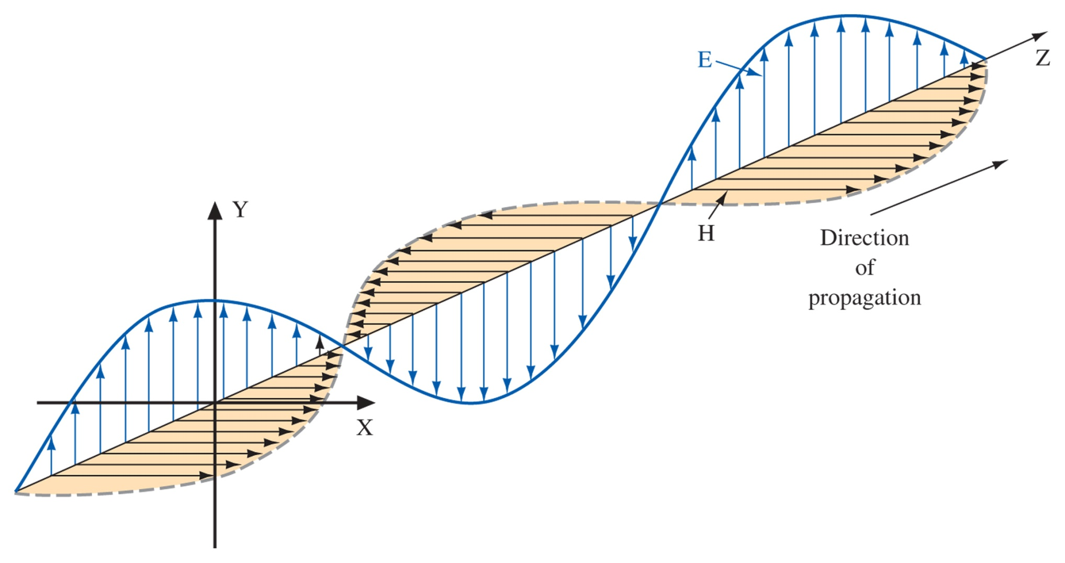
13-2 Electromagnetic Waves
Electric currents excite magnetic fields.
This energy can be radiated out as an electromagnetic wave, a transverse wave where electric and magnetic fields are perpendicular to each other.
The direction of propagation is perpendicular to both.
The polarization is in the direction of the E field
Figure 13-1 Electromagnetic wave.

Slide 7
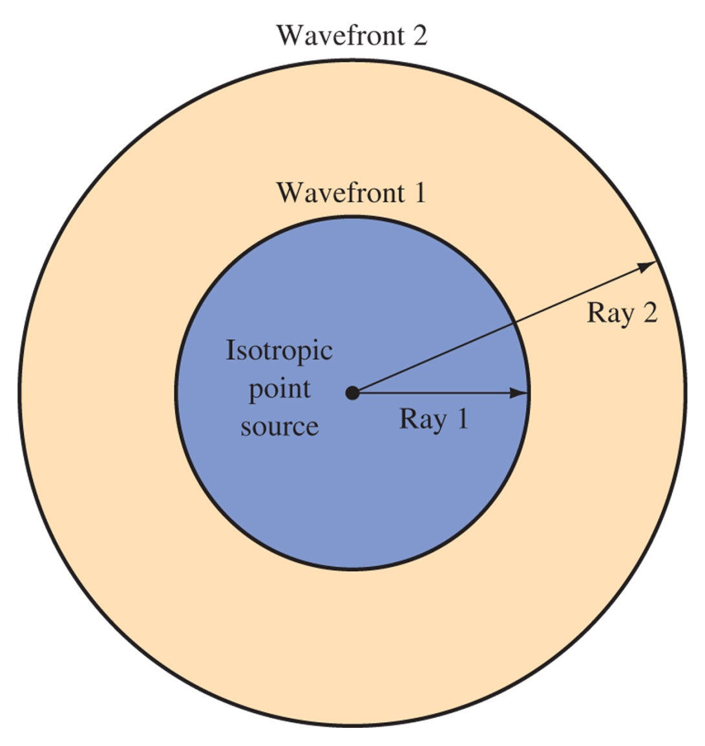
Wavefronts
Power at wavefront
Electric Field
Power relates to characteristic impedance, like Ohm’s Law
Spherical wavefronts from isotropic point source

Slide 8
13-3 Waves Not in Free Space
Electromagnetic waves obey all the laws of optics.
Radio waves are really no different than light, except that the frequency is much lower, and the wavelength much longer.

Slide 9
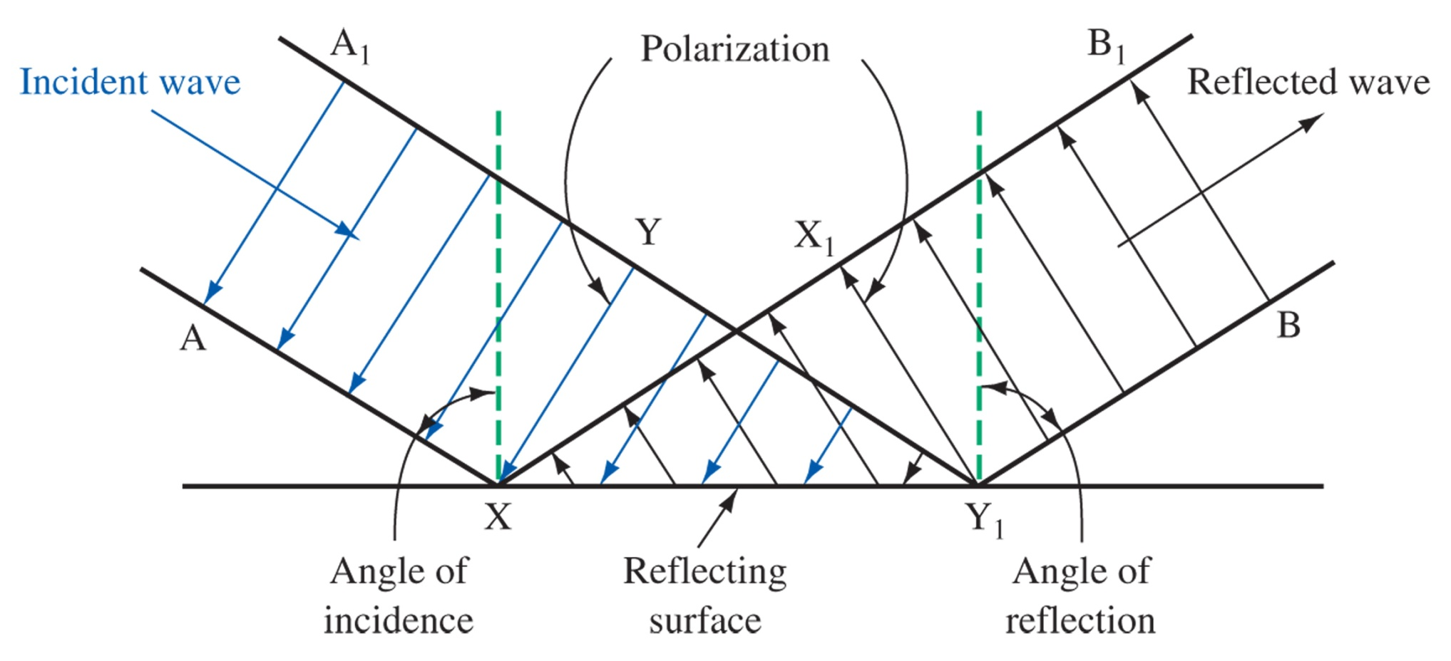
Reflection
Figure 13-3 Reflection of a wavefront.

Slide 10
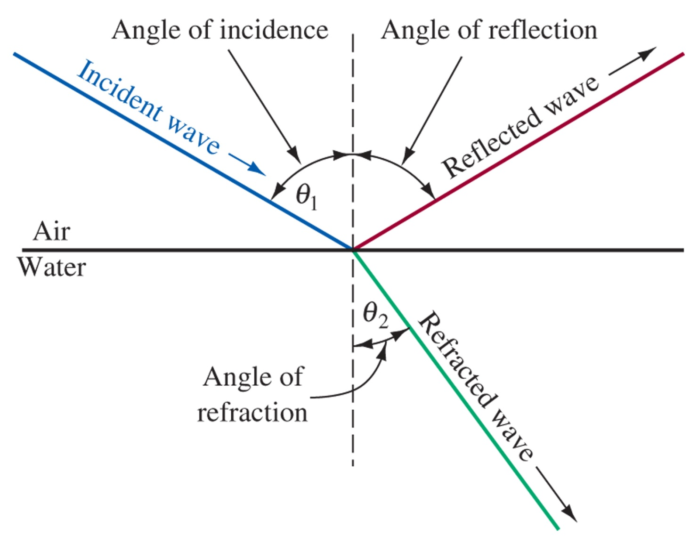
Refraction
Snell’s Law
Material | Index of Refraction (n)
Vacuum / Air | 1
Glass | 1.5
Water | 1.33
Diamond | 2.4
Silicon | 4
Figure 13-4 Wave refraction and reflection.

Slide 11
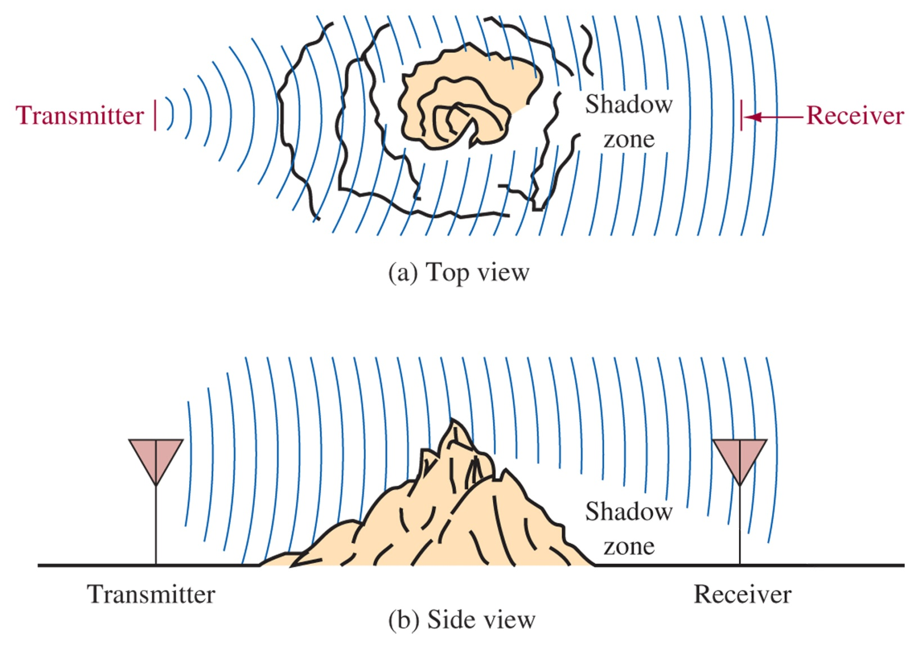
Diffraction
Figure 13-5 Diffraction around an object.

Slide 12
13-4 Ground- and Space-Wave Propagation
Ground Wave
Space Wave
Sky Wave
Satellite Communications
Frequency of the radio wave is the most important aspect when comparing the different types of propagation

Slide 13
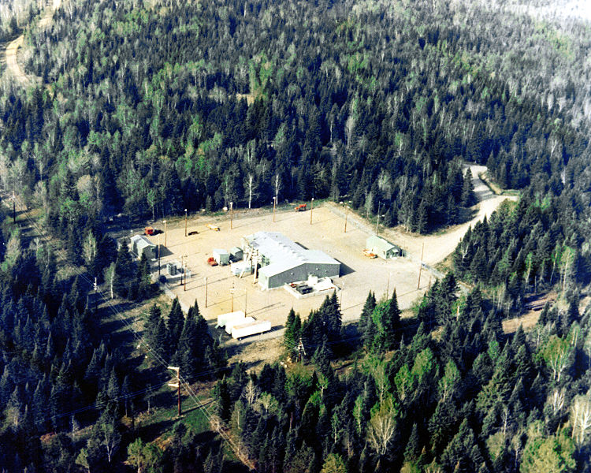
Ground Wave propagation
A vertically polarized EM wave propagates along the Earth’s surface
Effective over conductive surfaces (like seawater)
Only good to 2MHz, but are very reliable
ELF (30-3000 Hz) is used to communicate with submerged submarines. One transmitter can be “felt” all over the globe.
Clam Lake, WI: Project ELF (Seafarer), broadcast at 76 Hz using 30+ mile antenna. Requires it’s own power plant to drive.

Slide 14
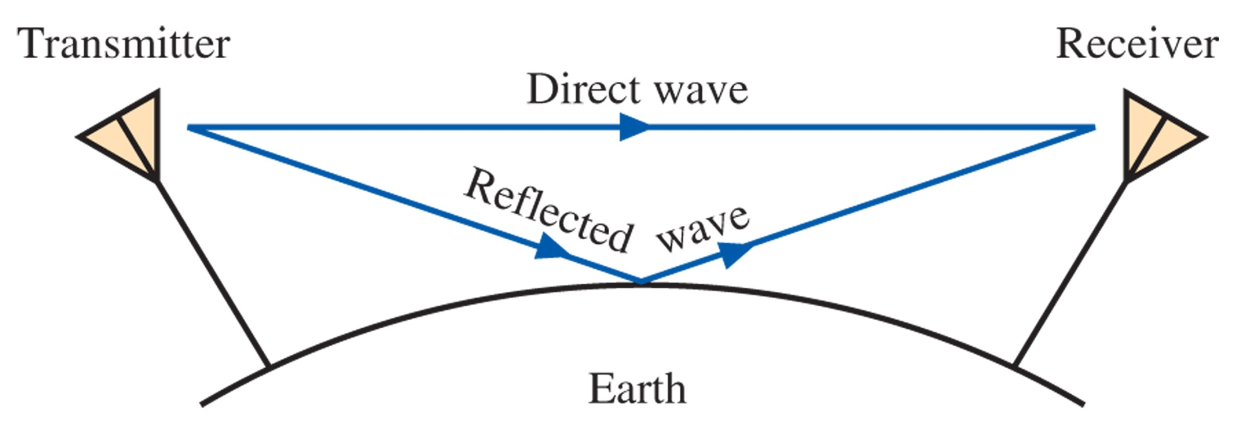
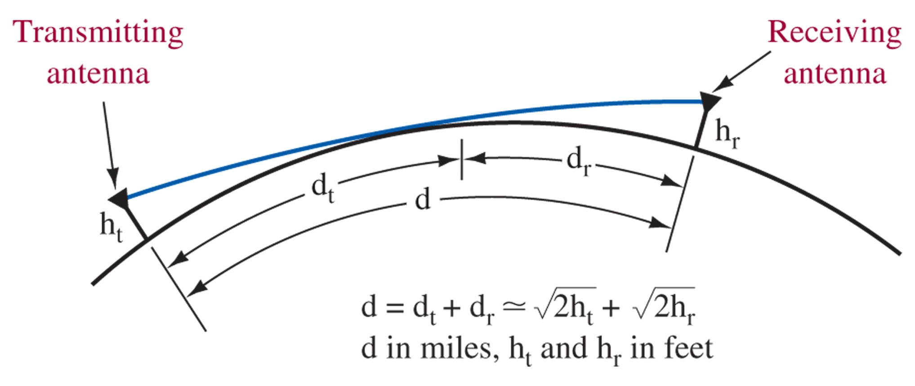
Direct Wave transmission
Figure 13-6 Direct and ground reflected space waves.
Roughly 50 mi range
Figure 13-7 Radio horizon for direct space waves.

Slide 15
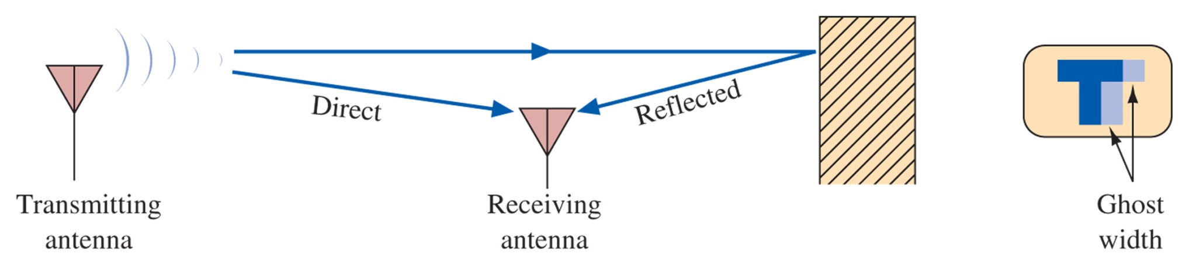
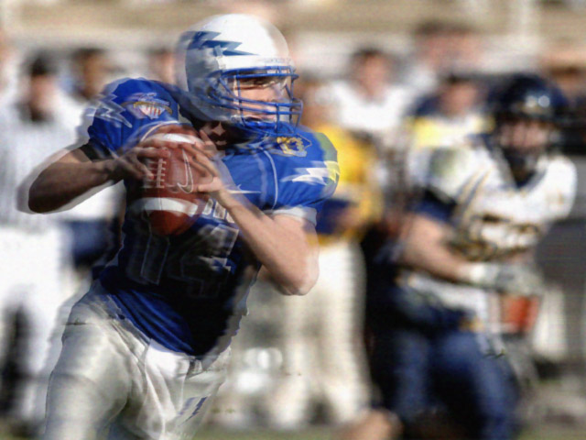
Ghosting
Figure 13-8 Ghost interference.
AM transmitted TV video signals can interfere with each other, creating a “double” or “ghost” image when the signal reflects off of the ground or another object

Slide 16
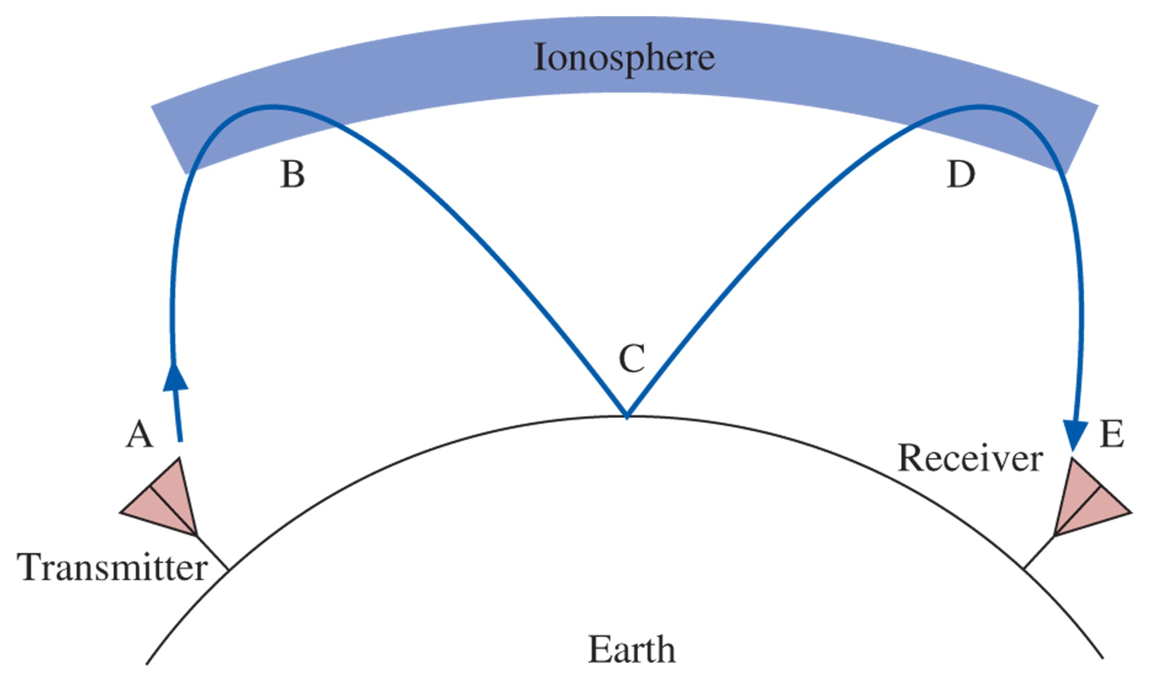
13-5 Sky-Wave Propagation
Figure 13-9 Sky-wave propagation.
The Sky has three zones: the Troposphere (0 - 6.5 mi), Stratosphere (6.5 – 23 mi), and Ionosphere (23 – 250 mi).
Radio waves can be “bounced” between the ionosphere and the ground to achieve long distance communications

Slide 17
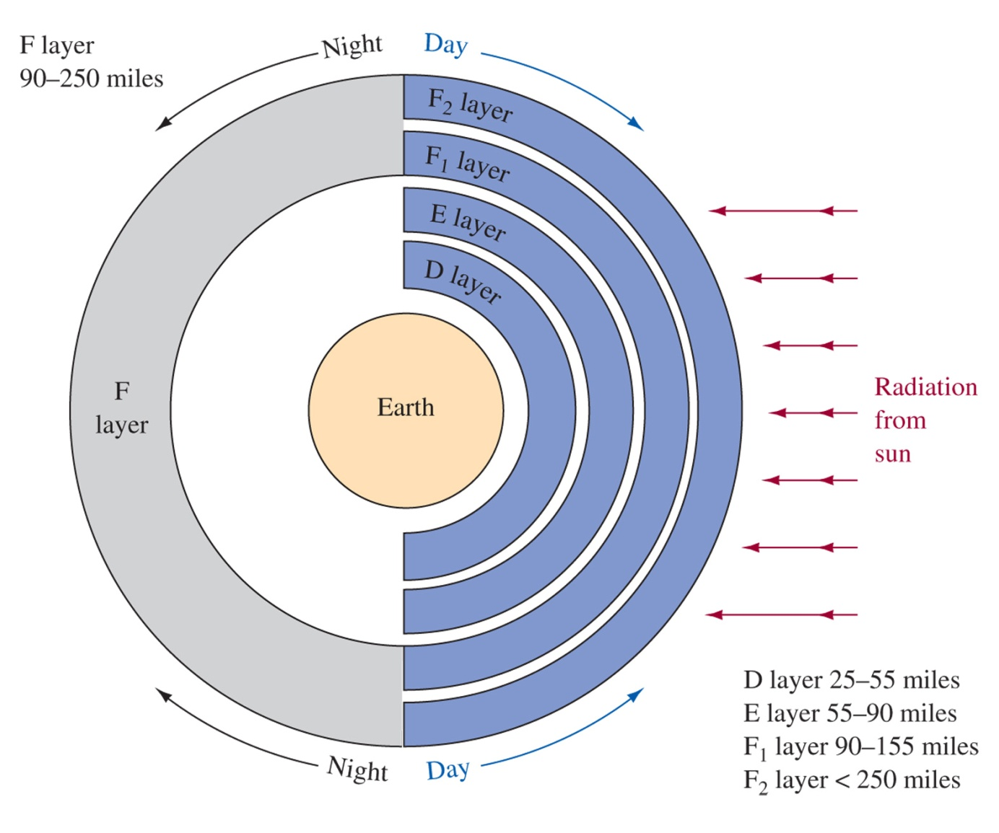
Layers of the Ionosphere
Low frequencies
f<20 MHz
f<30 MHz
Figure 13-10 Layers of the ionosphere.

Slide 18
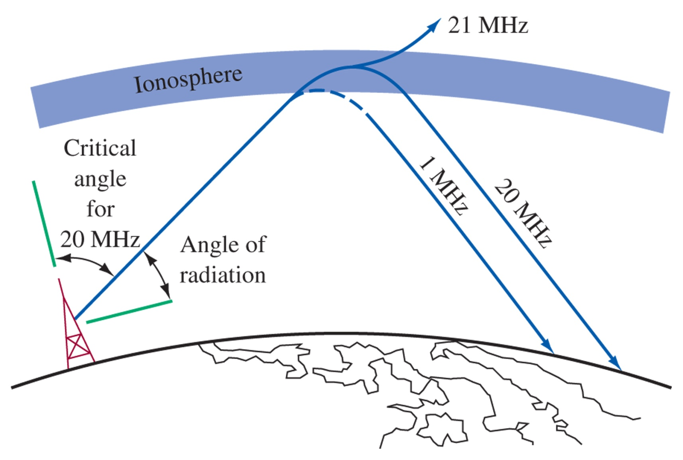
Critical Frequency and Angle
Figure 13-11 Relationship of frequency to refraction by the ionosphere.

Slide 19
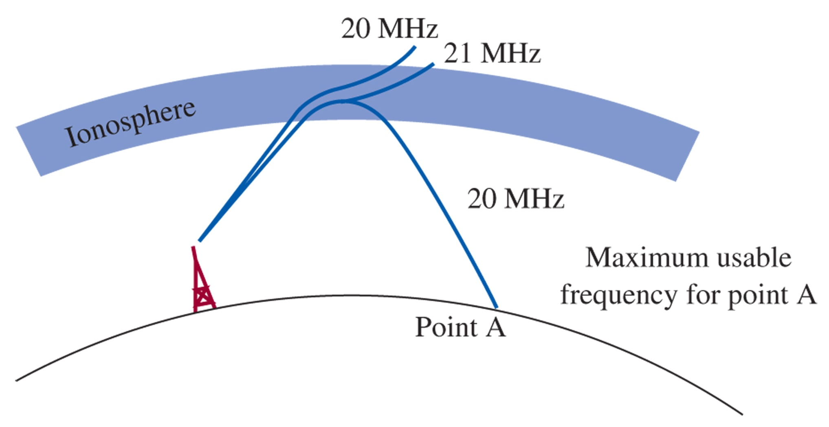
Maximum Usable Frequency
Figure 13-12 Relationship of frequency to critical angle.
See www.hfradio.org for current charts of MUF, FOT.
Based on data updated hourly regarding sunspot activity, geomagnetic information, weather patterns, etc.

Slide 20
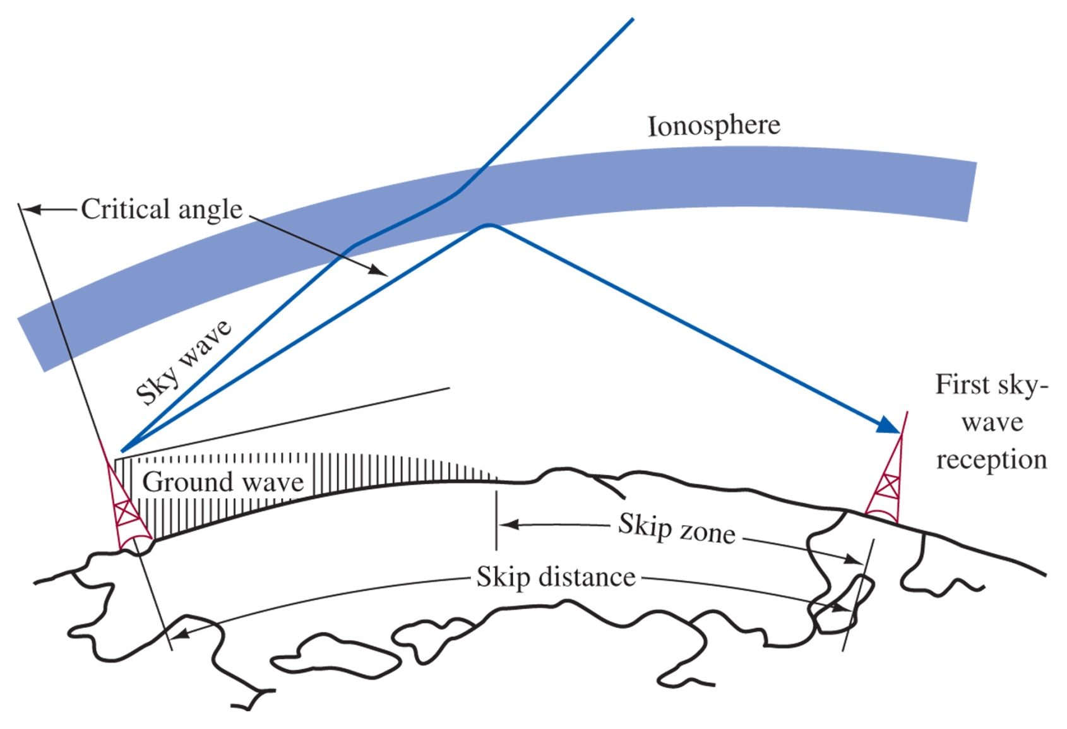
Skip Zone
Figure 13-13 Skip zone.
Between the end of the ground wave and the reception of the first sky-wave, is a quiet zone called the skip zone. The minimum occurs at the critical angle for the frequency broadcast.

Slide 21
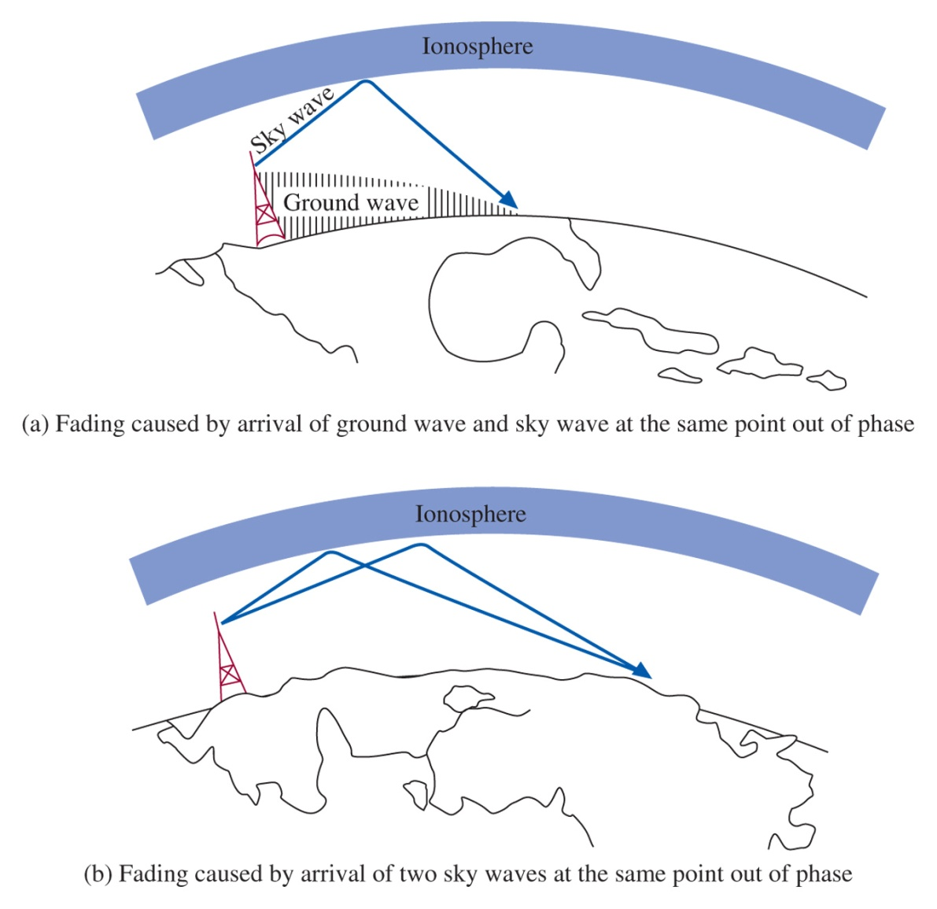
Fading
Figure 13-14 Fading.

Slide 22
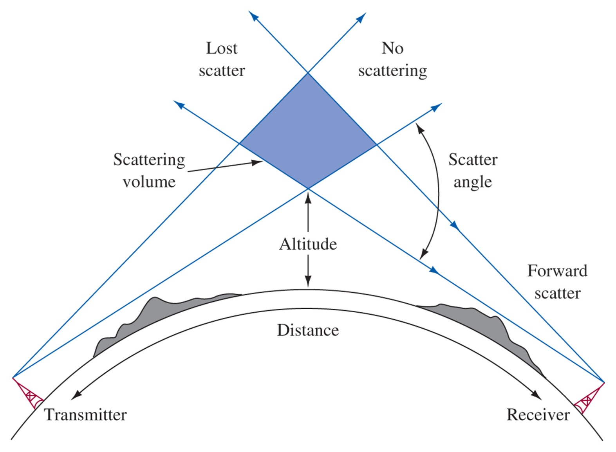
Tropospheric Scatter
Figure 13-15 Tropospheric scatter.
350 MHz to 10 GHz can attain distances up to 400 mi

Slide 23
13-6 Satellite Communications
Orbital Patterns
Azimuth and Elevation Calculations
GPS
Multiplexing Techniques
Earth Station Distance To and from the Satellite
VSAT and MSAT
Satellite Radio

Slide 24
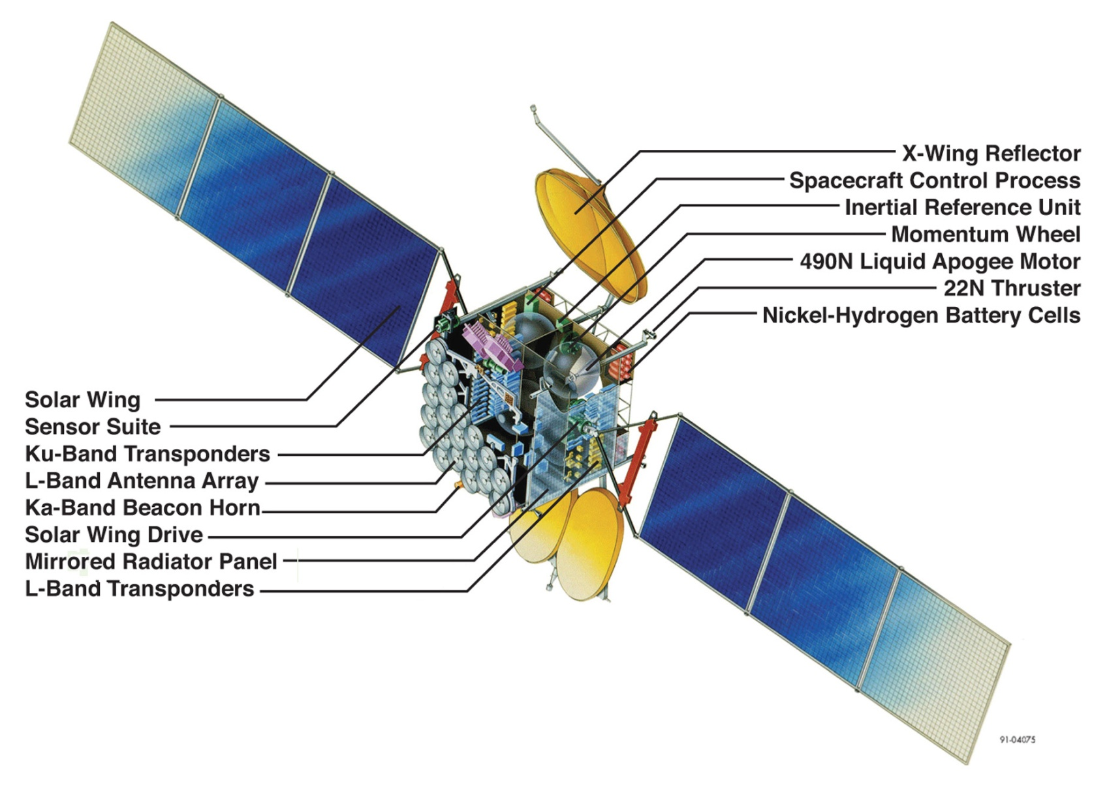
SATCOM
Geosynchronous orbit at 22,300 miles above the equator.
Acts as a transponder to receive and retransmit the signal from a terrestrial transmitter (the Uplink) to a terrestrial receiver (the Downlink)
Figure 13-16 A detailed view of the Boeing 601 satellite. (Courtesy of Boeing.)

Slide 25
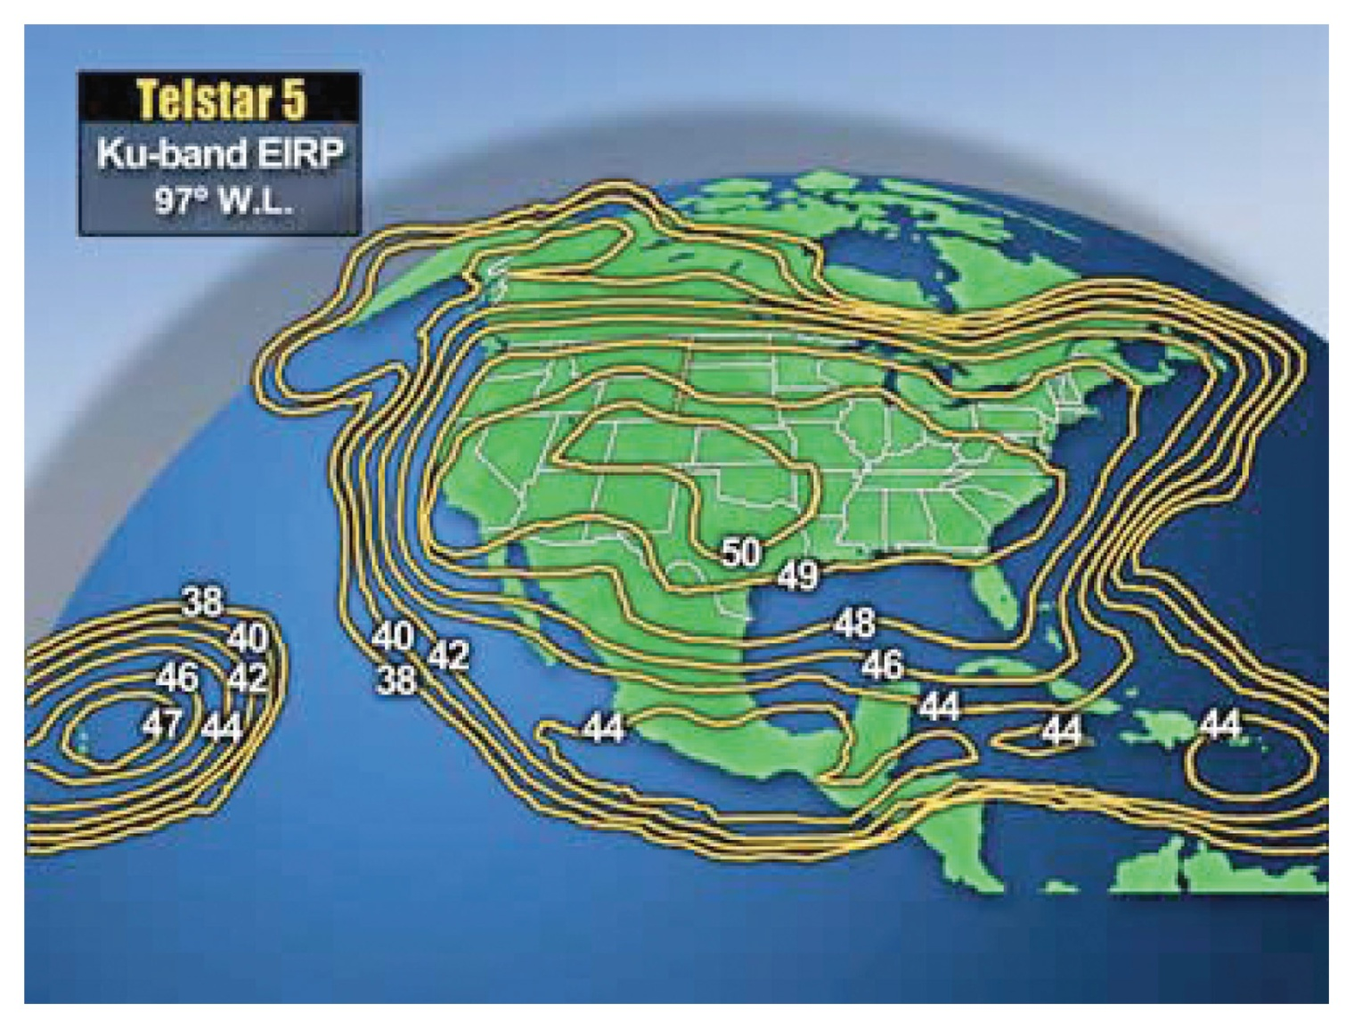
Satellite broadcast
Band | Uplink (GHz) | Downlink (GHz)
L | 1-2 | Various
S | 1.7-3 | Various
C | 5.9-6.4 | 3.7-4.2
X | 7.9-8.4 | 7.25-7.75
Ku | 14-14.5 | 11.7-12.2
Ka | 27-31 | 17-21
Satellite Frequency Bands
Figure 13-17 An example of a satellite footprint.

Slide 26
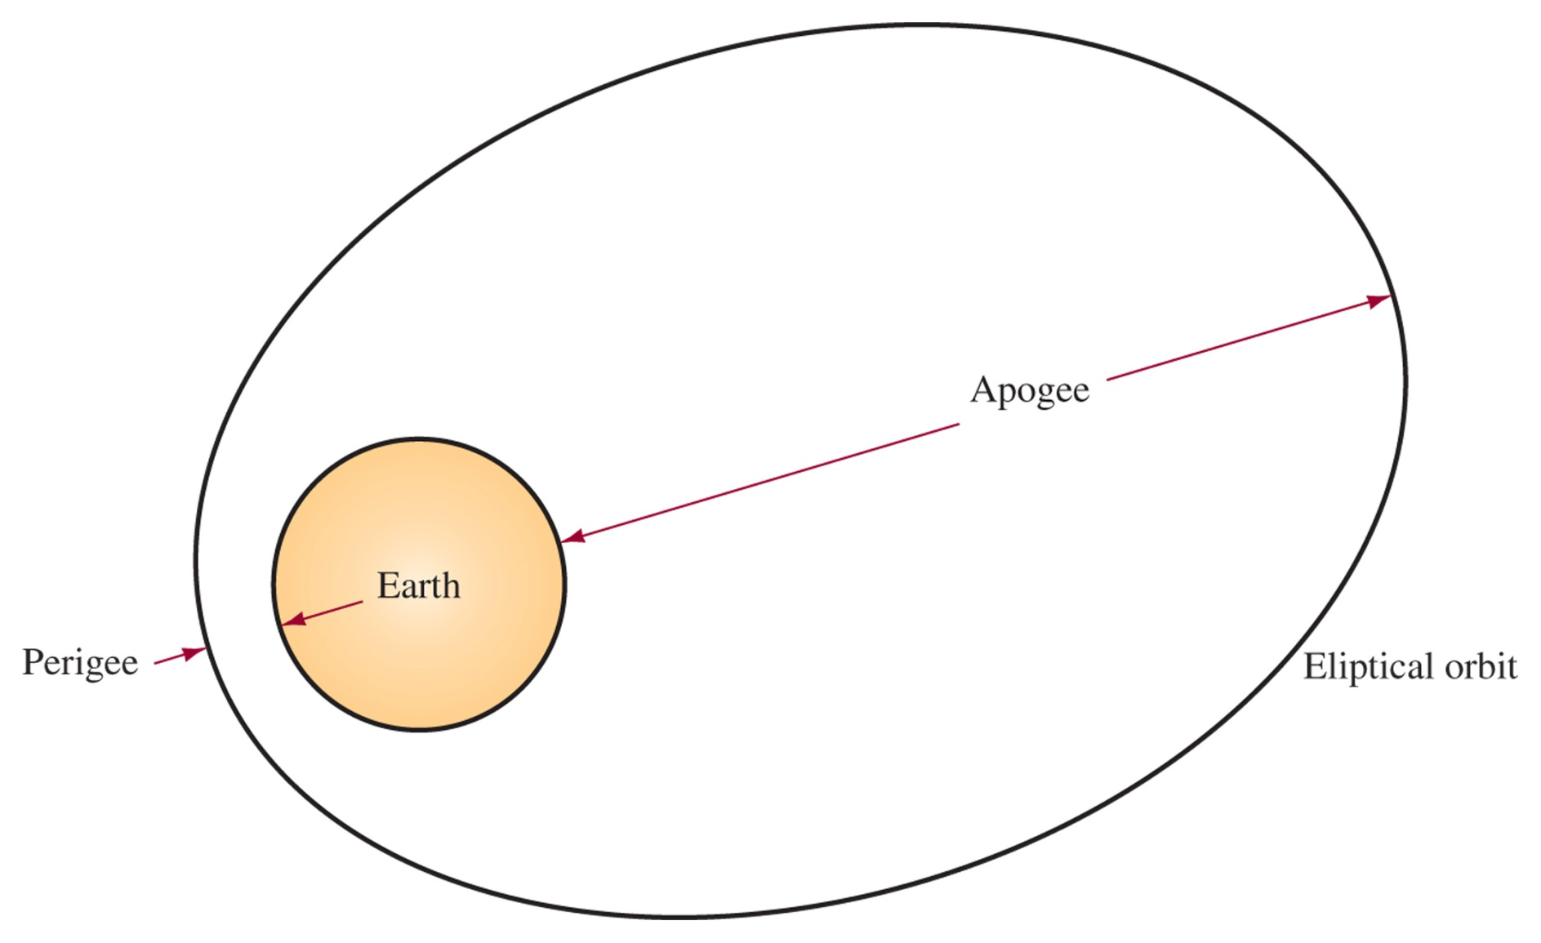
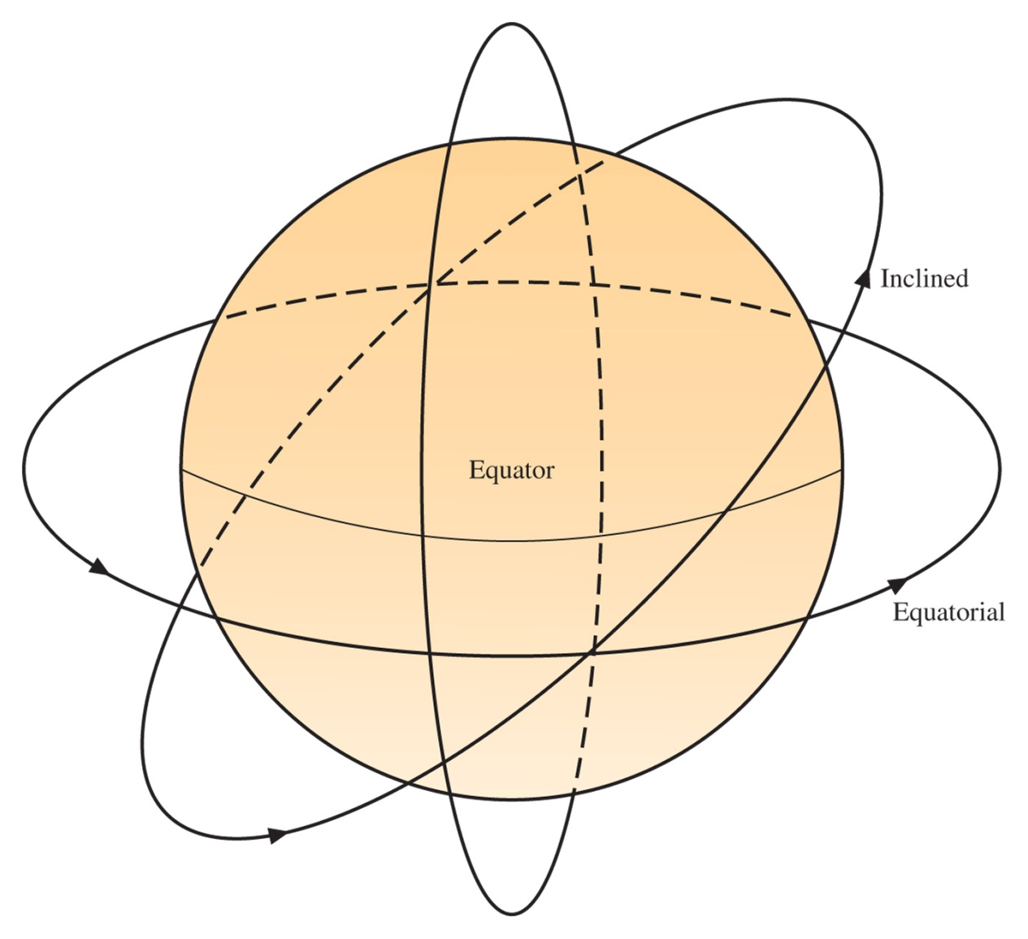
Orbital Patterns
Figure 13-19 Orbital patterns for satellites. (Courtesy of Iridium Satellite LLC.)
Figure 13-18 The perigee and apogee of a satellite’s orbit.
Equatorial – Geosynchronous (covers whole Earth between 76 N/S)
Polar – sees every point on earth 2x/day
Inclined – for extreme northern and southern latitudes, must be tracked

Slide 27
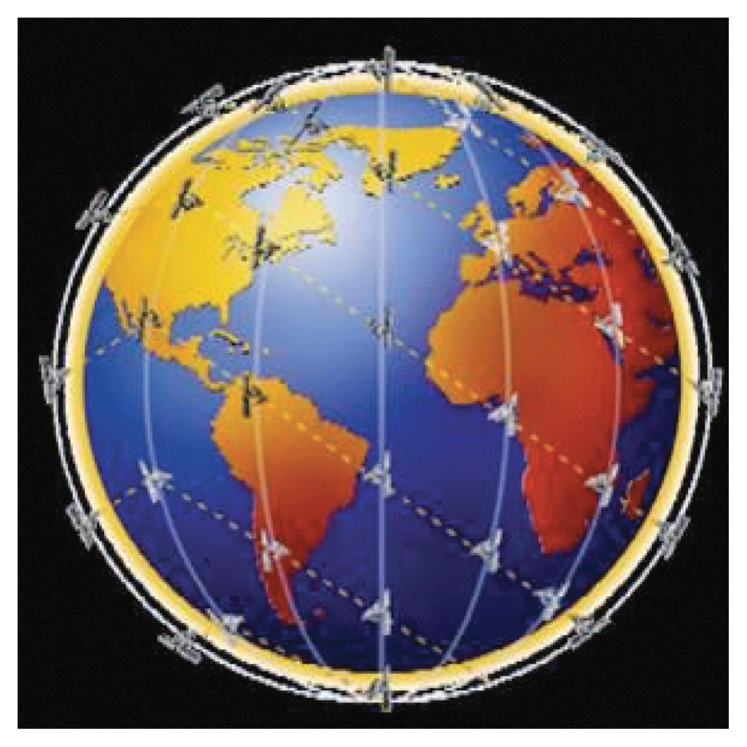
Low Earth Orbit
LEO satellites (between 250-1000 miles altitude) have short delay (5-10ms)
Cheaper launch, but a constellation of satellites is necessary to cover the whole earth.
Coordination between several satellites to hand-off communications as they orbit
Figure 13-20 A picture of the Iridium LEO satellite constellation. (Courtesy of Iridium Satellite LLC.) Iridium telephones use 66 satellites in near-polar orbit at 485 miles altitude. 100 minute orbit. Handles 2.4 kbps.

Slide 28
Azimuth and Elevation
To find the look angle of a terrestrial receiver or transmitter.
For Elevation
E = elevation in degrees
A = azimuth of the antenna
S = satellite longitude
N = site longitude
G = S-N
L = site latitude
For Azimuth

Slide 29
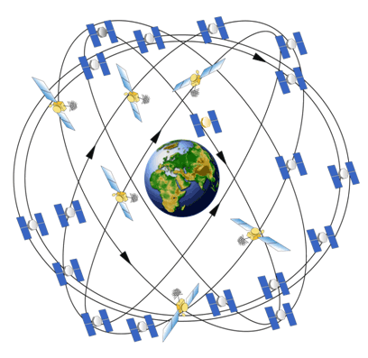
GPS
Constellation of 28 satellites, on 12 hour orbit at altitude of 10,900 miles.
Transmit course acquisition C/A on 1575.42 MHz (civilian OK)
Transmit precision code (P-code) on 1227.6 MHz and 1575.42 Mz (military only)
Need 4 satellites to calculate the time to receive each signal and determine position
Accurate to 2 meters (civilian) 1cm with differential correction

Slide 30
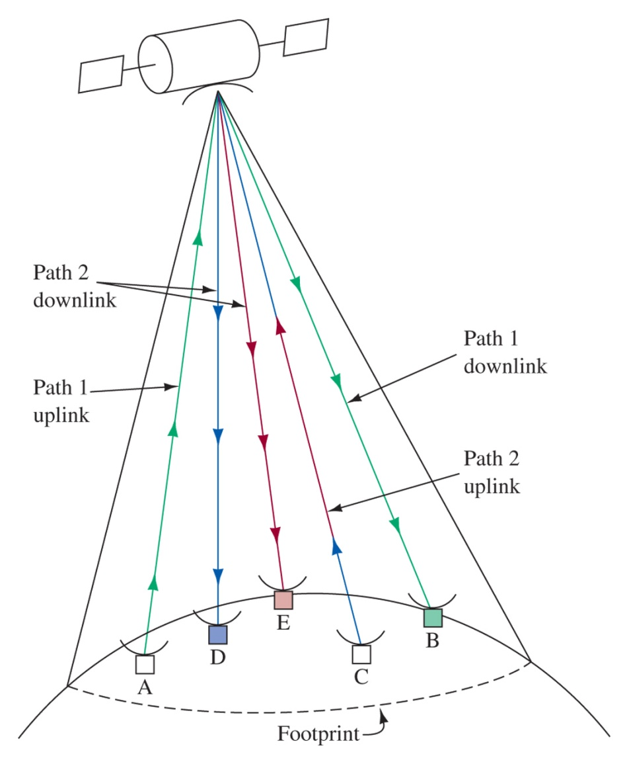
Mutliplexing Tecnhiques
Satellite can carry out communication with any earth stations within its footprint.
May be designed with 2 footprints to conserve power
Frequency Division Multiple Accses (FDMA) was originally used by satellites to allocate specific bands to transmitters as needed
Figure 13-21 Satellite footprint and multiple communications.

Slide 31
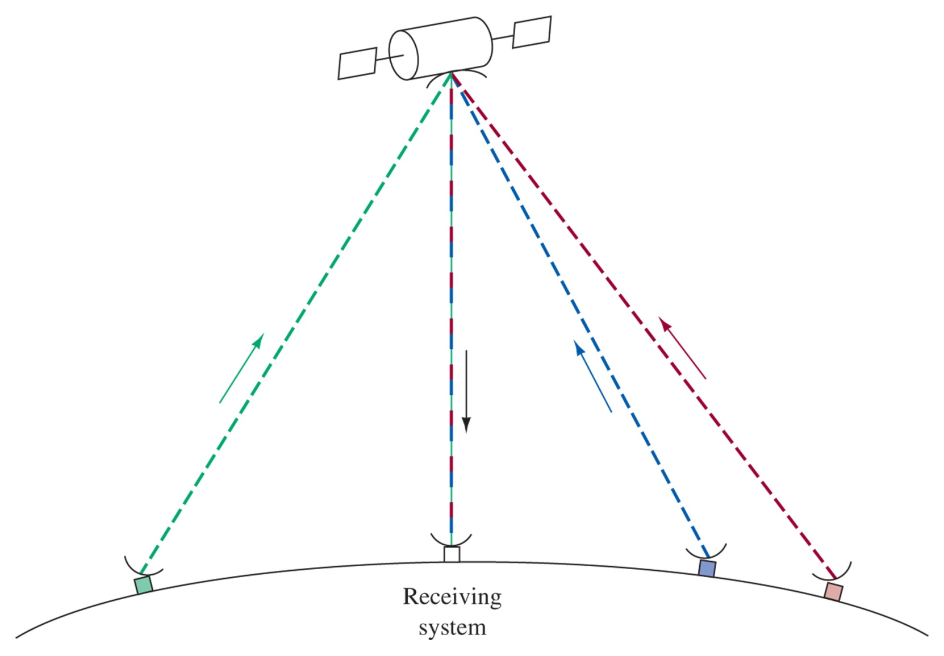
Time-Division Multiple Access (TDMA)
New satellites use TDMA to allow operation on only 1 frequency.
Use is allocated to data bursts which allow multiple users to communicate.
Very compatible with current digital technology, easily allows demand based multiplexing.
Figure 13-22 TDMA illustration.

Slide 32
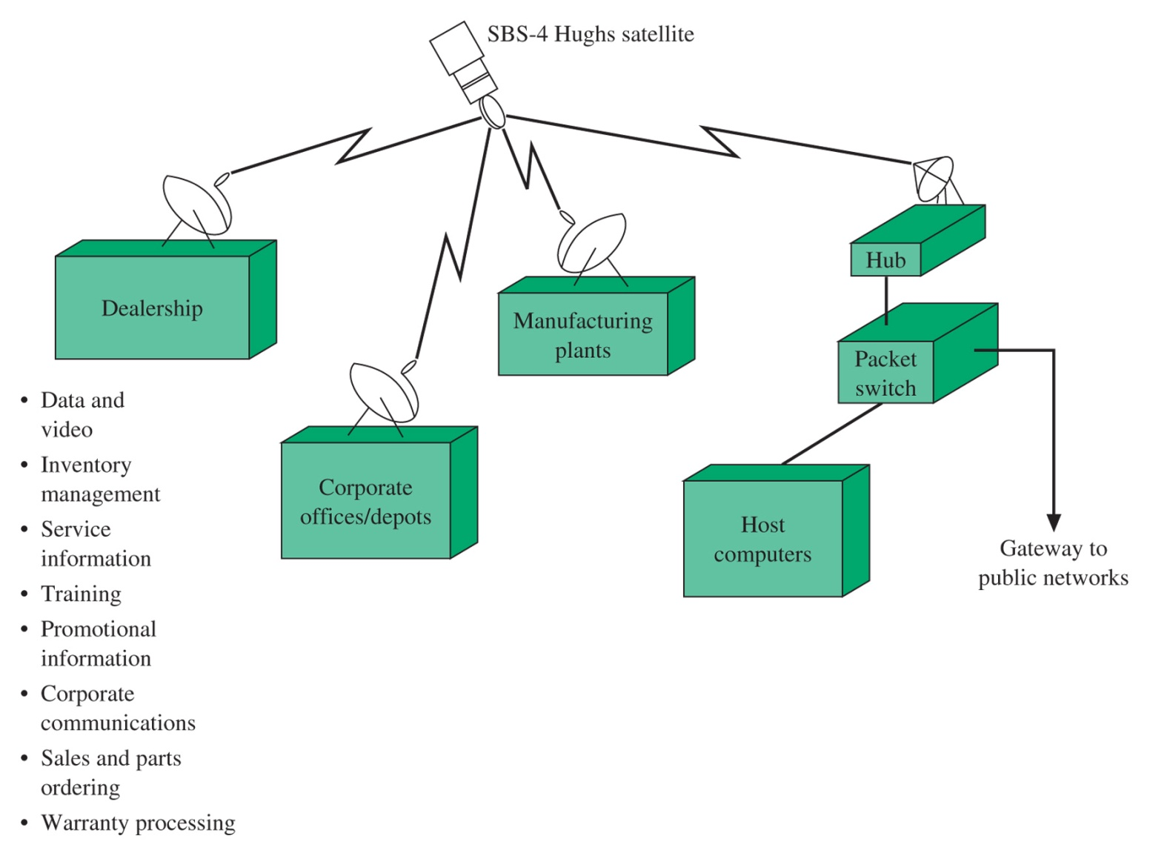
VSAT and MSAT systems
2-3 W transmitters around 30 GHz provide continuous shared access to central resources and information via 2’ diameter dishes

Slide 33
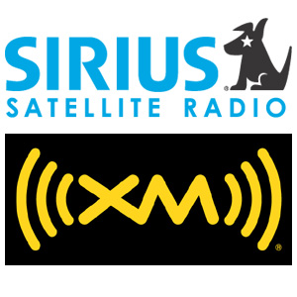
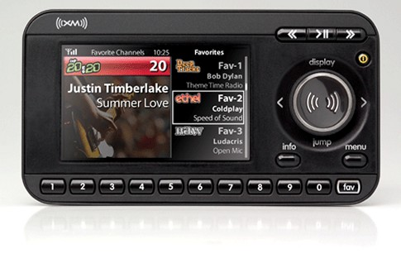
Satellite Radio
XM radio – 2 geosync sat’s over US (2.3 GHz S-band)
Sirius radio – 3 inclined orbits sat’s over US 16 hrs/day (2.3 GHz S-band, spatial diversity)
WorldSpace – 3 geosync sat’s outside US (1467-1492 MHz L Band, now defunct 2009)

Slide 34
13-7 Figure of Merit
The Figure of merit gives a way to measure performance of a satellite system
G/T = G – 10log(Ts)
G/T = figure of merit (dB)
G = antenna gain (dBi)
Ts = sum of all Teq (noise figure measurements)
Consider the noise temperature of the antenna, LNA, LNB, LNC, receiver, and passive components
The lower the noise temperature the more expensive the part generally

Slide 35
Link Budget Analysis
C/N ensures the earth station meets required signal-to-noise ratio or BER for digital
Free space path loss is a significant factor and increases with increased frequency
Uplink Budget
Downlink Budget
http://web.nmsu.edu/~jbeasley/Satellite/

Slide 36
13-8 Troubleshooting
Radio Interference
Sky-wave propagation
Satellite Communications
Moving the antenna can often be the key to solving reception problems

Slide 37
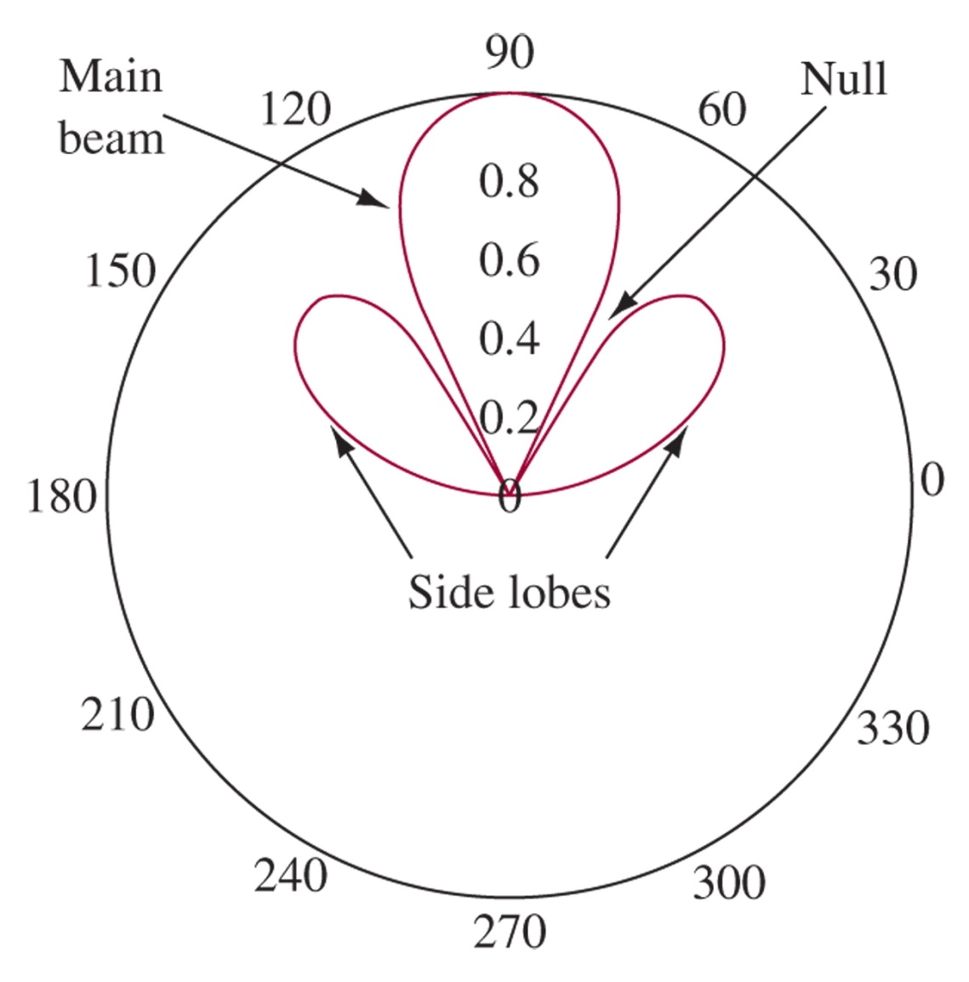
Antenna Reception

Slide 38
13-9 Troubleshooting w/ Multisim

Slide 39
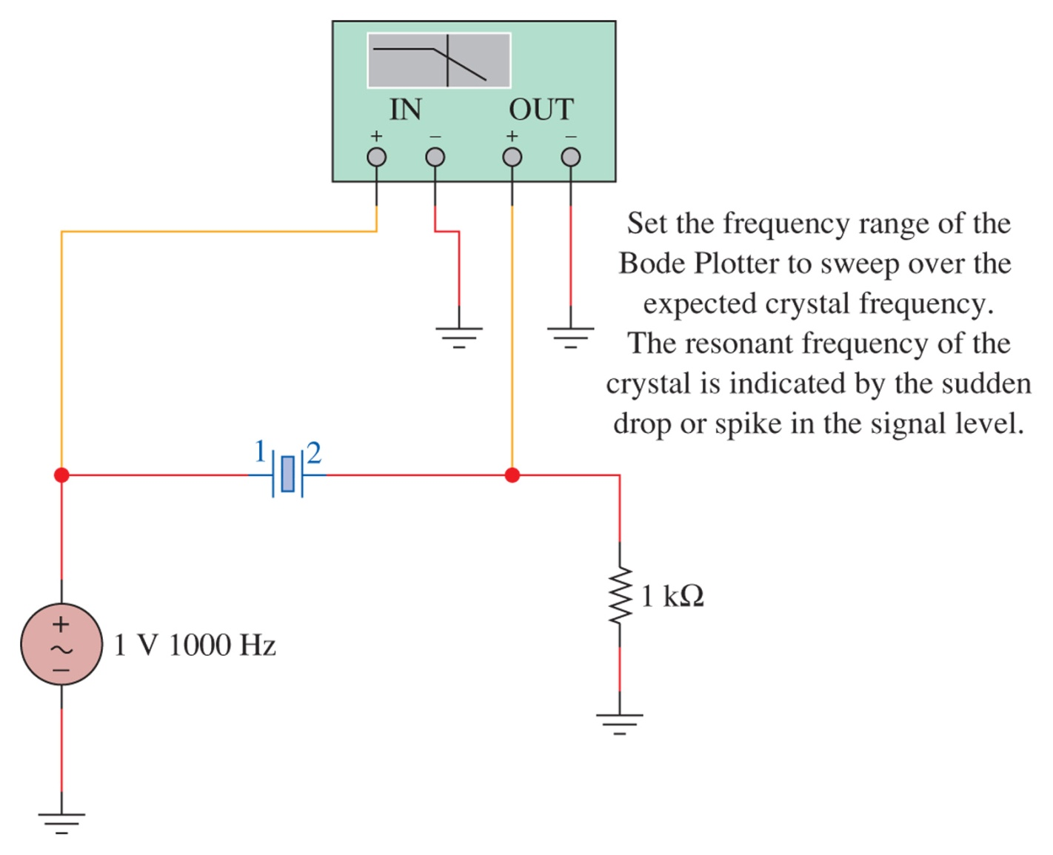
Figure 13-25 The test circuit for the crystal oscillator using EWB Multisim.

Slide 40
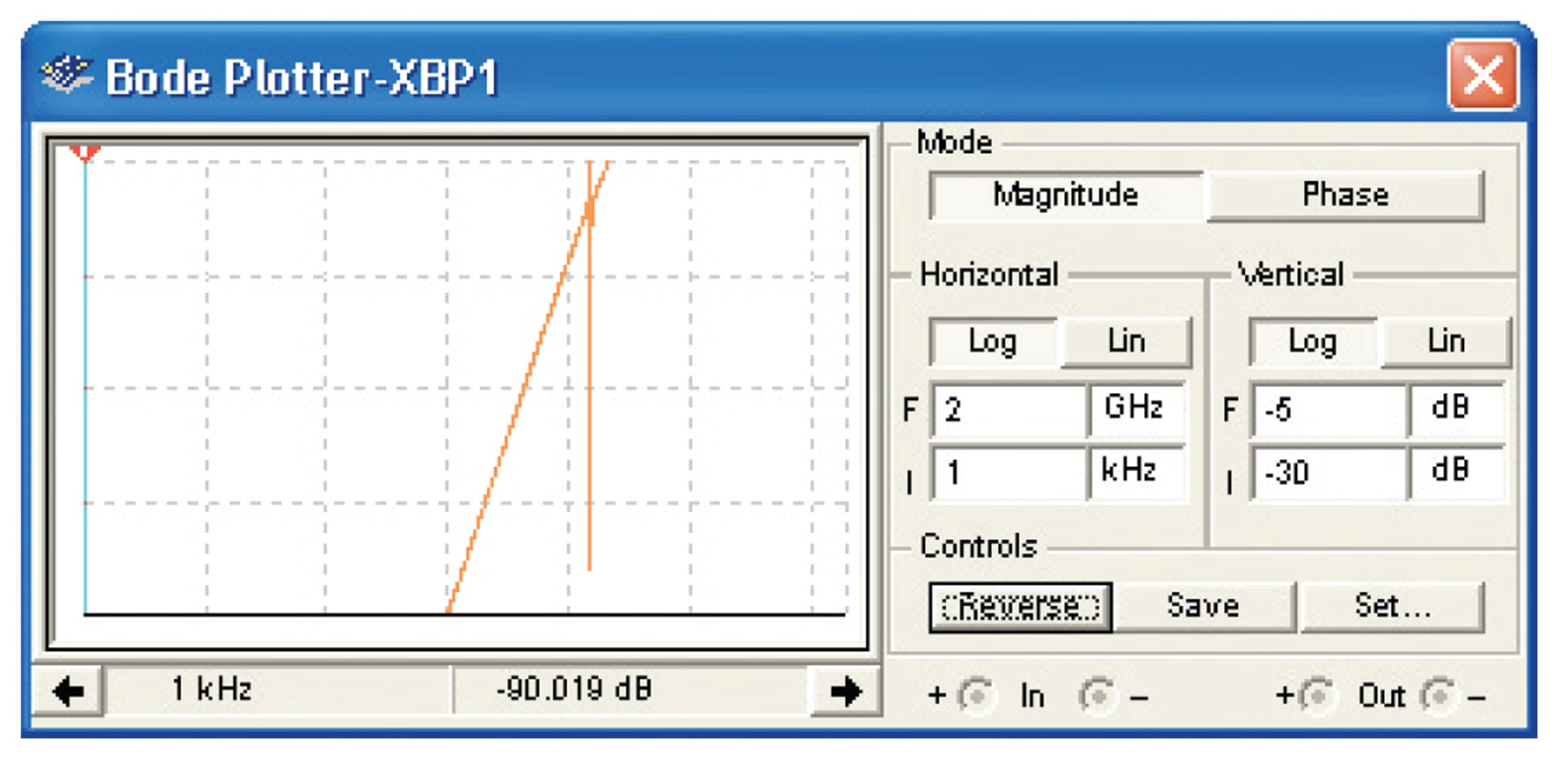
Figure 13-26 The frequency sweep of a crystal under test.

