Slide 1
EE 350 / ECE 490
Analog Communication Systems
Ch. 15 – Waveguides & Radar

Slide 2
Objectives
Differentiate among sending signals on transmission lines, antennas, and waveguides based on power and distance
Describe basic modes of operation for rectangular waveguides
Calculate the cutoff wavelength for the dominant mode of operation
Provide a physical picture of waveguide propagation, including the concepts of guide wavelength and velocity
Describe other types of waveguides including circular, ridged, flexible, bends, twists, tees, tuners, terminations, attenuators, and directional couples
Explain three methods for coupling energy into or out of a waveguide and the uses for cavity resonators
Calculate an object’s velocity when using a Doppler radar system
Calculate the characteristic impedance for microstrip and stripline.

Slide 3
15-1 Comparison of Transmission Systems
Waveguides allow you to send much more power over short distances than you could with transmission lines or antennas
At long distances waveguides are less efficient than antennas
There is also a frequency dependence: transmission lines above DC, antennas above 100 kHz, waveguides above 300 MHz

Slide 4
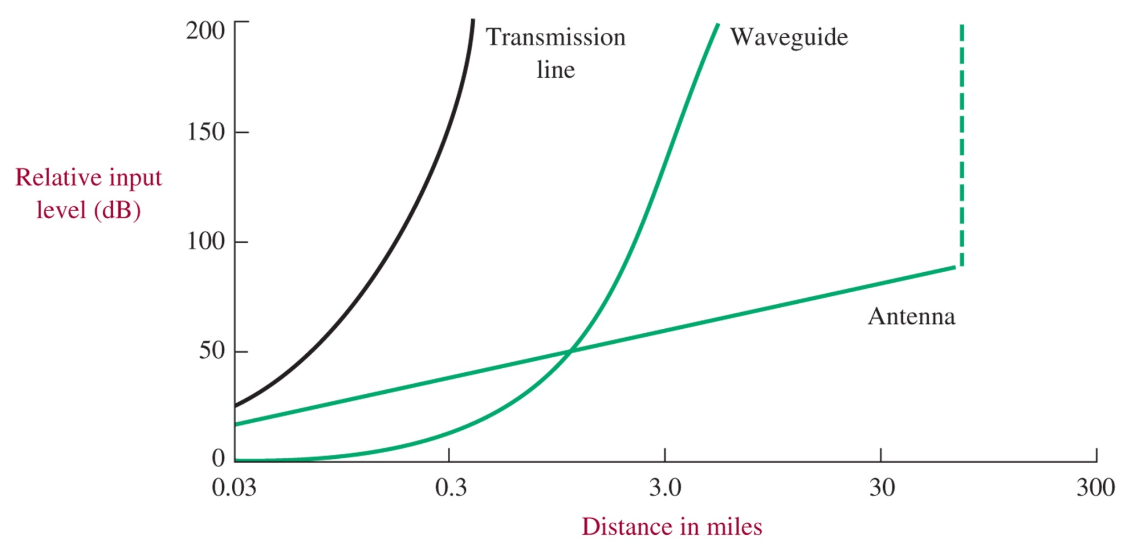
Power vs. Distance
Figure 15-1 Input power required versus distance for fixed receiver power.

Slide 5
15-2 Types of Waveguides
Waveguide Operation

Slide 6
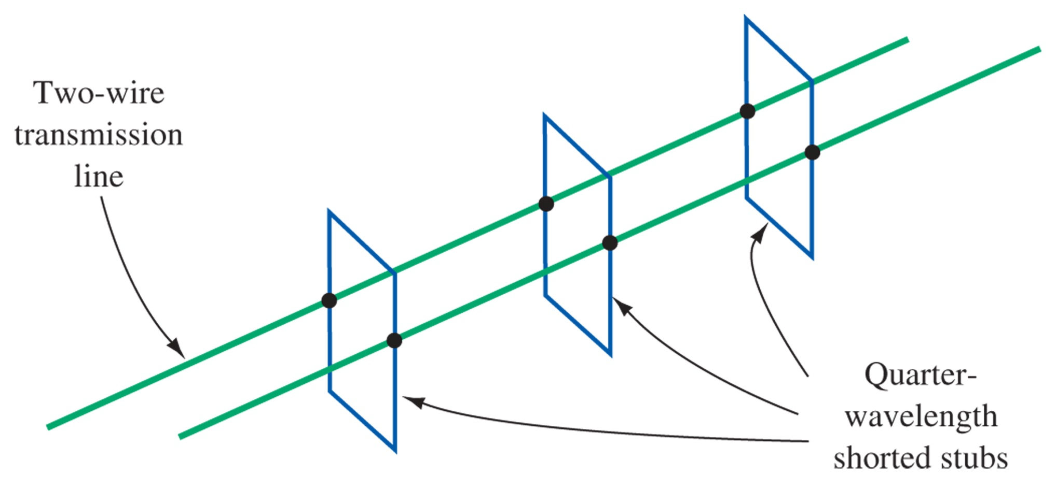
Waveguide Construction
Figure 15-2 Transforming a transmission line into a waveguide.

Slide 7
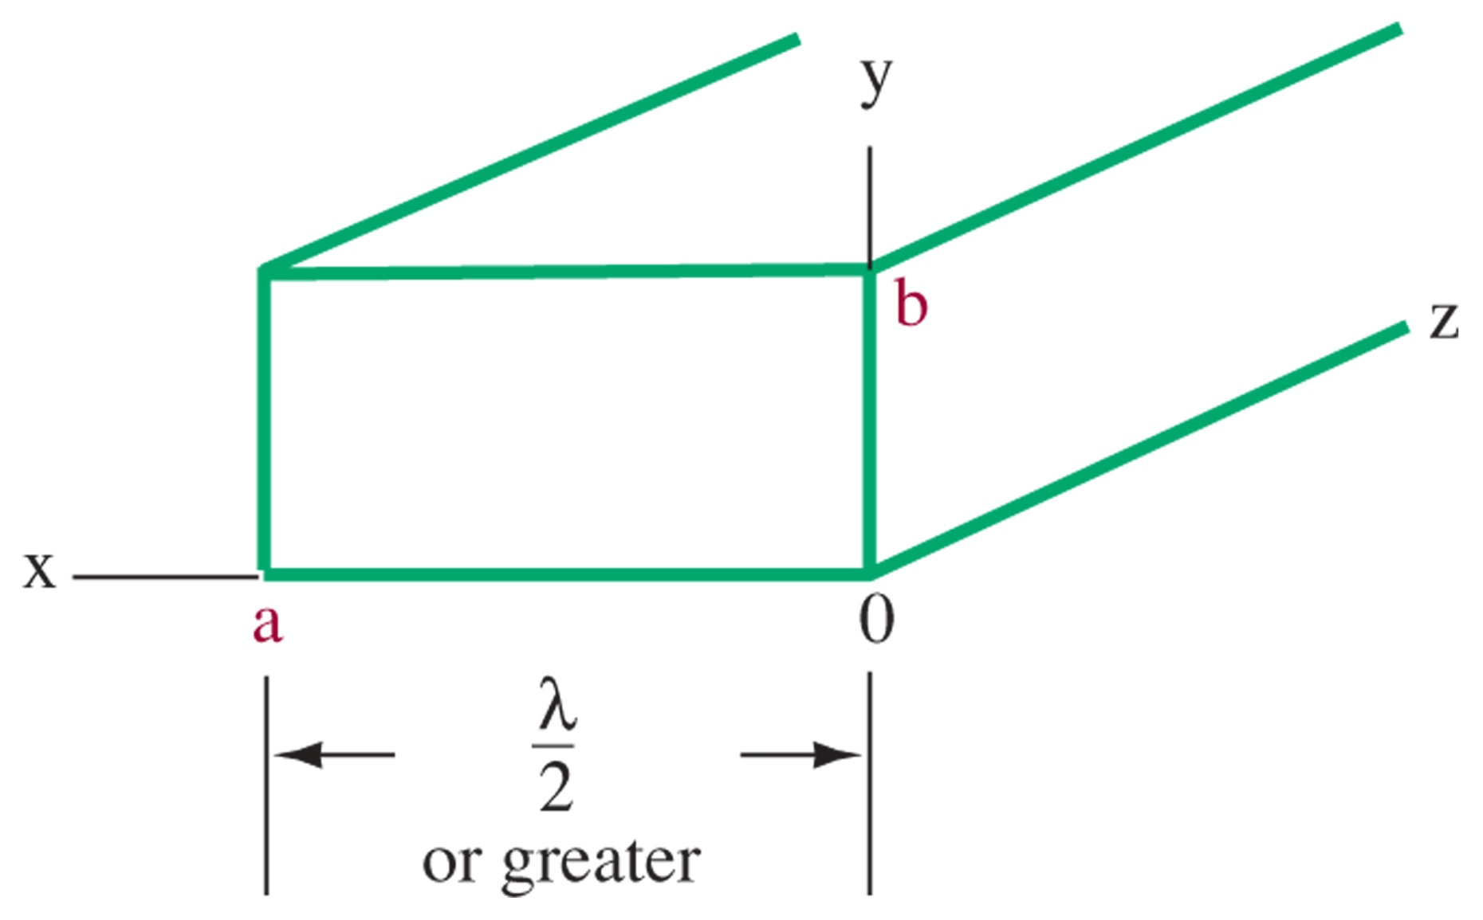
Waveguide Dimensions
Figure 15-3 Waveguide dimension designation.
The width, a, needs to be λ/2, while b is about half that. This is why waveguide is only used for high frequencies, otherwise the size would be far too large.

Slide 8
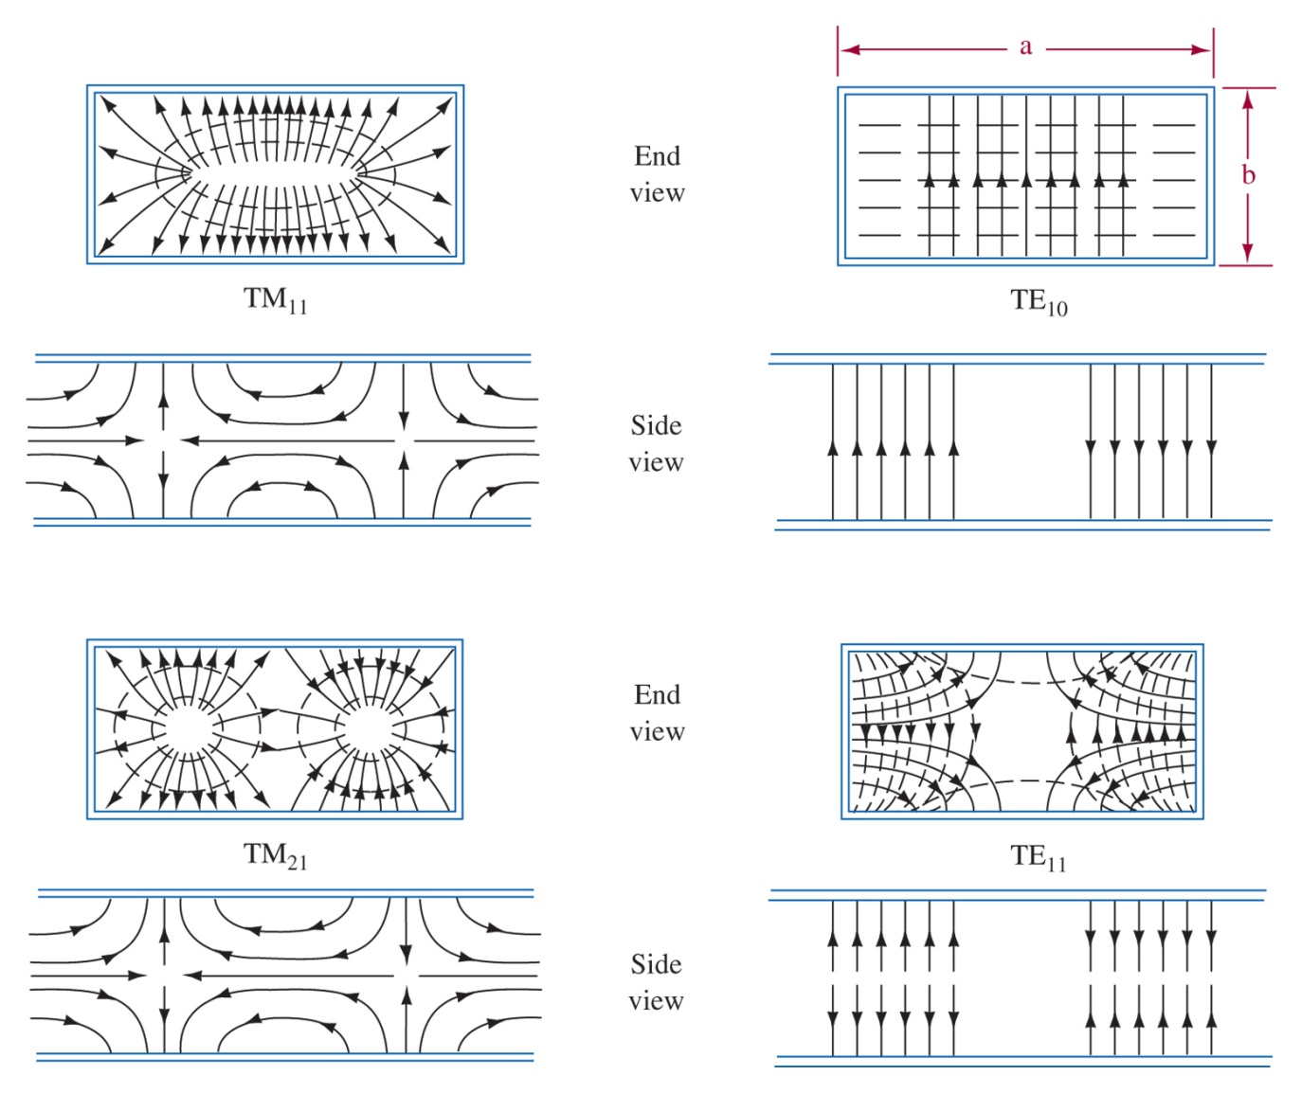
Modes
Figure 15-4 Examples of modes of operation in rectangular waveguides.
Multiple modes may travel down a waveguide simultaneously

Slide 9
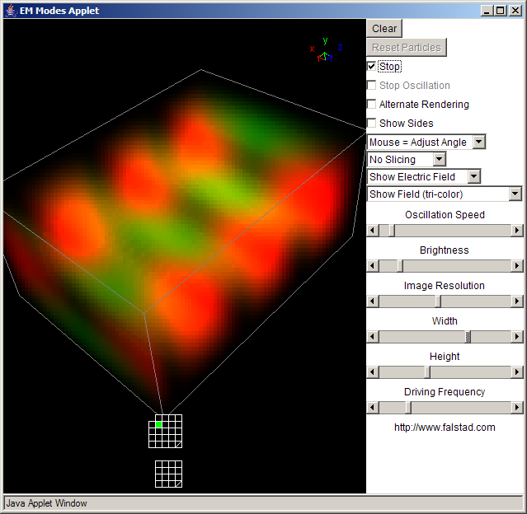
Falstad EM Waveguide Applet
http://www.falstad.com/embox/guide.html

Slide 10
Dominant Mode Operation
TE10 is the “natural” or dominant mode of operation
TE10 has the lowest cut-off frequency and there is a frequency “gap” before the next higher mode can be excited
TE10 allows the physically smallest waveguide for a given frequency
Cutoff wavelength: λco = 2a
For X-band waveguide is 0.9 x 0.4 in, λco = 1.8 in or 4.56 cm
fco = 6.56 GHz, with the next highest mode being TE20 at 13.1 GHz, so the recommended range of operation is 8.2 – 12.4 GHz

Slide 11
Waveguide Bands / Sizes
Range | Internal | Internal
GHz | (inches) | (mm. approx) | U.S. (EIA) | Narda
1.12 - 1.7 | 6.5 x 3.25 | 165.0 x 83.0 | WR650 | L
1.45 - 2.2 | 5.1 x 2.55 | 131.0 x 65.0 | WR510
1.7 - 2.6 | 4.3 x 2.15 | 109.0 x 55.0 | WR430 | LS
2.2 - 3.3 | 3.4 x 1.7 | 86.0 x 43.0 | WR340
2.6 - 3.95 | 2.84 x 1.34 | 72.0 x 34.0 | WR284 | S
3.3 - 4.9 | 2.29 x 1.145 | 59.0 x 29.0 | WR229 | A(7.5cm)
3.95 - 5.85 | 1.872 x 0.872 | 48.0 x 22.0 | WR187 | C
4.9 - 7.05 | 1.59 x 0.795 | 40.0 x 20.0 | WR159
5.85 - 8.2 | 1.372 x 0.622 | 35.0 x 16.0 | WR137 | XN
7.05 - 10.0 | 1.122 x 0.497 | 29.0 x 13.0 | WR112 | XB
8.2 - 12.4 | 0.9 x 0.4 | 23.0 x 10.0 | WR90 | X
10.0 - 15.0 | 0.75 x 0.375 | 19.0 x 9.5 | WR75
12.4 - 18.0 | 0.622 x 0.311 | 16.0 x 7.9 | WR62 | KU
15.0 - 22.0 | 0.510 x 0.255 | 13.0 x 5.8 | WR51
18.0 - 26.5 | 0.420 x 0.170 | 11.0 x 4.3 | WR42 | K
22.0 - 33.0 | 0.340 x 0.170 | 8.6 x 4.3 | WR34
26.5 - 40.0 | 0.280 x 0.140 | 7.1 x 3.6 | WR28 | V
33.0 - 50.0 | 0.224 x 0.112 | 5.7 x 2.9 | WR22 | Q
40.0 - 60.0 | 0.188 x 0.094 | 4.8 x 2.4 | WR19
50.0 - 75.0 | 0.148 x 0.074 | 3.8 x 1.9 | WR15 | M
60.0 - 90.0 | 0.122 x 0.061 | 3.1 x 1.6 | WR12 | E
75.0 - 110.0 | 0.100 x 0.050 | 2.4 x 1.3 | WR10
90.0 - 140.0 | 0.080 x 0.040 | 2.0 x 1.0 | WR8 | N
110.0 - 170.0 | 0.065 x 0.0325 | 1.7 x 0.82 | WR7
140.0 - 220.0 | 0.051 x 0.0255 | 1.3 x 0.65 | WR5 | A(7.5cm)
170.0 - 260.0 | 0.043 x 0.0215 | 1.1 x 0.55 | WR4
220.0 - 325.0 | 0.034 x 0.017 | 0.87 x 0.44 | WR3 | R

Slide 12
15-3 Physical Picture of Waveguide Propagation
You can imagine EM waves bouncing off the walls of the waveguide, much like total internal reflection. The lower the frequency the more perpendicular to the walls the waves must travel to reflect and interfere properly, eventually, below the cutoff frequency the waves travel entirely perpendicular, and no energy propagates down the wavegude.

Slide 13
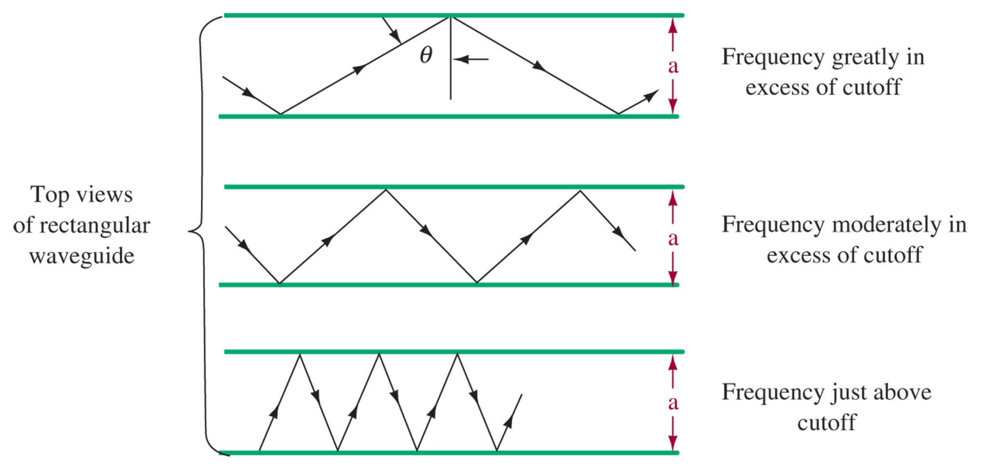
Wave paths
Figure 15-5 Paths followed by waves traveling back and forth between the walls of a waveguide.

Slide 14
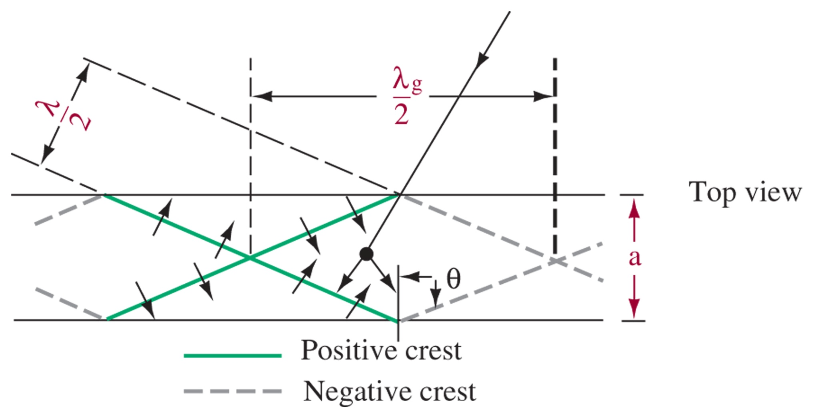
Wavefront propagation
Group Velocity:
Guide Wavelength:
As frequency goes down, wavelength goes up. As this approaches the cutoff wavelength, the wave must be travelling more perpendicular (theta near zero), which lowers the group velocity, eventually stopping propagation of energy when theta = 0 and Vg =0. At this condition in TE10 mode you have one half wavelength of E field across the a direction of the guide.
Figure 15-6 Wavefront reflection in a waveguide.

Slide 15
Wavefront Reflection

Slide 16
15-4 Other Types of Waveguides
Rectangular is by far the most common, but special applications may require use of special waveguide configurations

Slide 17
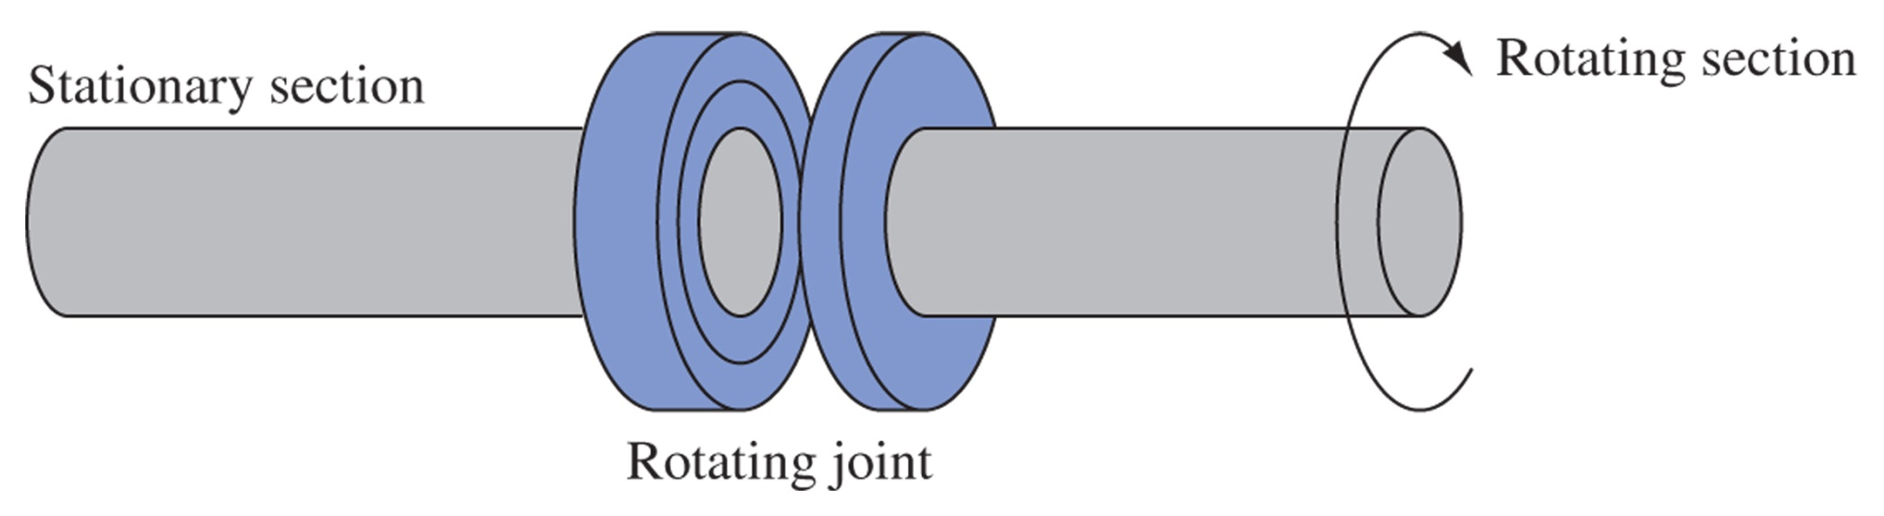
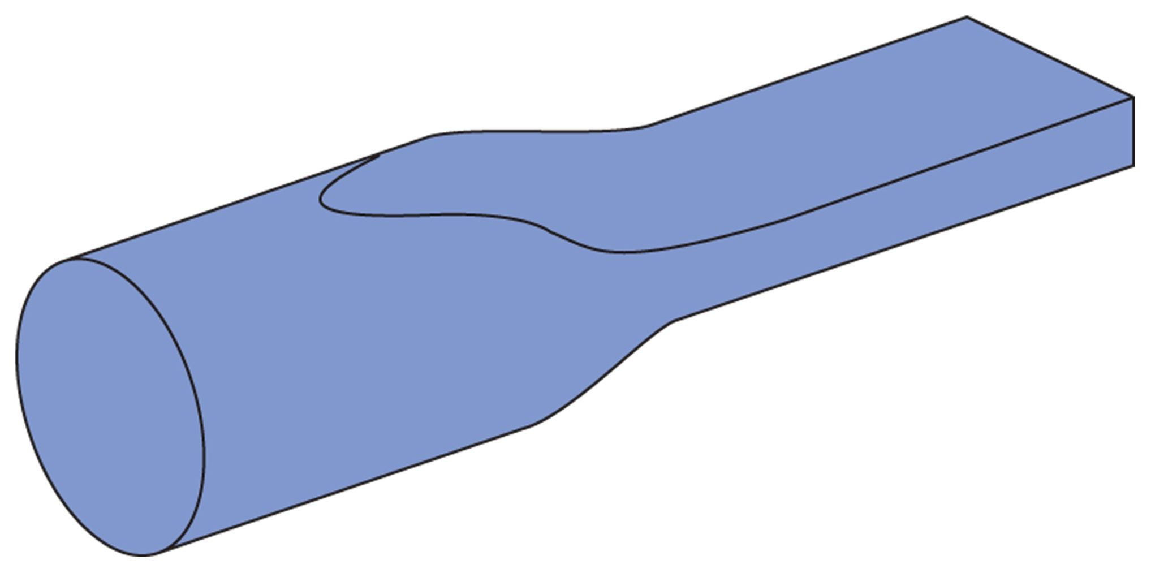
Circular Waveguide
Figure 15-7 Circular waveguide rotating joint.
Circular waveguide
Advantages:
Simple to manufacture
Rotationally symmetric – ideal for rotating radar installations
Disadvantages:
Twice the cross-section necessary
Expensive
Only 15% bandwidth as opposed to 50% BW for dominant mode
Figure 15-8 Circular-to-rectangular taper.

Slide 18
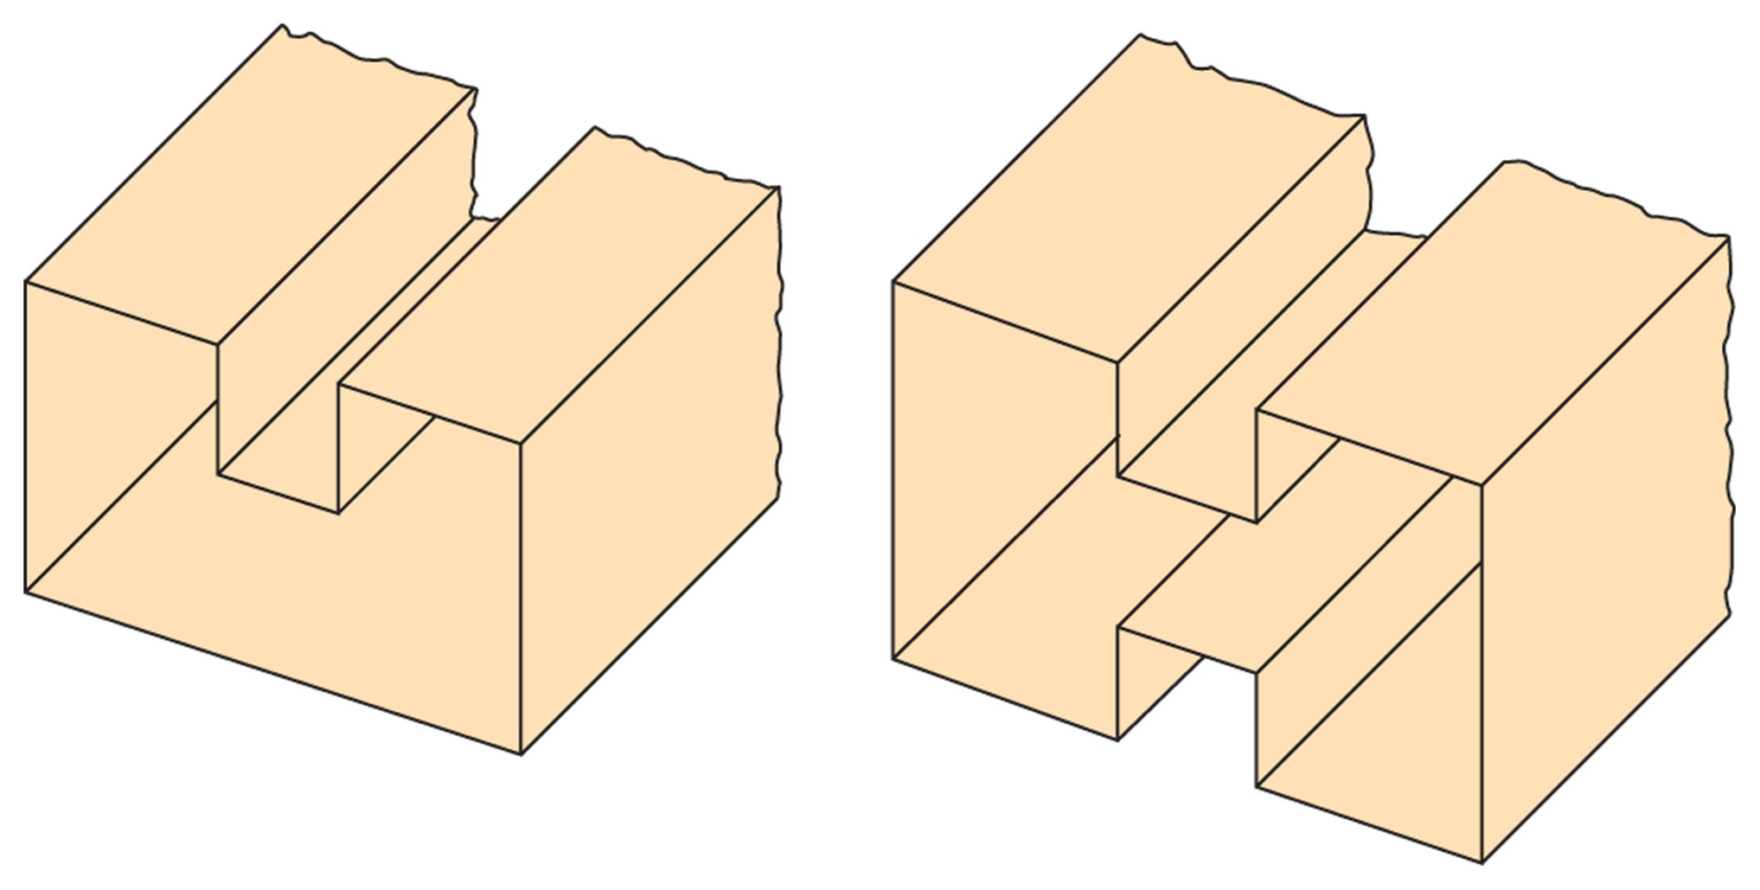
Ridged Waveguide
Figure 15-9 Ridged waveguides.
Allow longer wavelengths (lower frequencies) with smaller outside dimensions. Allow larger bandwidth. More expensive to manufacture, so only used when space is a premium (i.e. satellites).

Slide 19
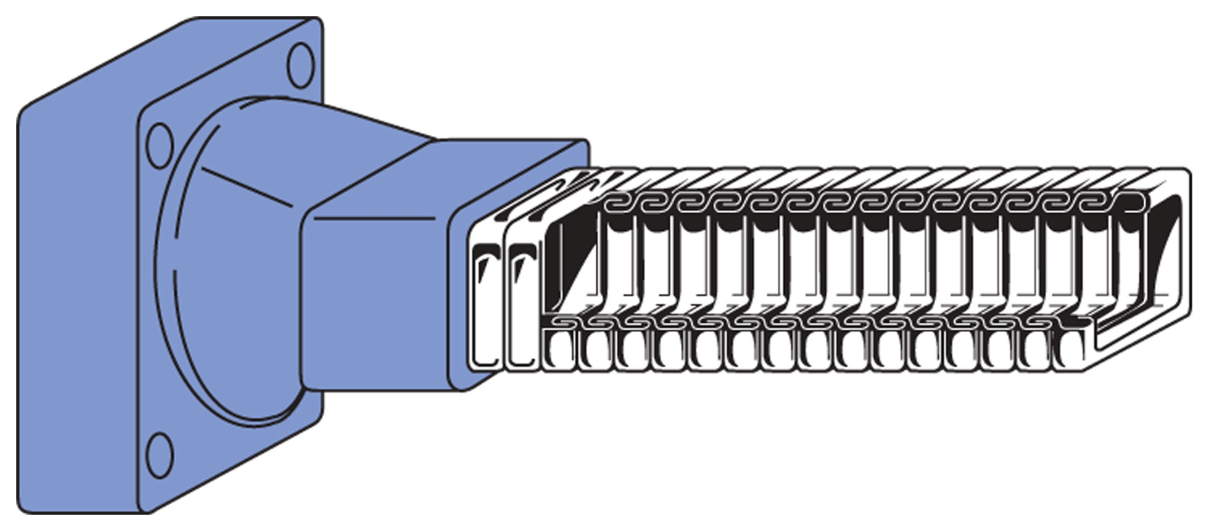
Flexible Waveguide
Figure 15-10 Flexible waveguide.
Spiral wound ribbons of metal allow continuous flexing for special applications. Usually coated with rubber to maintain seal, and are often pressurized to prevent water or dust buildup or are coated with silver or gold to prevent corrosion

Slide 20
15-5 Other Waveguide Considerations
Waveguide Attenuation
Waveguides can propagate up to 1 MW at 1.5 fco in air.
Generally waveguide losses are highest below fco
Above fco, the waveguide supports some travelling waves which have attenuation due to skin effect of walls and the dielectric losses.
Generally attenuation drops approaching fco, then is a broad minimum, and gradually rises as frequency increases

Slide 21
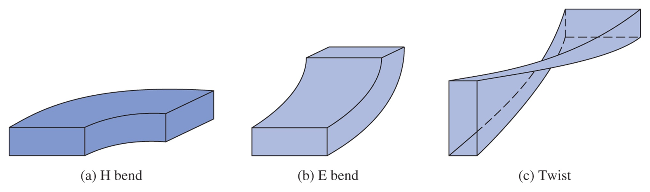
Waveguide Bends and Twists
Figure 15-11 Waveguide bends and twists.
H lines are bent
E lines are bent
E lines polarization plane is changed
These are used to mechanically move the wave around corners, or to change its polarization. Often governed by “plumbing” considerations.

Slide 22
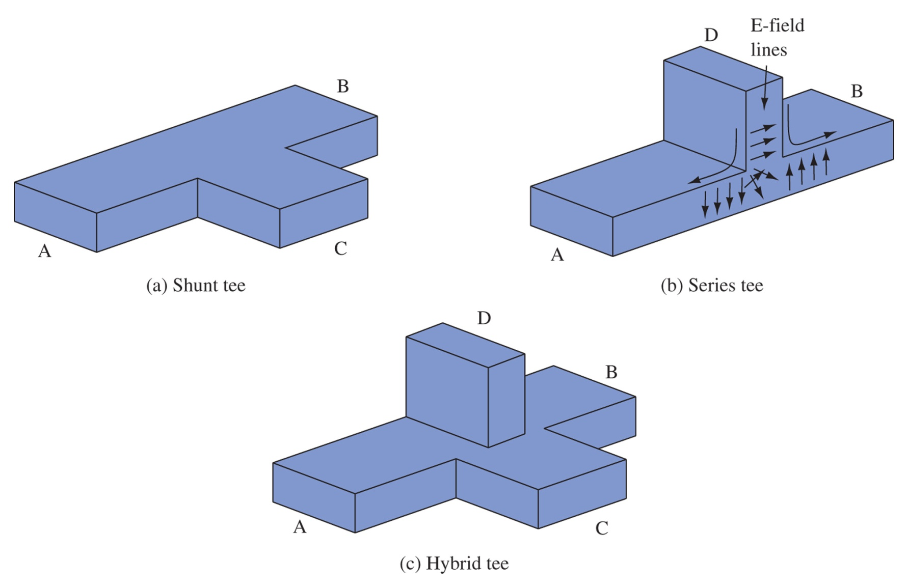
Waveguide Tees
Shunt – A+B add in phase to C, or C splits equally into A & B
Series – D splits equally, but opposite phase, into A and B. D can be used with a piston for a short circuit stub.
Hybrid or Magic Tee – combines the two previous forms, many interesting applications
Figure 15-12 Shunt, series, and hybrid tees.

Slide 23
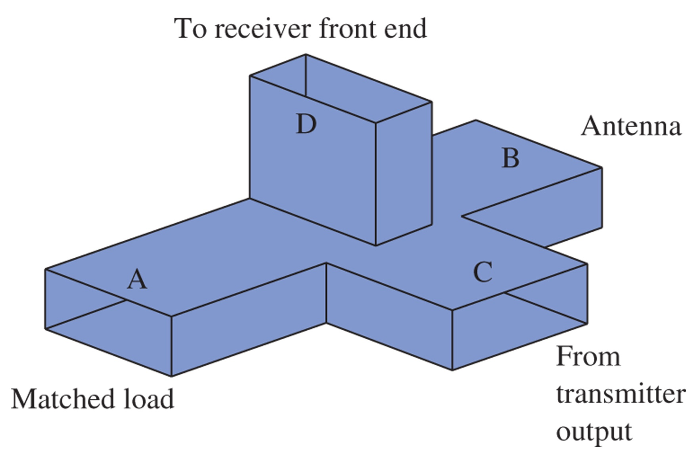
Magic Tee
Figure 15-13 Hybrid-tee TR switch.

Slide 24
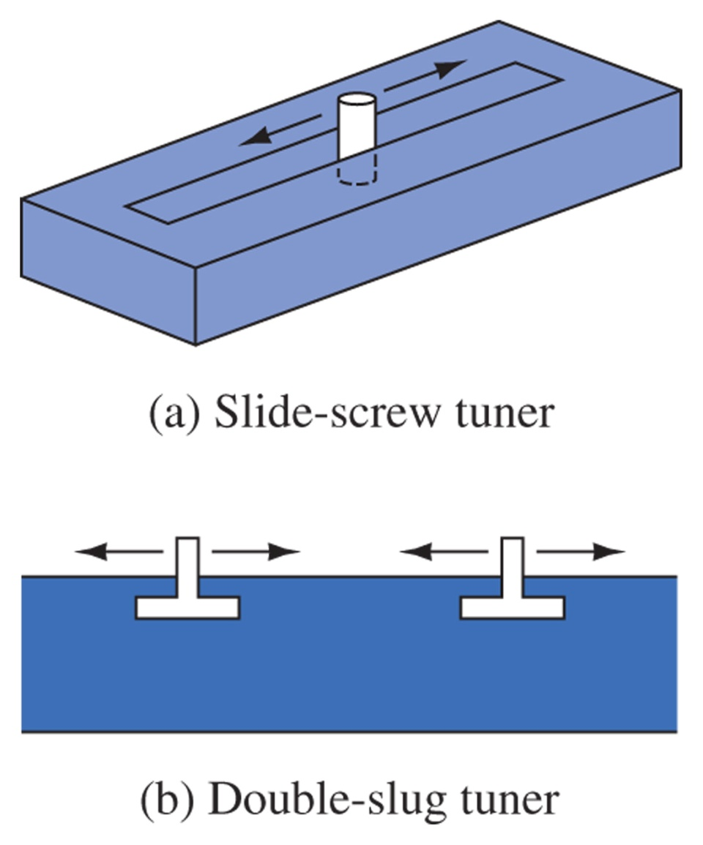
Tuners
Similar to shorted stub in a transmission line.
If less than ¼ wave it looks capacitive, if longer it looks inductive.
Can be used to match loads.
Is like a single-stub tuner
Is like a double-stub tuner
Figure 15-14 Tuners.

Slide 25
15-6 Termination and Attenuation
Characteristic Wave Impedance (depends on frequency):

Slide 26
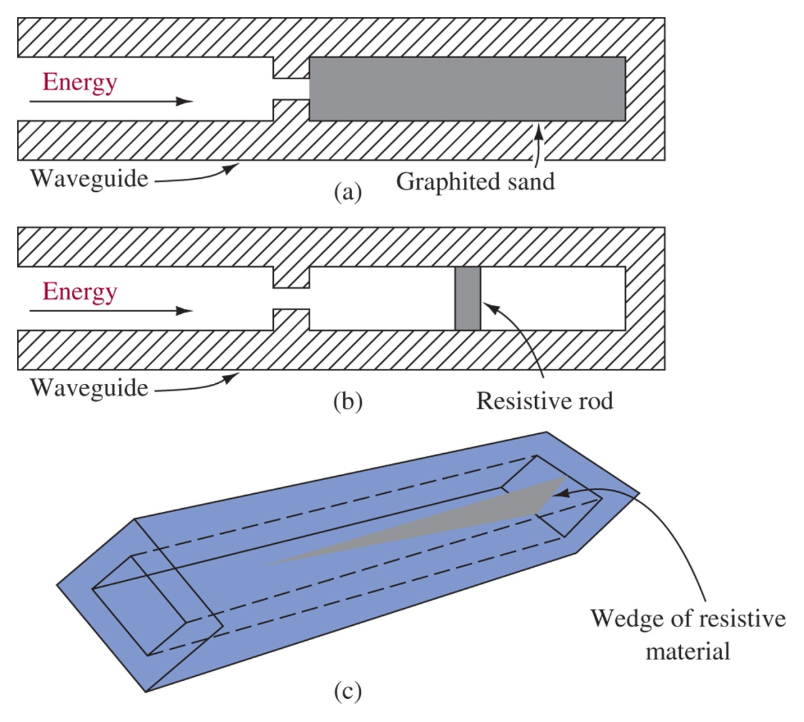
Termination
Figure 15-15 Termination for minimum reflections.
Graphite Sand or a high resistance rod or wedge at the end will serve to dissipate the energy as heat, preventing reflections back up the waveguide

Slide 27
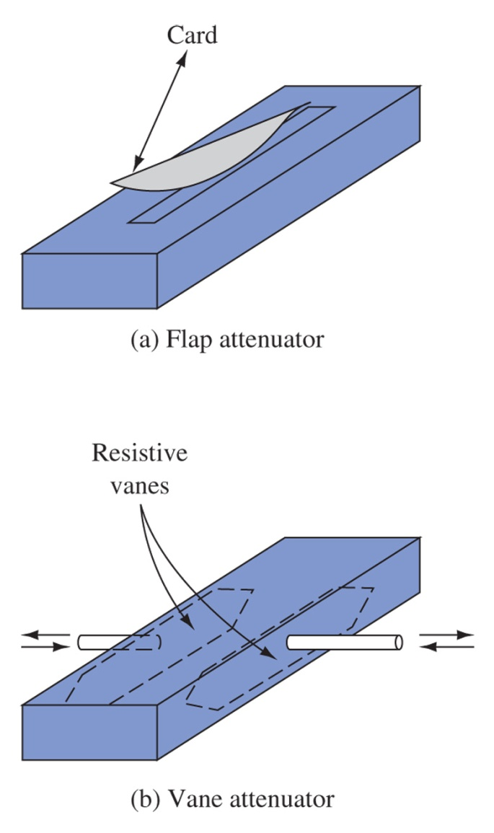
Attenuators
Flap attenuator, insertion of a resistive card causes attenuation, this is varied by how much the card is inserted.
Vane attenuator positions the vanes near the edges for low attenuation or the center for high attenuation
Figure 15-16 Attenuators.

Slide 28
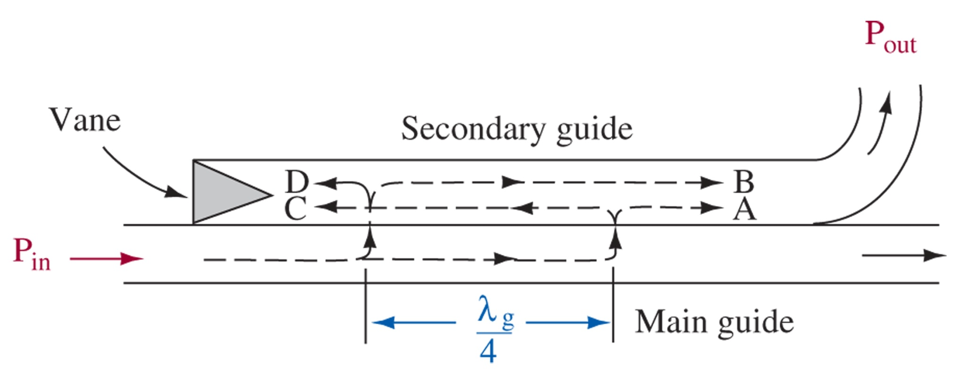
15-7 Directional Coupler
Power moving from left to right couples into the secondary, while power moving from right-to-left is dissipated in the secondary’s vane.
Figure 15-17 Two-hole directional coupler.

Slide 29
15-8 Coupling Waveguide Energy and Cavity Resonators
Coupling into the waveguide is accomplished by Probe, Loop, or Aperture coupling.

Slide 30
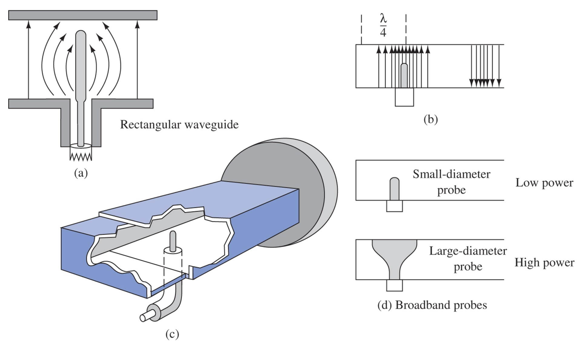
Probe Coupling
Figure 15-18 Probe, or capacitive, coupling.
The coax probe should be at the center of a and a ¼ wavelength from the end of the guide for maximum coupling

Slide 31
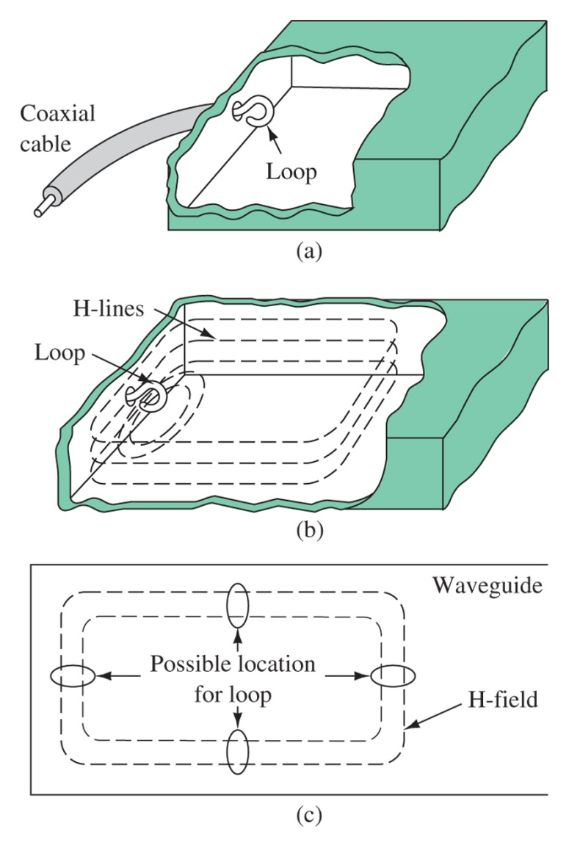
Loop Coupling
Figure 15-19 Loop, or inductive, coupling.

Slide 32
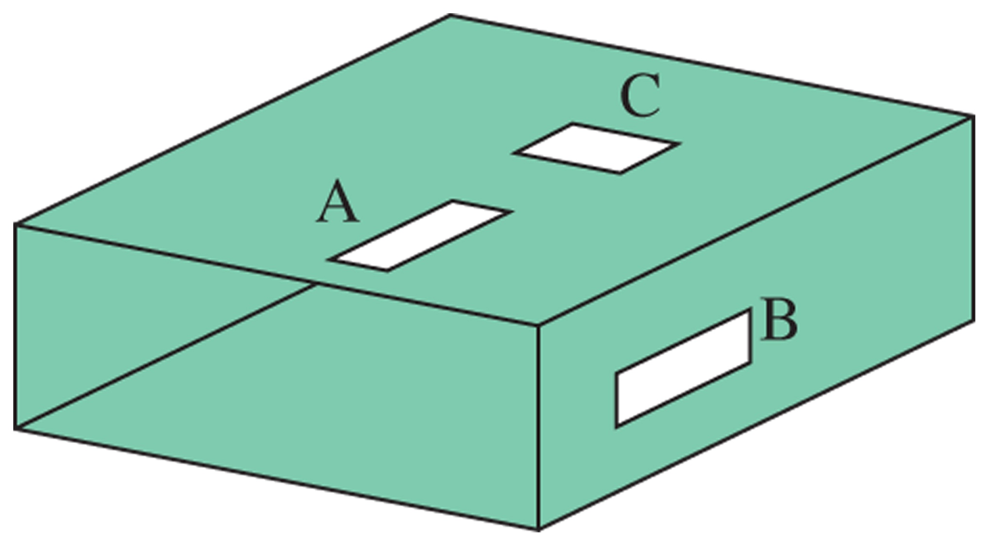
Aperture Coupling
Figure 15-20 Aperture, or slot, coupling.
Provide electric, magnetic, or EM field coupling

Slide 33
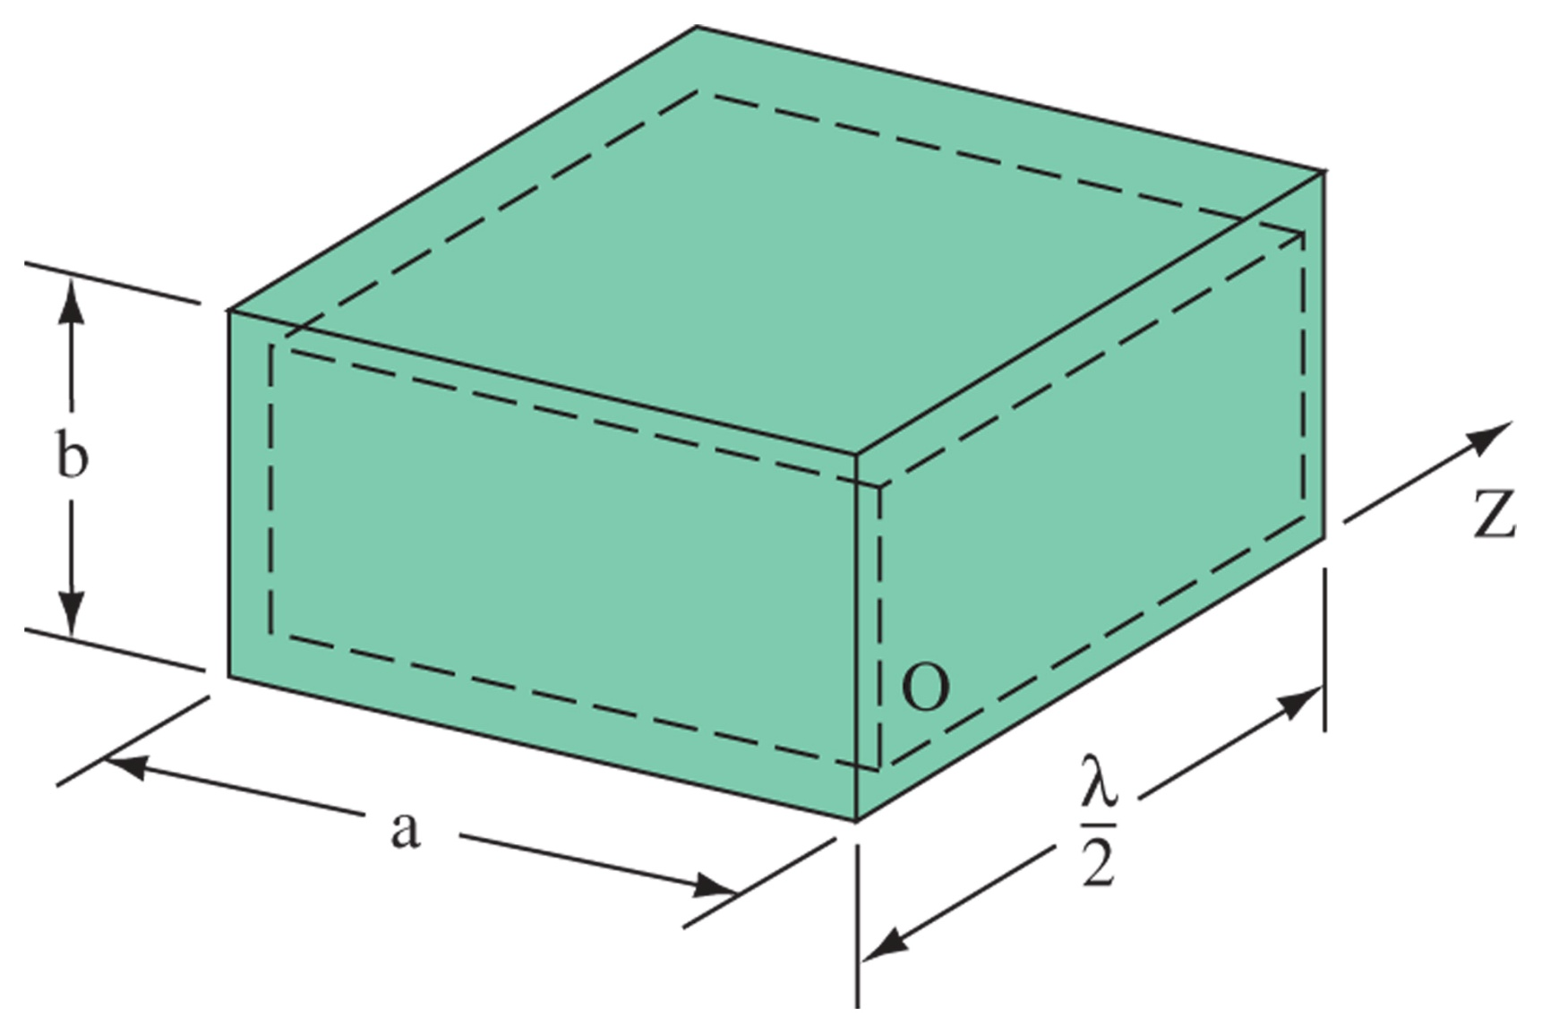
Cavity Resonators
Figure 15-21 Rectangular waveguide resonator.
Cavity Resonators are used at microwave frequencies in place of standard LC resonant circuits, just like transmission lines can be used in place of LC resonators in RF applications.

Slide 34
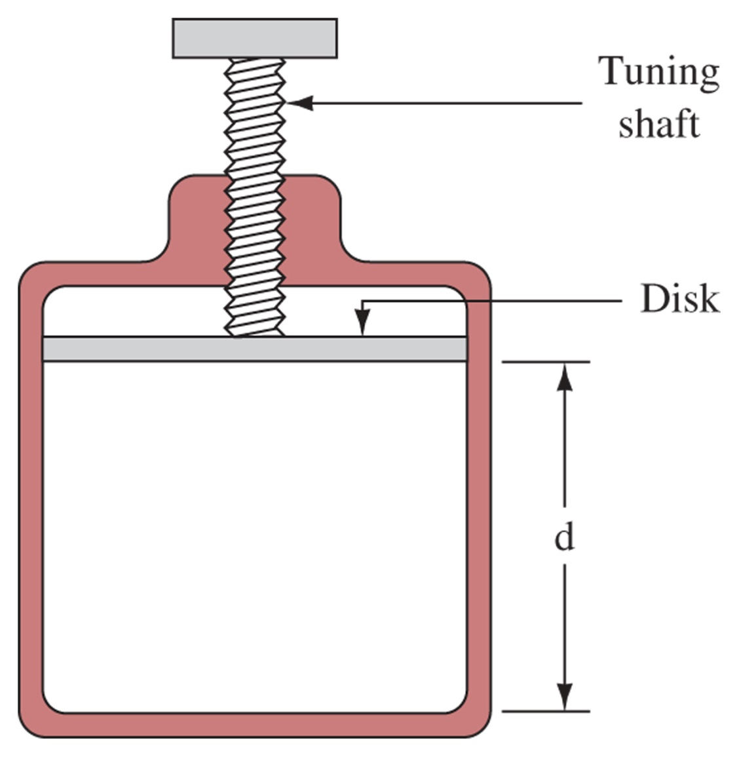
Cavity Tuning
Cavity volume can be tuned. Decreasing d increases f, and increasing d decreases f
Tuning can also be accomplished by inserting a non-ferrous screw or paddle near maximum H to increase or decrease the inductance inversely decreasing or increasing f.
Figure 15-22 Cavity tuning by volume.

Slide 35
15-9 Radar
Radio Detection and Ranging
Fundamentally a microwave transmitter and receiver
Measures waves reflected from an object such as a plane
Uses a directional antenna to determine range and distance to the object
Generally the larger the antenna, the better the resolution

Slide 36
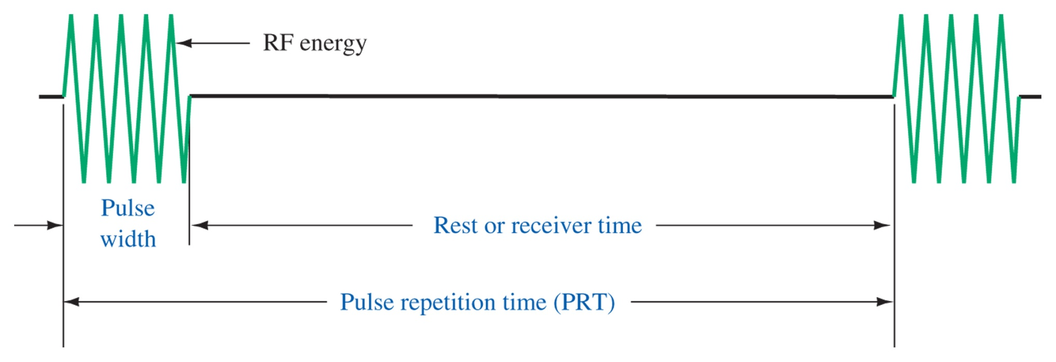
Radar Waveform and Range Determination
Figure 15-23 Radar pulses.
Speed of light, c = 186000 mi/s or 162000 nautical mi/s (6076 ft/s)
Radar mile is 2000 yards (6000 ft).
Range found from time, 6.18us to travel 1 radar mile. Range = t/12.36
Can be calculated from speed of light

Slide 37
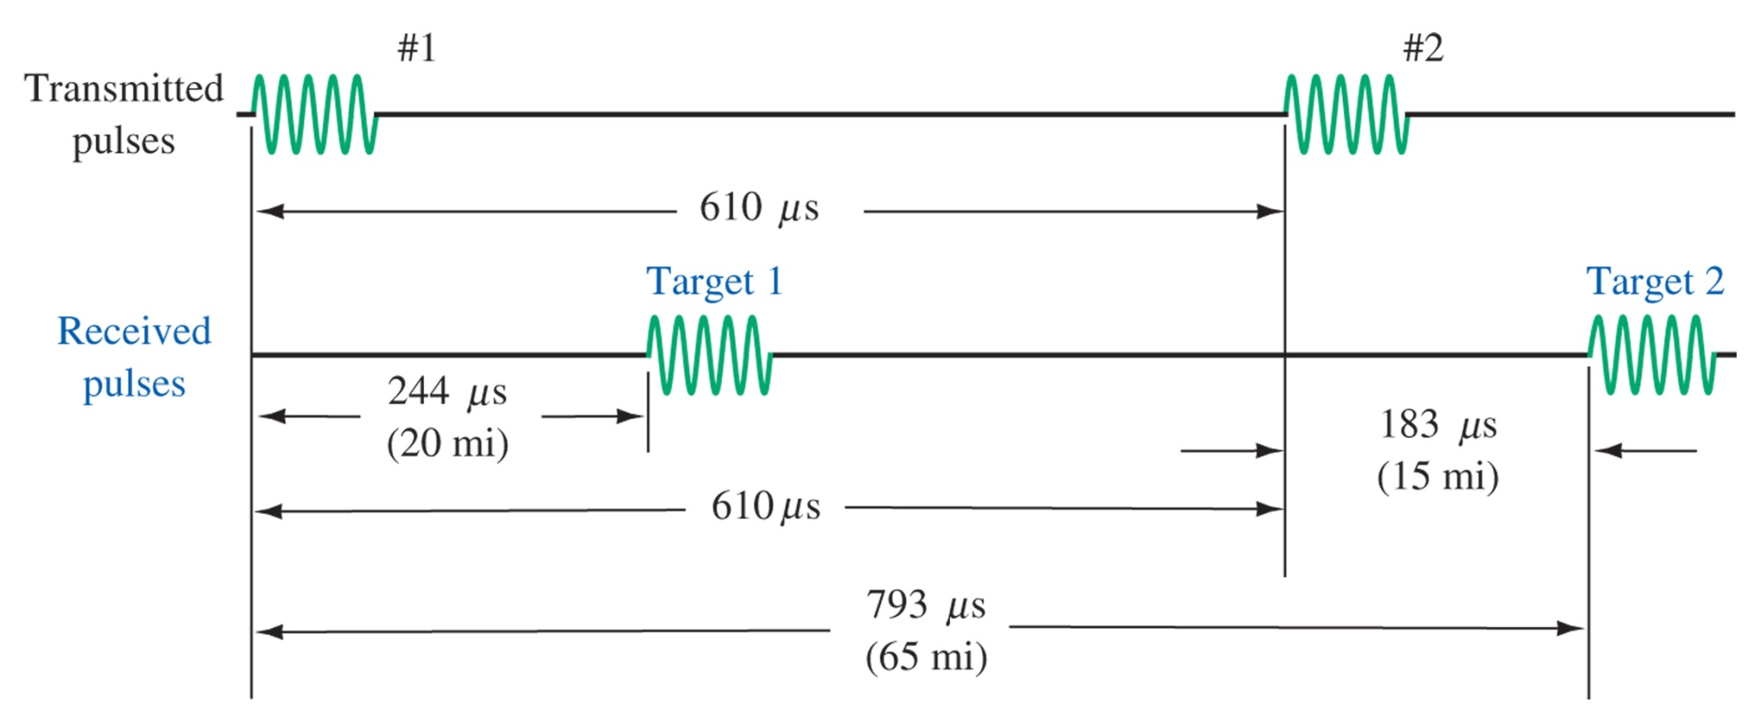
Radar System Parameters
Figure 15-24 Second return echo.
Max unambiguous range = PRT/12.2
Minimum Range = 150 PW
Duty cycle = PW / PRT

Slide 38
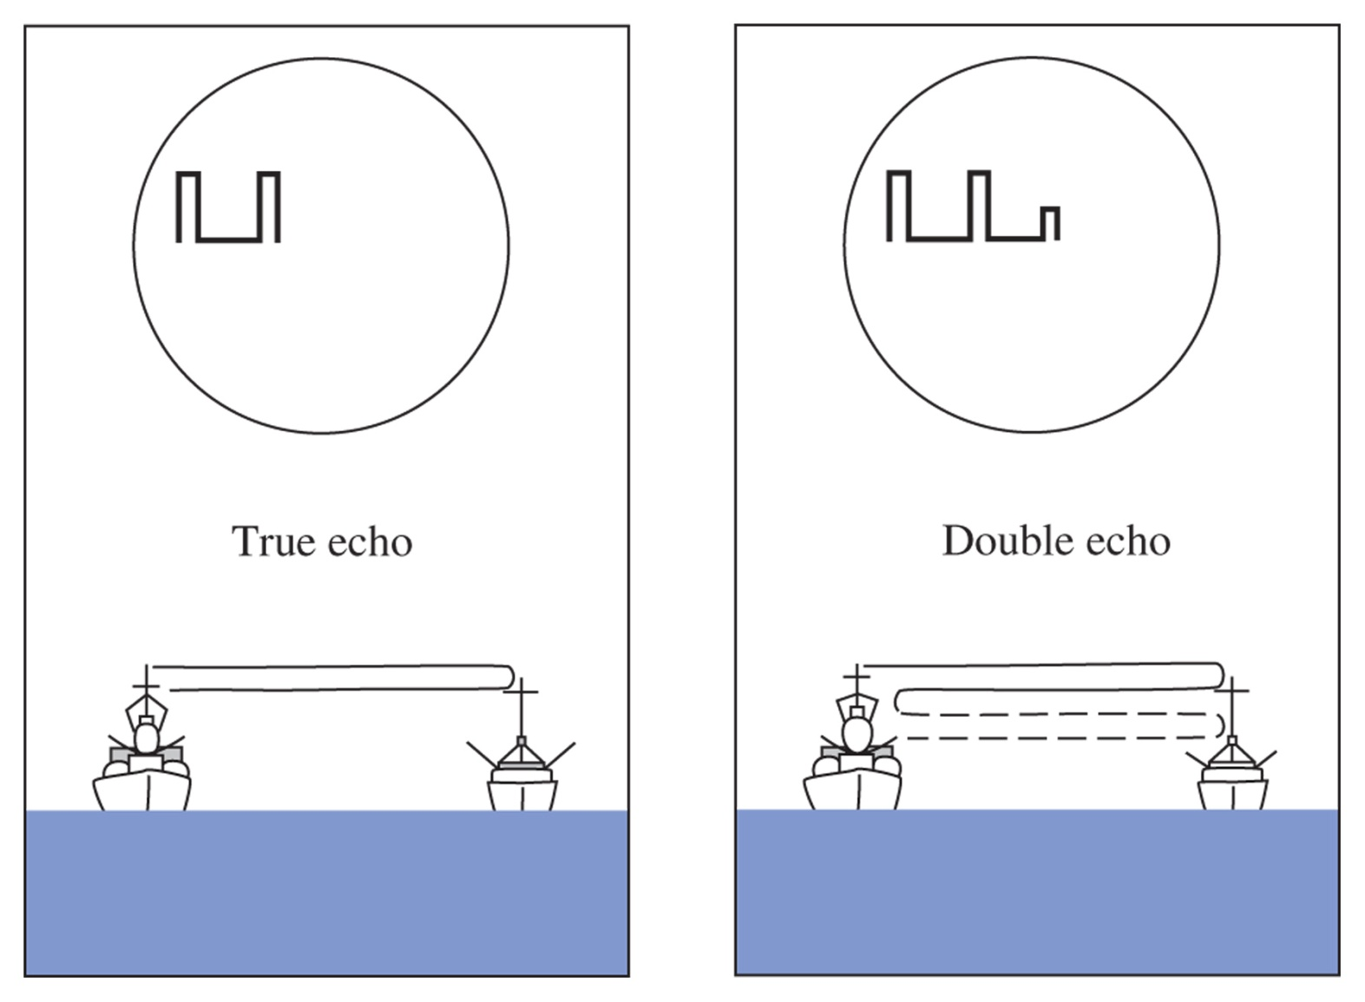
Figure 15-25 Double range echo.

Slide 39
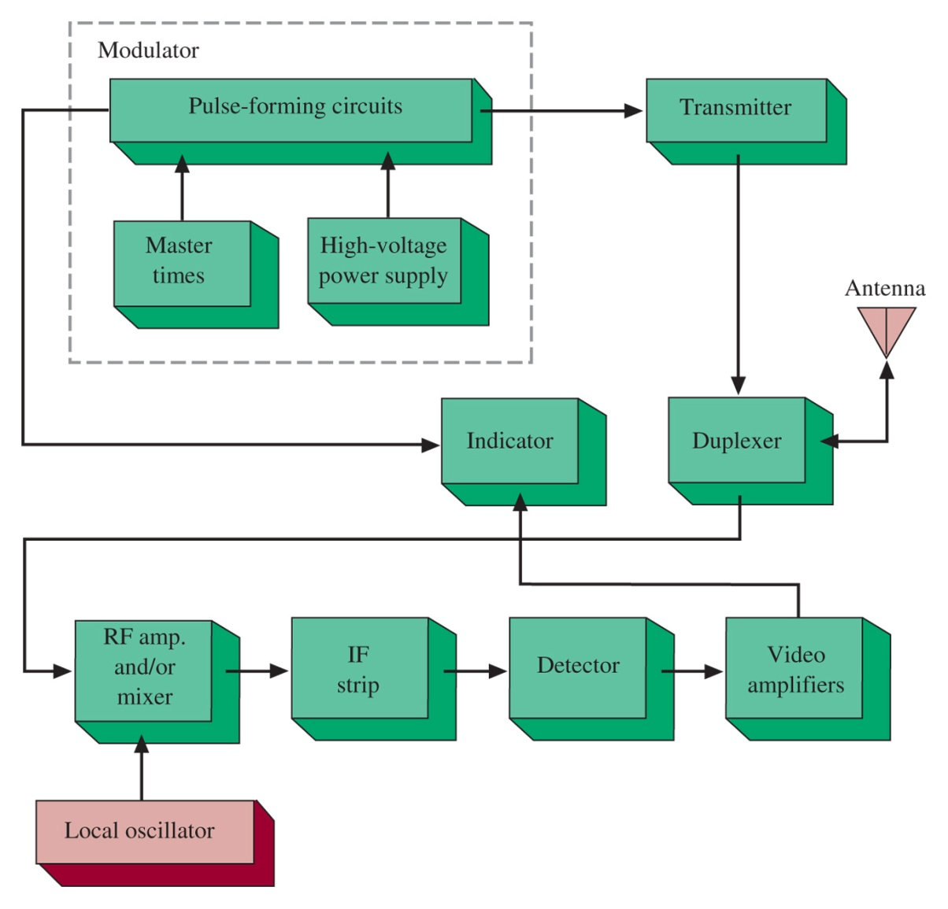
Figure 15-26 Radar system block diagram.

Slide 40
15-10 RFID - Radio Frequency Identification
Powering the Tag
Frequency of Operation
Communications (Air Interface) Protocol

Slide 41
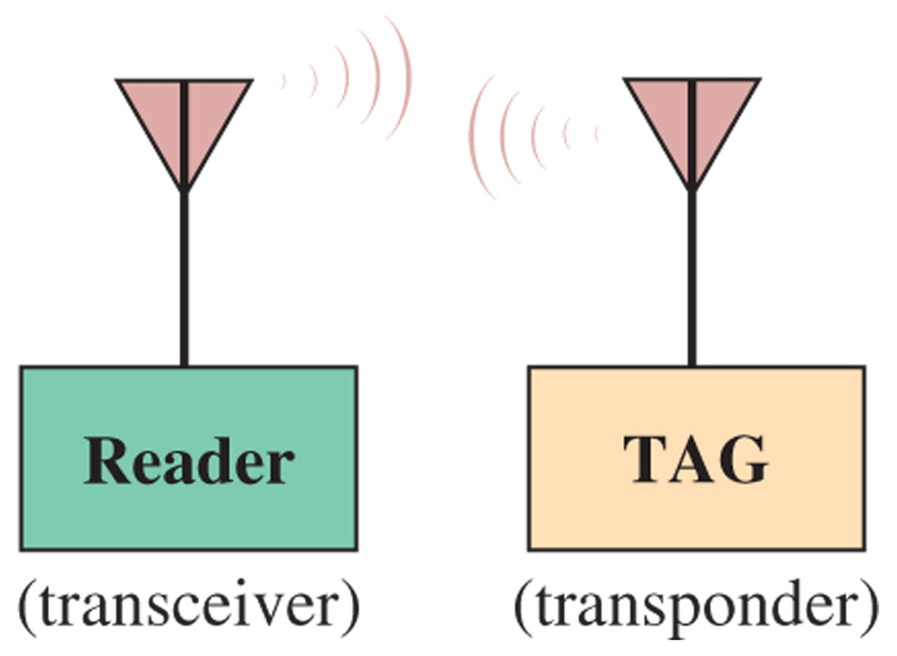
Figure 15-27 Basic block diagram of an RFID system.

Slide 42
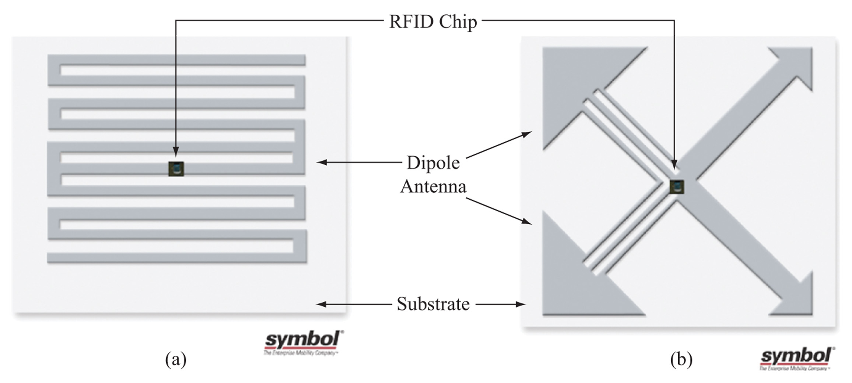
Figure 15-28 Examples of (a) single-dipole and (b) dual-dipole RFID inlays. ( 2007 Symbol Technologies, Inc. Reprinted with permission.)

Slide 43
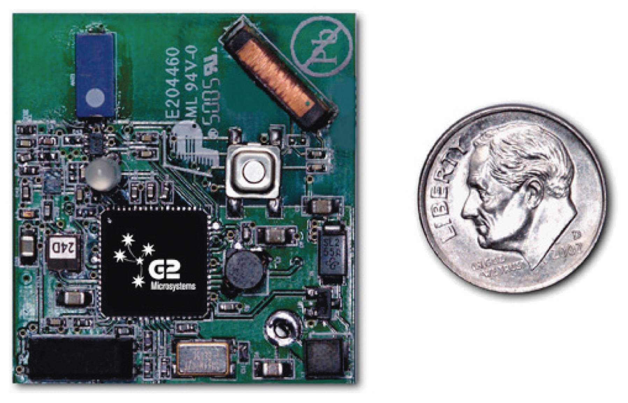
Figure 15-29 The G2C501 active RFID tag from G2 Microsystems. (Courtesy of G2 Microsystems.)

Slide 44
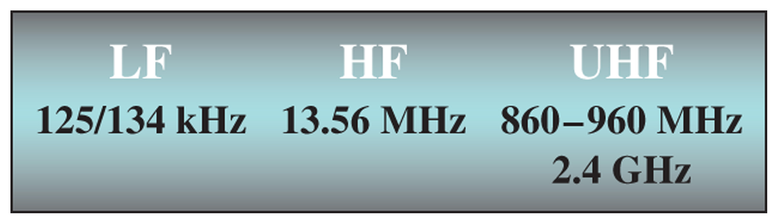
Figure 15-30 The frequency bands used by RFID tags.

Slide 45
15-11 Microintegrated Circuit Waveguiding

Slide 46
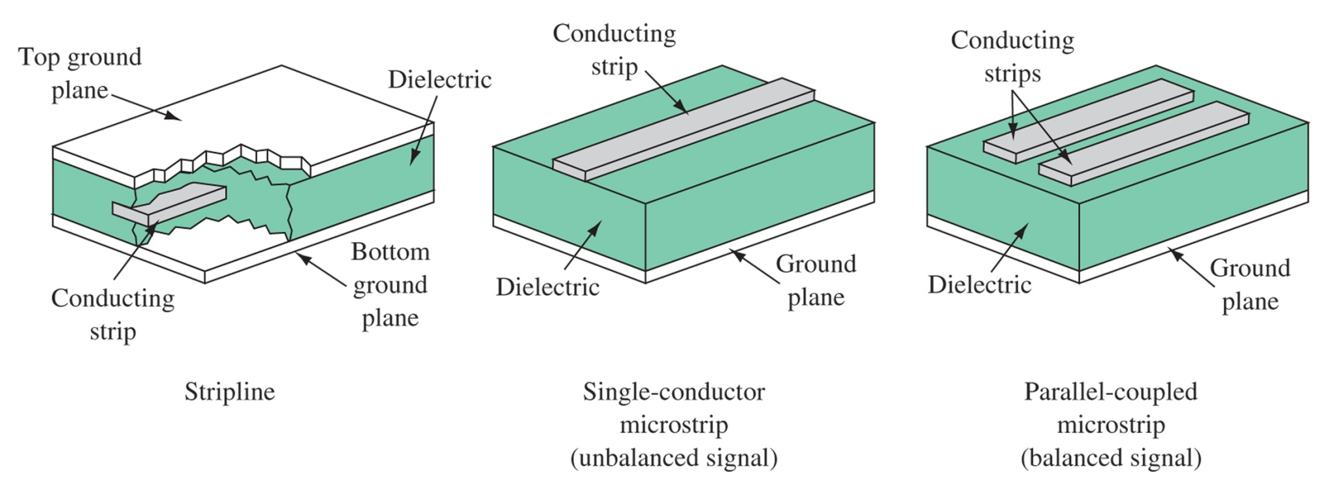
Figure 15-31 Stripline and microstrip.

Slide 47
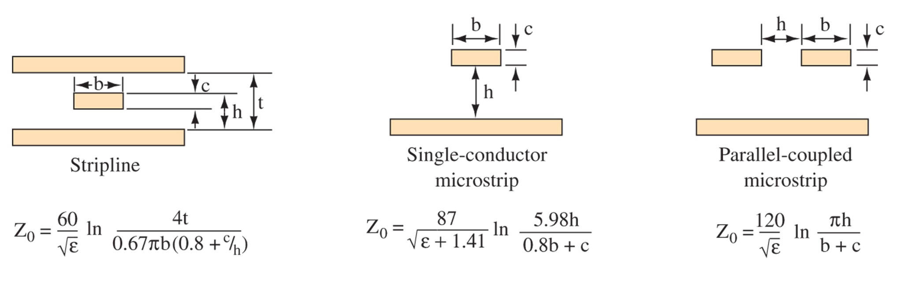
Figure 15-32 Characteristic impedance.

Slide 48
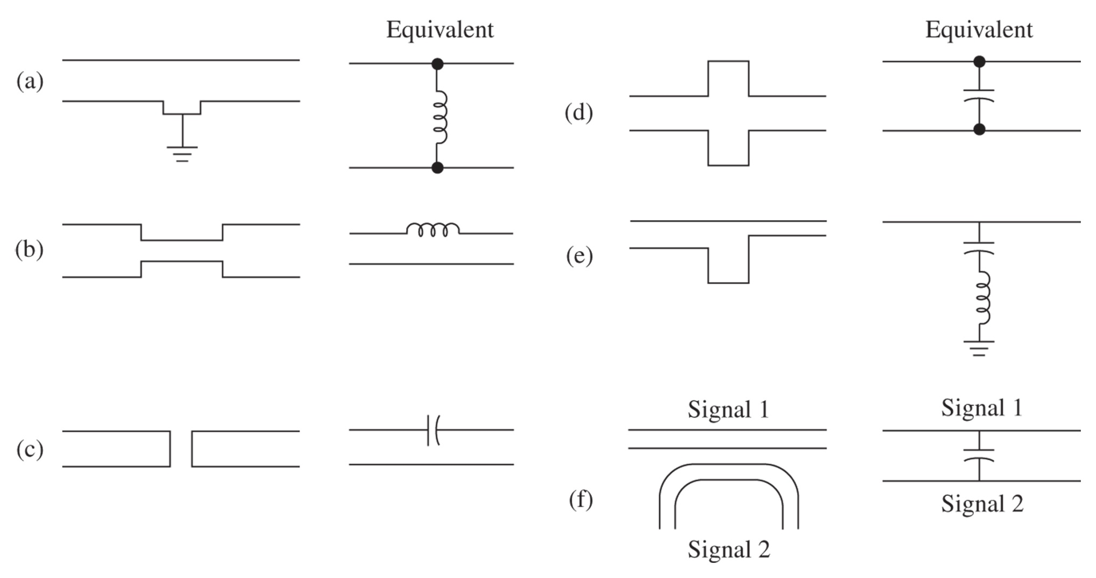
Figure 15-33 Microstrip circuit equivalents.

Slide 49
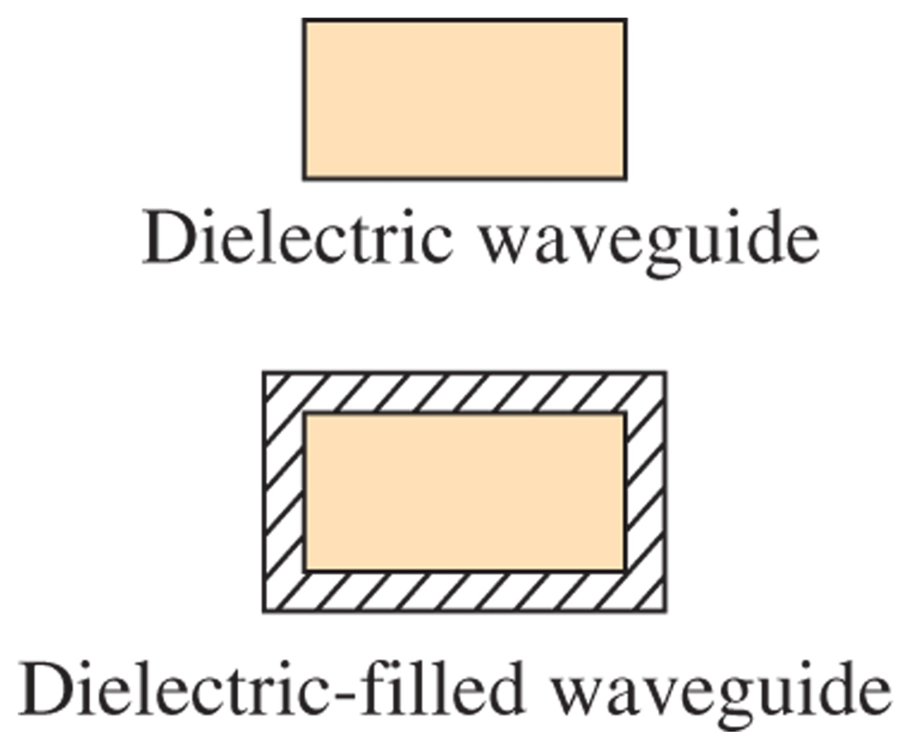
Figure 15-34 Dielectric waveguide and dielectric-filled waveguide.

Slide 50
15-12 Troubleshooting

Slide 51
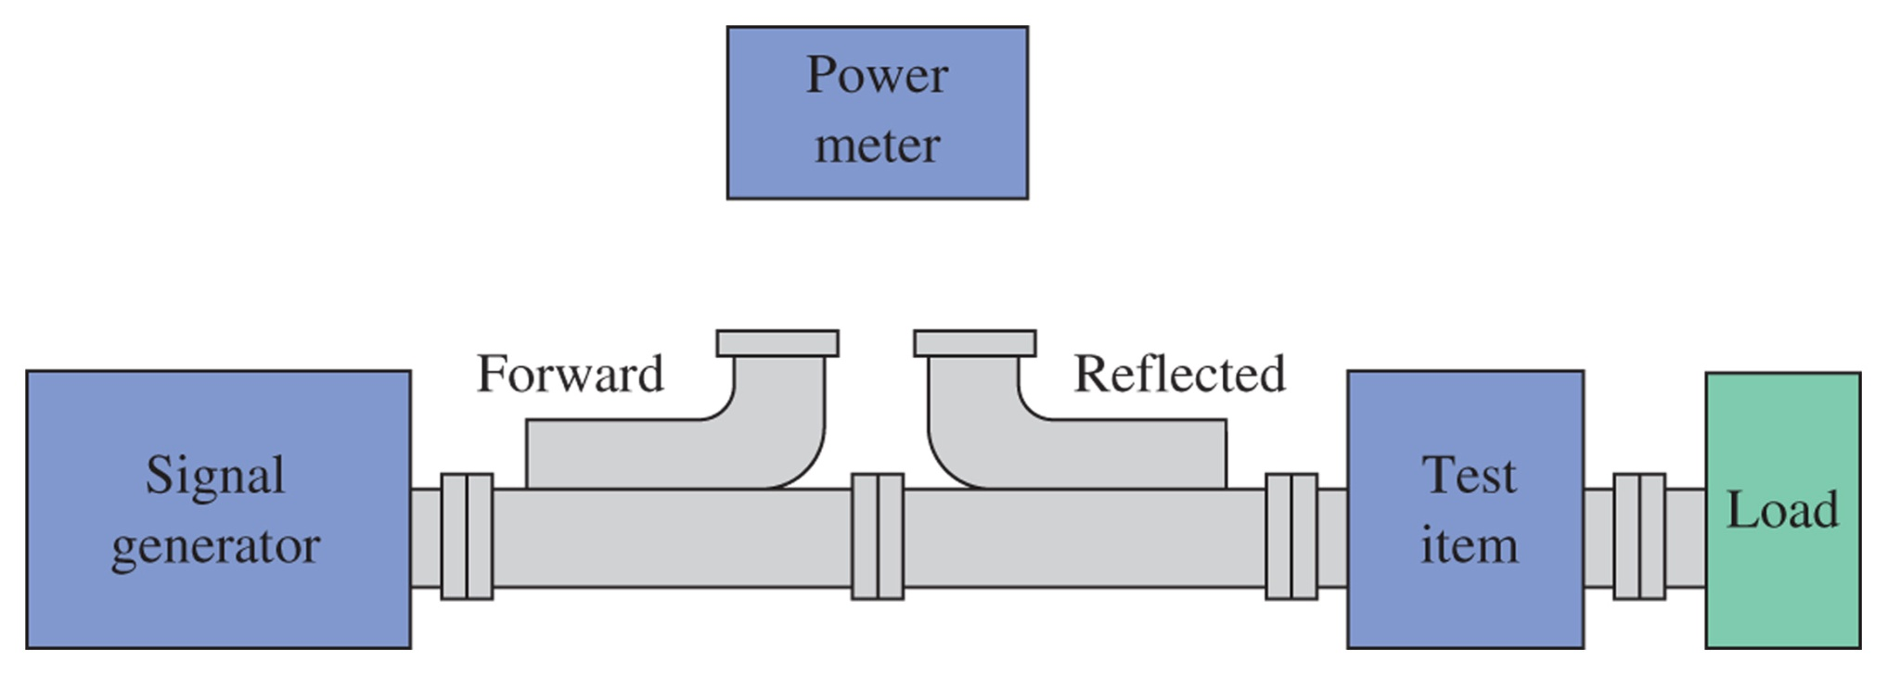
Figure 15-35 VSWR test.

Slide 52
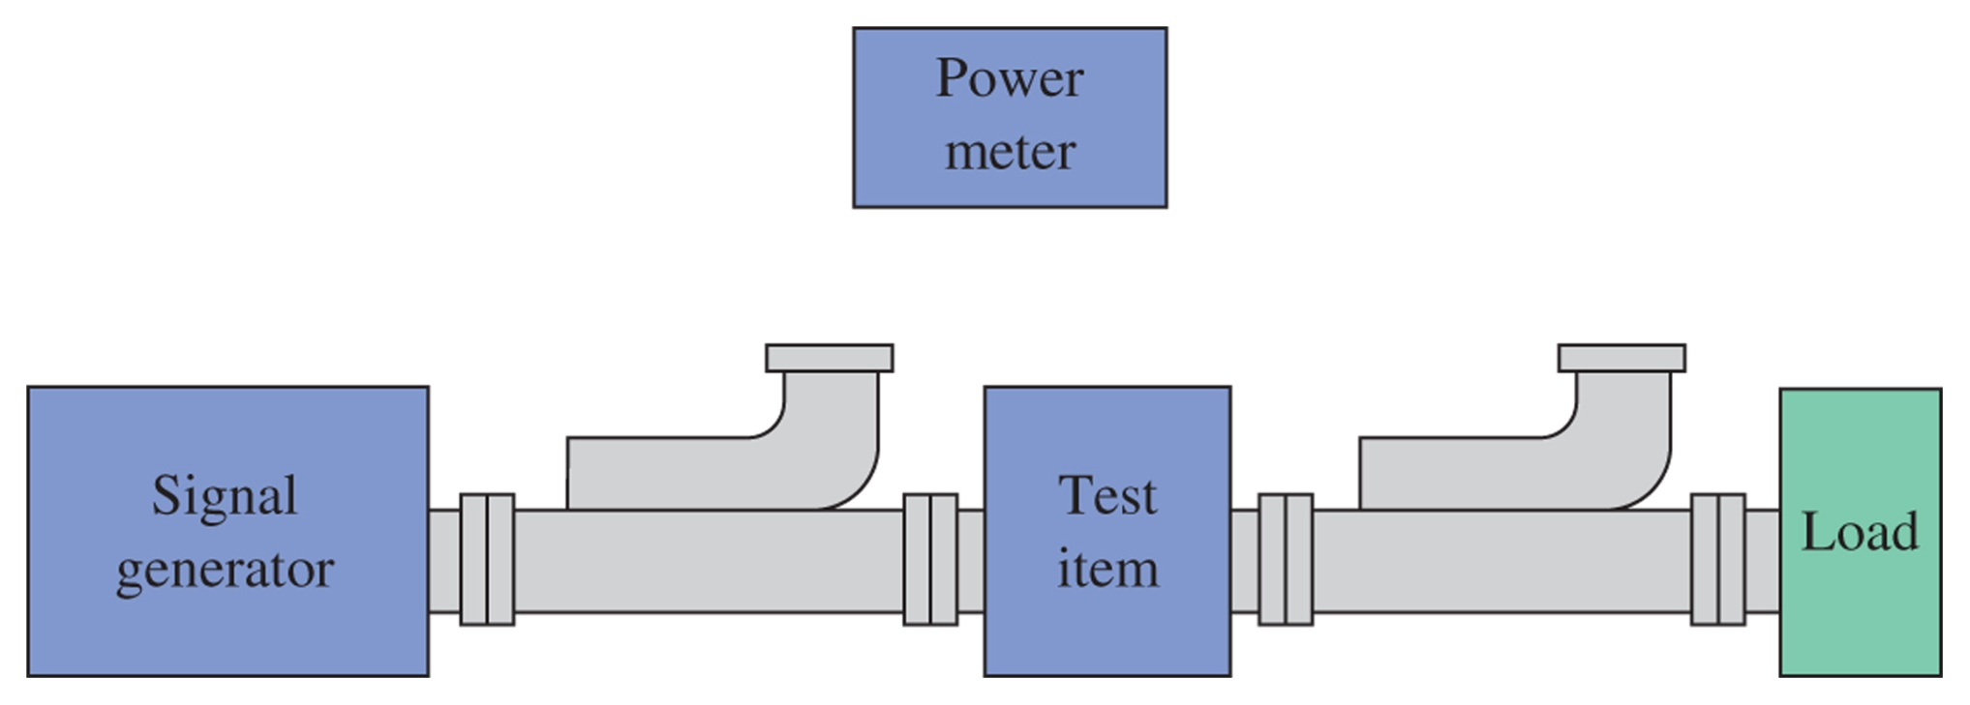
Figure 15-36 Loss test.

Slide 53
15-13 Troubleshooting w/ Multisim

Slide 54
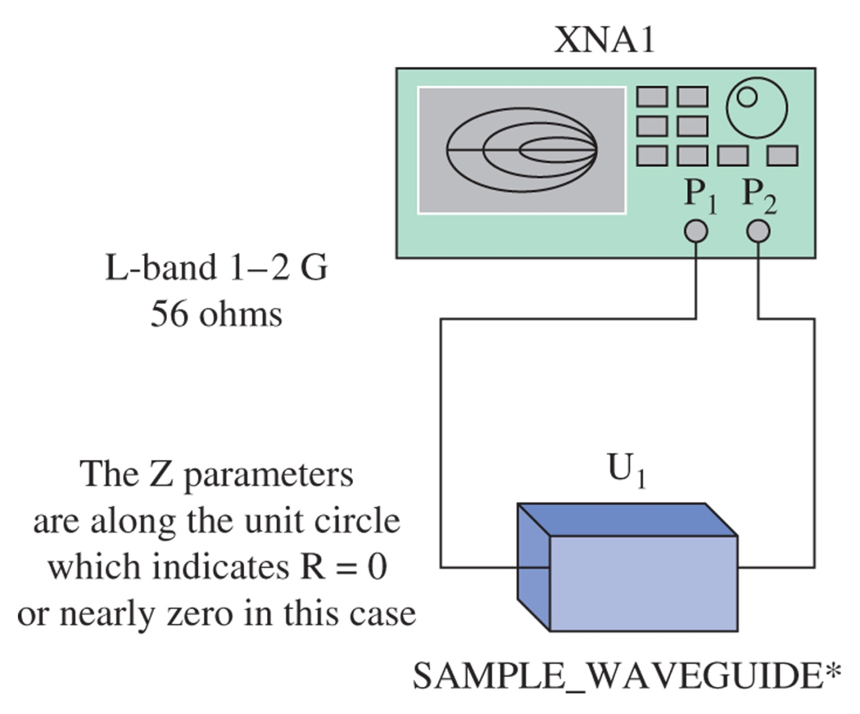
Figure 15-37 The circuit example of a low-loss waveguide section connected to a network analyzer.

Slide 55
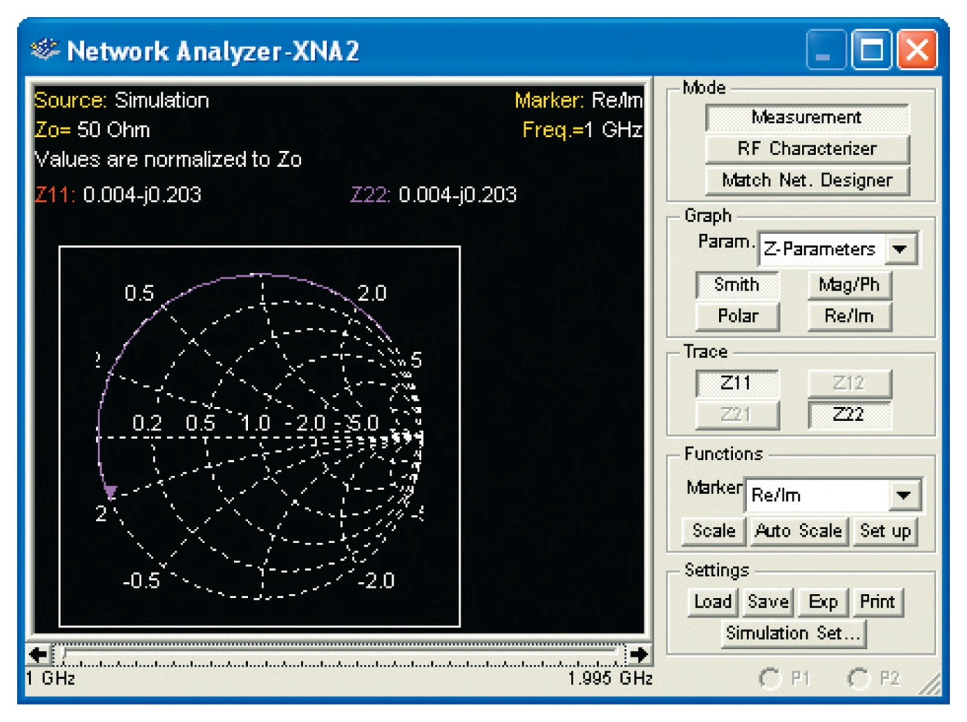
Figure 15-38 The simulation of a low-loss waveguide as viewed with the network analyzer.

Slide 56
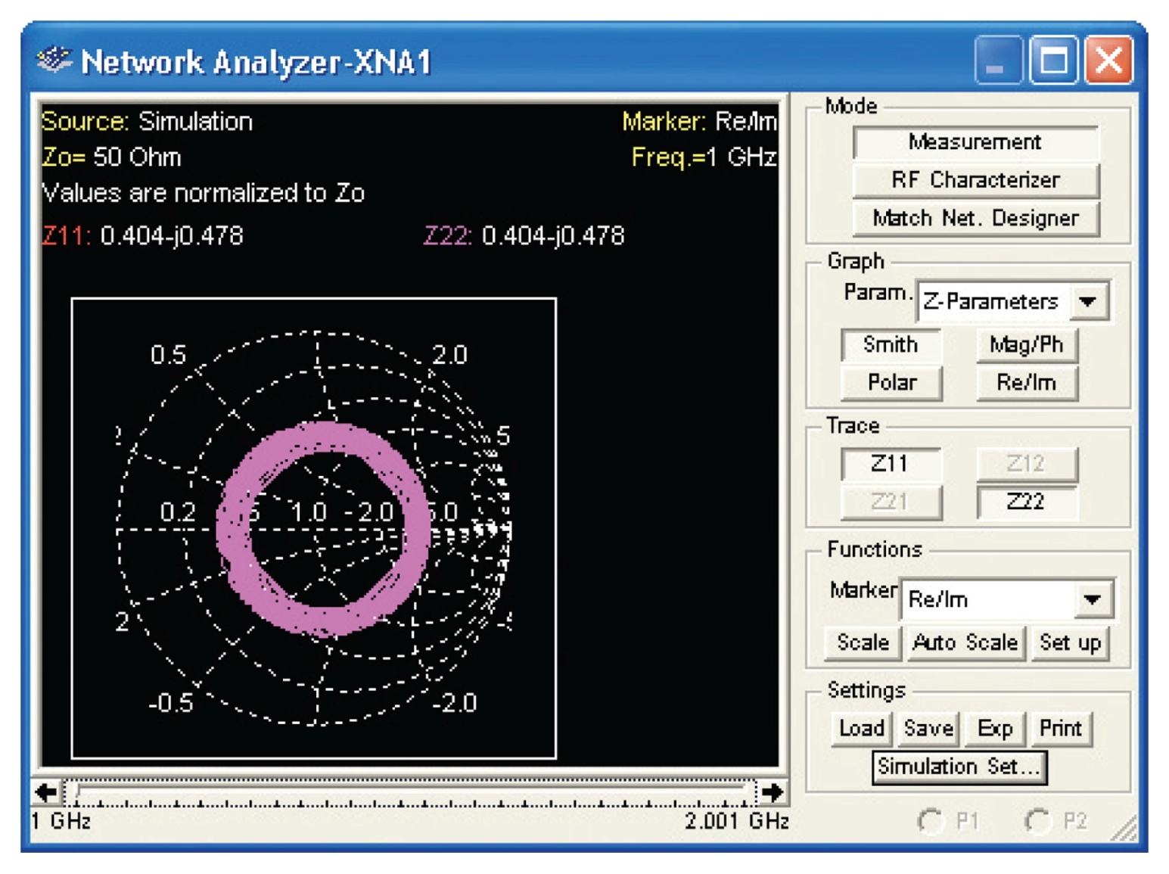
Figure 15-39 The simulation of a very lossy waveguide.

Slide 57
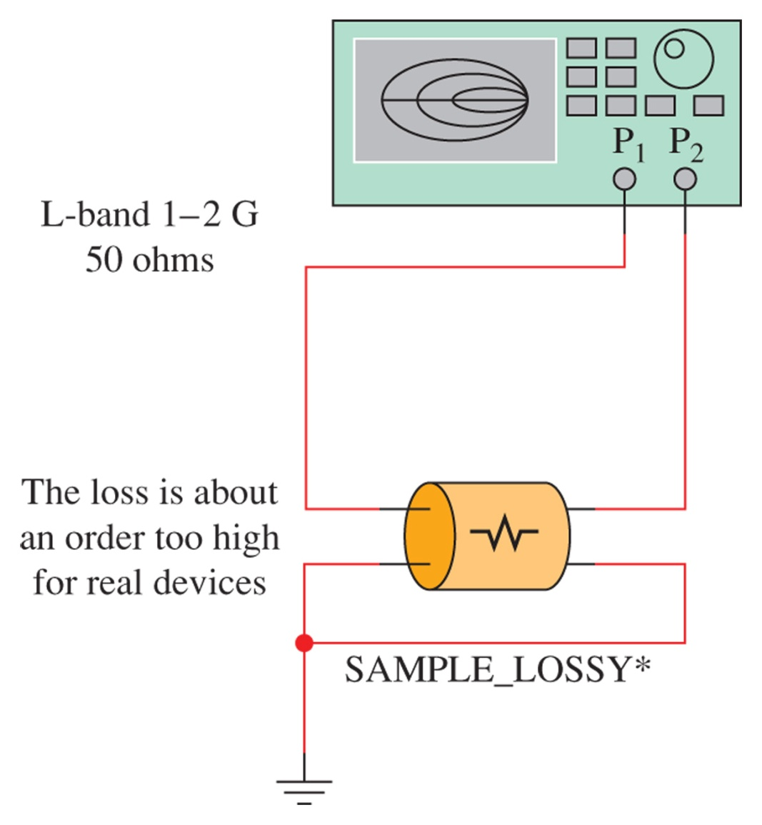
Figure 15-40 An example of a test on the Multisim sample lossy transmission line.

Slide 58
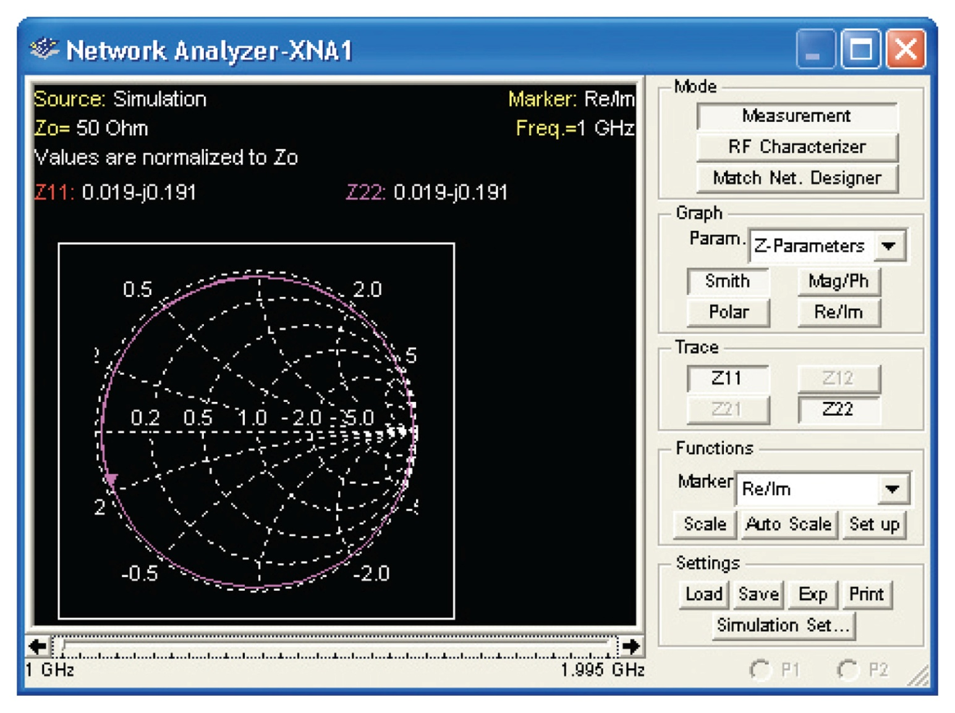
Figure 15-41 The simulation results of the lossy transmission line provided by EWB Multisim.

