Slide 1
EE 350 / ECE 490 Analog Communication Systems
Selected Topics

Slide 2
More References
Microwaves 101 – Microwave Encyclopedia – www.microwaves101.com
Spread Spectrum Scene - http://sss-mag.com/index.html
RF Café - http://rfcafe.com/
IEEE societies – Antennas and Propagation, Broadcast Technology, Communications http://www.ieee.org/societies_communities/societies/about_societies.html

Slide 3
Smith Chart Program
Freeware tool for calculating Smith Chart values
Resources available online:
RF Café - http://www.rfcafe.com/references/electrical/smith.htm
Agilent Smith Chart applet - http://education.tm.agilent.com/index.cgi?CONTENT_ID=5

Slide 4
16-1 Microwave Antennas
Horn Antennas
Parabolic Reflectors
Lens Antenna
Patch Antenna

Slide 5
Horn Antennas
Figure 16-1 Horn antennas. Provide up to 20dBd of gain, and are very simple to construct.

Slide 6
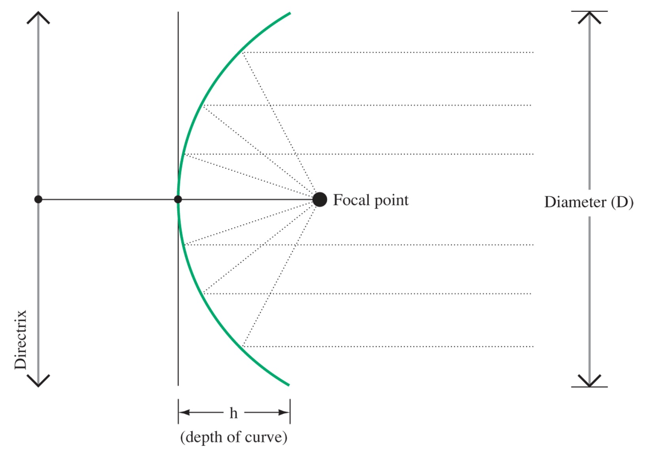
Parabolic Reflector
Figure 16-2 Location of the focal point for a parabolic reflector. Diameter should be 10x the wavelength.

Slide 7
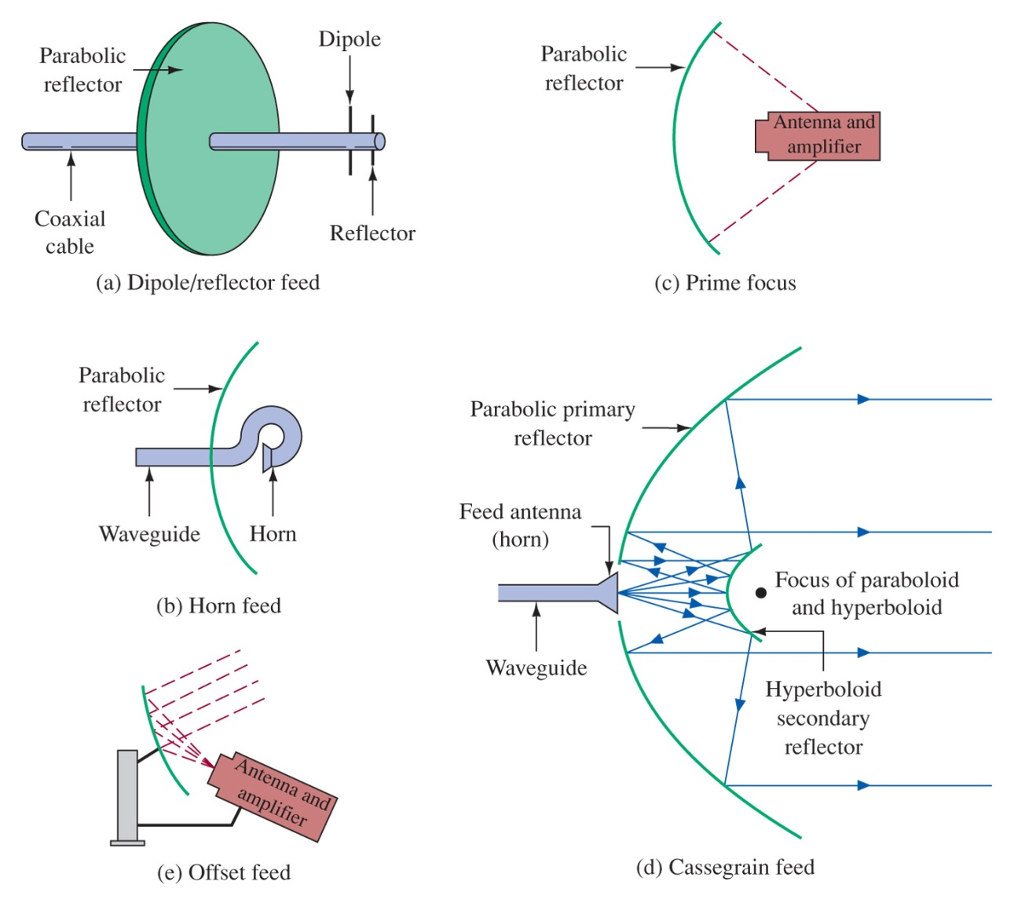
Dish Antennas
Figure 16-3 Microwave dish antennas.

Slide 8
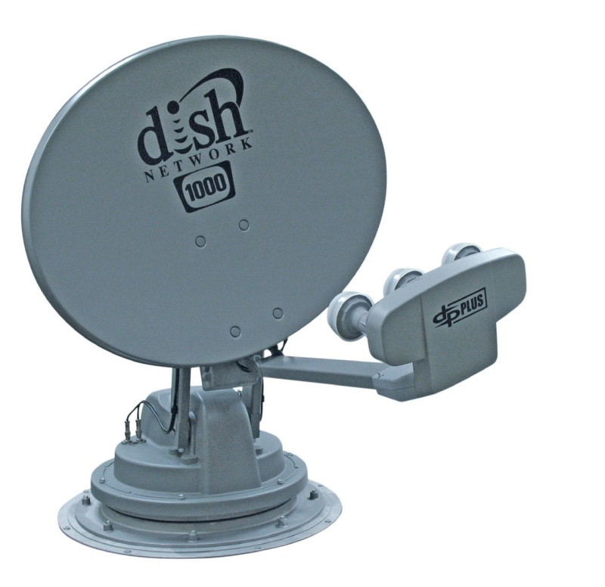
Dish Antennas

Slide 9
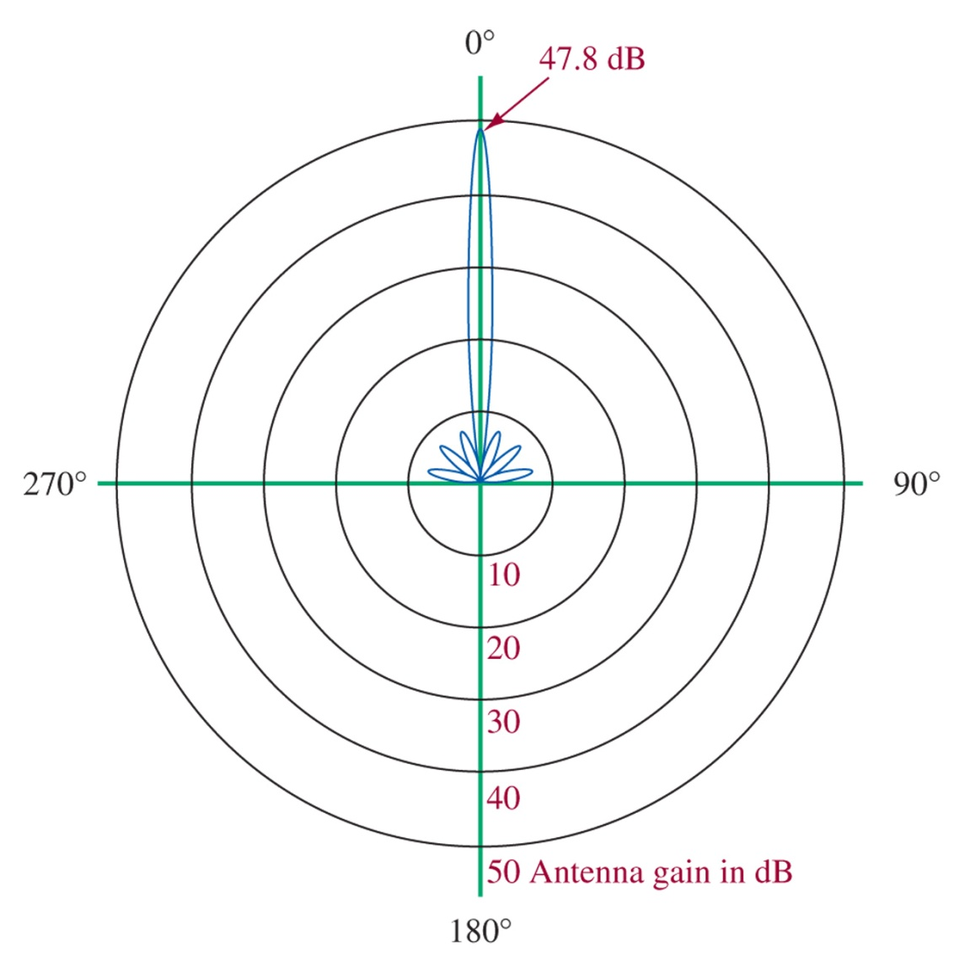
Figure 16-4 Polar pattern for parabolic antenna in Example 16-1.

Slide 10
Radomes

Slide 11
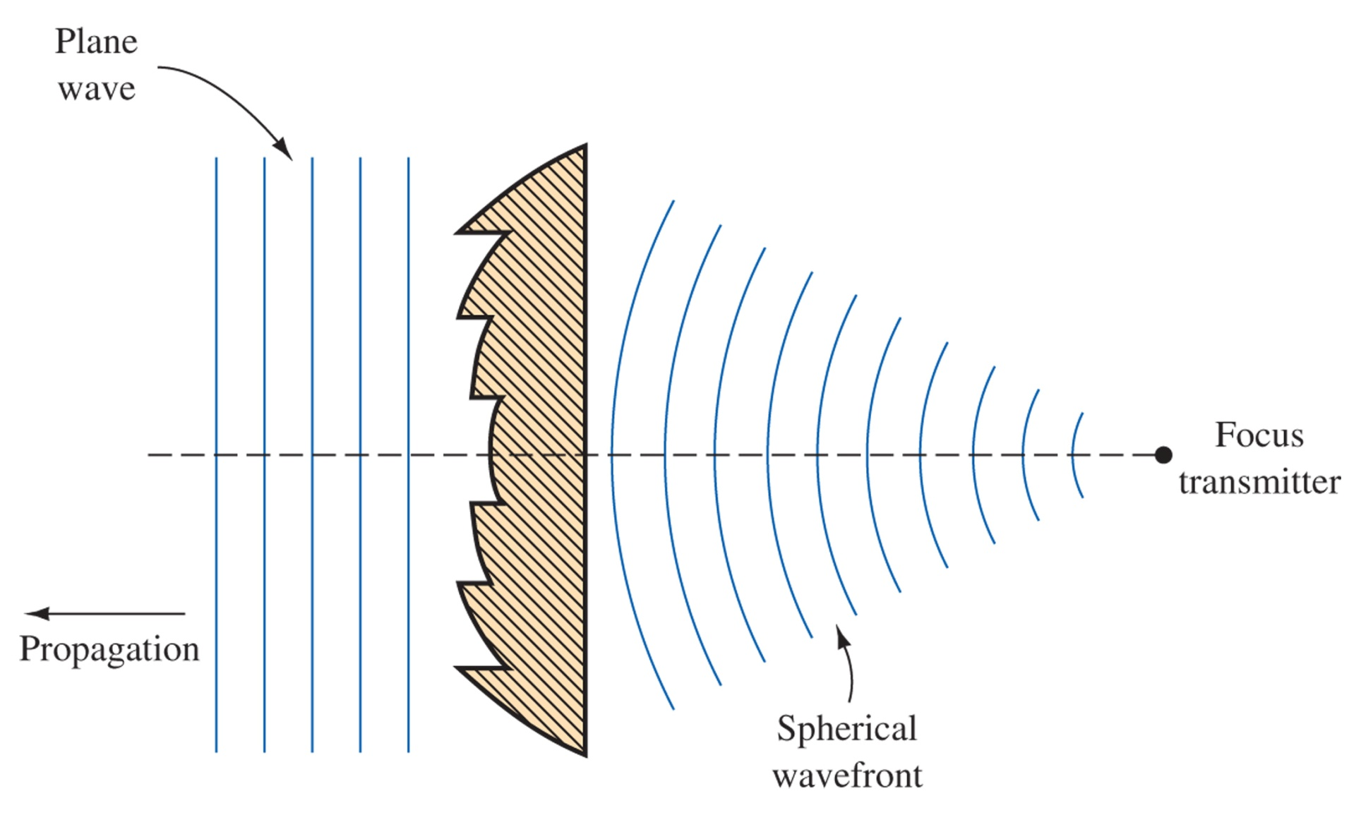
Lens antenna
Figure 16-5 Zoned lens antenna.

Slide 12
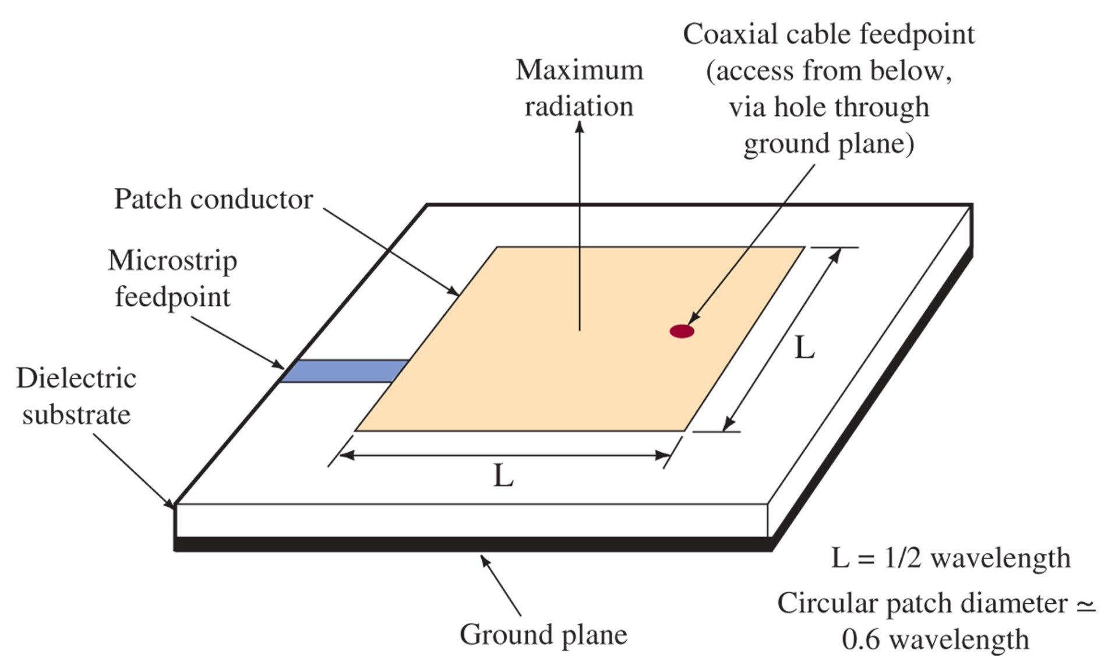
Figure 16-6 Patch antenna.

Slide 13
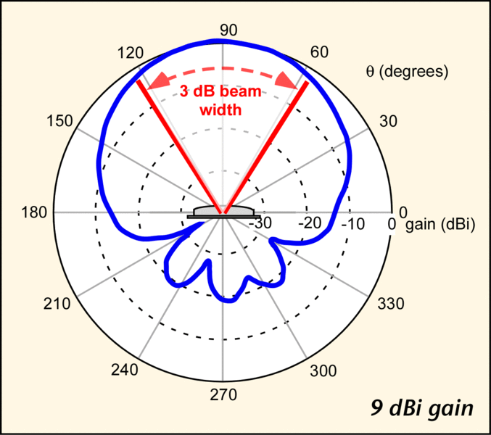
Patch Antenna

Slide 14
10-3 Spread-Spectrum Techniques
Modern communication are relying more and more on Spread Spectrum to make more efficient use of a single band, by making many channels within the band.

Slide 15
Figure 10-17 A 7-bit sequence generator.

Slide 16
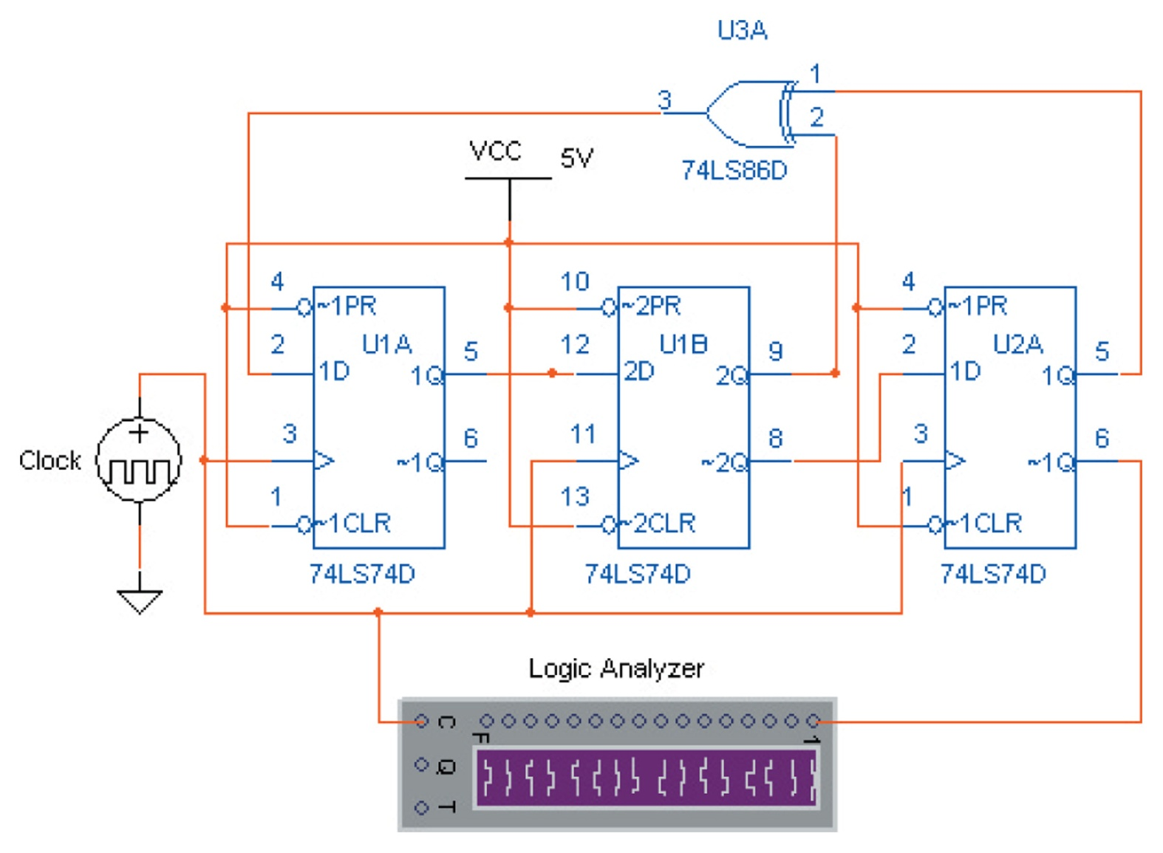
Figure 10-18 An implementation of a 7-bit PN sequence generator using Electronics WorkbenchTM Multisim.

Slide 17
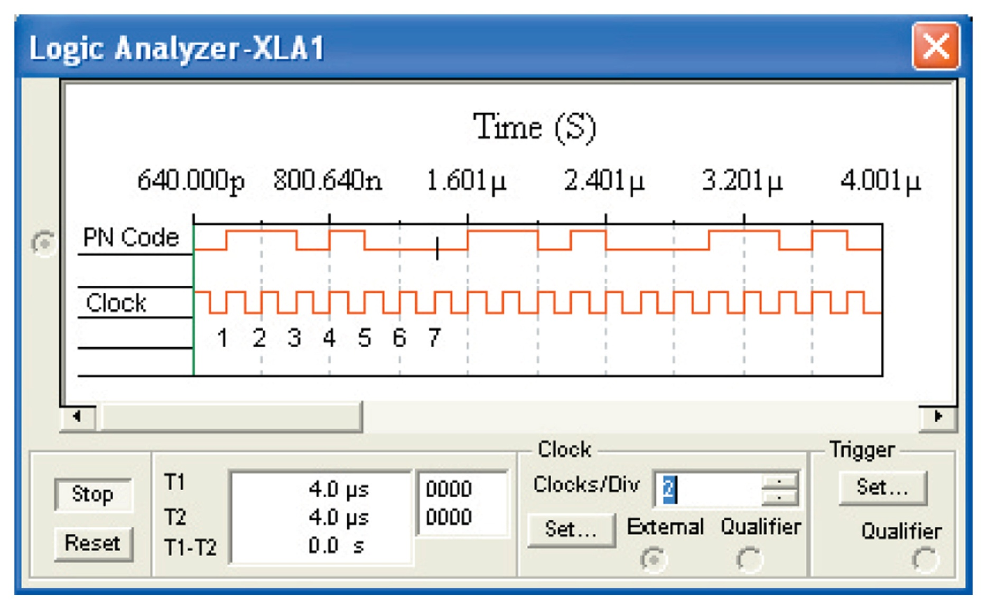
Figure 10-19 The serial data output stream for the 7-bit PN sequence generator.

Slide 18
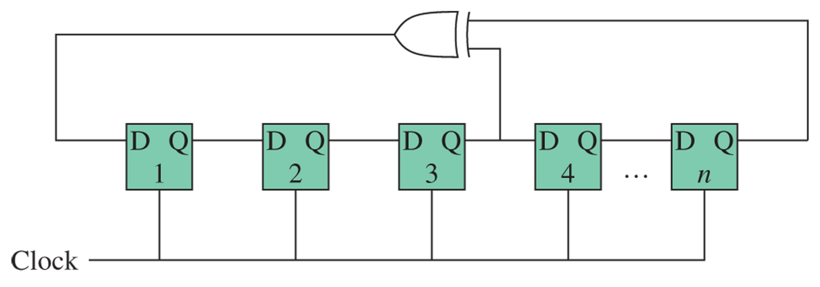
Figure 10-20 The PN sequence generator circuit structure for the connections listed in Table 10-2. The circuit shown is connected with five shift registers (n = 5) and a maximal length of 31.

Slide 19
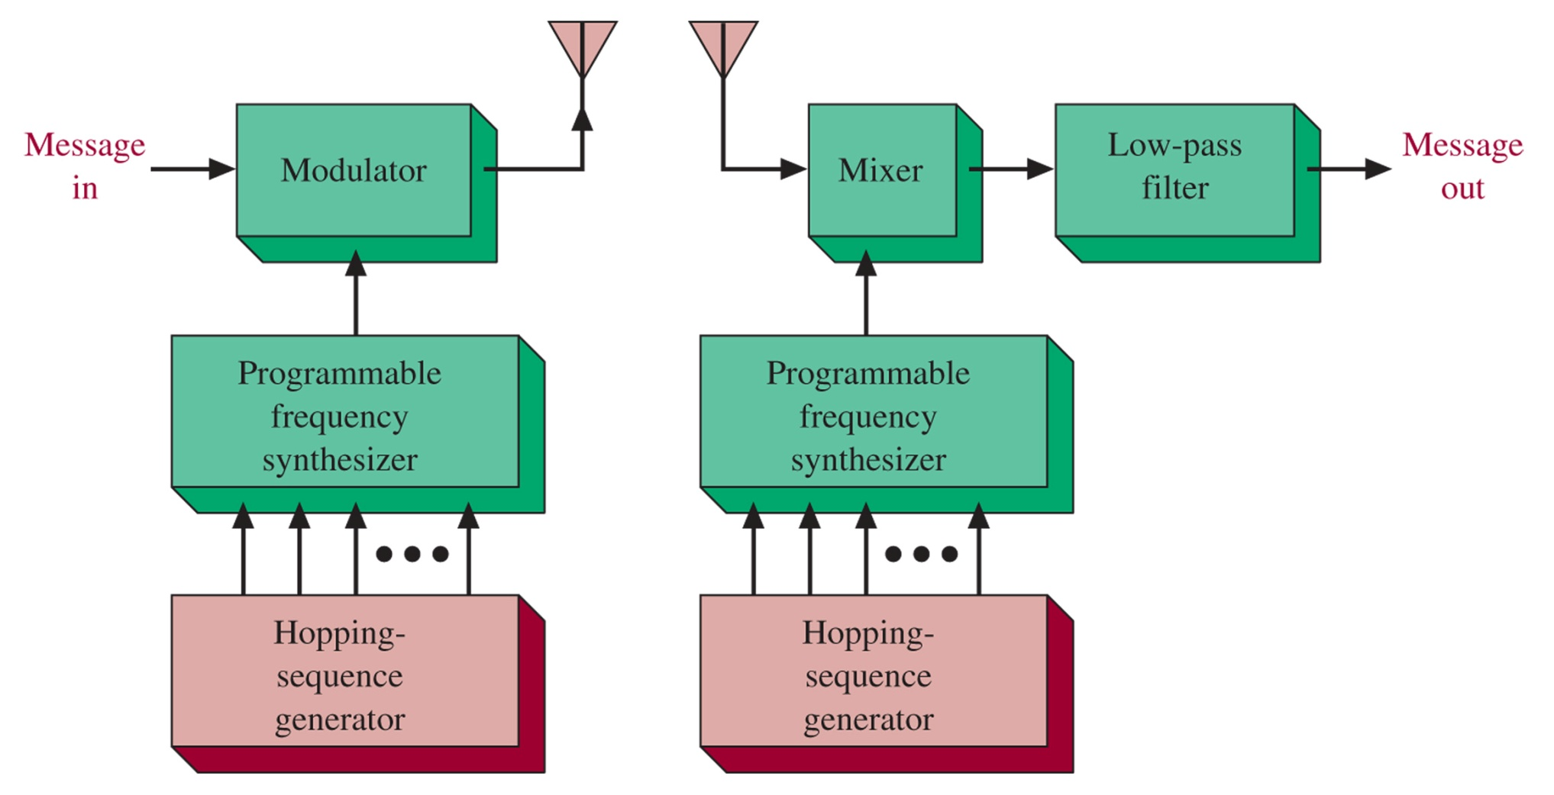
Figure 10-21 Frequency hopping spread spectrum.

Slide 20
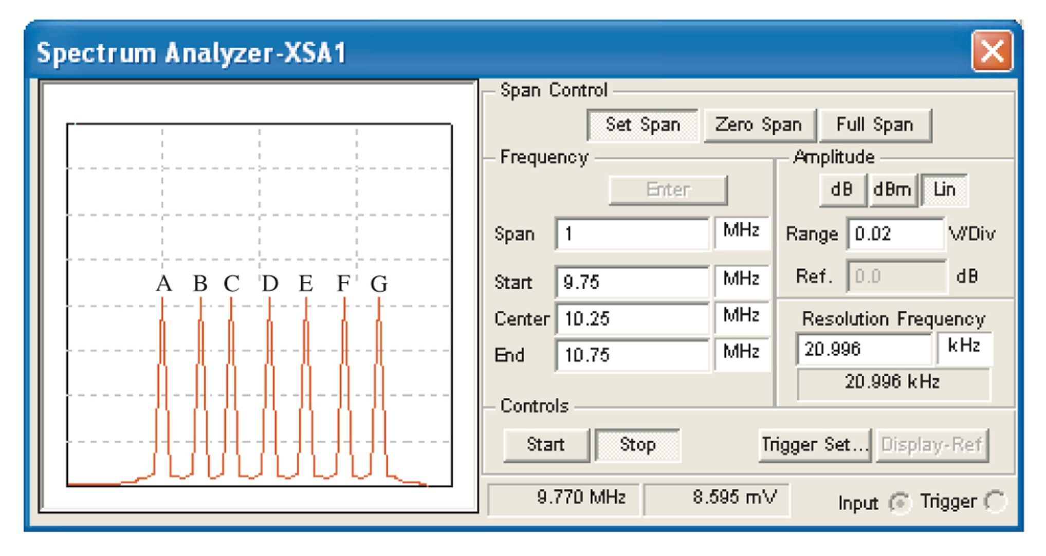
Figure 10-22 A simplified RE spectrum for a frequency hopping spread-spectrum signal.

Slide 21
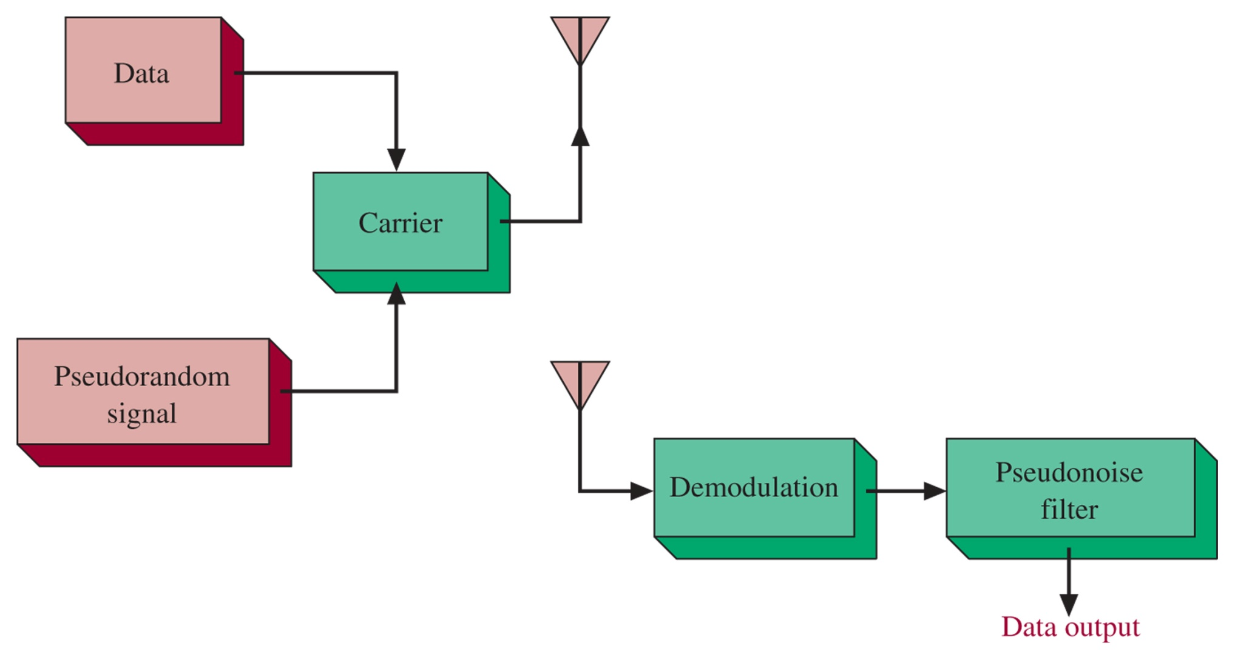
Figure 10-23 Direct sequence spread spectrum.

Slide 22
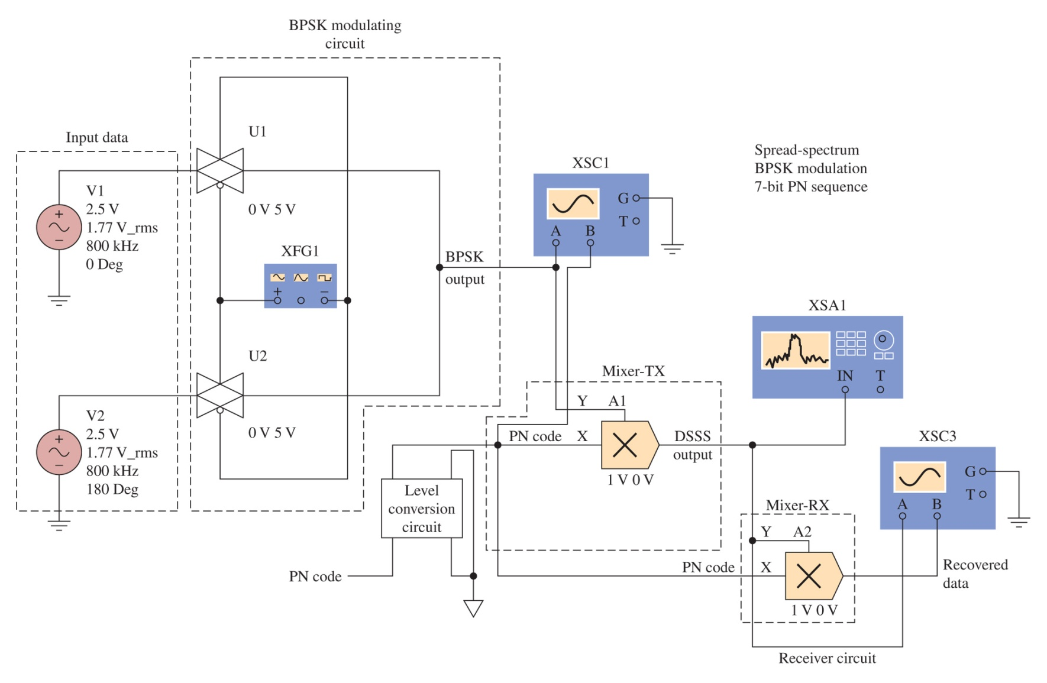
Figure 10-24 An implementation of a DSSS circuit using Electronics WorkbenchTM Multisim.

Slide 23
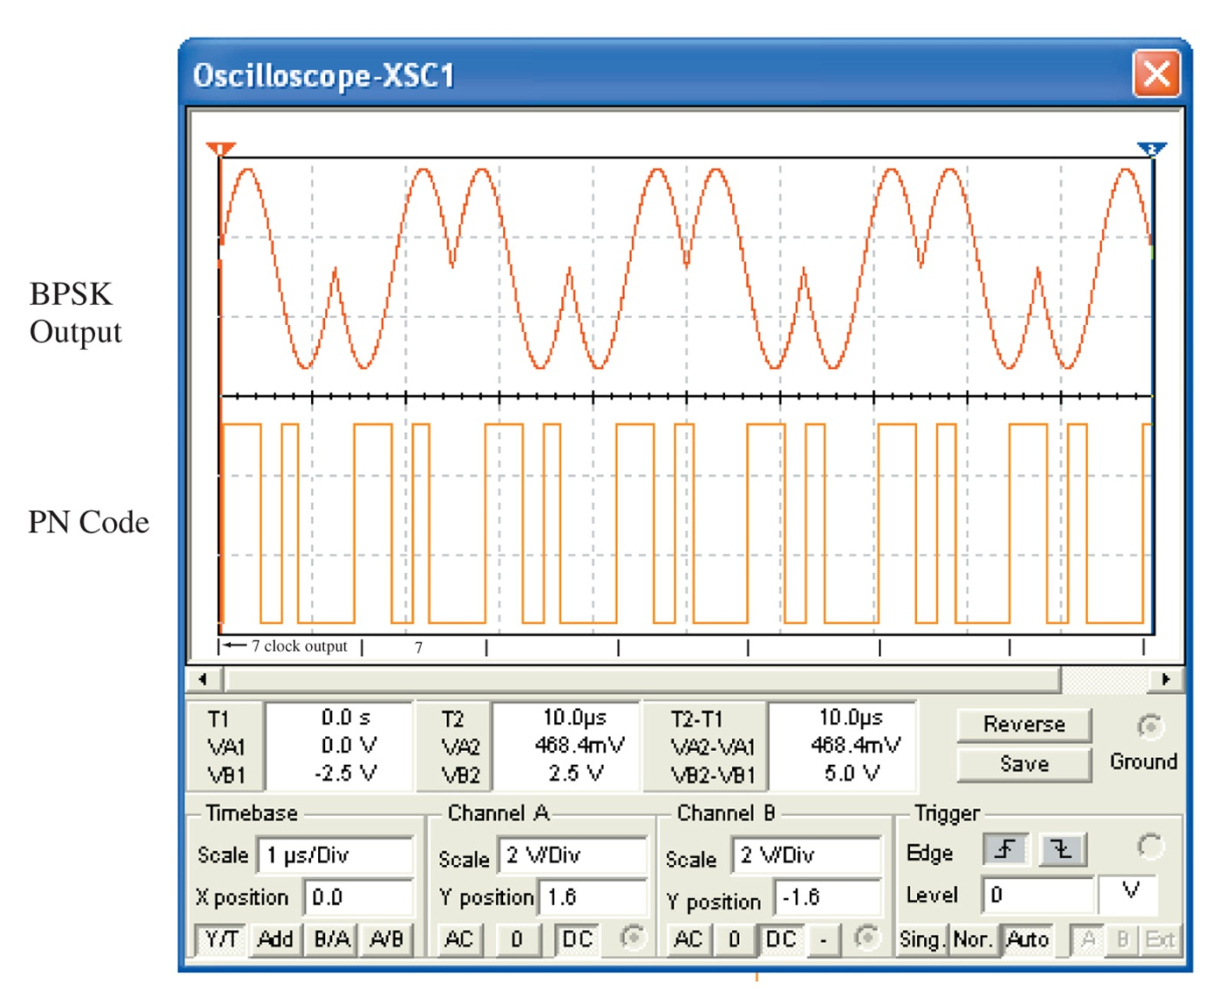
Figure 10-25 The waveforms for the BPSK output and the PN code.

Slide 24
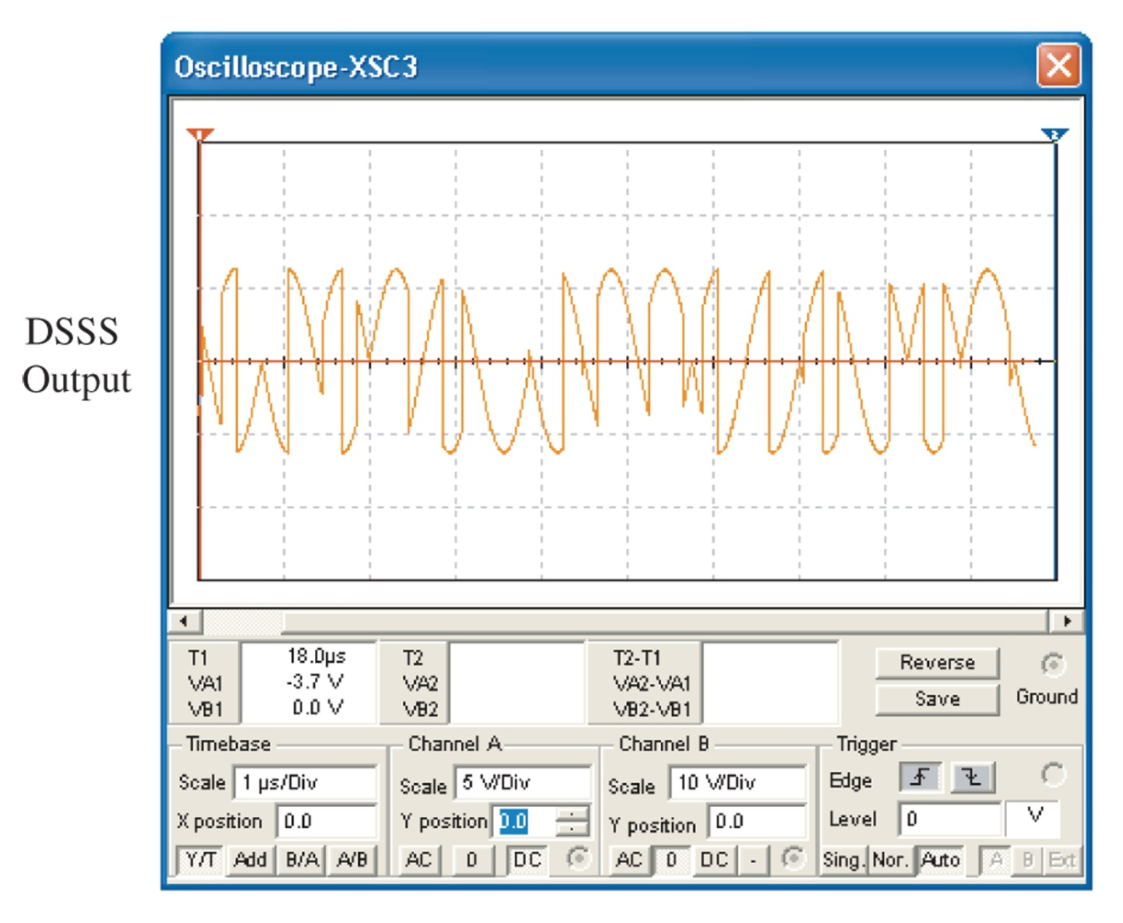
Figure 10-26 The DSSS output signal generated by mixing the BPSK output and the PN code.

Slide 25
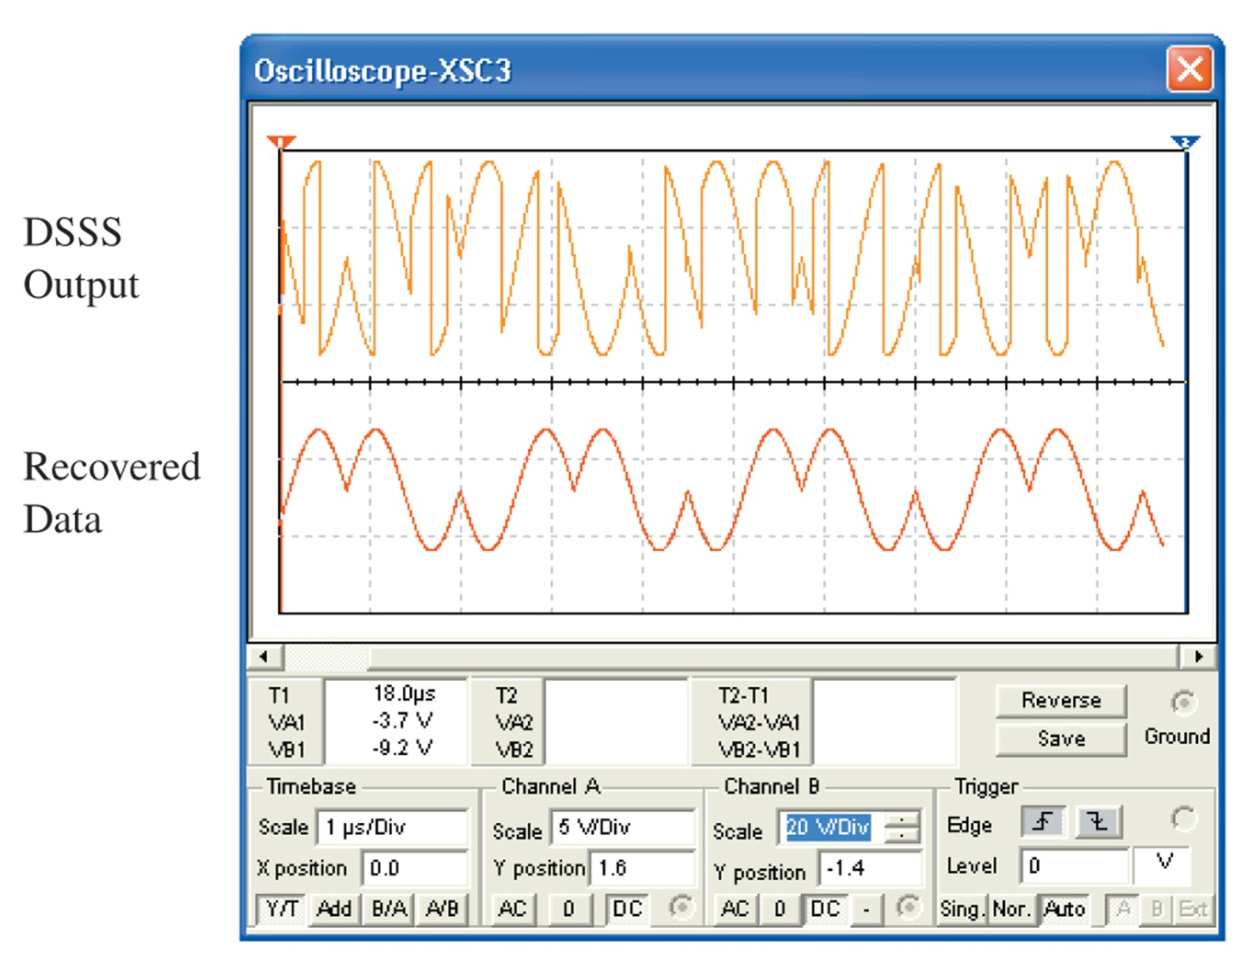
Figure 10-27 The DSSS signal input to the receiver and the recovered BPSK data.

Slide 26
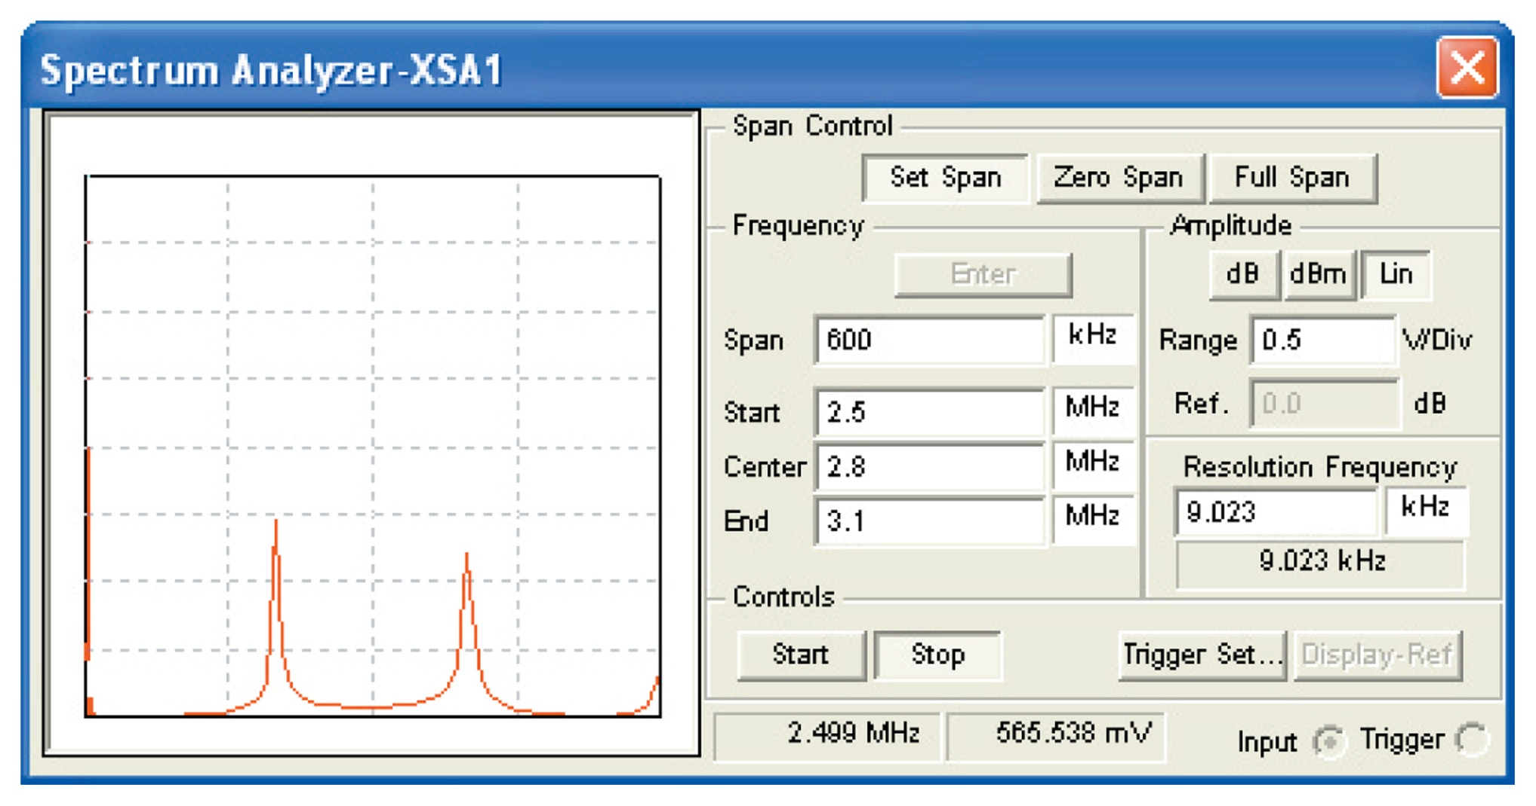
Figure 10-28 The spectrum of the BPSK signal.

Slide 27
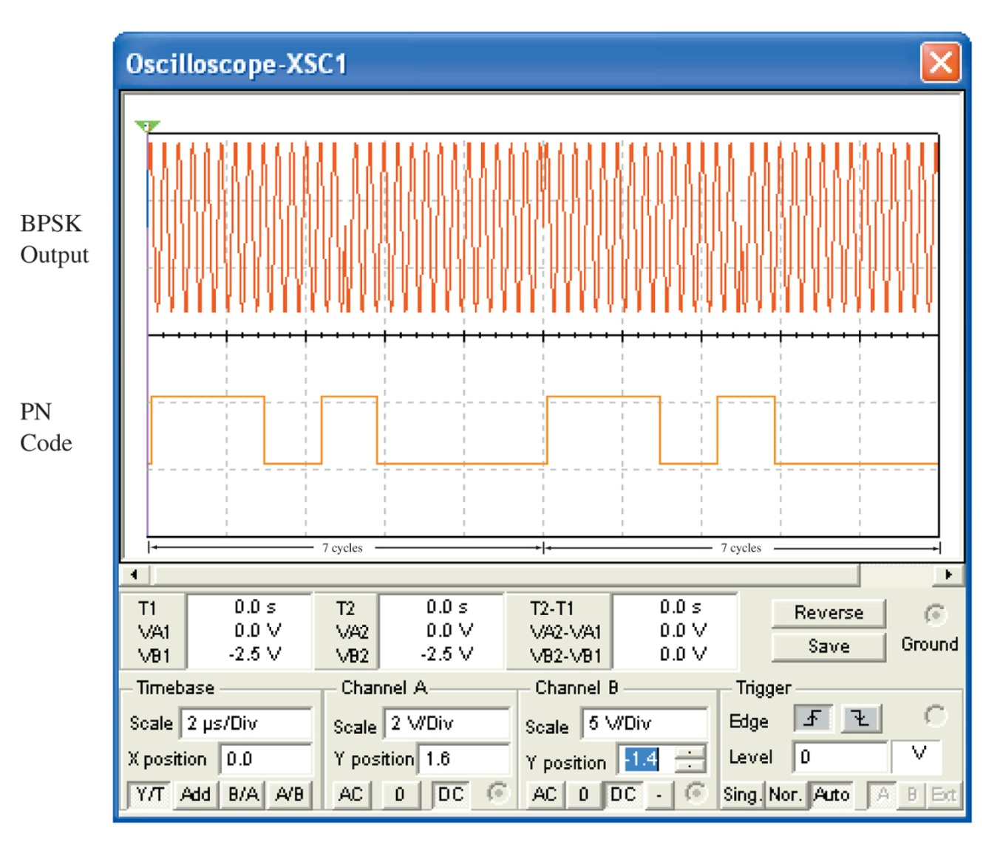
Figure 10-29 The time domain waveforms for the BPSK and PN code outputs using the proper chip modulation rate relationship.

Slide 28
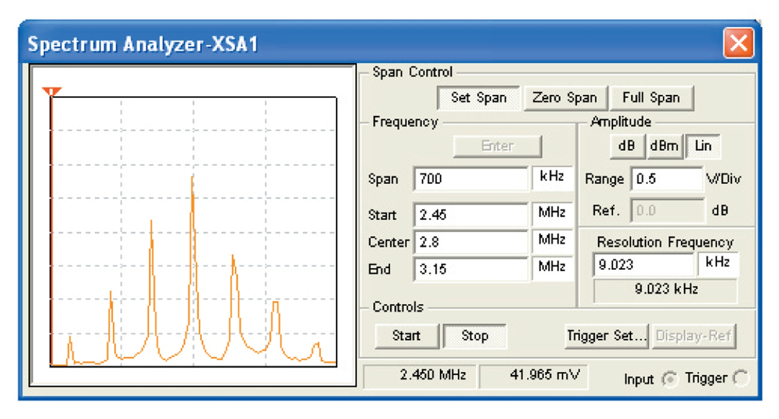
Figure 10-30 The spectrum of the signal after spreading.

