Slide 1
Course Summary
Signal Propagation and Channel Models
Modulation and Performance Metrics
Impact of Channel on Performance
Fundamental Capacity Limits
Flat Fading Mitigation
  Diversity
  Adaptive Modulation
ISI Mitigation
  Equalization
  Multicarrier Modulation/OFDM
  Spread Spectrum

Slide 2
Future Wireless Networks
Ubiquitous Communication Among People and Devices
Wireless Internet access
Nth generation Cellular
Wireless Ad Hoc Networks
Sensor Networks
Wireless Entertainment
Smart Homes/Spaces
Automated Highways
All this and more…
Hard Delay/Energy Constraints
Hard Rate Requirements

Slide 3
Design Challenges
Wireless channels are a difficult and capacity-limited broadcast communications medium
Traffic patterns, user locations, and network conditions are constantly changing
Applications are heterogeneous with hard constraints that must be met by the network
Energy, delay, and rate constraints change design principles across all layers of the protocol stack

Slide 4

Signal Propagation
Path Loss
Shadowing
Multipath
d
P_{r}/P_{t}
d=vt

Slide 5

Statistical Multipath Model
Random # of multipath components, each with varying amplitude, phase, doppler, and delay
Narrowband channel
  Signal amplitude varies randomly (complex Gaussian).
  2nd order statistics (Bessel function), Fade duration, etc.
Wideband channel
  Characterized by channel scattering function (B_{c},B_{d})

Slide 6
Capacity of Flat Fading Channels
Three cases
  Fading statistics known
  Fade value known at receiver
  Fade value known at receiver and transmitter
Optimal Adaptation with TX and RX CSI
  Vary rate and power relative to channel
  Goal is to optimize ergodic capacity

Slide 7
Optimal Adaptive Scheme
Waterfilling
Power Adaptation
Capacity
Alternatively can use channel inversion (poor performance) or truncated channel inversion
1
γ
γ₀
γ

Slide 8
Modulation Considerations
Want high rates, high spectral efficiency, high power efficiency, robust to channel, cheap.
Linear Modulation (MPAM,MPSK,MQAM)
  Information encoded in amplitude/phase
  More spectrally efficient than nonlinear
  Easier to adapt.
  Issues: differential encoding, pulse shaping, bit mapping.
Nonlinear modulation (FSK)
  Information encoded in frequency
  More robust to channel and amplifier nonlinearities

Slide 9
Linear Modulation in AWGN
ML detection induces decision regions
  Example: 8PSK
P_{s} depends on
  # of nearest neighbors
  Minimum distance d_{min} (depends on γ_{s})
  Approximate expression
d_{min}

Slide 10
Linear Modulation in Fading
In fading γ_{s} and therefore P_{s} random
Metrics: outage, average P_{s} , combined outage and average.
T_{s}
P_{s}
Outage
P_{s(target)}
P_{s}
T_{s}

Slide 11
Moment Generating
Function Approach
Simplifies average P_{s} calculation
Uses alternate Q function representation
P_{s} reduces to MGF of γ_{s} distribution
Closed form or simple numerical calculation for general fading distributions
Fading greatly increases average P_{s} .

Slide 12
Doppler Effects
High doppler causes channel phase to decorrelate between symbols
Leads to an irreducible error floor for differential modulation
  Increasing power does not reduce error
Error floor depends on B_{d}T_{s}

Slide 13
ISI Effects
Delay spread exceeding a symbol time causes ISI (self interference).
ISI leads to irreducible error floor
  Increasing signal power increases ISI power
ISI requires that T_{s}>>T_{m} (R_{s}<<B_{c})
0
Tm

Slide 14
Diversity
Send bits over independent fading paths
  Combine paths to mitigate fading effects.
Independent fading paths
  Space, time, frequency, polarization diversity.
Combining techniques
  Selection combining (SC)
  Equal gain combining (EGC)
  Maximal ratio combining (MRC)
Can have diversity at TX or RX
  In TX diversity, weights constrained by TX power

Slide 15
Selection Combining
Selects the path with the highest gain
Combiner SNR is the maximum of the branch SNRs.
CDF easy to obtain, pdf found by differentiating.
Diminishing returns with number of antennas.
Can get up to about 20 dB of gain.

Slide 16
MRC and its Performance
With MRC, γ_{Σ}=Σγ_{i} for branch SNRs γ_{i}
  Optimal technique to maximize output SNR
  Yields 20-40 dB performance gains
  Distribution of γ_{Σ} hard to obtain
Standard average BER calculation
  Hard to obtain in closed form
  Integral often diverges
MGF Approach

Slide 17
Variable-Rate Variable-Power MQAM
log₂ M(γ) Bits
One of the
M(γ) Points
To Channel
Point
Selector
M(γ)-QAM
Modulator
Power: S(γ)
Uncoded
Data Bits
Delay
γ(t)
γ(t)
BSPK
4-QAM
16-QAM
Goal: Optimize S(γ) and M(γ) to maximize EM(γ)

Slide 18
Optimal Adaptive Scheme
Power Water-Filling
Spectral Efficiency
γ_{k}
γ
γ
Equals Shannon capacity with an effective power loss of K.

Slide 19
Constellation Restriction
M₃
M(γ)=γ/γ_{Κ}*
M_{D}(γ)
M₂
M₃
M₂
M₁
M₁
0
Outage
γ₀
γ₁=M₁γ_{K}*
γ₂
γ₃
γ
Power adaptation:
Average rate:
Performance
loss of 1-2 dB

Slide 20
Practical Constraints
Constant power restriction
  Another 1-2 dB loss
Constellation updates
  Need constellation constant over 10-100T_{s}
  Use Markov model to obtain average fade region duration
Estimation error and delay
  Lead to imperfect CSIT (assume perfect CSIR)
  Causes mismatch between channel and rate
  Leads to an irreducible error floor

Slide 21
Multiple Input Multiple
Output (MIMO)Systems
MIMO systems have multiple (M) transmit and receiver antennas
With perfect channel estimates at TX and RX, decomposes to M indep. channels
  M-fold capacity increase over SISO system
  Demodulation complexity reduction
Beamforming alternative:
  Send same symbol on each antenna (diversity gain)

Slide 22
Beamforming
Scalar codes with transmit precoding
y=u^{H}Hvx+u^{H}n
Transforms system into a SISO system with diversity.
  Array and diversity gain
  Greatly simplifies encoding and decoding.
  Channel indicates the best direction to beamform
  Need “sufficient” knowledge for optimality of beamforming
Precoding transmits more than 1 and less than R_{H} streams
  Transmits along some number of dominant singular values

Slide 23
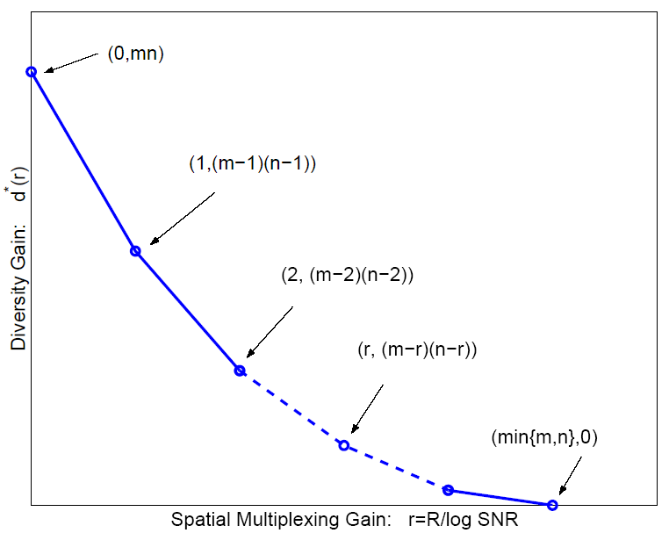
Diversity vs. Multiplexing
Use antennas for multiplexing or diversity
Diversity/Multiplexing tradeoffs (Zheng/Tse)
Error Prone
Low P_{e}

Slide 24



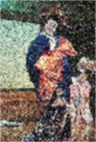

How should antennas be used?
Use antennas for multiplexing:
Use antennas for diversity
High-Rate
Quantizer
ST Code
High Rate
Decoder
Error Prone
Low-Rate
Quantizer
ST Code
High
Diversity
Decoder
Low P_{e}
Depends on end-to-end metric: Solve by optimizing app. metric

Slide 25
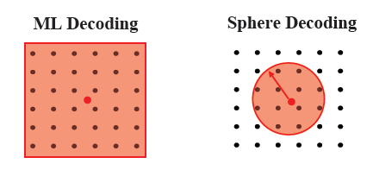
MIMO Receiver Design
Optimal Receiver: Maximum Likelihood
  Finds input symbol most likely to have resulted in received vector
  Exponentially complex # of streams and constellation size
Decision-Feedback receiver
  Uses triangular decomposition of channel matrix
  Allows sequential detection of symbol at each received antenna, subtracting out previously detected symbols
Sphere Decoder: searches within a sphere around rcvd symbol
  Design includes sphere radius and tree search algorithm
  Same as ML if there is a point within the sphere

Slide 26
Other MIMO Design Issues
Space-time coding:
  Map symbols to both space and time via space-time block and convolutional codes.
  For OFDM systems, codes are also mapped over frequency tones.
Adaptive techniques:
  Fast and accurate channel estimation
  Adapt the use of transmit/receive antennas
  Adapting modulation and coding.
Limited feedback:
  Partial CSI introduces interference in parallel decomp: can use interference cancellation at RX
  TX codebook design for quantized channel

Slide 27
Digital Equalizers
n(t)
d(t)=Σd_{n}p(t-nT)
^
y_{n}
d_{n}
c(t)
+
g*(-t)
H_{eq}(z)
Equalizer mitigates ISI
  Typically implemented as FIR filter.
Criterion for coefficient choice
  Minimize P_{b} (Hard to solve for)
  Eliminate ISI (Zero forcing, enhances noise)
  Minimize MSE (balances noise increase with ISI removal)
Channel must be learned through training and tracked during data transmission.

Slide 28
Multicarrier Modulation
Divides bit stream into N substreams
Modulates substream with bandwidth B/N
  Separate subcarriers
  B/N<B_{c} flat fading (no ISI)
Requires N modulators and demodulators
  Impractical: solved via OFDM implementation
R/N bps
QAM
Modulator
x
R bps
Serial
To
Parallel
Converter
cos(2πf₀t)
Σ
R/N bps
QAM
Modulator
x
cos(2πf_{N}t)

Slide 29
FFT Implementation: OFDM
X₀
x₀
TX
R bps
Serial
To
Parallel
Converter
Add cyclic
prefix and
Parallel
To Serial
Convert
QAM
Modulator
D/A
x
IFFT
X_{N-1}
x_{N-1}
cos(2πf_{c}t)
y₀
Y₀
RX
Remove
cyclic
prefix and
Serial to
Parallel
Convert
R bps
x
Parallel
To Serial
Convert
QAM
Modulator
LPF
A/D
FFT
y_{N-1}
Y_{N-1}
cos(2πf_{c}t)
Design Issues
  PAPR, frequency offset, fading, complexity
  MIMO-OFDM
  v

Slide 30
Multicarrier/OFDM Design Issues
Can overlaps substreams
  Substreams (symbol time T_{N}) separated in RX
  Minimum substream separation is B_{N}/(1+β).
  Total required bandwidth is B/2 (for T_{N}=1/B_{N})
Compensation for fading across subcarriers
  Frequency equalization (noise enhancement)
  Precoding
  Coding across subcarriers
  Adaptive loading (power and rate)
B/N
f₀
f_{N-1}

Slide 31
Direct Sequence
Spread Spectrum
Bit sequence modulated by chip sequence
Spreads bandwidth by large factor (K)
Despread by multiplying by s_{c}(t) again (s_{c}(t)=1)
Mitigates ISI and narrowband interference
  ISI mitigation a function of code autocorrelation
Must synchronize to incoming signal
S(f)
s(t)
s_{c}(t)
S_{c}(f)
S(f)*S_{c}(f)
1/T_{b}
T_{c}
T_{b}=KT_{c}
1/T_{c}
2

Slide 32
ISI and Interference Rejection
Narrowband Interference Rejection (1/K)
Multipath Rejection (Autocorrelation ρ(τ))
S(f)
I(f)
S(f)
S(f)*S_{c}(f)
I(f)*S_{c}(f)
Info. Signal
Receiver Input
Despread Signal
S(f)
S(f)*S_{c}(f)[αδ(t)+β(t-τ)]
αS(f)
βρS’(f)
Info. Signal
Receiver Input
Despread Signal

Slide 33
Spreading Code Design
Autocorrelation determines ISI rejection
  Ideally equals delta function
Would like similar properties as random codes
  Balanced, small runs, shift invariant (PN codes)
Maximal Linear Codes
  No DC component
  Max period (2^{n}-1)T_{c}
  Linear autocorrelation
  Recorrelates every period
  Short code for acquisition, longer for transmission
  In SS receiver, autocorrelation taken over T_{s}
  Poor cross correlation (bad for MAC)
1
-1
N
-T_{c}
T_{c}

Slide 34
Synchronization
Adjusts delay of s_{c}(t-τ) to hit peak value of autocorrelation.
  Typically synchronize to LOS component
Complicated by noise, interference, and MP
Synchronization offset of Δt leads to signal attenuation by ρ(Δt)
1
ρ(Δt)
Δt
-1
2^{n}-1
-T_{c}
T_{c}

Slide 35
RAKE Receiver
Multibranch receiver
  Branches synchronized to different MP components
These components can be coherently combined
  Use SC, MRC, or EGC
x
Demod
y(t)
s_{c}(t)
^
d_{k}
x
Diversity
Combiner
Demod
s_{c}(t-iT_{c})
x
Demod
s_{c}(t-NT_{c})

Slide 36
Megathemes of EE359
The wireless vision poses great technical challenges
The wireless channel greatly impedes performance
  Low fundamental capacity.
  Channel is randomly time-varying.
  ISI must be compensated for.
  Hard to provide performance guarantees (needed for multimedia).
Compensate for flat fading with diversity or adaptive mod.
MIMO provides diversity and/or multiplexing gain
A plethora of ISI compensation techniques exist
  Various tradeoffs in performance, complexity, and implementation.
  OFDM and spread spectrum are the dominant techniques
  OFDM works well with MIMO: basis for 4G Cellular/Wifi systems

