Slide 1
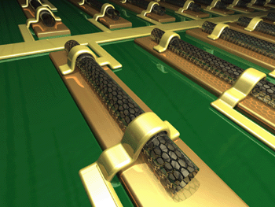
EE 315/ECE 451 Nanoelectronics I
Ch 1 Introduction to Nanoelectronics
Notes:
Derived from lecture created by Dr. Ryan Munden in 2011

Slide 2
Outline
Syllabus
“Top-Down” Approach
“Bottom-Up” Approach
Why Nanoelectronics?
Nanotechnology Potential
J. N. Denenberg- Fairfield Univ. - EE315
8/8/2015

Slide 3
Syllabus
Textbook:
Fundamentals of Nanoelectronics
George W. Hanson
Pearson/ Prentice Hall
ISBN: 978-0-13-195708-4
J. N. Denenberg- Fairfield Univ. - EE315
8/8/2015

Slide 4
Objectives & Outcomes
No. | Objectives | Outcomes | Cognitive Level | ABET a‑k
1 | To understand the physical laws governing the behavior of electrons in solid materials | Students will be able to solve mathematical models and describe the behavior of quantum mechanical and solid state physics of bulk materials | Knowledge & Application | a
2 | To understand how nanoscale phenomena can impact the electrical and optoelectronic properties of nanostructures | Students will mathematically analyze the effects of reducing electronic materials to the nanoscale | Analysis | a
3 | To understand the present state of nanotechnology in contemporary electronics and optoelectronics | Students will survey the available literature, write a report, and present an explanation of a current product incorporating Nano electronic components or methods. | Comprehension, Analysis, & Synthesis | I, j, k
 |  | Students will critique peers’ oral presentations on the effectiveness of their explanations and their analysis of the Nano electronic elements. | Evaluation | j, k
J. N. Denenberg- Fairfield Univ. - EE315
8/8/2015

Slide 5
Grading
Exams (2) 60%
Homework/Quizzes 20%
Team Seminar 20%
J. N. Denenberg- Fairfield Univ. - EE315
8/8/2015

Slide 6
Class Topics
Wk | Date | Topics/Chapters | Ch. | HW | References
1 | 2 - Sep | Introduction to Nanoelectronics | Intro, 1 | Ch.1 – 1,3,4 | Datta - New Paradigm
 | 7-Sep | Columbus Day, September 8 – “Tuesday is Monday”
2 | 8 - Sep 9 - Sep | Classical Particles and Waves, Quantum Particles Go to SOE Student Assembly (Oak Room) | 2 |  | Team Seminar Project
3 | 14 - Sep 16 - Sep | Quantum Mechanics of Electrons | 3
4 | 21 – Sep 23 – Sep | Free and Confined Electrons Review for Exam 1 | 4
5 | 28 - Sep 30 - Sep | First Exam (Ch. 1-4) Band Theory of Solids & Optoelectronics | 5
6 | 5 - Oct 7 - Oct | Exam 1 Reprise Tunnel Junctions & Applications | 6
7 | 12 - Oct 14 - Oct | Tunnel Junctions & Applications | 6
8 | 19 - Oct 21 - Oct | Coulomb Blockade and SET | 7
9 | 26 - Oct 28 - Oct | Density of States | 8
10 | 2 - Nov 4 - Nov | Semiconductor Quantum Wells/Wires/Dots | 9
11 | 9 - Nov 11 - Nov | Fabrication Techniques Semi/Classical/Ballistic Transport | 9 10
12 | 16 - Nov 18 - Nov | Nanotubes/Nanowires/Spintronics Review for Exam 2 | 10
13 | 23 - Nov | Exam 2 (Ch. 5-10)
 | 25-29 Nov | Thanksgiving
14 | 30 - Nov 2 - Dec | Exam 2 Reprise – Group Presentations Team Presentations
15 | 7 - Dec | Team Presentations
 | 8,9,13 Dec | Reading Days
 | 10-16 Dec | Final Exam Week - Team Presentations (as required)
J. N. Denenberg- Fairfield Univ. - EE315
8/8/2015

Slide 7
Conceptualize a nanometer
What's 100,000 times thinner than a strand of hair?
a nanometer
(10⁻⁹ meters)
J. N. Denenberg- Fairfield Univ. - EE315
8/8/2015
Notes:
We can now manipulate matter at the scale of 10⁻⁹ meter which defines a nanometer. Compared to bulk matter, material systems of several molecules only exhibit new properties. Those properties change as we change the size from, say, a system of 100 molecules, to fifty molecules, to twenty-five molecules. Optical, electrical and magnetic properties change.
In addition to size, the relation of surface to volume of a material system is another factor that impacts the properties of matter. As material systems become smaller and smaller, the surface to volume ratio becomes larger and larger. The more surface there is the greater number of reactions that can take place. At nanometer scale, matter is mostly surface.
Obtain a copy of Nanotechnology, the Power of the Small.
This is a 3-part, in-depth television series examining the implications of advances in nanotechnology, the art of manipulating matter at the nanoscale. Funded by the National Science Foundation, April 2008

Slide 8
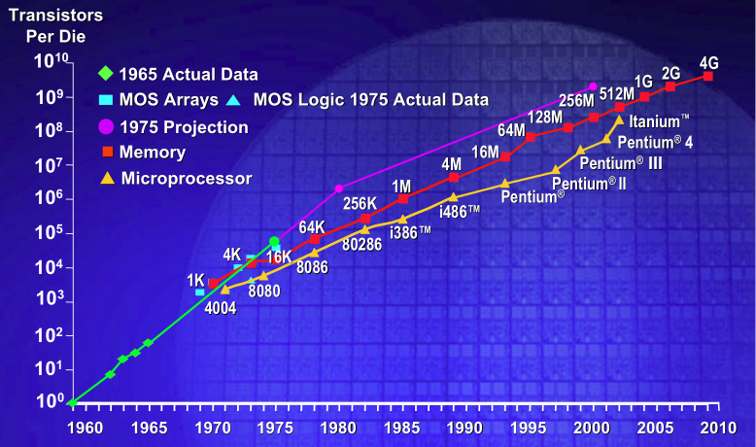
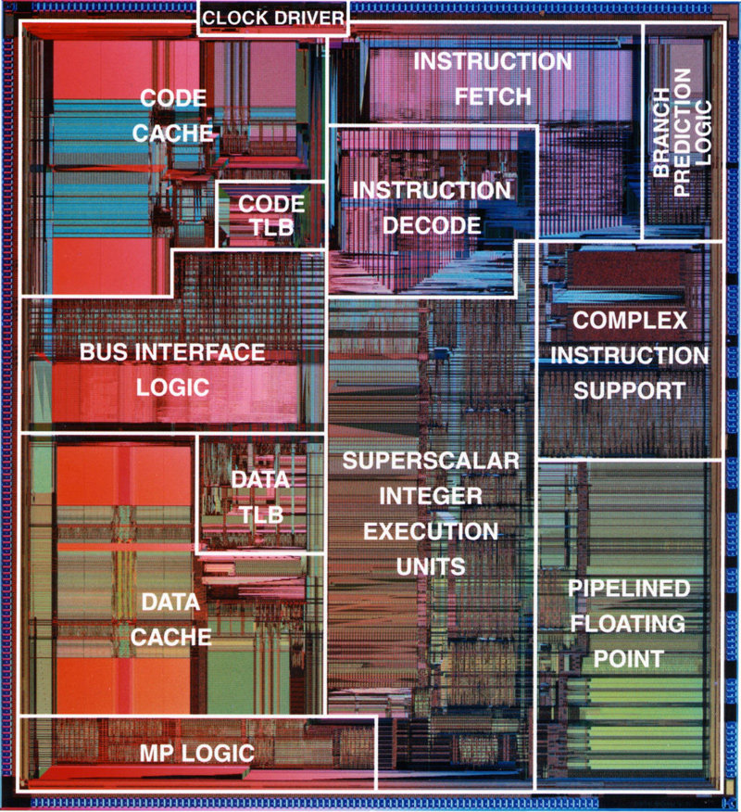
Moore’s Law
An empirical law from the 70’s that the number of transistors on a die will double every 18 month. This has been driving the technology industry for decades along the ITRS roadmap, but is now threatened by Quantum Theory.
J. N. Denenberg- Fairfield Univ. - EE315
8/8/2015

Slide 9
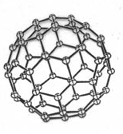
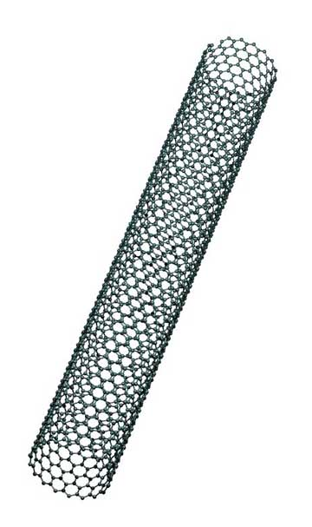
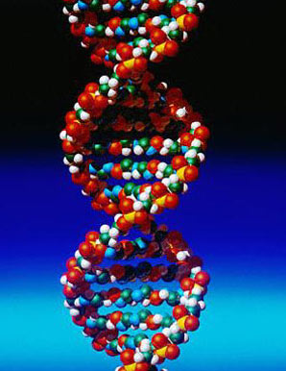
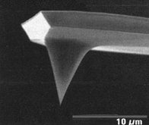
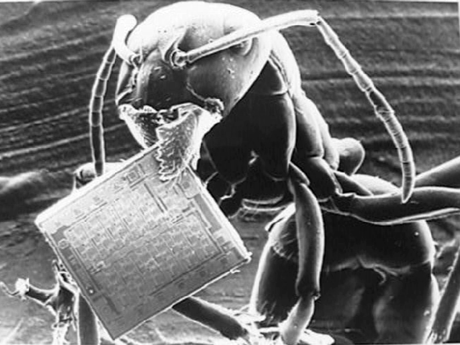
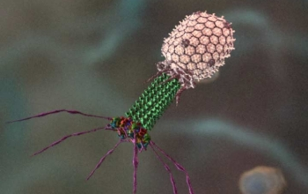
Nanotechnology –
Allows Continuing Moore’s Law?
Intersection of Physics and Engineering with Chemistry and Biology
J. N. Denenberg- Fairfield Univ. - EE315
8/8/2015

Slide 10
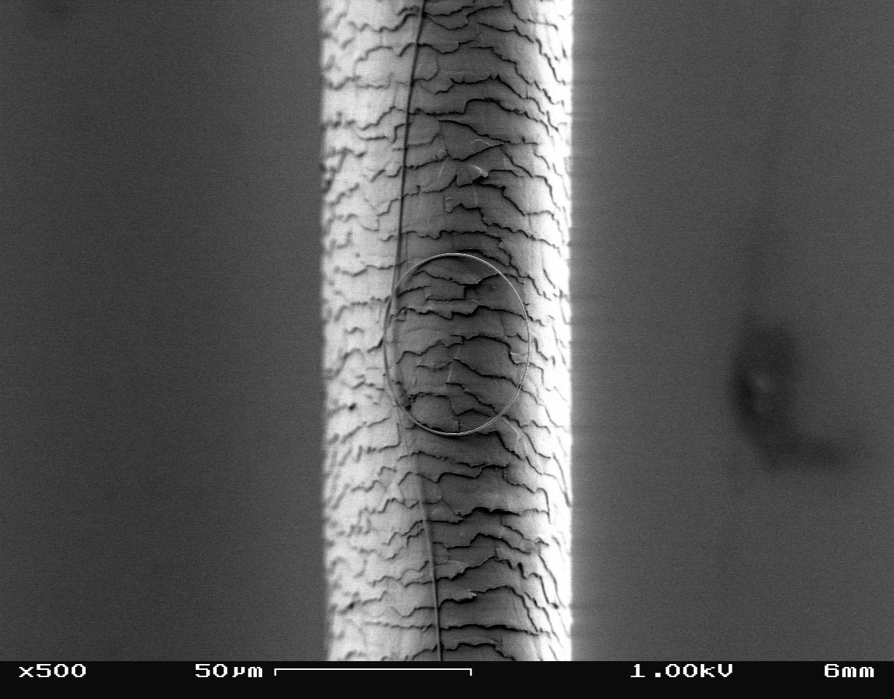
How Small is Nano?
J. N. Denenberg- Fairfield Univ. - EE315
8/8/2015

Slide 11
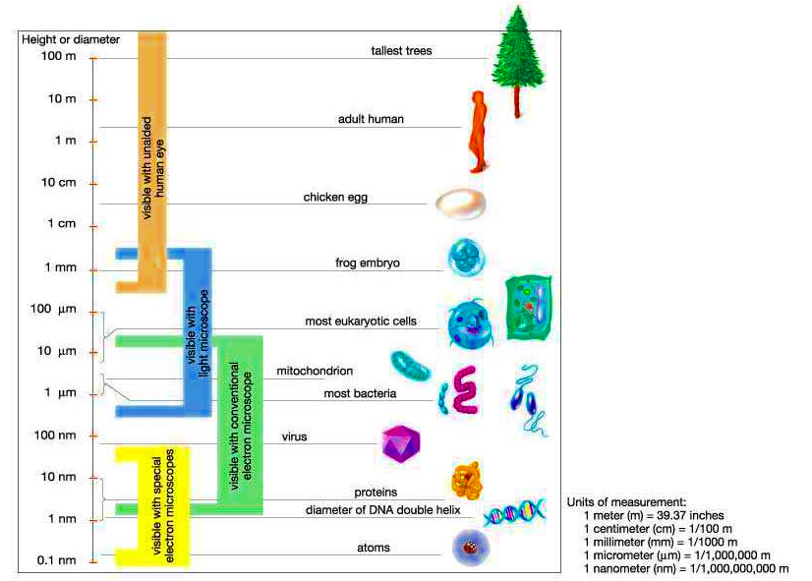
Scale from Top to Bottom
J. N. Denenberg- Fairfield Univ. - EE315
8/8/2015
Notes:
Note that the dimension of atoms is 1/10 of a nanometer, or 10⁻¹⁰ m; biological structures, e.g., DNA, proteins and viruses fall in the Nano-scale category. DNA-based chips will be a common assembly strategy for cells, with enormous implications for biomedicine. Nanoparticle based systems acquire increasing importance in clinical applications. Visit, for example, the web site regarding work in biomedicine at Stanford University, Harvard University and Boston University.
Already venture capitalists are focusing on commercial applications in nanomedicine development. See Proceedings for Nanotechnology in Medicine: From Diagnostics to Therapeutics, Boston University, April 4, 2008.

Slide 12
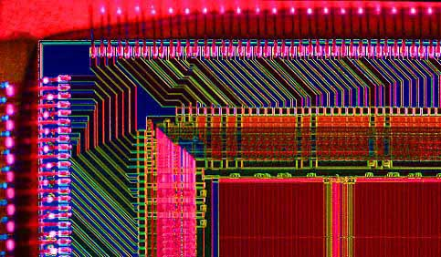
Electronics/Optoelectronics
Modern electronics are achieved using top-down technologies, especially in creating Integrated Circuits
J. N. Denenberg- Fairfield Univ. - EE315
8/8/2015
Notes:
Introduce basic electrical properties
Many students will have basics (what a resistor, capacitor, etc is;
If they don’t, any good basic intro physics book will do as an outline:
Haliday Resnick is recommended)
In general, materials on the basis of electric conductivity are in three classes:
Conductors,
Insulators
Semiconductors

Slide 13
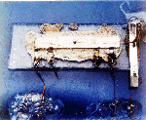
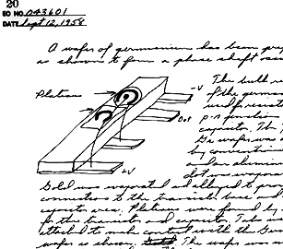
Modern Electrical Computers:
First Integrated Circuit
Jack Kilby (TI) (12 Sept. 1958)
invented while the rest of the company on vacation
awarded the Nobel Prize in 2000
J. N. Denenberg- Fairfield Univ. - EE315
8/8/2015
Notes:
Historical background
See Kilby’s Nobel lecture:
http://nobelprize.org/nobel_prizes/physics/laureates/2000/kilby-lecture.html
Assign a report on early history of computers.

Slide 14
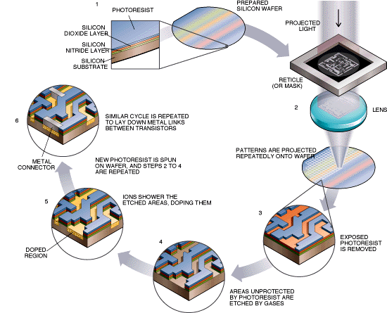
Parallel microchip fabrication
J. N. Denenberg- Fairfield Univ. - EE315
8/8/2015
Notes:
Transistors on a chip
The National Nanotechnology Infrastructure Network (http://www.nnin.org/) is a great resource, including outreach and tutorial resources

Slide 15
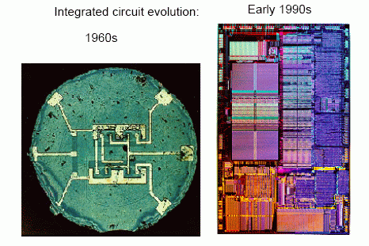
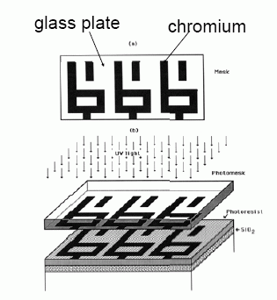
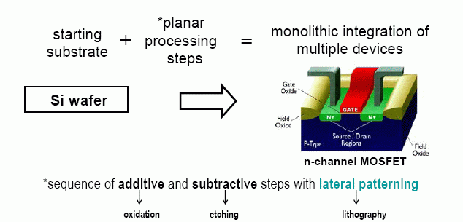
The critical innovation: (photo)lithography
J. N. Denenberg- Fairfield Univ. - EE315
8/8/2015
Notes:
Photolithography (also optical lithography) is a process used in microfabrication to selectively remove parts of a thin film (or the bulk of a substrate). It uses light to transfer a geometric pattern from a photomask to a light-sensitive chemical (photoresist, or simply "resist") on the substrate. A series of chemical treatments then engraves the exposure pattern into the material underneath the photoresist. In a complex integrated circuit (for example, modern CMOS), a wafer will go through the photolithographic cycle up to 50 times (Wikipedia)
See Jaeger, Richard C. (2002). "Lithography", Introduction to Microelectronic Fabrication. Upper Saddle River: Prentice Hall. ISBN 0-201-44494-7.

Slide 16
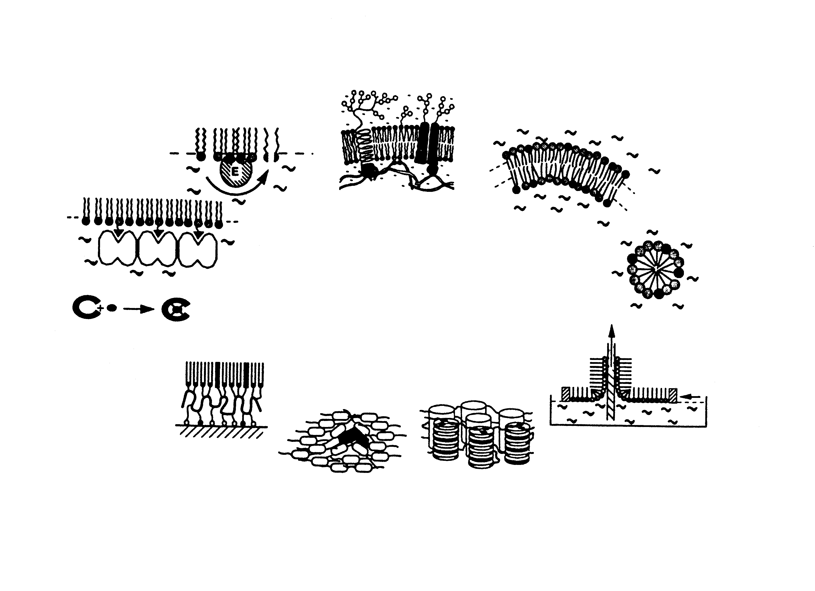
Bottom-up Approach
Life Science
Molecular
Recognition
Molecular
Self-organization
Enzyme
Function
Cells
Liposomes
Protain
Crystallization
Supramolecular
Systems
Micelles
Host/Guest
Systems
Monolayers: SAM
Surface Functionalization
Multilayers
Liquid Crystals
Function
via
Organization
Order &
Mobility
Materials Science:
Molecular Eng.
J. N. Denenberg- Fairfield Univ. - EE315
8/8/2015
http://www.chem.wisc.edu/courses/801/Spring00/Chapter1/Nrcbio-1.gif
Notes:
Up to now, we have talked about top-down approaches. Now, we examine and contrast to the bottom-up approaches to micro/nanostructures.
Supramolecular assembly, is the driving force for the most of life science rendering. Mother nature is a master in self-assembly.
Recent efforts in manmade assembly try to mimic and emulate the life sciences in order to create a new and useful self assembly motifs.
DNA nanotechnology is used to construct well-defined structures out of DNA and other nucleic acids
Molecular self-assembly uses supramolecular chemistry to create single molecule components which arrange themselves in useful patterns, e.g., synthetic molecular motors

Slide 17
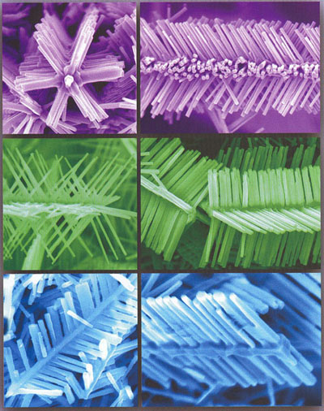
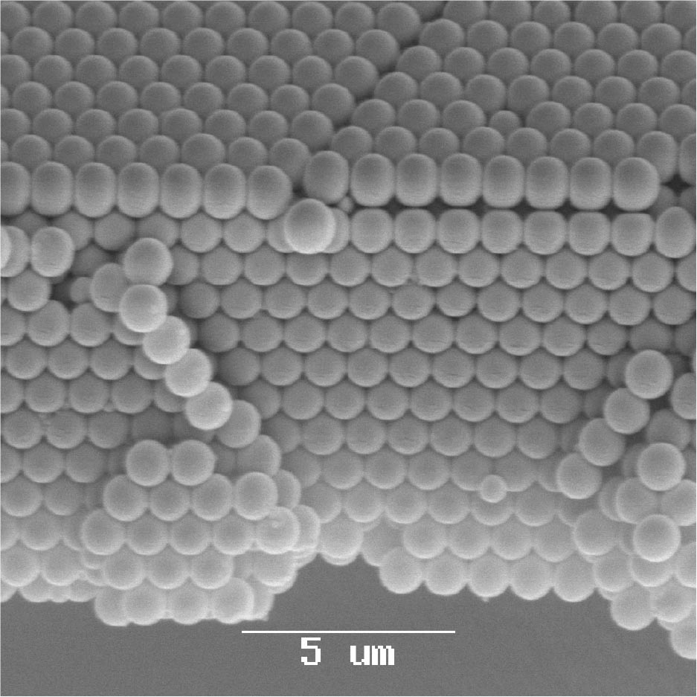
Nanofabrication
They are also fabricated, bottom-up, by growing in place, using molecular and atomic forces to direct the growth
Thorsten Schweizer, et al.Opaline-structured materials fabricated and further processed by ultrafast lasers make good templates for photonic crystal-based components.
7 April, 2008, SPIE Newsroom. DOI: 10.1117/2.1200803.1047
ZnO nanostructures - Z. Ren, J. Lao, and J. Wen. Nano Lett. 2002; 2(11).
J. N. Denenberg- Fairfield Univ. - EE315
8/8/2015
Notes:
Self-assembly offers a very economical alternative to traditional approaches. Each new generation of Intel processsor requires a new $10 billion foundry to make them. Self-assembly can be done in a test-tube or in a table-top system.

Slide 18
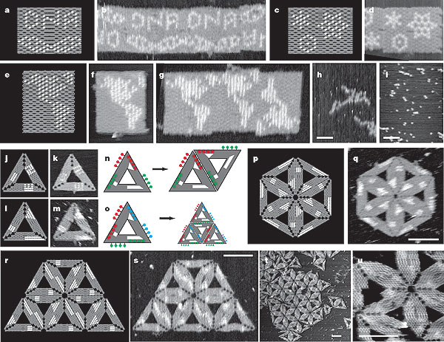
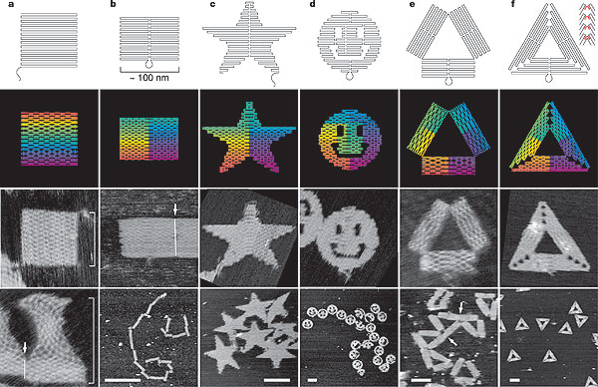
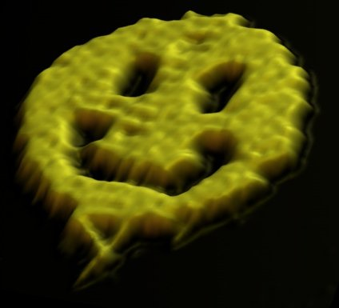
DNA Self-Assembly
DNA Origami: Paul Rothemund
Nature 440, 297-302 (16 March 2006)
J. N. Denenberg- Fairfield Univ. - EE315
8/8/2015
Notes:
“DNA is renowned for its double helix structure and the base pairing that enables the recognition and highly selective binding of complementary DNA strands. These features, and the ability to create DNA strands with any desired sequence of bases, have led to the use of DNA rationally to design various nanostructures and even execute molecular computations”. Using information and algorithms appears to be the way biological systems organize themselves.
See: Nature 452, 198-201 (13 March 2008) Hierarchical self-assembly of DNA into symmetric supramolecular polyhedra
Yu He, Tao Ye1, Min Su, Chuan Zhang, Alexander E. Ribbe, Wen Jiang & Chengde Mao
Department of Chemistry,
Markey Center for Structural Biology and Department of Biological Sciences, Purdue University, West Lafayette, Indiana 47907, USA
Correspondence to: Chengde Mao Correspondence and requests for materials should be addressed to C.M. (Email: mao@purdue.edu).
Reading Assignment: The Double Helix: A Personal Account of the Discovery of the Structure of DNA (Paperback), by James D. Watson – available from Aamazon.
Self Assembly of DNA
The DNA structure at left (schematic shown) will self-assemble into the structure visualized by atomic force microscopy at right. Image from Strong, 2004.

Slide 19
Nanoelectronics?
Problems with shrinking
Device Fabrication: This becomes more and more challenging to achieve in theory and in practice
Device Operation: Normally shrinking improves performance, but nanoscale may invoke quantum effects such as tunneling and ballistic transport that completely change behavior
Heat Dissipation: How do you get the heat from so many devices out? (for example: IC 100 W/cm², hotplate, 10 W/cm², Sun 7000 W/cm²⁾
J. N. Denenberg- Fairfield Univ. - EE315
8/8/2015

Slide 20
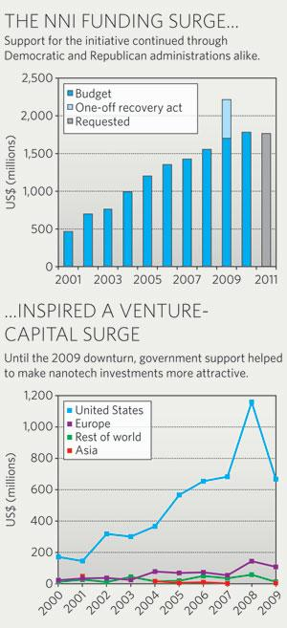
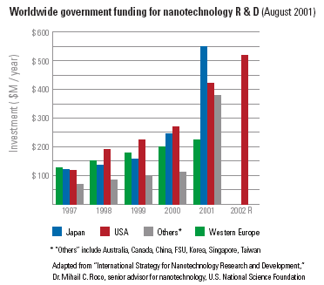
Nanotechnology Potential
J. N. Denenberg- Fairfield Univ. - EE315
8/8/2015

