Slide 1
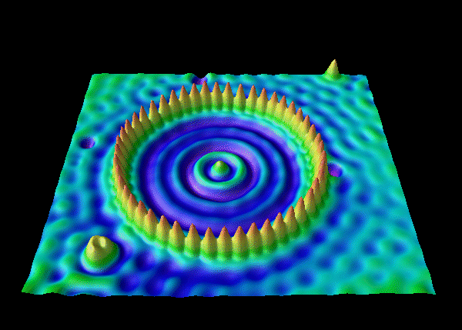
EE 315/ECE 451 Nanoelectronics I
Ch 3 Quantum Mechanics of Electrons
Notes:
Derived from a lecture created by Dr. Ryan Munden in 2011

Slide 2
Outline
3.1 General Postulates of QM
3.2 Time-Independent Schrödinger Equation
3.3 Analogies Between Quantum Mechanics and Electromagnetics
3.4 Probabilistic Current Density
3.5 Multiple Particle Systems
3.6 Spin and Angular Momentum

Slide 3
Where to Begin?
Start with
a plane wave
Classically
Quantize energy
with DeBroglie
Voila!
Schrödinger's
Equation
Notes:
ψ(x,t) is the Complex plane wave, the classical, real wave is found by taking the real part of ψ(x,t) or A cos(kx - ωt), if A is real

Slide 4
3.1 General Postulates of Quantum Mechanics
POSTULATE 1 - To every quantum system there is a state function, ψ(r,t), that contains everything that can be known about the system
The state function, or wavefunction, is probabilistic in nature.
Probability density of finding the particle at a particular point in space, r, at time t is:
Notes:
r is the position vector. In Cartesian coordinates: r = a_{x}x + a_{y}y +a_{z}z = ix + jy +kz

Slide 5
Postulate 1
Normalization Factor
Notes:
P is the probability of a particle being in the region Ω

Slide 6
Postulate 2
A) Every physical observable O (position, momentum, energy, etc.) is associated with a linear Hermitian operator ô
B) Associated with the operator ô is the eigenvalue problem, ô ψ_{n} = λ_{n} ψ_{n}
such that the result of a measurement of an observable ô is one of the eigenvalues λ_{n} of the operator
c) If a system is in the initial state ψ, measurement of O will yield one of the eigenvalues λ_{n} of ô with probability
And the system will change from ψ (an unknown state) to ψ_{n}.
Notes:
“In mathematics, a Hermitian matrix (or self-adjoint matrix) is a square matrix with complex entries that is equal to its own conjugate transpose—that is, the element in the i-th row and j-th column is equal to the complex conjugate of the element in the j-th row and i-th column, for all indices i and j:
or , in matrix form.Hermitian matrices can be understood as the complex extension of real symmetric matrices.
If the conjugate transpose of a matrix is denoted by , then the Hermitian property can be written concisely as
Hermitian matrices are named after Charles Hermite, who demonstrated in 1855 that matrices of this form share a property with real symmetric matrices of always having real eigenvalues.”
Wikipedia

Slide 7
3.1.1 Operators
An operator maps one quantity to another
For example 3x2 matrices map 2x1 onto 3x1 matrices
The derivative operator maps sine onto cosine
The operator in that case would be d/dx

Slide 8
3.1.2 Eigenvalues and Eigenfunctions
An eigenfunction of an operator is a function such that when the operator acts on it we obtain a multiple of the eigenfunction back
ô ψ_{n} = λ_{n} ψ_{n}
λ_{n} are the eigenvalues of the operator
Notes:
These definitions are covered in a course on Linear Algebra

Slide 9
3.1.3 Hermitian Operators
A special class of operators.
They have real eigenvalues
Their eigenfunctions form an orthogonal, complete set of functions

Slide 10
3.1.4 Operators for QM
Momentum operator -
Energy -
Position
Commutator
2 operators commute if
which allows measurement to arbitrary precision

Slide 11
3.1.5 Measurement Probability
If a system is already in an eigenstate of the operator we are interested in, we are guaranteed 100% to measure it in that state
However, if we do not know the state, we can only find the probability of finding it in that state
Once measured however, we are “locked in” to that state, and subsequent measurements will return the same value

Slide 12
Collapse of the State function
-the Measurement Problem
Postulate 2 says that any observable measurement is associated with a Linear Hermitian operator, and the result of every measurement will be an eigenvalue of the operator
After measurement (observation) the system will be in an eigenstate until perturbed

Slide 13
Postulate 3
The mean value of an observable is the expectation value of the corresponding operator
For a QM system
Position
Momentum
Energy
Notes:
ρ(x) is the Probability Density Function (PDF). See my PowerPoint presentation “Introduction to Noise” at my web site.
QM – short for quantum mechanics

Slide 14
Postulate 4
The state function ψ(r,t) obeys the Schrödinger equation
Where H is the Hamiltonian (total energy operator), kinetic + potential energy (plus field terms if necessary)
Notes:
“In quantum mechanics, the Hamiltonian is the operator corresponding to the total energy of the system in most of the cases. It is usually denoted by H, also Ȟ or Ĥ. Its spectrum is the set of possible outcomes when one measures the total energy of a system. Because of its close relation to the time-evolution of a system, it is of fundamental importance in most formulations of quantum theory.
The Hamiltonian is named after Sir William Rowan Hamilton (1805 – 1865), an Irish physicist, astronomer, and mathematician, best known for his reformulation of Newtonian mechanics, now called Hamiltonian mechanics.
Wikipedia

Slide 15

3.2 Time-Independent Schrödinger's Equation
If the potential energy does not depend on time we can simplify considerably to the time-independent Schrödinger Equation
Notes:
“In physical terms, the divergence of a three-dimensional vector field is the extent to which the vector field flow behaves like a source or a sink at a given point. It is a local measure of its "outgoingness"—the extent to which there is more exiting an infinitesimal region of space than entering it. If the divergence is nonzero at some point then there must be a source or sink at that position.^{[1]} (Note that we are imagining the vector field to be like the velocity vector field of a fluid (in motion) when we use the terms flow, sink and so on.)”
Wikipedia

Slide 16
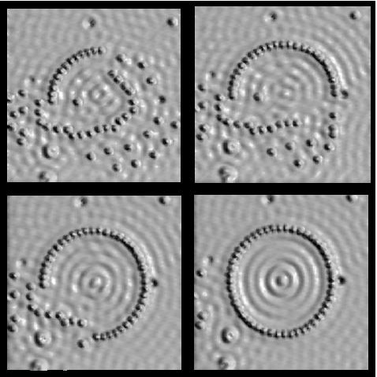
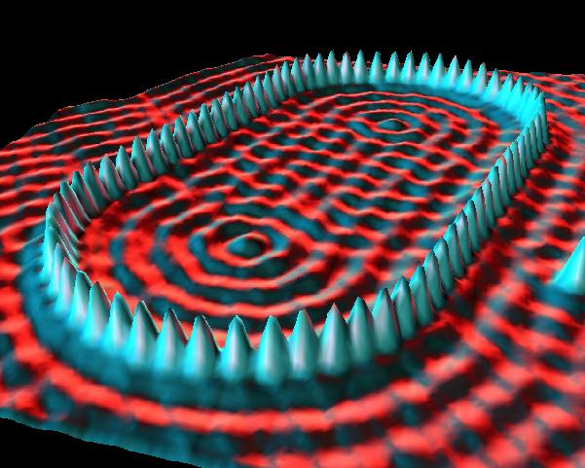
Quantum Corral
An example of standing
electron waves

