Slide 1
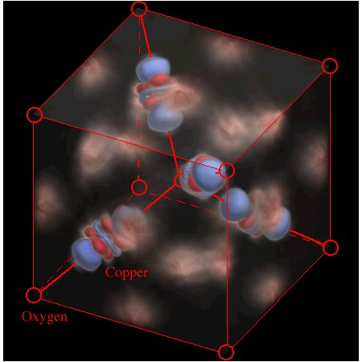
EE 315/ECE 451 Nanoelectronics I
Ch 4 Free and Confined Electrons
Notes:
From a lecture created by Dr. Ryan Munden in 2011

Slide 2
Outline
4.1 Free Electrons
4.2 Free Electron Gas Theory of Metals
4.3 Electrons Confined to a Bounded Region of Space and Quantum Numbers
4.4 Fermi Level and Chemical Potential
4.5 Partially Confined Electrons – Finite Potential Wells
4.6 Electrons Confined to Atoms – The Hydrogen Atom and the Periodic Table
4.7 Quantum Dots, Wires, and Wells
4.8 Main Points

Slide 3
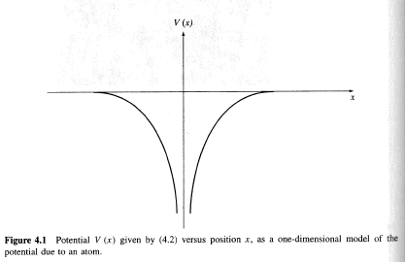
4.1 Free Electrons
Atomic Potential related to Coulomb interaction

Slide 4
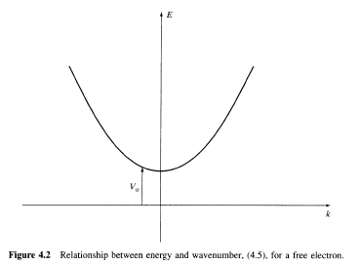
4.1.1 One-Dimensional Space

Slide 5
4.2 Free Electron Gas Theory of Metals
Loosely bound electrons in a metal behave as if they are in a free electron gas

Slide 6
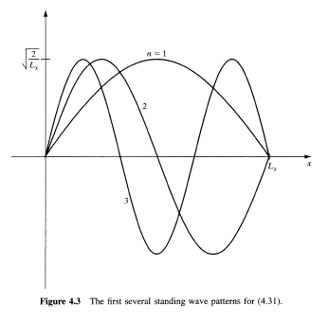
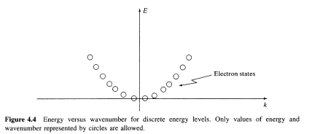
4.3 Electrons Confined to a Bounded Region of Space and Quantum Numbers
Electrons can be confined in space to a quantum well or quantum box

Slide 7
4.3.3 Periodic Boundary Conditions
Periodic Boundary Conditions result in travelling wave instead of standing wave solutions

Slide 8
4.4 Fermi Level and Chemical Potential
Chemical Potential is the energy necessary to add the Nth electron to a system with N-1 electrons, which is basically the energy of the highest occupied state.
For Fermi statistics the chemical potential of N-electron system is:
[E_{t}(N+1)-E_{t}(N-1)]/2

Slide 9
Fermi Level
Fermi level is the chemical potential at T=0
Often term fermi level is used in place of chemical potential in semiconductor physics
Electrons arrange themselves into the lowest energy states at T=0, forming Fermi Sea
Chemical potential is temperature dependent

Slide 10
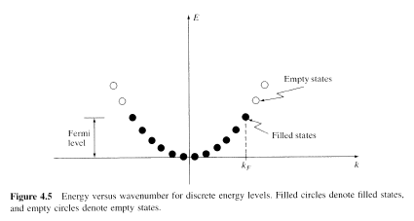
Fermi Level
Notes:
k_{b} = 1.38 x 10⁻²³ J/°K = 8.62 x 10⁻⁵ eV/°K
Boltzmann's constant is a conversion factor between temperature (Kelvin) and energy

Slide 11
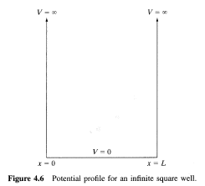
4.5 Partially Confined Electrons –
Finite Potential Wells
Infinite Square Well – this is the boundary condition where the wave goes to zero at the boundary
Notes:
An infinite well that yields closed form solutions to Schrödinger's equation, but electrons cannot escape.

Slide 12
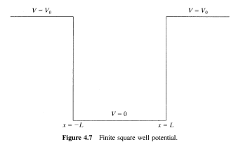
4.5.1 Finite Rectangular Well
Classically the particle could never be outside the well, if E is less than V₀
We will see this is not the case in QM
Notes:
Now they can escape

Slide 13
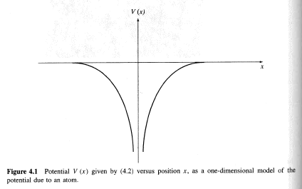
Aside
This is an approximation of the effect of an ionized atom on an electron

Slide 14
Solve Schroedinger in
3 Regions
Region I (x<-L):
Region II (-L<x<L):
Region III (L<x):

Slide 15
Apply Boundary Conditions

Slide 16
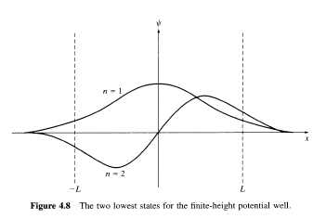
Graphical Solutions
Notice that now there are very definite finite “tails” of the wavefunction extending beyond the “walls” of the well

Slide 17
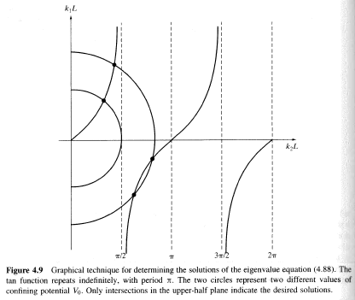
Graphical Eigenvalues
Vo defines the radius of the circle, whose intersections with the tan curves represent solutions
As Vo increases, more crossings are observed, increasing the numbers of states which electrons can occupy
In the limit as Vo goes to infinity, we approach an infinite number of solutions, which match the infinite square well

Slide 18
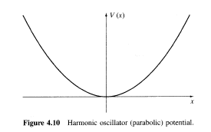
4.5.2 Parabolic Well-
Harmonic Oscillator

Slide 19
Harmonic Well Solutions

Slide 20
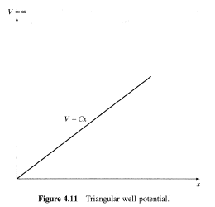
2.5.3 Triangular Well
Useful for modeling the junction between materials
Airy Function solutions

Slide 21
Energy Solutions
Rectangular Well:
Parabolic Well:
Triangular Well:

Slide 22
4.6 Electrons Confined to Atoms
The Hydrogen Atom can actually be solved exactly, and is one of the few realistic QM systems which can be solved.
Most others require numerical methods to solve.
We can put Schroedinger’s equation into spherical coordinates and solve via separation of variables

Slide 23
Hydrogen Atom
Quantum Numbers
We get solutions dependent on 3 quantum numbers:
n=1,2,3,… is called the principle quantum number
l = 0,1,2,…, n-1 is called the angular momentum q.n.
m_{l} = 0,+/- 1, +/- 2, … +/- l is called the magnetic q.n.

Slide 24
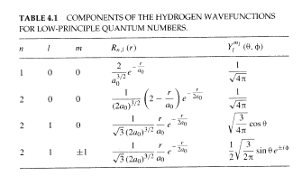
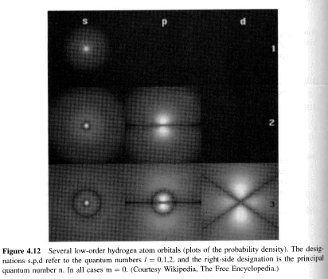
Hydrogen Atom
Wavefunctions
We can see these on Falstad.org as well
Notes:
Bohr Radius: Approximate size of the Hydrogen atom = 4πε₀h2/m_{e}q_{e}²
Hydrogen electron energy levels: E_{n} = -13.6/n₂ eV
Electrons fill “shells” and n is the shell number – My view is that electrons can only exist at energy levels where the wavelength is an integral number of the “orbit” circumference.

Slide 25
Bohr Radius
In the preceding Table the constant a0 is the Bohr radius, which physically, is the approximate size of the hydrogen atom
This is the inverse of the expectation value of the Coulomb potential which goes like 1/r

Slide 26
Hydrogen Energy
Energy depends only on the principle q.n., n
-13.6eV is the Rydberg energy
n is the shell number
l states are the s,p,d,f,g,h,i,k,… states
m_{l} states and s (+/- ½) spin give the 4 q.n.

Slide 27
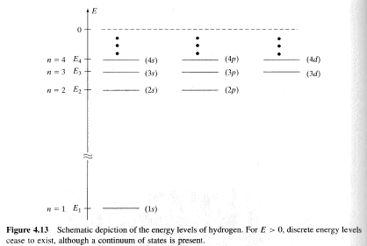
Hydrogen Energy Levels

Slide 28
Beyond Hydrogen
Thanks to the Pauli Exclusion principle, we can get an approximation for other atoms by “filling-up” the states in the Hydrogen atom.
This assumes no interactions, which isn’t entirely accurate, but gives a place to start
Chemical reactions are entirely dominated by the filling of the last shell
Hund’s rule states that same-spin states fill first, so all else equal, in a partially filled shell, all electrons will have the same spin. This is important for determining magnetic materials

Slide 29
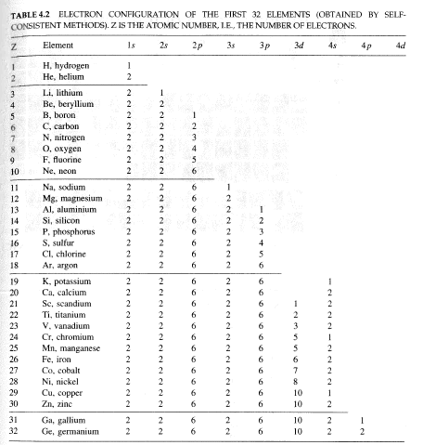

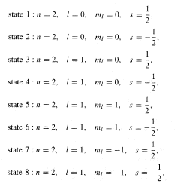
Periodic Table
n = 1 shell
n = 2 shell

Slide 30
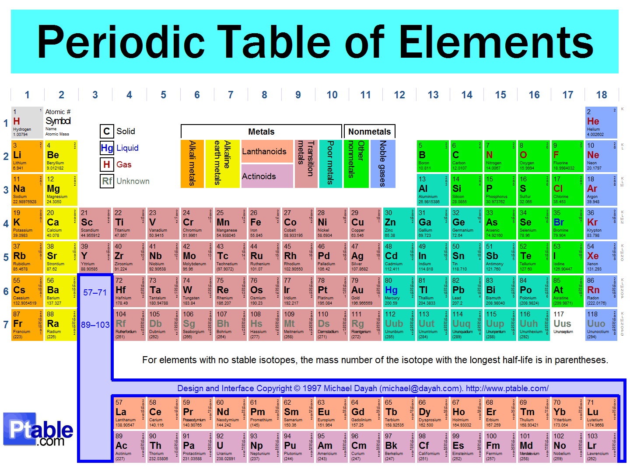

Slide 31
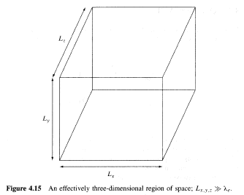


4.7 Quantum Dots, Wires, and Wells

Slide 32
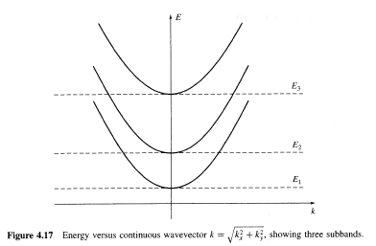
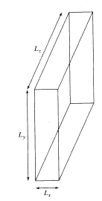
Quantum Wells
2D Region of Space

Slide 33
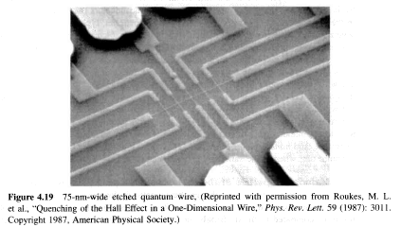
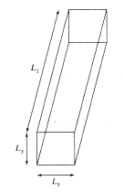
Quantum Wires
1D Region of Space

Slide 34
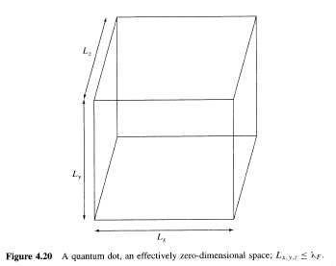
Quantum Dots
0D Region of Space

