Slide 1
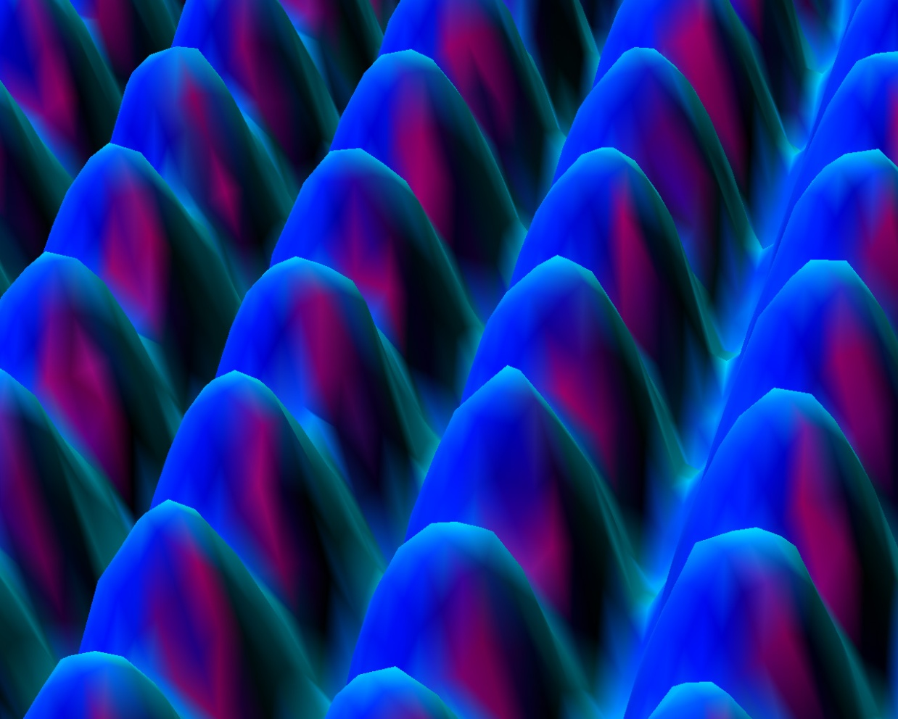
EE 315/ECE 451 Nanoelectronics I
Ch 5 Electrons Subject to a Periodic Potential – Band Theory of Solids
Adapted from a lecture by Dr. Ryan Munden

Slide 2
Outline
5.1 Crystalline Materials
5.2 Electrons in a Periodic Potential
5.3 Kronig-Penny Model of Band Structure
5.4 Band Theory of Solids
5.5 Graphene and Carbon Nanotubes
5.6 Main Points

Slide 3
5.4 Band Theory of Solids
Notes:
eφ - Work Function – the energy difference between the vacuum level and the Fermi level – the energy needed to liberate an electron from the metal at absolute zero

Slide 4
Photoelectric Effect
Photons with energy greater than the work function can liberate the electrons from a metal

Slide 5
Insulator Band Structure
Notes:
Eg – energy required to raise an electron to a conduction band.

Slide 6
Semicondcutor Band Structure
Don’t forget the holes!
Notes:
Eg is smaller for a semiconductor (~1.2-1.4 ev) than for an insulator (8-10 ev)

Slide 7
Doping
Notes:
Type n silicon extra free electrons

Slide 8
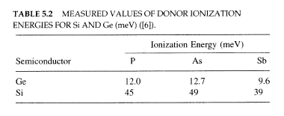
Donors
These are n-type semiconductors

Slide 9
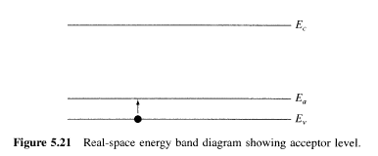
Acceptors
These are p-type semiconductors
Notes:
Extra holes – type P silicon - The Type is determined by the “majority” carrier – holes are “heavier” than electrons (effective mass). – They are less mobile.

Slide 10
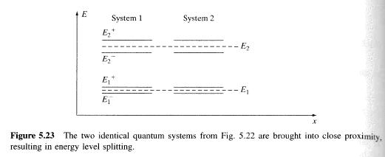
Interacting Systems Model
Notes:
Splitting is due to the overlap of each system’s wavefunction.

Slide 11
Atomic Bonding

Slide 12
Atomic Development of Bands

Slide 13
Electric Fields
Notes:
Positive voltage pushes the energy level down – electrons will tend to “roll” downhill

Slide 14
Direct Bandgap Semiconductors
Notes:
e.g. GaAs, InP – the bottom of the conduction band is at k-0

Slide 15
Indirect Bandgap Semiconductors

Slide 16
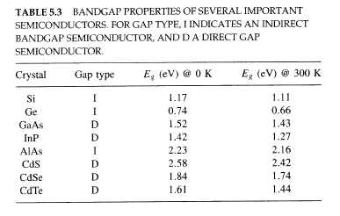
Electron and Hole Energy

Slide 17
Optical Transitions – Direct Gap
For T1
Notes:
e.g. Si, Ge, AlAs – k > 0

Slide 18
Optical Transitions – Indirect Gap

Slide 19
Excitons
Notes:
Exitron – a “bonded” hole-electron pair – easily broken apart by thermal energy into free electrons and holes

Slide 20
Low-Temperature Effects

Slide 21
5.5 Graphene
Notes:
A flat, one molecule thick, crystalline sheet of carbon – a two dimensional structur

Slide 22
Graphene Unit Cell

Slide 23
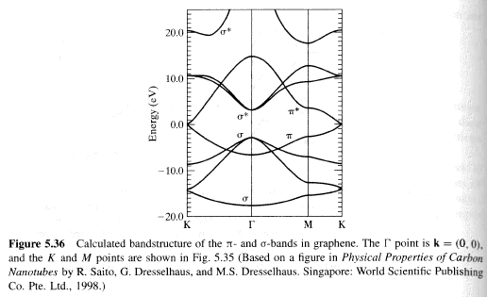
Graphene Bands

Slide 24
Carbon Nanotubes
3 types: zigzag, armchair, and chiral tubes
Notes:
Wrap a graphene sheet into a tube – occurs naturally in an arc discharge of carbon electrodes.

Slide 25
Chirality

Slide 26
Nanotubes
Zigzag, armchair and chiral where
Are metallic, otherwise semiconducting
Where the bandgap is:
Notes:
3 types depending on the symmetry reqired to “close” the tube.

Slide 27
4.8 Problems

