Slide 1

EE 315/ECE 451 Nanoelectronics I
Ch 6 – Tunnel Junctions and Applications of Tunneling
Adapted from a lecture by Dr. Ryan Munden

Slide 2
Outline
6.1 Tunneling Through a Potential Barrier
6.2 Potential Energy Profiles for Material Interfaces
6.3 Applications of Tunneling
6.4 Main Points

Slide 3
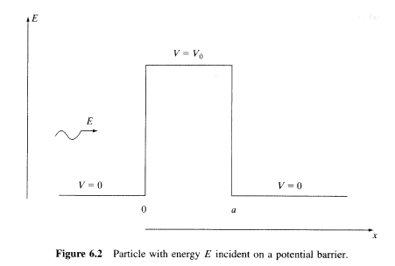
6.1 Tunneling Through a Potential Barrier

Slide 4
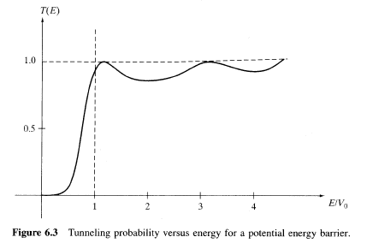
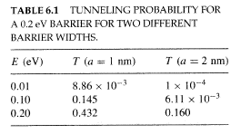
Transmission Probability

Slide 5
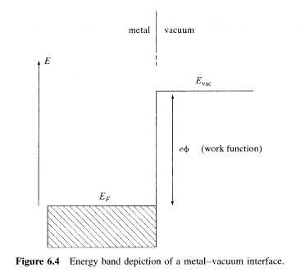
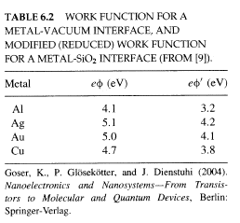
Metal-Vacuum Junction

Slide 6
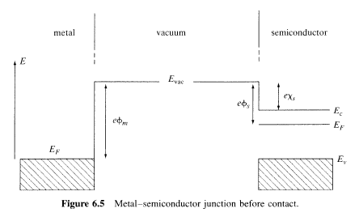
Metal Semiconductor Junction

Slide 7
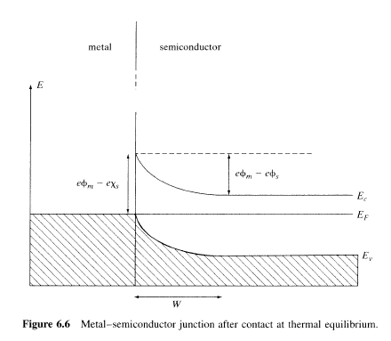
Metal Semiconductor Junction

Slide 8
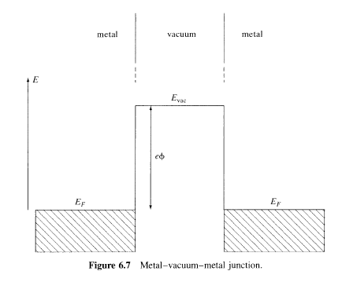
Metal-Insulator-Metal Junction

Slide 9
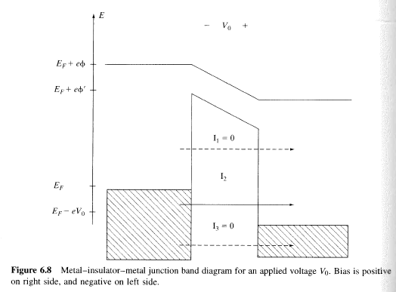
Metal-Insulator-Metal Applied Bias

Slide 10
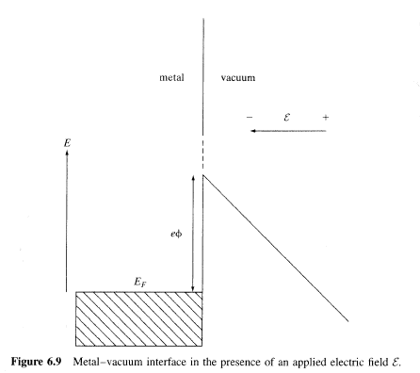
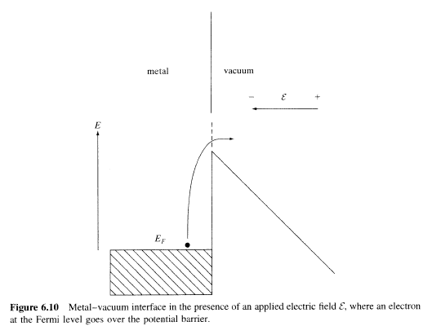
6.3 Field Emission

Slide 11
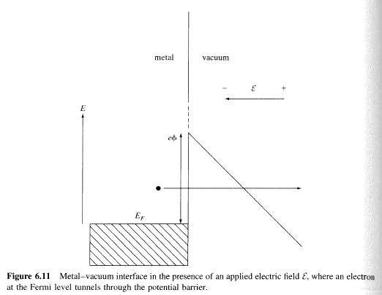

Fowler-Nordheim Tunneling
Fowler-Nordheim Tunneling

Slide 12
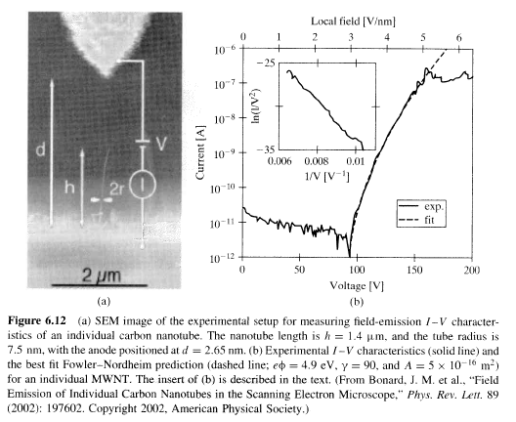
CNT Field Emission

Slide 13
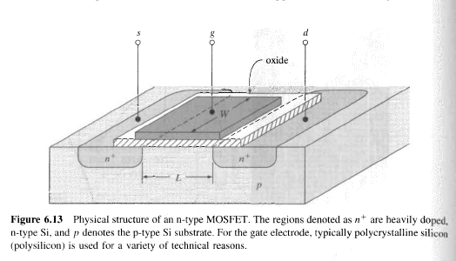
MOSFET Structure

Slide 14
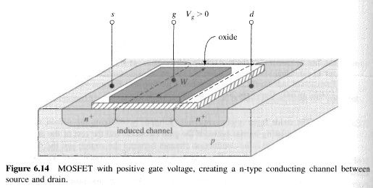
MOSFET Inversion

Slide 15
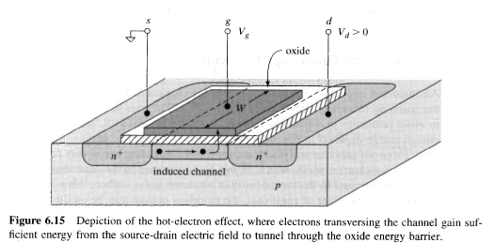
Hot Electron Effect

Slide 16
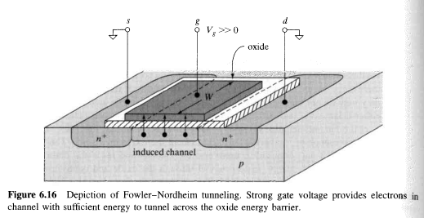
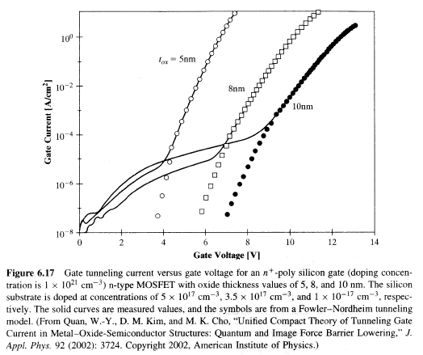
FN Tunneling in MOSFET

Slide 17
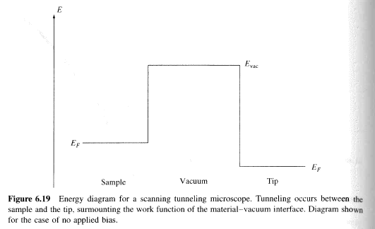
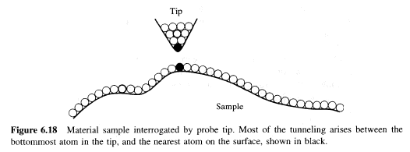
STM

Slide 18
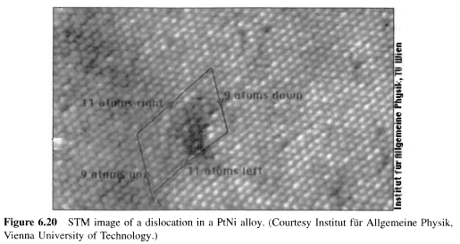
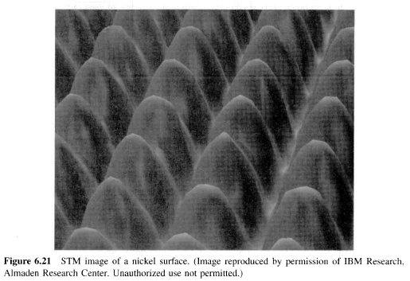
STM

Slide 19
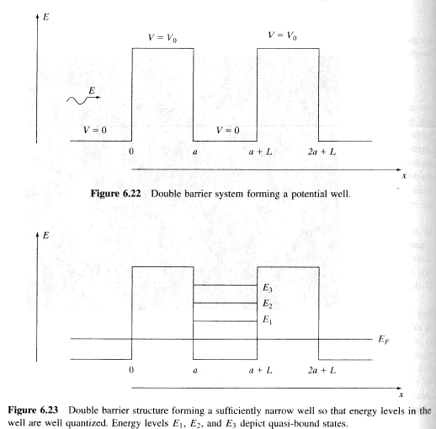
RTD

Slide 20
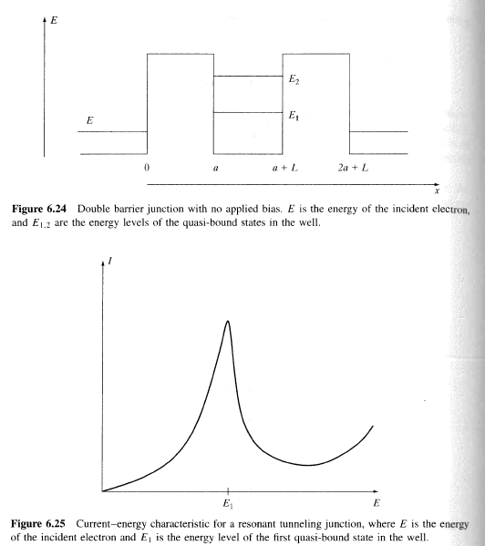
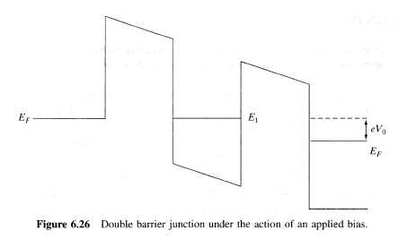
RTD

Slide 21
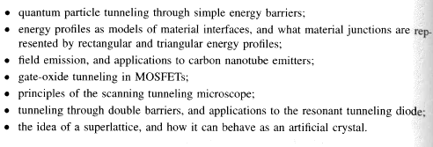
Main Points

Slide 22
6.5 Problems

