Slide 1
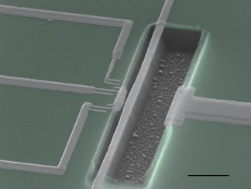
EE 315/ECE 451 Nanoelectronics I
Ch 7 – Coulomb Blockade and the Single-Electron Transistor
From notes by R Munden - 2010

Slide 2
Outline
7.1 Coulomb Blockade
7.2 The Single-Electron Transistor
7.3 Other SET and FET Structures
7.4 Main Points

Slide 3
7.1 Coulomb Blockade

Slide 4
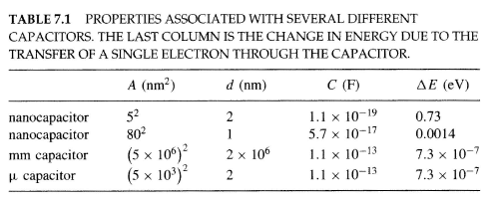
Capacitor Properties
Notes:
For nanoscale dimensions, small values of capacitance lead to observing that a transfer of a single electron results in an appreciable energy change ΔE
This is “Coulomb Blockade”
Note: femto = 10⁻¹⁵ and atto = 10⁻¹⁸ to deal with very small capacitances.

Slide 5
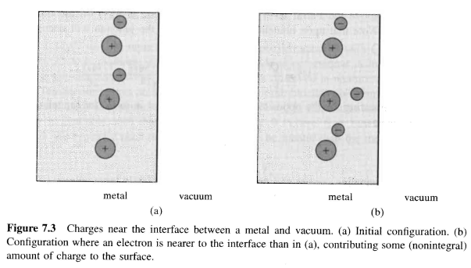
7.1.1 Nanocapacitor
Tunnel one electron
Classical Model of Capacitance
This leads to:
Notes:
Tunneling is very fast ~ 10⁻¹⁴ seconds from their Fermi velocity
It will only occur when |V| > |q_{e}| / 2C or “Coulomb Blockade”

Slide 6
Coulomb Blockade in Nanocapacitor
So,
We only notice the Blockade effect for very small capacitors
Energetically,
And temperature plays a role
@ 293K
k_{b} = 86 μeV/K -> k_{b}T @ RT ~ 25 meV
For || C, let d = L/10
C or T must be very small!
Notes:
The DeBroglie wavelength at the Fermi level determines if the electron is “localized’ – A delocalized electron is spread across the capacitor

Slide 7
Tunnel Junctions

Slide 8
Temperature Dependence
Notes:
Curves are offset for clarity

Slide 9
Temperature Dependence of Nanoparticle Clusters
Notes:
Can’t use large d (plate separation) to get small C as tunneling won’t occur. Need to use small A (cross section area of plates)

Slide 10
7.1.2 Tunnel Junctions
Rt represents the ability of the electron to tunnel (the distance between the plates), while C is the capacitor that we are charging up.
Rt cannot be too large, therefore, simply increasing d to decrease C does not make Coulomb Blockade a visible effect
Uncertainty:
Generally R>>Ro ~ 26kOhms

Slide 11
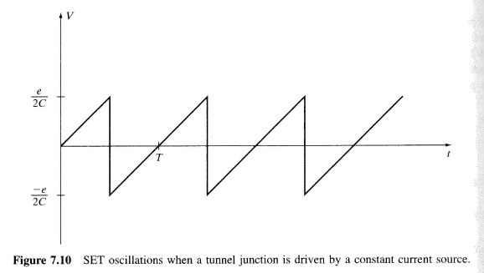
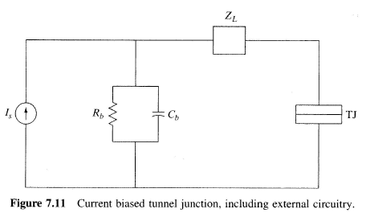
7.1.3 Tunnel Junction Excited by Current Source
Classically:
But when we allow tunneling:
Hard to achieve experimentally

Slide 12
7.1.4 Quantum Dot Circuits
Using to TJ to achieve a small quantum dot (QD), or island, between them makes it easier to control the behavior.
Where electron tunneling allows nq electrons to accumulate on the island
Notes:
Only room for a few electrons on the “dot” (nq)
The capacitance is also a function of nq! Ignored for now

Slide 13
QD Stored Energy

Slide 14
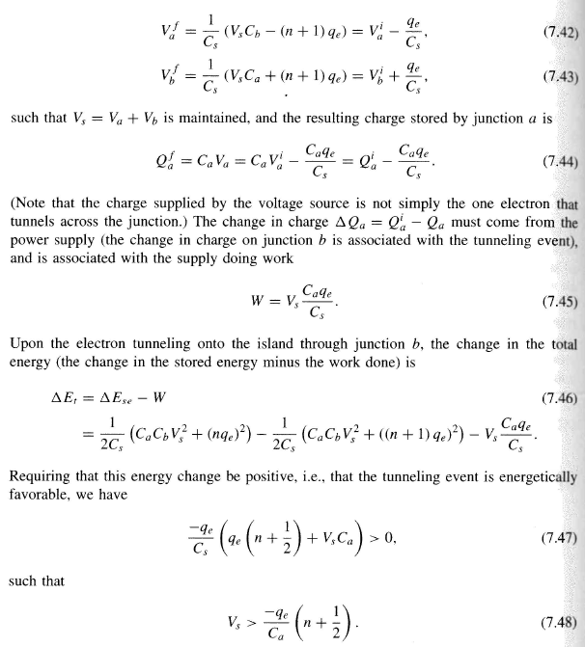
QD Tunneling Event

Slide 15
QD Energy Band Diagrams
Notes:
The leads affect the energy states of the island, ignored for now.

Slide 16
Energy Bands (2)

Slide 17
Energy Bands (3)

Slide 18
Energy Bands (4)

Slide 19
Coulomb Staircase
Tunneling Occurs @:
Notes:
Discrete steps due to each electron that “tunnels”.

Slide 20
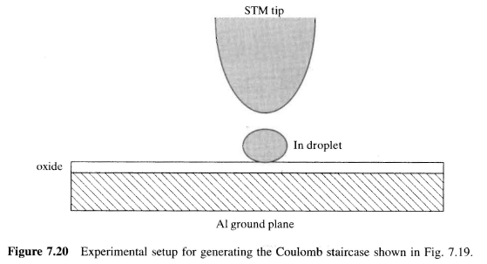
STM Coulomb Staircase

Slide 21
7.2 Single-Electron Transistor
Notes:
Now we add a “gate” electrode. We now have a “SET”

Slide 22
SET Energy Diagram

Slide 23
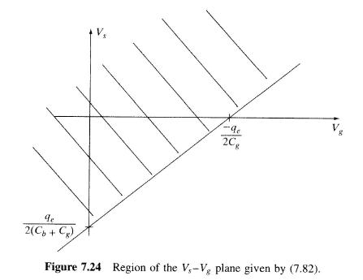
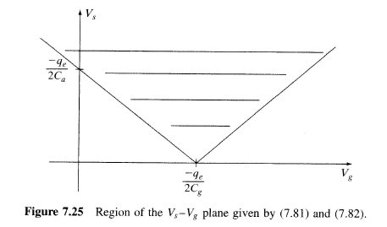
Coulomb Diamonds
Use the gate to adjust the potential on the island
Tunneling Onto the island
Tunneling Off the island
Tunneling occurs when both conditions are met.

Slide 24
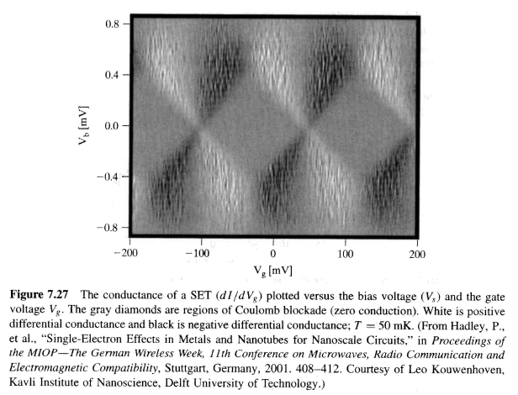
Coulomb Diamonds

Slide 25
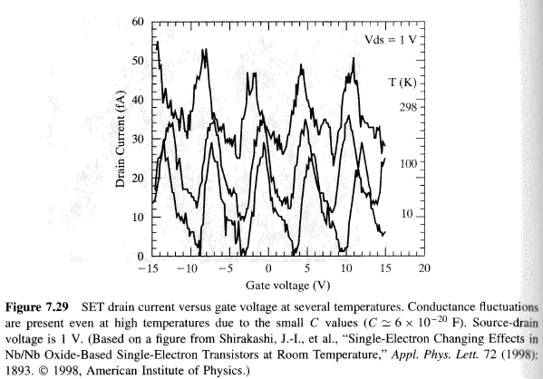
Gate Voltage Control for Transistor Effect
For very small C the effect is visible at Room Temp.

Slide 26
7.2.1 SET Logic
Notes:
CMOS Logic is the prevalent logic family in today’s ICs

Slide 27
SET inverter
Notes:
Voltage State Logic – We can also have Charge State Logic

Slide 28
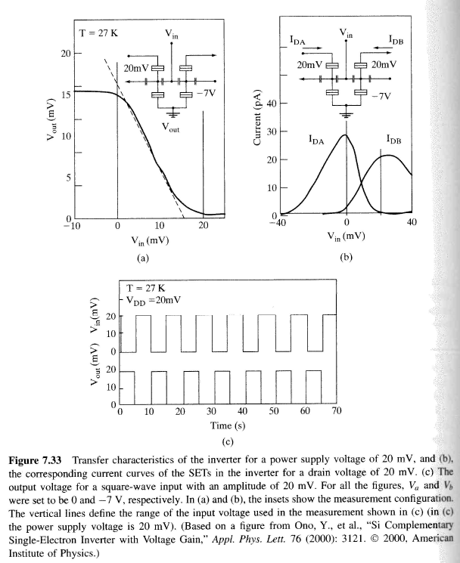
SET Logic
Notes:
SET can also be made using carbon nanotubes or molecules

Slide 29
7.3 SET & FET Structures

Slide 30
7.3.1 CNT FETs and SETs

Slide 31
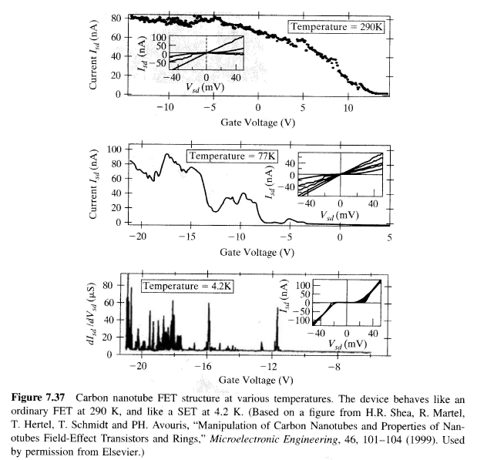
CNT FET Properties

Slide 32
7.3.2 Semiconductor Nanowire FETs
Notes:
Semiconductor nanowires have diameters in the range of 10 – 100 nm

Slide 33
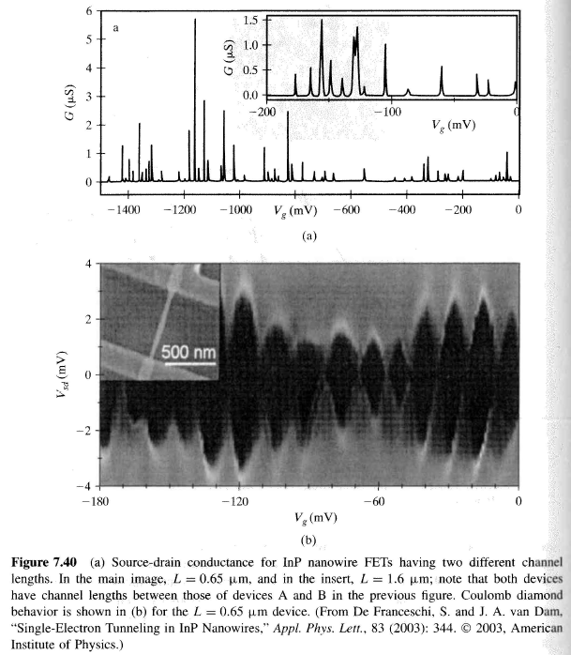
Semiconducting NW SET

Slide 34
7.3.3 Molecular SETs and Molecular Electronics
Notes:
So the “gate” gives us some control of the current in the “element”

Slide 35
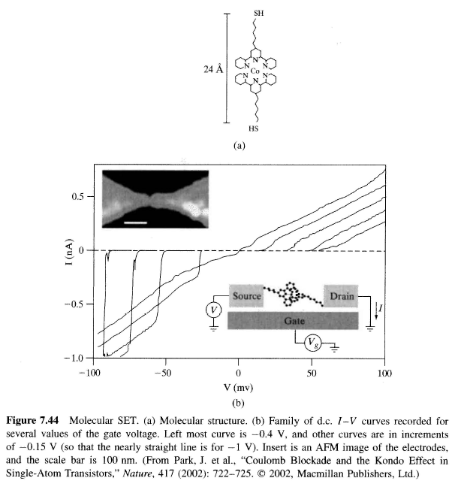
Molecular RTD and SET

Slide 36
Main Points
the Coulomb blockade effect
current-biased tunnel junctions
the influence of capacitance and energy on tunneling and Coulomb blockade
basic Coulomb blockade structures
tunnel junction models, tunneling in quantum dot circuits, and the Coulomb Diamond
the SET and its applications
electronic channels based on carbon nanotubes and semiconducting nanowires
the basic idea of molecular electronics

Slide 37
7.5 Problems

