Slide 1
Chapter 2
Signals and Systems
Part 1

Slide 2
Signals and Systems
A signal is a real (or complex) valued function of one or more real variables.
  voltage across a resistor or current through inductor
  pressure at a point in the ocean
  amount of rain at 37.4225N, 122.1653 W
  amount of rain at 16:00 UTC as function of latitude, longitude
  price of Google stock at end of each trading day
  In this course the independent variable is almost always time.
Physical signals have units, e.g., volts or psi (Si pascal = N/m2)
  Signals can (usually or in principle) be measured:
  g(t) 7→ g(0)
  g(t) 7→ R-∞ ∞ g(u) du (area)
  g(t) 7→ R-∞ ∞ |g(u)|2 du (energy)
  The mathematical term for a measurement is functional.

Slide 3
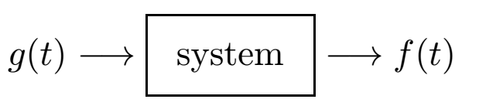



Signals and Systems (cont.)
A system is an object that takes signals as inputs and produces signals
as outputs.
In general, the output signal depends on entirety of input signal; e.g.,
Examples of physical systems:
  Electrical circuit: voltage in, voltage or current out
  Building: earth shaking in, building shaking out
  Audio amplifier

Slide 4

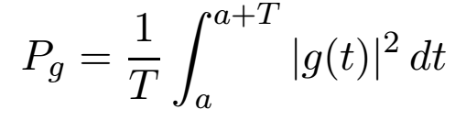
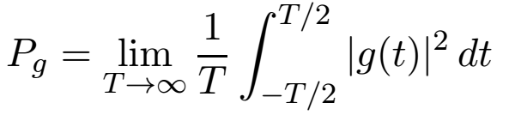
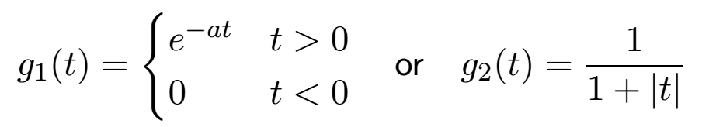
Signal Energy and Power
A signal is periodic if it repeats: for every t.
E.g., sin(t) has period 2π and tan(t) has period π.
The power of a periodic signal g(t) is
where T is the period of g(t). If g(t) is complex valued, then |g(t)|² is
the square of magnitude/modulus.
The power of a general signal is a limit:
This limit may be zero. E.g.:

Slide 5
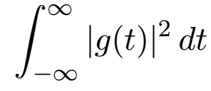
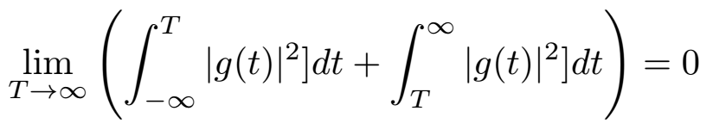
Signal Energy and Power (cont.)
The energy of a signal g(t) is:
We are interested in energy only when it is finite. Common cases:
  Bounded signal of finite duration; e.g., a pulse
  Exponentially decaying signals (output of some linear systems with pulse
  input)
  Necessary conditions for finite energy.
The energy in the “tails” of the signal must approach 0:
We would expect that the instantaneous power |g(t)|² → 0, but that is
not required. (This is only of mathematical interest.)

Slide 6
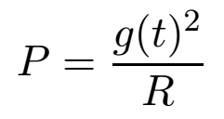
Units of Power
If a signal g(t) measured in volts is applied to a load resistor R, then the power in watts is:
Normally we do not care about the load, so we normalize to R = 1.
In many applications, the effect of the signal varies as the log of the
signal; e.g., human hearing and sight.
Power can be expressed in decibels (dB), which are logarithmic and
relative to some standard power. If P is measured in watts, then
  Power in dBW is 10 log₁₀ (P) (power relative to 1 W)
  Power in dBm (or dBmW) is log₁₀(1000 P ) = 30 + 10 log10 P
  One bel (B) is too large to be useful.
  The bel is named for Alexander Graham Bell (1847–1922).
  The dB was adopted by NBS in 1931. It is not an SI unit.

Slide 7
Classification of Signals
Signals can have a variety of characteristics, including
  values can be continuous or discrete
  continuous or discrete time variable
  deterministic or random
For deterministic signals, we have four cases:
  continuous time, continuous valued (mathematics)
  continuous time, discrete valued
  discrete time, continuous valued (digital signal processing)
  discrete time, discrete valued (digital switching)
Time can be restricted to a finite interval (e.g., one period)

Slide 8
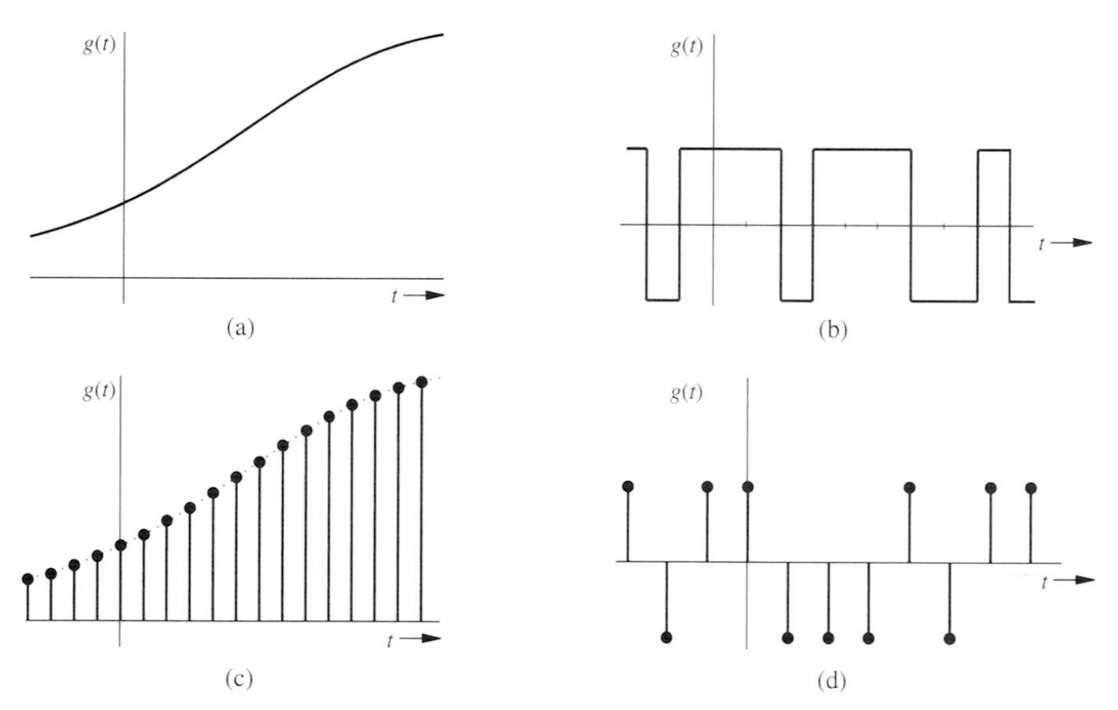
Classification of Signals (cont.)

Slide 9
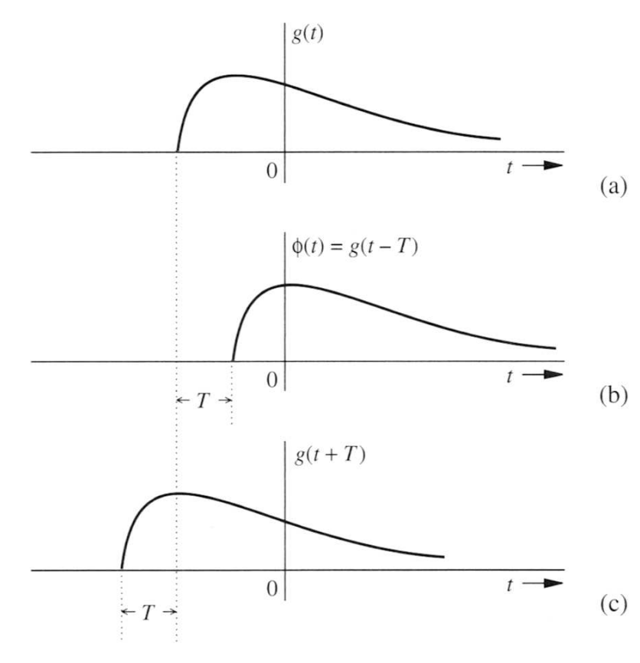
Operations on Signals
Time shifting/delay: g(t ± T )

Slide 10
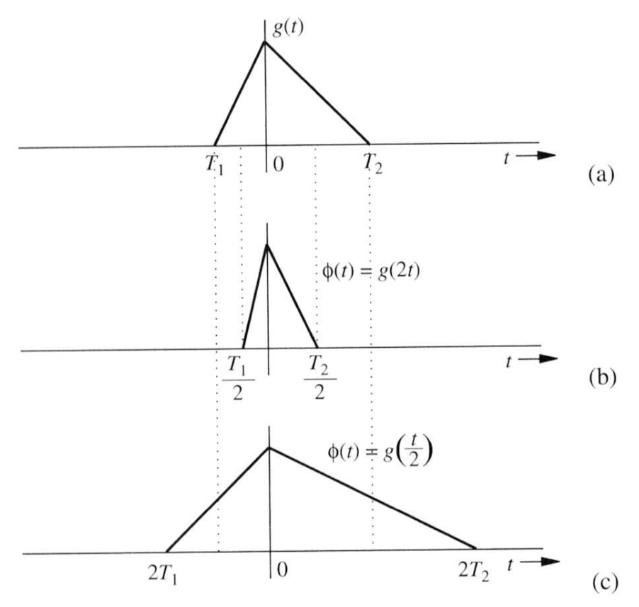
Operations on Signals 2
Time scaling: g(at) stretches (0 < a < 1) or squeezes (a > 1)

Slide 11
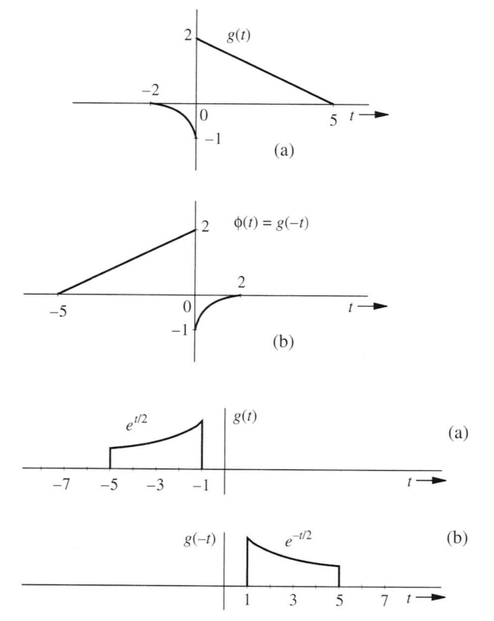
Operations on Signals 3
Time reversal: g(-t)
Each of these operations corresponds to a linear system

Slide 12
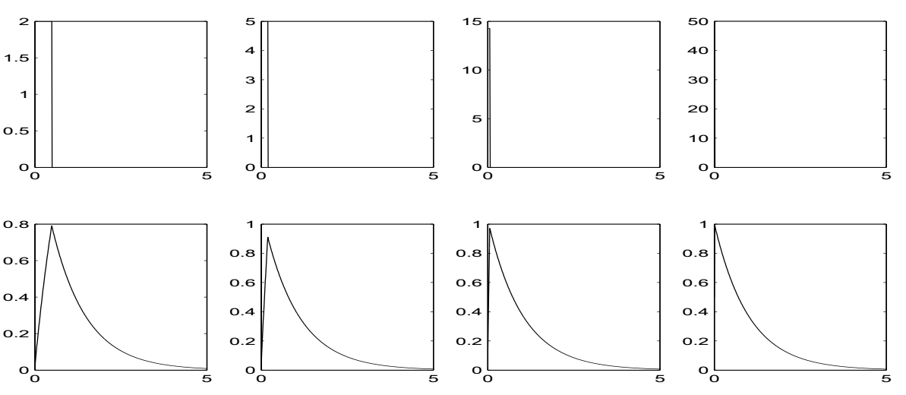
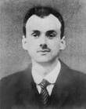
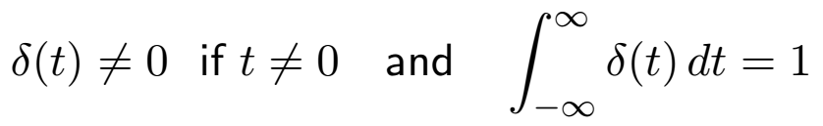
Unit Impulse Signal
Most physical systems give the same output for any narrow pulse with a given area.
The abstraction of a infinitely narrow signal with area 1 is the unit
impulse signal. Paul A. M. Dirac “defined” δ(t) by:
The area of the impulse is important; the energy of δ(t) is not defined.

Slide 13
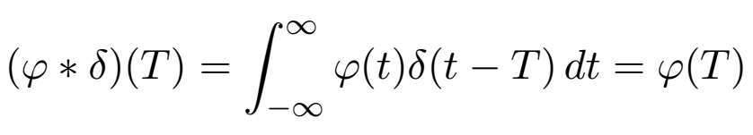

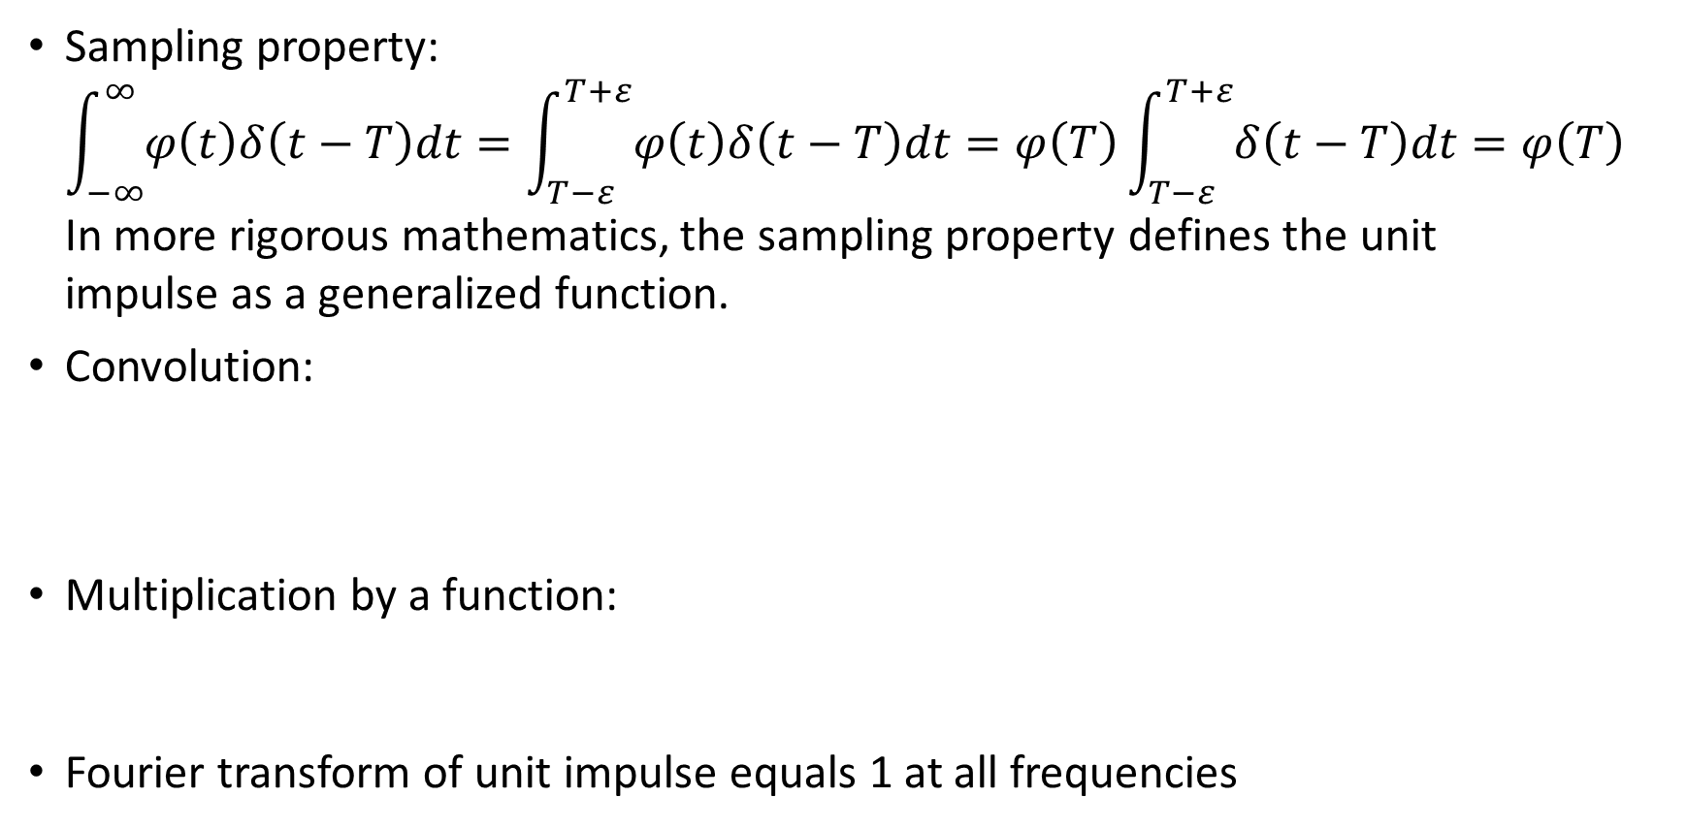
Properties of Unit Impulse Signal
Sampling property:
$\int_{−∞}^{∞}{φ\left(t\right)δ\left(t−T\right)dt}=\int_{T−ε}^{T+ε}{φ\left(t\right)δ\left(t−T\right)dt}=φ\left(T\right)\int_{T−ε}^{T+ε}{δ\left(t−T\right)dt}=φ\left(T\right)$
In more rigorous mathematics, the sampling property defines the unit
impulse as a generalized function.
Convolution:
Multiplication by a function:
Fourier transform of unit impulse equals 1 at all frequencies

Slide 14


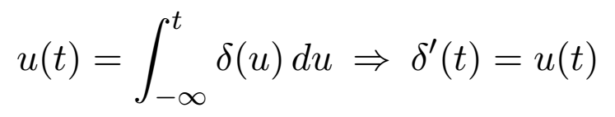
Unit Step Function u(t)
The Heaviside unit step function is defined by
The unit step function corresponds to turning on at time 0.
Unit step is integral of unit impulse:
Oliver Heaviside (1850-1925) was a self-taught English electrical engineer, mathematician, and physicist who adapted complex numbers to the study of electrical circuits, invented mathematical techniques to the solution of differential equations (later found to be equivalent to Laplace transforms), reformulated Maxwell’s field equations in terms of electric and magnetic forces and energy flux, and independently co-formulated vector analysis.

Slide 15
Periodic Signals
A signal g is called periodic if it repeats in time; i.e., for some T > 0,
g(t + T ) = g(T )
for all t.
If g is periodic, its period is the smallest such T .
Examples: trignometric functions are periodic. Period of cos t is 2π;
period of tan t is π.
The period of g(mt) is T/m.
E.g., period of cos 2πft is 2π/f, and its frequency is f Hz.
If g and f are periodic, their common period is LCM(T_{g}, T_{f} ).
E.g., period of sin πt + sin 2πt/5 is LCM(2, 5) = 10.

Slide 16
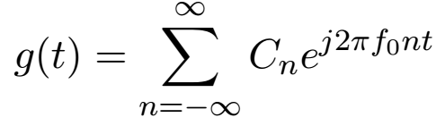
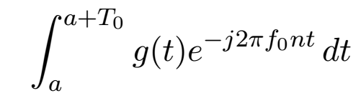
Fourier Series
Periodic signals can be written as the sum of sinusoids whose frequencies are integer multiples of the fundamental frequency f₀ = 1/T₀.
The most general representation uses complex exponential functions.
In general, the Fourier series coefficients Cn are complex numbers, even when the signal is real valued.
The Fourier series coefficients can be computed by
The integral is over any period of the signal.

Slide 17
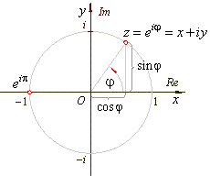
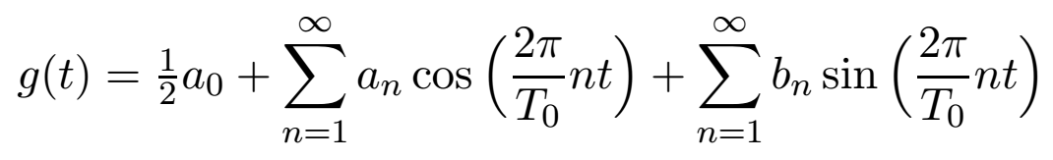
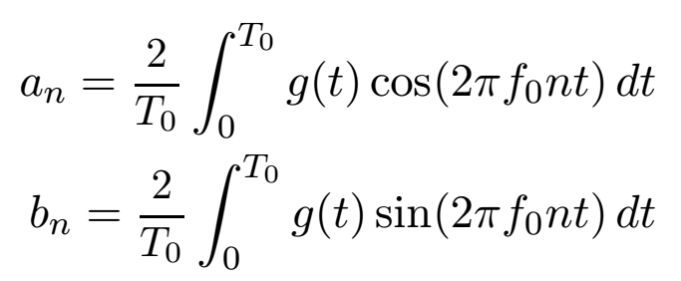
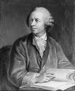

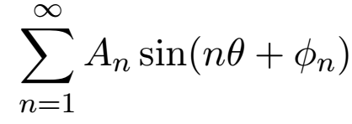
Fourier Series Alternative Forms
Euler’s formula e^{jθ} = cos(θ) + j sin(θ) allows us to represent periodic
signals as sums of sines and cosines:
The coefficients are:
A third form is:
Where each frequency component is described by an amplitude and a phase.

Slide 18

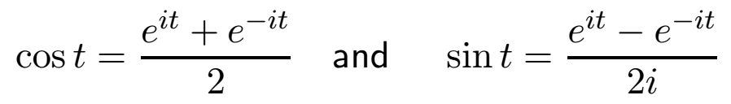
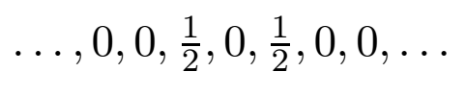


Fourier Series Examples 1: Sinusoids
Sinusoids have a finite number of terms. By Euler’s formula:
Therefore:
The Fourier exponential series coefficients are:
and
Note that power of cos or sin is: which is the
(RMS value)²

Slide 19
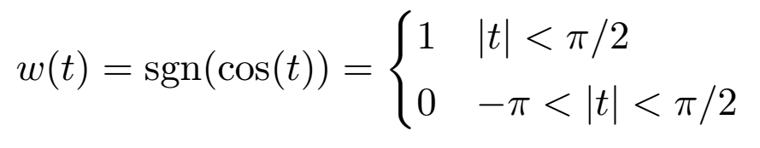
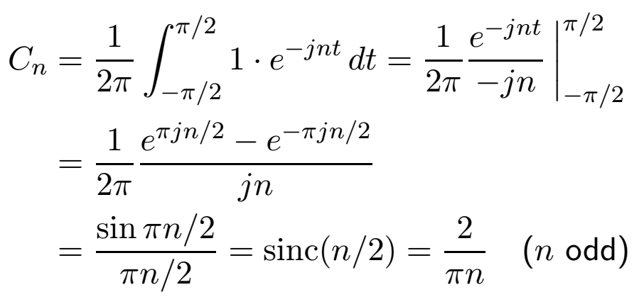
Fourier Series Examples 2: A Square Wave
Square wave with period 2π defined over interval [-π, π] by
Fourier series coefficients: if n > 0,

Slide 20
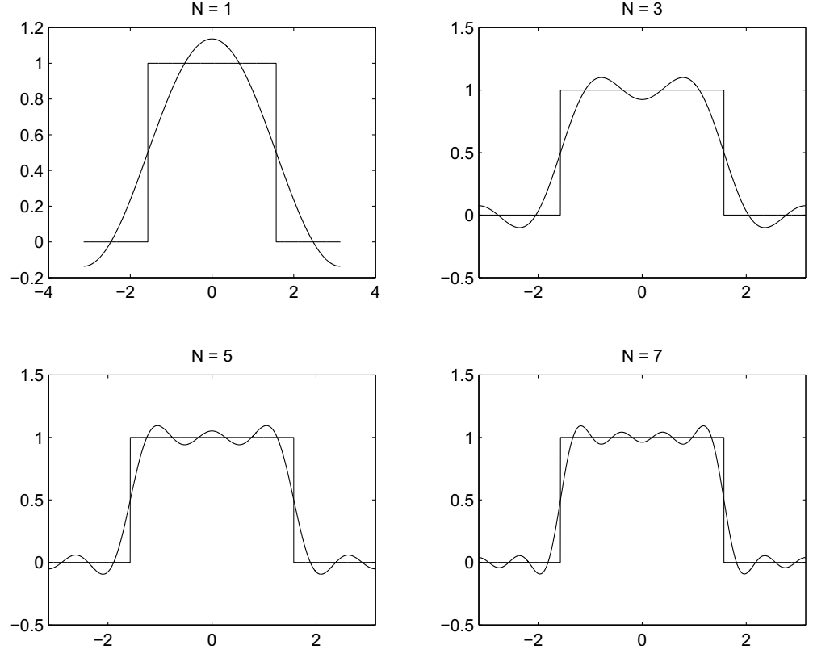
Square Wave (cont.)
The overshoot is an example of the Gibbs’ phenomenon.
The overshoot is ≈ 9% and occurs no matter how many terms are used.

Slide 21
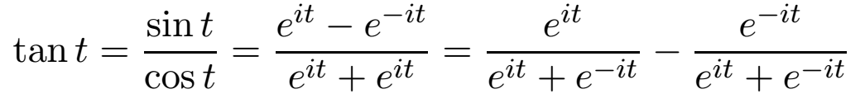
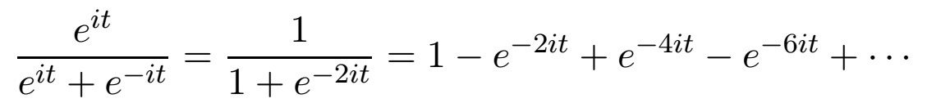
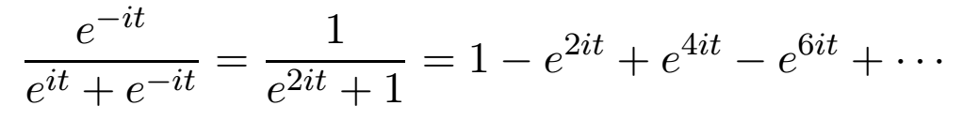
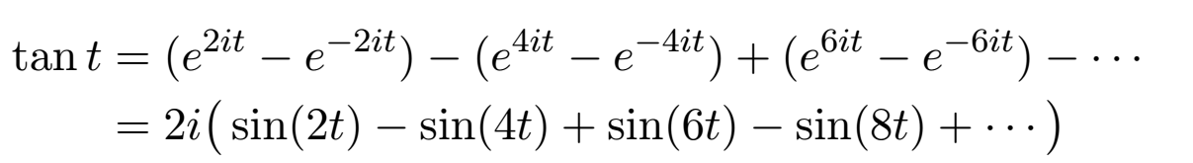
Fourier Series Examples 3
Trigonometric function: tan(t):
First term:
Second term:
Combine terms:
The Fourier series of this odd function has only even harmonics:
A trigonometric series with many terms (not well behaved):

Slide 22
Types of Systems
For theoretical and practical reasons, we restrict attention to systems and have useful properties and represent the physical world.
  Causal
  Continuous
  Stable
  Linear*
  Time invariant*
Fundamental fact: every linear, time-invariant system (LTIS) is
characterized by
  Impulse response: w(t) = h(t) ∗ v(t)
  Transfer function: in frequency domain, W (f) = H(f) · V (f)
* In this course we will sometimes relax these restrictions

