Slide 1
Chapter 3
Signal Analysis and Transmission
Part 1

Slide 2
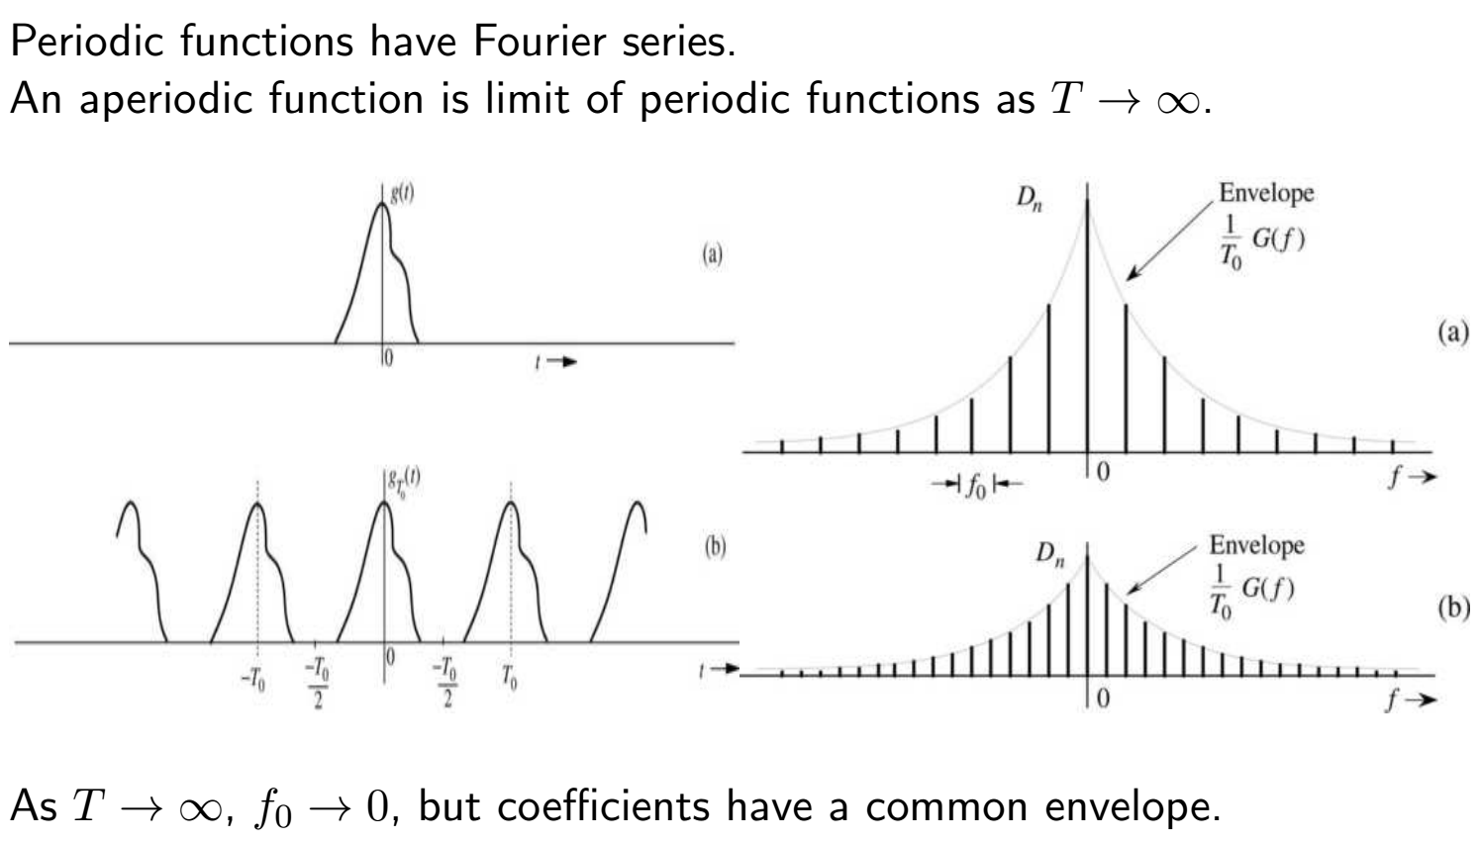
Fourier Transform Motivated
Notes:
You are probably familiar with Laplace transforms. In the communication world we prefer Fourier as it provides a better intuitive view of communication systems. Laplace deals better with transients and is preferred in filter analysis and for analyzing feedback control systems. When we need to look at time varying systems, we use either short-term (windowed) Fourier or Wavelet analysis.

Slide 3
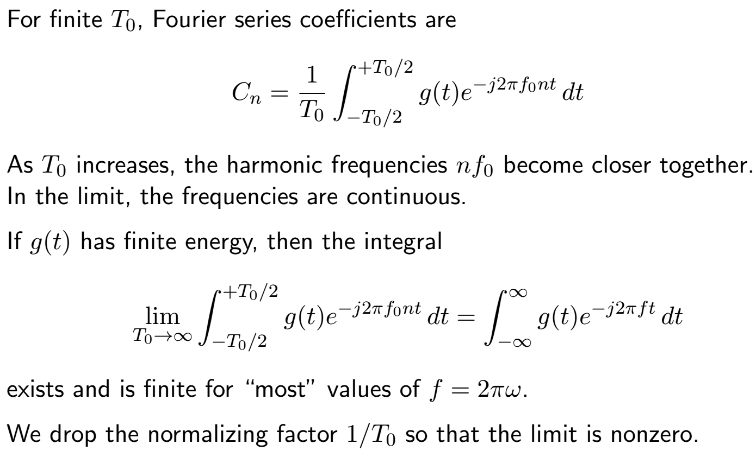
Fourier Transform Motivated (cont.)

Slide 4
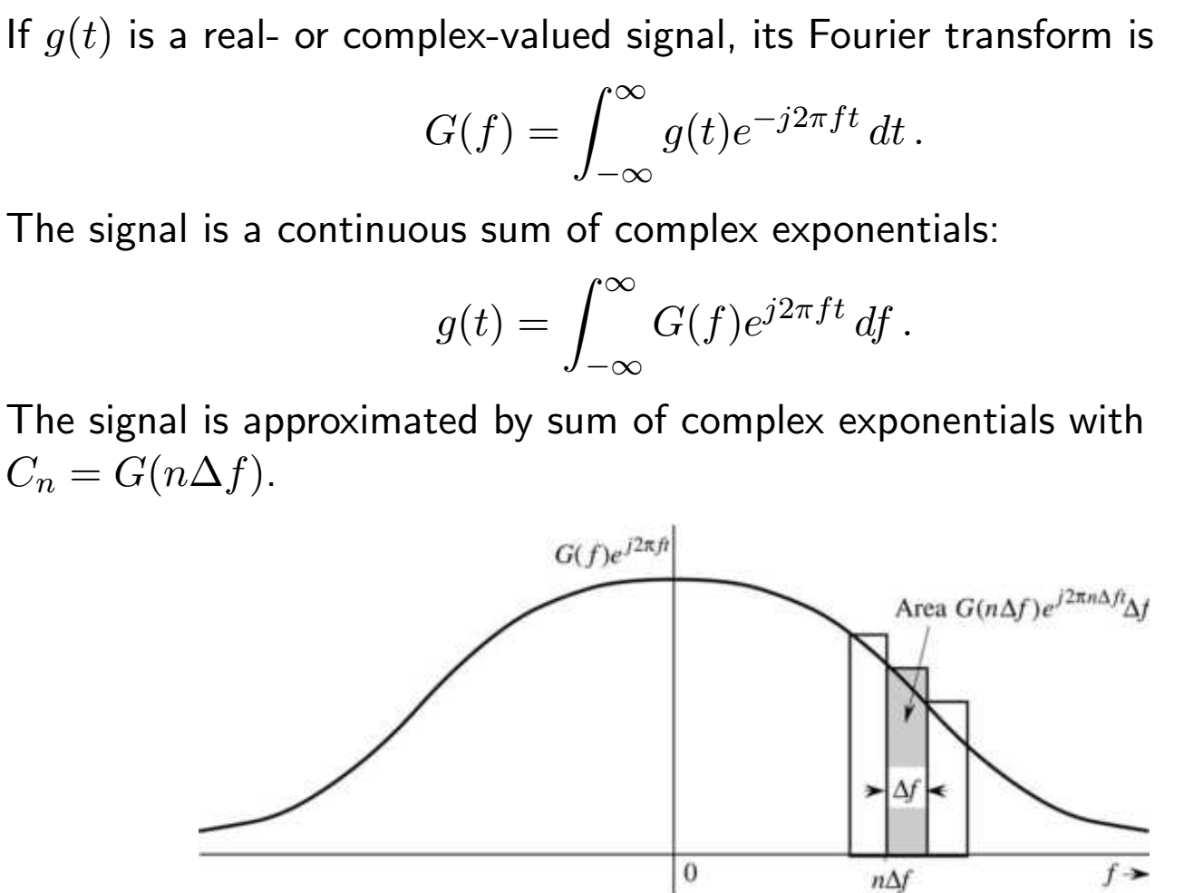
Fourier Transform Definition

Slide 5
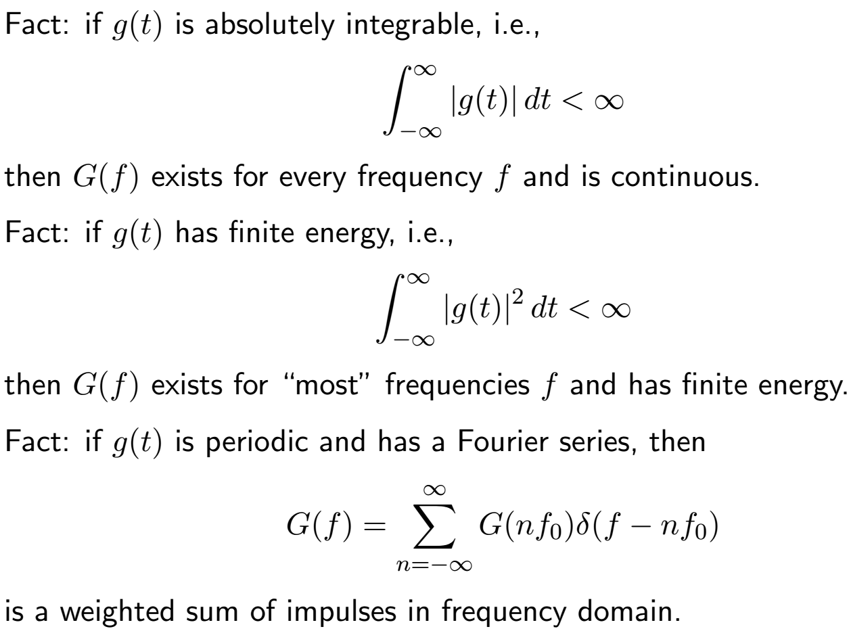
Fourier Transform Existence

Slide 6
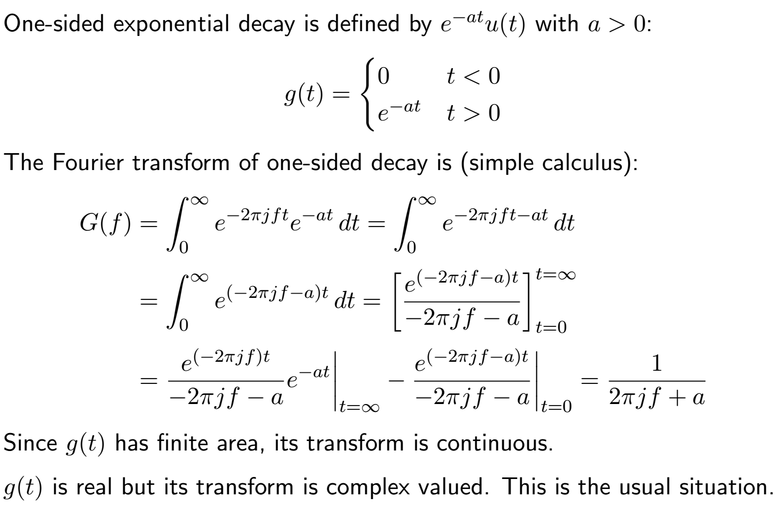
Fourier Transform Examples

Slide 7
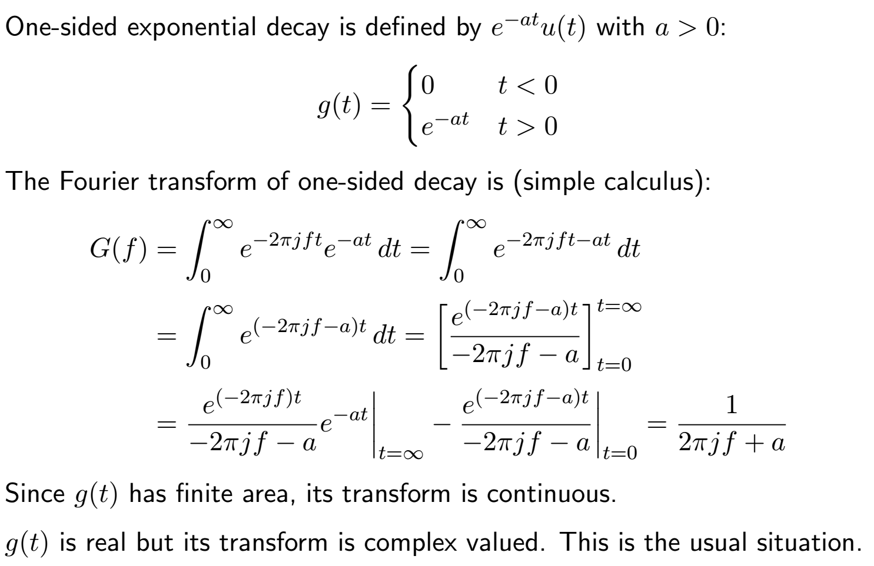
Fourier Transform Examples

Slide 8
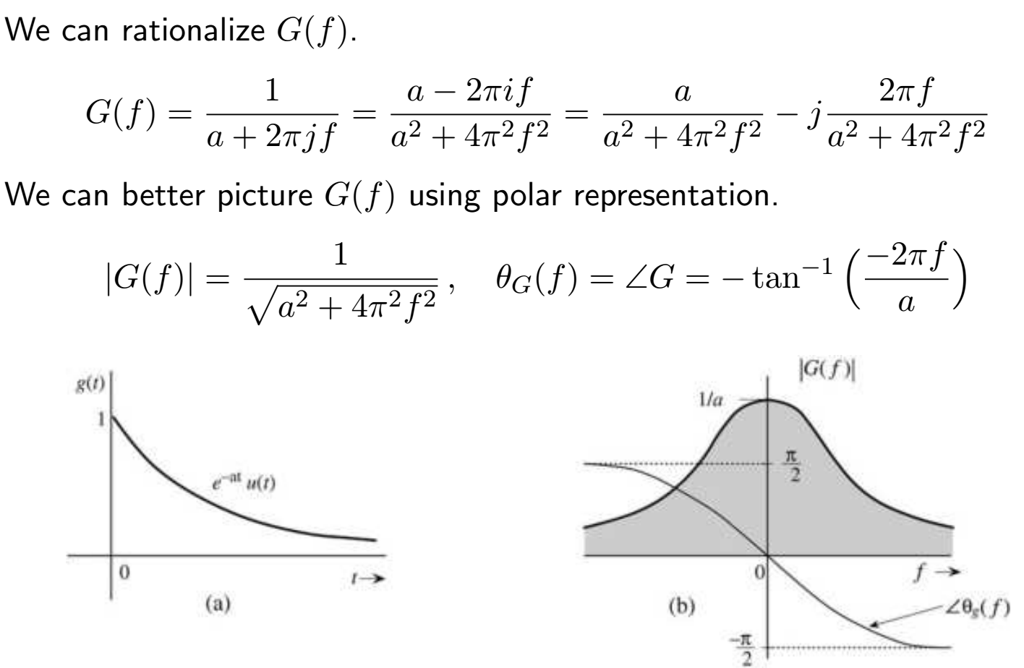
Fourier Transform Examples 2
Notes:
Rationalize = Multiply numerator AND denominator by the complex conjugate of the denominator.

Slide 9
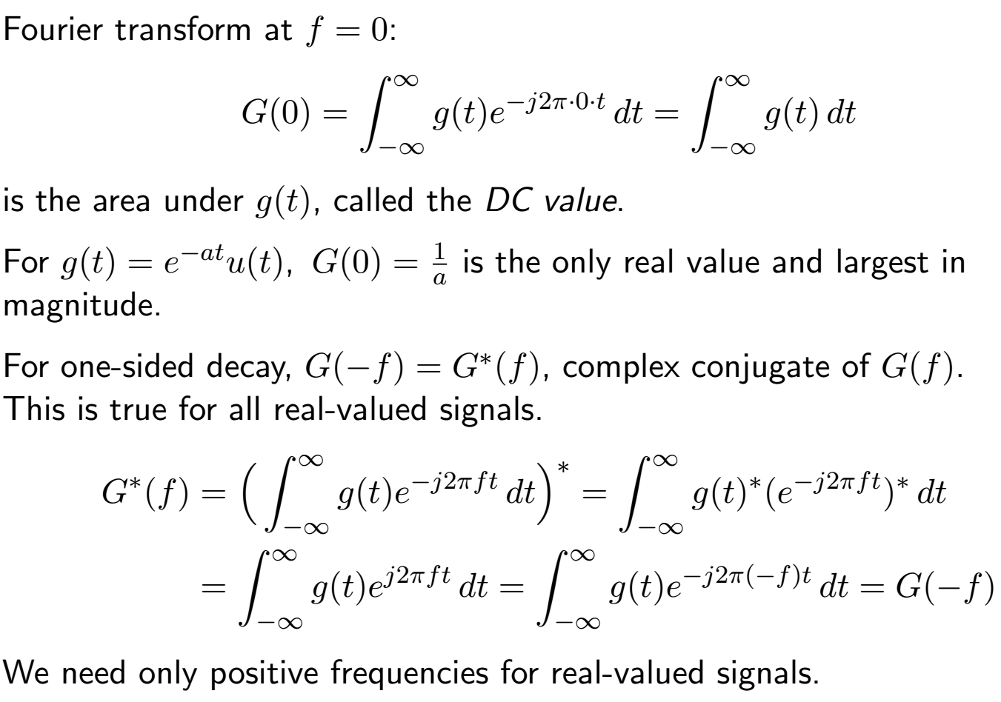
Fourier Transform Examples 3
Notes:
Real signals have symmetric spectra. Complex signals can be assymetric.

Slide 10
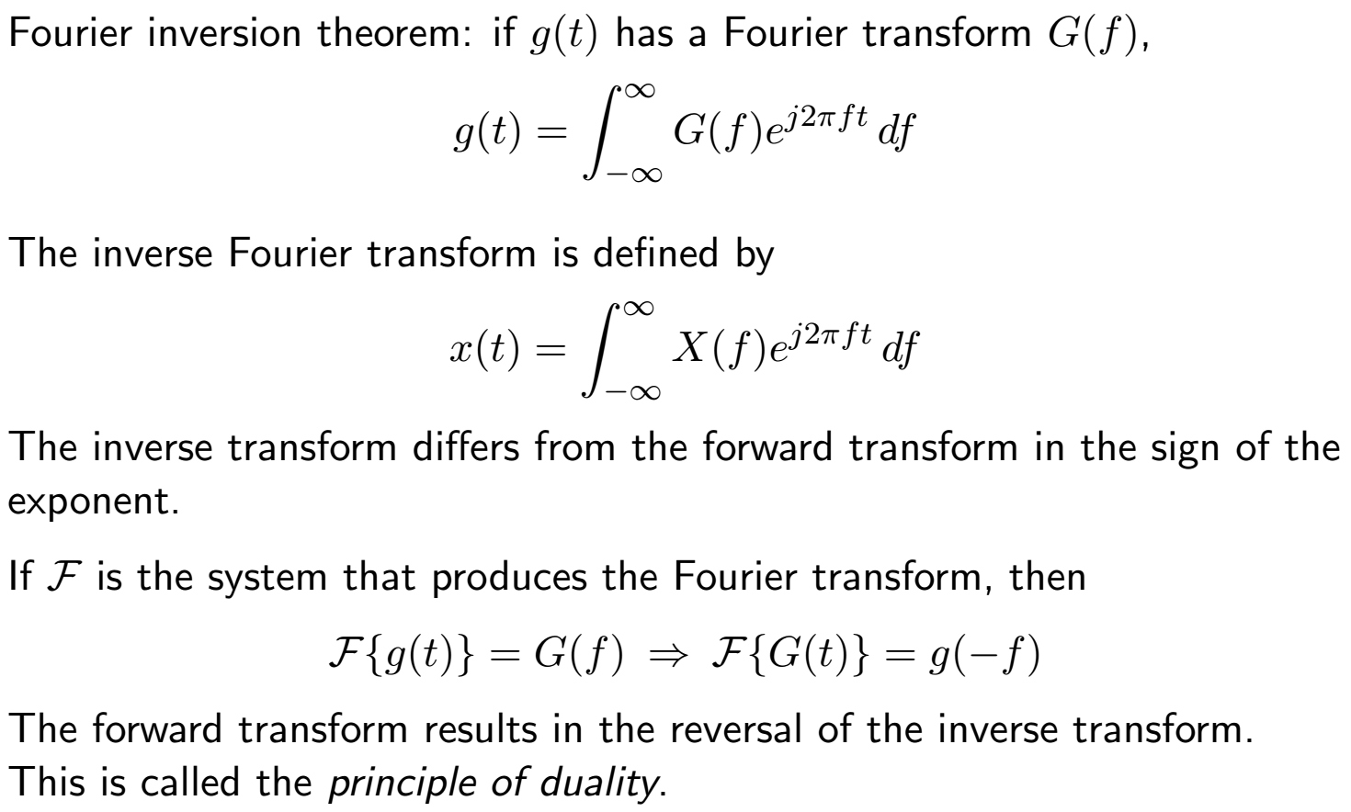
Fourier Inversion Theorem and Duality
Notes:
If you use ω = 2πf as the variable there is a 1/2π scaling factor. Depending on the reference it is sometimes on the forward transform, or on the inverse transform, or the square root of 1/2π is on both. Read my tutorial on the Fourier Transform to see that the correct place for the scaling factor is in the forward transform, not the inverse.

Slide 11
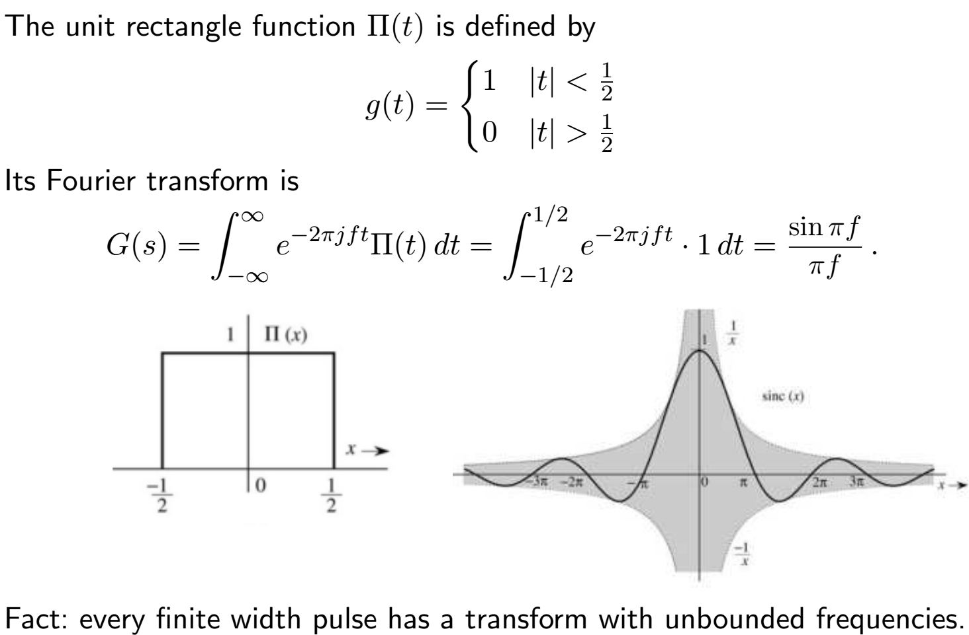
Important Fourier Transforms
Notes:
1 – The higher frequency energy is determined by the “rise/fall time” of the pulse. Faster rise/fall yields more high frequency content.
2 – Sine(x)/x is the result of a rectangular pulse.

Slide 12
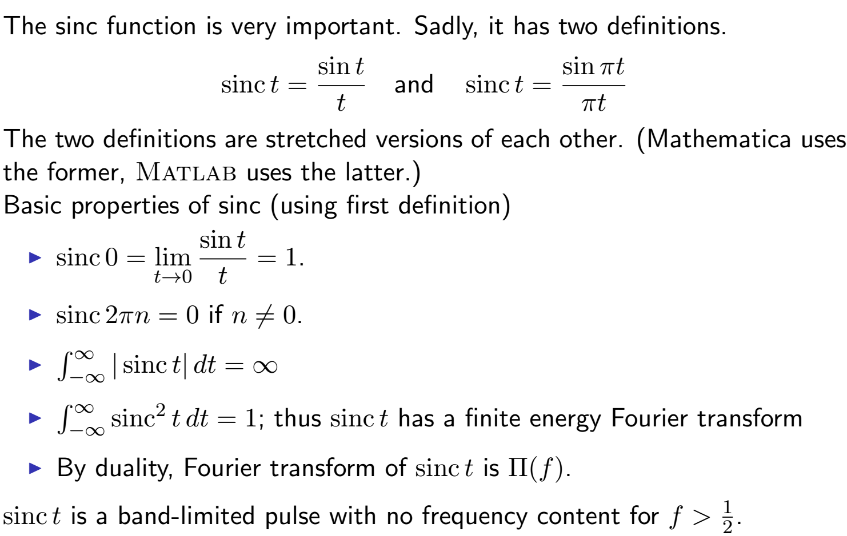
Sinc
Notes:
But it is not time limited. You can’t be both!

Slide 13
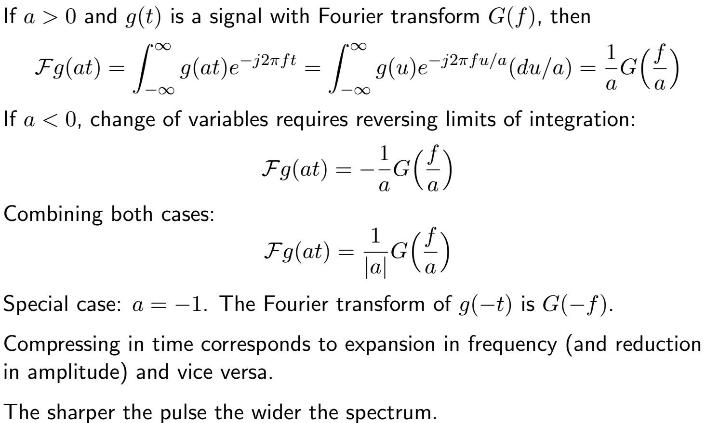
Fourier Transform Time Scaling

Slide 14
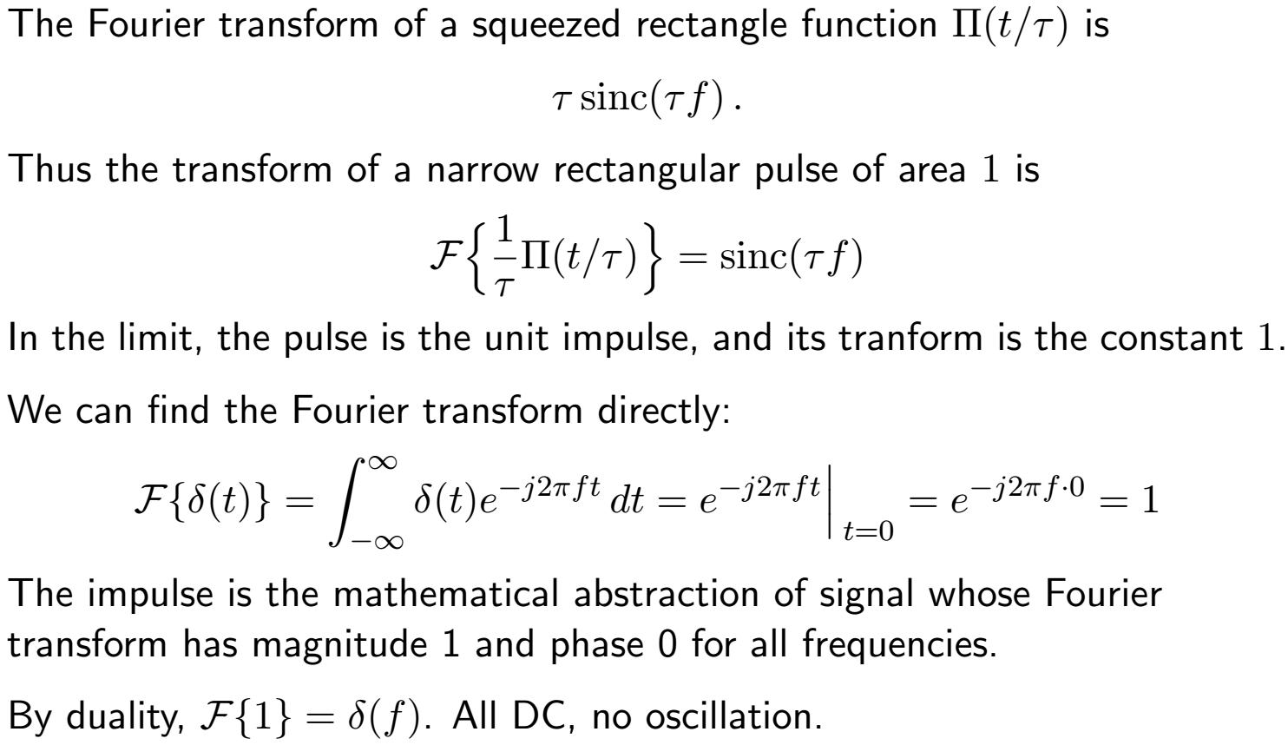
Fourier Transform Time Scaling Example
Notes:
You can also show the DC results by taking the limit of any pulse as the time duration approaches infinity as I do in my tutorial using the double sided decaying exponential pulse (Laplacian Pulse)

Slide 15
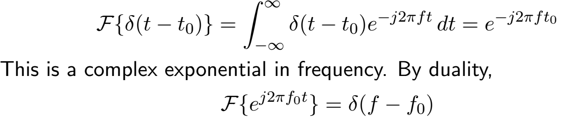
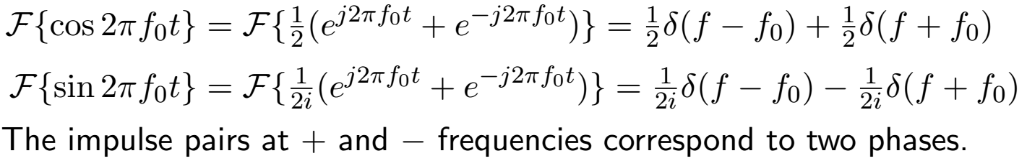
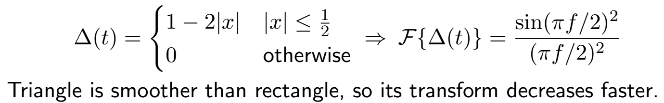
Important Fourier Transforms 2
Shifted impulse δ(t - t0):
Sinusoids:
Triangle function ∆(t):

Slide 16
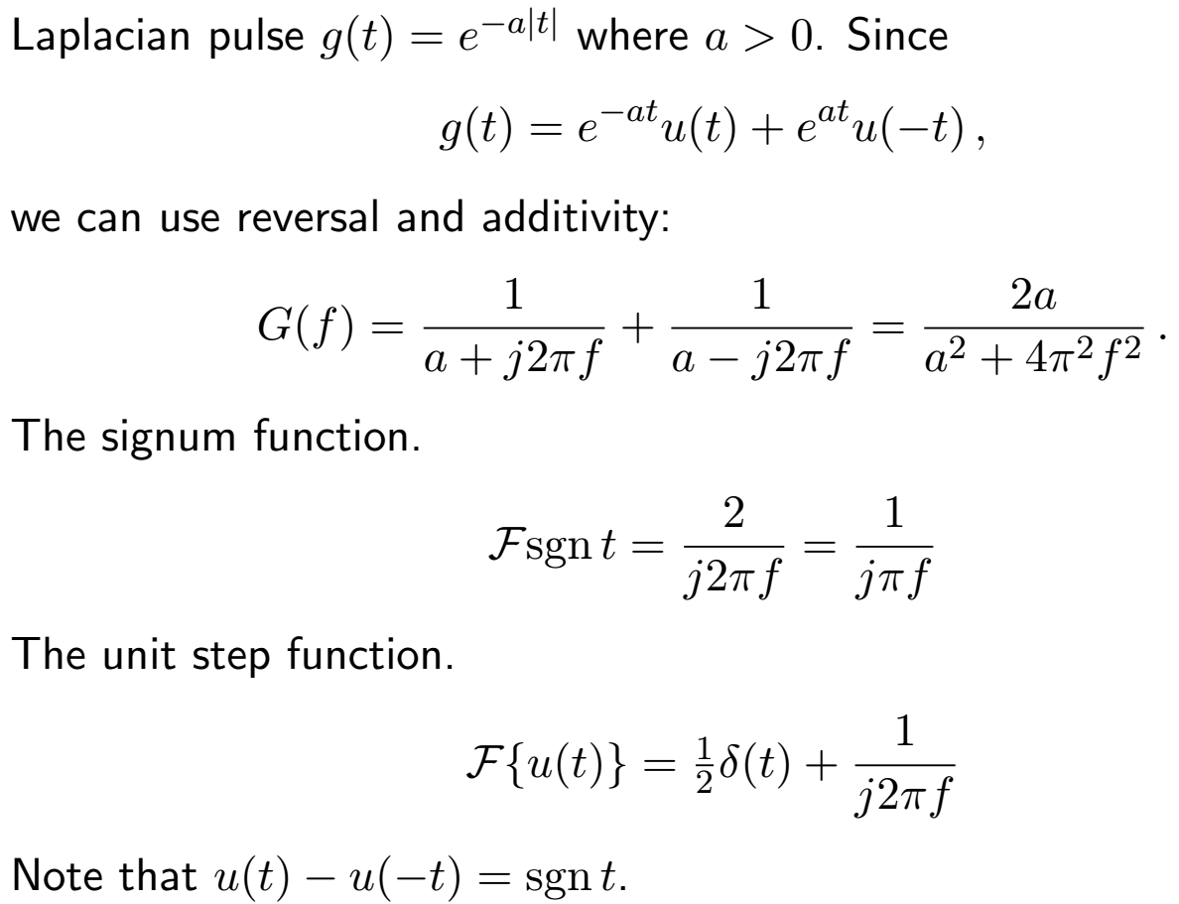
Important Fourier Transforms 3

