Slide 1
Chapter 7a
Baseband Digital Communication Part 1

Slide 2
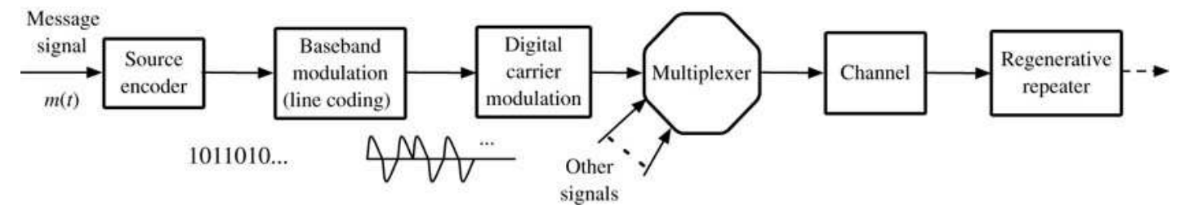
Line Coding for Digital Communication
Goal is to transmit binary data (e.g., PCM encoded voice, MPEG
encoded video, financial information)
Transmission distance is large enough that communication link
bandwidth is comparable to signal bandwidth.
  Connections between nearby logic gates have bandwidth greater than
  switching speed, so no line coding is needed. But longer connections use pulse shaping.
Multiple links may be used, with regenerative repeaters
First consider baseband communication (e.g., single twisted pair)

Slide 3
Line Coding Requirements
Small transmission bandwidth
Power efficiency: as small as possible for required data rate and error probability
Error detection/correction
Suitable power spectral density, e.g., little low frequency content
Timing information: clock must be extracted from data
Transparency: all possible binary sequences can be transmitted

Slide 4
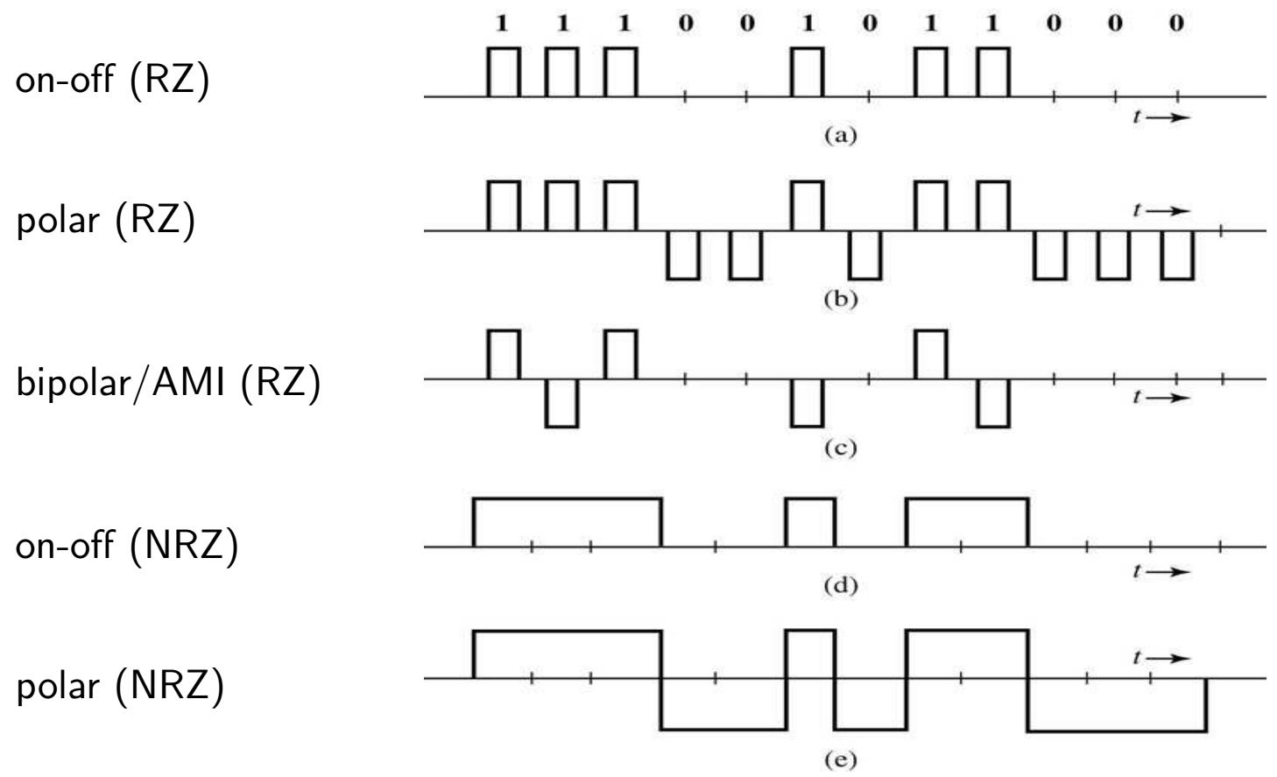
Line Code Examples
Notes:
RZ = return to zero, NRZ = non return to zero

Slide 5
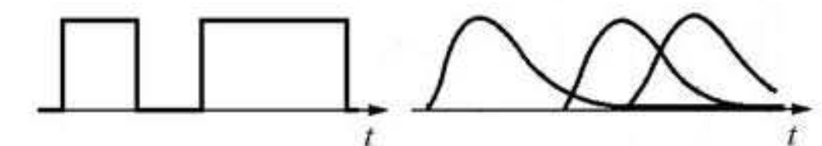
Power Spectral Density (PSD) of Line Codes
The output distortion of a communication channel depends on the
power spectral density of the input signal
Input PSD depends on
  pulse rate (spectrum widens with pulse rate)
  pulse shape (smoother pulses have narrower PSD)
  pulse distribution
Distortion can result in smeared channel output; output pulses are
(much) longer than input pulses
Inter-Symbol interference (ISI): received pulse is affected by previous
input symbols

Slide 6
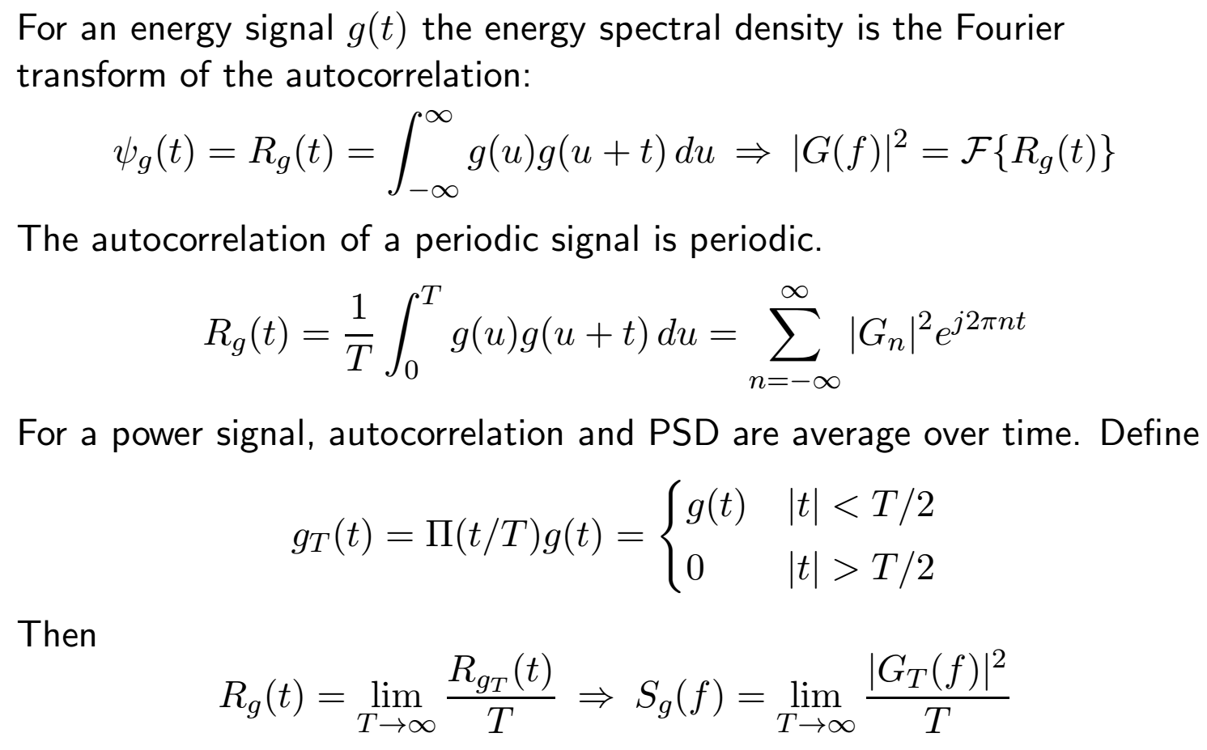
Power Spectral Density (review)

Slide 7
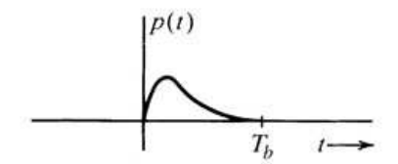
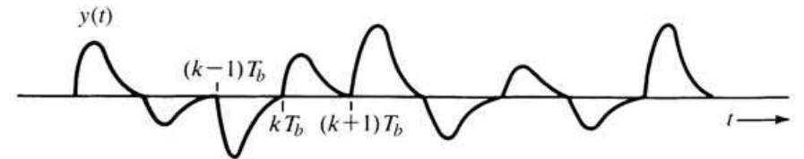
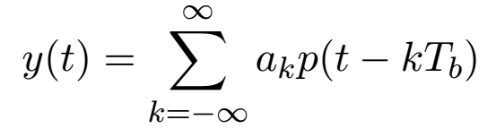
PSD of Line Codes
The PSD of a line code depends on the shapes of the pulses that
correspond to digital values. Assume PAM.
The transmitted signal is the sum of weighted, shifted pulses.
where T_{b} is spacing between pulses. (Pulse may be wider than T_{b}.)

Slide 8
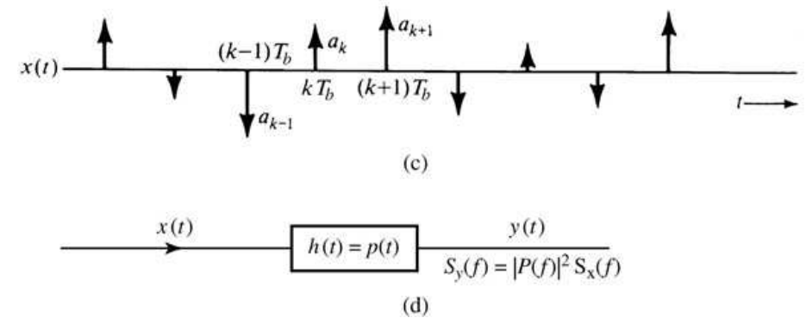
PSD of Line Codes 2
PSD depends on pulse shape, rate, and digital values {a_{k}}.
We can simplify analysis by representing {a_{k}} as impulse train.
PSD of y(t) is S_{y}(f) = |P(f)|2S_{x}(f).
  P(f) depends only on the pulse, independent of digital values or rate.
  S_{x}(f) increases linearly with rate 1/T_{b} and depends on distribution of
values of {a_{k}}. e.g., a_{k} = 1 for all k has narrower PSD.

Slide 9
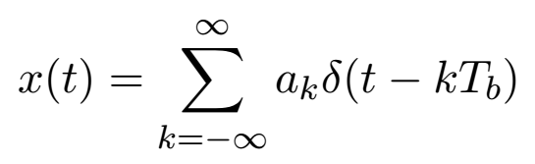
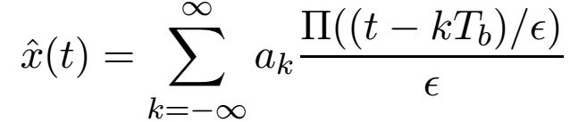
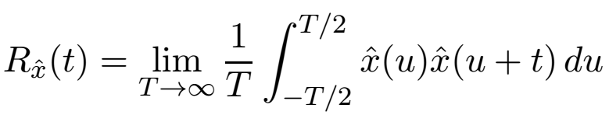

PSD of Impulse Train
The autocorrelation of
can be found as the limit of the autocorrelation of pulse trains:
The autocorrelation of this pulse train (a power signal) is

Slide 10
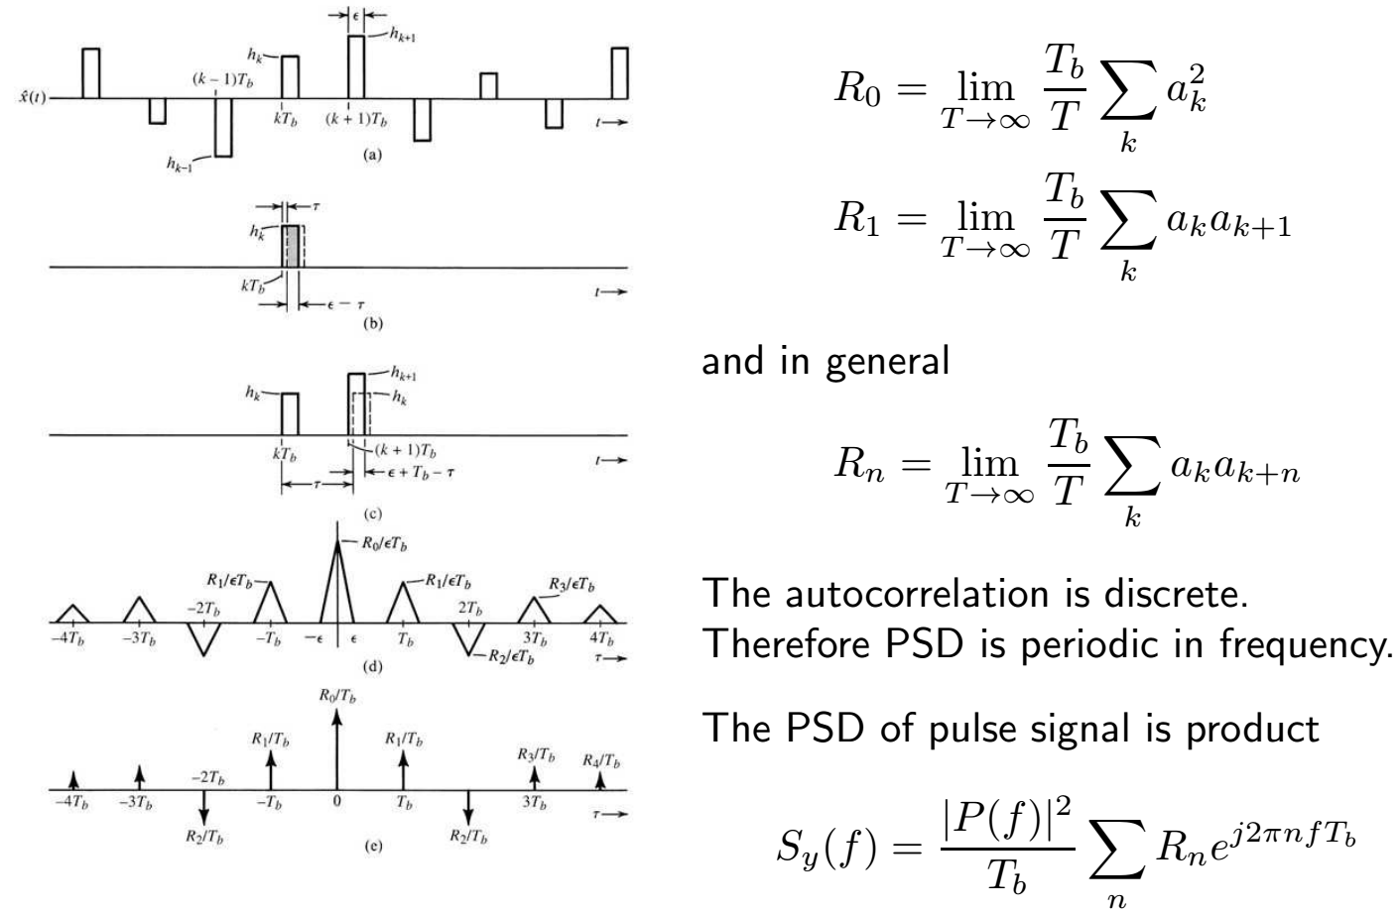
PSD of Impulse Train 2

Slide 11
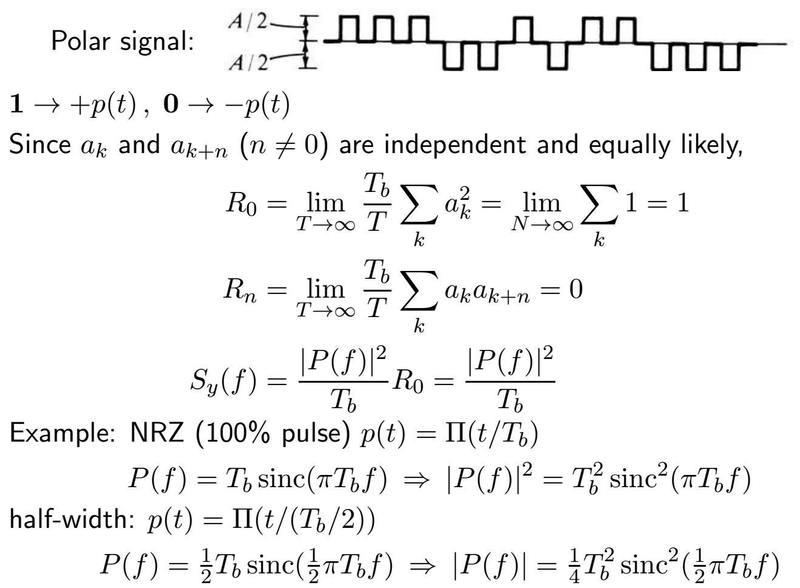
PSD of Polar Signaling

Slide 12
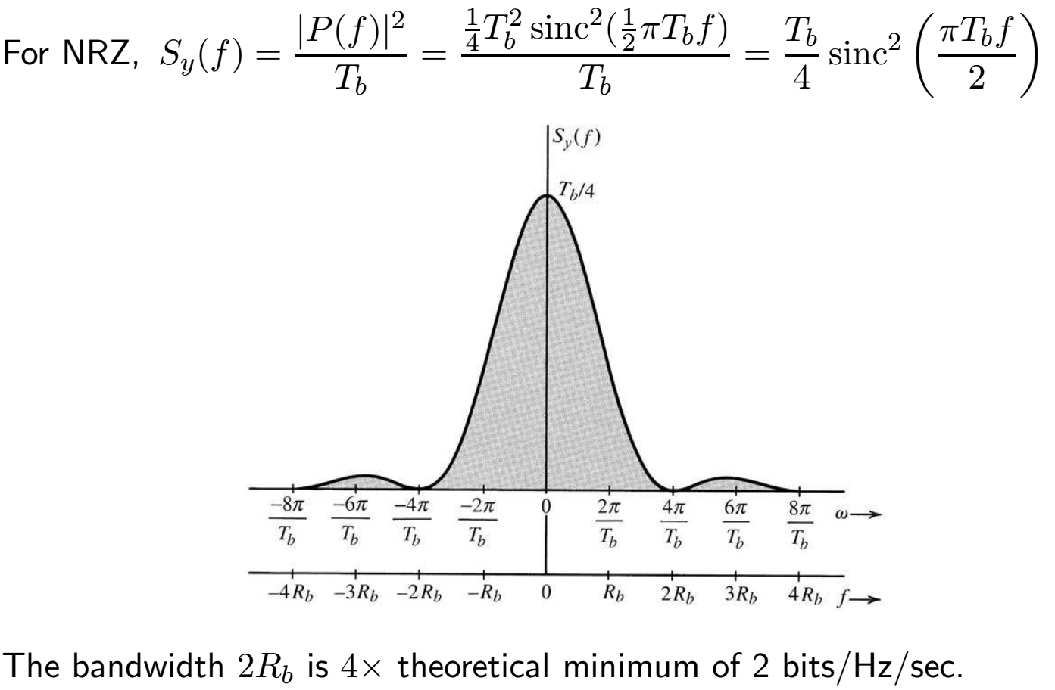
PSD of Polar Signaling (Half-Width Pulse)

Slide 13
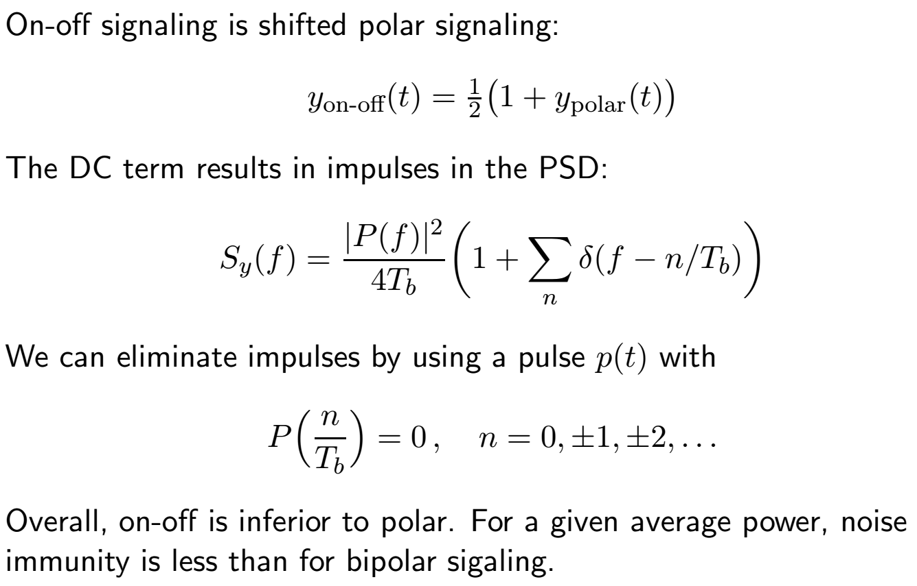
PSD of On-Off Signaling

Slide 14
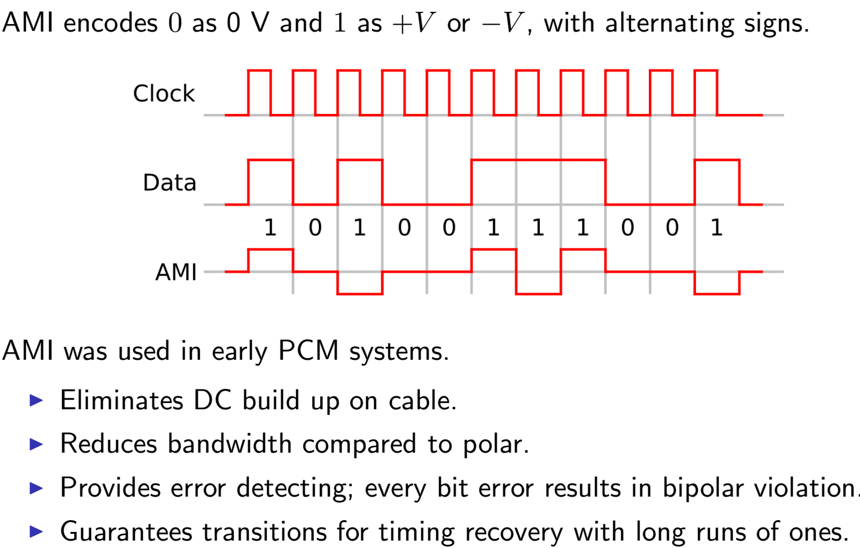
Alternate Mark Inversion (Bipolar) Signaling
Notes:
AMI is also called bipolar and pseuodternary.

Slide 15
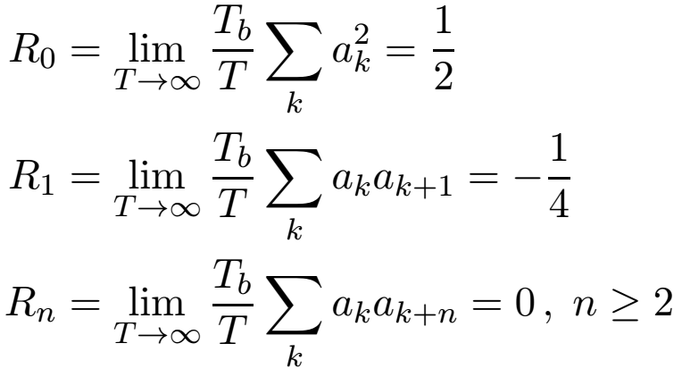
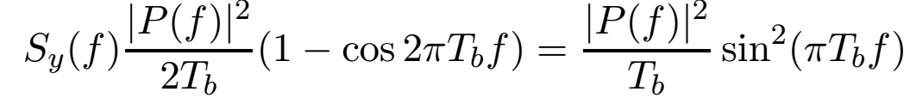
PSD of AMI Signaling
If the data sequence {a_{k}} is equally likely and independent 0s and 1s, then the autocorrelation function of the sequence is
Therefore
This PSD falls off faster than sinc πT_{b}f.
The PSD has a null at DC, which aids in transformer coupling.

Slide 16
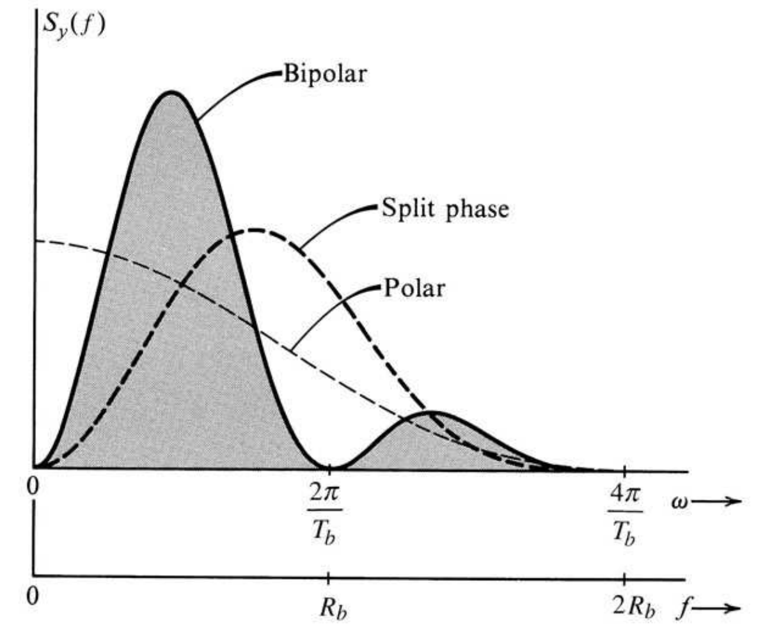
PSD of AMI Signaling 2

Slide 17
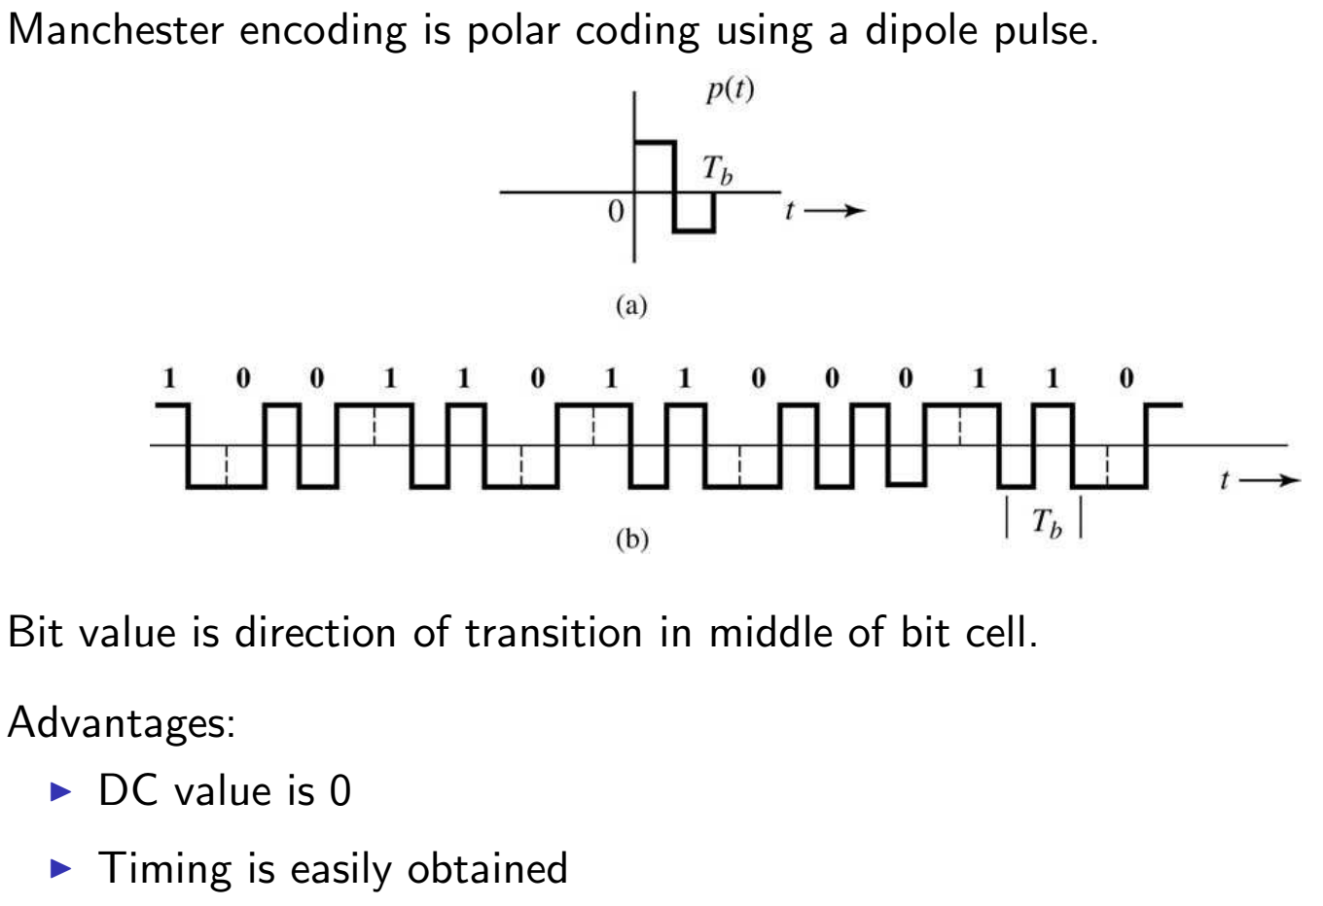
Split-Phase (Manchester) Coding

Slide 18
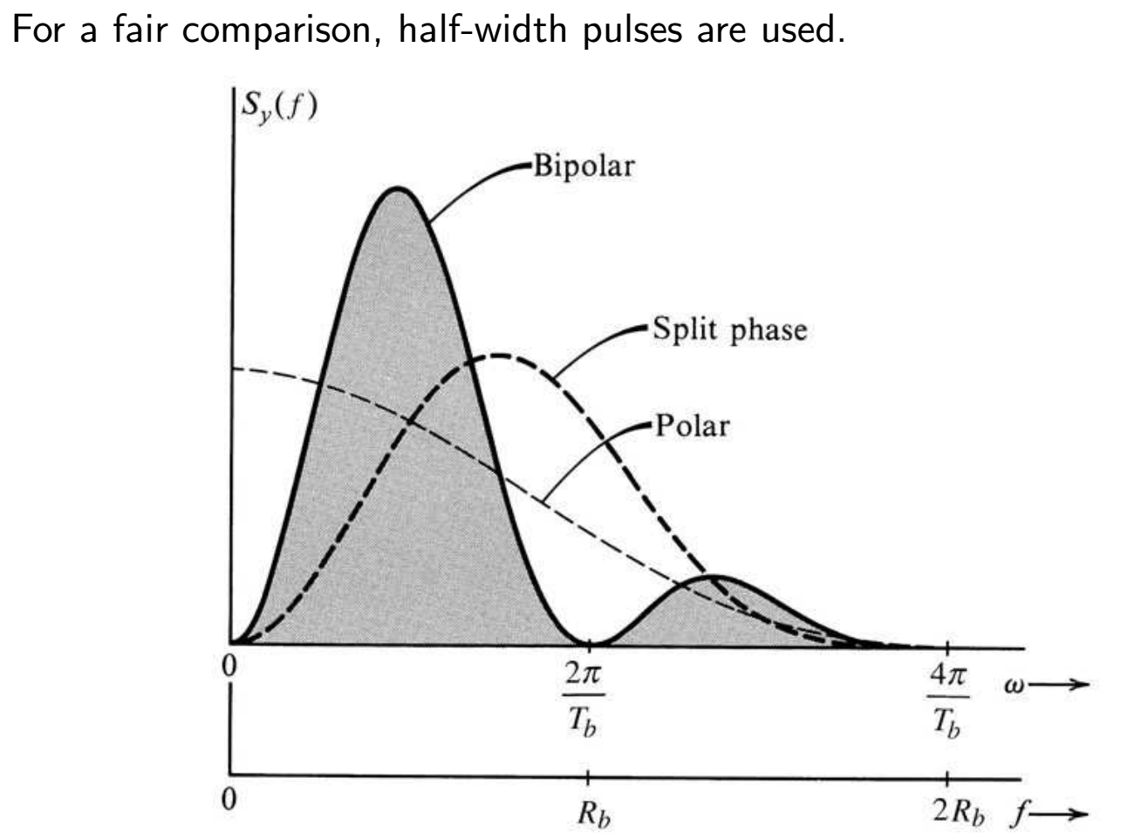
PSD of Polar, Split-Phase, Bipolar RZ Signals

Slide 19
Data Transfer in Digital Systems
In a synchronous digital system, a common clock signal is used by all devices.
data + clock
Multiple data signals can be transmitted in parallel using a single clock signal.
Serial peripheral communication schemes (RS-232, USB, FireWire) use various clock extraction methods
  RS-232 is asynchronous with (up to) 8 data bits preceded by a start bit (0) and followed by optional parity bit and stop bit (1); clock recovery by “digital phase-locked loop”
  USB needs a real phase-locked loop and uses bit stuffing to ensure enough transitions
  FireWire has differential data and clock pairs; clock transitions only when data does not
Notes:
RS-232 is the old PC “Serial Port”

