Slide 1
Chapter 7b
Baseband Digital Communication Part 2

Slide 2

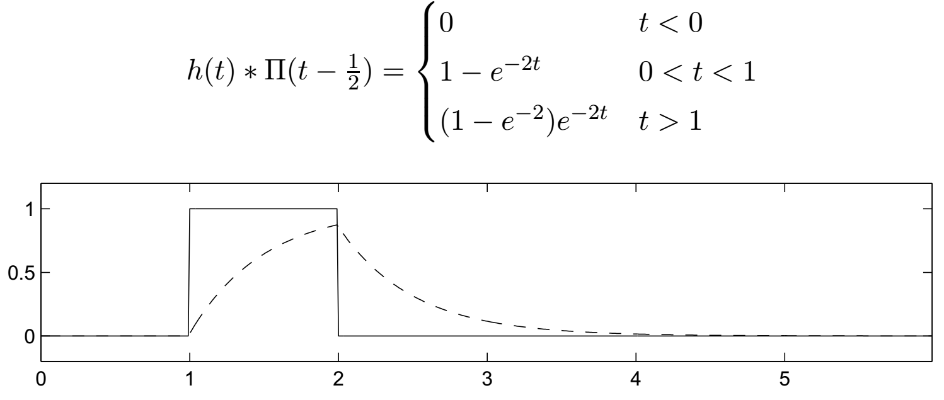
Inter-Symbol Interference (ISI)
Pulses transmitted over a physical channel (linear time-invariant system) have their shape distorted
E.g., the impulse response of an RC-circuit is
For RC = 0.5 the pulse response is
Notes:
Besides pulse stretching as in this case there is “Group Delay Distortion” (non-linear phase response) which distorts pulses by propagating different frequencies at different speeds.

Slide 3
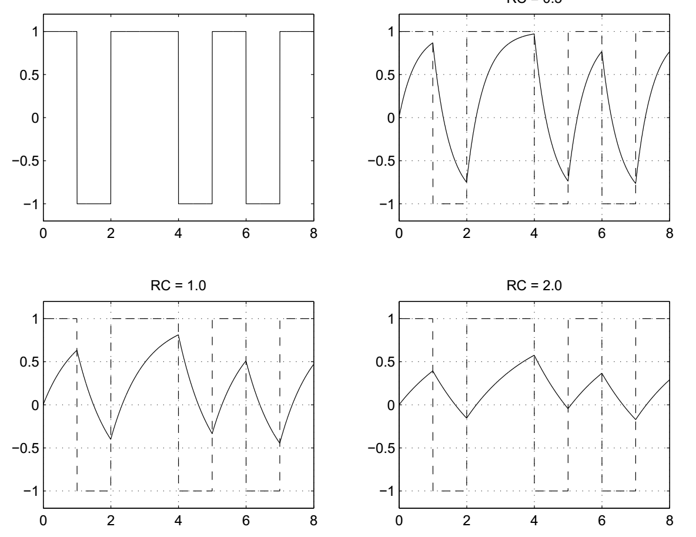
ISI Example: h(t) = (1/RC)e^{-t/RC}

Slide 4
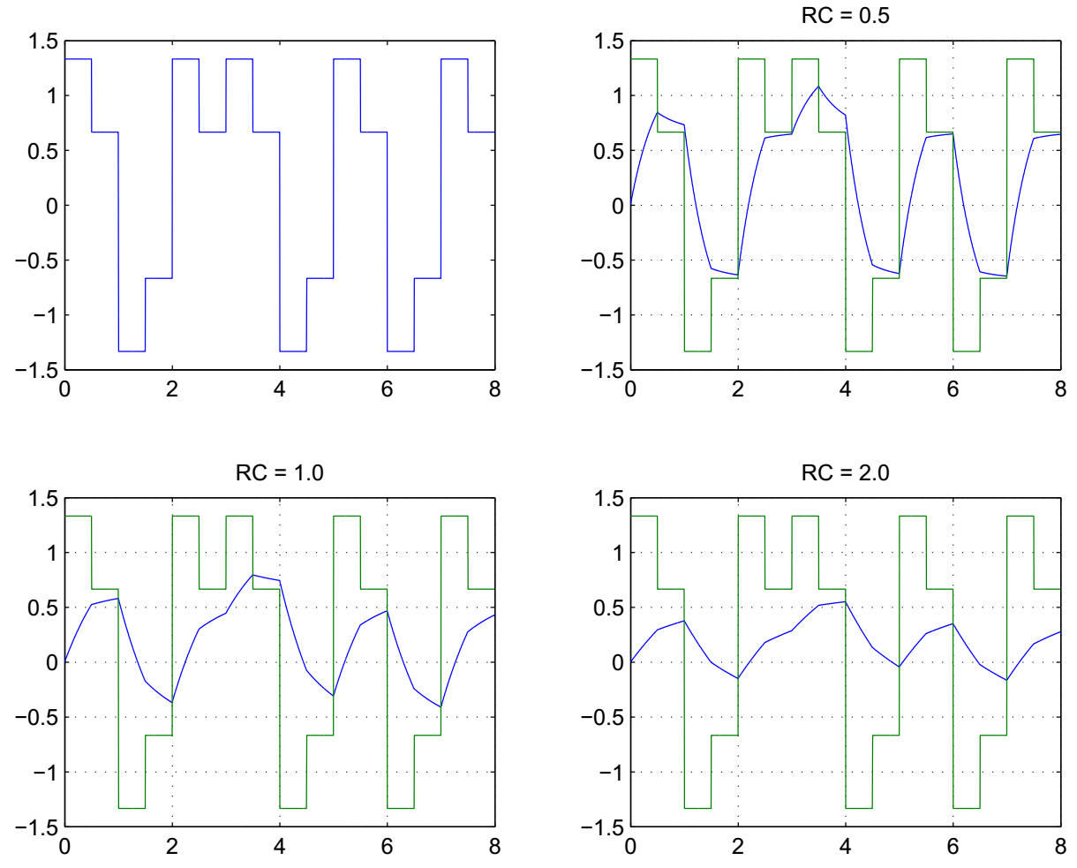
Reducing ISI: Pre-Emphasis

Slide 5
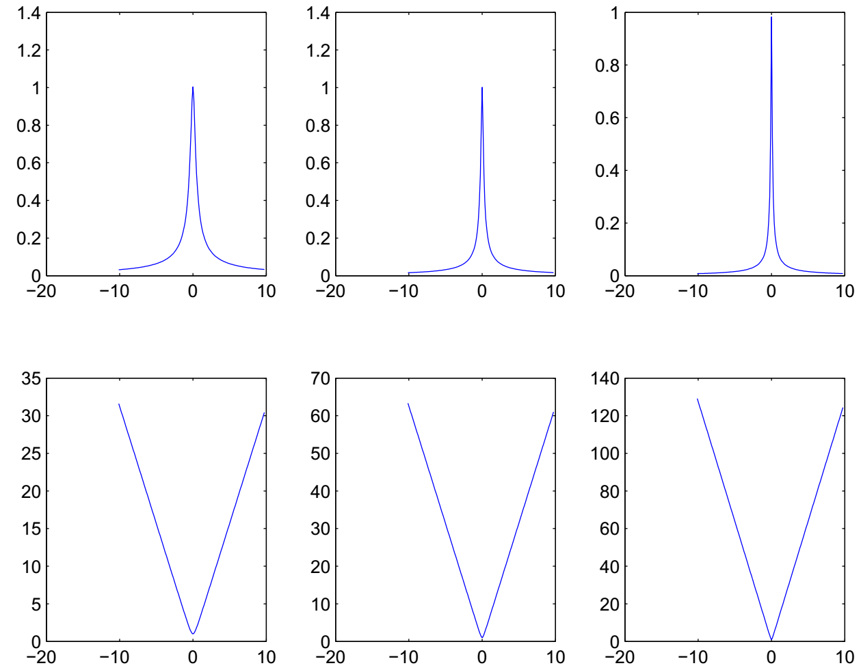
Reducing ISI: Transfer Functions and Equalization Filters

Slide 6
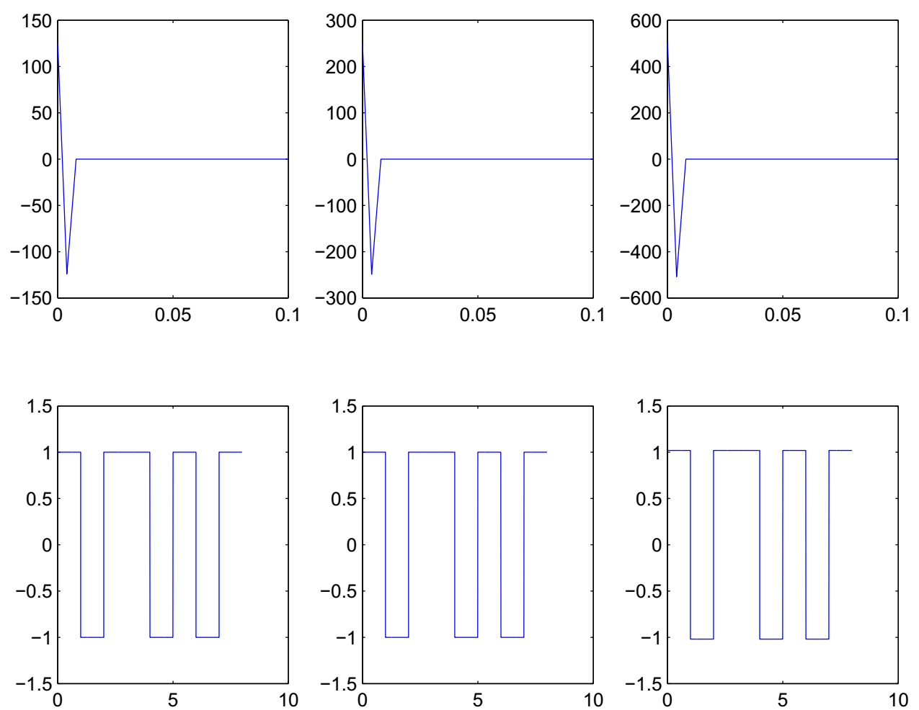
Equalization Impulse Responses, Signals after Equalization

Slide 7
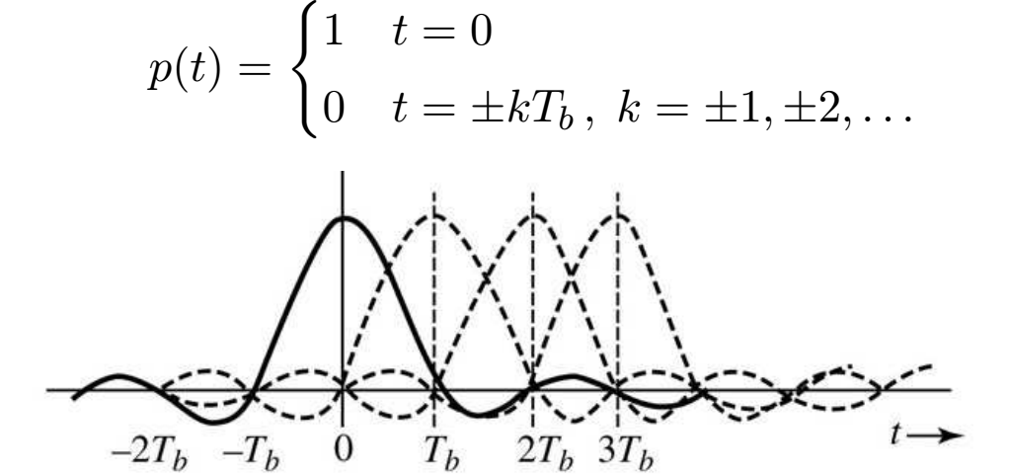
Reducing ISI: Pulse Shaping
A time-limited pulse cannot be bandlimited
Linear channel distortion results in spread out, overlapping pulses
Nyquist introduced three criteria for dealing with ISI.
The first criterion was that each pulse is zero at the sampling time of
other pulses.
Notes:
Harry Nyquist, “Certain topics in telegraph transmission theory”, Trans. AIEE, Apr. 1928

Slide 8
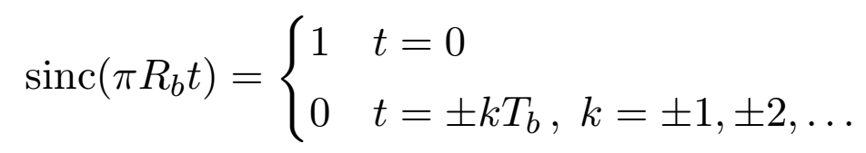
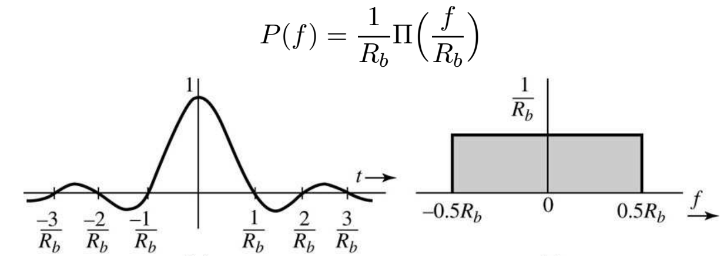
Pulse Shaping: sinc Pulse
Let R_{b} = 1/T_{b}. The sinc pulse sinc(πR_{b}t) satisfies Nyquist’s first
criterion for zero ISI:
This pulse is bandlimited. Its Fourier transform is
Unfortunately, this pulse has infinite width and decays slowly

Slide 9

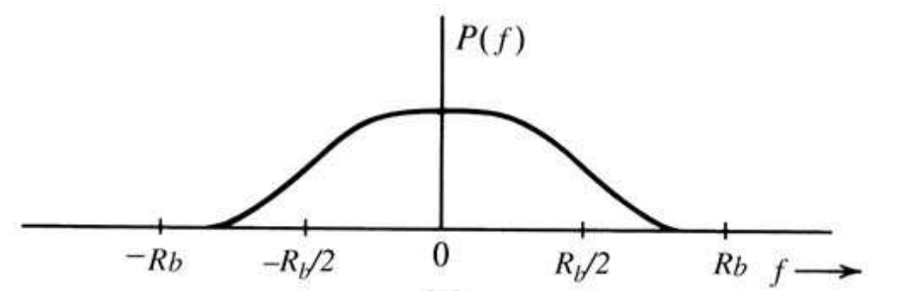
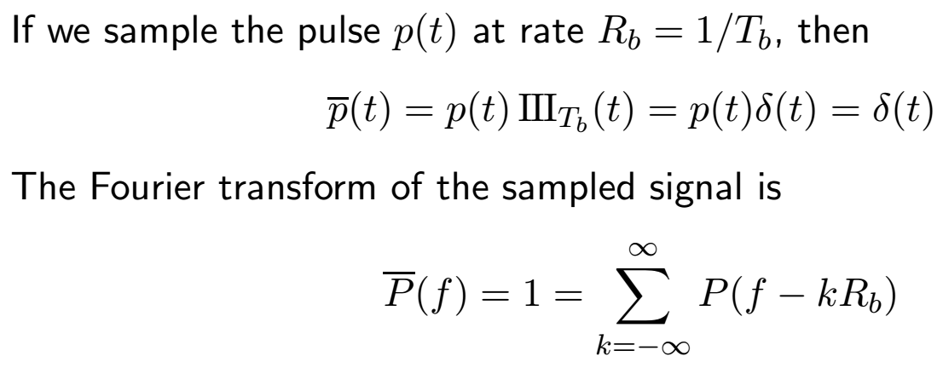
Nyquist Pulse
Nyquist increased the width of the spectrum in order to make the pulse fall off more rapidly.
The Nyquist pulse has spectrum width

Slide 10
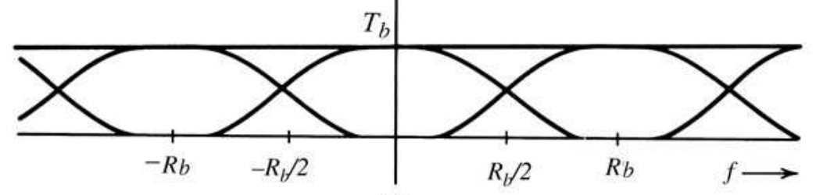
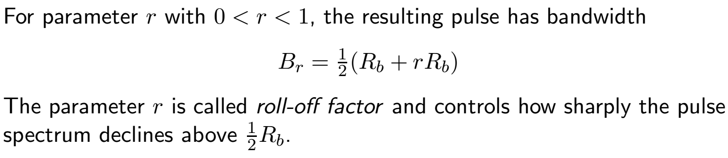
Nyquist Pulse 2
Since we are sampling below the Nyquist rate 2Rb, the shifted transforms overlap.
Nyquist’s criterion requires pulses whose overlaps add to 1 for all f.

Slide 11
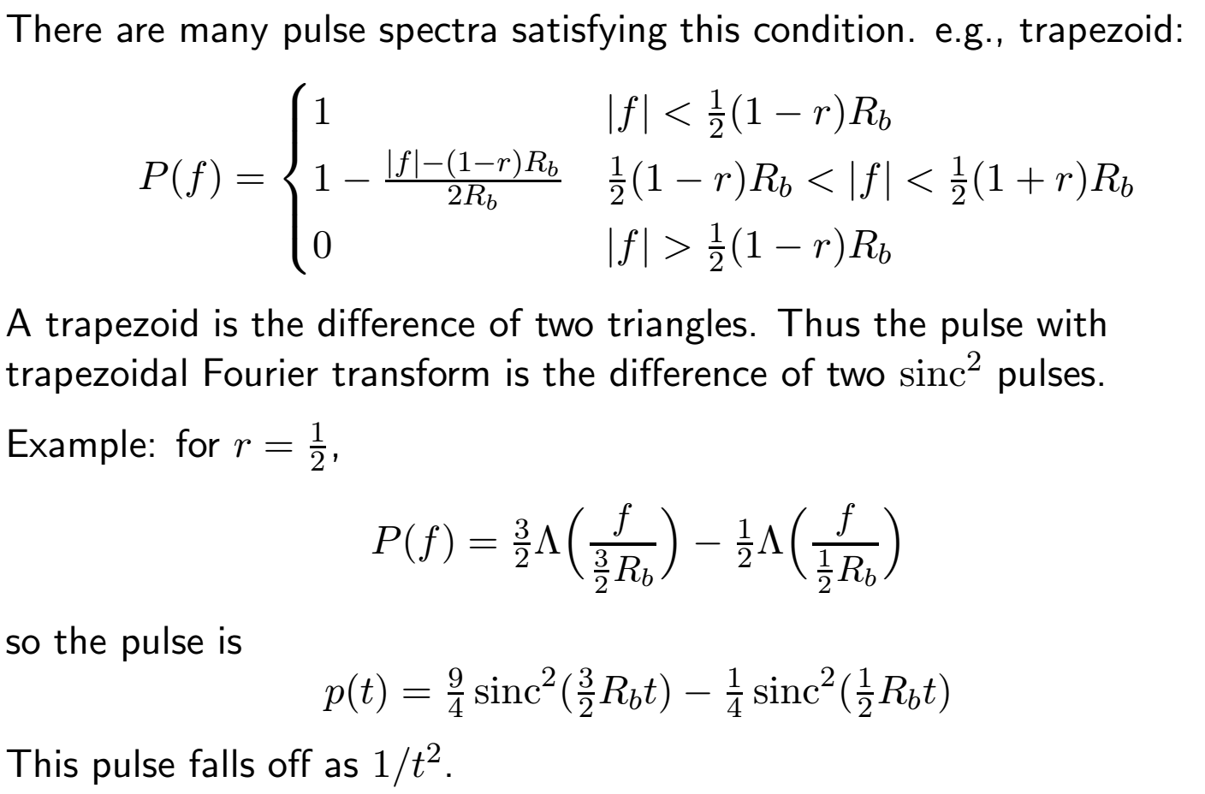
Nyquist Pulse 3

Slide 12
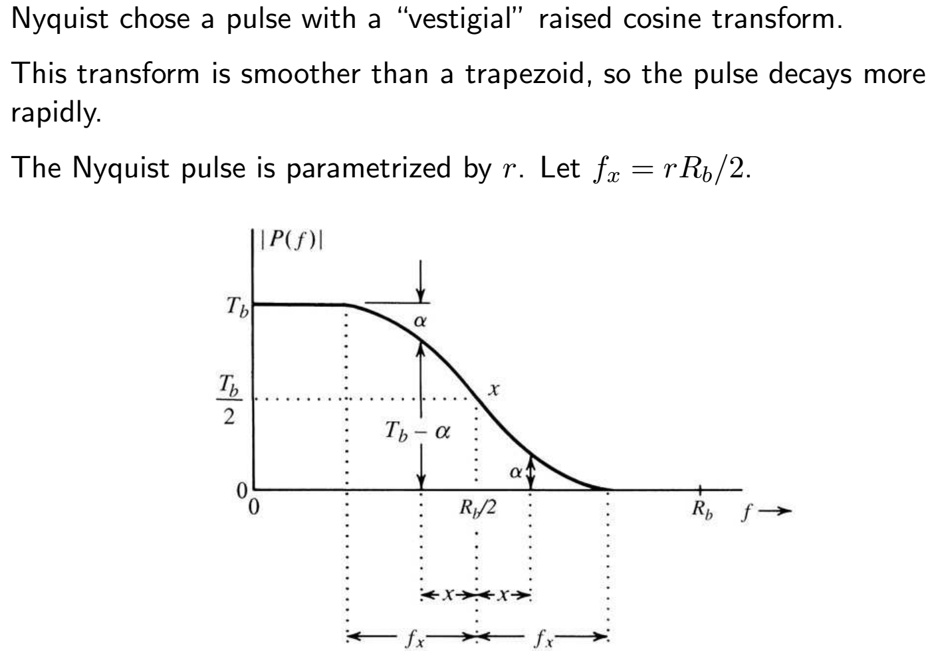
Nyquist Pulse 4

Slide 13
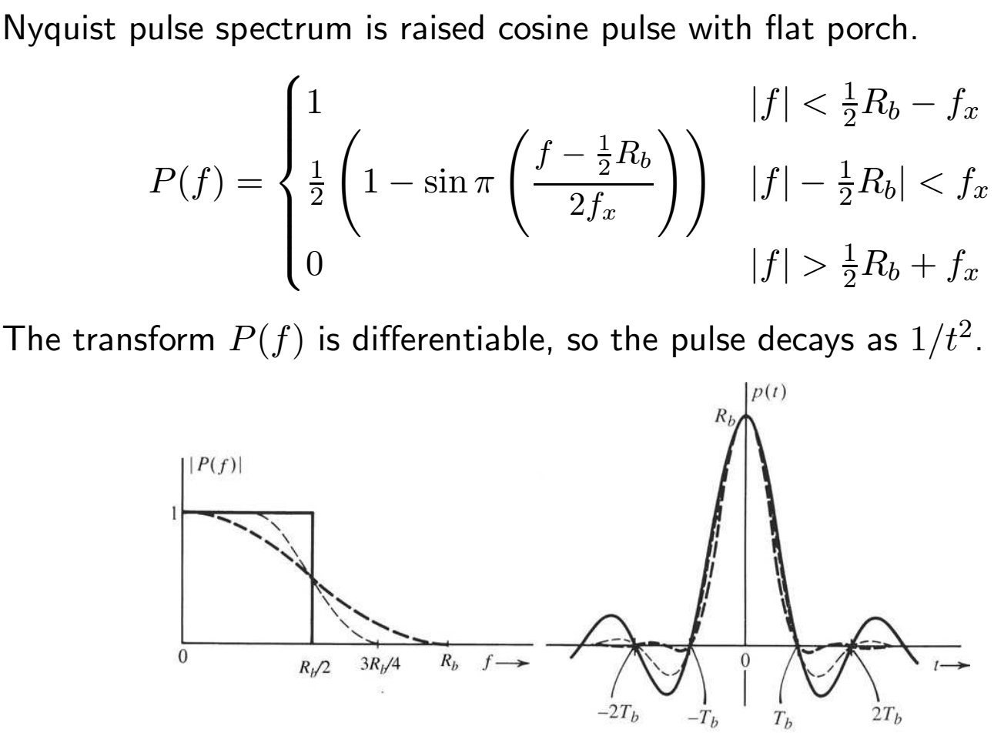
Nyquist Pulse 5

Slide 14
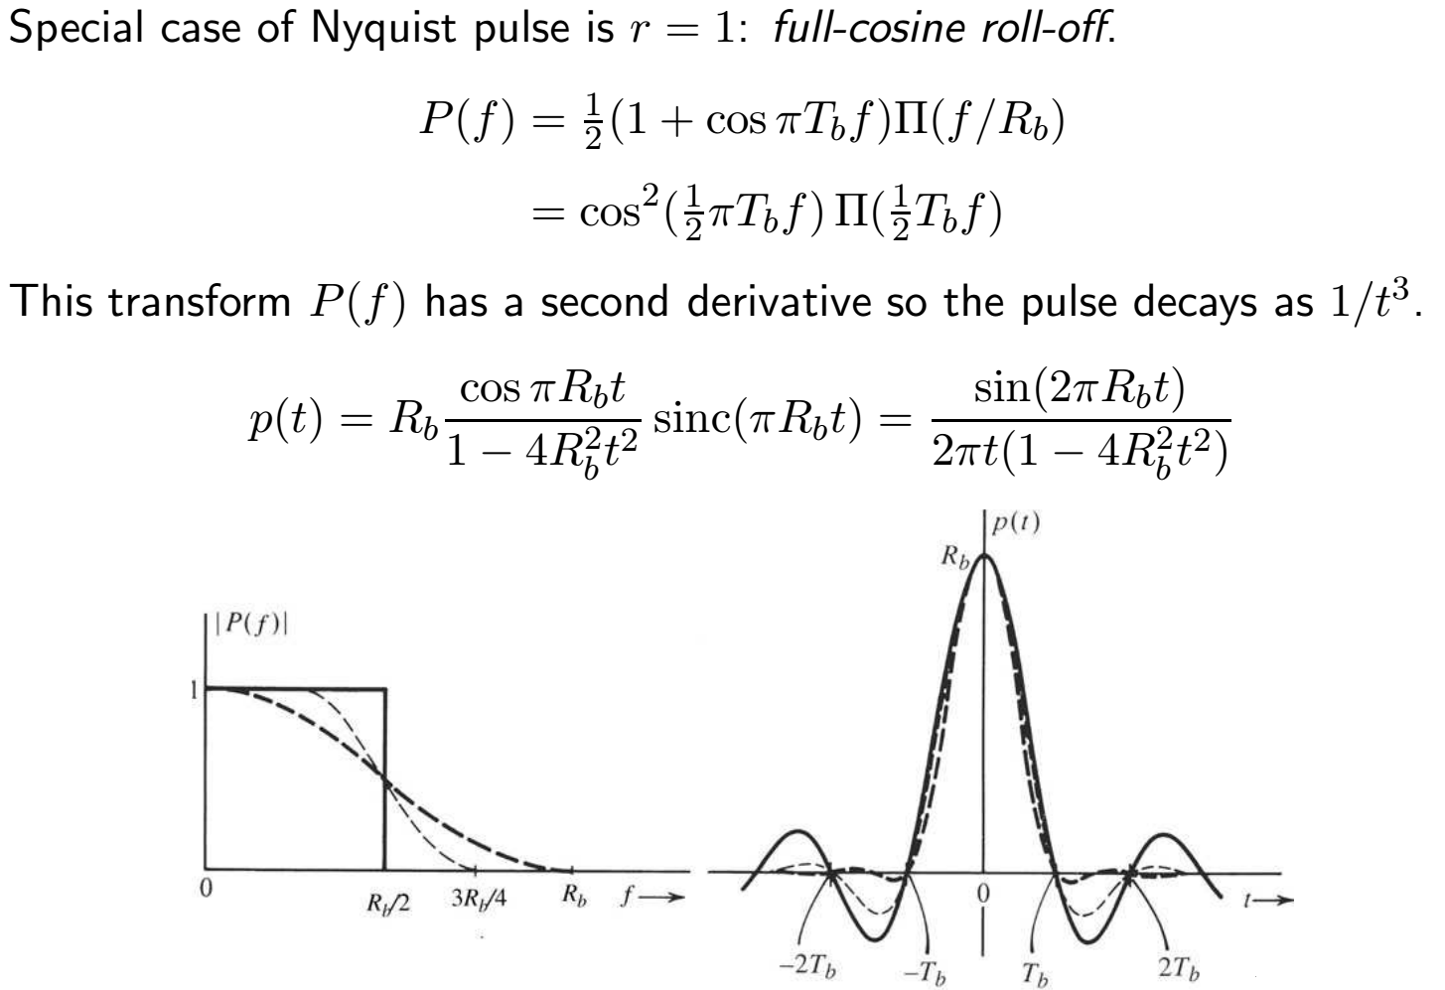
Nyquist Pulse 6
Notes:
To produce a pulse, just synthesize a filter with that impulse response and excite it with impulses.

