Slide 1
Chapter 7c
Baseband Digital Communication Part 3

Slide 2
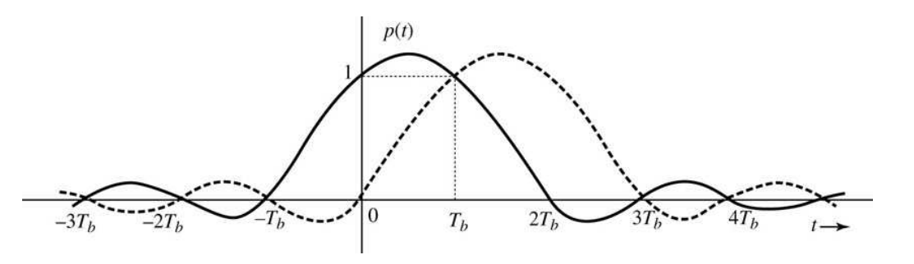
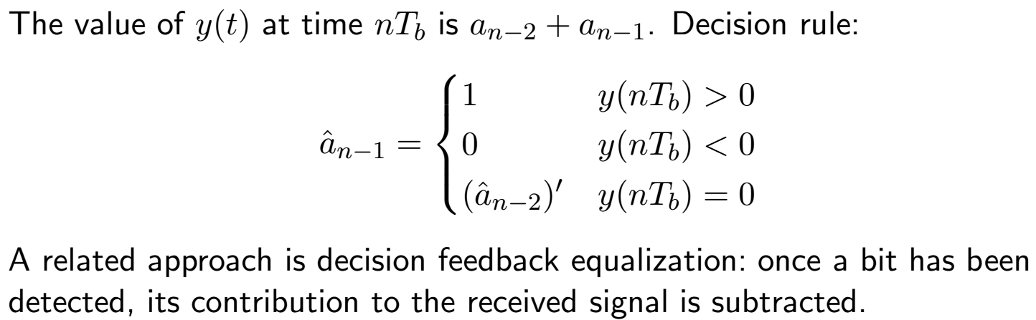
Controlled ISI (Partial Response Signaling)
We can reduce bandwidth by using an even wider pulse.
This introduces ISI, which can be canceled using knowledge of the pulse shape.

Slide 3
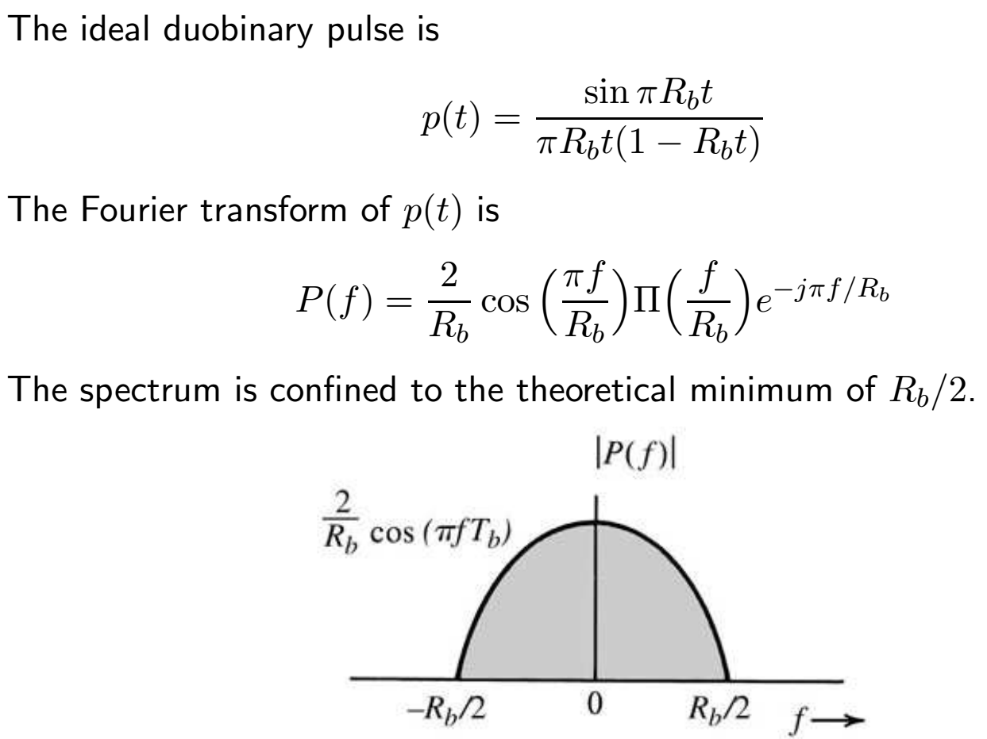
Partial Response Signaling 2

Slide 4
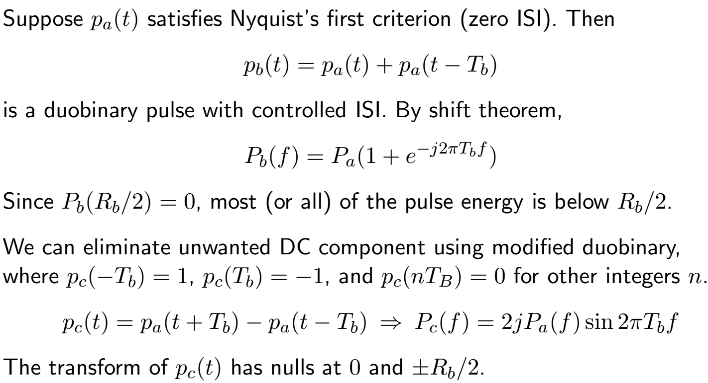
Zero-ISI, Duobinary, Modified Duobinary Pulses

Slide 5
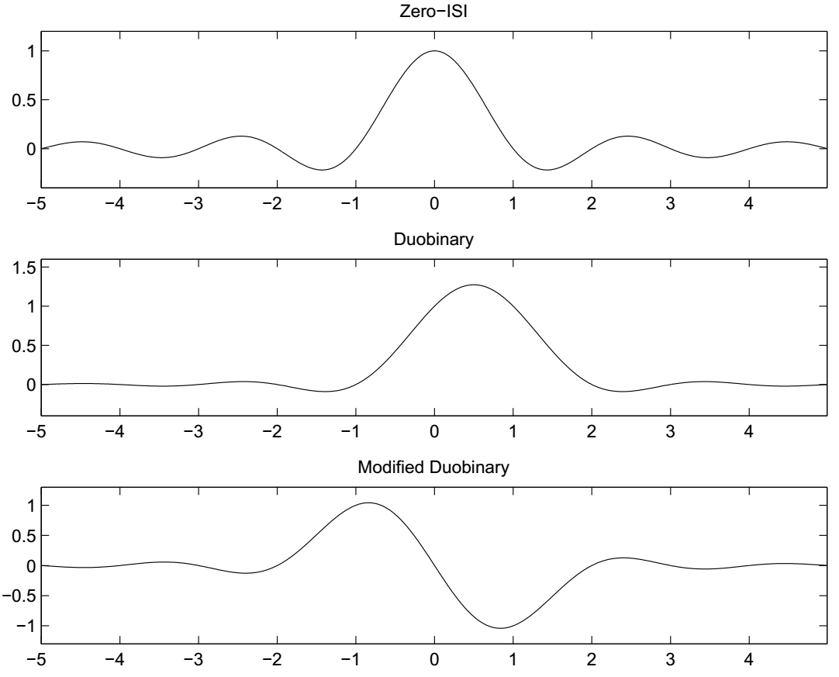
Zero-ISI, Duobinary, Modified Duobinary Pulses 2

Slide 6
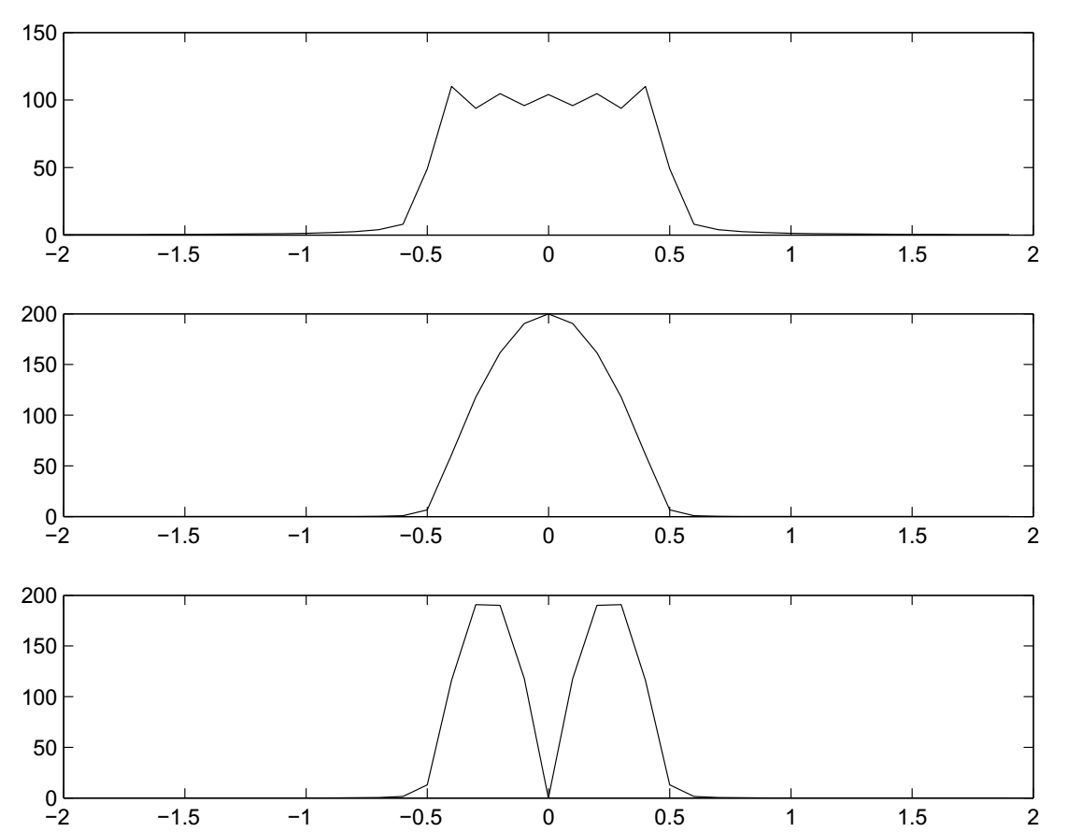
Zero-ISI, Duobinary, Modified Duobinary Pulses 3

Slide 7
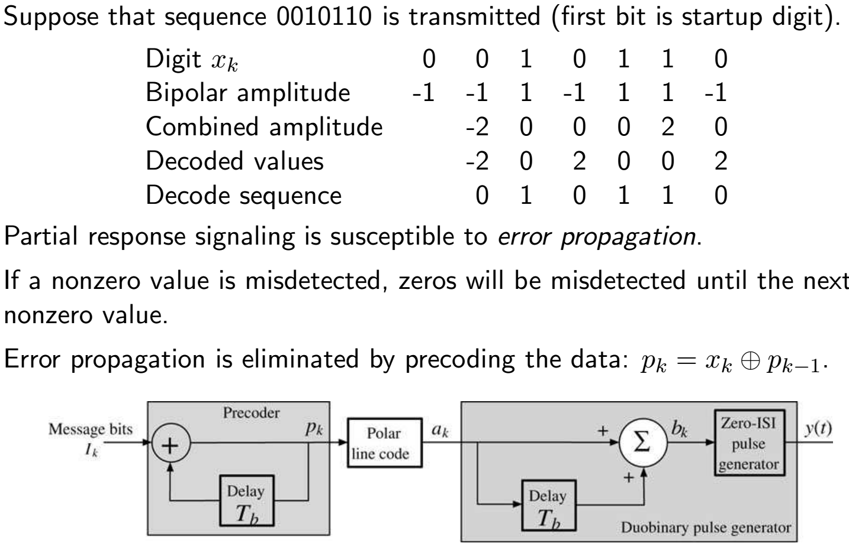
Partial Response Signaling Detection

Slide 8
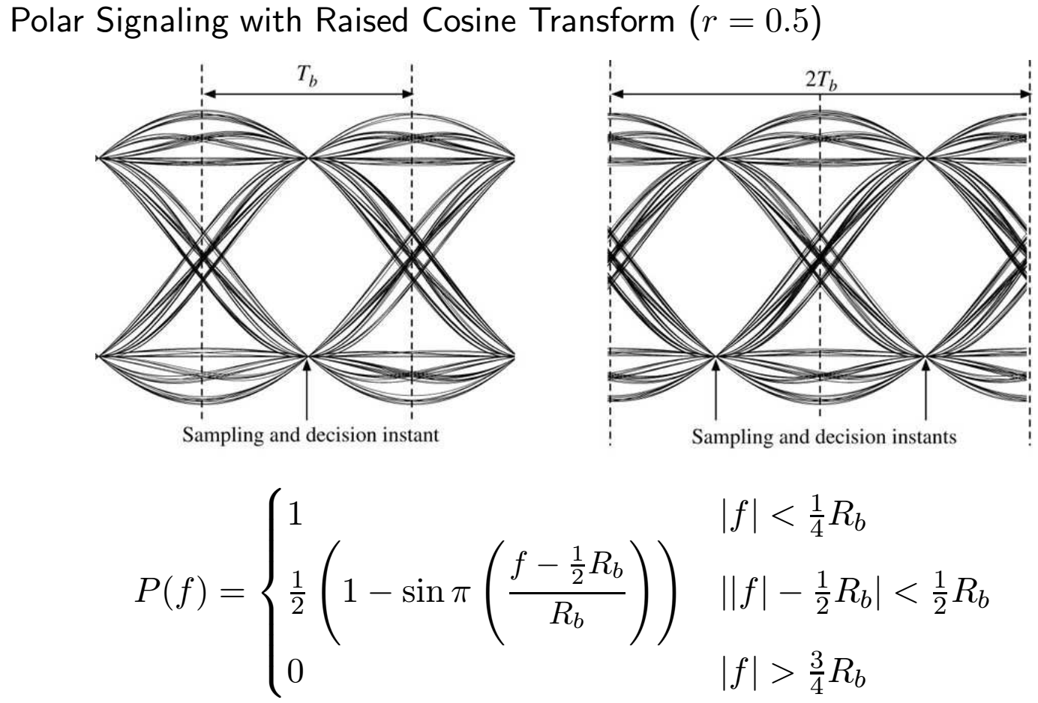
Eye Diagrams

Slide 9
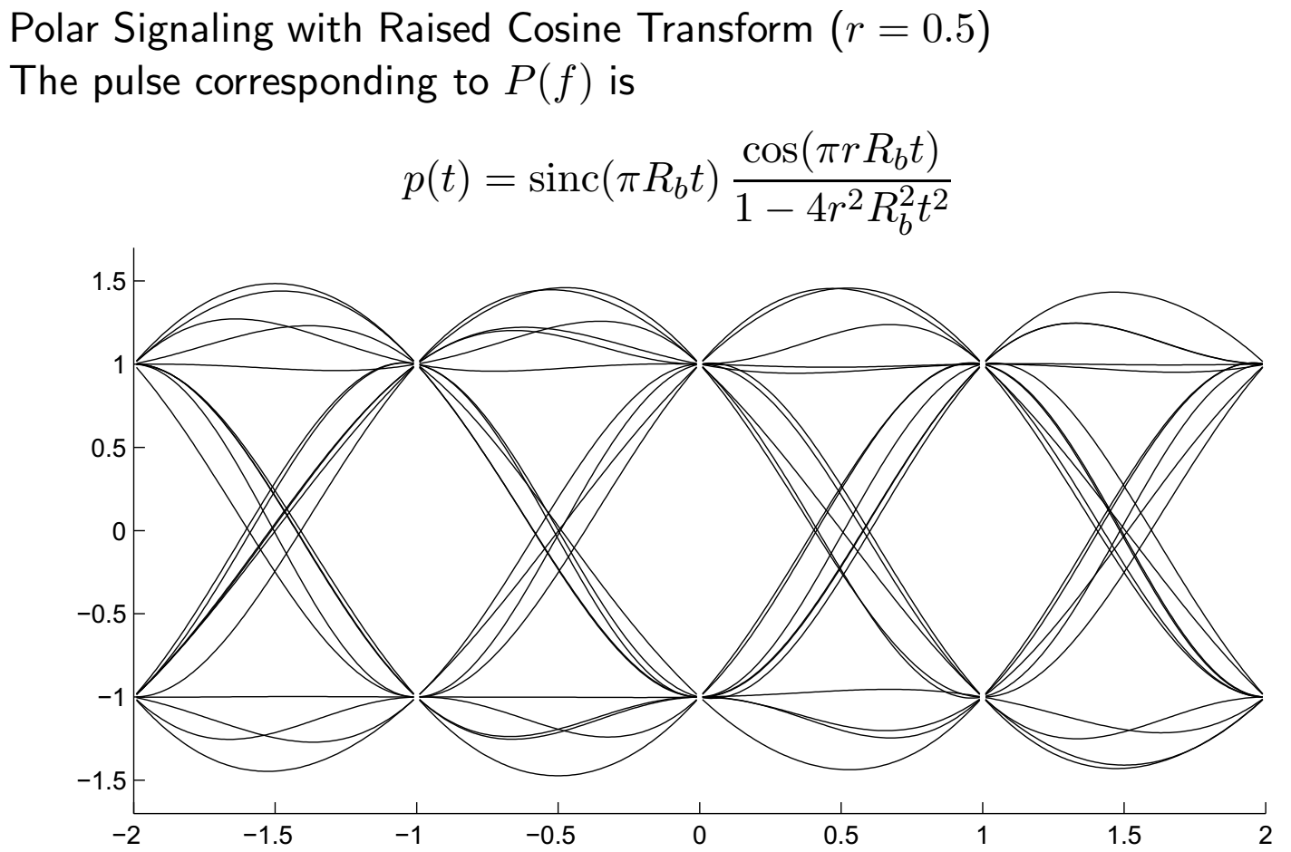
Eye Diagrams 2

Slide 10
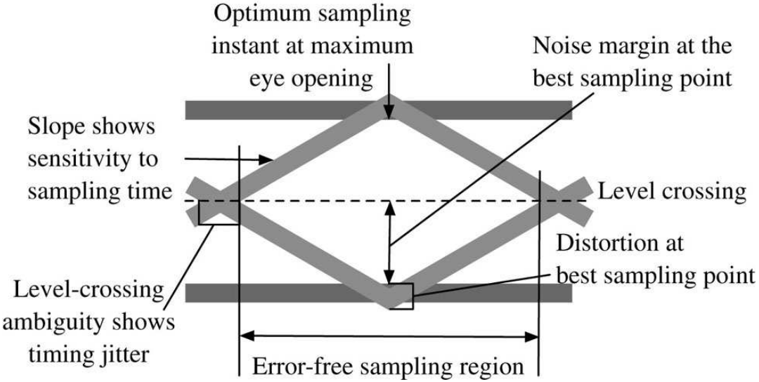
Eye Diagram Measurements
Maximum opening affects noise margin
Slope of signal determines sensitivity to timing jitter
Level crossing timing jitter affects clock extraction
Area of opening is also related to noise margin

Slide 11
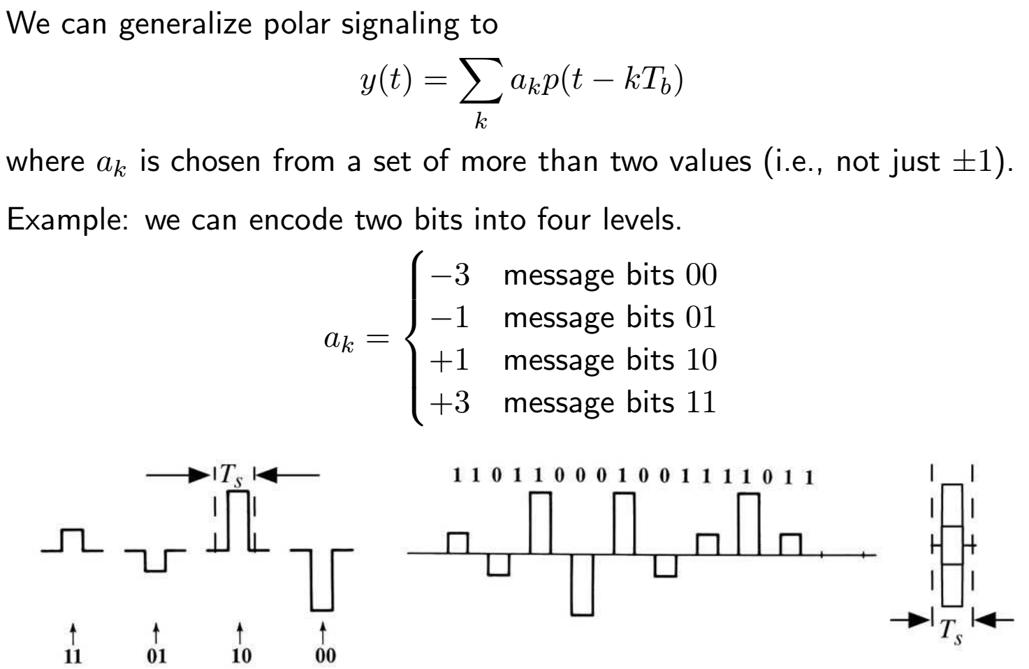
PAM: M-ary Baseband Signaling

Slide 12
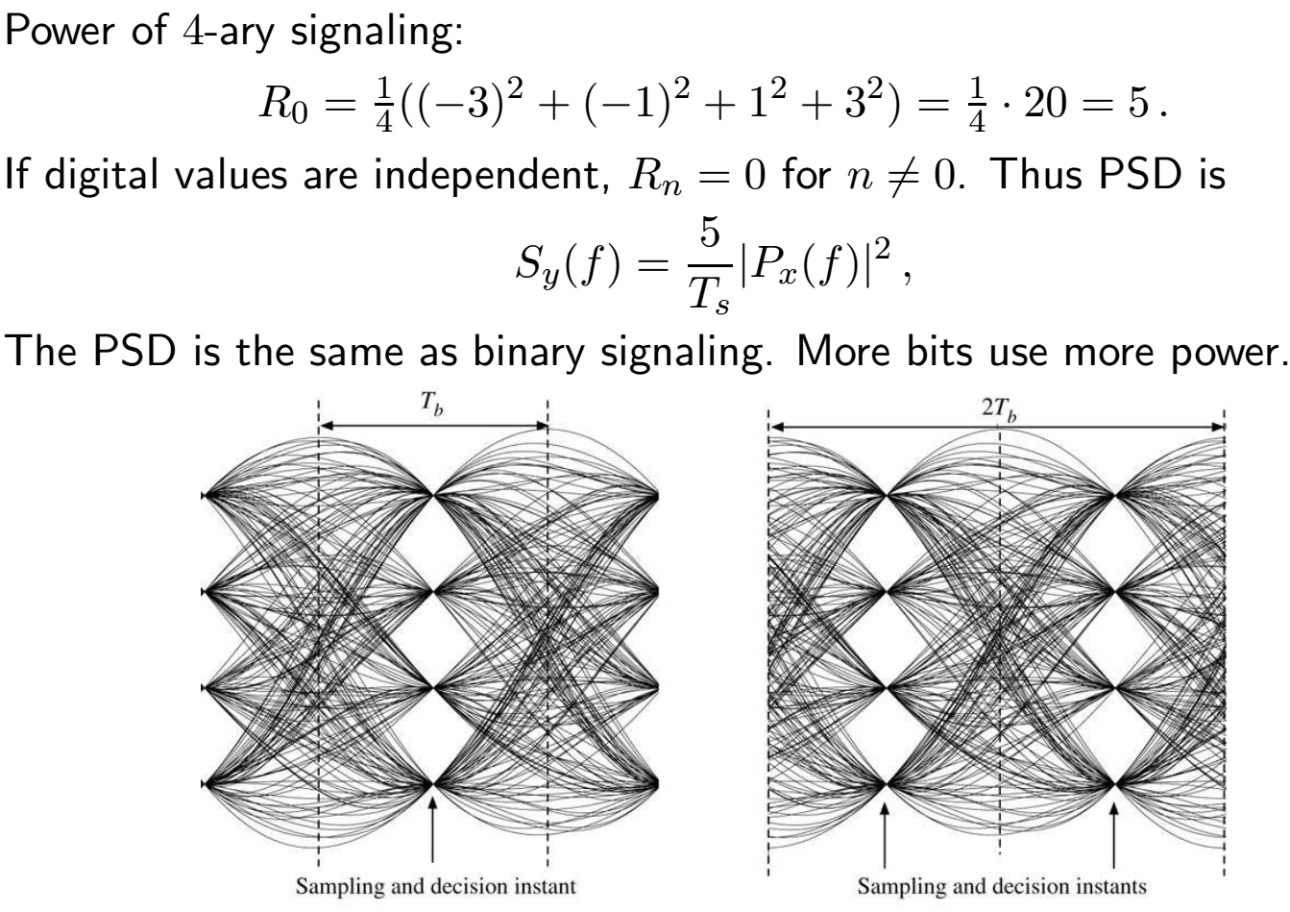
PAM: M-ary Baseband Signaling 2

